Slide 1

Mechanical engineering department
Graduation project
PLATERING WALL MACHINE
Group member :-
Ali Al-Hamad
Osaid Hamdalah
Rand Khraishi
Sami younis
Supervisor:-
Dr.Iyad Assaf

Slide 2
out line :-
Introduction
Problem statement
lecture review
Methodology
Result and analysis
Recommendation Conclusion :

Slide 3
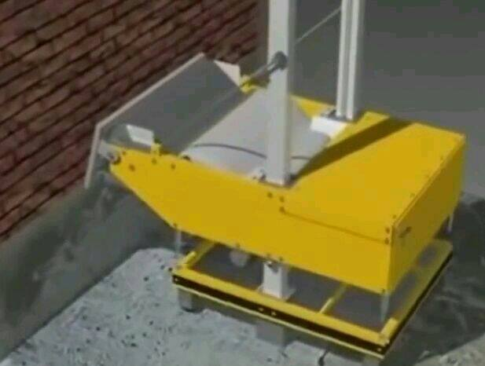
Introduction
Plastering machine is a machine that plster the walls in buildings by a mechanical parts
It is going up and down and drawn the cement in wall

Slide 4
Problem statement
The workers and vocational and people in our society and every where facing difficulty from the Rendering process and the solution is plastering machine
The plastering machine is inexpensive comparing with traditional way :صورة
It consume time less than other methods:صورة
Safe (no hazards):صورة
Getting rid from scaffolds and them problems :صورة

Slide 5
Literature review
The first machines to be developed were automated mixers which made the task of manual plaster mixing obsolete.
The introduction of plastering machines such as RUMA 1,Putzmeister KS 1 and Putzmeister Gipsomat in the sixties was considered revolutionary and marked the beginning of a new era in plastering technology.
The development of the AMPA machine was the first attempt to significantly increase the level of automation but this kind of equipment has never been accepted in practice.
Automated spraying of mortar and paint has recently been demonstrated by means of the mobile articulated prototype robot TAMIR which had been developed in Israel and a prototype of a cartesian robot which had been constructed in a Swedish joint venture between Swedish construction companies and universities

Slide 6
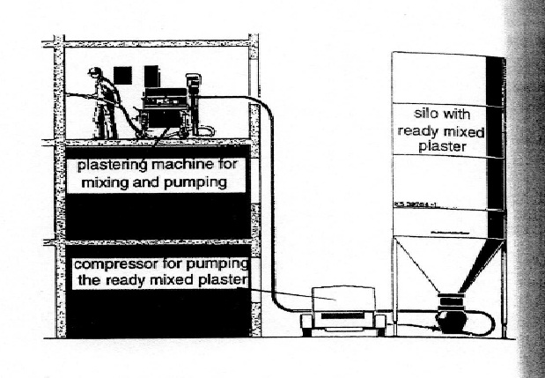
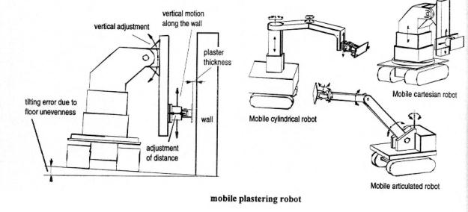

Slide 7
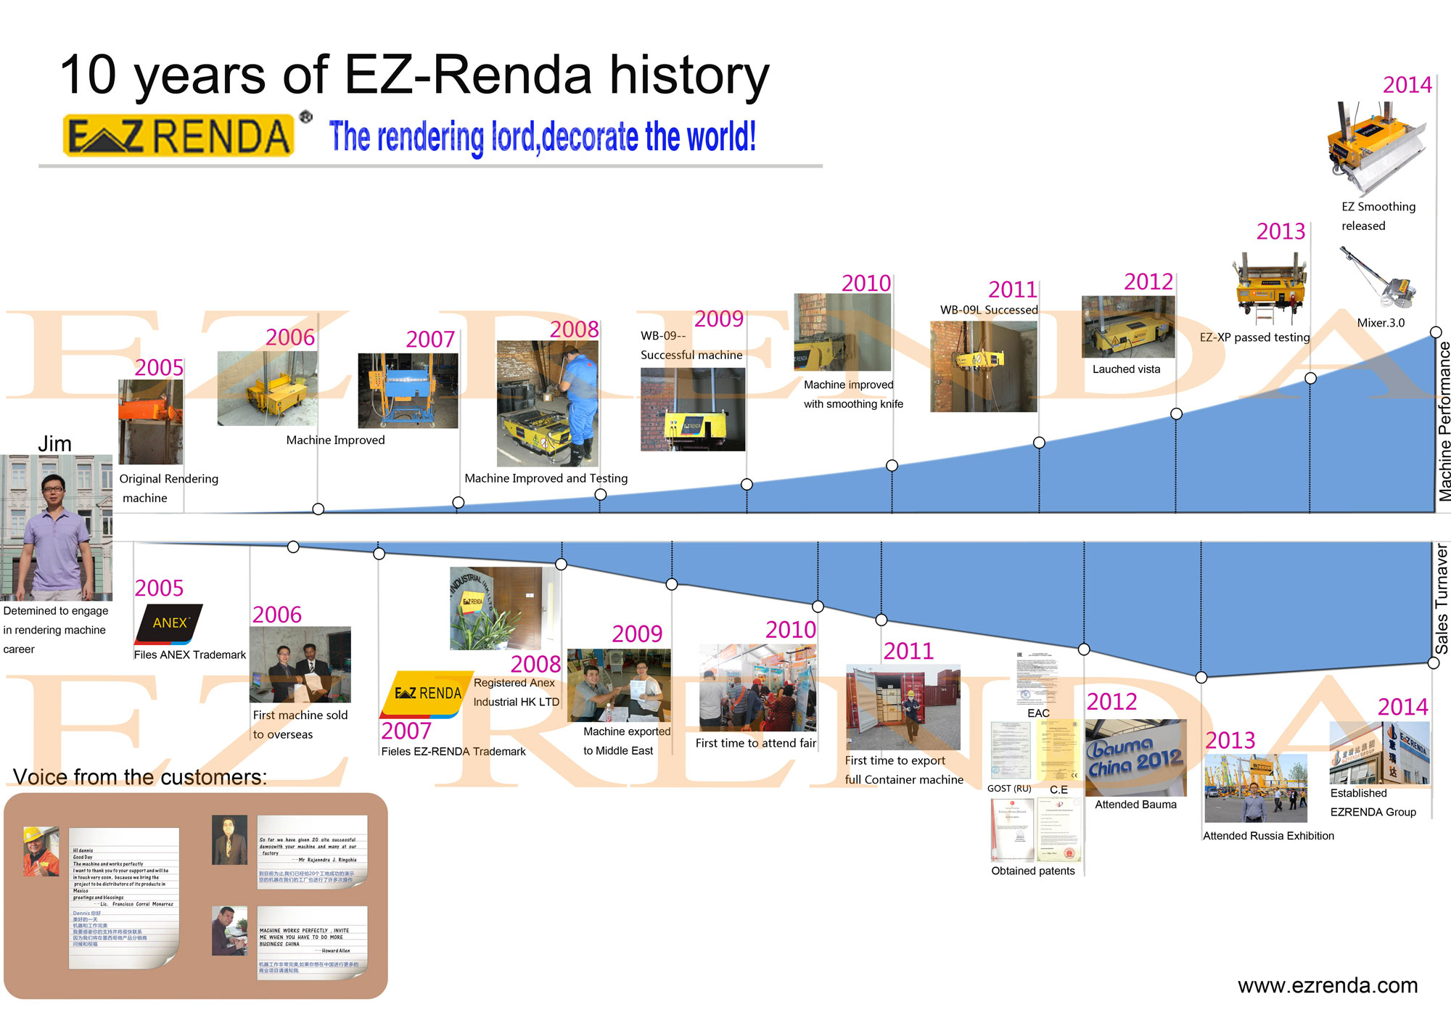
From 2005-2014/ china

Slide 8
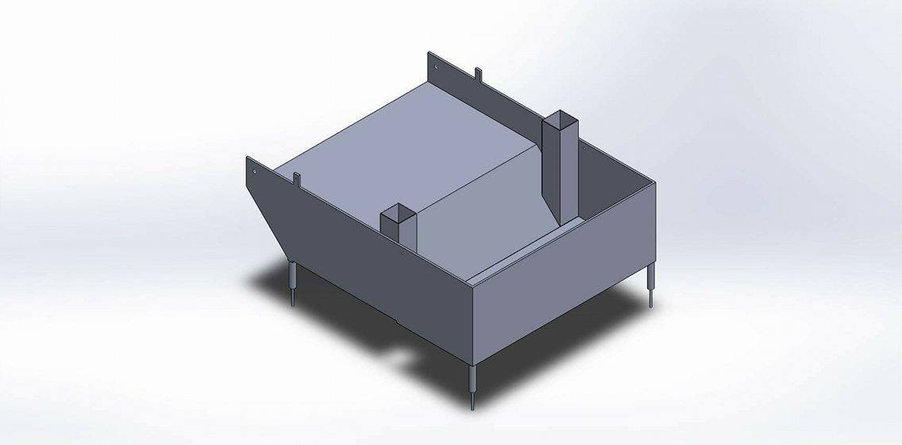
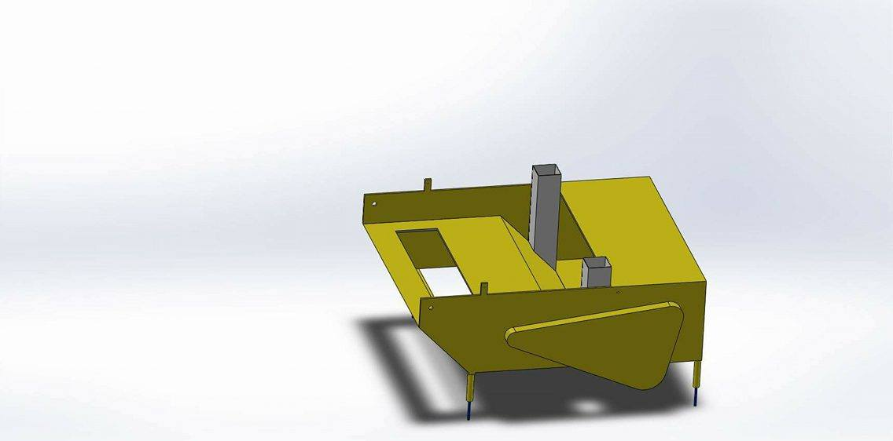
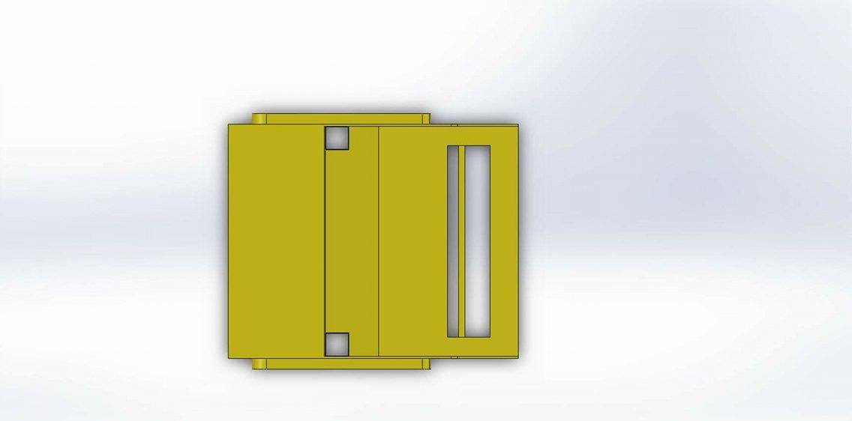
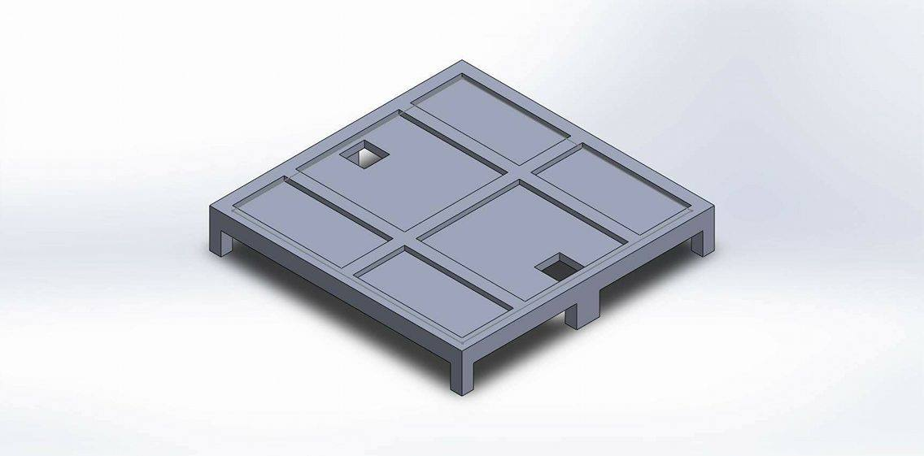
Methodology
Design and solidwork:
A:external parts

Slide 9
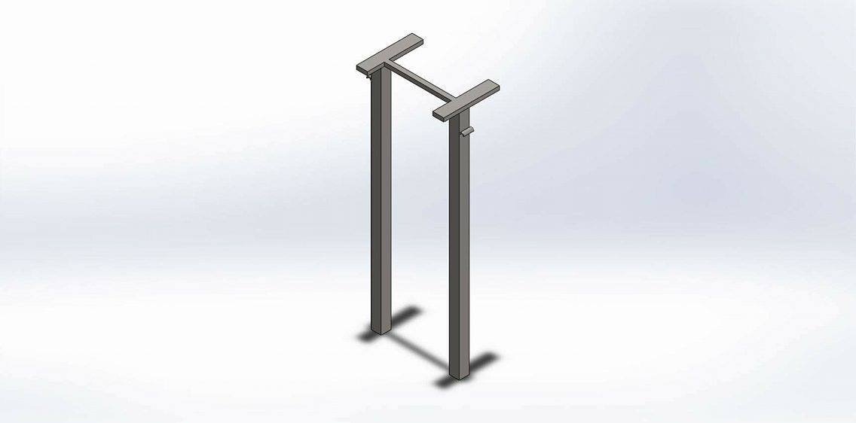
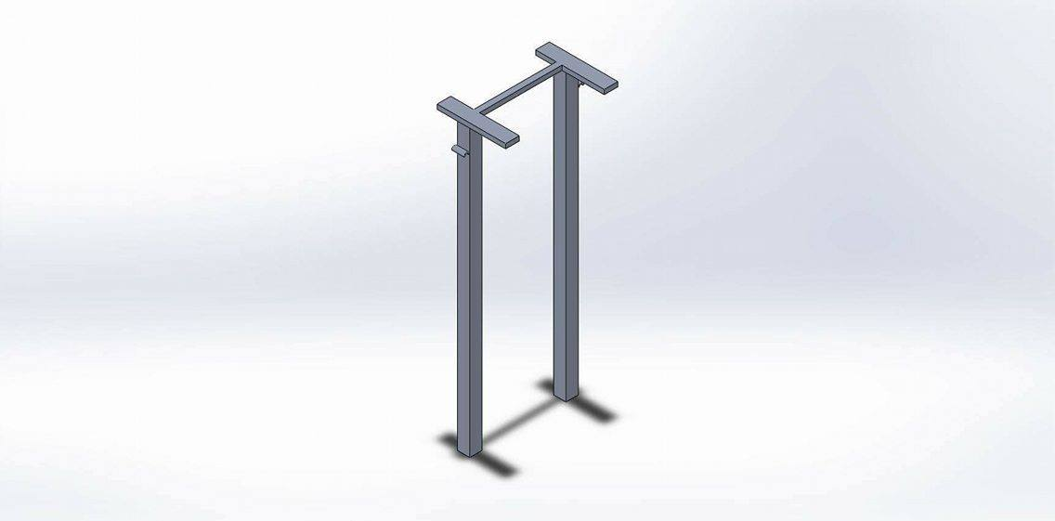
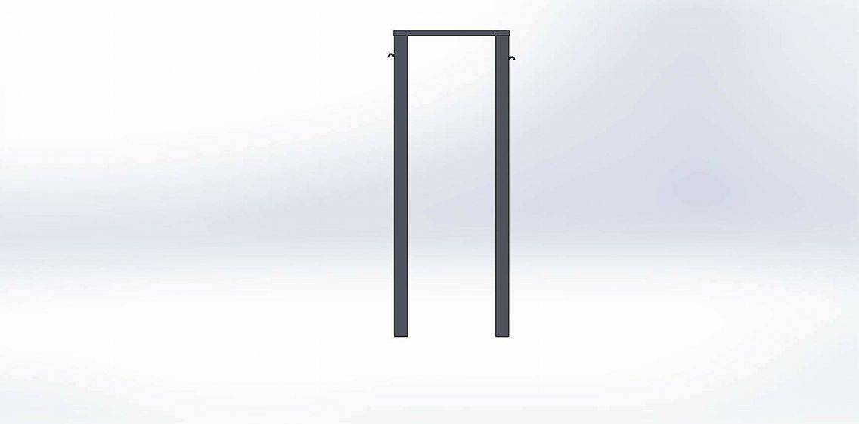

Slide 10
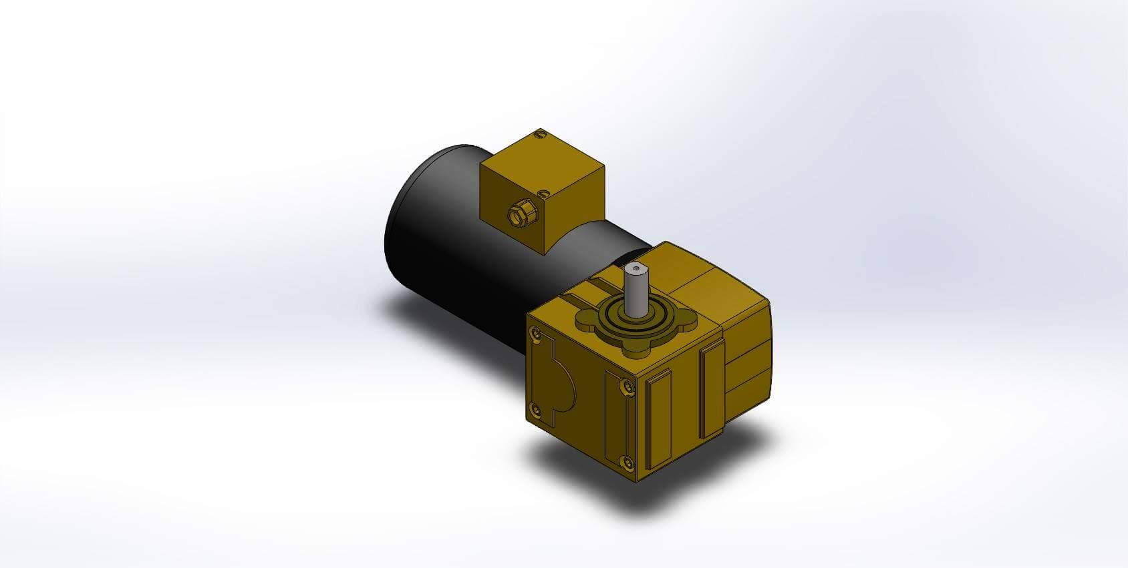
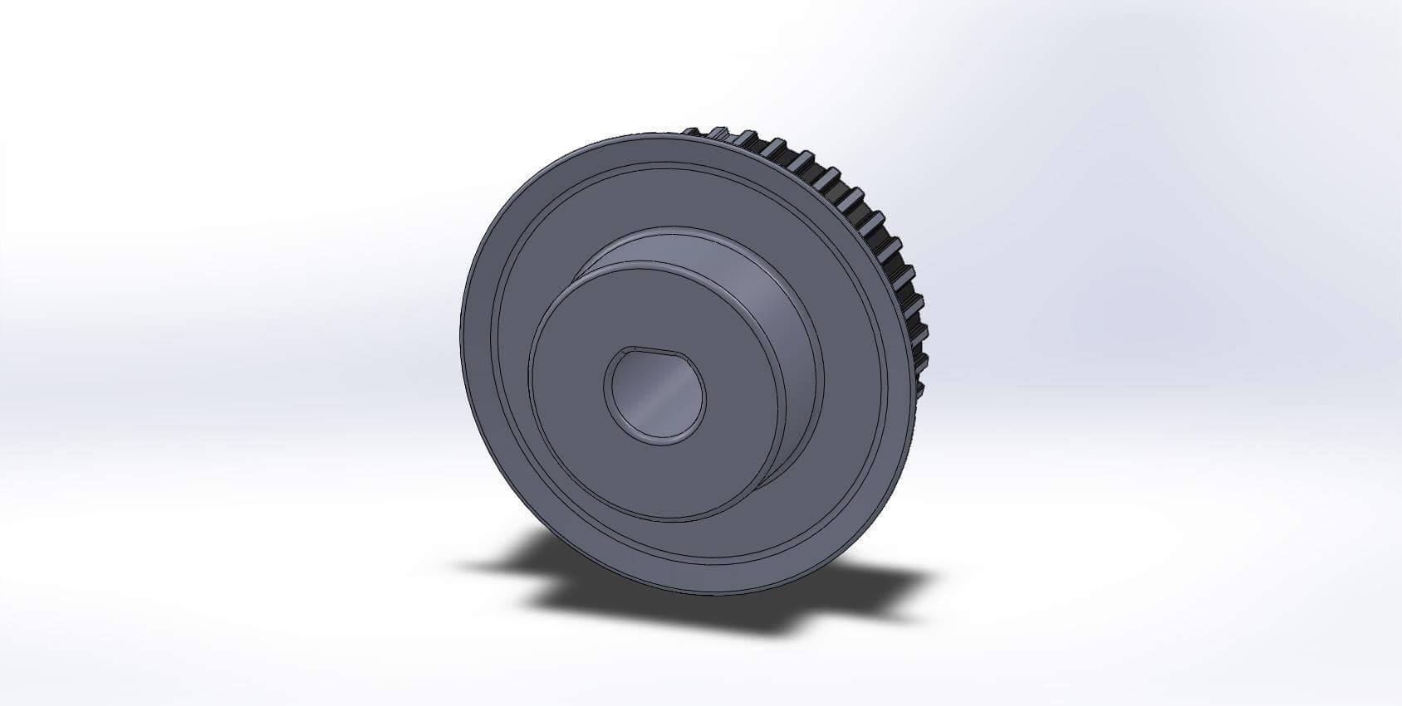
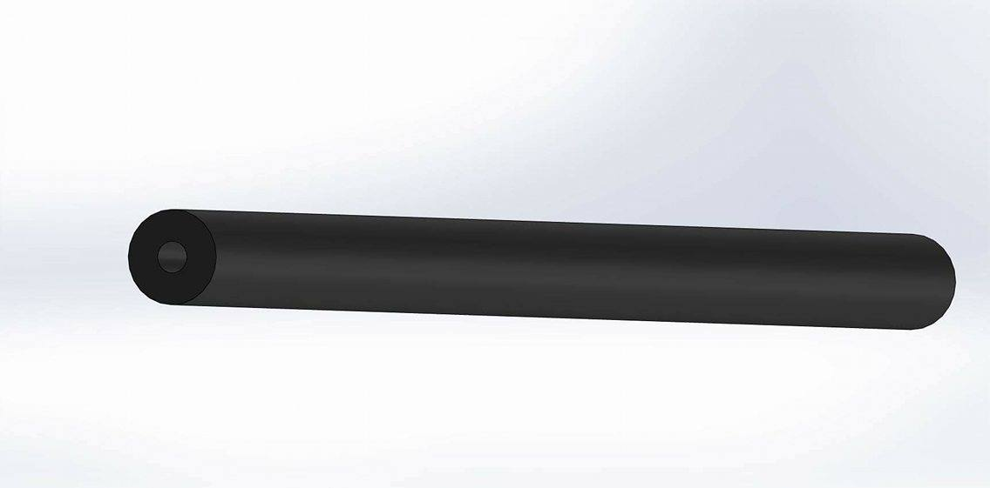
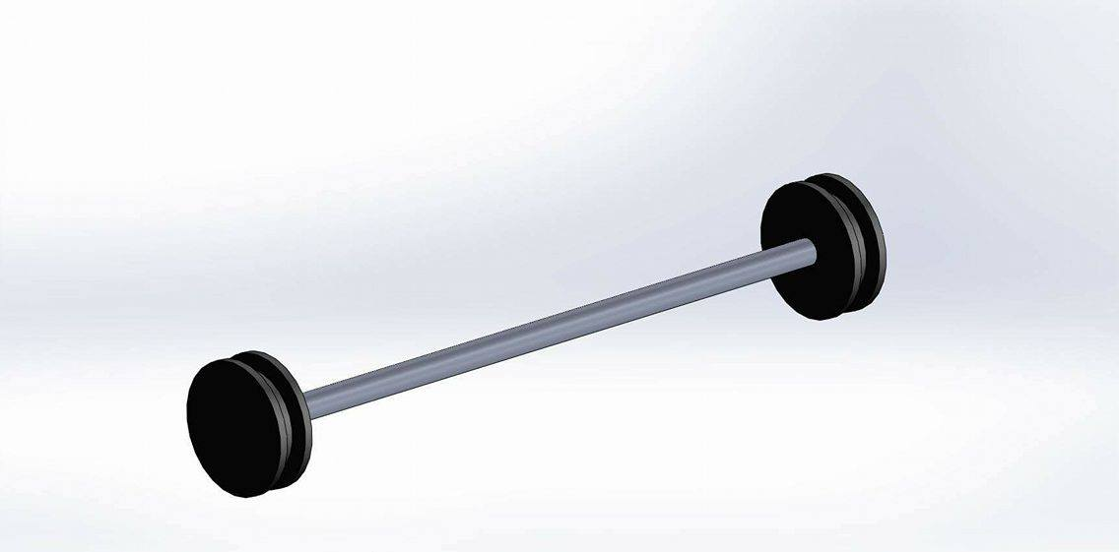
B-internal parts:

Slide 11
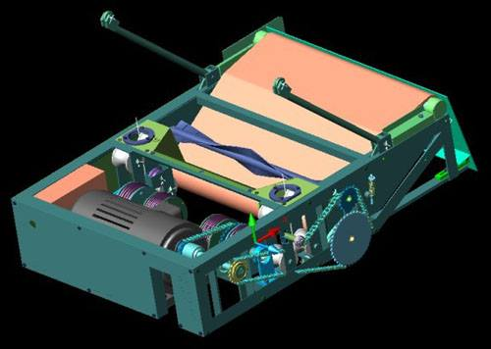
Car of cement and internal parts

Slide 12
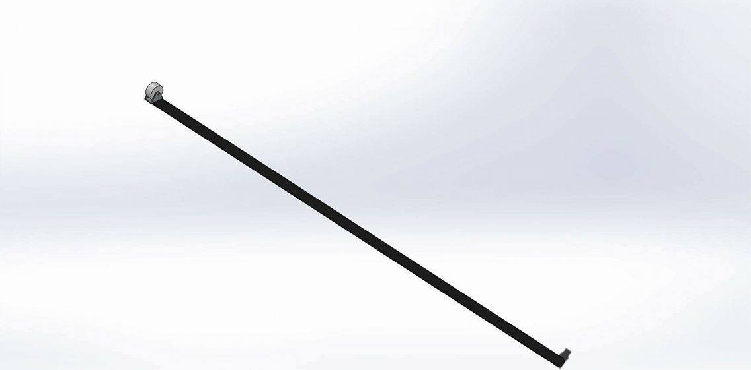
Developents:
Sensor for stop

Slide 13
2. horizantal direction

Slide 14
3.Hydroulic impulse

Slide 15

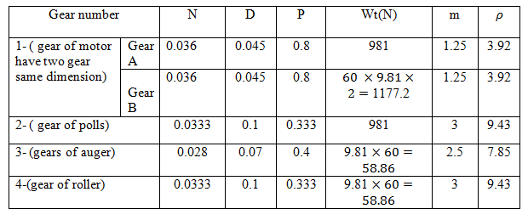
Gears calculations :

Slide 16

Bearing calculations:
To select the bearing the catalog rating load(C10) ,have to be found by the equation:-
C10=
= 31.7 KN

Slide 17
Tube :
Checking the buckling by Euler method by equation
The load on the tubes is from the weight and equal
P= = 0.50 KN
1.16> 0.50 ( safe )

