Slide 1

Amaan
Presented by: Shahd Zabade
Zahra Abu Zahra
Supervisor: Dr.Abdallah Rashed

Slide 2
Outline
Name Inspiration
Introduction
Problem
Amaan
  Features
  Technologies & Tools
  Components
Constraints
Future Work

Slide 3
Name inspiration
Main objective: Our house give the owner high level of luxury in daily life. Adding to that, in case of danger, it provides safety for him and the first responder at the same time
Amaan «أمان»:
  An Arabic word
  Means safety and security

Slide 4
Introduction: Amaan
Connect between you and your house from any where in the world.
Smart response in case of danger.
Helps both house owner and first responders.

Slide 5
Problem
An increased need to have technology that gives the concerned authorities complete and detailed information about the situation in case of danger.
  We need something to provide speed of response, and reduce human and material losses first.

Slide 6
Problem
An increased need to have technology that gives the concerned authorities complete and detailed information about the situation in case of danger.
  We need something to provide speed of response, and reduce human and material losses first.
Solution: Providing ability to control the house from anywhere in the world ,and giving detailed information on the house current status.

Slide 7
Features
PIN access code.
2. Turning on security alerts in the case of burglary.
3. Turning on danger alerts in the case of gas leakage and fires.
4. Remote control on all the windows, doors and lights using the application.
5. Showing detailed information about the current house status
using an application.

Slide 8
Features cont.
6. Registration in the application as house owner or firefighter.
7.Notification send to house owner when there is a danger.
8. House owner can send notification to firefighter If needed.
And all that was made using minimum number of wires with a
relatively reasonable budget.

Slide 9





Technologies & Tools
React Native Arduino Firebase
Expo VS Code

Slide 10
Components
Collecting values from all the sensors around the house.
- By interlacing the wires in a certain way for the sensors with the Arduino, the values of the sensors were collected. As mentioned in the report

Slide 11
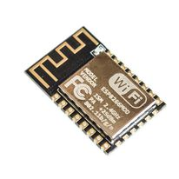
Store data to firebase.
-ESP was used
- The connection between the esp and the arduino was
done through (Tx, Rx), and the data was transferred
through a serial port.

Slide 12
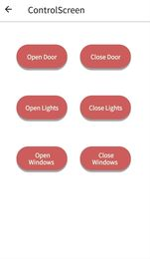
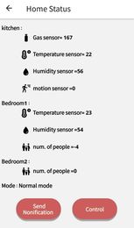
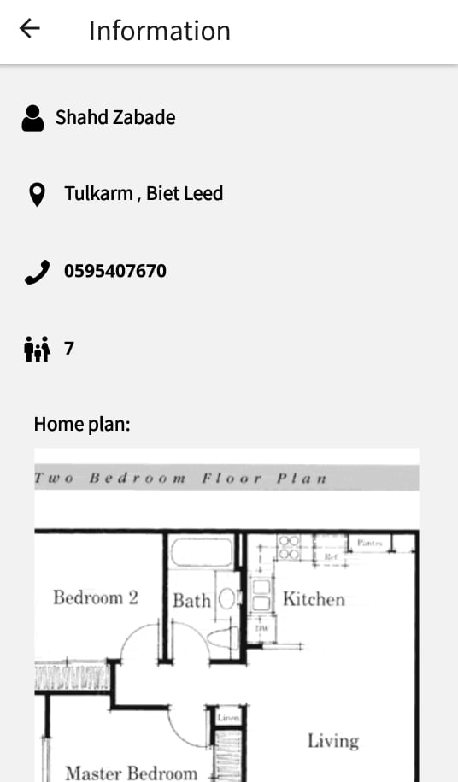
Use the data for the application
-React native firebase was used to display sensors
values and control the home.
-Expo notification was used to send the notifications.

Slide 13
Constraints
PIR Sensors: before a short time from filming the demo, the PIR sensors ,unfortunately, failed to do its job correctly and we didn't have time to buy another one.
The LCD broke down shortly before filming the demo.
While the arduino is sending the sensors value to the esp, the keypad always stop reading any new values so moving between modes was impossible.
The distance between me and my partner, limited our meetings
and affected our work,which should be more co-operative.

Slide 14
Future Work
Controlling all the electrical machines in the house remotely.
Adding a fingerprint authentication as a replacement of the PIN.
Improving the application by adding new users such as the police department to ensure getting a fast response.

