Slide 1


An-Najah National University
Telecommunications Engineering Department
PI-Phone Using Raspberry PI
Prepared by:
Raghad J Foqha
Supervisor:
Dr. Saed Tarapiah

Slide 2
Outlines
Introduction.
Project Main Idea.
Project Main Components.
SWOT Analysis
Results
Conclusions and Recommendations

Slide 3
Introduction
In this graduation project , a new hardware microcontroller called a Raspberry pi (RPI) will be used.
Making a call is possible by owning it.
The concept is making an interface between RPI features with another components allows sending standard AT commands for calling , hanging up.

Slide 4
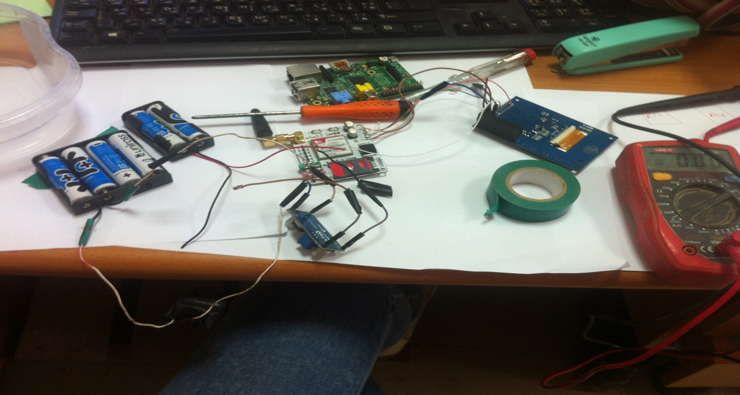
Project Main Components

Slide 5
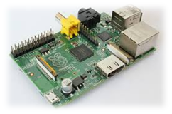
What is Raspberry Pi ?
Credit card size single board computer or a
Programmable PC.
Why?
Dynamic microcontroller, small PC.
Great tool for Learning Programming, Computers & Concepts of Embedded Linux, etc
Support for all Age Groups (School Children, College Undergraduates, Professional Developers, Programmers)

Slide 6
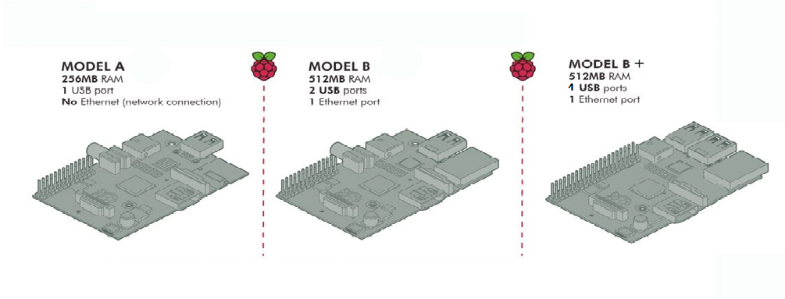
Raspberry Pi Versions

Slide 7
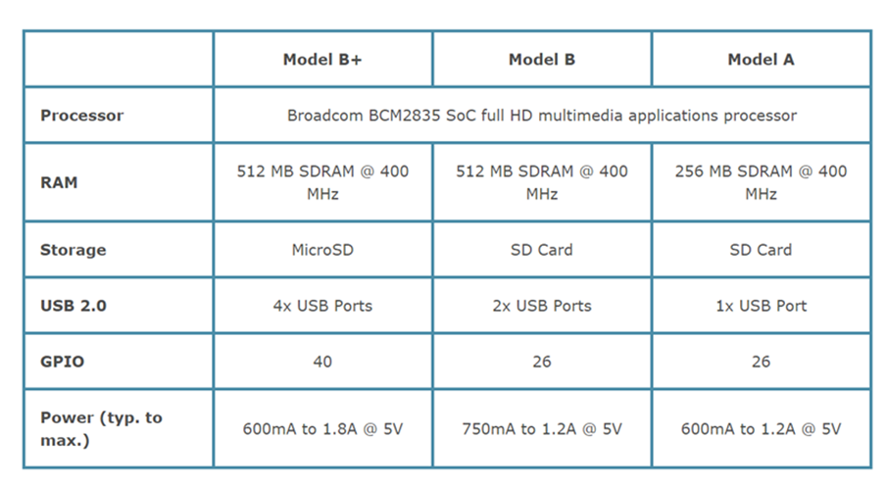
Comparison

Slide 8
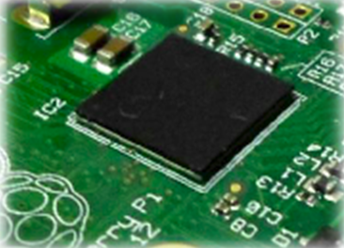
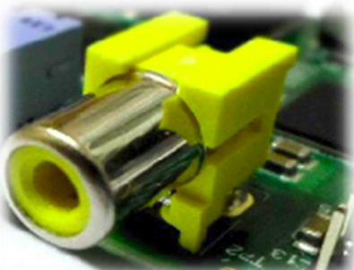
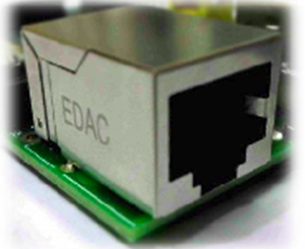
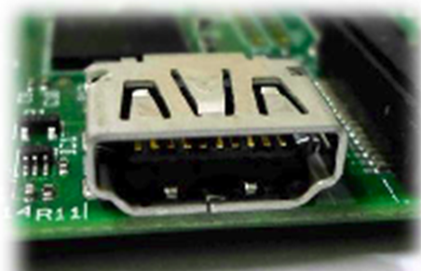
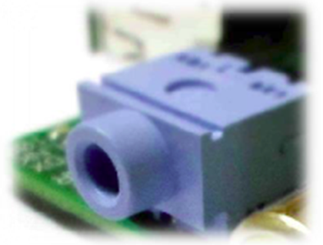
Raspberry Pi Contents
RCA Video Output
SOC
Ethernet Port
HDMI Output
Audio Jack Output

Slide 9
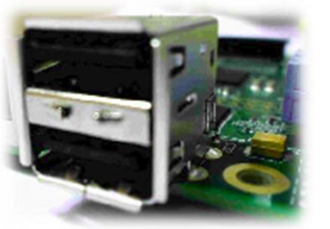
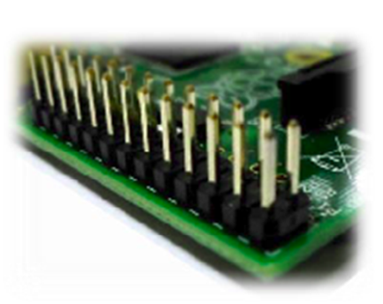
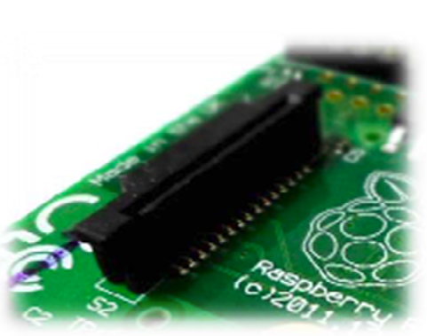
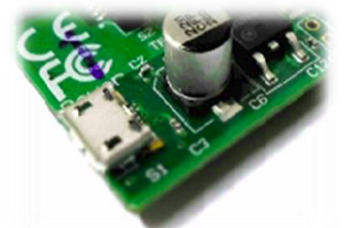
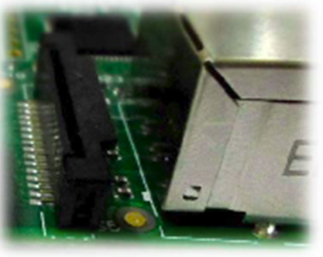
Raspberry Pi Contents
USB Port
GPIO Pins
DSI Display
Micro USB
CSI Camera Input

Slide 10
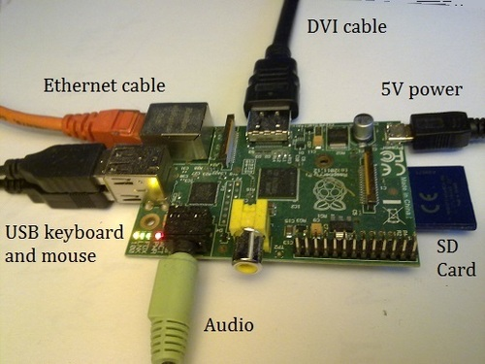

Operating System
WHY LINUX?
OPEN SOURCE
FREE

Slide 11
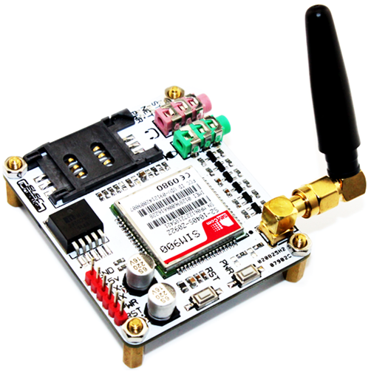
GSM\GPRS Module
Frequency-Band 850/ 900/ 1800/ 1900 MHz
Control via AT commands
Low power consumption

Slide 12
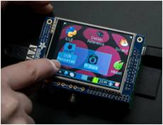
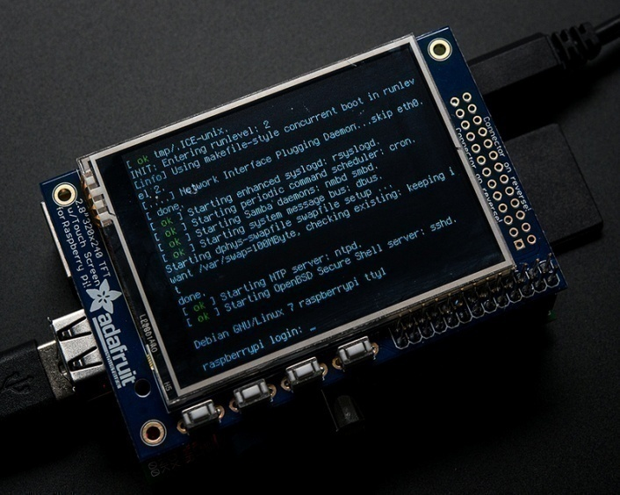
Touch screen
Mini kit
320*240
16 bit color pixels
Resistive touch overlay
Adafruit

Slide 13
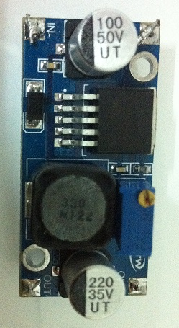
DC-DC Boost Converter Module
Used to isolate sensitive circuits from noise or high voltage from the rest of the circuit
DC-DC Converter

Slide 14
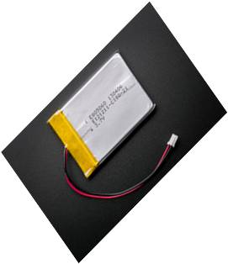
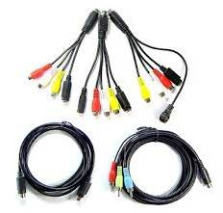
LIPO Battery
Keeps the battery voltage from going too high
(Over-Charging), or low (Over-Use)
Protect against output shorts
Cables, Connectors, Switches

Slide 15

Software Components
Python
Powerful modern computer programming language
Friendly and easy to learn
Open Source
Support many applications such as Web, Internet development
Ability to deal with the electronic control GPIO ports.

Slide 16
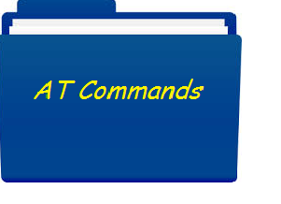
AT Commands
Set of commands for controlling and communicating with external communication devices such as GSM modem and GPRS modem
Using Voice Mode AT Commands
Using AT Calling Commands
Using AT Hanging Commands

Slide 17
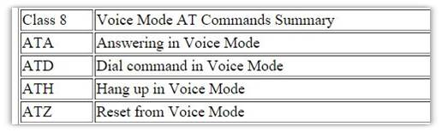

Slide 18
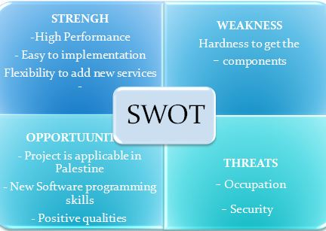
SWOT ANALYSIS

Slide 19
RESULTS
>> OPEN VEDIOS

Slide 20
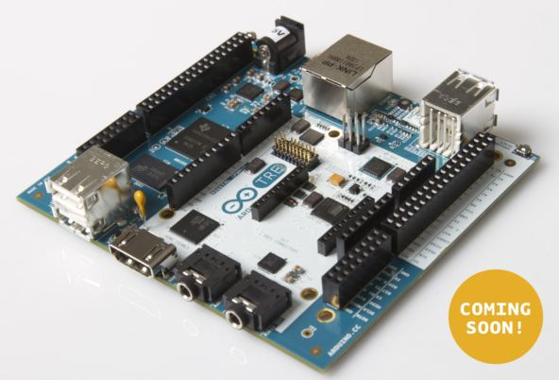
RECOMMENDATIONS
Due to hard dealing with a raspberry pi , particularly in programming. We recommend using component which called Arduino Tre.
But it coming soon !

Slide 21
RECOMMENDATIONS
Why we recommend it ?
Arduino TRE Design builds upon the experience of both Arduino and raspberry pi. And combining the benefits of both community based boards. Arduino TRE final board will be available within a few months, pending results of Beta Testing Program.

Slide 22
THANK YOU

Slide 23
ANY QUESTIONS

