Slide 1
Deep drawing and Rolling Process using Finite Element Analysis
Prepared by:
Mohammad Alawni
Bilal Abdelrazeq
Supervisor:
Dr. Iyad Assaf

Slide 2
Rolling and Deep drawing process
Rolling process:

Slide 3
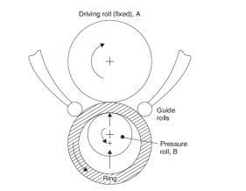
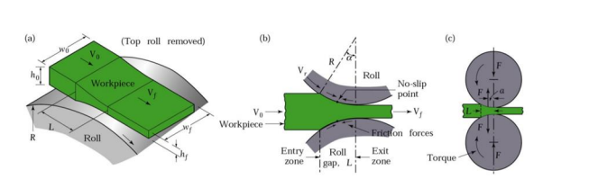
The Rolling process:
The force calculated:
F= LWYavg
The type of rolling process :

Slide 4
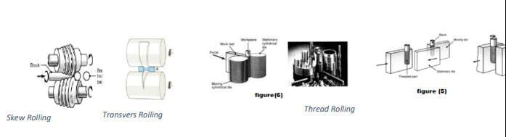
Some types of rolling process

Slide 5
Hot and cold work the rolling process

Slide 6
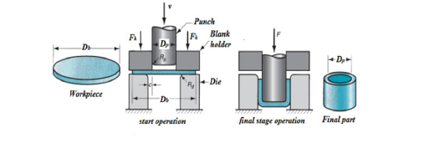
Deep drawing process
The forces calculated:
F_{max}= πD_{p} t (UTS)[(D_{b}/D_{p})-0.7]

Slide 7
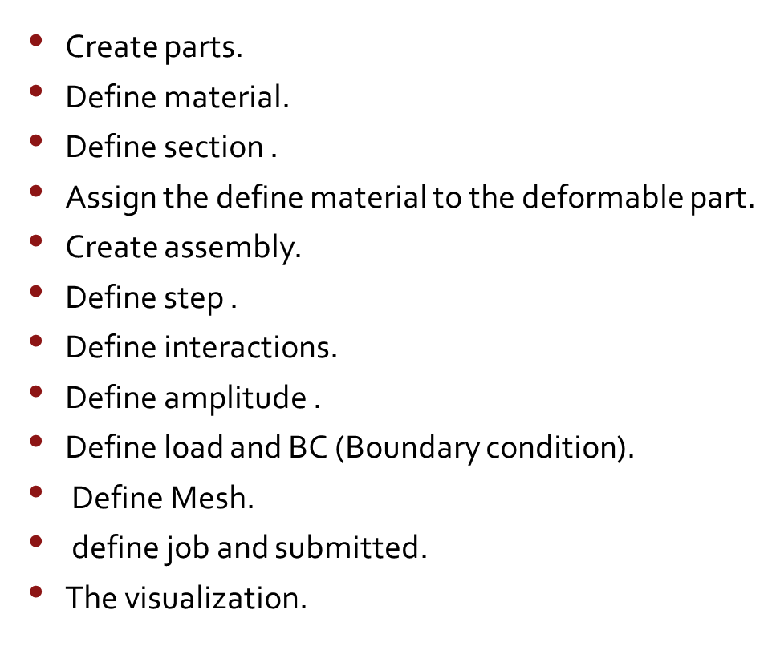
Finite Element Analysis the flat rolling process
:

Slide 8
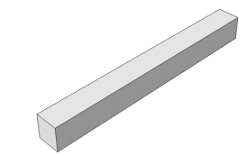
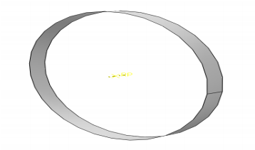
Create parts
3D→Deformable→solid→extrusion 3D →discreate shell→solid→extrusion

Slide 9
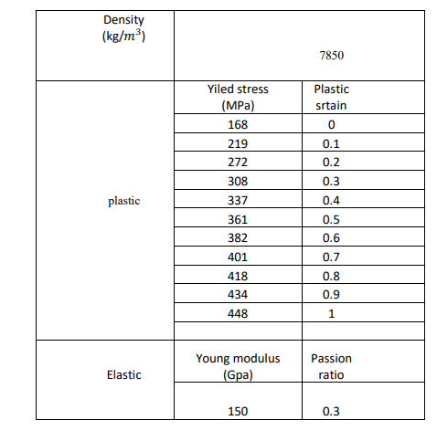
Define material

Slide 10
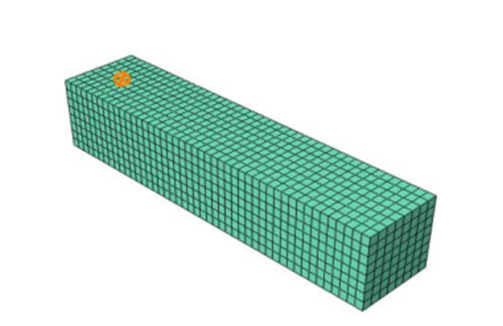
Assign the define material to the deformable part

Slide 11
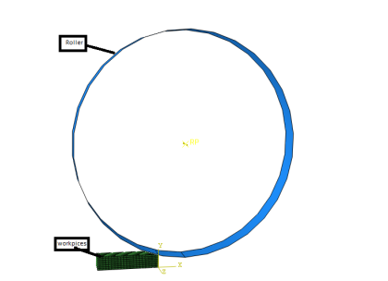
Create Assembly

Slide 12
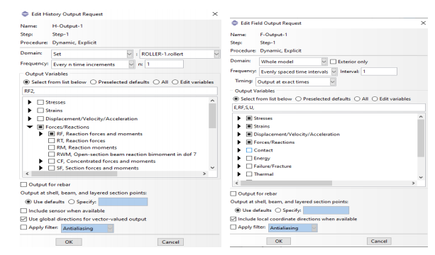
Define step
Explicit .dynamic
Time period =0.089 sec

Slide 13
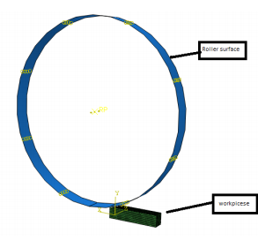
Interaction Model

Slide 14
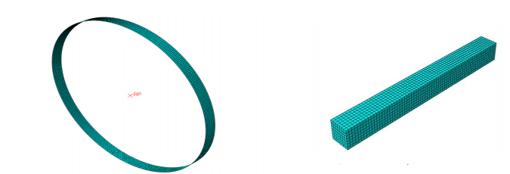
Mesh
the Element Library was Explicit

Slide 15
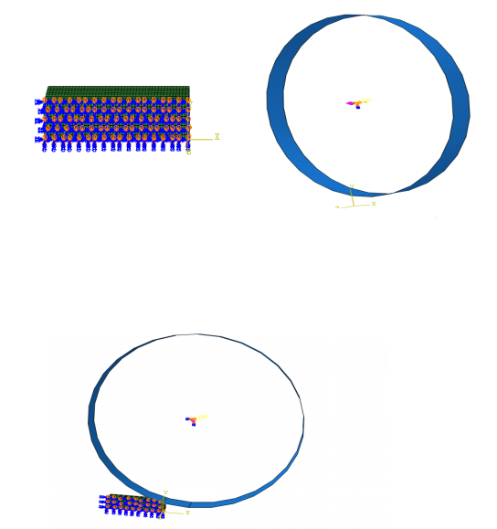
Load and Boundary condition
workpieces (ENCASTRE →U2=0)., U3=UR1=UR2=0
ROLLER → U1=U2=U3=UR1=UR2=0,UR3)

Slide 16
Define job
Job-1 was created and submitted.
.

Slide 17
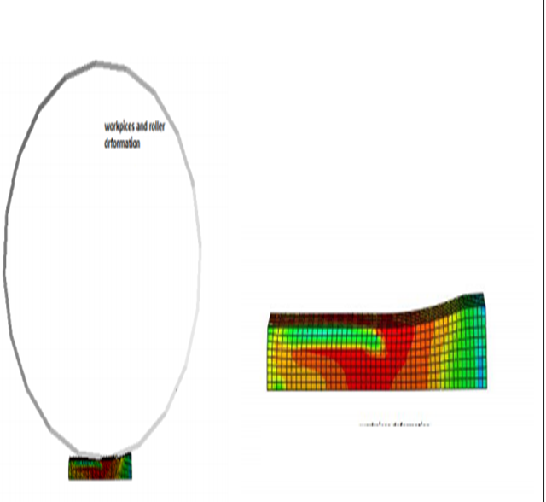
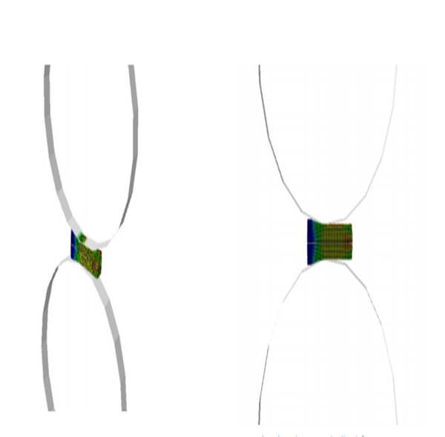
The Visualization

Slide 18
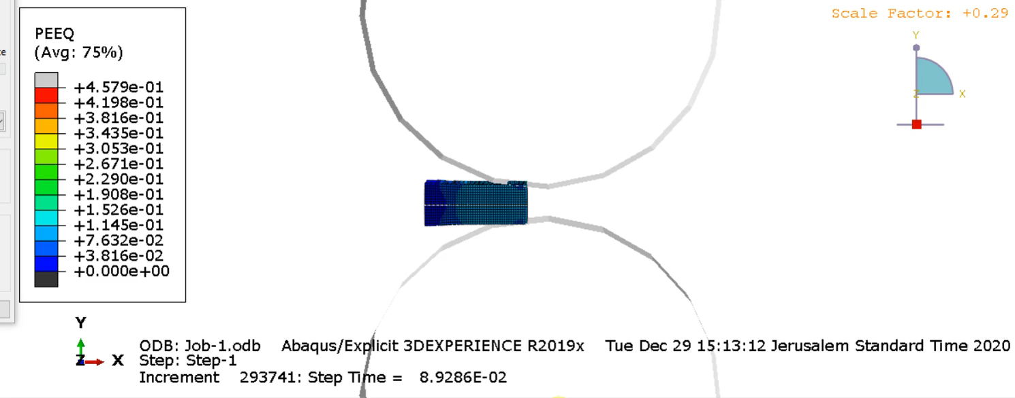

Slide 19
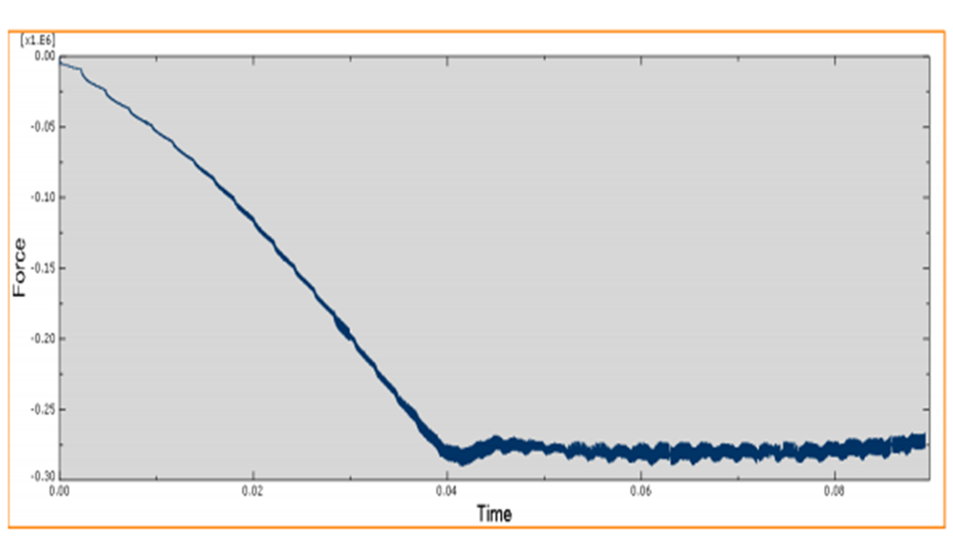
Force-time

Slide 20
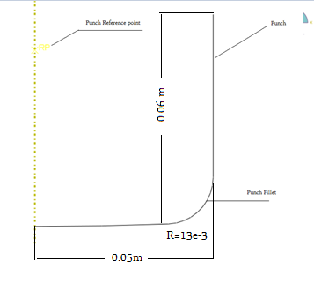
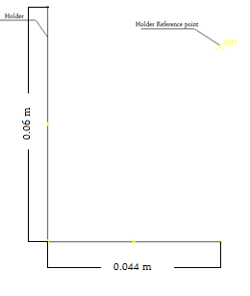
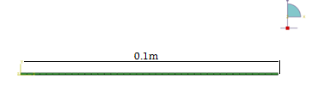
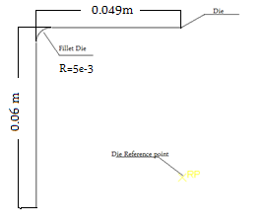
Deep drawing process using finite element analysis
Create parts

Slide 21
Define material and assign
Aluminum-killed steel properties
 | Young’s Modulus (GPa) | Poisson’s ratio
Elastic | 210 | 0.3
 | Yield stress (MPa) | Plastic strain
Plastic | 91 | 0
 | 181 | 0.0085618
 | 281 | 0.066236
 | 381 | 0.26252
 | 481 | 0.7489
 | 521 | 1.0721

Slide 22
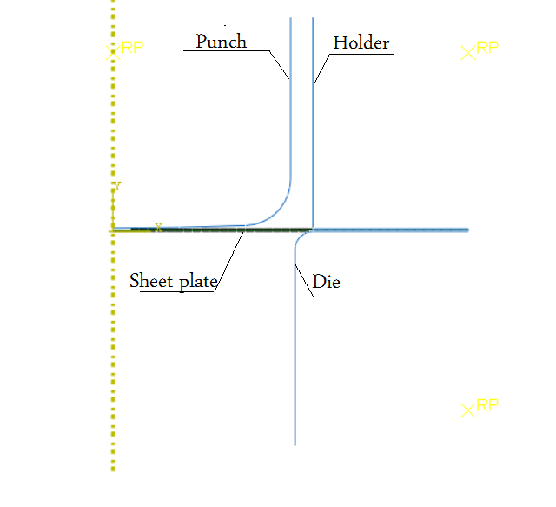
Create Assembly

Slide 23
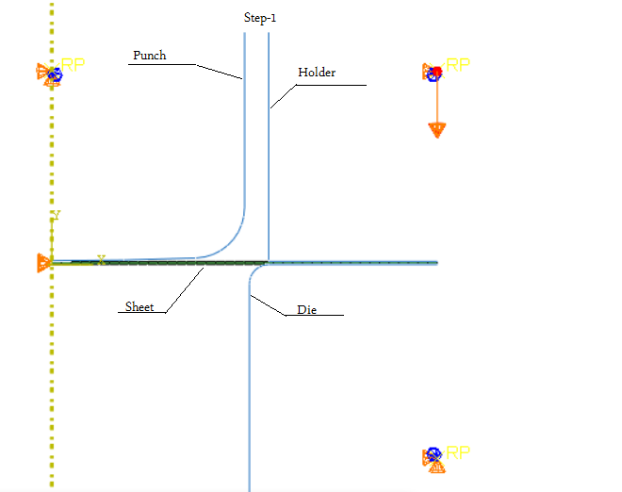
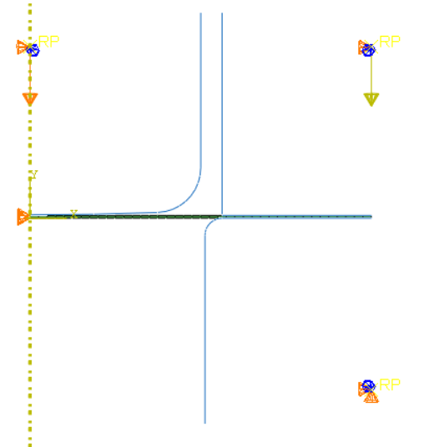
Define Step and BC
Static → standard, General.

Slide 24
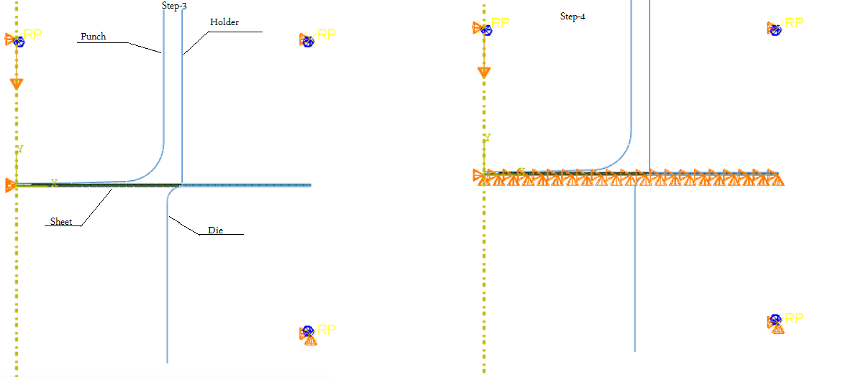
Define step

Slide 25
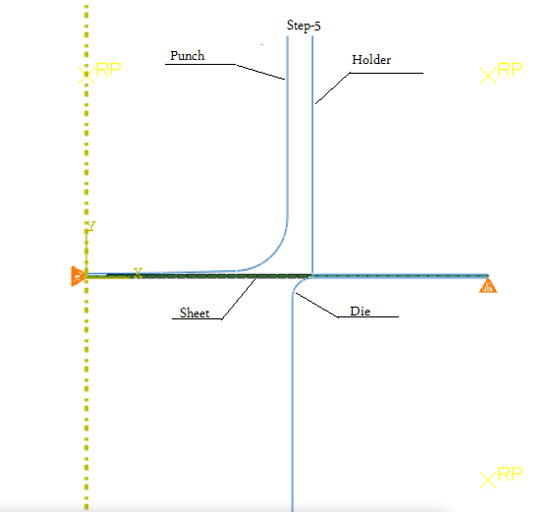
Define step

Slide 26
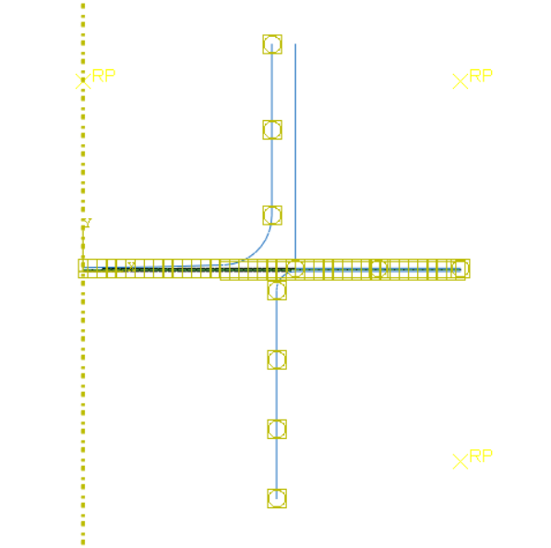
Define interactions

Slide 27
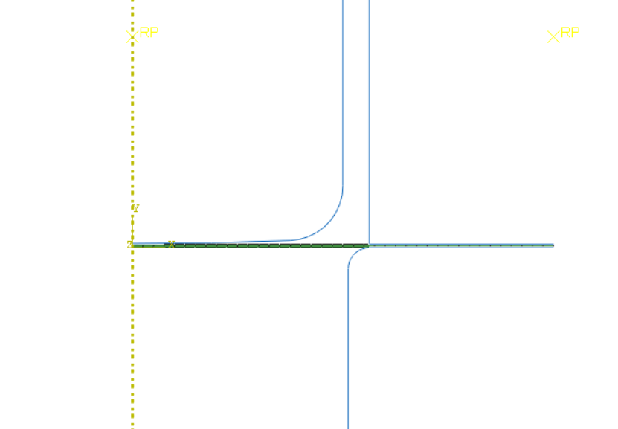
Mesh

Slide 28
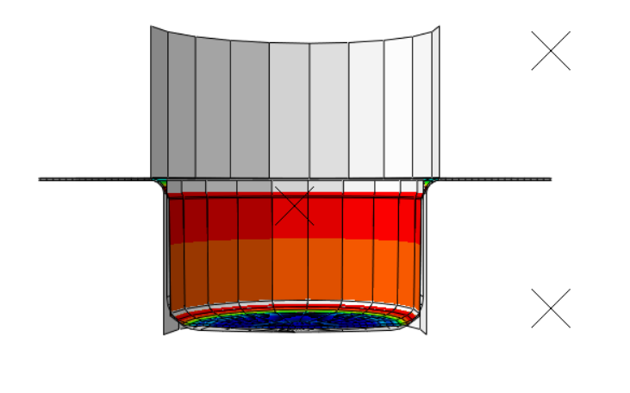
Define jops and results

Slide 29
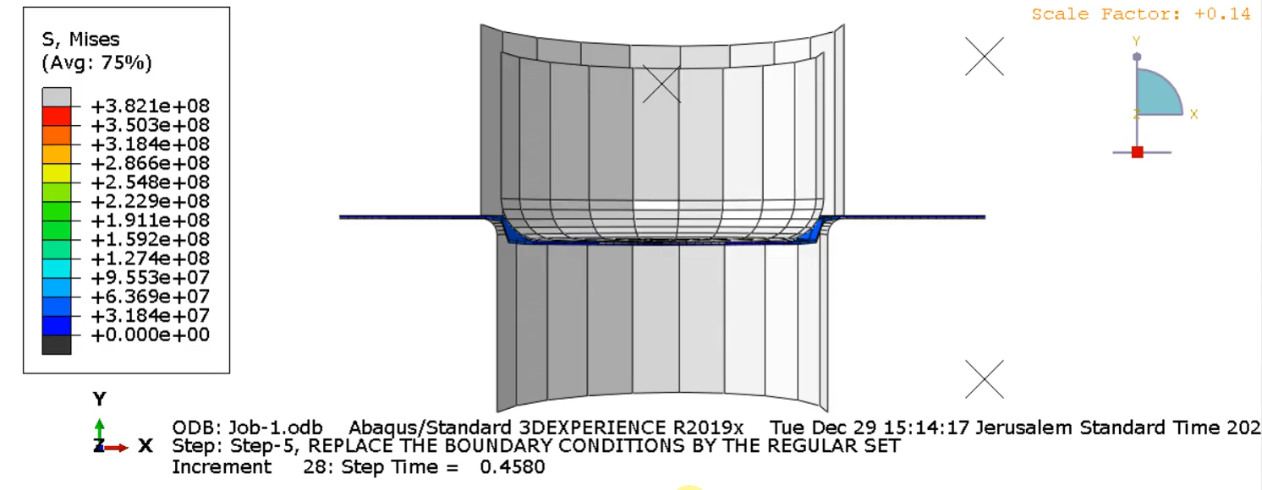

Slide 30
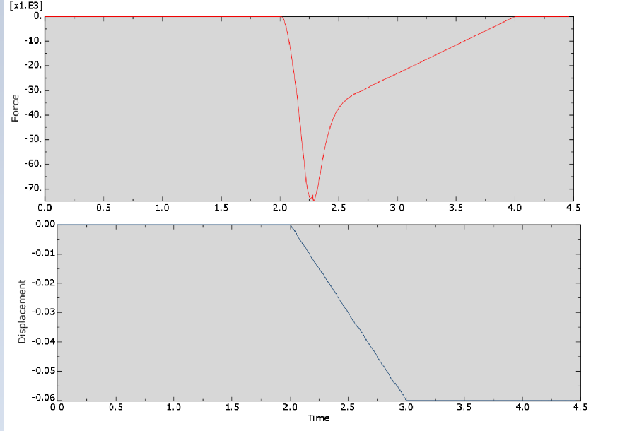
Force_time and Displacement_time curves

Slide 31
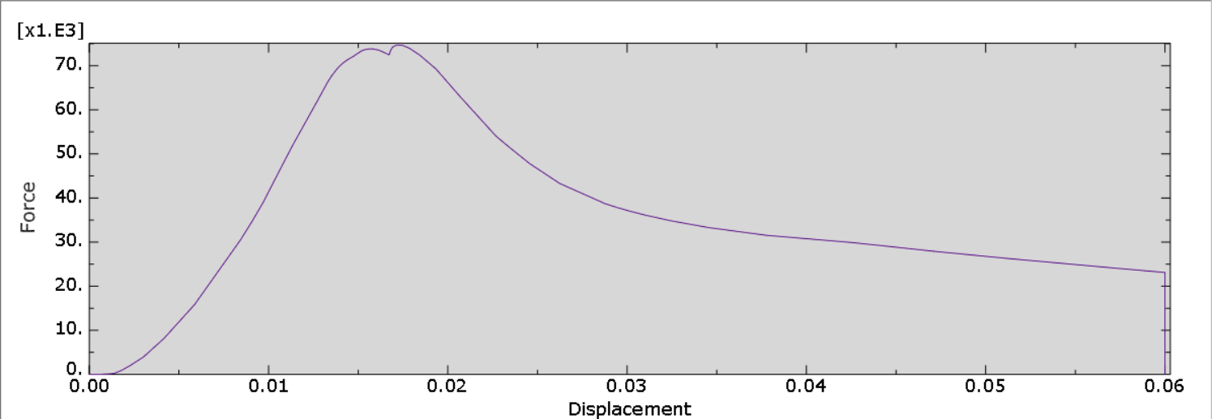
Force_displacement curves

Slide 32
Flat rolling limitation:
Maximum draft possible:
ho – hf = µ 2R= dmax
final width:
The strip thickness is reduced at each rolling pass and the strip width increases slightly (around 2%) → h0V0W0 = hfVfWf .
wf = 1.02 w0.
3) Contact length:
L=√(R(h0-hf)) .

Slide 33
Calculate the force
4) Final thickness:
Vo/Vf =hf/ho
5)Slip of strip:
s=(Vf-Vr)/Vr
R2 = L2 +(R-((ho-hf)/2)2
1702 = L2+(170-((40-30)/2)2
L = 40.9 mm
yavg== 308.585MPa
F = 305.58 (40)(40.9) = 504k N
for the force in ABAQUS equal = 275 KN

Slide 34

Deep drawing limitation
Where:
Db = 0.2 m.
Dp = 0.1 m.
t = 0.0082m.
Then:
1) r =$\frac{D_{b}−D_{p}}{D_{b}}$ = 0.5
2) DR =$\frac{D_{b}}{D_{p}}=2$
3) c= 1.1×t = 0.009

Slide 35

Force calculation
Where:
UTS=521 Mpa
F_{max}= πDp t (UTS)[($\frac{D_{b}}{D_{p}}$)-0.7] = 174.3KN

Slide 36
Thank you

