Slide 1

Attractive Learning
Prepared by:
Sahar Qawariq & Deema Hamdan
Supervisors: Alaa AlMasri & Hanal Abu Zant

Slide 2
Outline:
What is our project
The goal of the project
Methodology
First grade
Second grade
website
Future work

Slide 3
What is our project?
Cross platform application for mathematics learning for primary school students, that enable them to learn exercise by game in our application.
Attractive learning Website:
Teachers side: added by admin who is head master responsible for adding other teachers .

Slide 4
The goal of the project
motivate and attract first and second grade students to train and learn mathematics by using our application.
Instead of students spending time on playing Entertainment games on mobile, tablet or desktop without any benefits , we want to attract them to our attractive learning game.
Enable teachers to follow their score .

Slide 5
Methodology:
Technique that used in our project:
LibGdx:is a free and open-source game-development application framework written in the Java programming language.
PHP:to build our website.
HTml,Css and javascript
Mysql.
WampServer:for database.

Slide 6
How our project work?
Application.
Website.

Slide 7
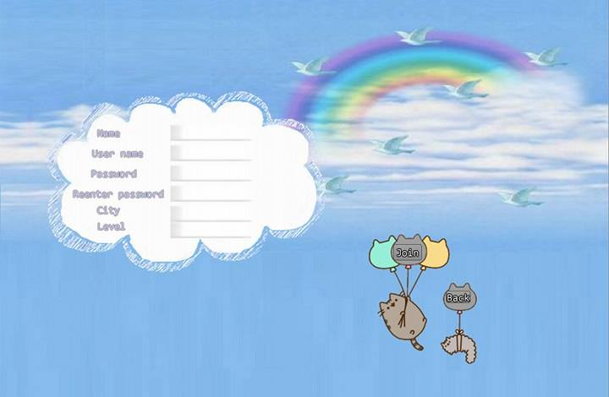
Signup
You should register in signup to have an account:

Slide 8
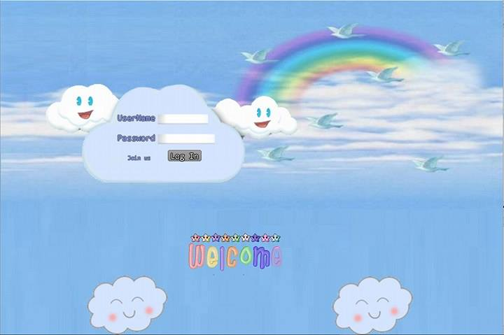
Sign In
This page enable you enter app if you have an account:

Slide 9
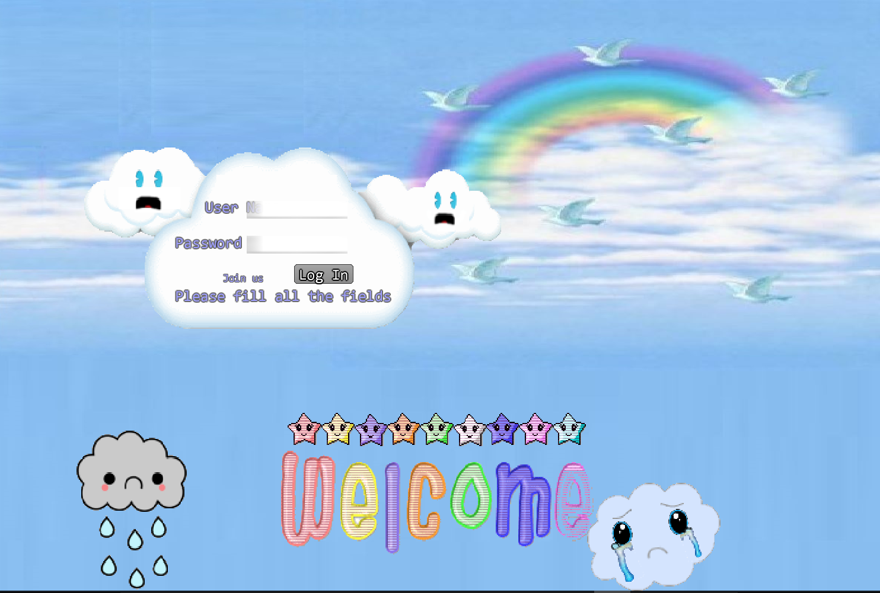
Failed sign in:
When user try to sign in without fill all the field:

Slide 10
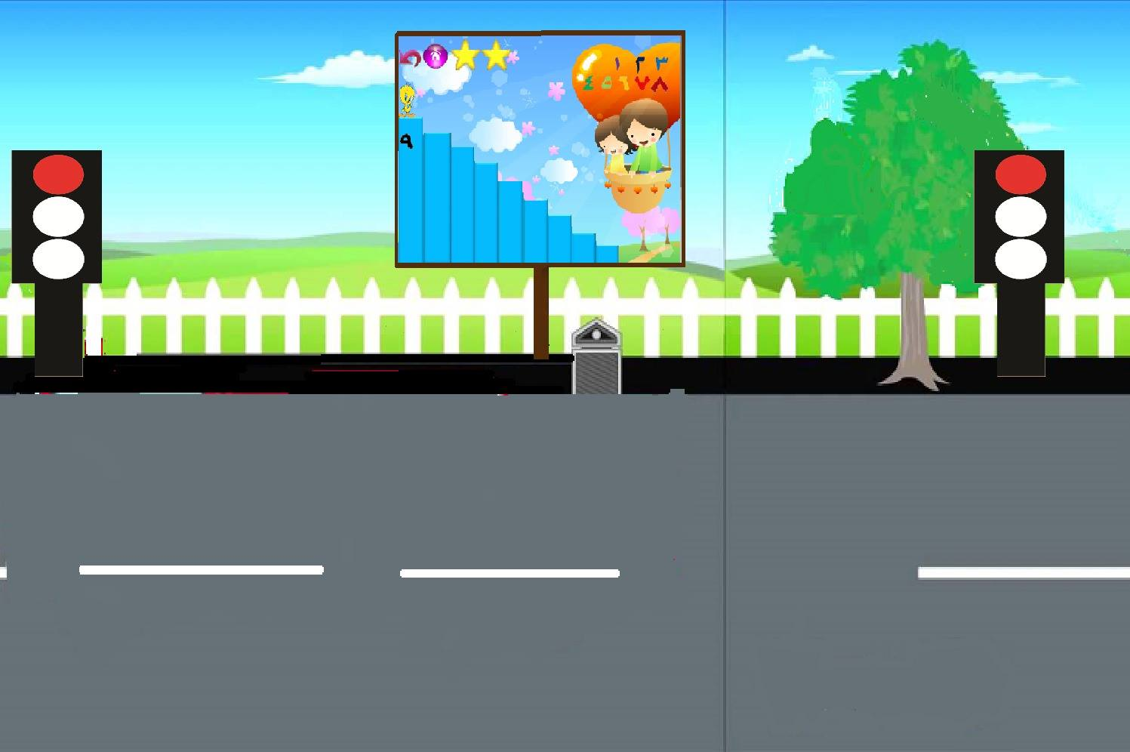
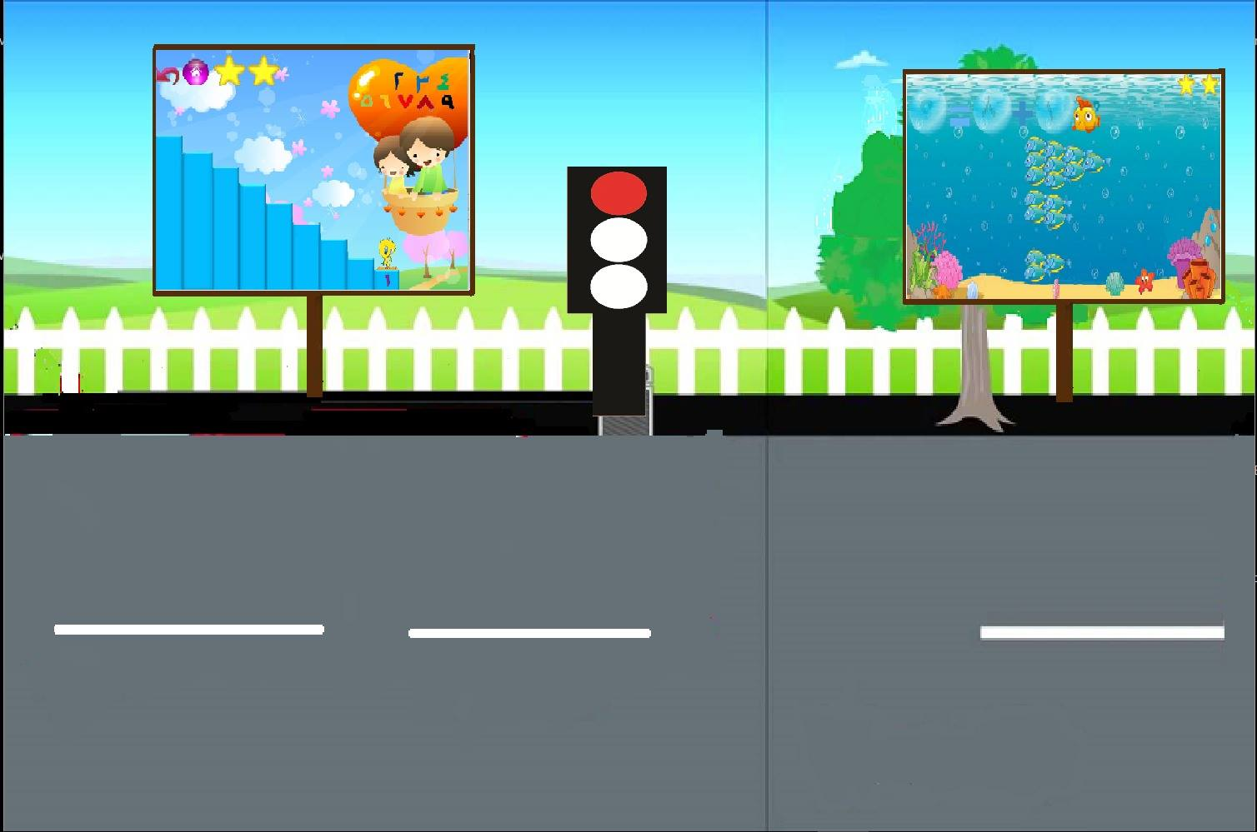
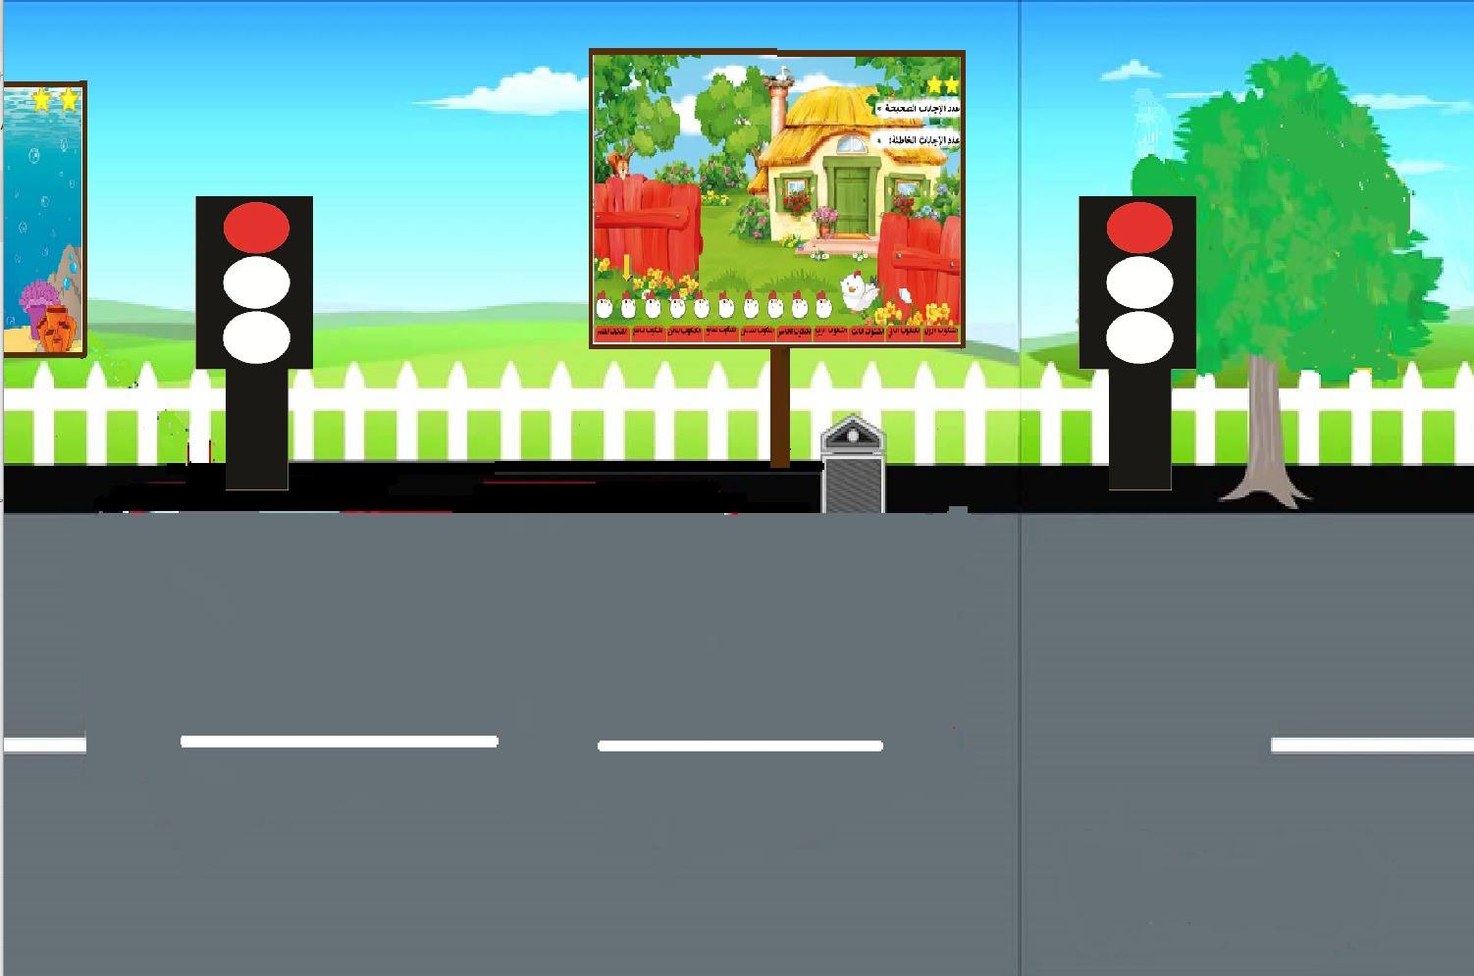
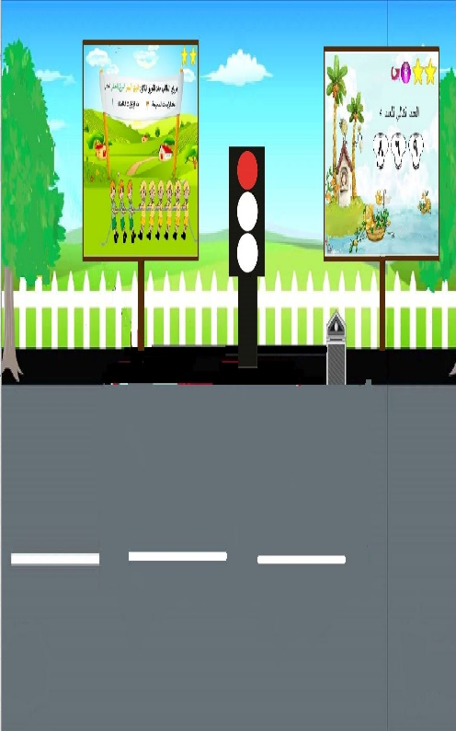
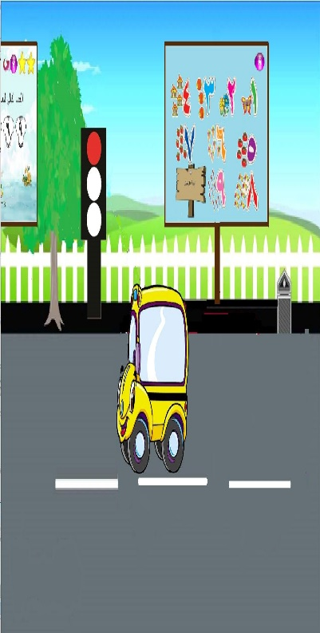
First Grade:
After sign in ,if you are in first grade this page will appear:

Slide 11

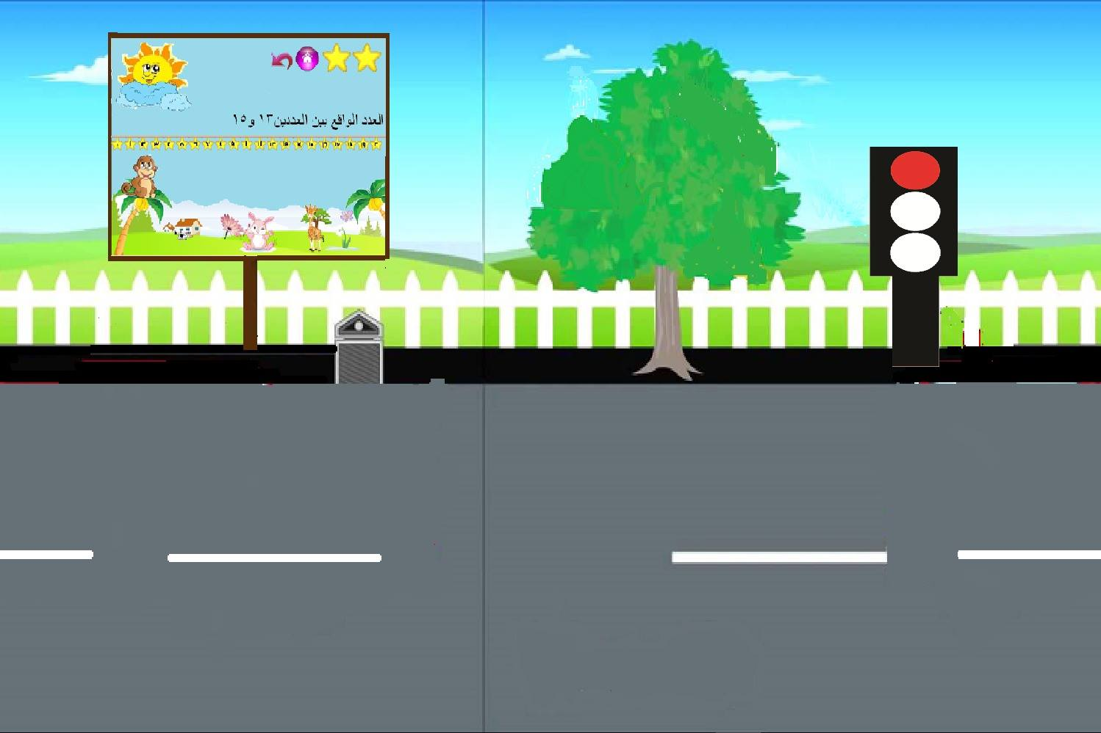
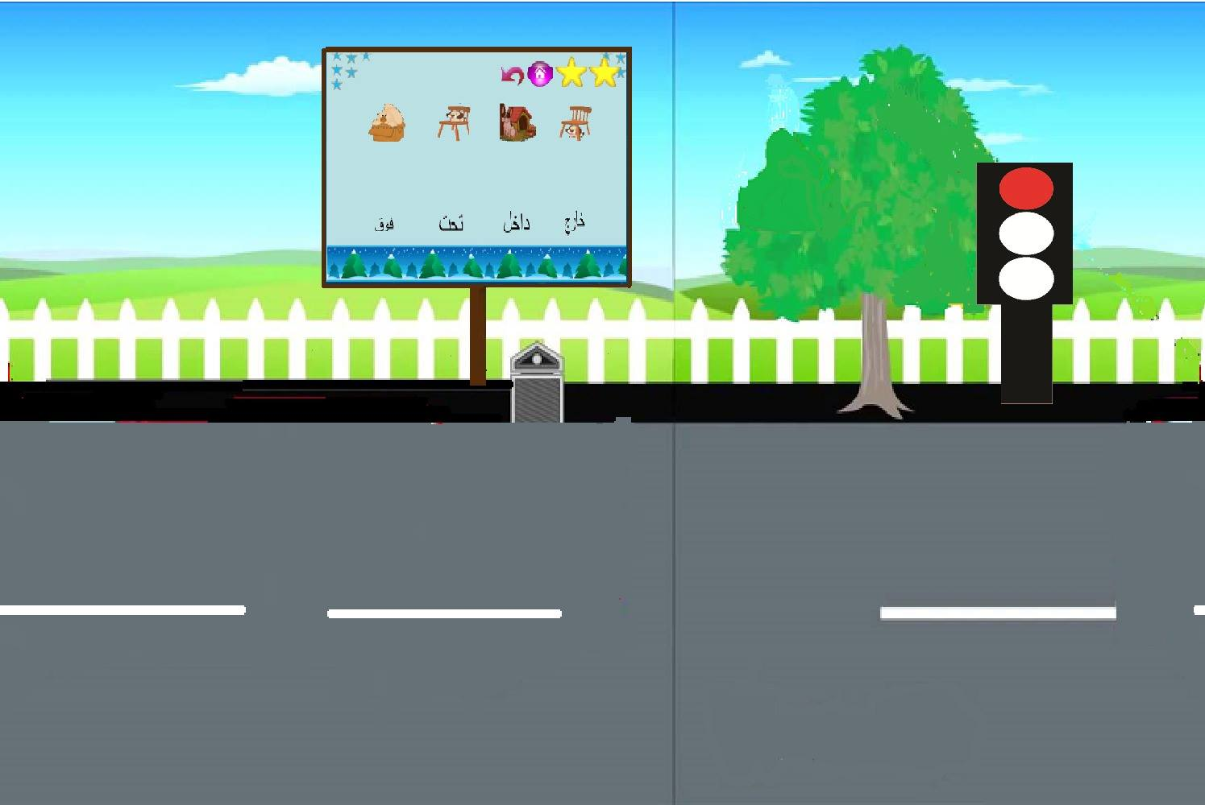
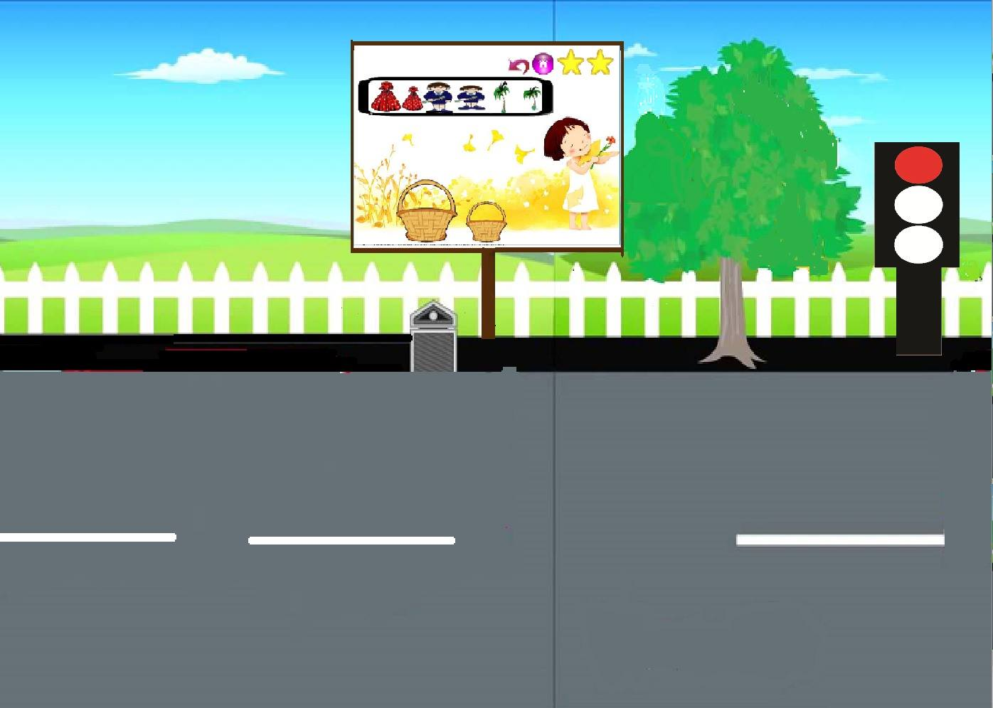
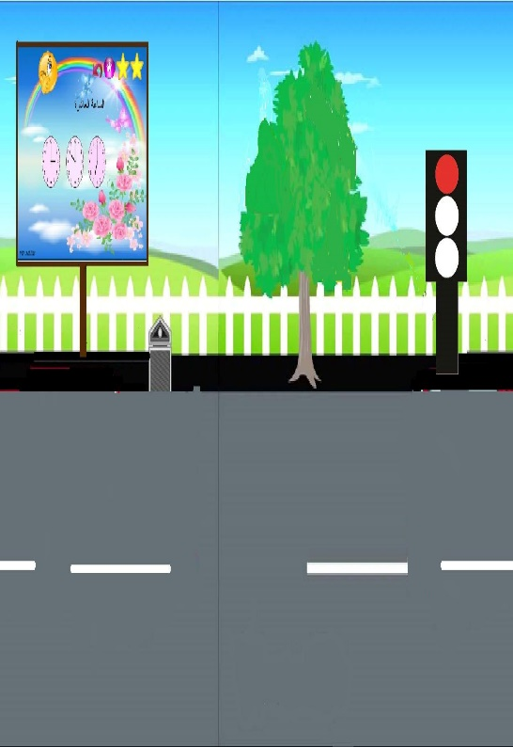
First_Grade game(cont):

Slide 12



First grade (second game):
Next Number:

Slide 13
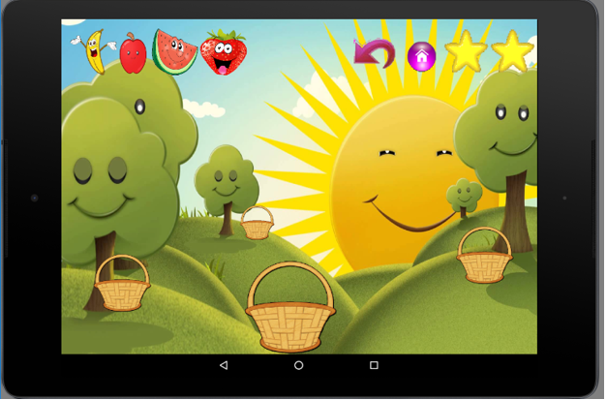

First grade(eighth game):
Direction:

Slide 14



First grade(tenth game):
Time:

Slide 15



First grade (12th game):

Slide 16
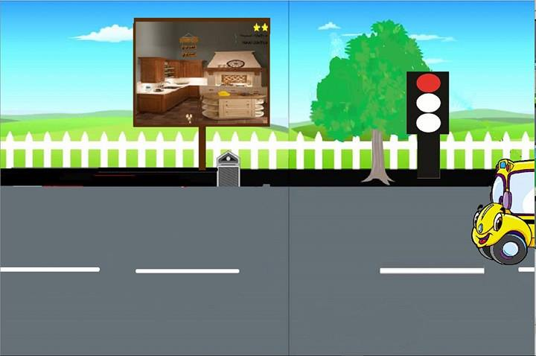
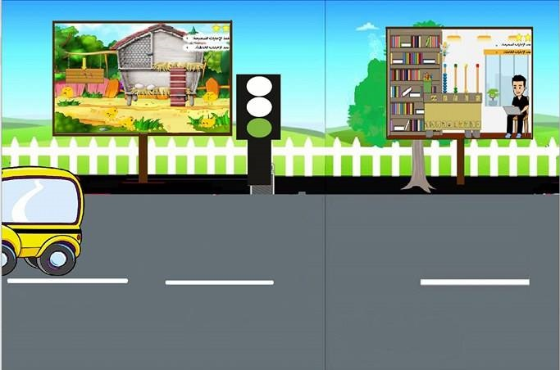
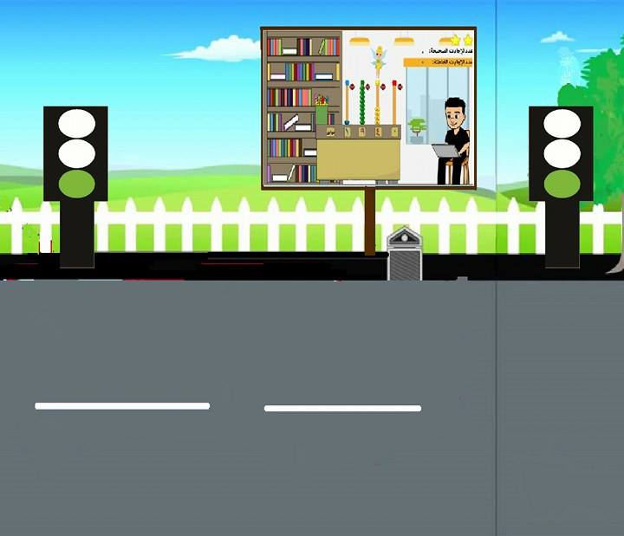
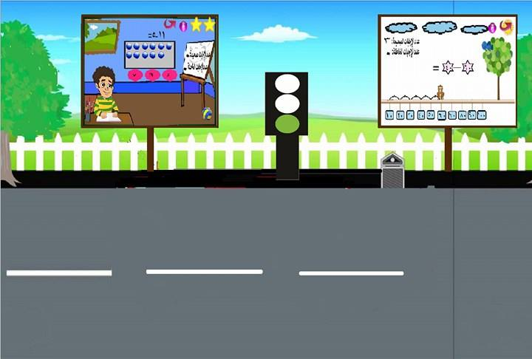
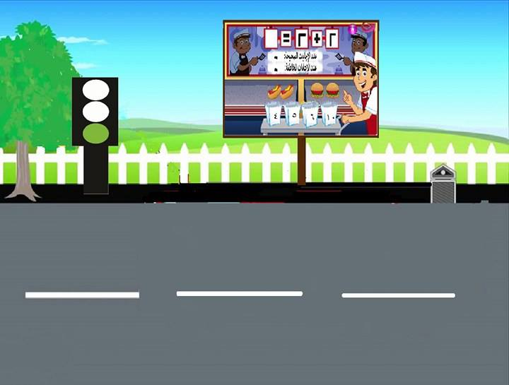
Second Grade:

Slide 17
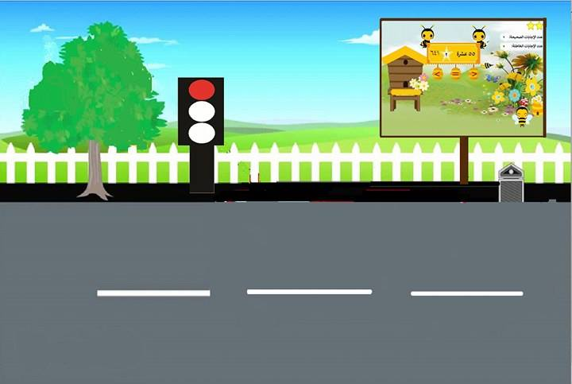
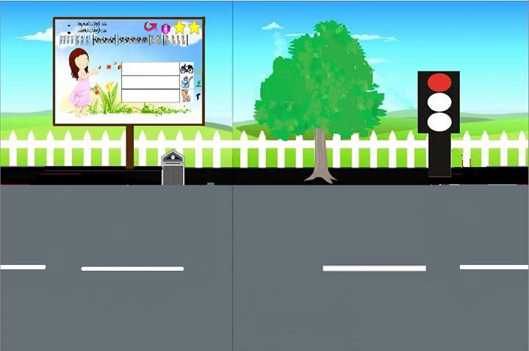
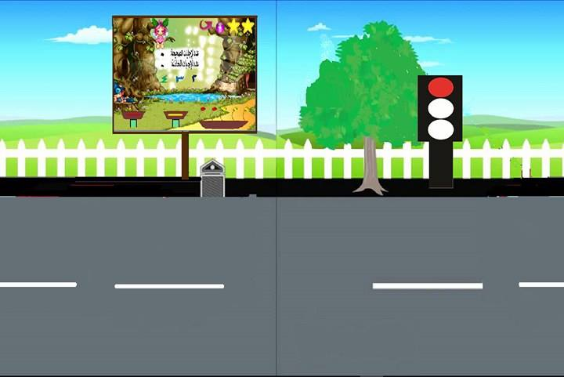
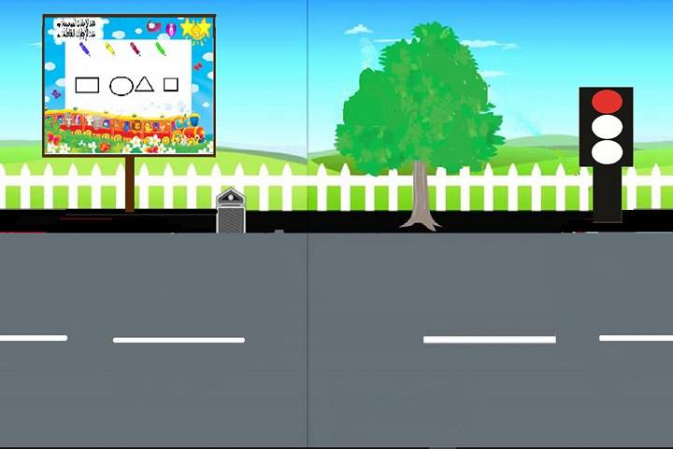
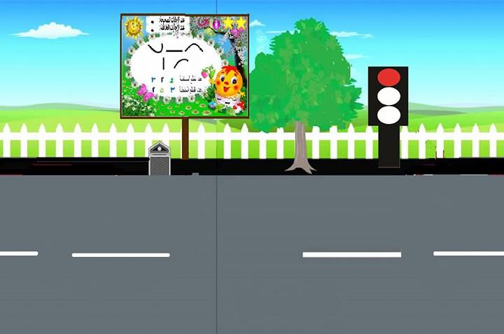
Second Game(cont):

Slide 18
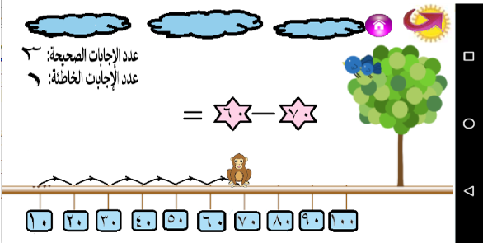
Second grade(second game):
Addition and subtraction :

Slide 19
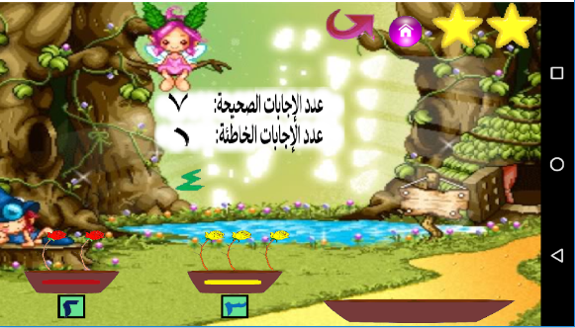
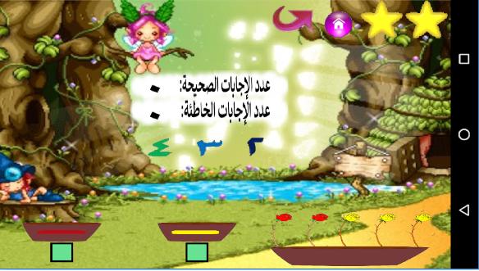
Second grade(11th gam):
Data Representation:

Slide 20
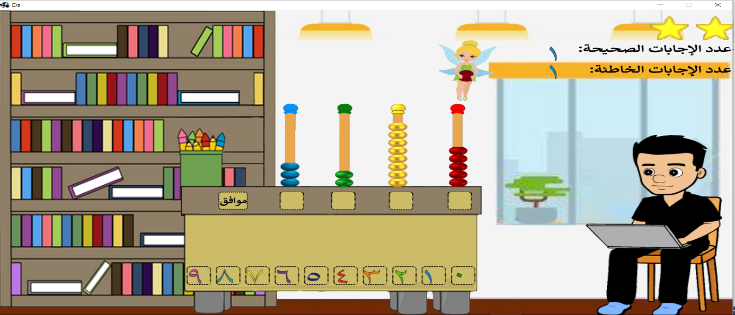
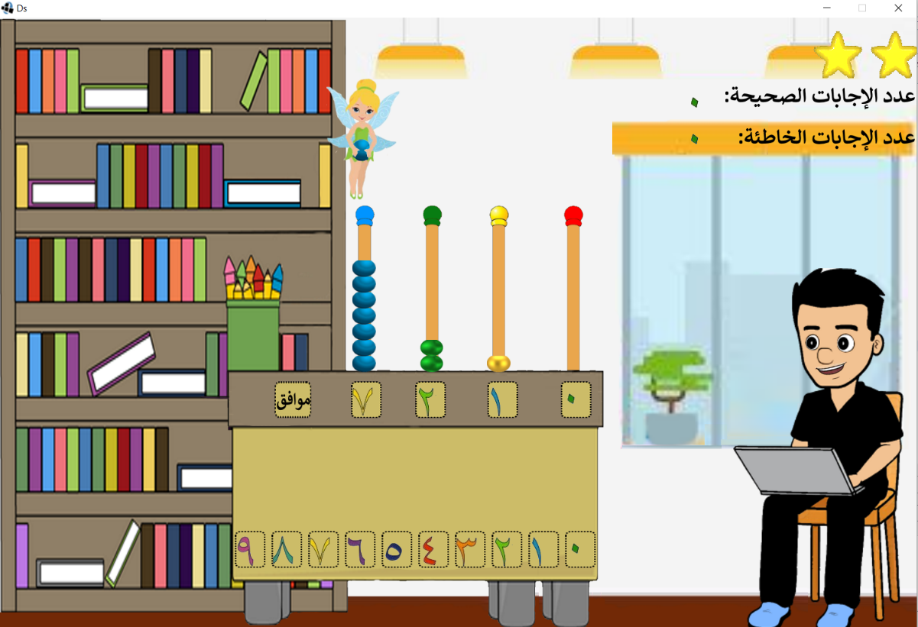
Second grade(fifth game)

Slide 21
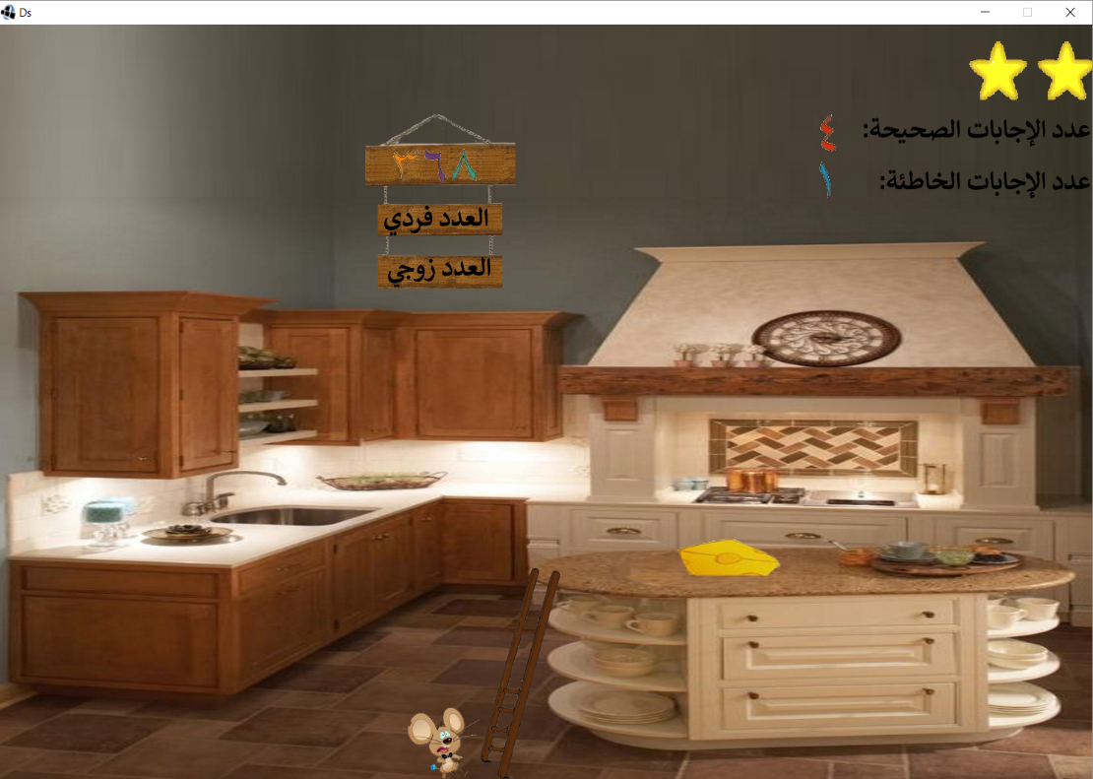
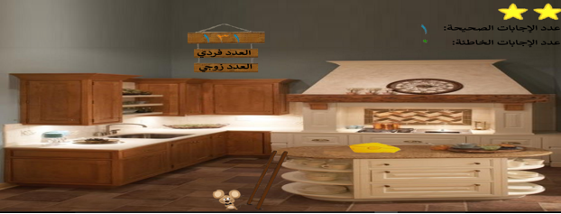
Second grade(seventh game):
Even and odd number:

Slide 22

Second grade:
Number Comparison :

Slide 23
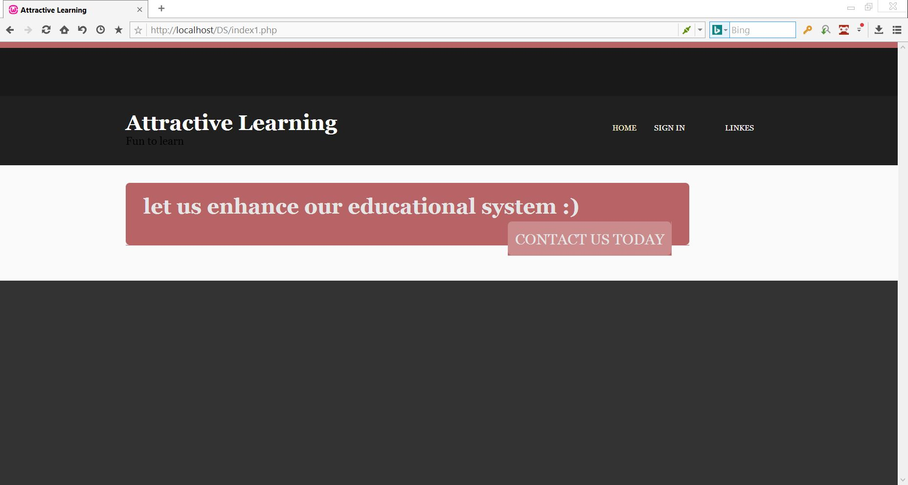
Website:
Home page:

Slide 24
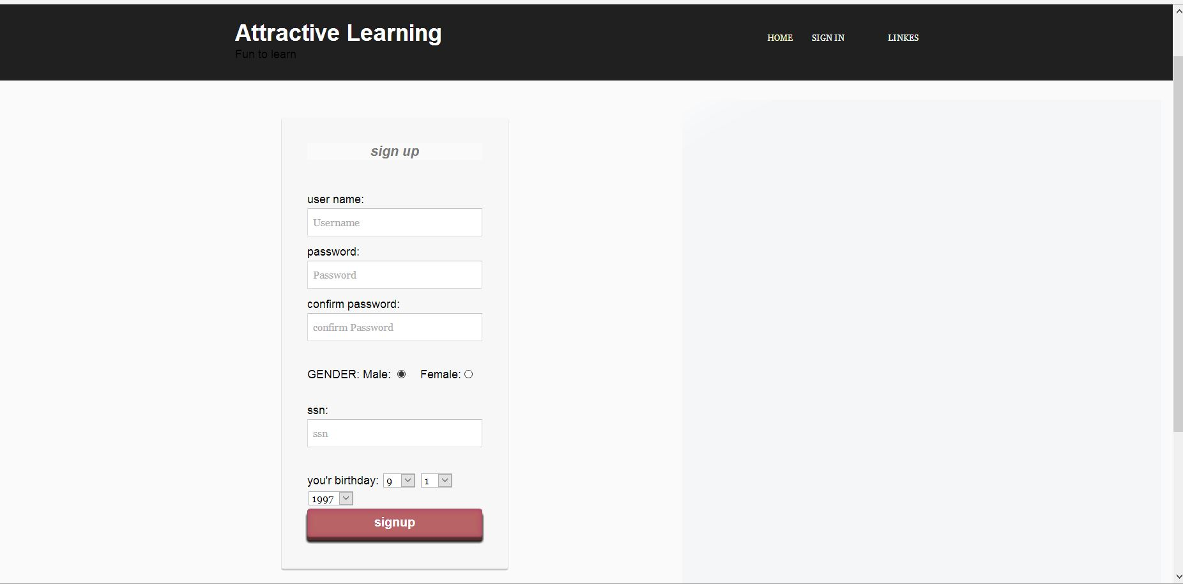
Sign up:

Slide 25
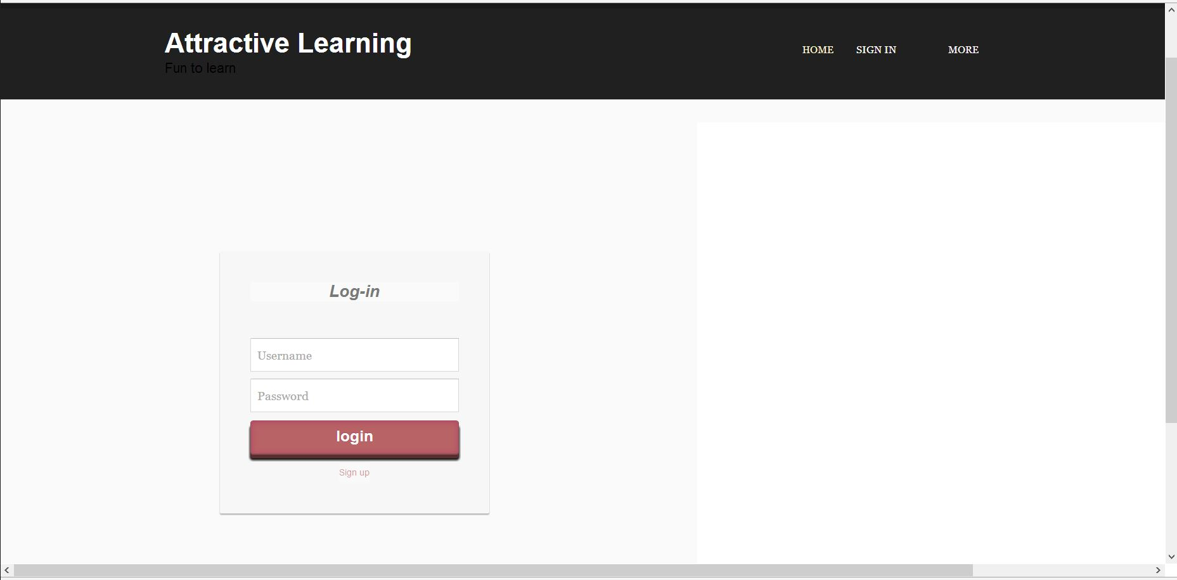
Sign in:

Slide 26
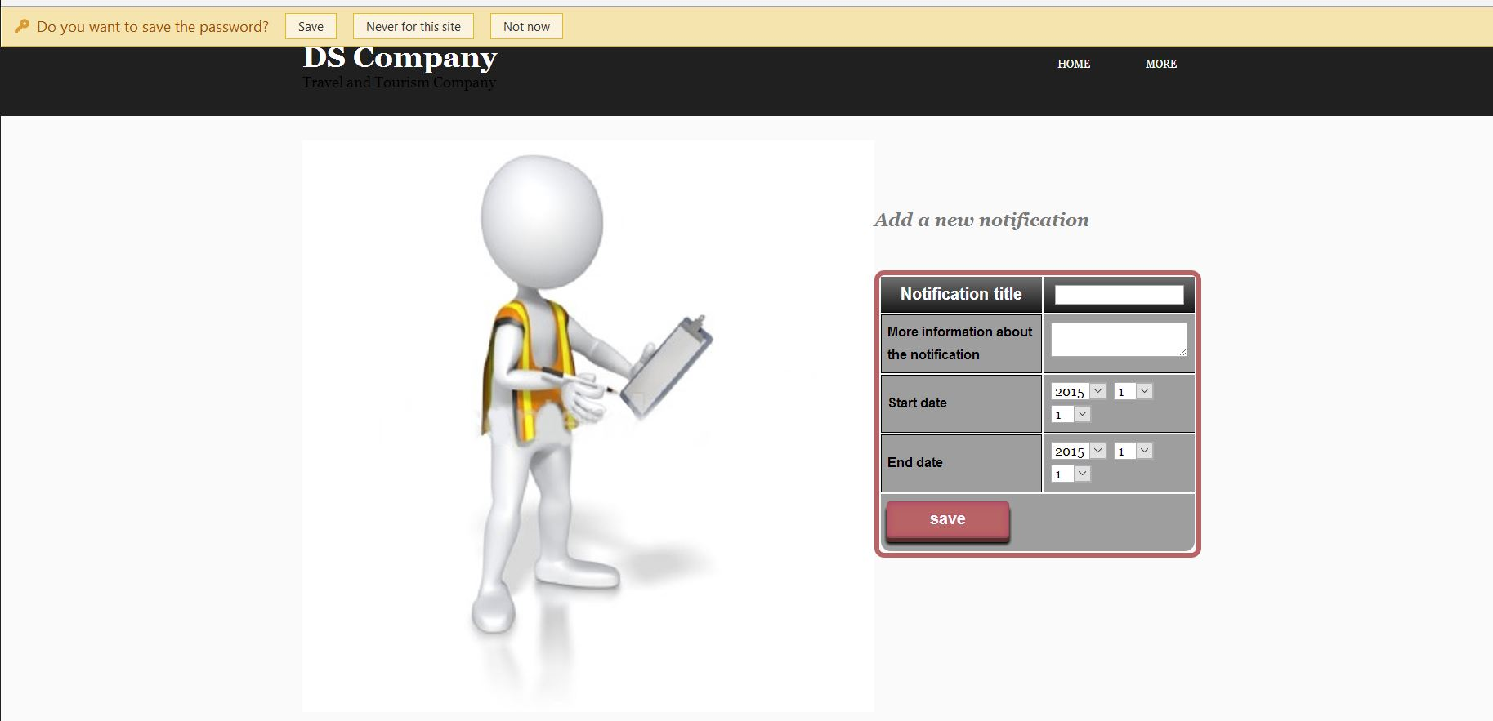
Add news:

Slide 27
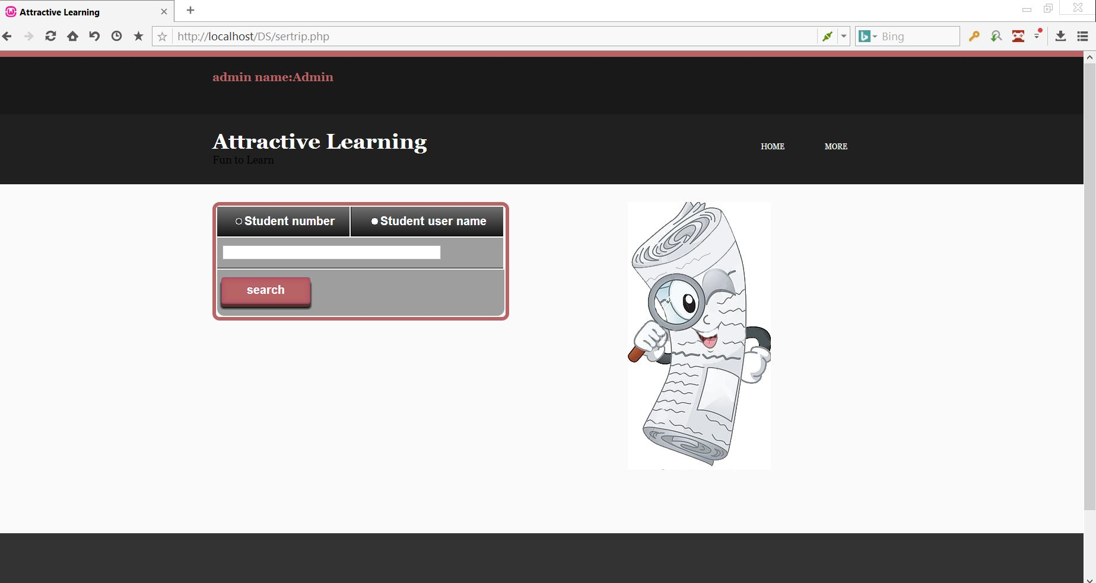
Track student scores:

Slide 28
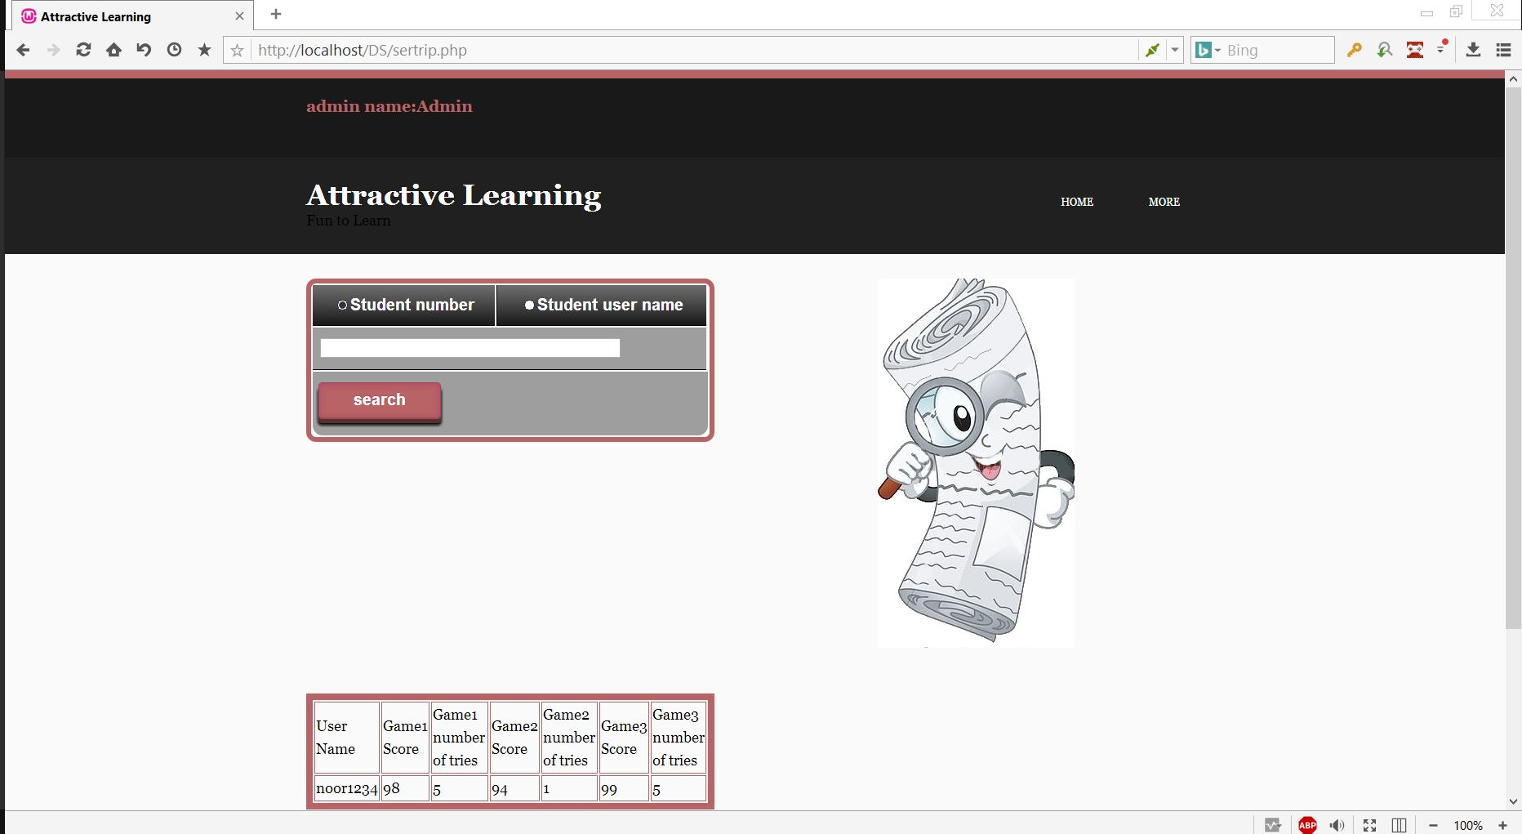
Track student scores:

Slide 29
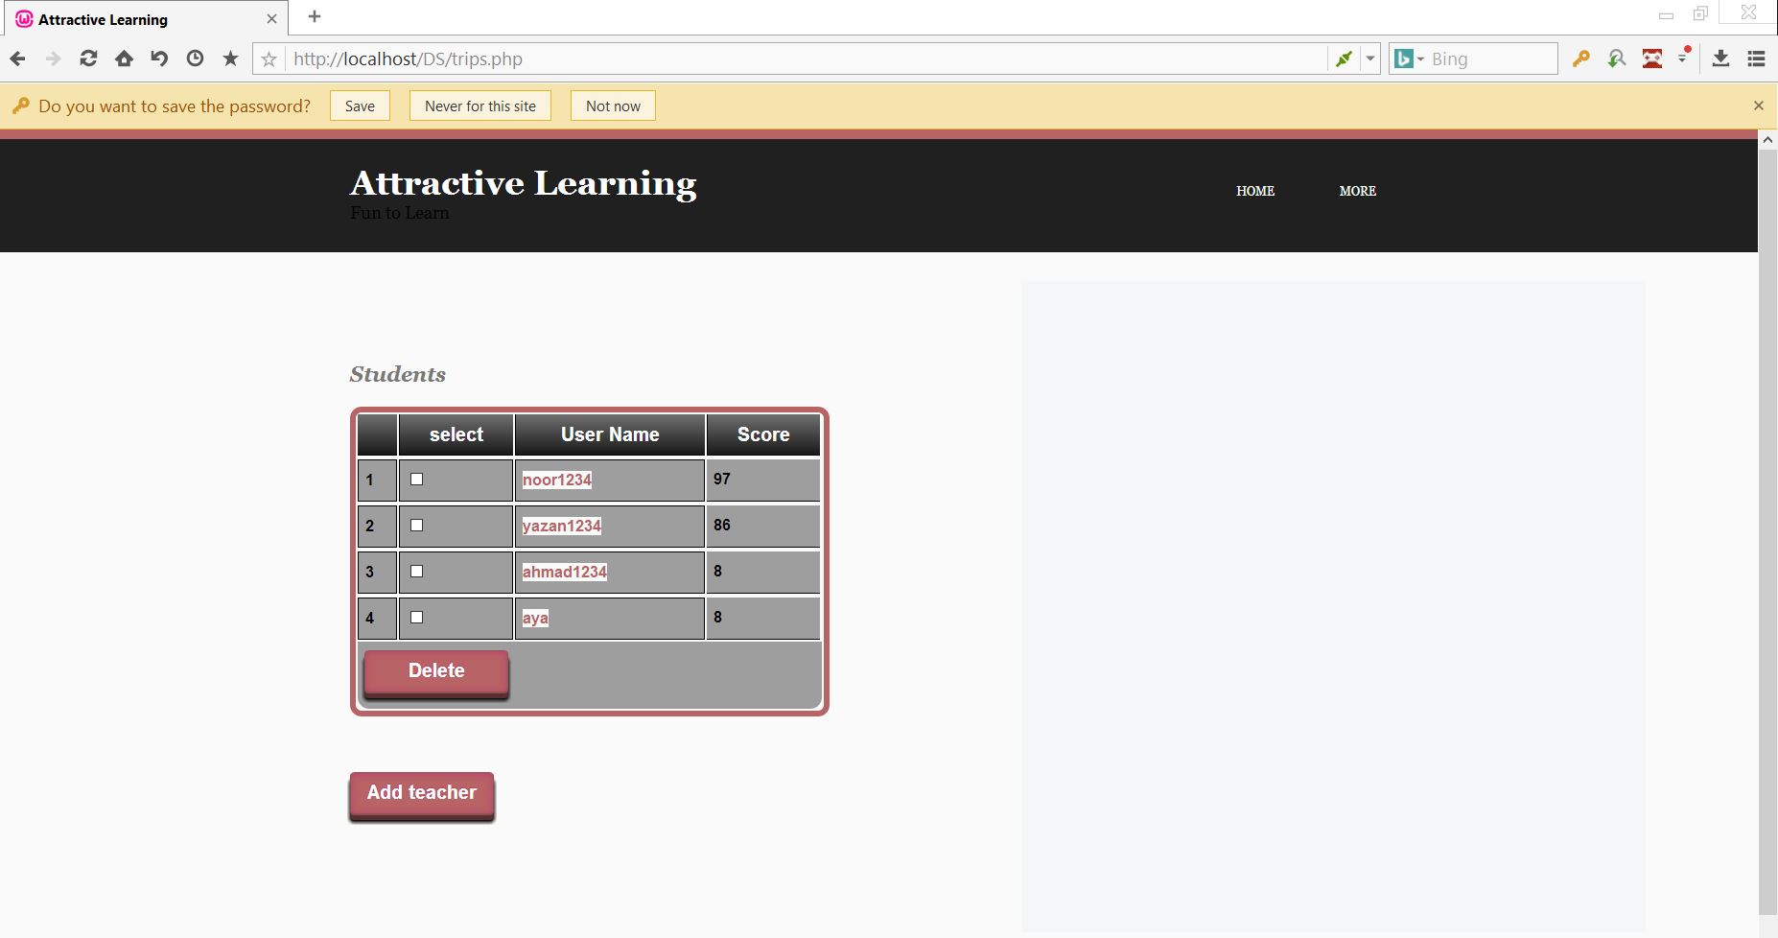
Teacher home page:

Slide 30
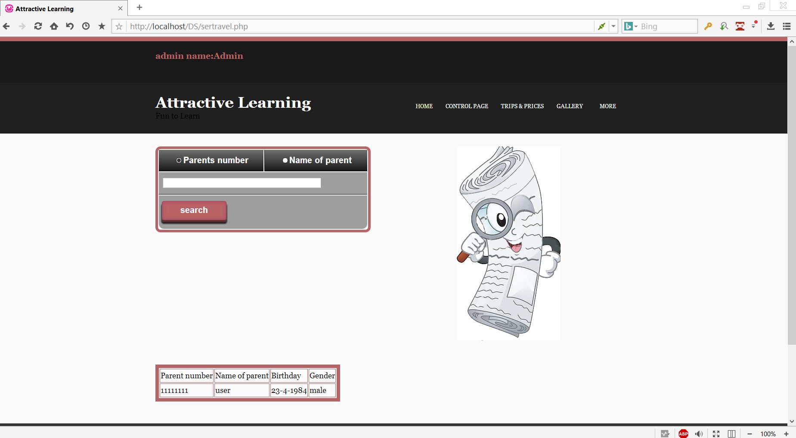
Search for student parent

Slide 31
Future Work:
Add parent side functionalities to our website .
Add messages between parent part and the teacher side.
Add more control features to make our system works as an Evaluation tool for the student, teacher and curriculum.

