Slide 1
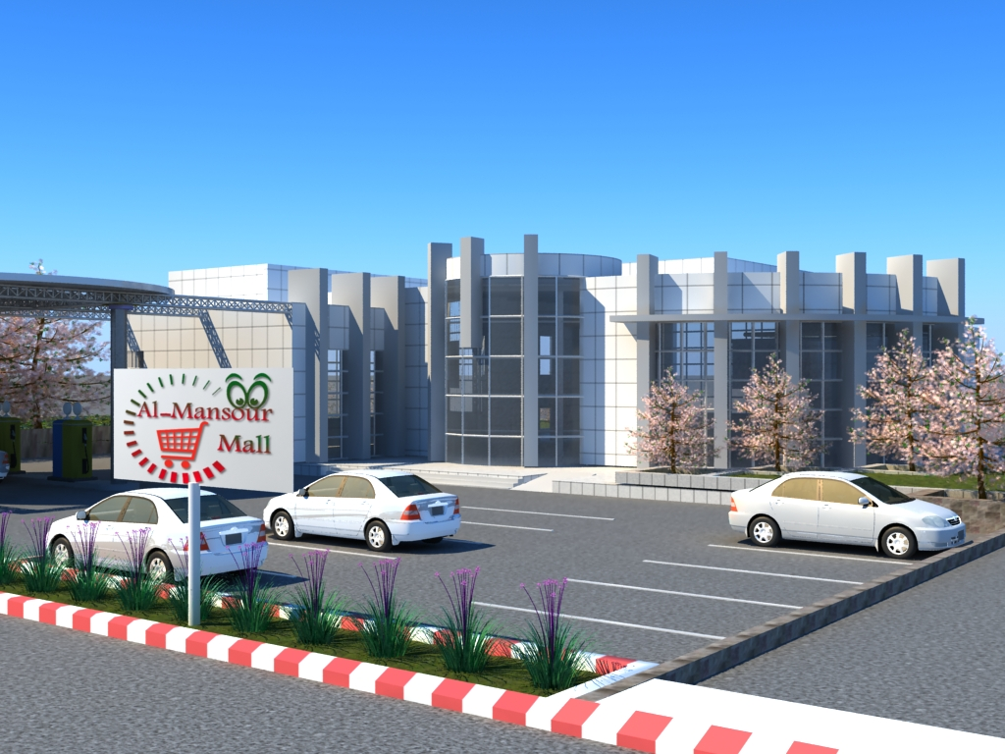
An-Najah National University
Faculty of Engineering
Civil Engineering Department
AL-Mansour Mall

Slide 2
Graduation Project Thesis:
Structural Analysis & Design of
“Al-Mansour Mall”
Prepared by:
Abeer F. Malayshi
Ola M. Qarout
Supervisor:
Dr. Riyad Awad
Submitted in partial fulfillment of the requirements of the B.Sc./degree in Civil Engineering Department

Slide 3
Table of content
Chapter one: introduction
Chapter two: preliminary design
Chapter three: Sap modeling
Chapter four: blast analysis
Chapter five: references

Slide 4
Chapter one: introduction
This project shows the structural analysis and design of Al-Mansour Mall in Nablus city; it is a project in the Department of Architecture at An-Najah National University. This project was designed by the student Anas Mansour.
The project consists of commercial building of three stories, each story has the area of 797 m²
The commercial building is designed using reinforced concrete .
The project is designed manually and using SAP program version 15, and according to ACI code 2008 and IBC 2009
The project is designed for gravity and the forces affecting the building from blast have been unanalyzed.

Slide 5
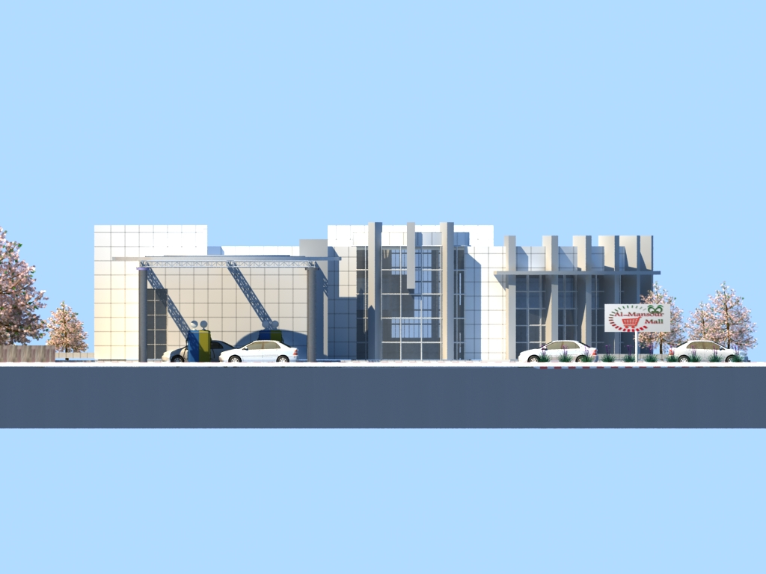
Al-Mansour Mall

Slide 6
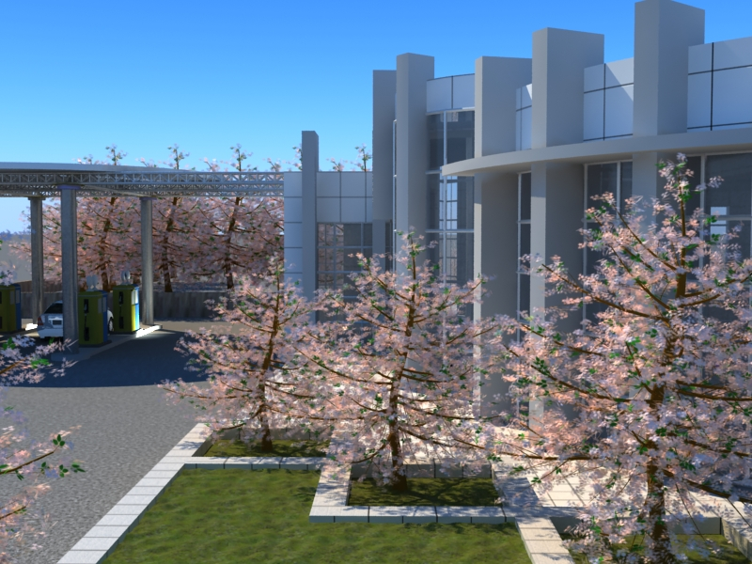
Al-Mansour Mall

Slide 7
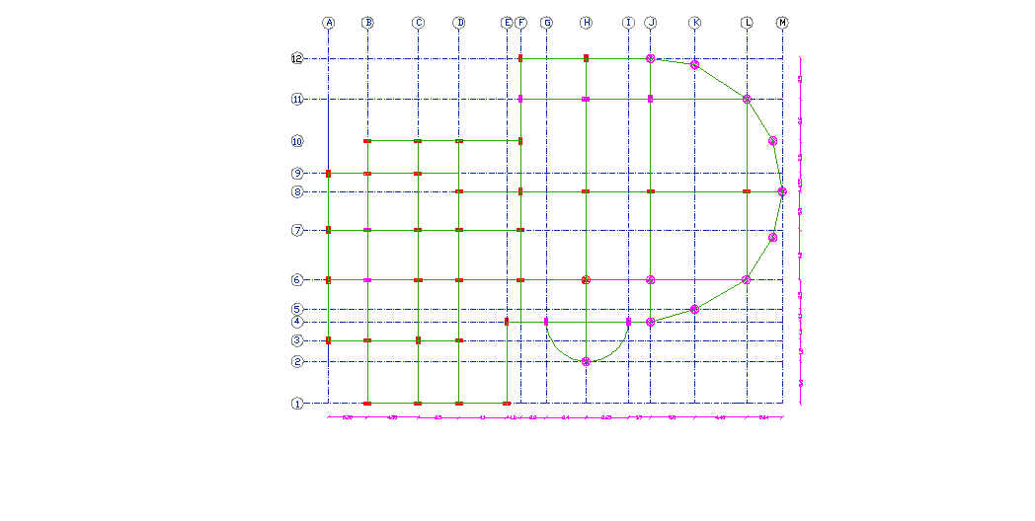
Design steps

Slide 8
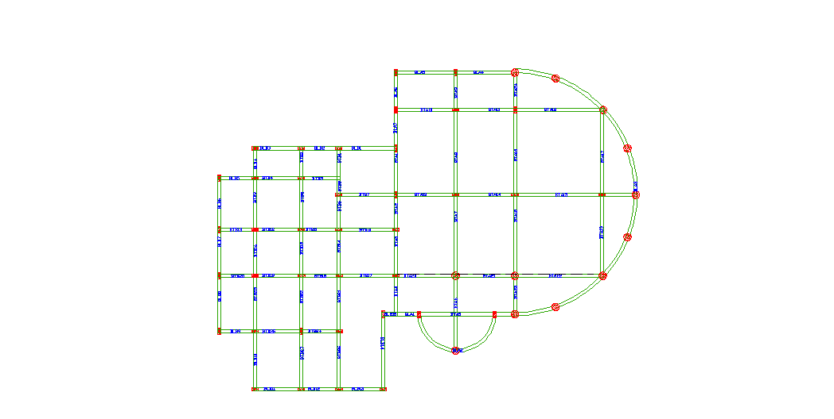
Design steps

Slide 9
Materials
The compressive strength of concrete cylinders in this project is:
f`c = 28 Mpa
Ec = 24.8×10⁶ Mpa
Steel for reinforcement accordance to ASTM standards
1- Modulus of elasticity, Es= 200000 Mpa
2- Yielding strength, fy= 420 Mpa

Slide 10
Design code and load analysis
ACI code and IBC code are used in the project
Load analysis:
Dead load : own weigh +SIDL
SIDL=4.04 KN/m²
Live load =4.8KN/m²
Load combination:
1.2D+1.6L is used

Slide 11
Chapter two: preliminary design
The preliminary design includes all the hand calculation we made in the project , the preliminary design is very important process because it's define the preliminary loads and dimensions that need to be entered in the SAP program , and help understand the structure.
The preliminary design is not precise but should be within accepted tolerance.

Slide 12
Design of slabs
Slab system in the project is two way solid slab ,and it's divided in two areas right (Part A) and left (Part B ) each has different slab thickness and different dimensions for beams

Slide 13
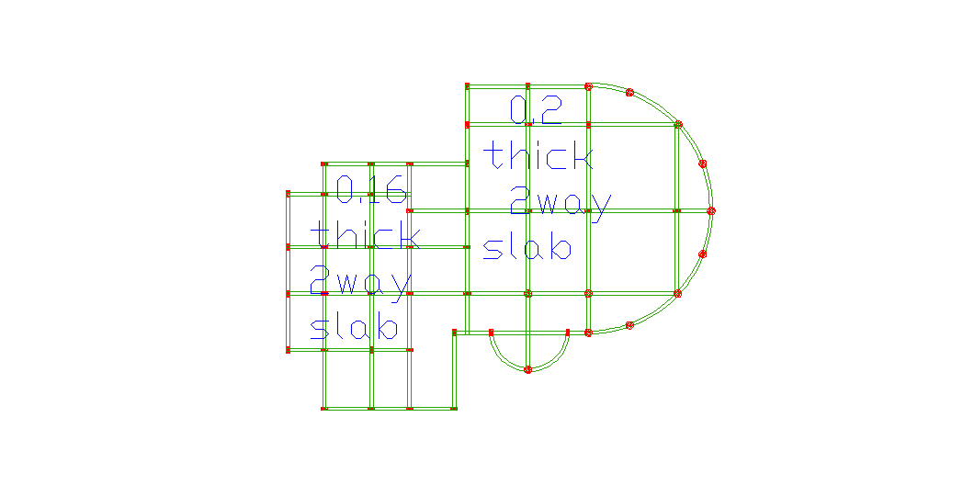
Slabs

Slide 14
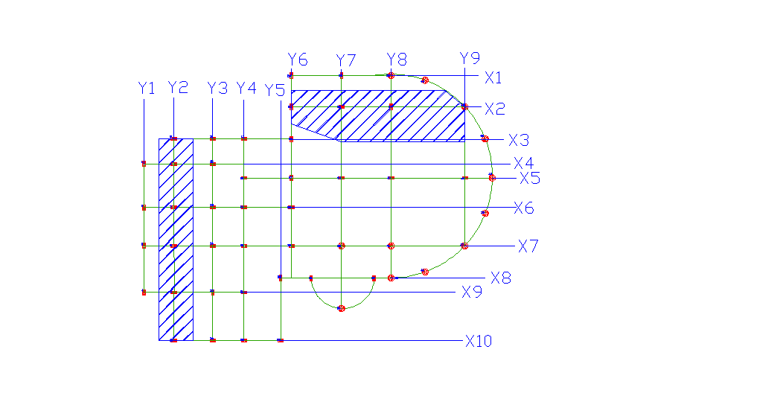
Design of frame A(X2)

Slide 18
Column strip and beam moment

Slide 19
Column strip moment

Slide 20
Middle strip moment

Slide 21
check for shear in slab (using SAP)
Vu max = 71.4 KN < 105.8 ok
Asmin = 0.0018×1000×200 = 360 mm²
ρmin = 360/ (1000×160) = .0023

Slide 22
Slab C.S Moment
Span no. | Location | Mu | b(M) | d (mm) | ρ | As | no. of ɸ12 bars
1 | exterior negative | 27 | 2.275 | 160 | 0.0023 | 837 | 8
 | Positive | 22.1 |  |  | 0.0023 | 837 | 8
 | interior negative | 32.5 |  |  | 0.0023 | 837 | 8
2 | exterior negative | 27.8 | 2.26 | 160 | 0.0023 | 832 | 8
 | Positive | 8.6 |  |  | 0.0023 | 832 | 8
 | interior negative | 44.3 |  |  | 0.0023 | 832 | 8
3 | exterior negative | 40.3 | 2.775 | 160 | 0.0023 | 1021 | 9
 | Positive | 43.8 |  |  | 0.0023 | 1021 | 9
 | interior negative | 63.4 |  |  | 0.0024 | 1066 | 9

Slide 23
Middle Strip Moment
1 | exterior negative | 10.5 | 3.425 | 160 | 0.0023 | 1260 | 11
 | Positive | 49.1 |  |  | 0.0023 | 1260 | 11
 | interior negative | 72.2 |  |  | 0.0023 | 1260 | 11
2 | exterior negative | 60.7 | 3.44 | 160 | 0.0023 | 1266 | 11
 | Positive | 19.1 |  |  | 0.0023 | 1266 | 11
 | interior negative | 98.5 |  |  | 0.003 | 1651 | 11
3 | exterior negative | 89.2 | 2.925 | 160 | 0.0032 | 1498 | 13
 | positive | 61.9 |  |  | 0.0023 | 1076 | 10
 | interior negative | 10.6 |  |  | 0.0023 | 1076 | 10

Slide 24
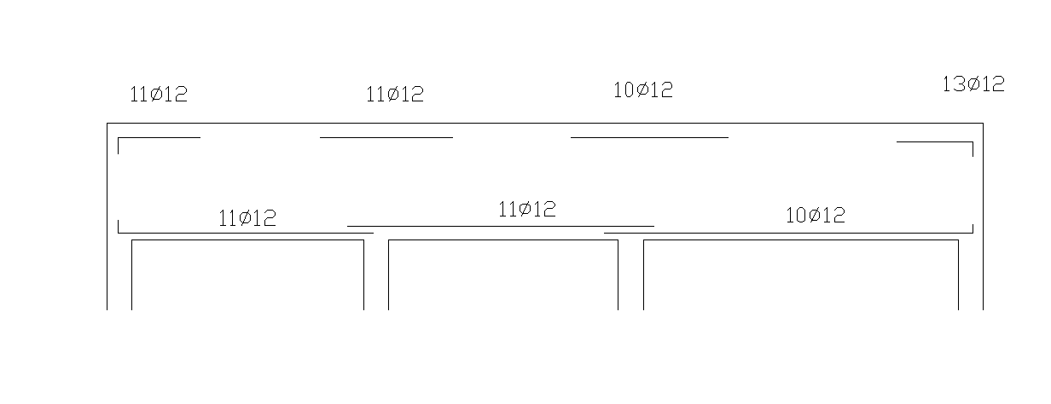
MS reinforcement

Slide 25
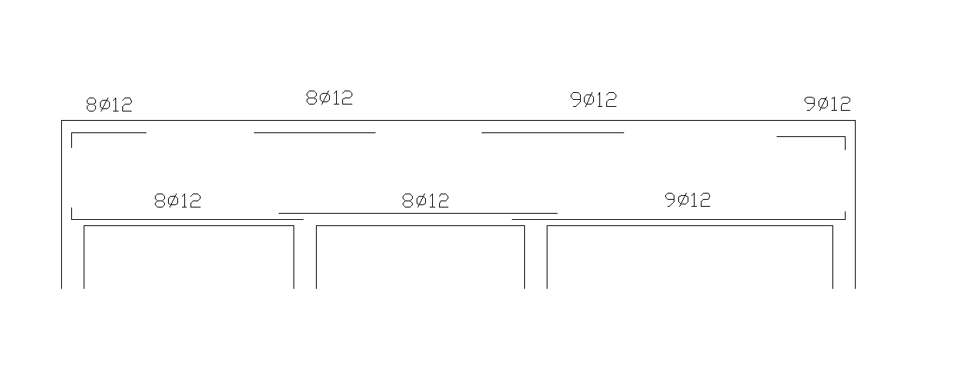
CS reinforcement

Slide 26
reinforcement details in middle strip

Slide 27
reinforcement details in column strip

Slide 28
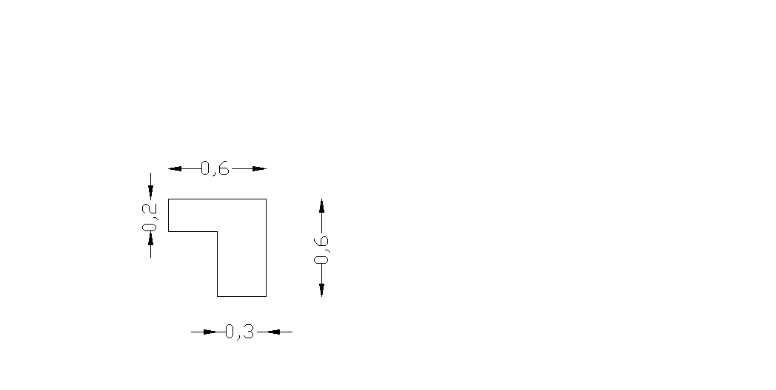
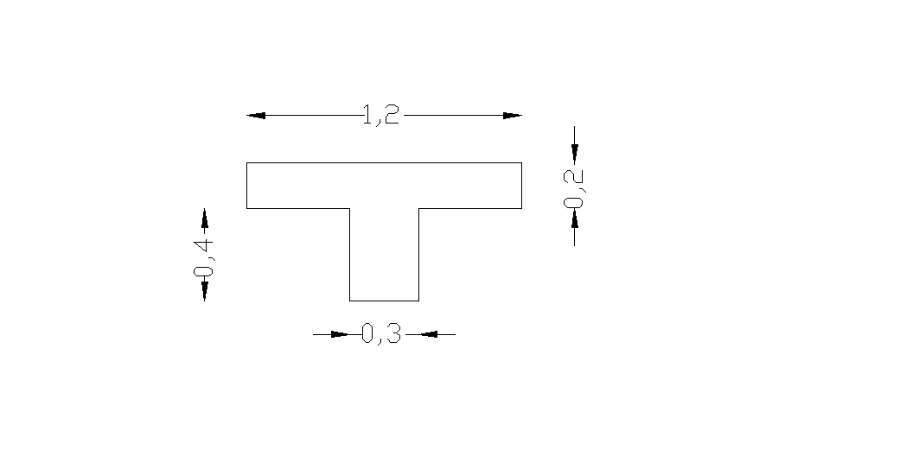
Beams
TA& LA

Slide 29


Beams TB&LB

Slide 30
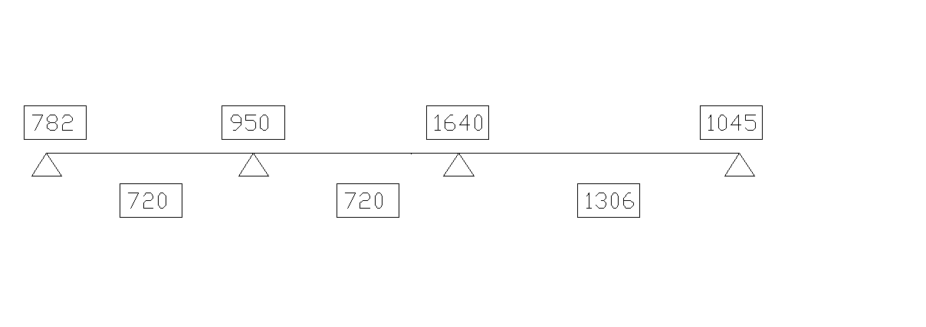
Beam(X2)reinforcement

Slide 31
Columns preliminary design:
Where:-
Ag: -cross section area of column.
As: - area of longitudinal steel.
Ø:-strength reduction factor.
Ø=0.65 (tied column).
Ø=0.70 (spirally reinforced column).
λ:- reduction factor due to minimum eccentricity,
λ=0.8 (tied column).
λ=0.85 (spirally reinforced column).

Slide 32
rectangular
Column No. | Pu | Ag | b | h
1 | 366 | 25352.93 | 300 | 300
2 | 577 | 39968.97 | 300 | 300
3 | 598 | 41423.64 | 300 | 300
4 | 378 | 26184.18 | 300 | 300
5 | 305 | 21127.44 | 300 | 300
6 | 866 | 59988.09 | 300 | 300
7 | 1156 | 80076.47 | 300 | 300
8 | 1183 | 81946.77 | 300 | 300
9 | 1077 | 74604.12 | 300 | 300
10 | 441 | 30548.21 | 300 | 300
11 | 462 | 32002.88 | 300 | 300
12 | 1033 | 71556.23 | 300 | 300
13 | 1139 | 78898.88 | 300 | 300
14 | 1161 | 80422.83 | 300 | 300
15 | 1336 | 92545.13 | 300 | 350
16 | 715 | 49528.27 | 300 | 300
17 | 658 | 45579.86 | 300 | 300
18 | 835 | 57840.71 | 300 | 300
19 | 844 | 58464.14 | 300 | 300

Slide 33
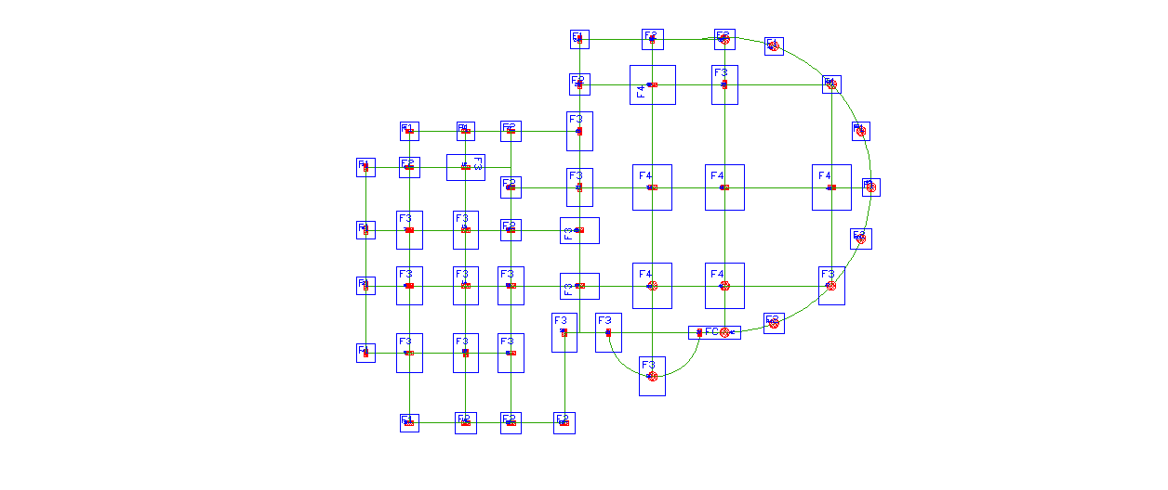
footings

Slide 34
footing in this project can be classified into groups according to the applied
load on the columns :
Column No. | Pu | Group | Column No. | Pu | Group
5 | 305 | F1 | 30 | 897 | F3
1 | 366 |  | 31 | 999
4 | 378 |  | 36 | 1016
24 | 416 |  | 12 | 1033
10 | 441 |  | 9 | 1077
11 | 462 |  | 26 | 1114
43 | 500 |  | 28 | 1114
45 | 500 |  | 13 | 1139
48 | 500 |  | 7 | 1156
2 | 577 |  | 14 | 1161
49 | 583 |  | 8 | 1183
3 | 598 |  | 20 | 1262
42 | 617 | F2 | 27 | 1265
44 | 636 |  | 21 | 1300
32 | 657 |  | 15 | 1336
17 | 658 |  | 29 | 1484
50 | 675 |  | 47 | 1691
38 | 691 |  | 39 | 1941
16 | 715 |  | 46 | 2202 | F4
22 | 716 |  | 33 | 2204
23 | 778 |  | 35 | 2669
25 | 783 |  | 34 | 2705
37 | 795 |  | 41 | 2804
18 | 835 |  | 40 | 3059
19 | 844
6 | 866

Slide 35

Design of F1 (single footing):
Calculating required footing area :
F.A = = 1.72
use square footing
L=B = 1.4 m
qu = Pu / F.A
= 600/ 1.4×1.4
=306.1 KN/m^2
Thickness : ( ultimate load =600KN )
Vu = Φ Vc
Φ Vc = Φ (1/6 ) bw d = 0.75 (1/6 ) (1400) d
Vu = 306.1×1.4×(((1.4-.3)/2)-d)
solving for d :
d= 0.17m H = .22 m

Slide 36


Check two way punching shear :
T = = 1.090 Mpa ok > фVc min
Steel reinforcement needed :
Mu = = 64.8 KN.m
(b= 1400mm, d= 250mm)
Ρ = [ 1- ] = 3.48×10^-3
As = Ρbd = 3.48×10^-3×1400 × 250 = 1220 mm2> Asmin
As min = 0.0018 × b × h = 0.0018×1400×300 = 756 mm2
Use (6 Φ 16) for the two directions

Slide 38
Design of footing
footing | Width(m) | Length(m) | Thickness(m) | Reinforcement long direction | Reinforcement short direction
F1 | 1.4 | 1.4 | 0.3 | 6Φ16 | 6Φ16
F2 | 1.6 | 1.6 | 0.35 | 8Φ14 | 8Φ14
F3 | 2 | 3 | 0.55 | 16Φ16 | 15Φ16
F4 | 3 | 3.5 | 0.65 | 18Φ16 | 21Φ16

Slide 39
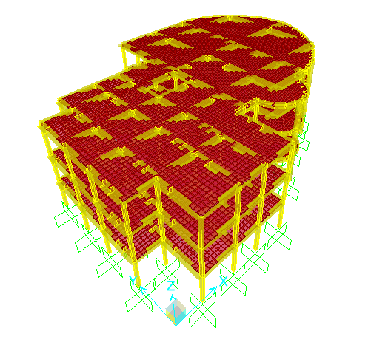
Chapter three: SAP modeling

Slide 40
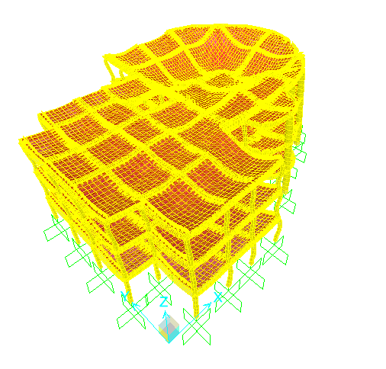
Check SAP results compatibility

Slide 41
Equilibrium check
Total weight of structure=22450.8KN
Total weight of structure from SAP=22454.797KN
Error=0.02%.it is acceptable
Total live load and super imposed loads (manually)=20225.92KN
Total live load and super imposed loads (SAP)= 19785.13KN
Error=2%. It is acceptable

Slide 42
Stress –strain relationship
For beam BTB11
The moment value from SAP=67.8KN.m
The Wl²/8 value =65.2KN.m
Error=3%. It is acceptable

Slide 43
Check deflection
The maximum deflection manually =34.42mm
The maximum deflection from SAP=7.8mm
So that the deflection check is ok

Slide 44
Chapter four: blast analysis
Since the building is located beside a gas station (12 meter far away from the nearest
point) a practical approach of assumed explosion in one of the gasoline tanks has
been developed. The loads on columns and slabs were estimated and 3D modeling of
the structure and loads using SAP2000 has been created.

Slide 45
SAP results slab reinforcement

Slide 46
Explosion and air blast loading
An explosion is defined as a large-scale, rapid and sudden release of energy
The threat for an explosion can be defined by two equally important elements, the explosive size, or charge weight W, and the standoff distance R between the blast source and the target

Slide 48
Prediction of blast pressure

Slide 49
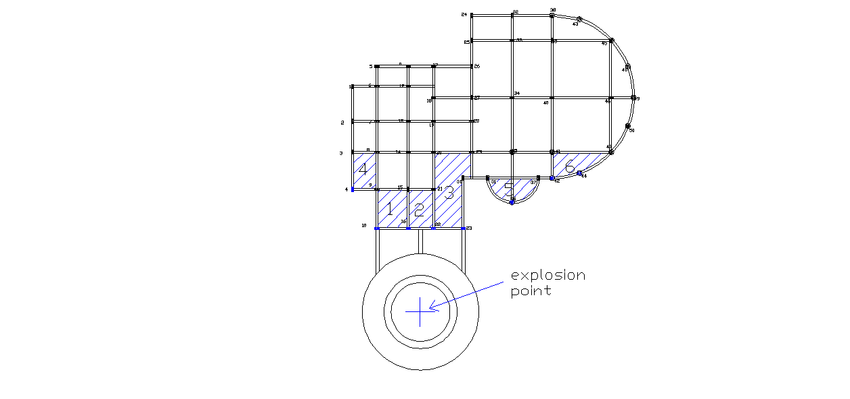
Explosion point

Slide 50
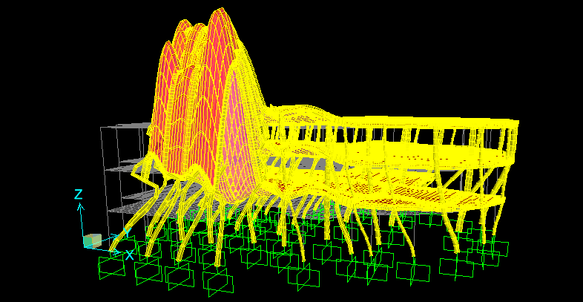
Effect of explosion on the structure

Slide 51
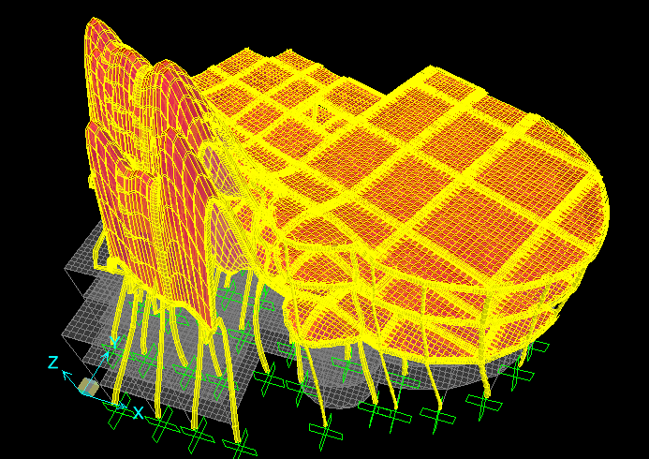
Effect of explosion on the structure

Slide 52
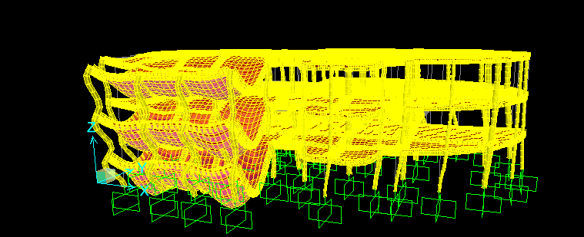
Effect of explosion on the structure

Slide 53
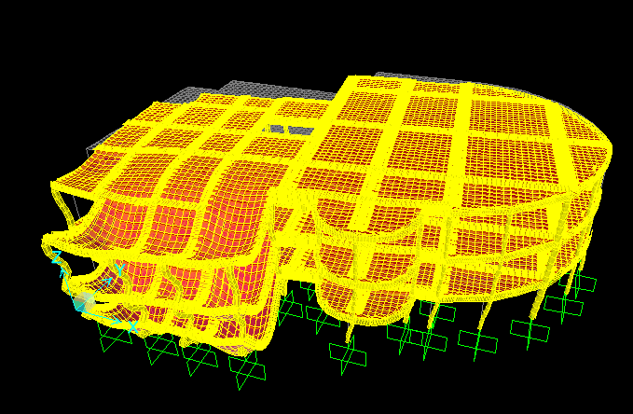
Effect of explosion on the structure

Slide 54
Recommendation
The gas station should be far from the building by at least 60 m
The glass interface is not recommended because the glass has a high thermal coefficient .
Replace the glass interface by shear walls

