Slide 1


Slide 2
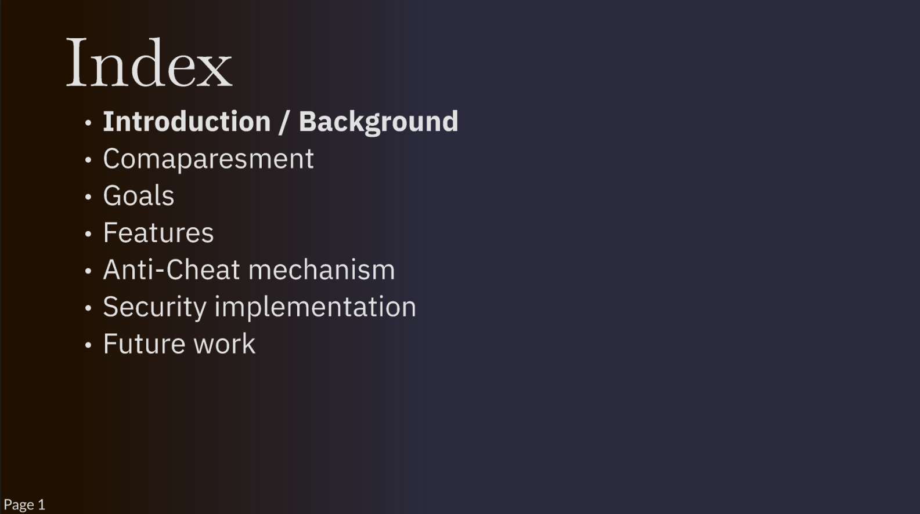
Index
Introduction/
Background
Comaparesment
Goals
Features
Anti-Cheat
mechanism
Security implementation
Future work

Slide 3
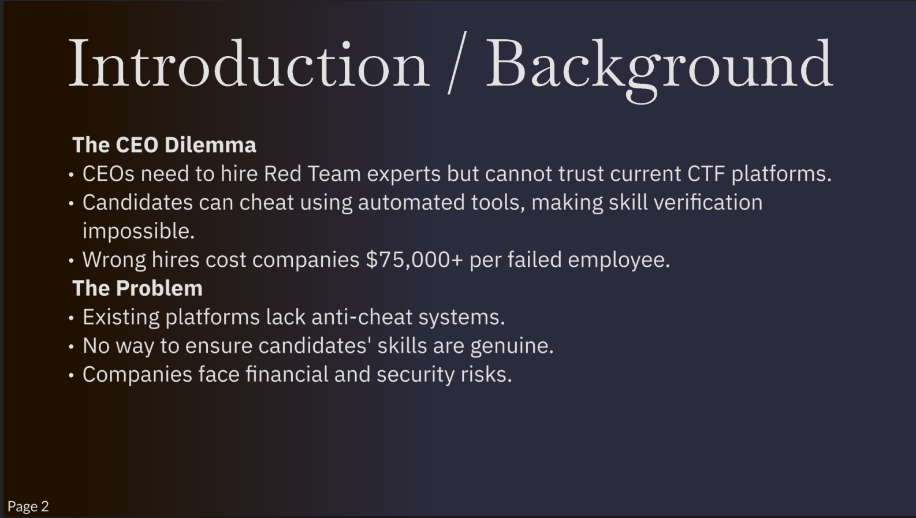
Background
Introduction
The CEO Dilemma
CEOs need to hire Red Team experts but cannot trust current CTF platforms.
Candidates can cheat using automated tools, making skill verification impossible.
Wrong hires cost companies $75,000+ per failed employee.
The Problem
Existing platforms lack anti-cheat systems.
No way to ensure candidates' skills are genuine.
Companies face financial and security risks.

Slide 4
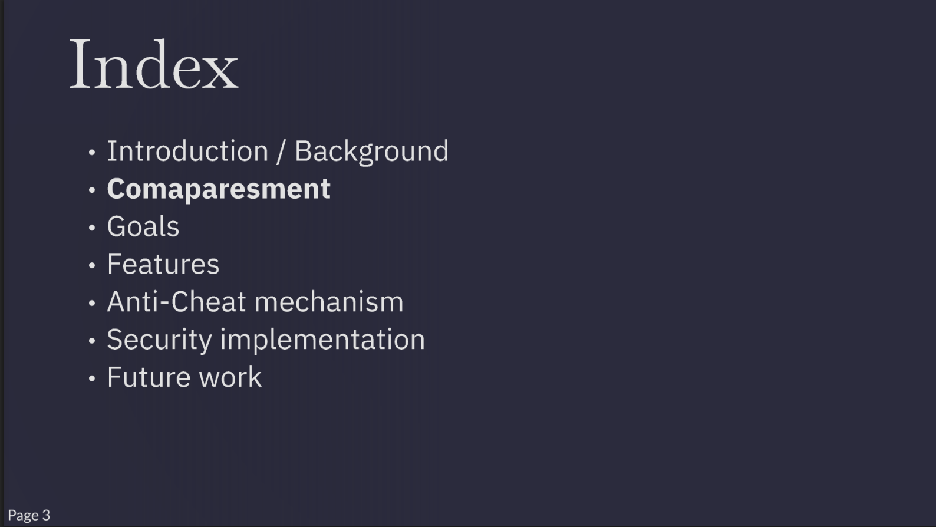
Index
Introduction/ Background
Comaparesment
Goals
Features
Anti-Cheat mechanism
Security implementation
Future work

Slide 5
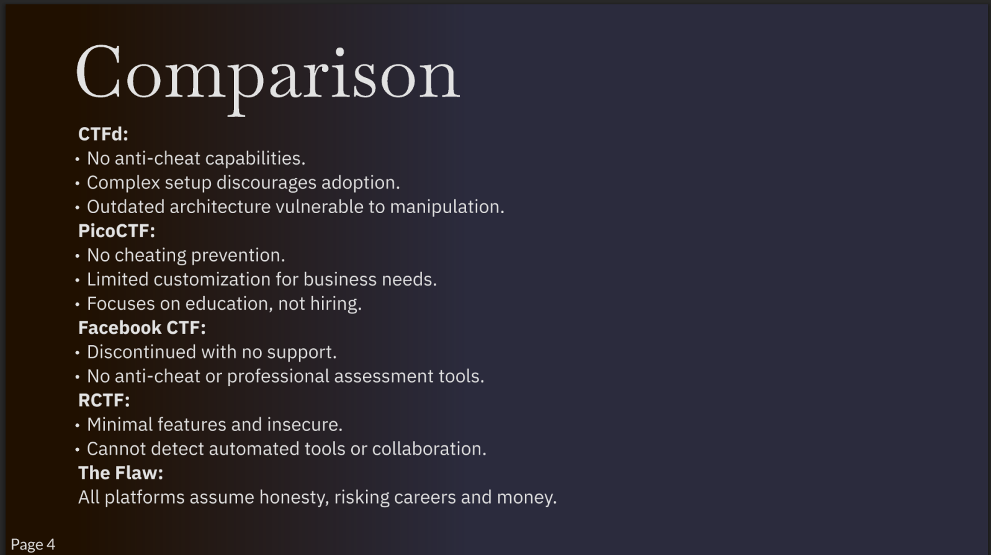
Comparison
CTFd:
No anti-cheat capabilities.
Complex setup discourages adoption.
Outdated architecture vulnerable to manipulation.
PicoCTF:
No cheating prevention.
Limited customization for business needs.
Focuses on education, not hiring.
Facebook CTF:
Discontinued with no support.
No anti-cheat or professional assessment tools.
RCTF:
Minimal features and insecure.
Cannot detect automated tools or collaboration.
The Flaw:
All platforms assume honesty, risking careers and money.

Slide 6
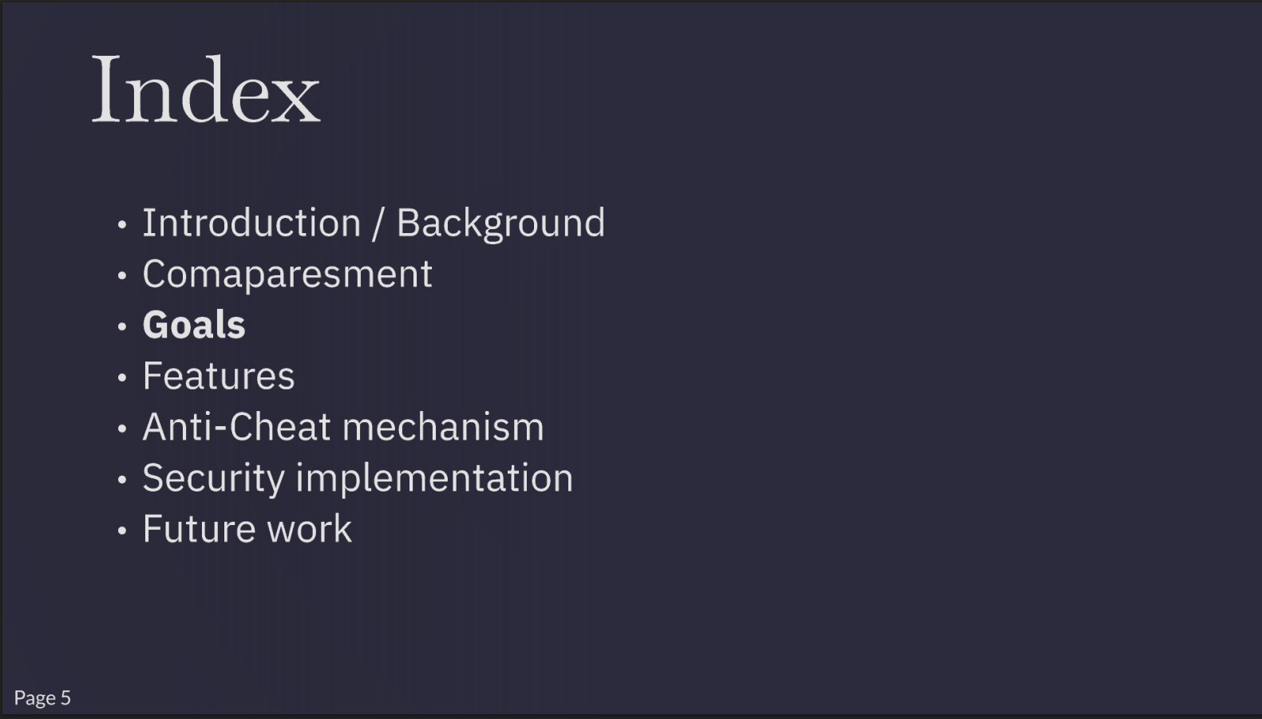
Index
Introduction/ Background
Comaparesment
Goals
Features
Anti-Cheat mechanism
Security implementation
Future work

Slide 7
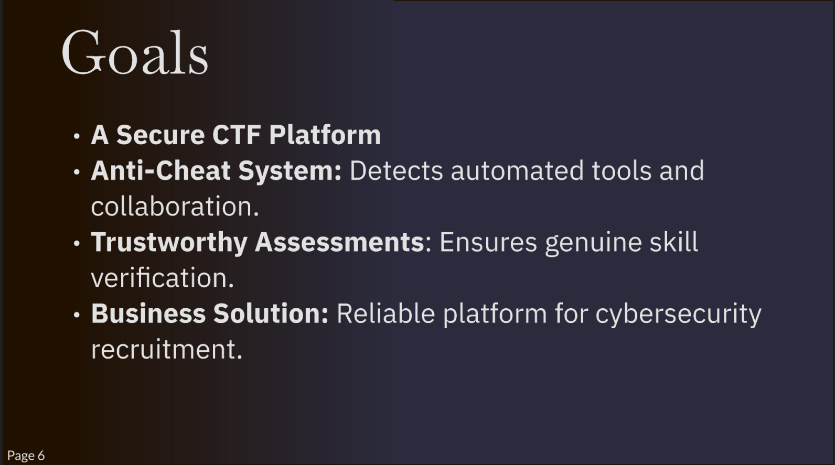
Goals
A Secure CTF Platform
Anti-Cheat System: Detects automated tools and collaboration.
Trustworthy Assessments: Ensures genuine skill
verification.
Business Solution: Reliable platform for cybersecurity recruitment.

Slide 8
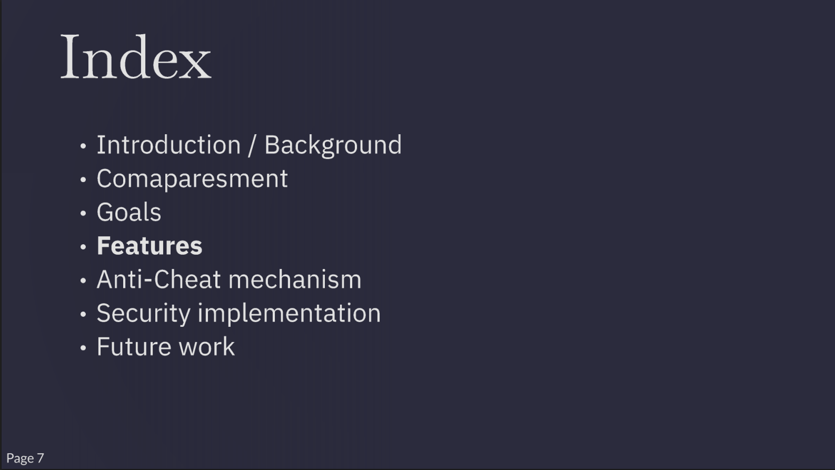
Index
Introduction/ Background
Comaparesment
Goals
Features
Anti-Cheat mechanism
Security implementation
Future work
Page?

Slide 9
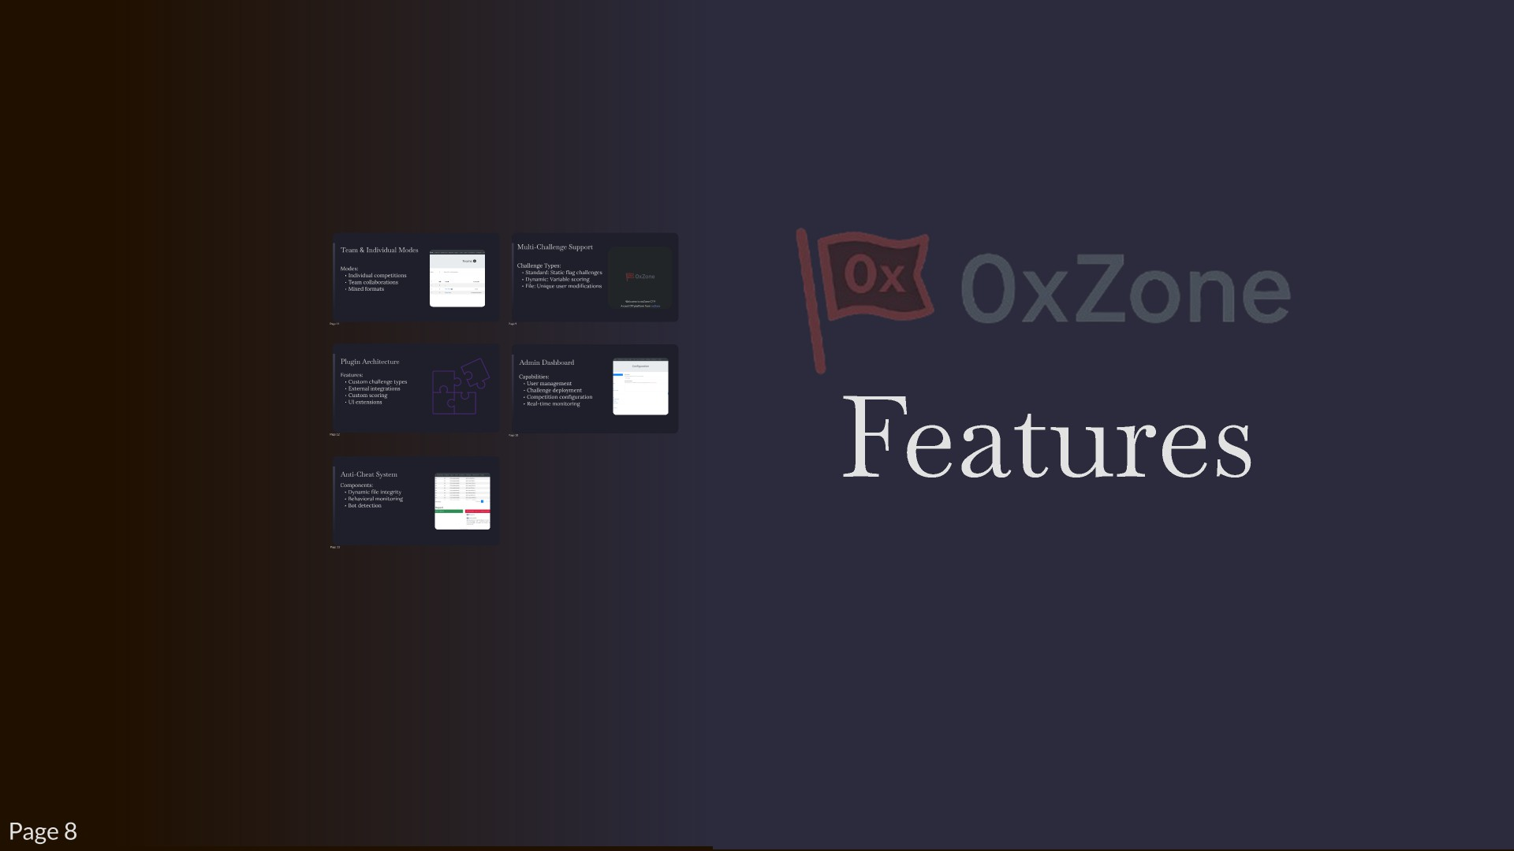

Slide 10
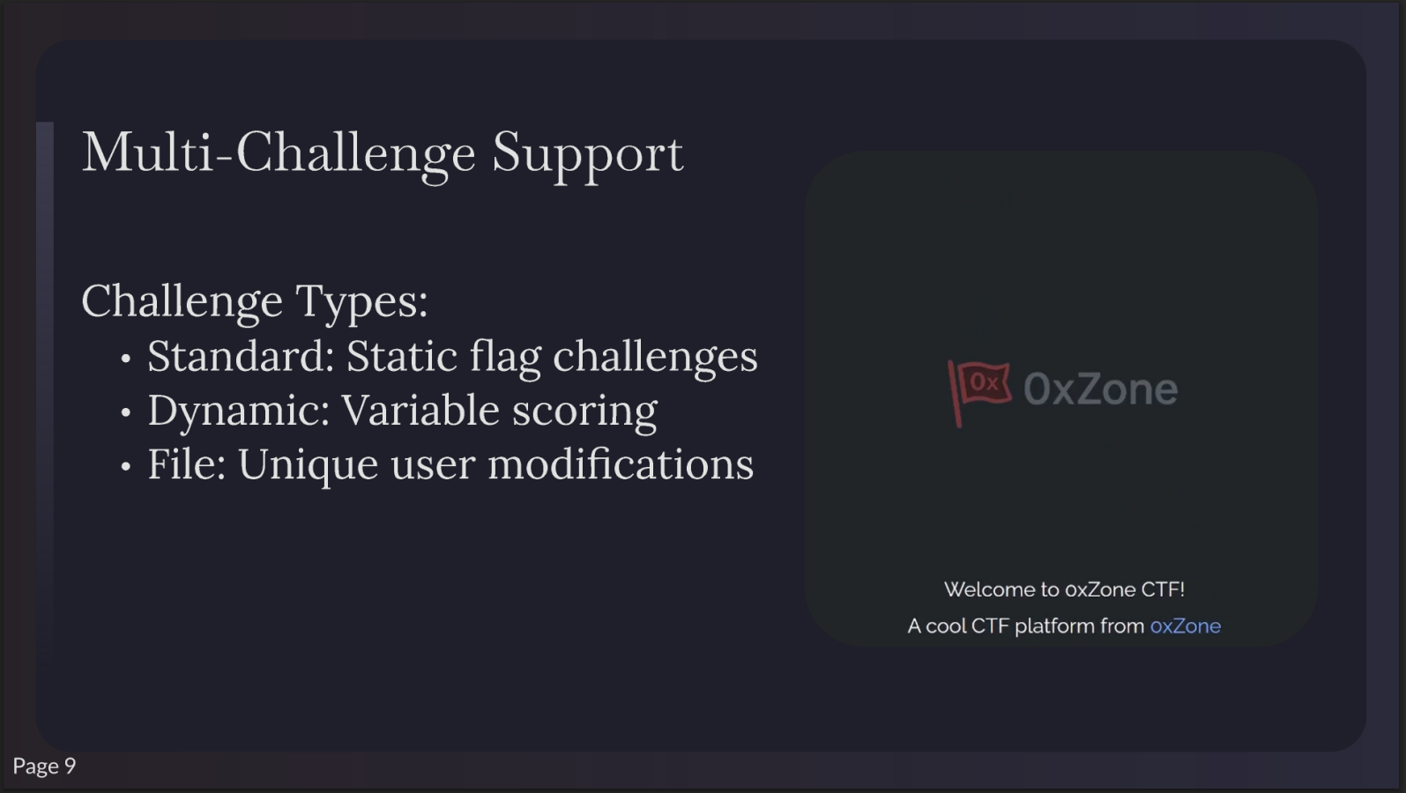
Multi-Challenge Support
Challenge Types:
Standard: Static flag challenges
OxZone
Dynamic: Variable scoring
File: Unique user modifications
Welcome
to oxZone CTF¹
A cool CTF platform from
oxZone
Page 9

Slide 11
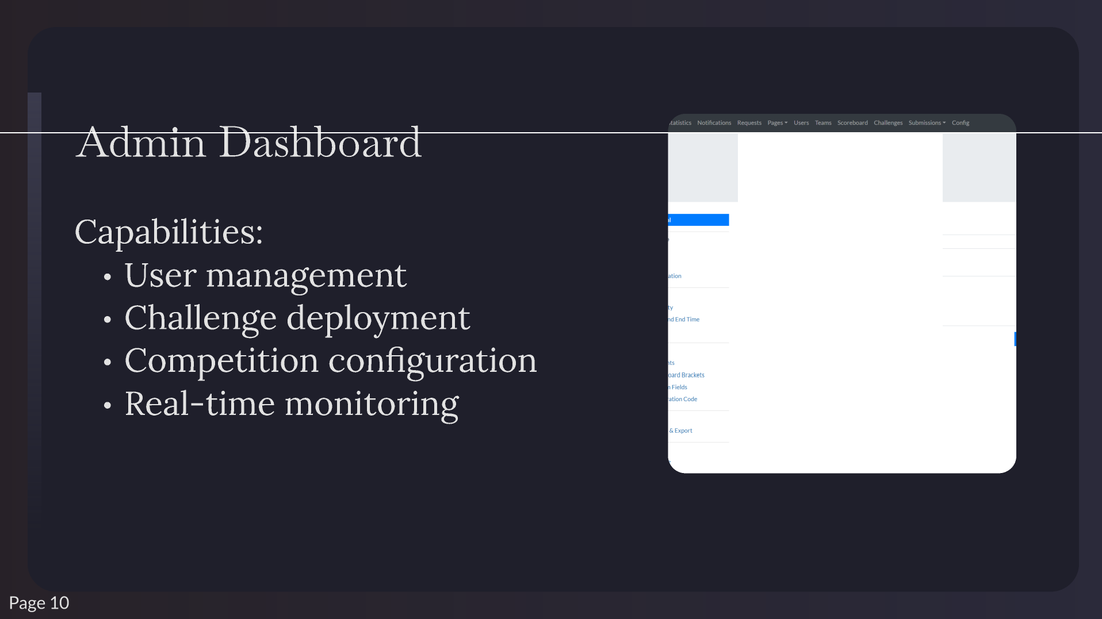
Configuration
Event Name
Whennokllo tSSl)eOOtd. theCTF'snameisused lnstt:id.
CTFName
Event Description
Descnptlonof voutClf.Avill.lblefor useon OJstompagesand emails {n • _d• c,.tptton).

Slide 12
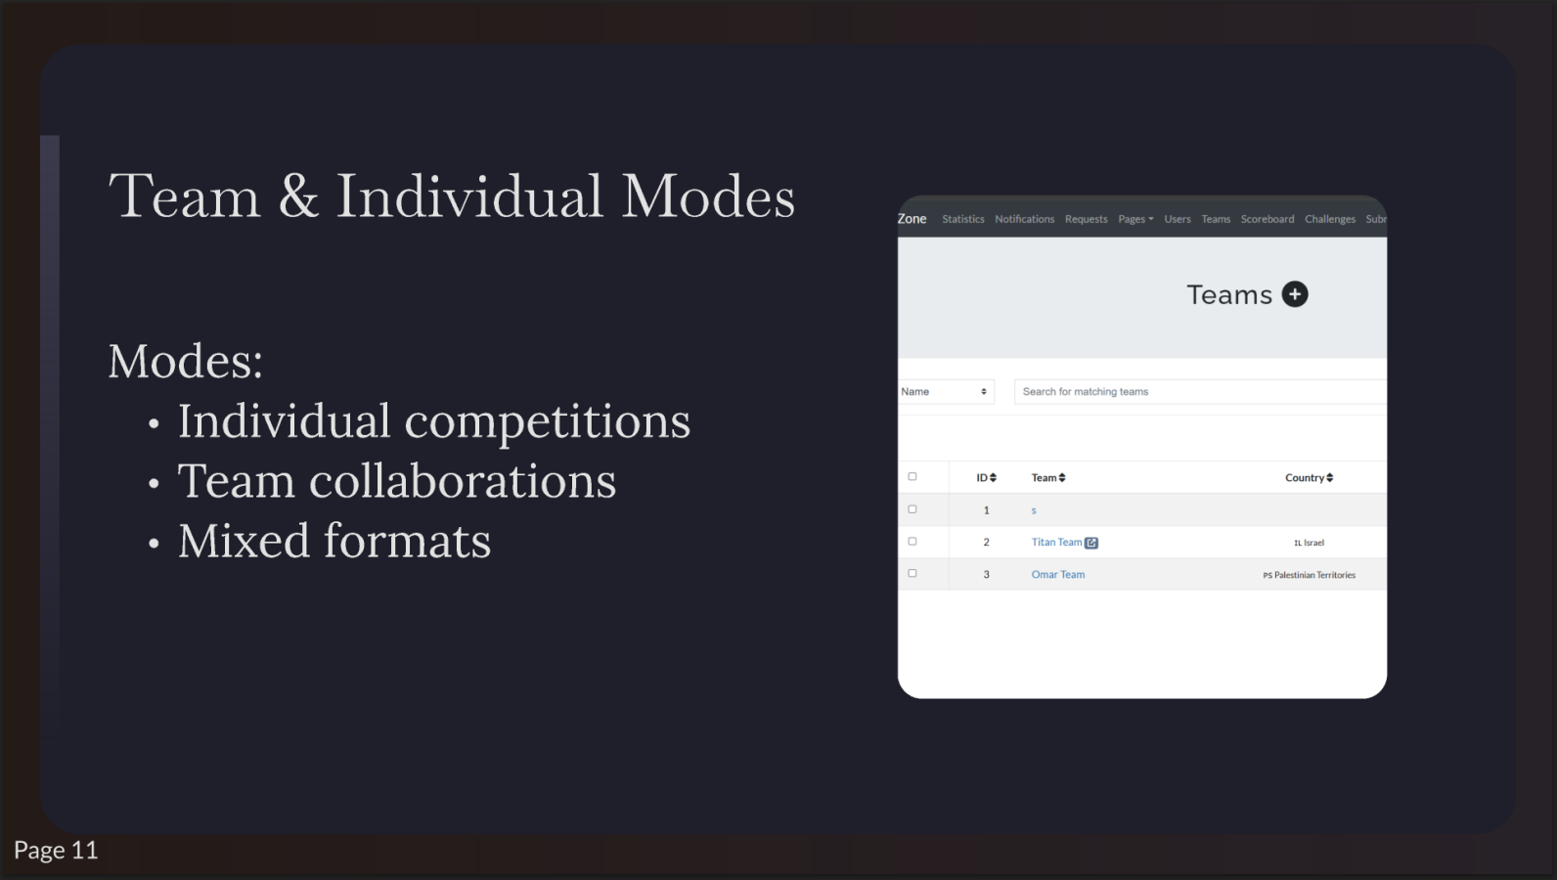
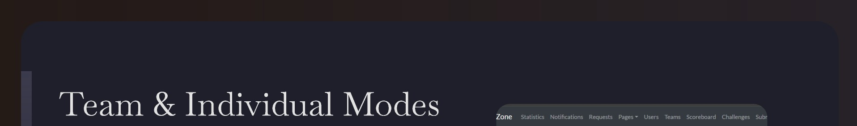
Teams0
Modes:
Individual competitions
Search for matching teams
Team collaborations
•
•
•
•
Team
Country
Mixed formats
1
2
TitanTeaml!I
tllsrae1
3
Omar Team
PSPalcslinian Territories
Page 11

Slide 13
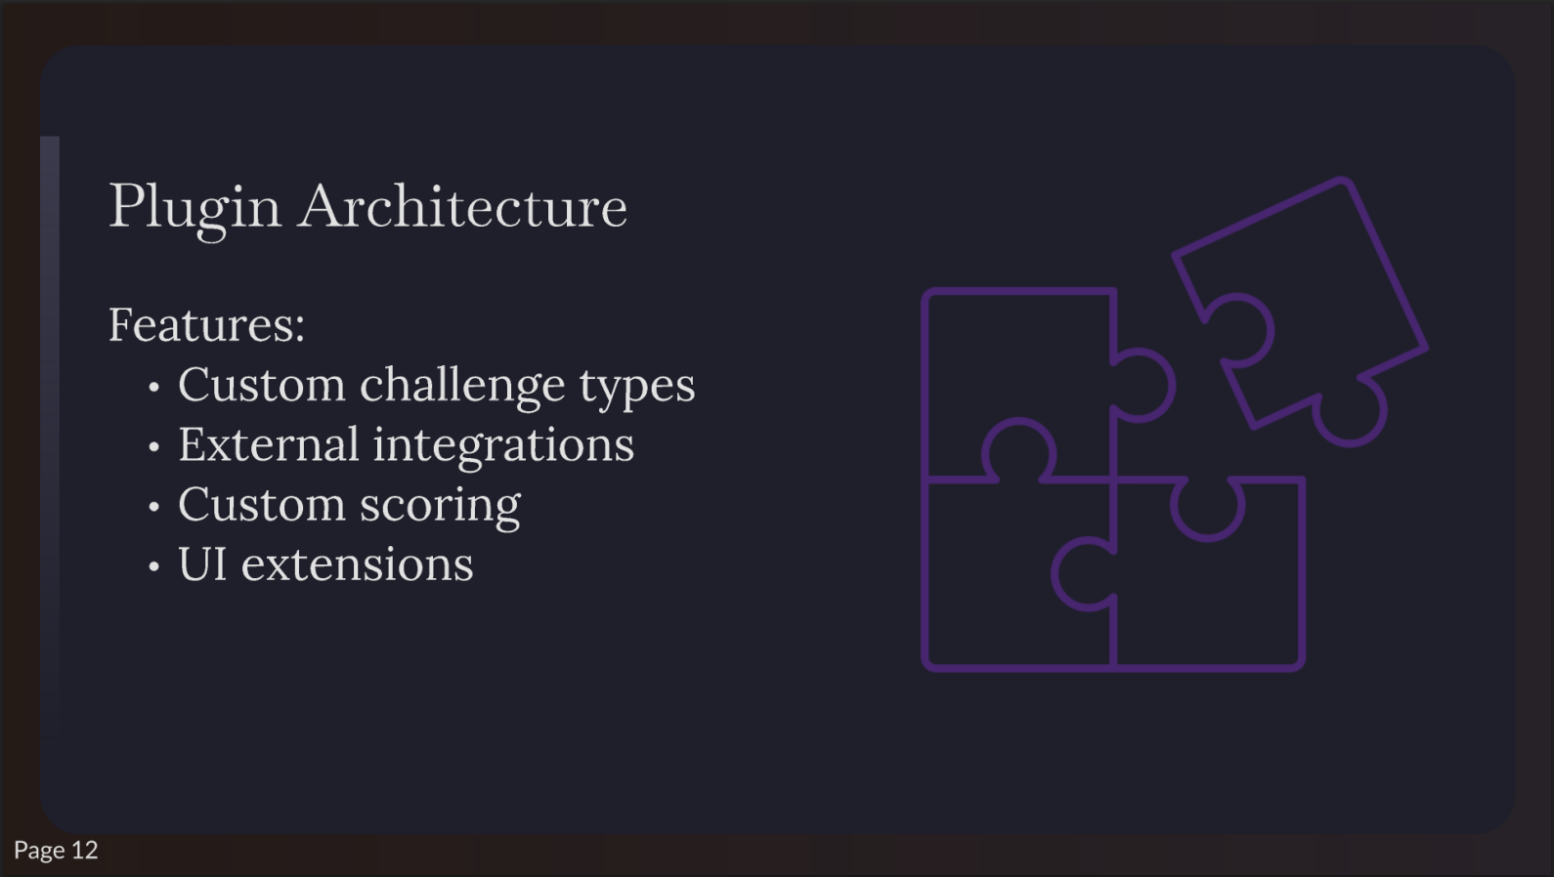
Plugin
Architecture
Features:
Custom challenge types
External integrations
Custom scoring
UI extensions

Slide 14
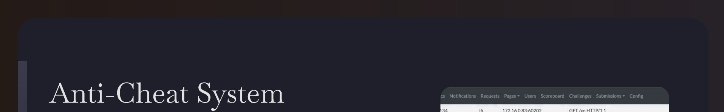
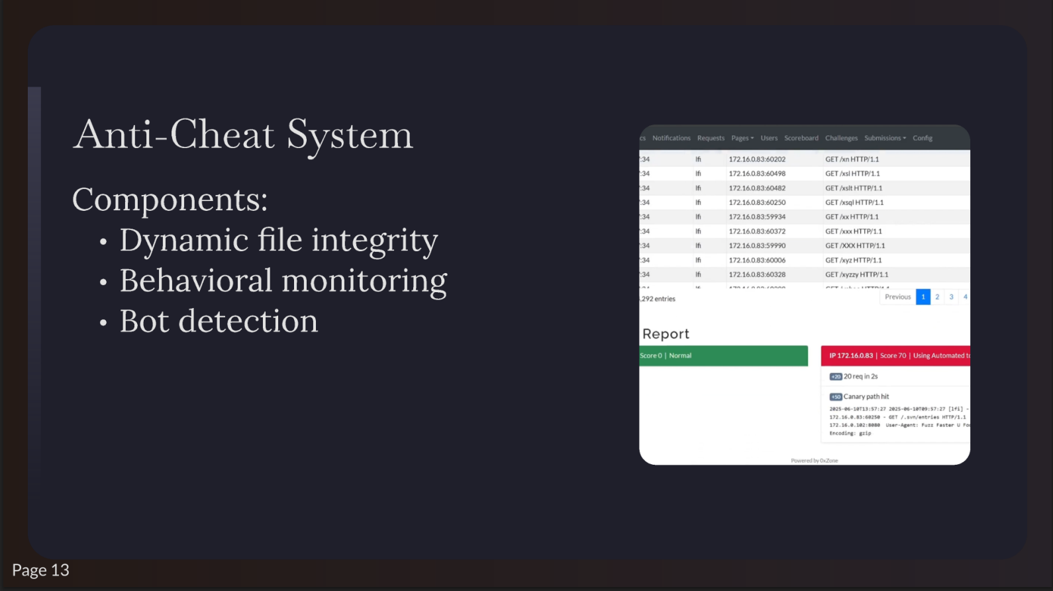

Components:
In | 172.16.0.83:60498 | GET/Xsl HTTP/1.1
In | 172.16.0.83:60482 | GET /Xslt HTTP/1.1
In | 172.16.0.83:60250 | GET/Xsql HTTP/1.1
In | 172.16.0.83:59934 | GET/Xx HTTP/1.1
In | 172.16.0.83:60372 | GET/Xxx HTTP/1.1
In | 172.16.0.83:59990 | GET/XXXHTTP/1.1
In | 172.16.0.83:60006 | GET/Xyz HTTP/1.1
In | 172.16.0.83:60328 ........,.. .......... ,,.,...,.,.... | GET/Xytty HTTP/1.1
Dynamic file integrity
Behavioral monitoring
Pre111ous ■₂ 3
Bot detection
••••
Score0 I Normal
IP 172.16.0.83
I Score 70 I Using Automated t,
,O I •
IE:JCanary pathhit
282S•e6•11Tl.3 S7:27 282S•96•11TH:S7:27 [lfi] •
172,1',I.U:612S8 • GET /.1vn/•ntriH HTTP/1,1
172.16.1.182'.1618 UHr-·A1•nt: fun fHt•I"'U P
£ncodin1: adp

Slide 15
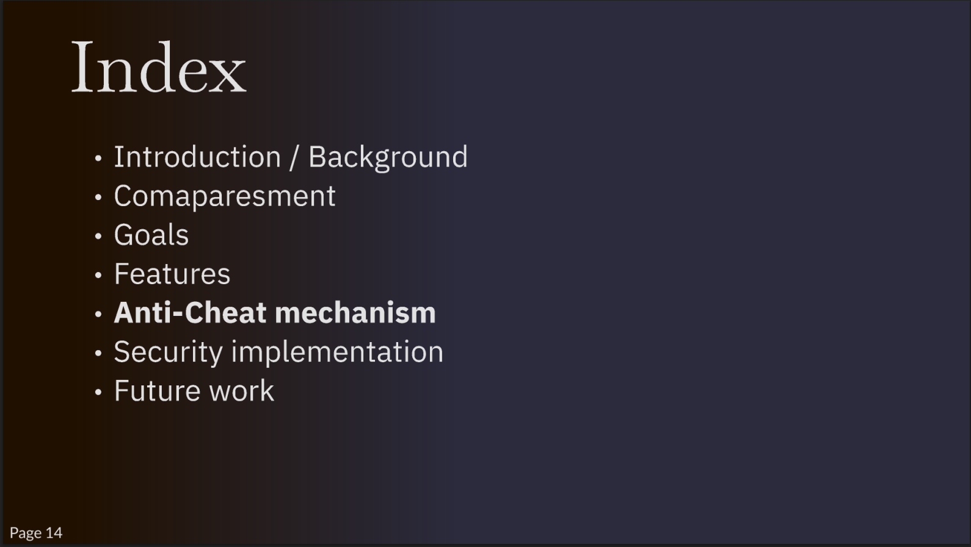
Index
Introduction/
Background
Comaparesment
Goals
Features
Anti-Cheat
mechanism
Security implementation
Future work
Page 14

Slide 16
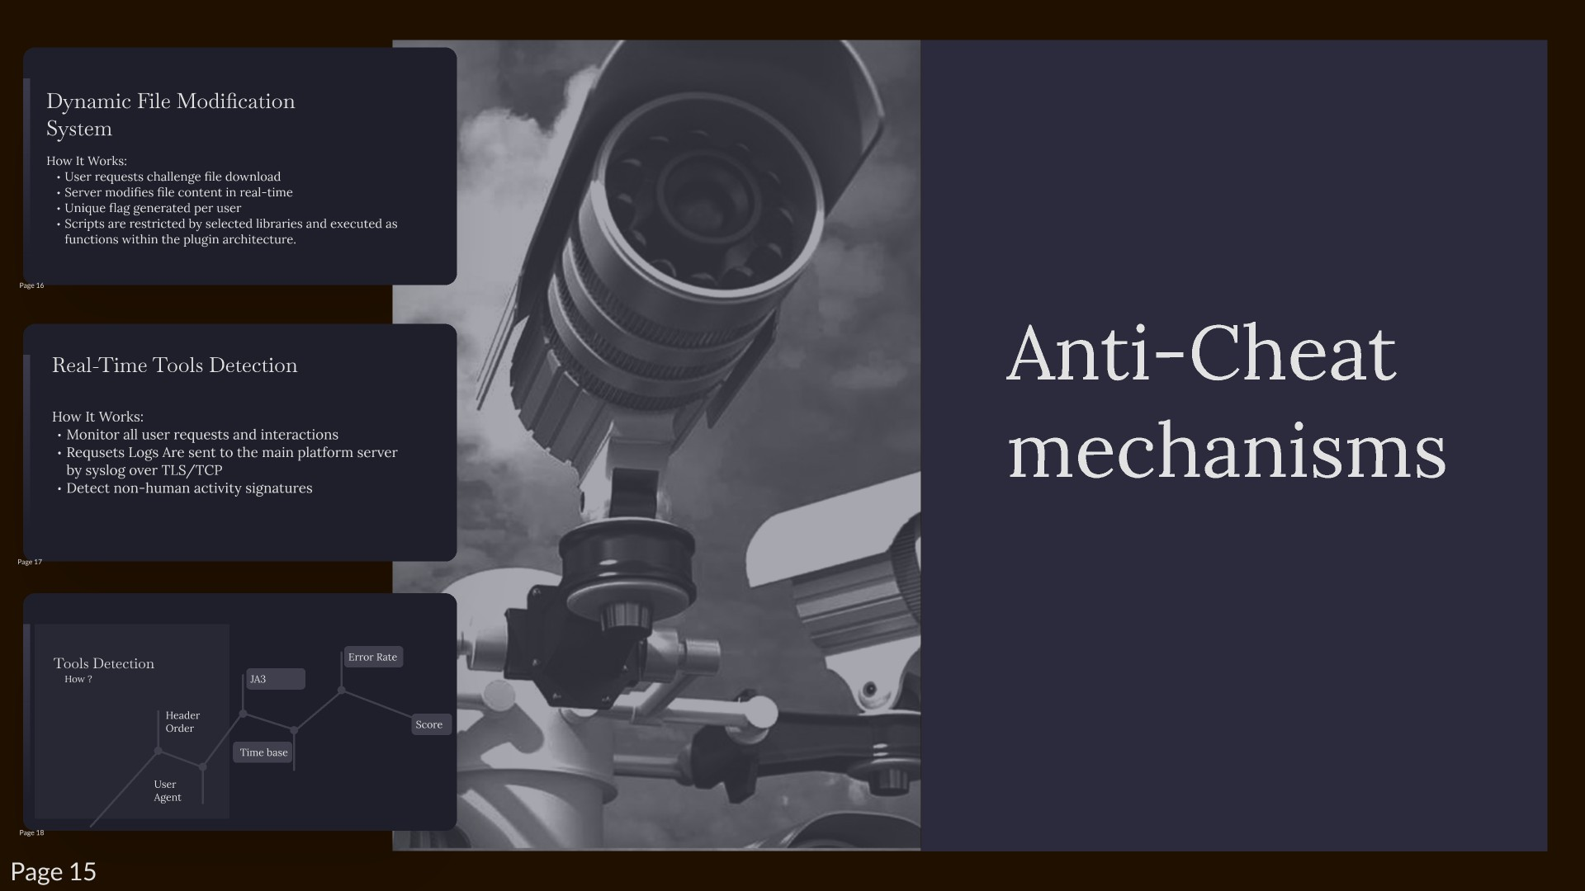

Slide 17
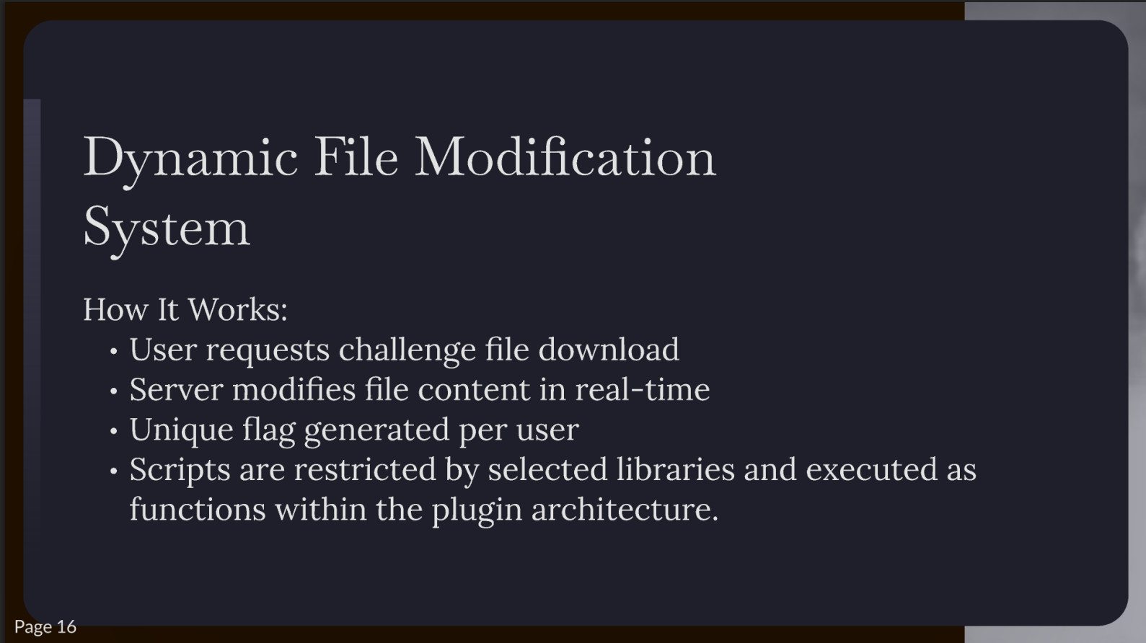
Dynamic File Modification
System
How It Works:
User requests challenge file download
Server modifies file content in real-time
Unique flag generated per user
Scripts are restricted by selected libraries and executed as
functions within the plugin architecture.

Slide 18
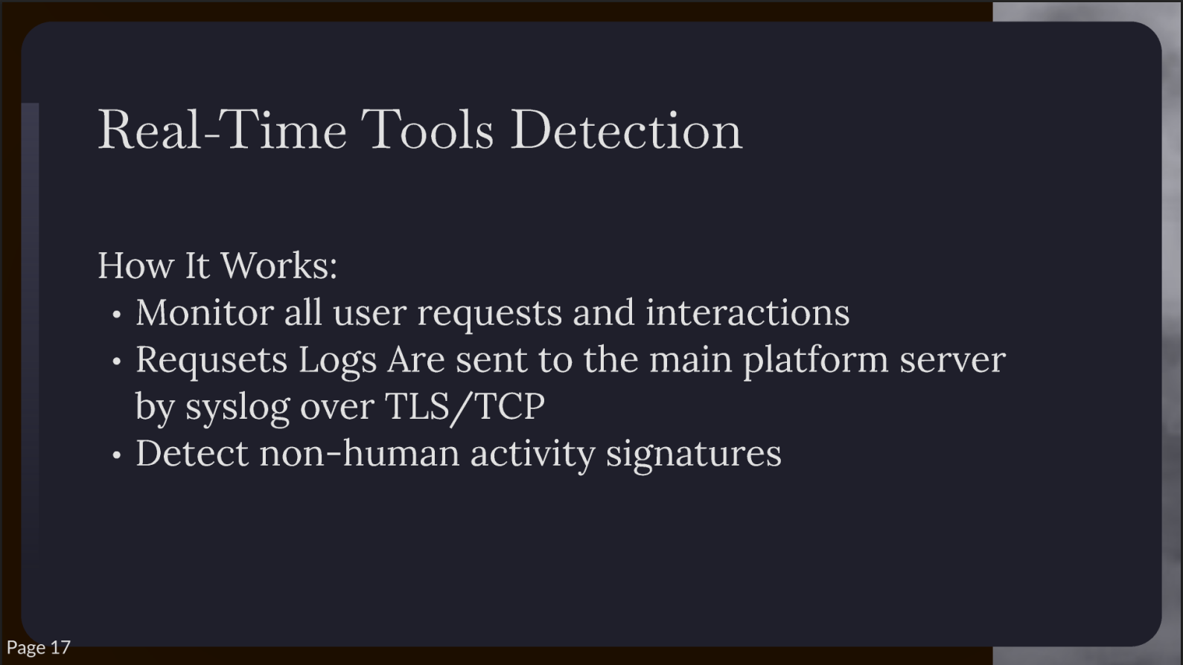
Real-Time Tools Detection
How It Works:
Monitor all user requests and interactions
Requsets Logs Are sent to the main platform server
by syslog over TLS/TCP
Detect non-human activity signatures
►

Slide 19
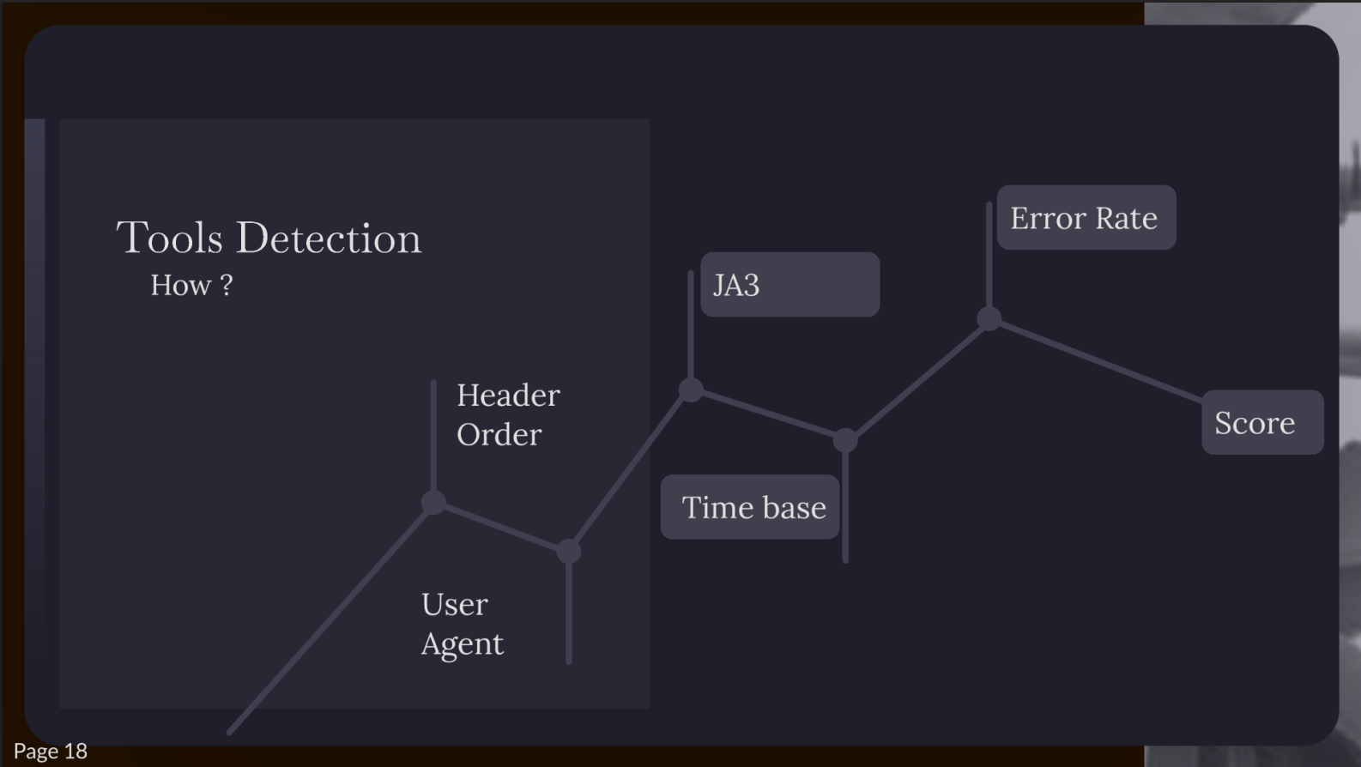
Error Rate
Tools Detection
How?
JA3
Header Order
Score
Time base
User
Agent

Slide 20
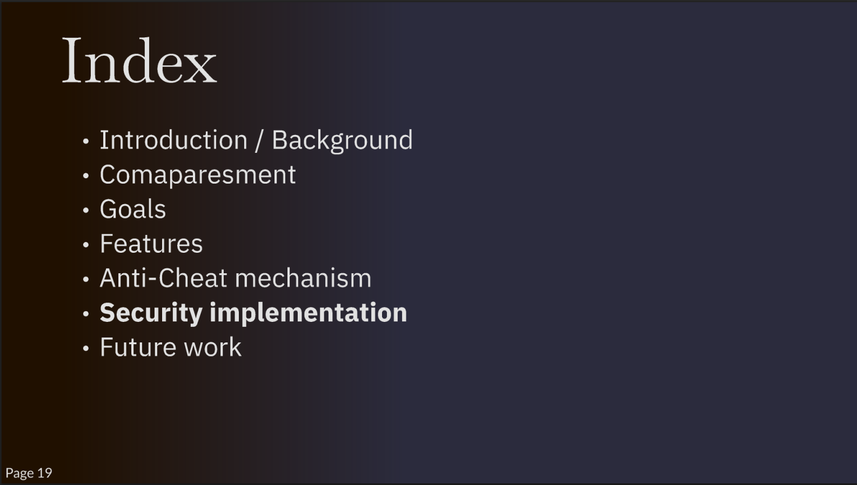
Index
Introduction/
Background
Comaparesment
Goals
Features
Anti-Cheat
mechanism
Security
implementation
Future work

Slide 21
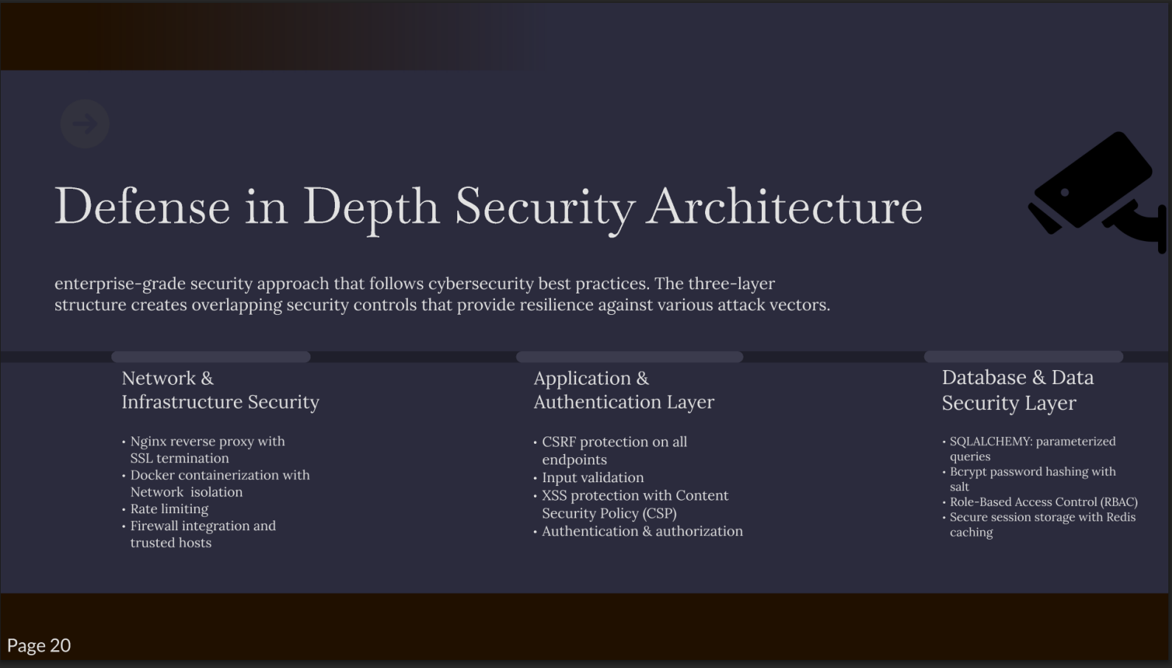
Defense in Depth Security Architecture
enterprise-grade
security approach that follows cybersecurity best practices. The three-layer
structure
creates overlapping security controls that provide resilience against various attack vectors.
Network &
Application &
Database & Data Security Layer
Infrastructure
Security
Authentication Layer
Nginx reverse proxy with
CSRF protection on all
SQLALCHEMY: parameterized
SSL termination
endpoints
queries
Docker containerization with
Input validation
Bcrypt password hashing with
Network
isolation
XSS protection with Content
salt
Rate limiting
Security Policy (CSP)
Role-Based Access Control (RBAC
)
Firewall integration and
Authentication & authorization
Secure session storage with Redis
trusted hosts
caching

Slide 22
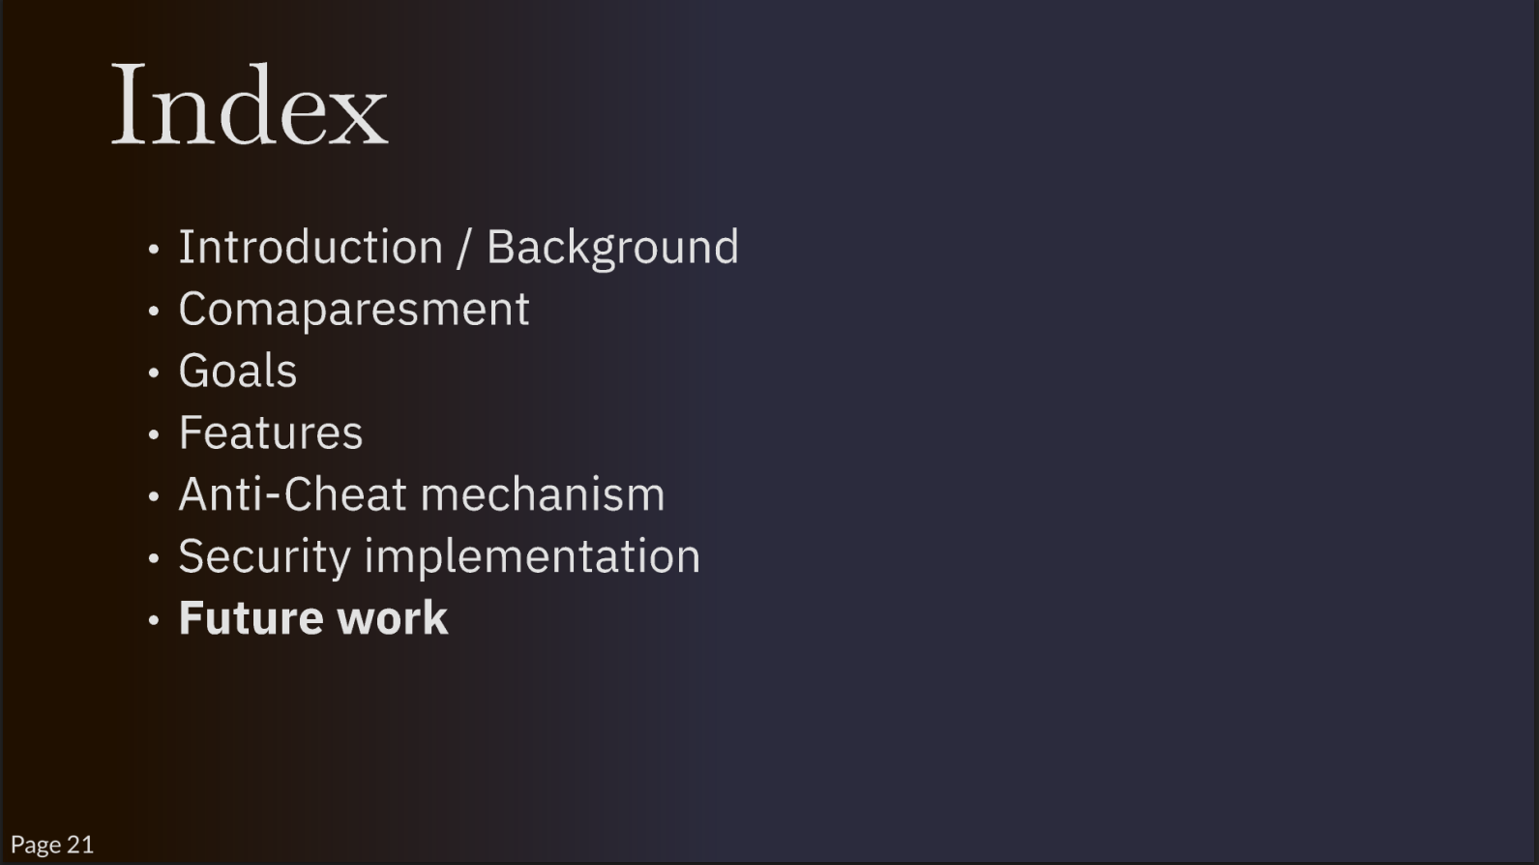
Index
Introduction/
Background
Comaparesment
Goals
Features
Anti-Cheat
mechanism
Security implementation
Future work

Slide 23
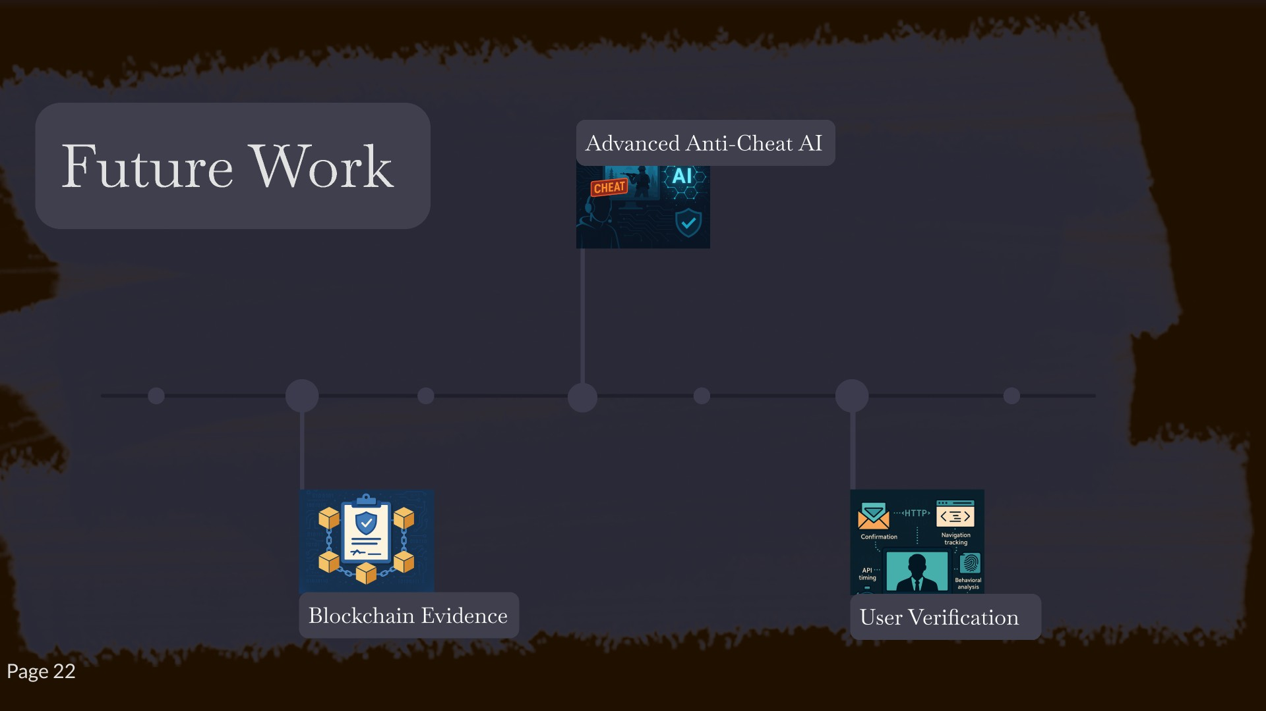

Slide 24


Slide 25
