Slide 1

DC MOTOR SPEED CONTROLLER
Prepared By :
Mohanad Sama’neh
Ayman manasrah
Supervised by : Dr. Kamel Subhi

Slide 2
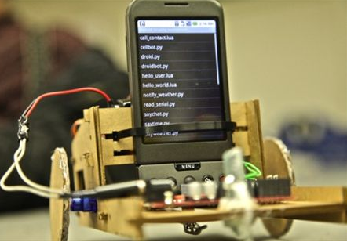
DC MOTOR SPEED CONTROLER | Layout
`
Introduction
DTMF
Section 2
Power Circuit
Results & Video
Future Outock
Conclusion & Cost

Slide 3
DC MOTOR SPEED CONTROLER | Introduction
Why we choose this project
Important of dc motor in industry
Dc motor used in many application

Slide 4
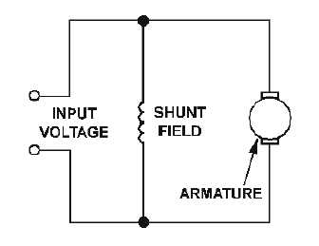
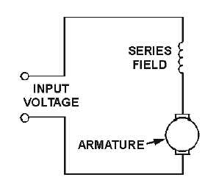
DC MOTOR SPEED CONTROLER | DC MOTOR
Dc motor :
Types Of dc motor :
Shunt dc motor :
Seried dc motor :

Slide 5
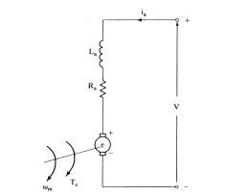
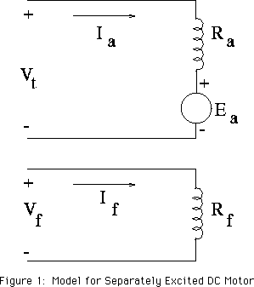
DC MOTOR SPEED CONTROLER | DC MOTOR
Seperately excited motor :
PMM motor :

Slide 6
DC MOTOR SPEED CONTROLER | DC MOTOR
Seperately excited motor :
PMM motor :

Slide 7
DC MOTOR SPEED CONTROLER | PMM MOTOR
PMM MOTOR :
Why we use PMM motor :
Specification
Types of controlling
Speed = (Va- I Ra)/kø
  Changing Armature resistance
  Changing flux Kø
  Changing applied voltage Va
100 w | Rated power
500 rpm | Reted speed
12 | Rated voltage
700mA | Rated current
0.0212 | Constant k*Q

Slide 8
DC MOTOR SPEED CONTROLER | DTMF
DTMF(Core Of The Project)
  (Dual Tone Multi frequency)
  Beebe is generated when you press any number on the phone
  Combination of two distinct freq.'s
  Number 9 freq is (1447&852) Hz Signal
  Simple DTMF Decoder Control the DC motor
Upper band
1633 | 1477 | 1336 | 1209 | Freq(Hz)
A | 3 | 2 | 1 | 697
B | 6 | 5 | 4 | 770
C | 9 | 8 | 7 | 852
D | # | 0 | * | 941
Lower band
CLICHERE FOR MORE INFO

Slide 9
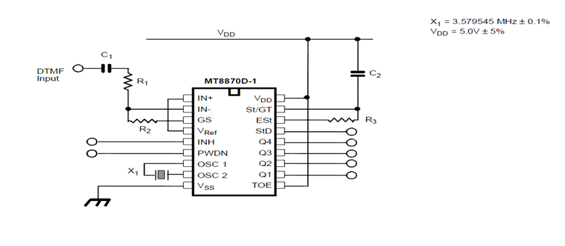
DC MOTOR SPEED CONTROLER | DTMF
DTMF(Core Of The Project)
MT8870D
DTMF Receiver
Small size and low power consumption
High Performance
BandBass Filter section
Digital Counting Signal
Passing the corresponding code to the bus
CLICHERE FOR MORE INFO

Slide 10
DC MOTOR SPEED CONTROLER | DTMF
DTMF(Core Of The Project)
  How It Works !
INH : Enable The Letters (A,B,C,D)
PWDN : power the Device down
StD : Interrupt
TOE: Enable The O/P
CLICHERE FOR MORE INFO

Slide 11
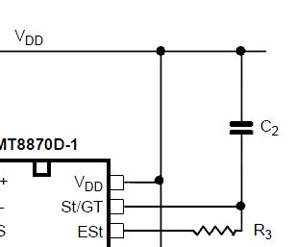
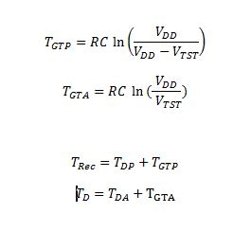
DC MOTOR SPEED CONTROLER | DTMF
Decoding DTMF (contiued ) :
Guard time adjustment :
C2 , R3 calculated as follows :
Where :
Vdd = 5 . Trec = 40ms
Vtst = 2.4 td = 40ms
Tdp = 5ms
Tda = 20ms
CLICHERE FOR MORE INFO
R 3 = 330K Ohm C2 = 100 nf

Slide 12
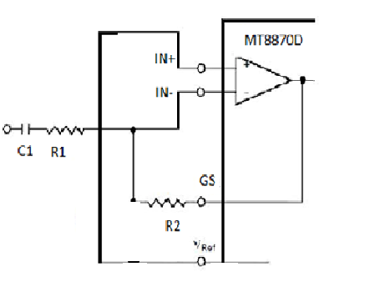
DC MOTOR SPEED CONTROLER | DTMF
Decoding DTMF (contiued )
Differential input configuration :
voltage gain = R2 / R1
R1 = 100K
R2 = 200K
C1 Chosen to be 100nf

Slide 13
DC MOTOR SPEED CONTROLER | Microcontroller
Microcontroller
Has I/O circuitry as built in
Interface with real world devices
Pic 18f4620 used
Specification
Value | Parameter type
Flash | Program Memory Type
64 | Program Memory (KB)
2CCP | Digital Communication Peripherals
1 x 8-bit, 3 x 16-bit | Timers
2 to 5.5 | Operating Voltage Range (V)
CLICHERE FOR MORE INFO

Slide 14
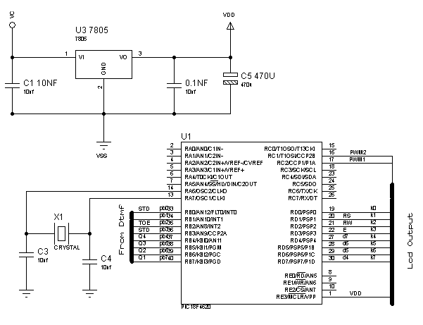
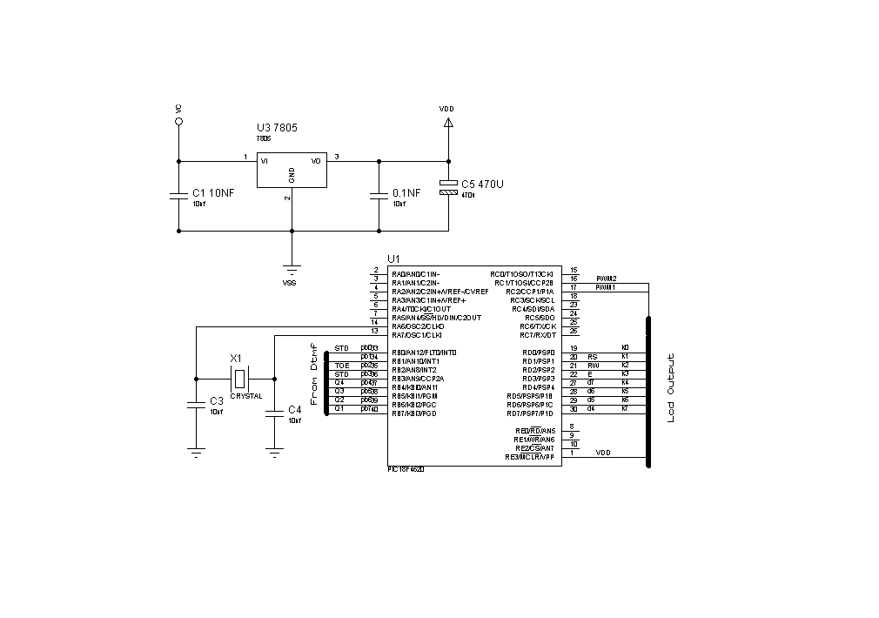
DC MOTOR SPEED CONTROLER | Microcontroller
CLICHERE FOR MORE INFO

Slide 15
DC MOTOR SPEED CONTROLER | Programming
Programming
  Mikroc Programme Used for writing the code
  JDM circuit used for programming the PIC
  The Important Parts Of The Code
Lcd configuration :
void lcd_con() {
Lcd_Config (&PORTD , 1, 3, 0, 4, 5, 6, 7) ; //configure portd as output
LCD_Cmd(LCD_CURSOR_OFF); // send command to LCD (cursor off)
LCD_Cmd(LCD_CLEAR); // send command to LCD (clear LCD)
}
Interrupt :
void interrupt() {
portb.f 2 = 1 ; // Enable the output from dtmf
number = portb ; // register the nalue taken from DTMF
portb.f2=0 ; //Disaple the output from DTMF
INTCON = 0x90; // Set T0IE, clear T0IF
}}
CLICHERE FOR MORE INFO

Slide 16
DC MOTOR SPEED CONTROLER | Microcontroller
Pwm signal generation code :
Void pwm2_generation() {
PWM2_Init(500kHz); // Initialize PWM1 module at 5KHz
PWM2_Change_Duty(current_duty2) ; // Set The Duty Of The Signal
PWM2_Start(); // start PWM1
}
VOID MAIN :
void main(){
ADCON1 = 0X0F ; // Set AN pins to Digital I/O
INTCON = 0x90; // Enable INT0 interrupt
INTCON.INT1IE=1 ; //configure int
TRISb=0Xf9 ; // CONFIGURE PORTb AS i/P
TRISA=0X00 ; //configure port a as o/p
porta= 0 ;
}
CLICHERE FOR MORE INFO

Slide 17
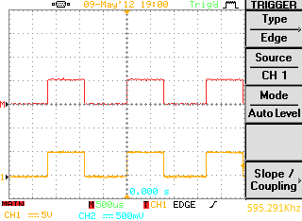

DC MOTOR SPEED CONTROLER | PWM Signal
PWM Signal
Setting Duty from (0-100)%
determines the DC voltage according To this equation :
V = (Duty) * Vdc
Duty = 50% Duty = 75%
Section 2

Slide 18
DC MOTOR SPEED CONTROLER | Controlling Process
Phone # 1 (make call )
Controlling Process
Communication network
Section 2
Phone #2 Receive the call
Acknowledgment
Security Code
Acknowledgment
Starting Controll

Slide 19
DC MOTOR SPEED CONTROLER | Power Circuit
Gate Driver
Converter
DC MOTOR
CLICHERE FOR MORE INFO

Slide 20
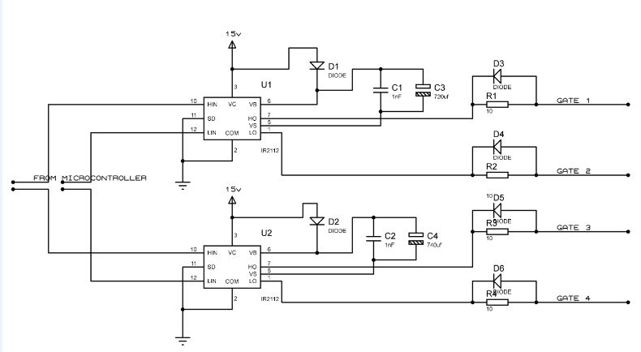
DC MOTOR SPEED CONTROLER | Gate Driver
Gate Driver
Why we use Gate Driver
What device used
The Schematic Diagram
Section 2

Slide 21

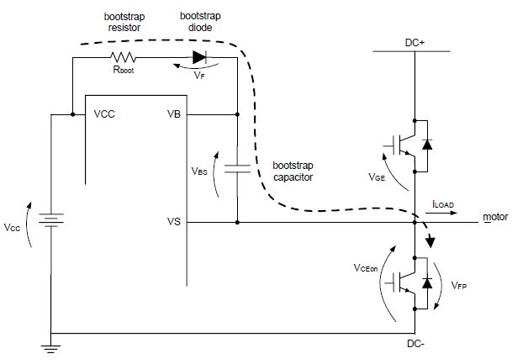

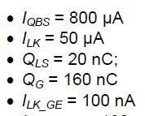
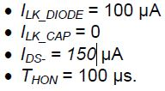
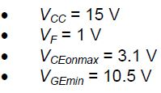

DC MOTOR SPEED CONTROLER | Gate Driver
Bootstrap capacitor sizing :
Section 2

Slide 22
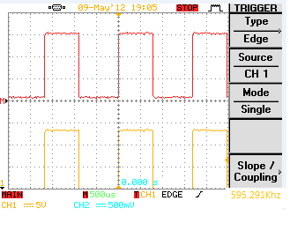
DC MOTOR SPEED CONTROLER | Gate Driver
I/P And Output
input pwm with 50%duty output Signal With 50%duty
And 15 Voltage
Section 2

Slide 23
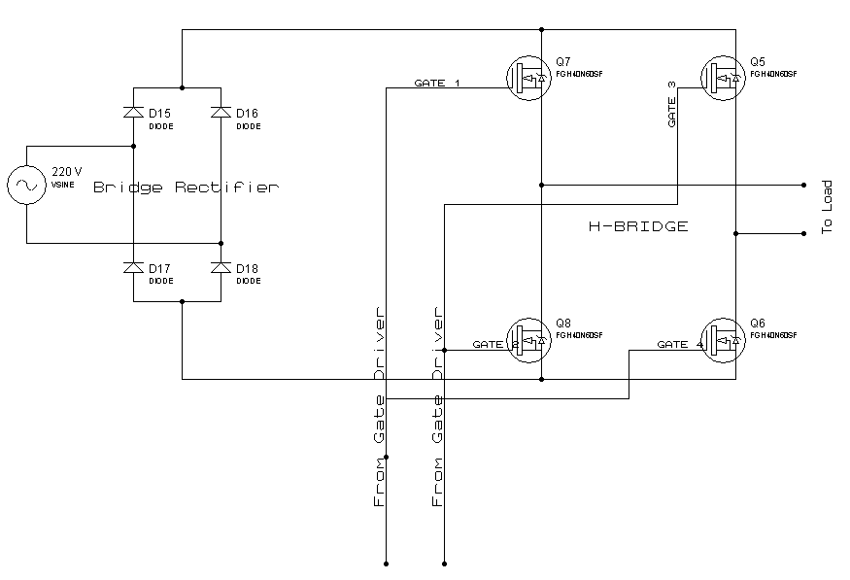
DC MOTOR SPEED CONTROLER | Converter
Why Use Converter
Device Used FGH40N60SF
Features Of IGBT
Section 2

Slide 24
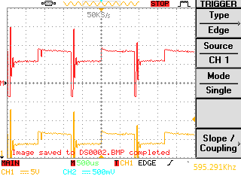
DC MOTOR SPEED CONTROLER | Results
Outputs & results :
Section 2
From Gate Driver
At DC Terminals

Slide 25
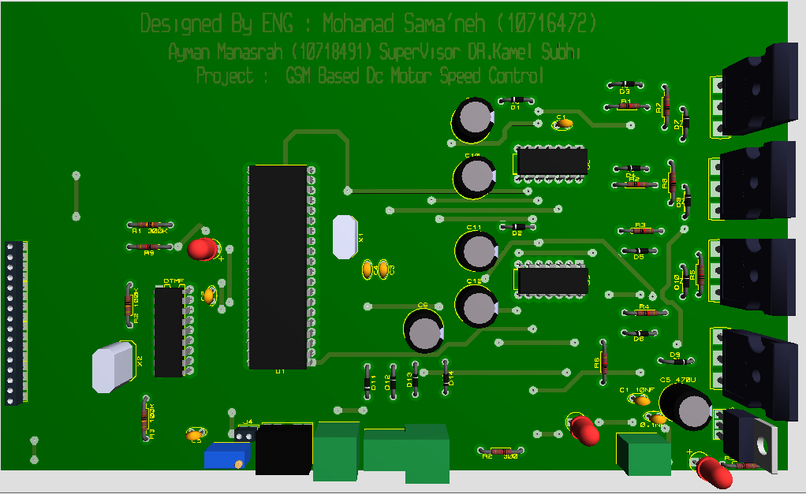
DC MOTOR SPEED CONTROLER | Results
Designing PCB (Picture )
Section 2

Slide 26
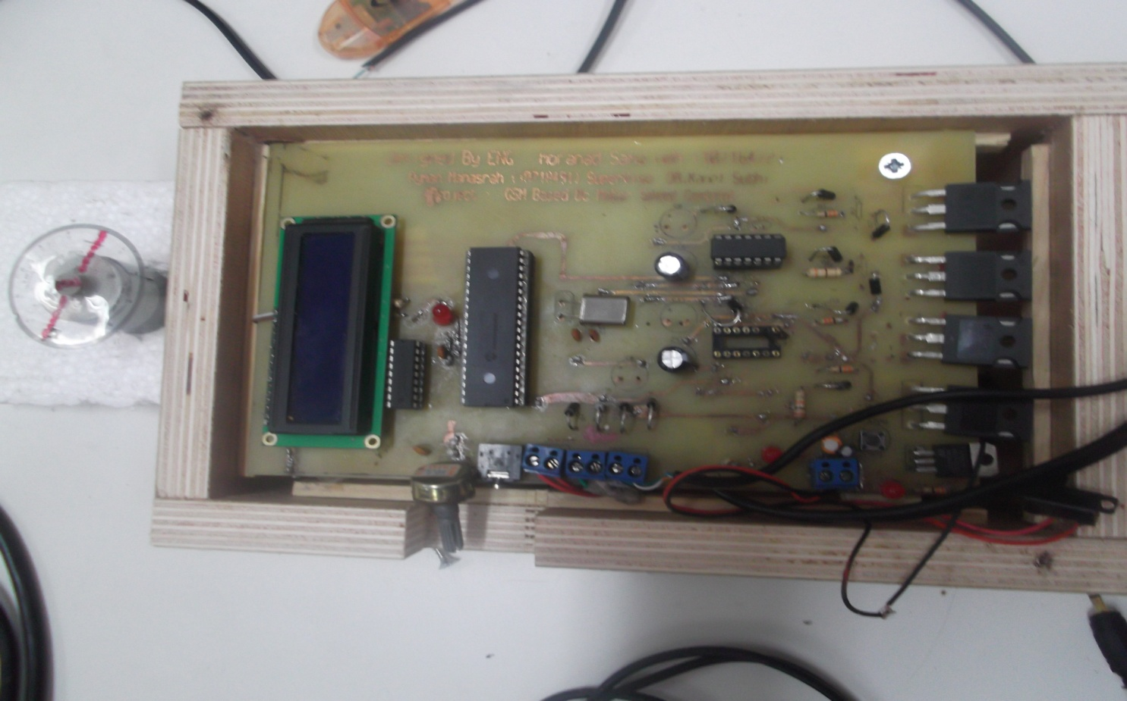
DC MOTOR SPEED CONTROLER | Results
Designing PCB (Hardware )
Section 2

Slide 27
DC MOTOR SPEED CONTROLER | Results
Section 2
Video

Slide 28
DC MOTOR SPEED CONTROLER | Future Outlock
Future Out lock:
improve the project in order to use it for driving large dc motors
Improve the project to control and monitor the device in house
Improving the programming
Section 2

Slide 29
DC MOTOR SPEED CONTROLER | Conclusion
Conclusion :
The necessary code has been made and downloaded in microcontroller by using appropriate software. The analog instructions received by the receiving mobile phone were successfully converted into digital strobes as interrupt signals to the microcontroller through DTMF The actuation of the motor is driven by the output ports of the microcontroller.
The proposed work has following advantages :
The dc motor can be controlled from anywhere on the globe with low cost with using more advanced technique .
2) A number of devices can be controlled through a dedicated output port bits by writing the individual controlling algorithm for each device .
Section 2

Slide 30
DC MOTOR SPEED CONTROLER | Cost
Cost (NIS)
40 | Microcontroller
30 | Ir2110
140 | IGBT’S
60 | PCB
70 | BOX
10 | DC MOTOR
70 | LCD
100 | OTHERS
TOTAL = 600 NIS
Section 2

Slide 31

DC MOTOR SPEED CONTROLER | Any Question
Section 2

Slide 32

DC MOTOR SPEED CONTROLER | Thanks
Section 2

