Slide 1
Lean Manufacturing in Dalia Factory for Plastic Bags
Graduation Project II
Prepared By :
Waleed Jamal Faqeeh
Abdul Rahman Herzallah
Under Supervision of :
Eng. Majd Abu Amsha

Slide 2
Table of Contents
Introduction
Process
Flow chart of the process
Seven Wastes
Result and Analysis
Discussion
Conclusion and Recommendations

Slide 3
Introduction
Dalia plastic factory, north of Nablus.
It was founded in 1995, it produces full capacity throughout the day for 2 shift
Number of workers→ 9
The factory has 4 production lines produces plastic bags of all shapes and sizes
Exports 60% of its products occupied territory and 40% inside the West Bank

Slide 4
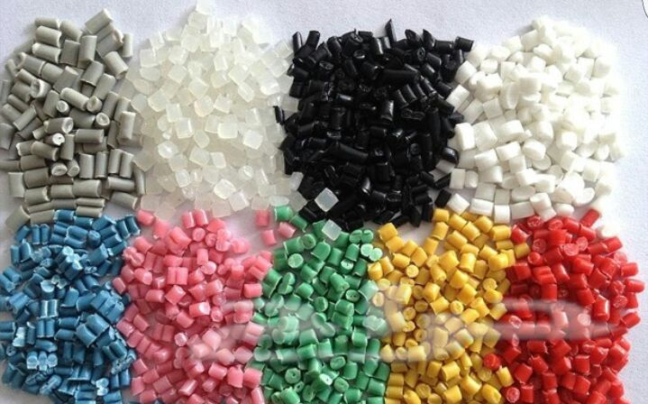
Process
Stage1: bring raw materials

Slide 5
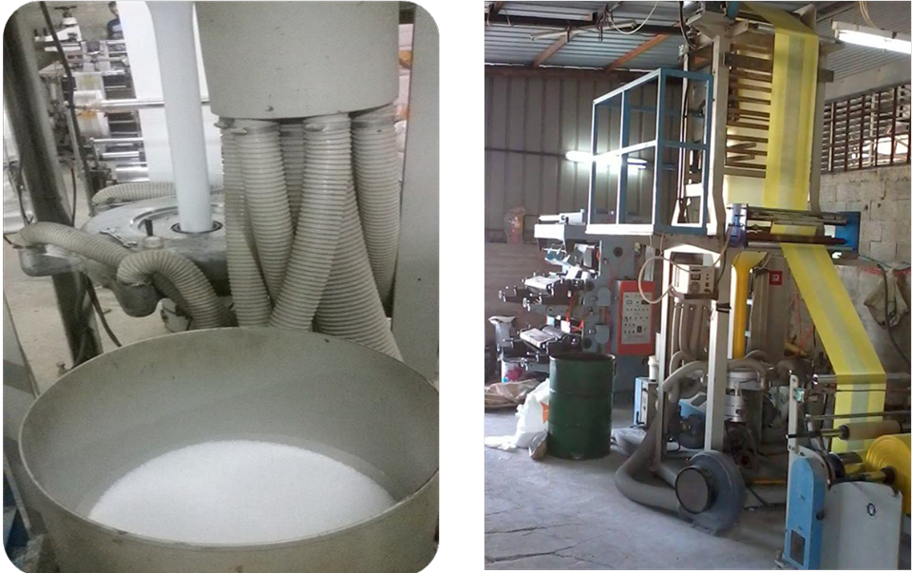
Stage 2: Film blowing machine processes

Slide 6
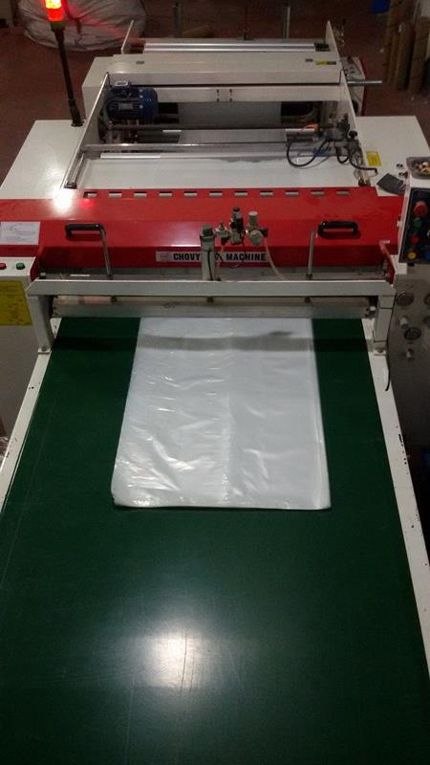
Stage 3
The rolls is moved to the shearing machine according to the required sizes and the scissors are equipped with heaters to weld the bag and are horizontal

Slide 7
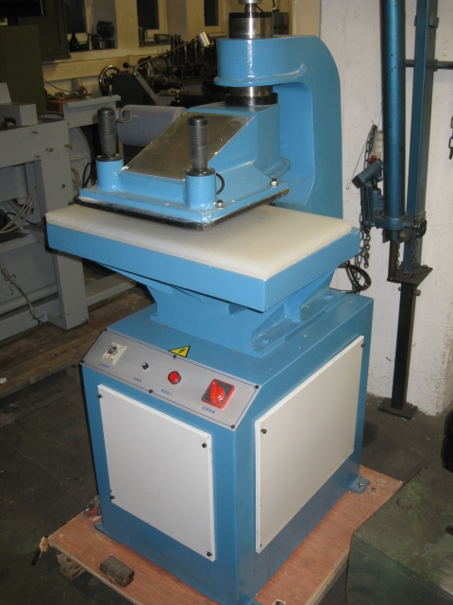
Stage 4
Moves the product to the piston to unload the hand by hydraulic arm cutting machine to facilitate the process of pregnancy

Slide 8
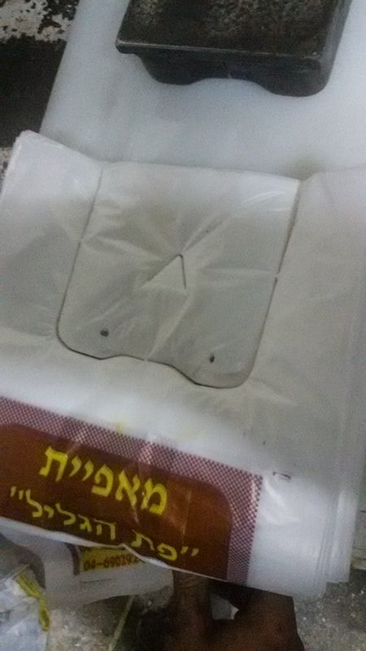
Stage 5
Final product →Bags are regularly collected for weight and packaging

Slide 9
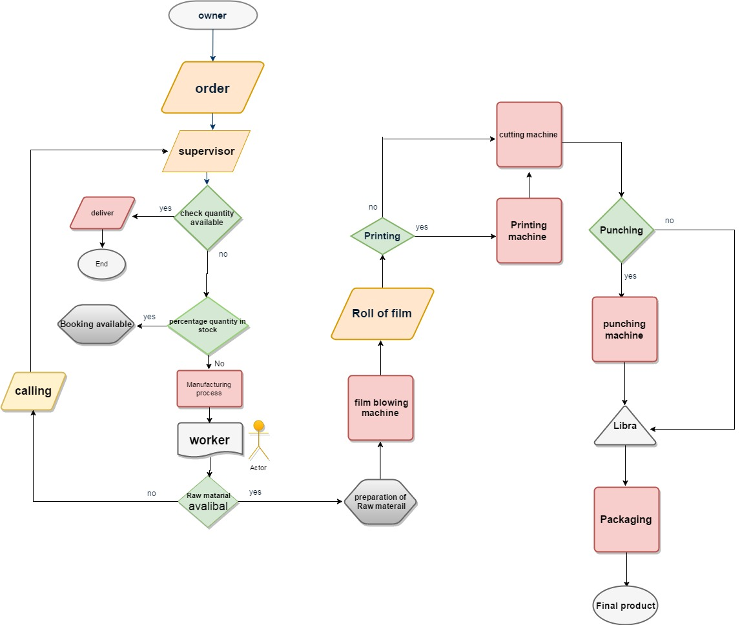
Flow chart of the process

Slide 10
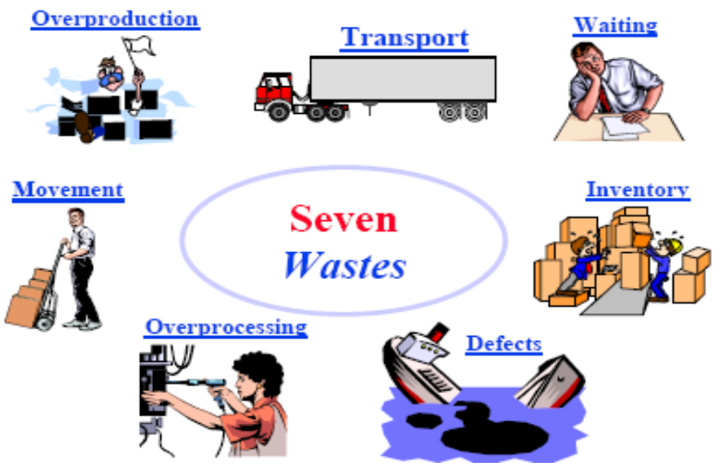
Seven Wastes

Slide 11
Result and Analysis

Slide 12
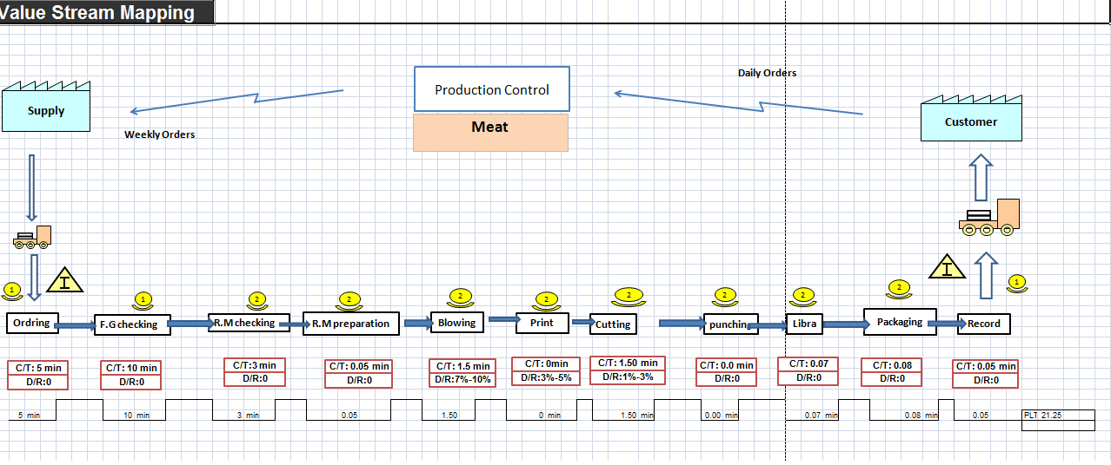
    Value Steam Mapping Implementation

Slide 13
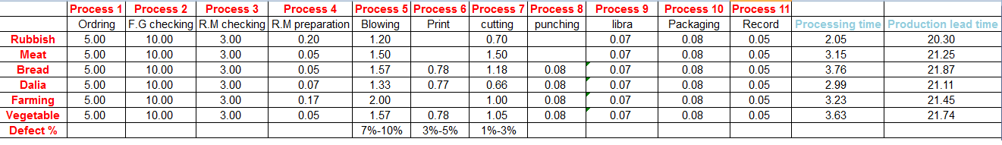
Lead time

Slide 14
Note that the first three activities have most time of the lead time. They consider very long. Processing time is lead time without three activities . There is huge different between processing time and lead time. That due to :
Lack of inventory document and excessive inventory.
lack of cleanliness and organization
lack of important forms : Order form, Inventory order form , Supplier order form , Maintenance order form , Delivery order form

Slide 15
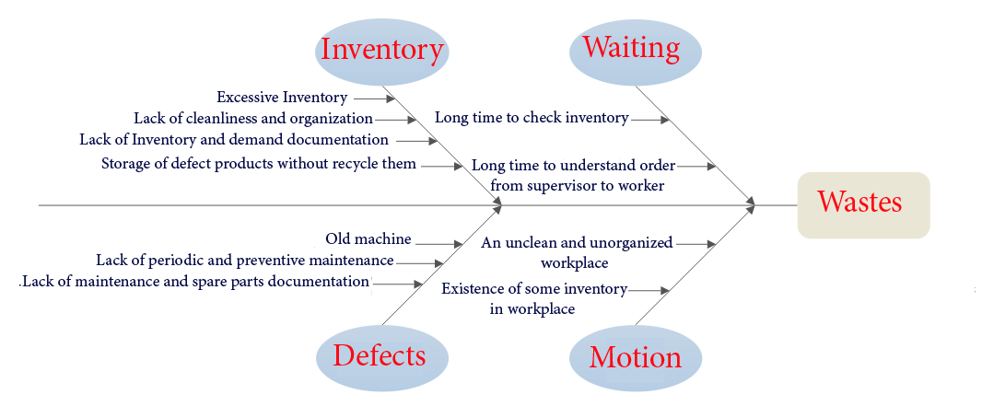
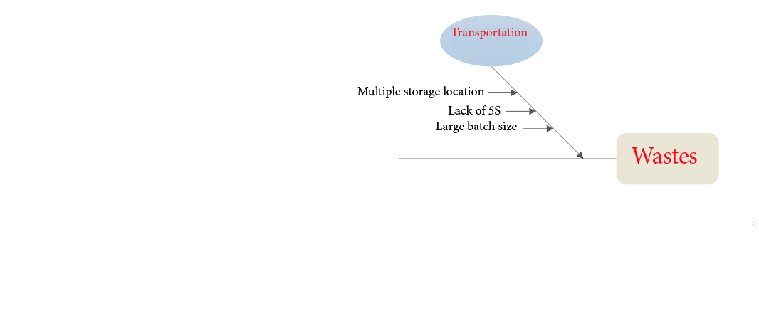
Wastes in Factory

Slide 16
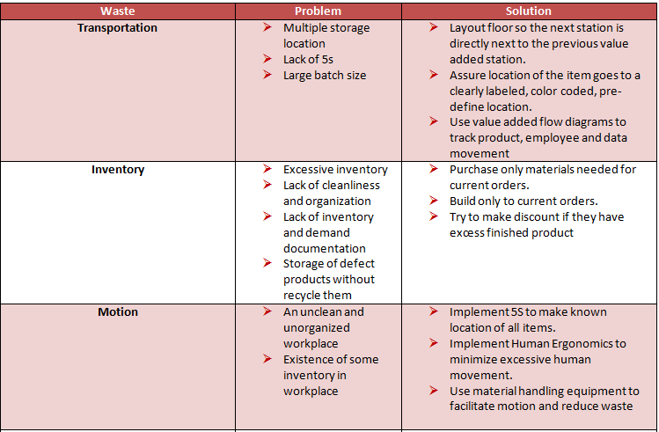
Problems and Solutions of the Waste

Slide 17
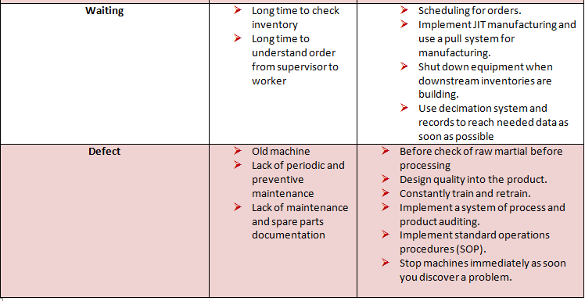

Slide 18
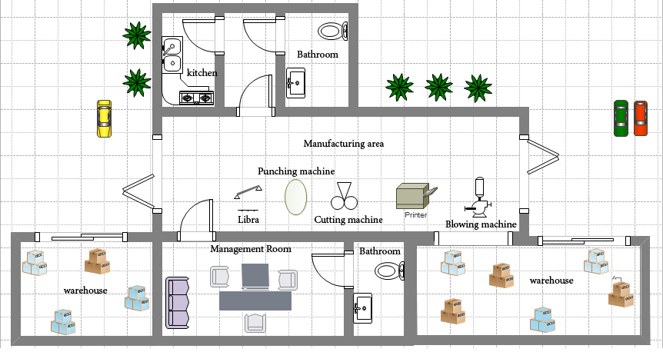
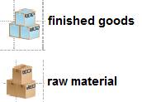
Factory Layout

Slide 19
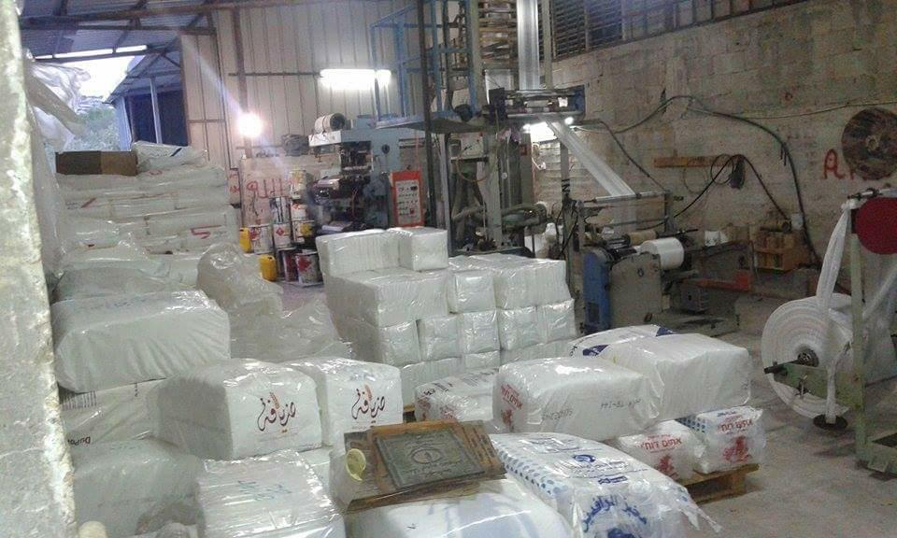

Slide 20
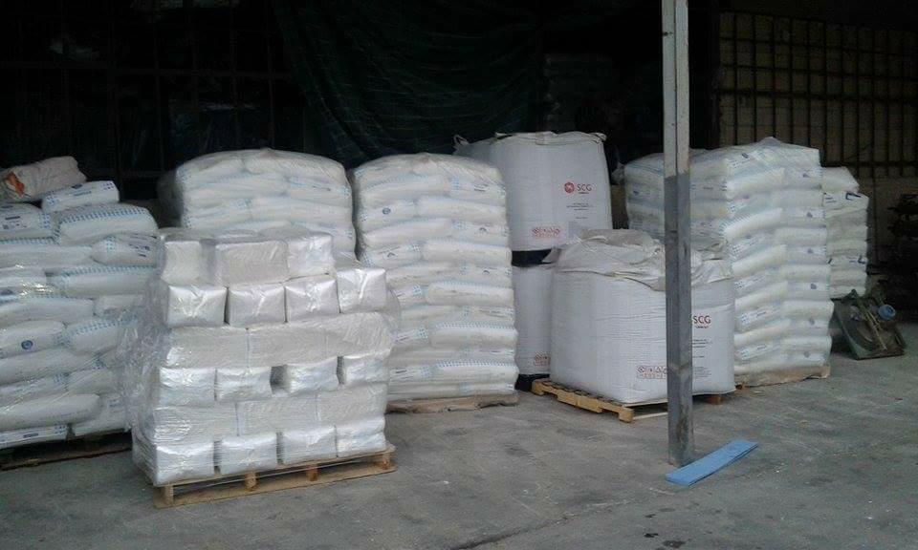

Slide 21
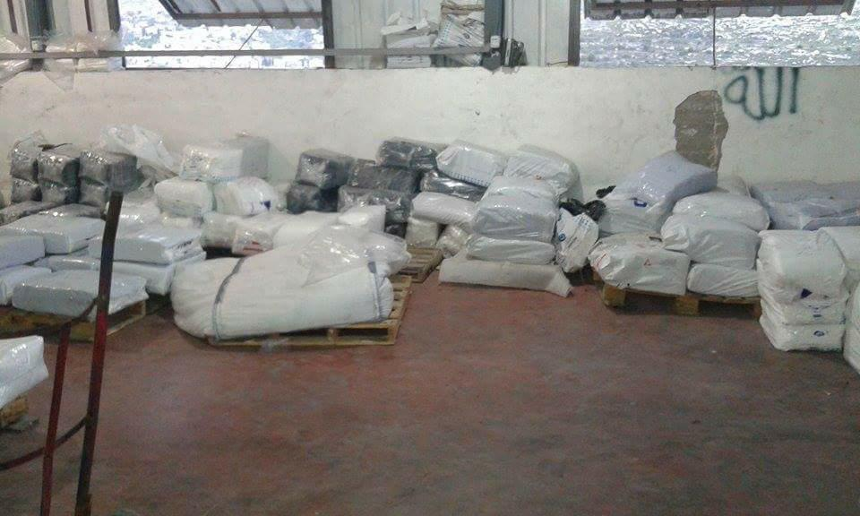

Slide 22
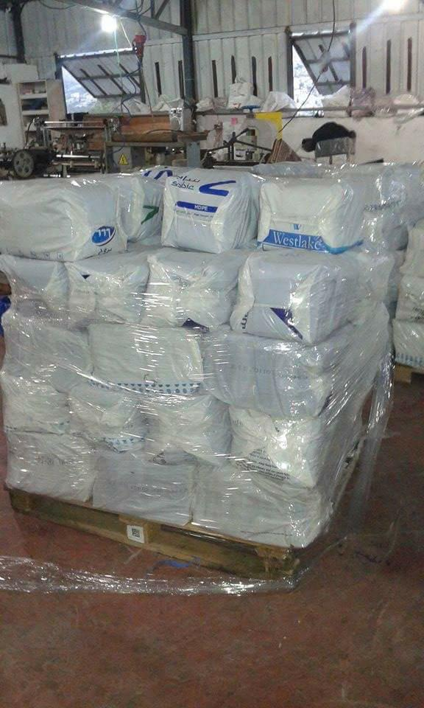

Slide 23
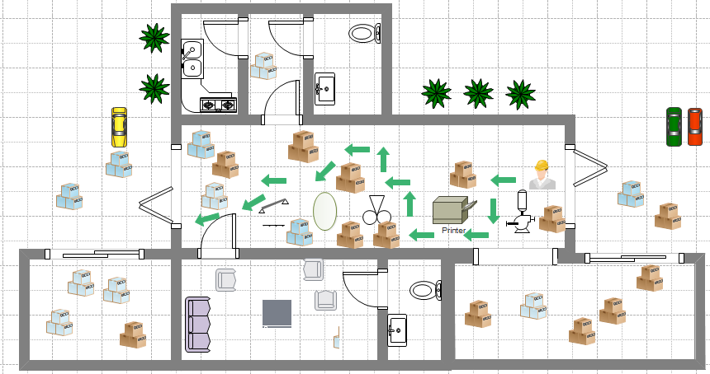
Worker motion

Slide 24
  5S Tool
The implementation of 5S will solve many benefits such as:
Solve time problem.
Solve motion problem.
Solve safety problem.
Making the worker more comfortable

Slide 25
Why the 5s?
According to the current situation in the factory , the most appropriate tool for possible improvement is 5s, as it helps to eliminate waste, streamline production, and optimize efficiencies. When you adopt 5s thinking, you make a commitment to put safety, organization and effectiveness ahead of production deadlines, profits and output. The end result is always an increase in overall success

Slide 26
    5s Implementation
S1 – SORT.
Red Tagging:

Slide 27
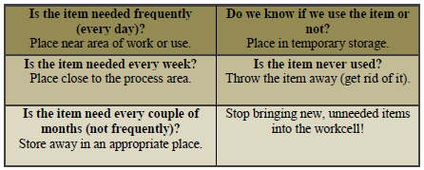
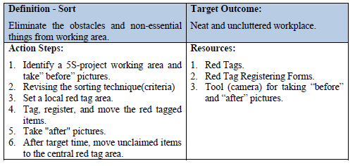

Slide 29
Progress Check: _ Clear team within the workplace boundaries. _Final approval authority for the red tag criteria identified (e.g. item can/cannot be red tagged). _ Sorting criteria set (e.g., frequency of use; actual quantity needed-no buffer). _ Time set for Sorting phase is clearly defined (e.g., one hour). _ Red floor marking tape or similar boundary for the local red tag area. _ Red tags and red tag log form exist and available. _“Before” pictures are taken. _ The unnecessary items are identified and red tagged. _ The red tagged items moved to its location (red tag area). _ Red tag log for is updated. _ Plans put in place for the items to be moved to the central red tagging area. _ “After” pictures are taken.
Tips to follow: _ Make communication to make sure that the management and employees in the target area are notified when the red tagging will happen. _ Remove all the things that are not used at least weekly. _ Eliminate waste by minimizing the following: _ Inventory : raw material, Recycled material , finished bags . _ Equipment: machine :stools, vehicles, etc. _ Space: core work area floor, storage areas, bins, shelving, etc. _ Not to remove anything before having the local work group's approval.

Slide 30
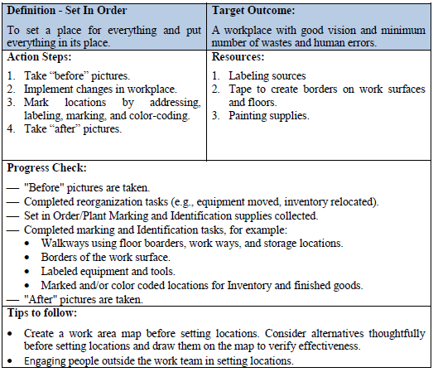
S2 – SET IN ORDER.

Slide 31
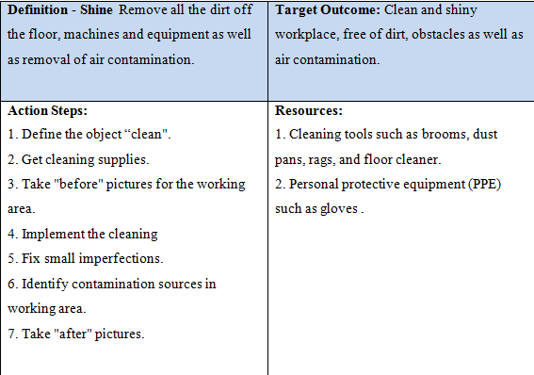
S3 – SHINE.

Slide 32
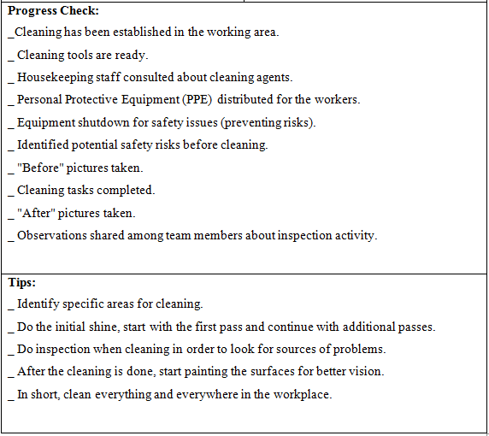

Slide 33
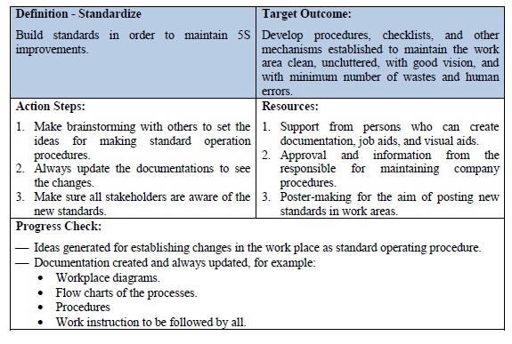
S4 – STANDARDIZE.

Slide 34
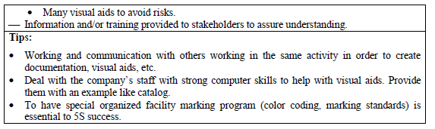
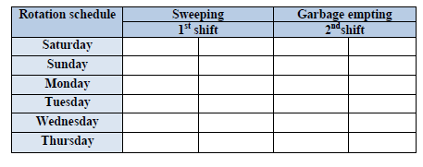
Table below shows standardizing cleaning form.

Slide 35
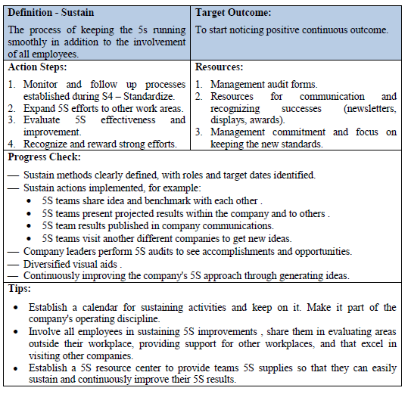
S5 – SUSTAIN.

Slide 36
SAFETY
The implementation of lean manufacturing and 5S tools can strongly affect the safety at any organization or workplace. Since5S results in a number of benefits such as: higher efficiencies, less stress, fewer accidents, higher levels of quality, fewer breakdowns and so on. In addition to the 5S, 6S is referred to as implementing to the 5S plus the added step of safety. The main benefit of 6S over the benefit of 5S is that added focus on safety, identifying and eliminating all hazards for a zero accident and injury free workplace.
In order to achieve the 6s stage effectively here are some guiding principles:
Wear appropriate PPE (personal protective equipment). .
Ensure warning signs are largely located (Emergency exits, High voltage, slippery-wet floor, etc ).
Use tag-out-lock-out procedures

Slide 37
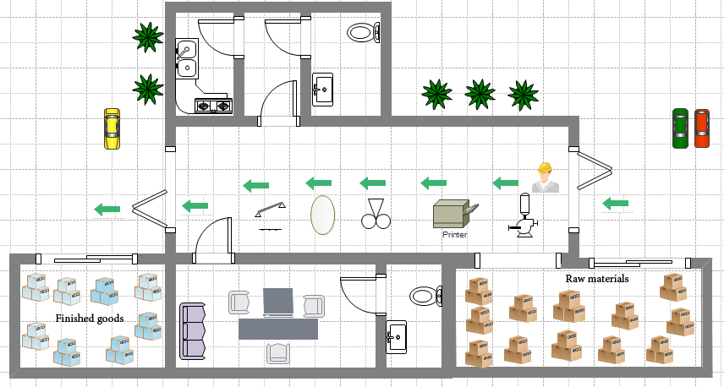
Worker motion after 5S implantation

Slide 38
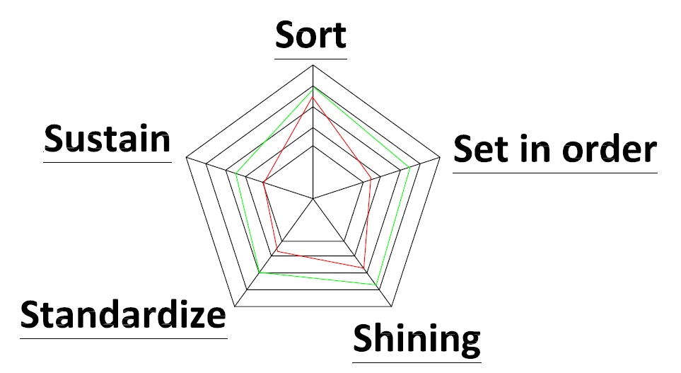
5 S diagram
The diagram below shows the different between the states before and after S diagram

Slide 39
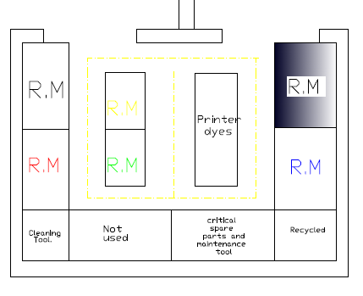
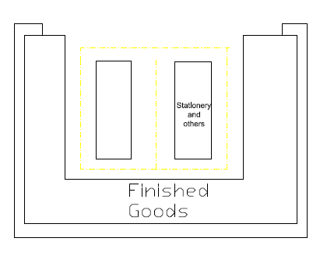
  Warehouses

Slide 40
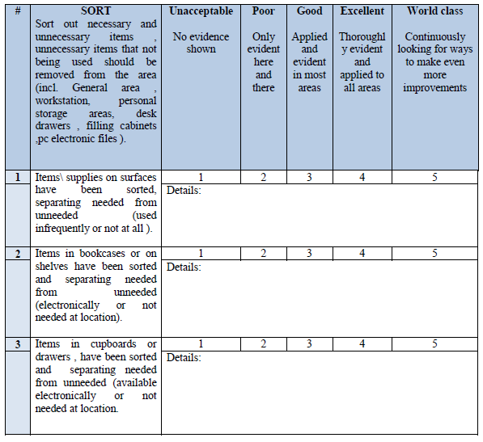
    5S Audit Form
Sort Audit Form

Slide 41
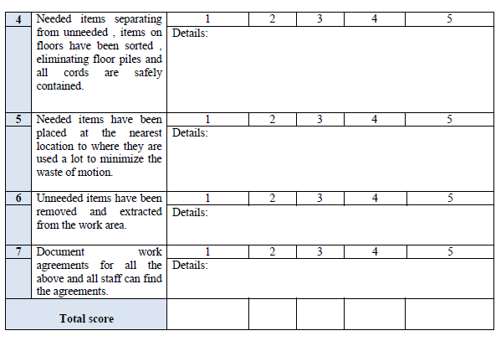

Slide 42
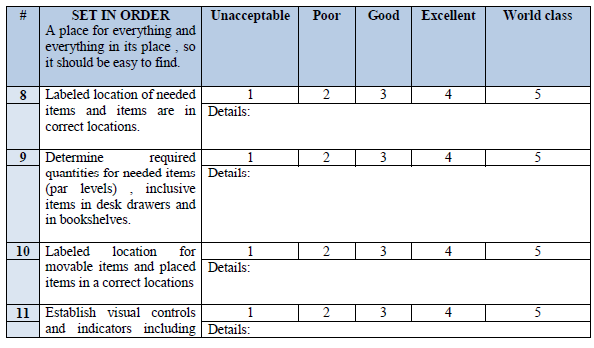
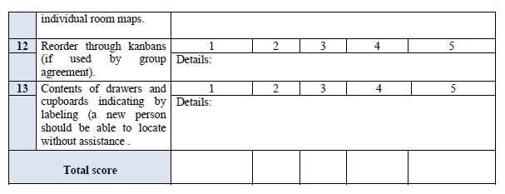
SET IN ORDER Audit Form

Slide 43
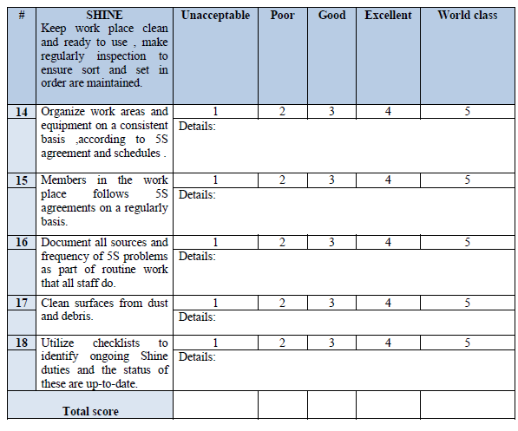
SHINE Audit Form

Slide 44
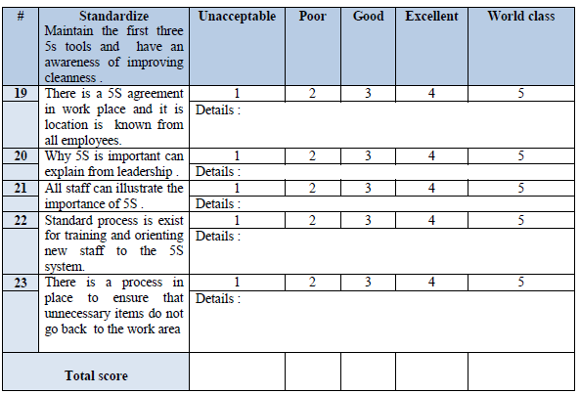
Standardize Audit Form

Slide 45
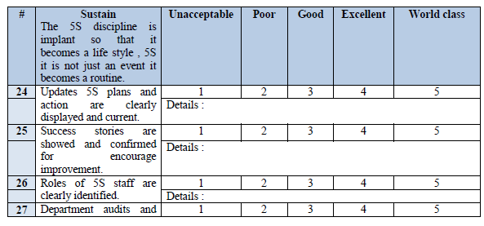
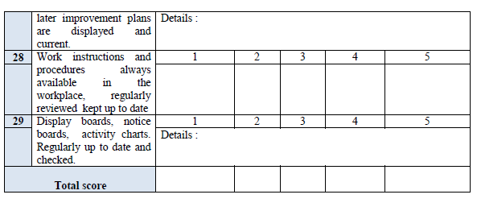

Sustain Audit Form

Slide 46
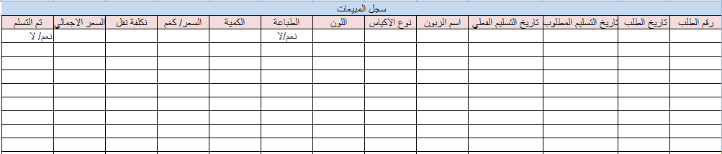
  Processes decimation
  Ordering process.
Sales record

Slide 47
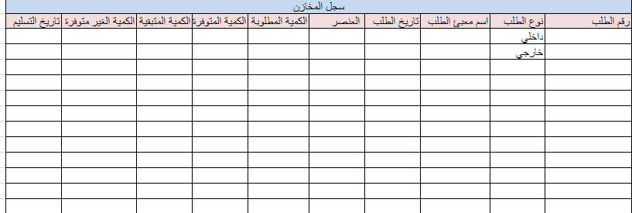
Inventory record

Slide 48
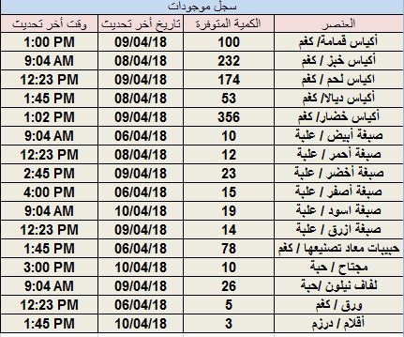
current inventory

Slide 49
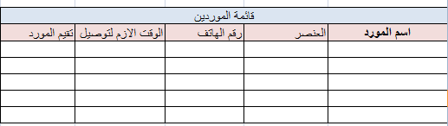
    Raw Material Ordering
suppliers list

Slide 50
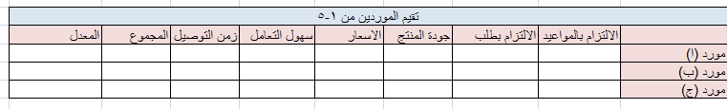
Evaluation of suppliers

Slide 51
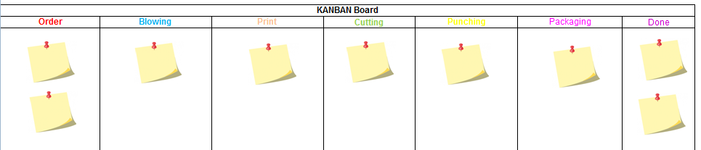
    KANBAN Board

Slide 52
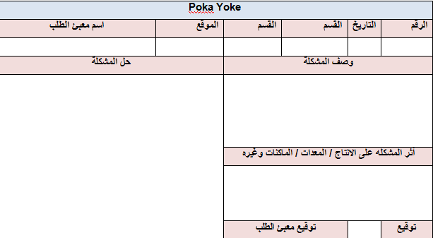
    Poka Yoke

Slide 53
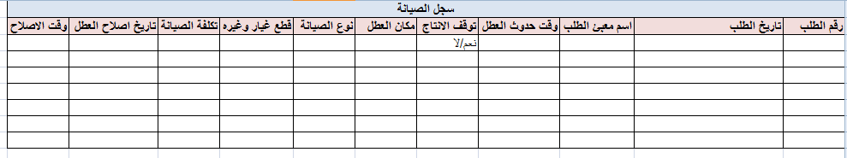
    Maintenance ordering
قائمة بمصادر الصيانة الخارجية وقطع الغيار
اسم الجهة | الخدمة المقدمة أو القطعة المباعة | رقم الهاتف | التقييم

Slide 54
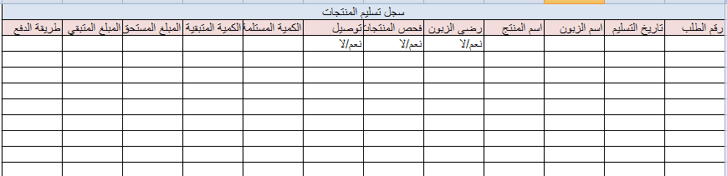
    Delivery Order Form

Slide 55
Discussion
Lean approach will achieve high improvement. Lean can provide an organization with a clear competitive advantage since the correct application of the Lean principles will realize substantial benefits that include:
Greater productivity
Greater throughput
Improved quality
Reduced cycle times
Less Defects
Smoother operation

Slide 56


The tables below show before adjustment and table show after adjustment for lead time (minutes) took by stopwatch

Slide 57

***

Slide 58
Conclusion
In this part of the project we discussed the concept of lean manufacturing, its principles and tools, we used this concept and applied it to Dalia factory for plastic bags, we have talked about the nature of the industry, the factory, its structure, what the factory produces , and how to do the manufacturing process.
Implementation of the Lean Manufacturing concept is a shift from a traditional production scheme to a modern manufacturing systems, rapidly responding to market changes and varying demands of final recipients. It also stands for reduction of the amount of operating resources involved in the production process.
There are many limitations that have affected us in applying the concept of industry to the fullest in the factory, such as factory do not have the tendency to implement lean and that is not because they do not want or do not know about lean production advantages, rather it is because they cannot do that, the lack of skilled employees is concluded, and occupation policy aimed at obliterating Palestinian industries.

Slide 59
  Recommendations
  The workers need for improvement course regularly.
  Document system should be improved and regularly edited.
  The factory need to forecast system , quality management system ,inventory management system and planning .
  The workers must adhere to the new system instructions.
  Lean manufacturing should be as culture in side factory.

