Slide 1

An- Najah National University
Faculty of Engineering & Information Technology.
Building Engineering Department.
Graduation project (2)
Integrated redesign of the multistorey car park.
Prepared By: Rawan Salahat
Supervisor: Dr. Luay Dwaikat

Slide 2
TABLE of CONTENTS
01
03
02
Site analysis
Introduction
Architectural Aspects
04
05
06
Environmental Aspects
Electro-Mechanical Aspects
Structural Aspects

Slide 3
Introductory
01
Project location
Project description
Users and zoning

Slide 4
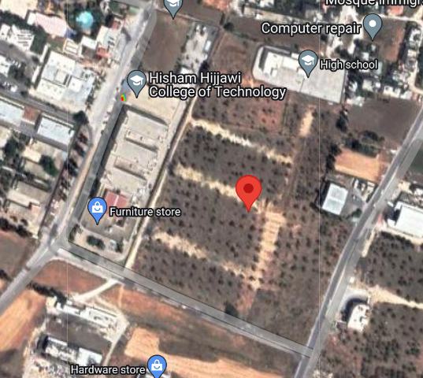
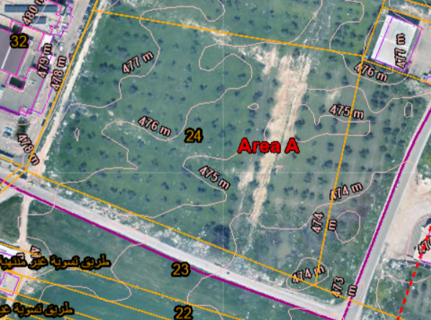
Project location
Project location
Contour line

Slide 5
Project description
Multi storey car park
located in Nablus.
site area 5867.
number of floors 5

Slide 6
Users and zoning
Floor | Function | users | Number of car parks
Ground floor | Parking | managers and visitors | 63
First floor | Parking | employees | 63
Second floor | Parking | employees and students | 71
Third floor | Parking | students | 71
Fourth floor | Art gallery | - | -

Slide 7
Site analysis
02
Sun path
Climate
CFD analysis

Slide 8
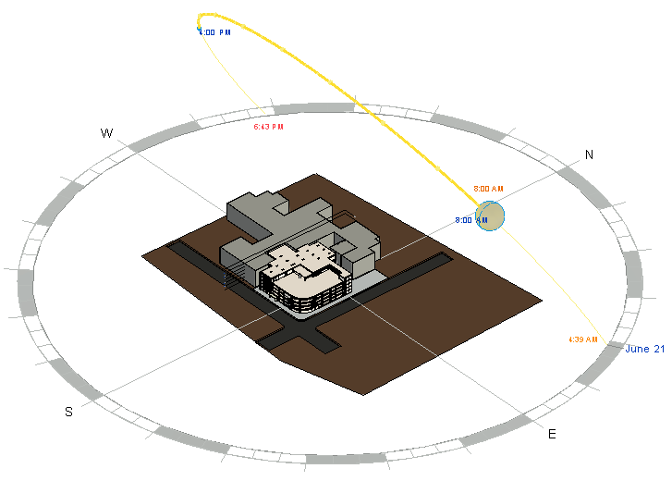
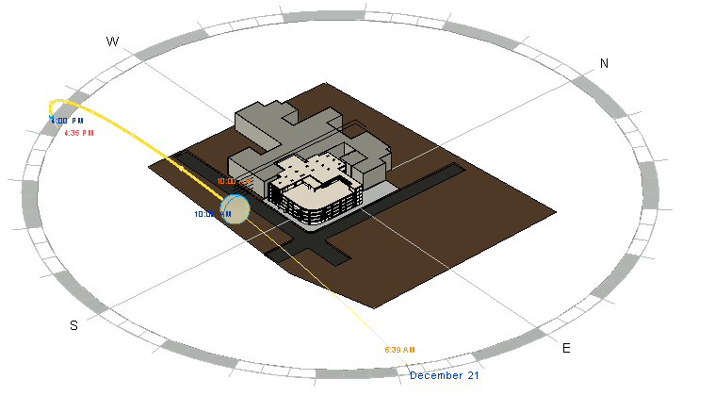
Site analysis
Sun path in winter
Sun path in summer

Slide 9
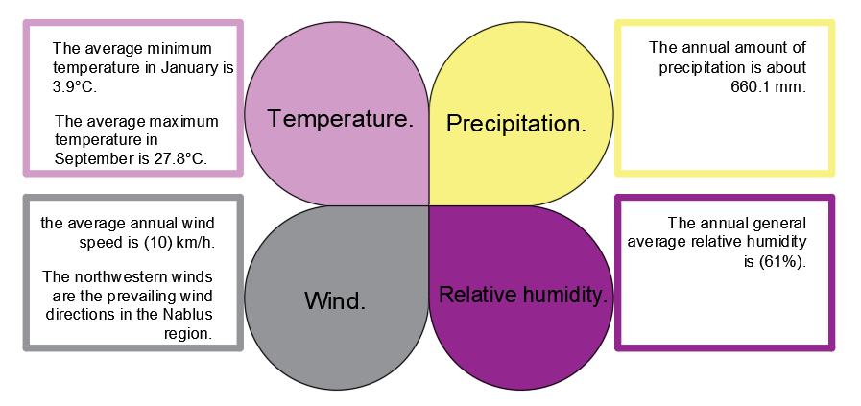
Climate

Slide 10
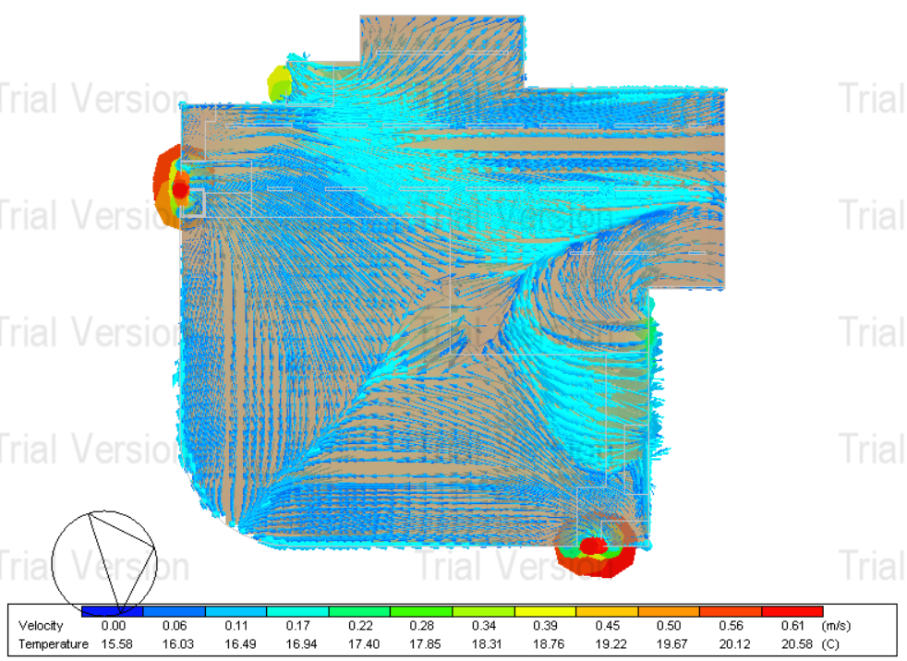
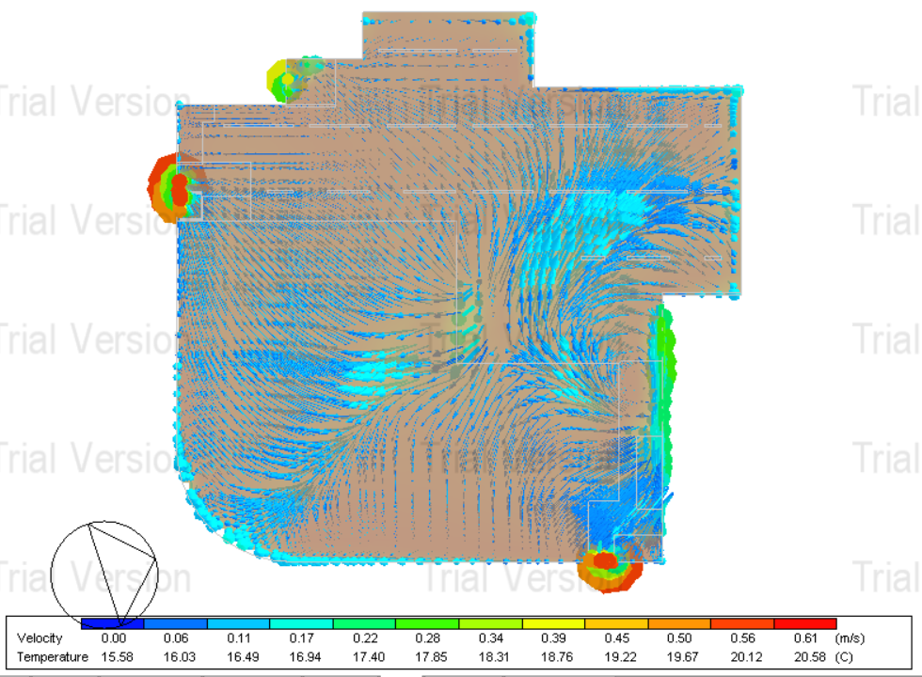
CFD analysis
CFD analysis for ground floor
CFD analysis for first floor.

Slide 11
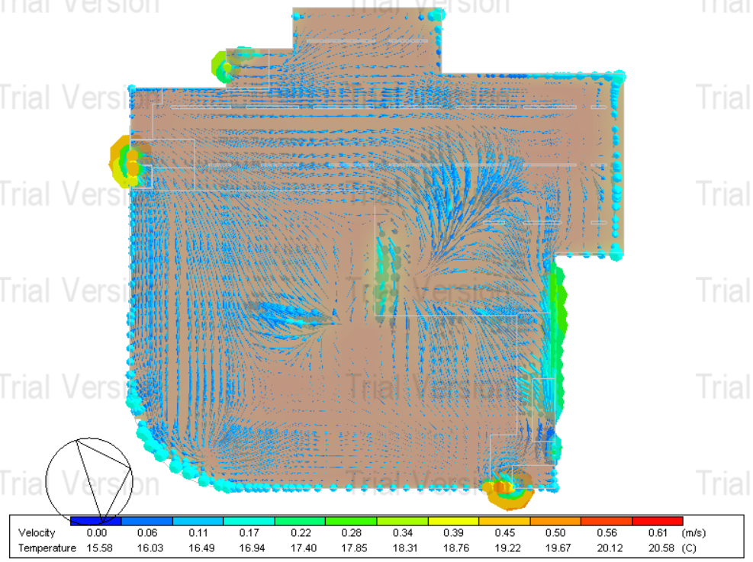
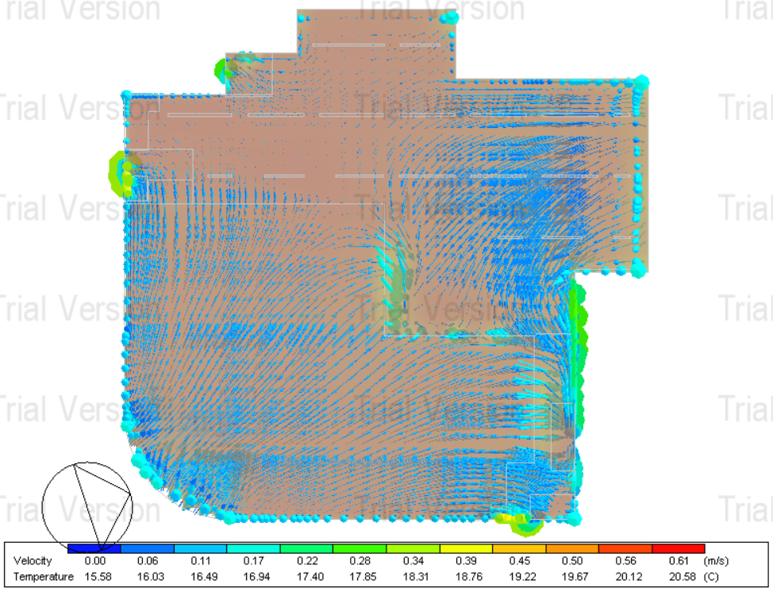
CFD analysis
CFD analysis for second floor.
CFD analysis for third floor.

Slide 12
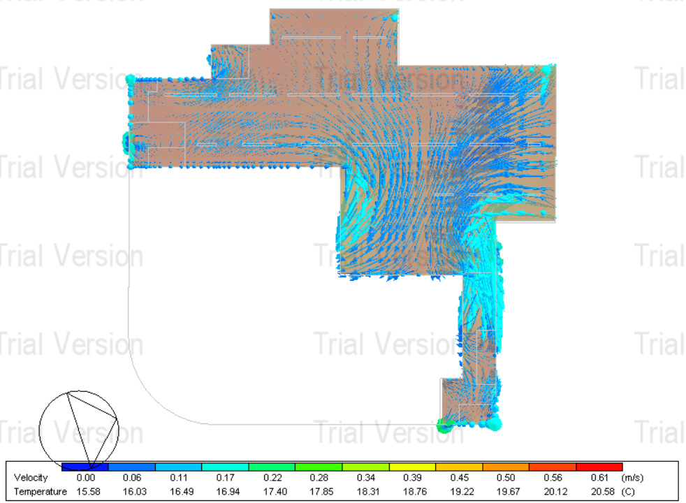
CFD analysis
CFD: Computational fluid dynamics
CFD analysis for fourth floor.

Slide 13
Architectural Aspects
03
Architecture plans
Elevations
Sections

Slide 14
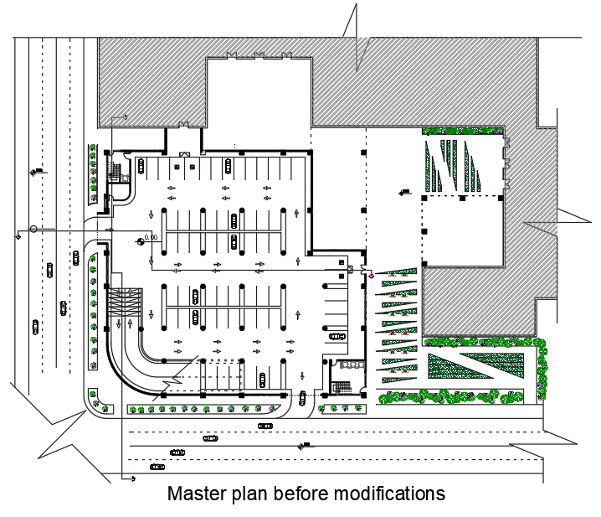
Master plan

Slide 15
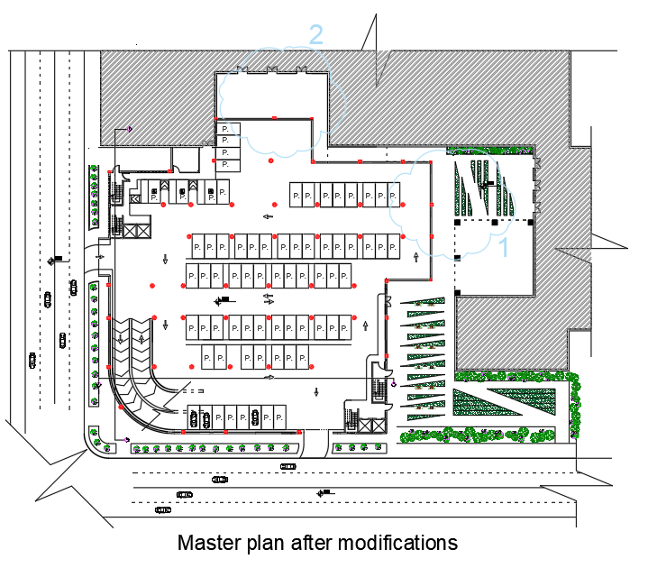
Master plan

Slide 16
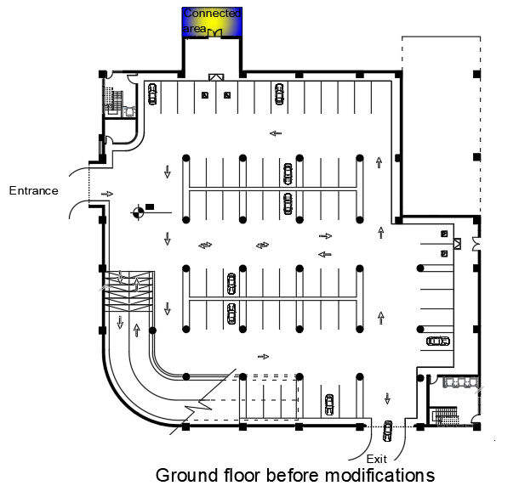
Ground floor plan

Slide 17
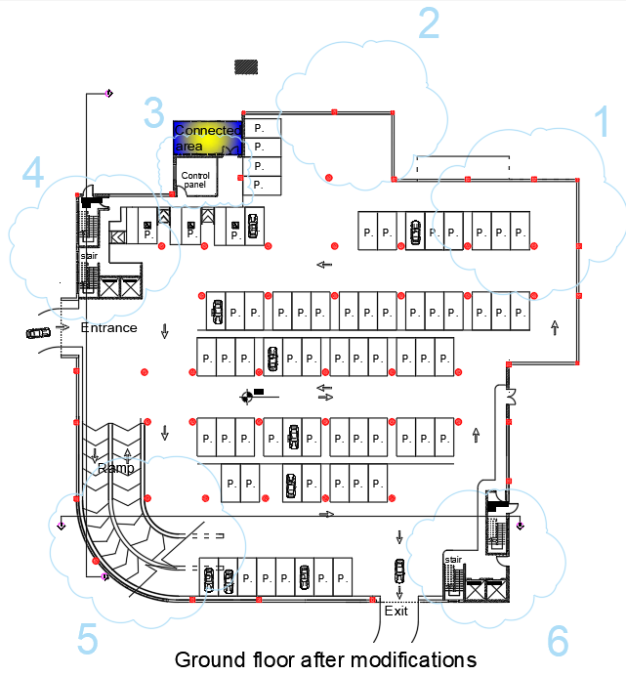
Ground floor plan

Slide 18
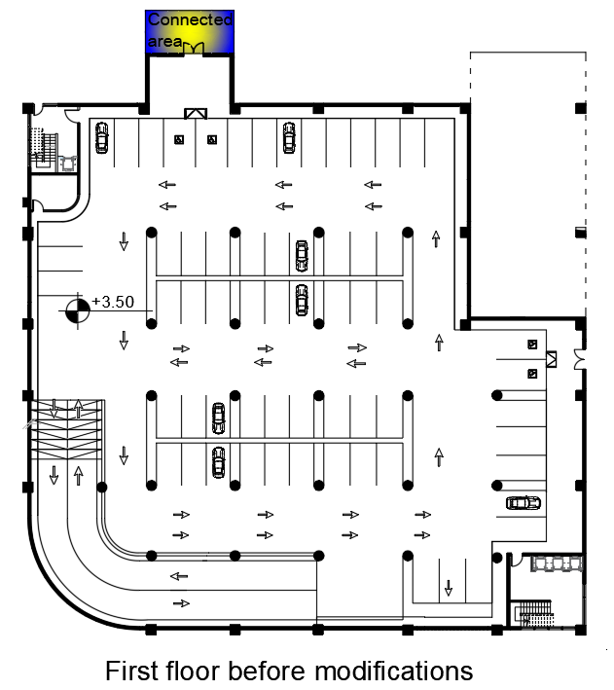
First floor

Slide 19
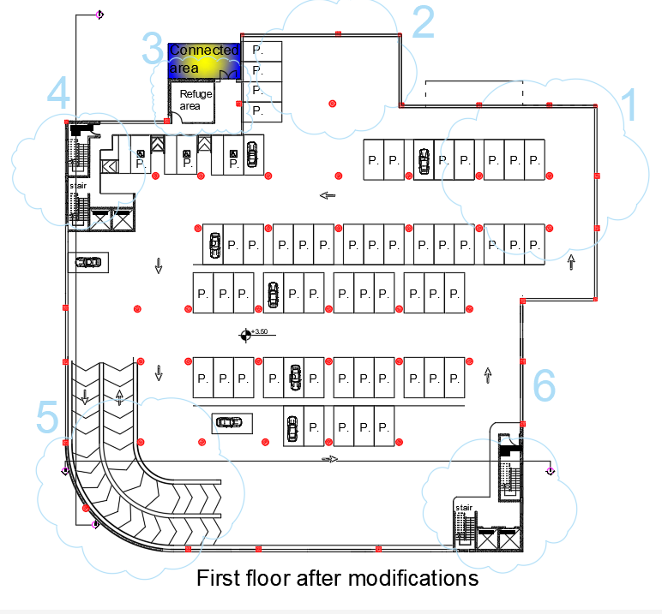
First floor

Slide 20
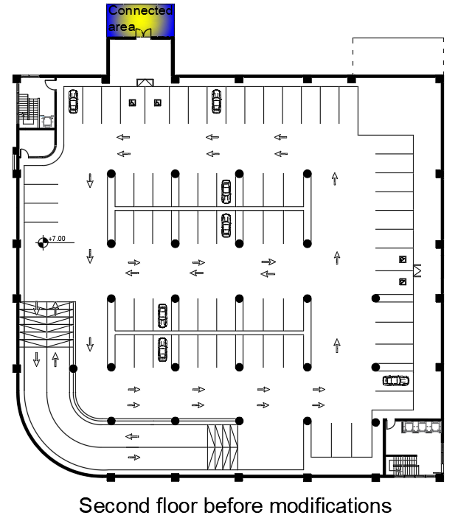
Second and third floors

Slide 21
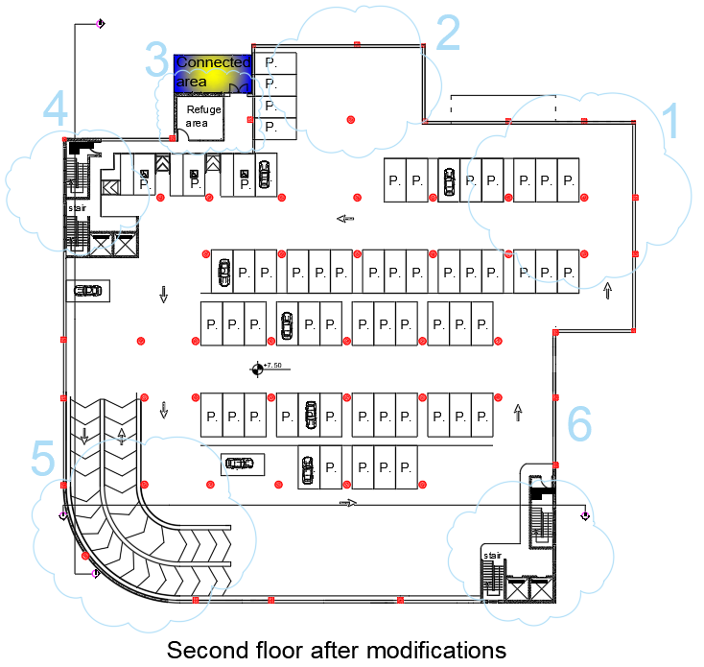
Second and third floors

Slide 22
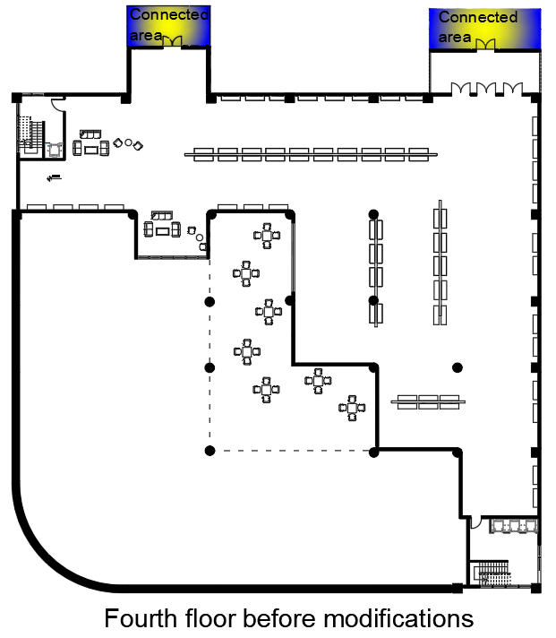
Fourth floor

Slide 23
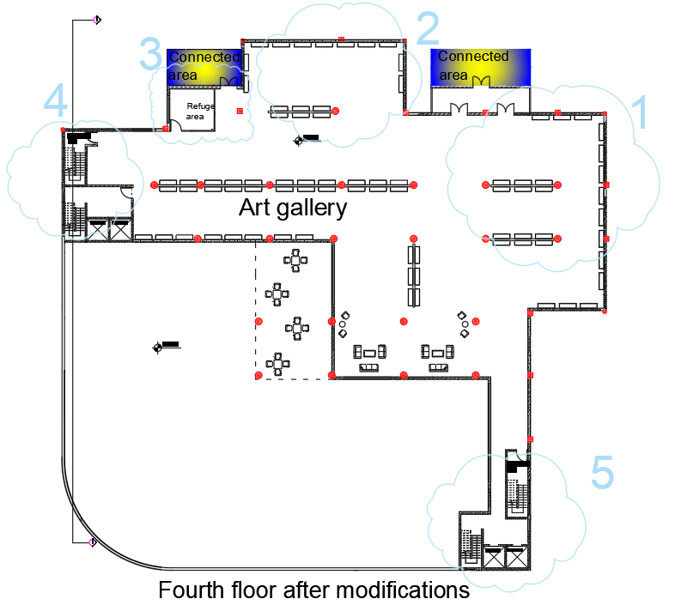
Fourth floor

Slide 24
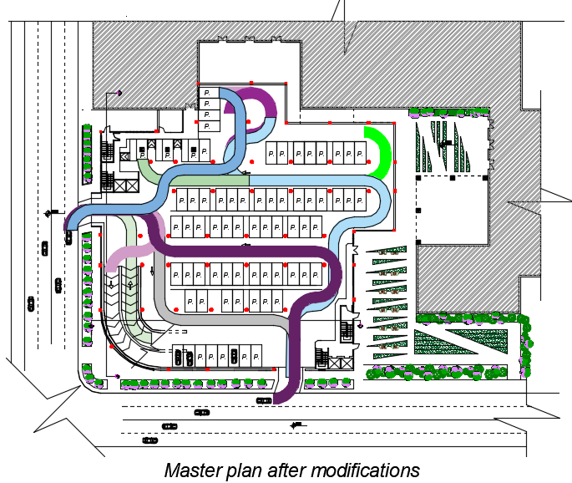
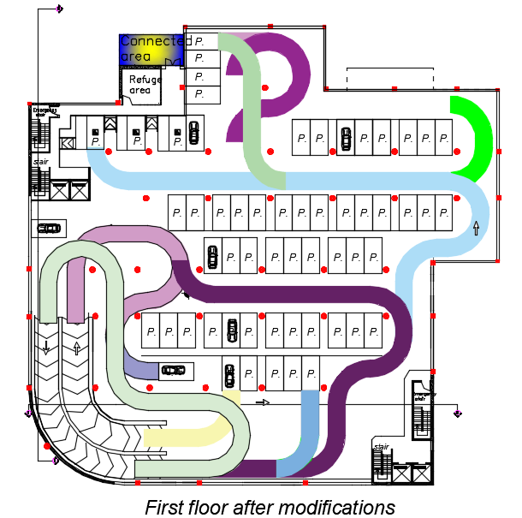
Dimensions check

Slide 25
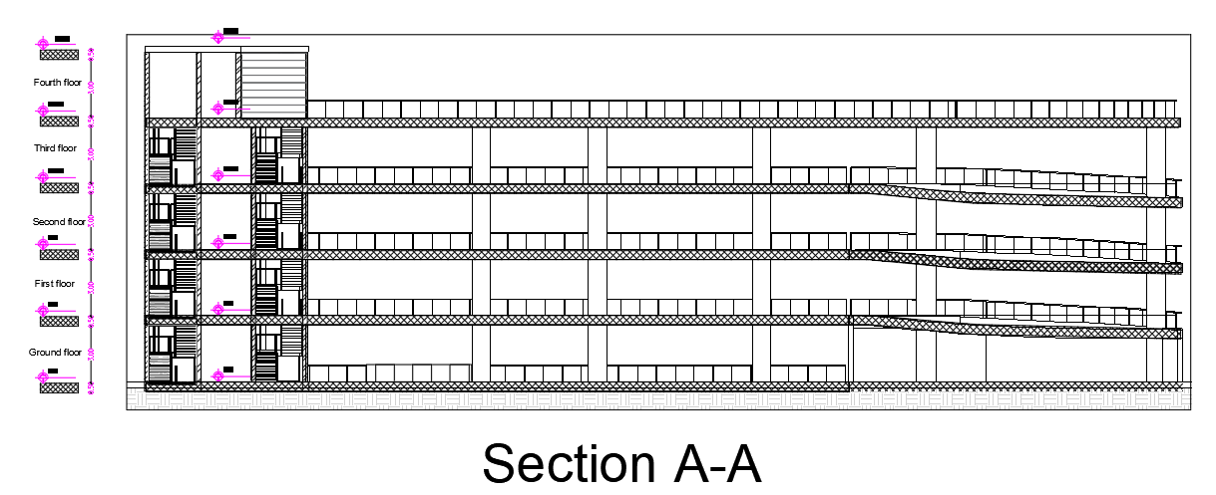
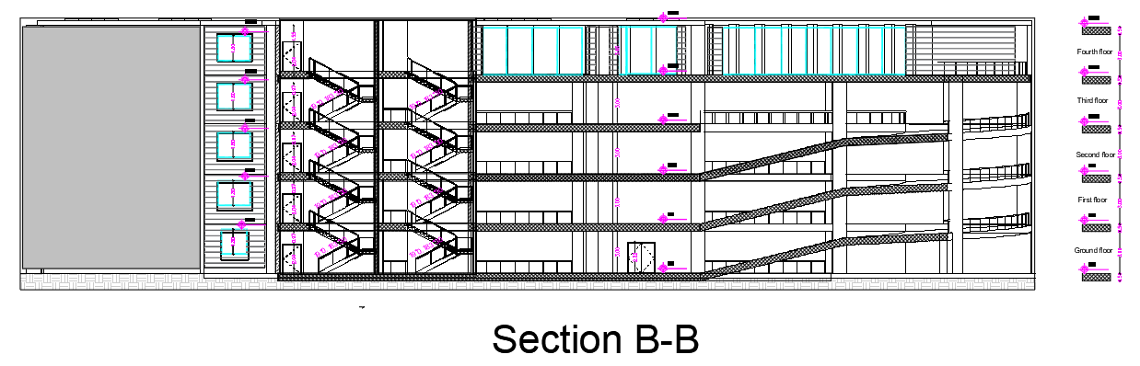
Sections

Slide 26
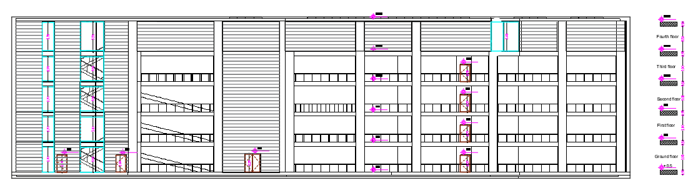
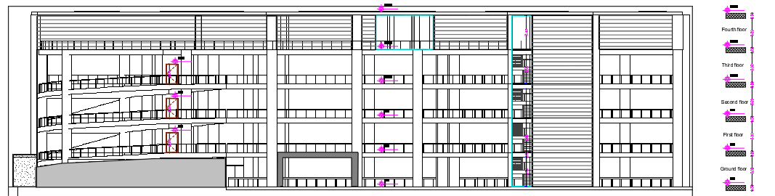
Elevations
North elevation
East elevation

Slide 27
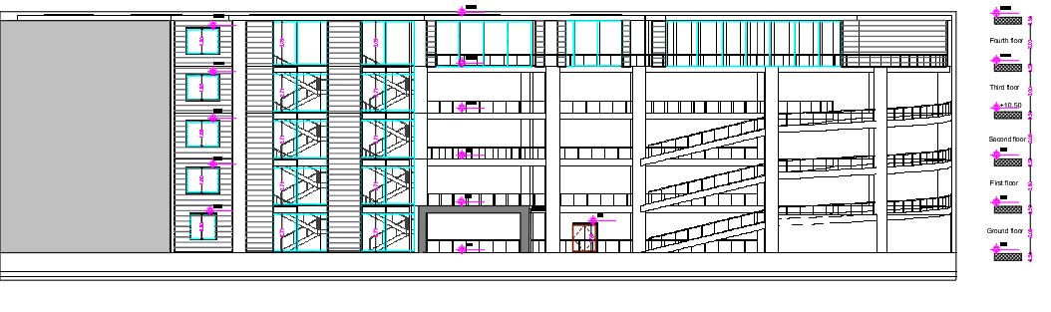
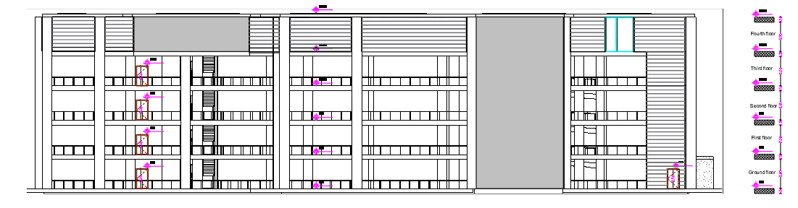
Elevations
South elevation
West elevation

Slide 28
Environmental aspects
04
Shadowing and overshadowing
Daylight factor
Heating and cooling loads for the art gallery

Slide 29

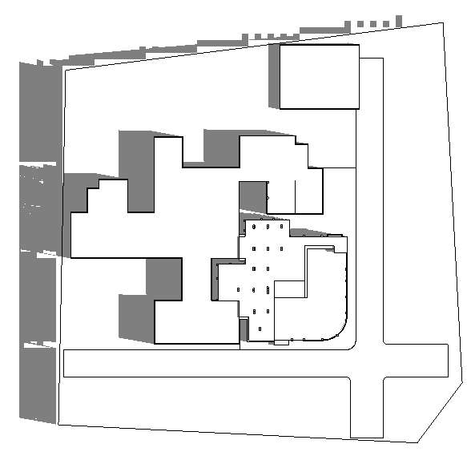
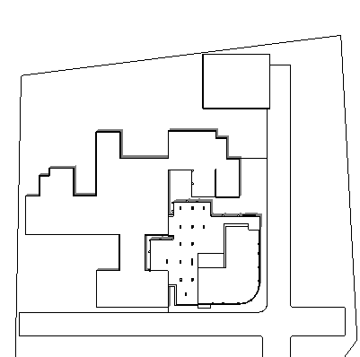
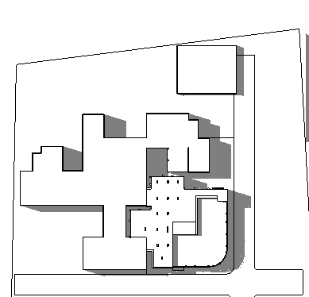
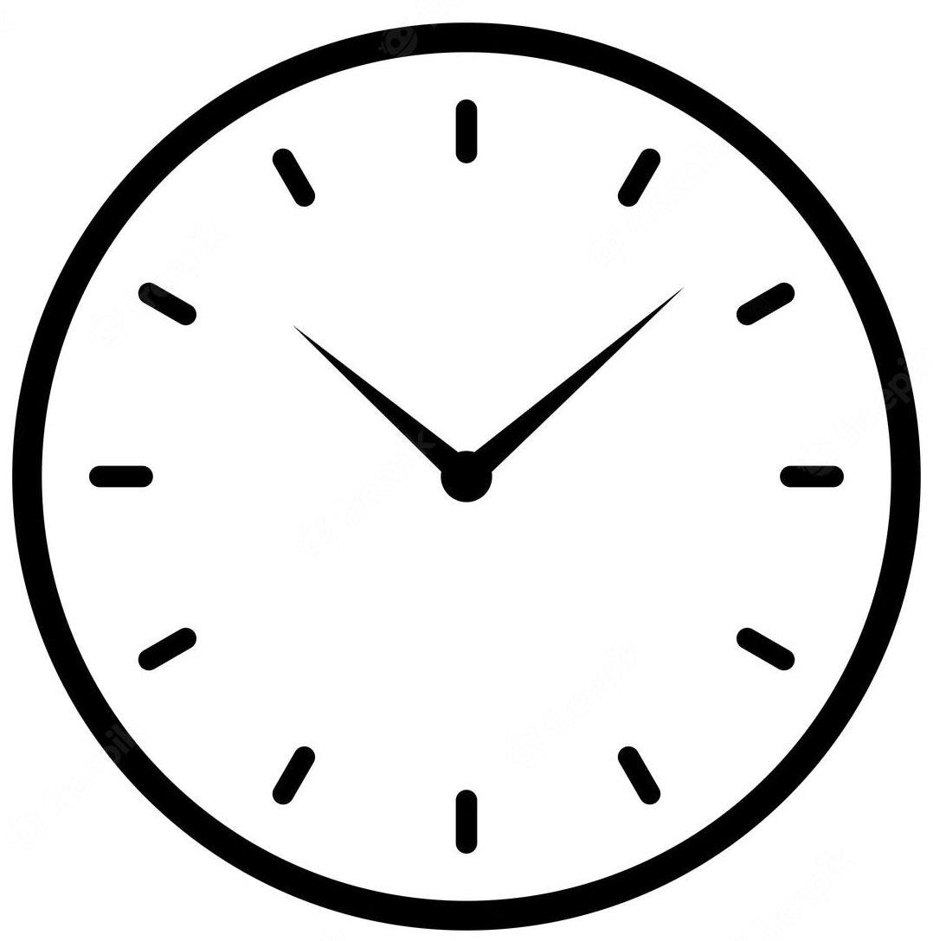
Shadowing and overshadowing
21/6
8:00 am
12:00 pm
3:00 pm

Slide 30
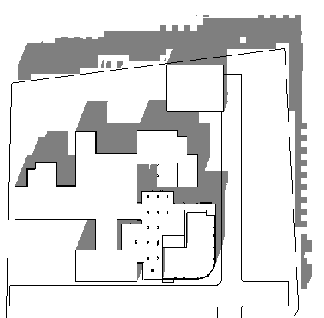
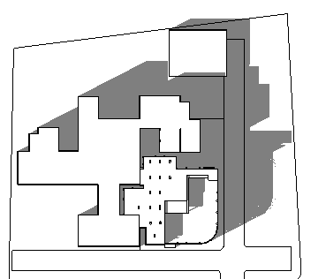
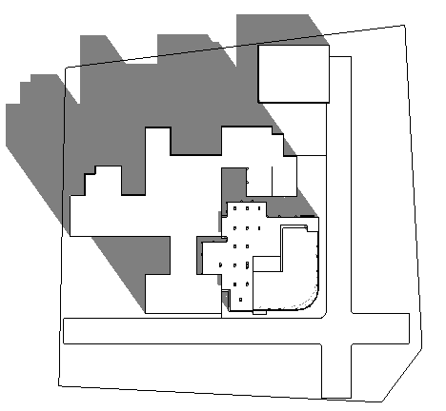
Shadowing and overshadowing
21/12
8:00 am
12:00 pm
3:00 pm

Slide 31
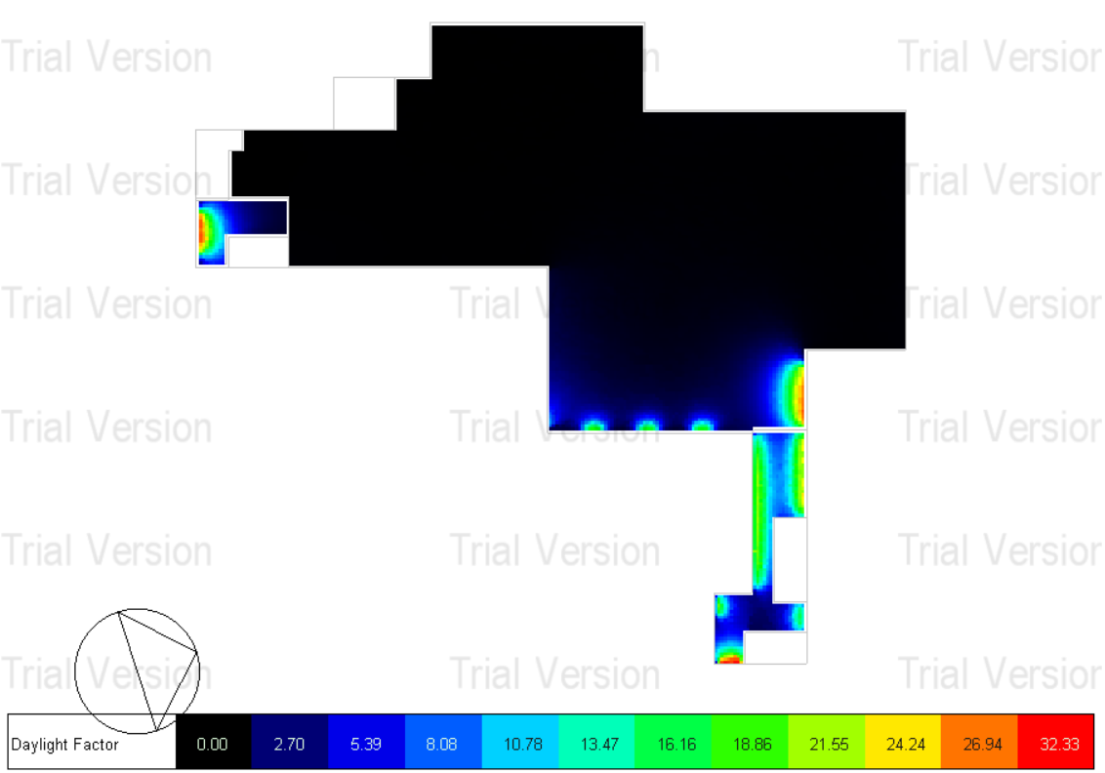
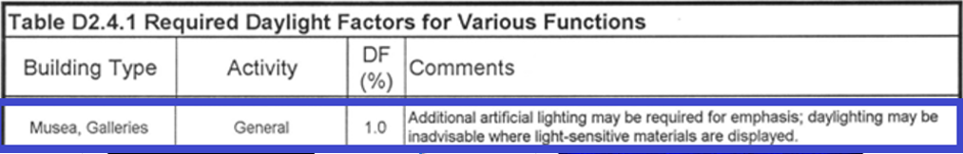
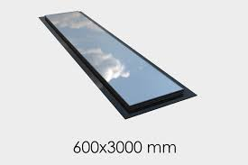
Daylight factor
skylight
Daylight factor before modification

Slide 32
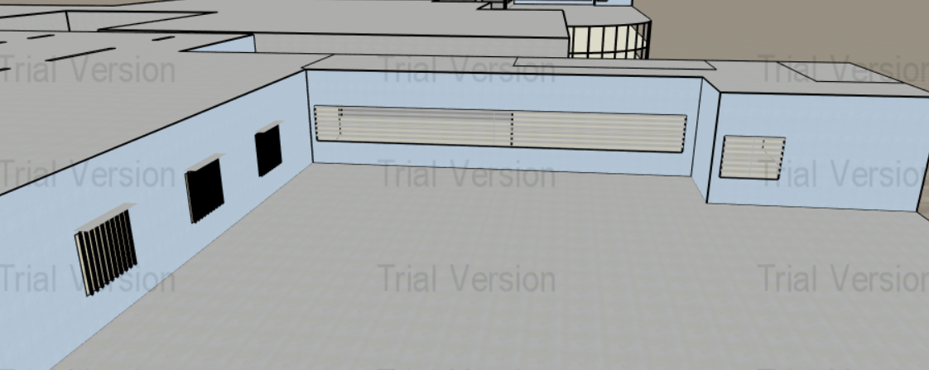
Daylight factor
Daylight factor before modification
Shading

Slide 33
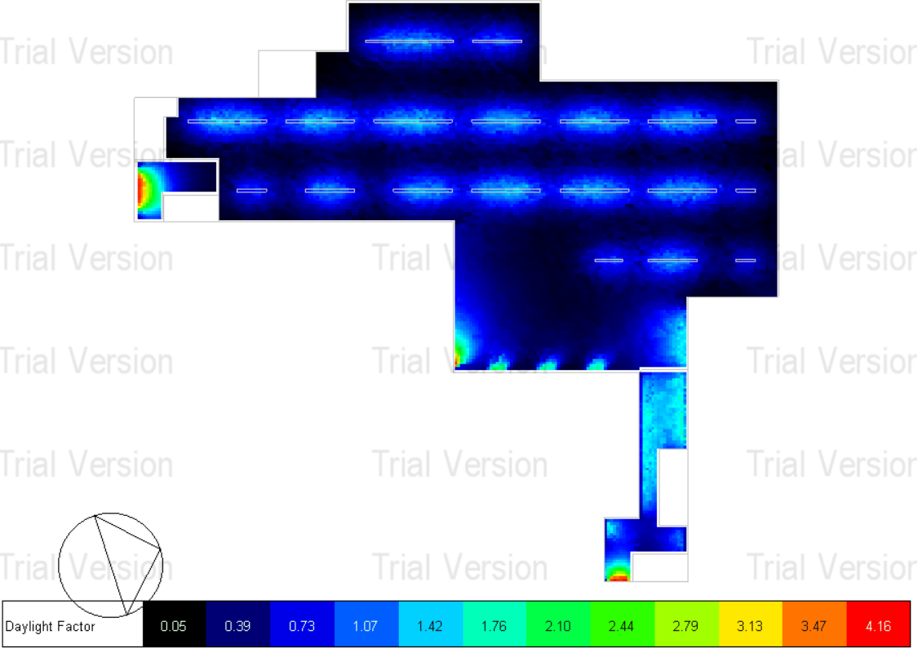
Daylight factor
Skylight
Shading
Glass type
Daylight factor before modification
Daylight factor after modification

Slide 34
Heating and cooling loads for the art gallery
Case 1
Case 2
External wall section
External wall section
Roof cross section
Roof cross section
Glazing type and layers
Glazing type and layers
Results
Results
Selection?

Slide 35
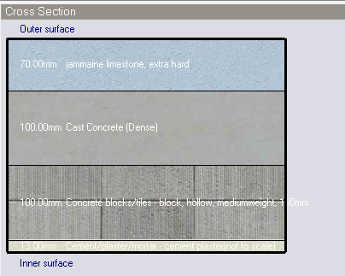
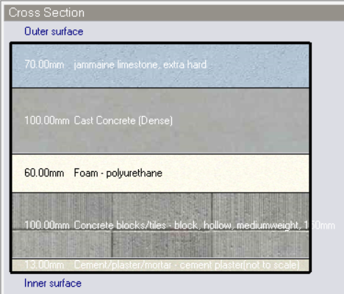


External wall section
External wall section in case 1
External wall section in case 2

Slide 36
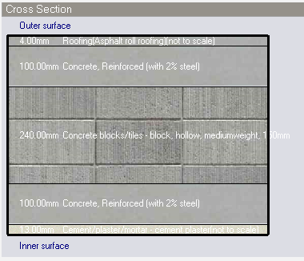
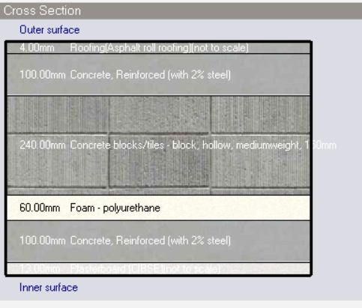


Roof cross section
Roof cross section in case 1.
Roof cross section in case 2.

Slide 37
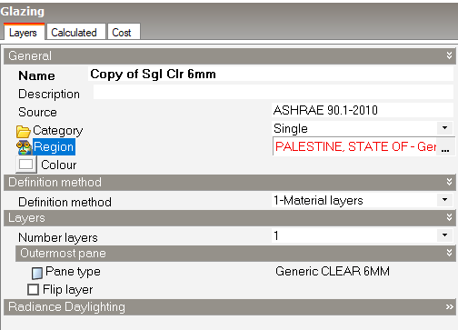
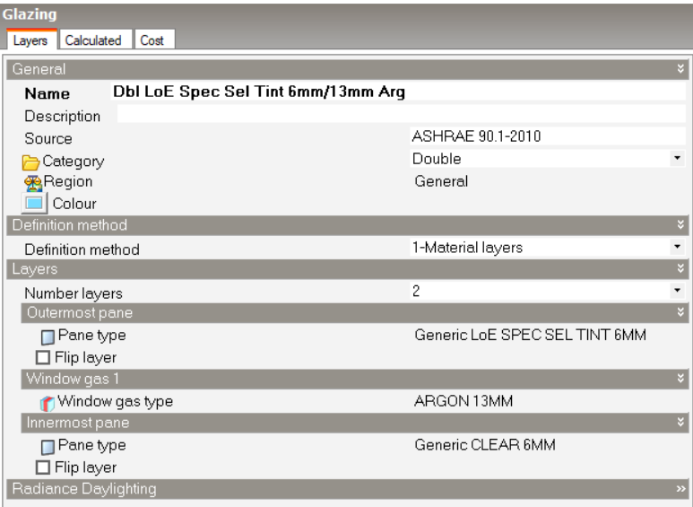
Glazing type and layers
Glazing type and layers in case 1.
Glazing type and layers in case 2.

Slide 38
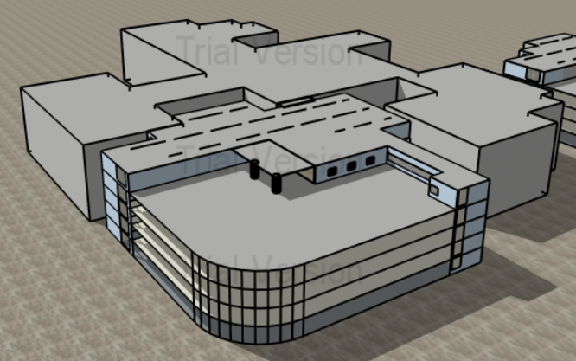
Shading
Shading
3D view

Slide 39
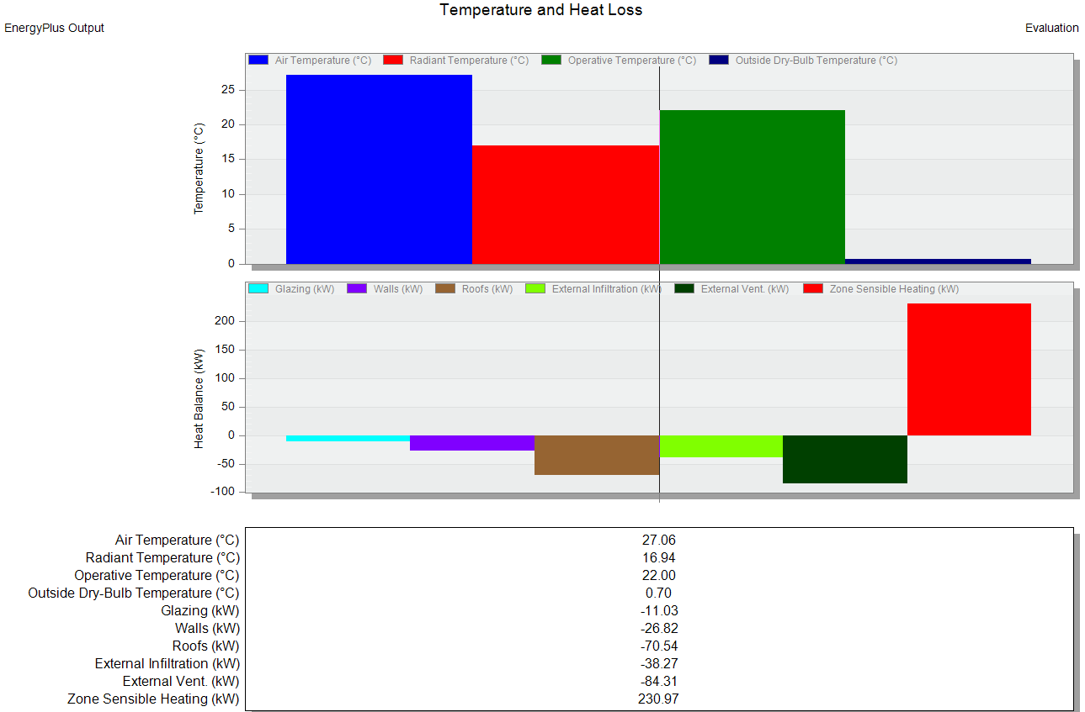
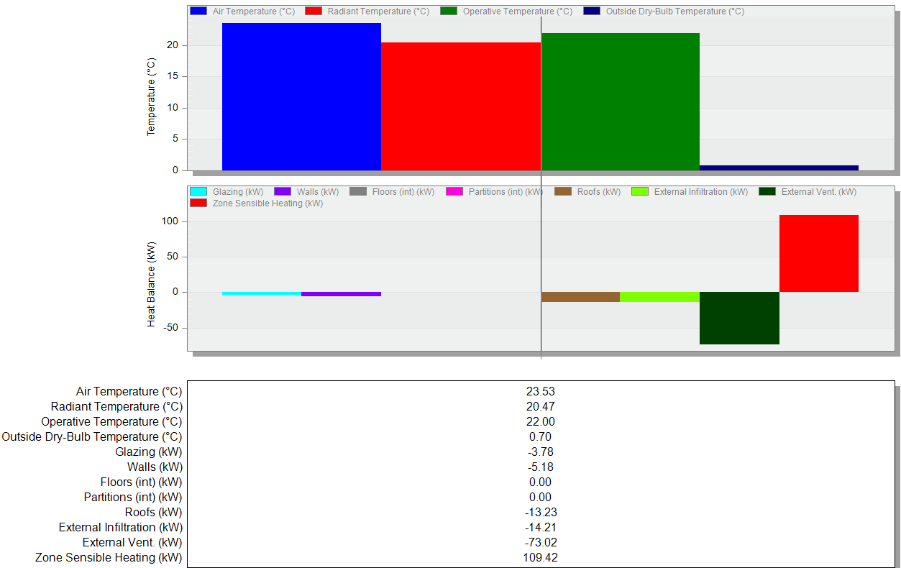
Temperature and heat loss in the art gallery
Case 1
Case 2

Slide 40

Heating and cooling loads for the art gallery
Saving 48 %
Heating load in case 2 (after modification).
Saving
64 %
Cooling load in case 2 (after modification).

Slide 41
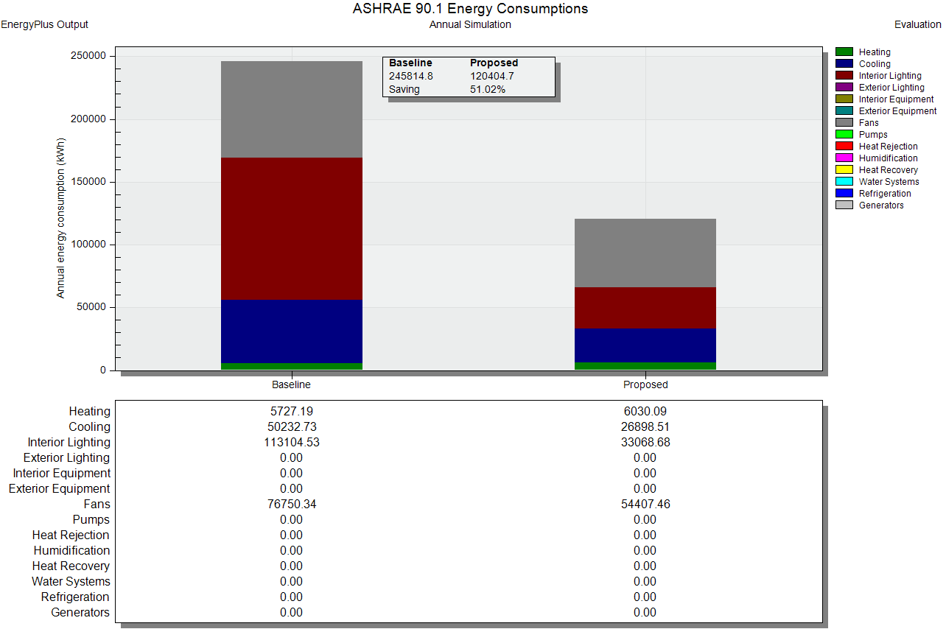


Energy consumption
(Saving 51%)
Art gallery area = 1570 m2

Slide 42
Structural aspects
05
Codes
Construction material
Structural element dimensions
Structural grid
Loads
Checks
Seismic data
Structural detailing

Slide 43
Codes
ACI-2019 for reinforced concrete structural design.
ASCE 7-2010 for loads.
UBC-97 for seismic design.

Slide 44
Construction material
Reinforced Concrete
Structural element | Compressive Strength (f’c)
Slabs and beams | Concrete 28 Mpa
Columns and shear walls | Concrete 40 Mpa
element | Yield Stress (Fy)
Steel bars | 420 Mpa

Slide 45
Structural element dimensions
Columns
Column No. | Column dimensions (m)
C1 | 0.4 x 0.4
C2 | 0.6 x 0.6
C3 | Diameter = 0.8
C4 | Diameter = 1
Beams
Beam No. | Width (m) | Depth (m)
B1 (hidden) | 0.5 | 1
B2 (drop) | 0.35 | 0.7
B3 (around openings) | 0.3 | 0.45

Slide 46

Slab section
Slab section
Long span
Voided
slab
Less load on structural
members
Lower cost

Slide 47
Loads
Design loads
Space/ element | L.L (Kn/ m2) | SID (Kn/ m2)
Parking | 6 | 2.5
Art gallery | 4 | 2.5
Stone wall | - | 6
Curtain wall | - | 0.6

Slide 48


Structural grid
(G.F - Th.F) floors
Fo.F floor

Slide 49

Typical slab Layout

Slide 50

Checks
Compatibility check

Slide 51
Checks
Equilibrium check
Equilibrium check
Load | Manual (KN) | ETABS (KN) | % Error | Check status (%error < 5%)
Dead | 200314.97 | 207648.95 | 3.5 % | OK
Live | 72528.38 | 72638.36 | 0.15 % | OK
SID | 54684.85 | 54831.59 | 0.26 % | OK

Slide 52
Checks
Deflection check for slab
Allowable limit (mm) | ETABS (mm) | Check status
46.78 | 56.25 | OK
Stress-strain check for column
Stress-strain check for columns from live loads
 | Manual (KN) | ETABS (KN) | % Error | Check status (<15%)
Edge | 891.66 | 888.55 | 0.35 % | OK
Internal | 1993.64 | 1851.71 | 7.66 % | OK
Corner | 381.48 | 336.31 | 13.43 % | OK

Slide 53


Checks
Stress-Strain Check for slab
Frame
Moment | Manual (KN.m) | ETABS (KN.m) | % Error
Negative | 854.63 | 831.53 | 2.77 %
Positive | 460.19 | 576.49 | 20.17 %
Negative | 854.63 | 790.81 | 8.07 %
Selected frame
Column strip
Moment | Manual (KN.m) | ETABS (KN.m) | % Error
Negative | 664.04 | 646.09 | 2.77 %
Positive | 350.06 | 439.28 | 20.31 %
Negative | 664.04 | 614.45 | 8.07 %
Frame dimensions
Frame width = 8.15 m
Column strip width = 3.79 m
Middle strip width = 4.46 m

Slide 54
Checks
Stress-Strain Check for slab
Middle strip
Moment | Manual (KN.m) | ETABS (KN.m) | % Error
Negative | 190.59 | 185.44 | 2.77 %
Positive | 109.53 | 137.21 | 20.17 %
Negative | 190.59 | 176.36 | 8.06 %
Stress-Strain Check for beam
Beam
Moment | Manual (KN.m) | ETABS (KN.m) | % Error
Negative | 553.14 | 491.76 | 12.48%
Positive | 292.09 | 323.68 | 9.75%
Negative | 553.14 | 520.17 | 6.33%

Slide 55

Seismic data
UBC-97 code
Response spectrum method
Structural system: Concrete intermediate moment-resisting frame (IMRF)
Zone 2B → Z = 0.2
Soil profile: Sc
Cv =0.32
Ca = 0.24
R = 5.5
I = 1

Slide 56
Seismic Checks
Period check
Check name | ETABs result | Allowable limit | Check status
Period check | 0.599 Sec | ≤ 0.646 Sec | OK
Base shear check
Load case (KN) | ETABs results | Allowable limit | Check status
Earthquake (x) | 27359.24 | ≥ 27355.20 | OK
Earthquake (y) | 27362.84 | ≥ 27355.20 | OK

Slide 57
Seismic Checks
Modal participating mass ratio check
 | ETABs results | Allowable limit | Check status
Sum (Ux) | 0.91 | ≥ 0.9 | OK
Sum (Uy) | 0.90 | ≥ 0.9 | OK
Drift check
Δ Mx max. (mm) | Δ My max. (mm) | Δ Limit (mm) | Check status
10.52 | 6.514 | 100 | OK

Slide 58

Structural detailing
Slab Reinforcement in
y-direction :

Slide 59

Structural detailing
Slab Reinforcement in
x-direction :

Slide 60

Structural detailing
Ramp Detailing:

Slide 61


Structural detailing
Column Detailing:

Slide 62




Structural detailing
Beams Detailing:
Section A-A
Section B-B
Section C-C

Slide 63

Structural detailing
Shear wall Detailing:

Slide 64


Structural detailing
Stair Detailing:

Slide 65





Electro-Mechanical ASPECTS
05
HVAC Design for Art Gallery
Artificial lighting design
Fire Fighting System
Acoustical design
Photovoltaic system design

Slide 66
HVAC Design for Art Gallery
Heating and cooling loads for the art gallery
Art gallery area = 1570 m2
Heating and cooling loads for the art gallery
Cooling load | 173.23
Heating load | 136.777
HVAC system: VRV HVAC system

Slide 67




HVAC Design for Art Gallery
Outdoor unit:
Indoor unit- fan coil:
Indoor units- slot linear Diffusers :

Slide 68

HVAC Design for Art Gallery
Distribution of fan coils and diffusers
(Art gallery area = 1570 m²).

Slide 69
Fire Fighting System
Hazard type
Alarm systems
Fire suppression

Slide 70




Fire Fighting System
Parking
“low hazard storage, group S-2”.
Hazard type
Art galleries
“Assembly Group A-3”.
Call point
Parking
Smoke detector
Alarm systems
Detectors
Art galleries
Heat detector
Flasher electronic sounder

Slide 71






Fire Fighting System
Parking
Powder extinguisher (10 B) / 50 ft (15 m)
Fire extinguishers
Art galleries
Water extinguisher (2 A) / 75 ft (22 m)
Fire suppression
Not required in open parking
Automatic sprinklers
Required in “Group A-3” 1 sprinkler/ 21 m2
Parking
Stand pipe system: Class I
Standpipe system
/150 ft (45.72 m) for areas
without sprinklers + Stair + Horiz. exits
Art galleries
Stand pipe system: Class III

Slide 72


Fire Fighting System
Fire alarm system

Slide 73

Fire Fighting System
Standpipe system

Slide 74

Fire Fighting System
Automatic sprinklers

Slide 75
Artificial lighting design
Types of Artificial lighting:
General
Accent
Task
Decorative

Slide 76



Artificial lighting design
3D lighting Modeling for the parking

Slide 77




Artificial lighting design
3D lighting Modeling for the art gallery

Slide 78

Artificial lighting design
Lighting plan

Slide 79

Acoustical design of the art gallery
Recommended reverberation time in art galleries: (0.8-1.2) sec
Actual reverberation time
= (0.81 -1.08) within allowable limit

Slide 80
Acoustical design of the art gallery
Noise control
Allowable background noise (dB) ≤ 35 dB
STC (Required)= 40 dB
Noise level from outside = 80 dB
*STC: Sound transmission class (STC) is a rating of sound isolation of a building wall assembly.

Slide 81


Acoustical design of the art gallery
STC (gallery external wall)
STC > 40 dB ok

Slide 82



Acoustical design of the art gallery
TLC (gallery ceiling)
STC (gallery ceiling)
STC (glass)

Slide 83


Photovoltaic system design
Case 1: Portrait arrangement.
Case 2: landscape arrangement.
Number of modules = 72
Number of modules = 63

Slide 84


Photovoltaic system design
Case 2: Portrait arrangement
Number of modules = 72 module
Invertor size = 33 KW
Number of Invertors = 1 invertor
Module type
Invertor type

Slide 85


Photovoltaic system
Produced energy
Initial cost

Slide 86

Photovoltaic system
Cash flow

Slide 87
THANKS

Slide 88


Slide 89


Slide 90


Slide 91


Slide 92


Slide 93


Slide 94


Slide 95
Outdoor unit:
Outdoor unit capacity | Design load | No. of outdoor units required
95.4 | 173.23 | 2 units
Indoor unit- fan coil:
Fan coil cooling capacity | Design load | No. of outdoor units required
28 | 173.23 | 7 units
Indoor units- slot linear Diffusers :
Design flow rate | 1m slot diffuser flow rate | No. of slot diffusers | Art gallery area
13.36 m³/sec | 0.094 m³/sec/m | 143 diffuser | 1570 m2

Slide 96



Slide 97


Slide 99




Slide 100



Slide 101


Slide 102




Slide 103



