Slide 1
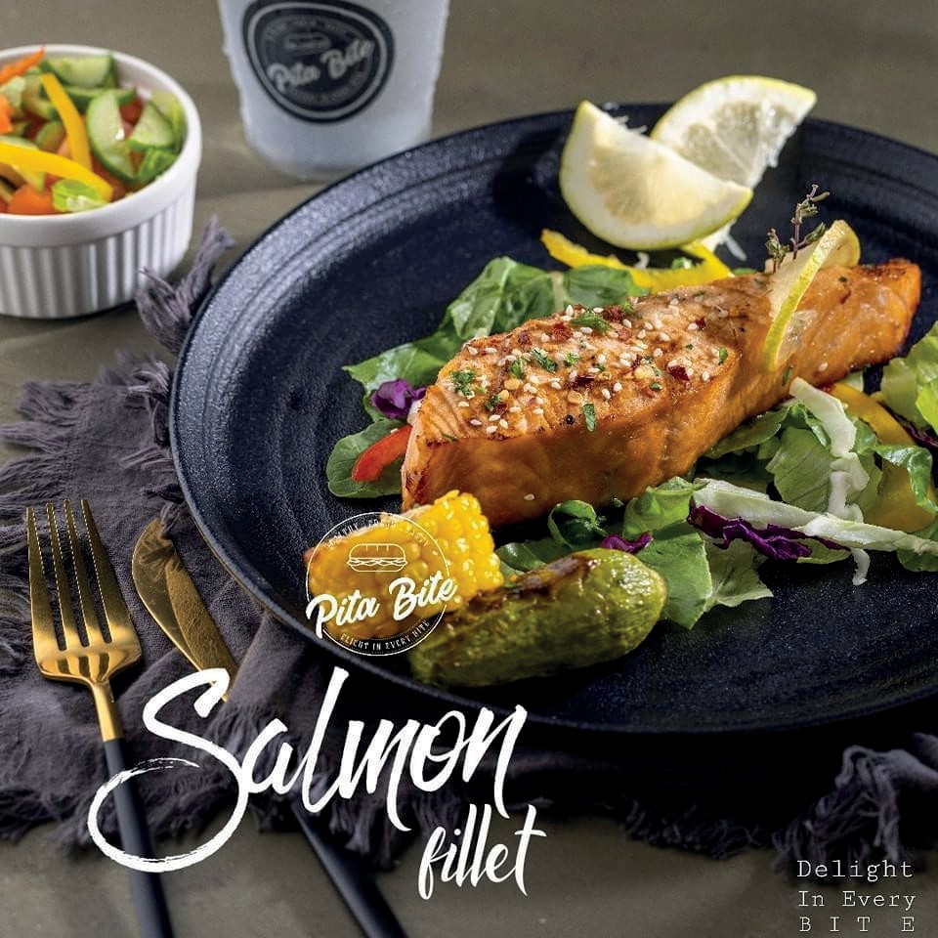
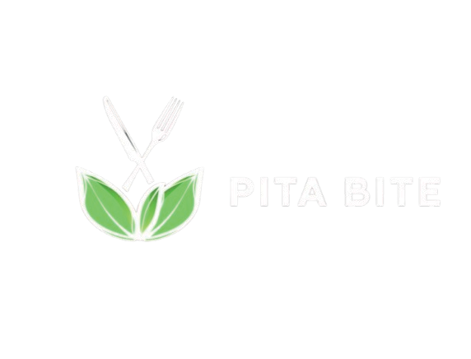
P i t a B i t e
Presented by :
Rusol Asbeh . Batool Dardouk
. Yasmin Alwani
Under the supervision of
Dr. Maher Arafat

Slide 2
Study from An-Najah University (304 students)
100
80
68%
Key student Health Concerns
percentage of students (%)
Problem Statement
60
40
20%
20
0
Weight Issues
Irregular Eating
Local study

Slide 3
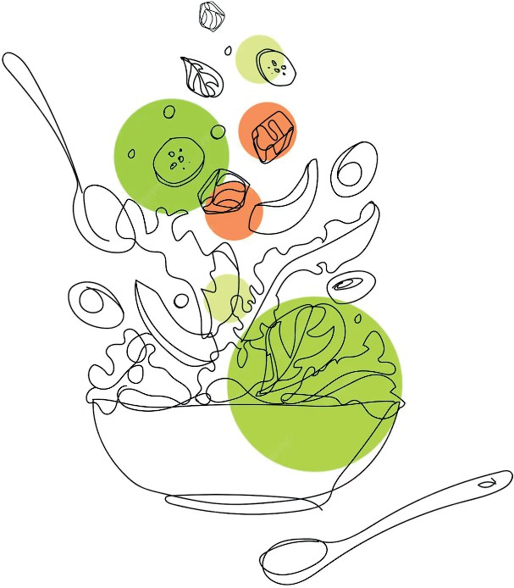
International studies
Other international studies (Texas Tech):
Many students underestimate their caloric needs
Obesity correlates with poor nutritional awareness
* This reveals a need for healthy food services that clearly communicate calorie content and nutrition .

Slide 4

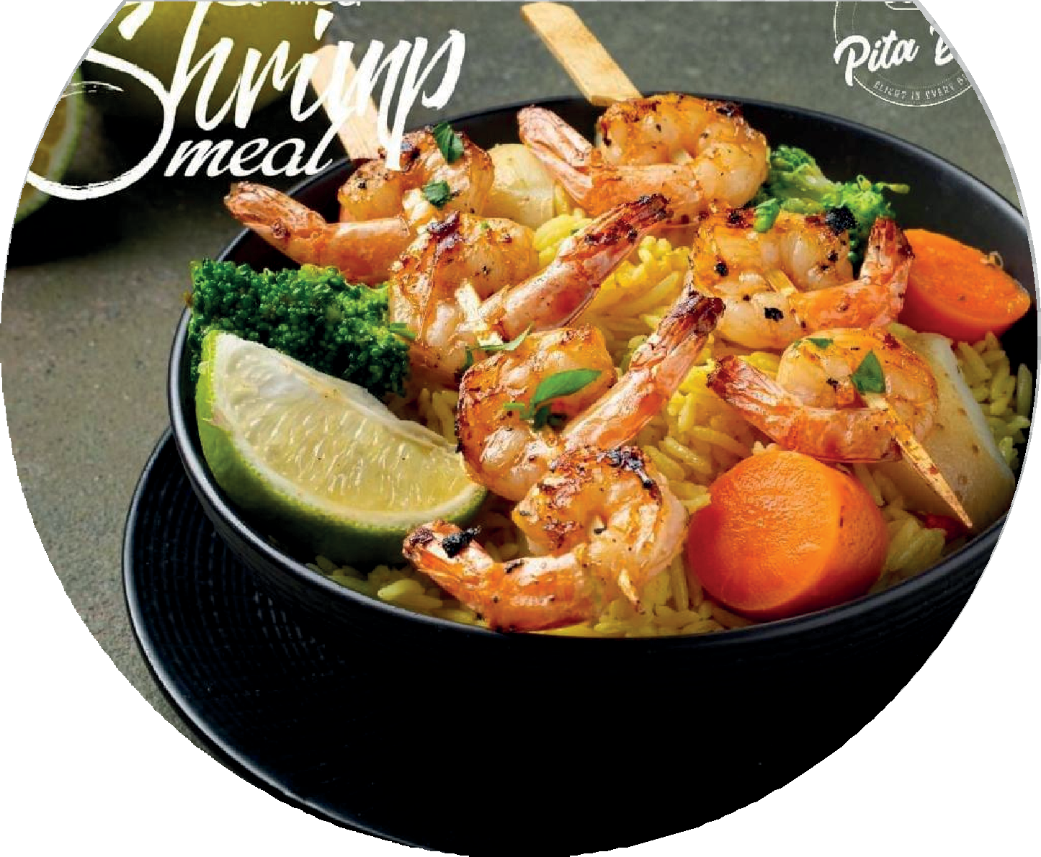



Project idea
Our solution
A website for Pita Bite that offers:
Digital browsing of meals Clear display of calories
Online ordering and order tracking Modern, responsive experience
Increase revenue

Slide 5








CMS: WordPress
for ease of use and flexibility
01
Security
SSL certificate & HTTPS protocol
02
Technical Tools
Hosting
trusted hosted provieder
03
Backups
Daily backups via FTP and plugins
04
Chatbot Integration
05
A chatbot was developed using the Dialogflow ES platform.

Slide 6

Project Objectives
. Develop an online platform for ordering healthy meals easily.
. Provide a filter based on nutritional values.
. Enable order tracking from placement to delivery.
. Display calorie information for each meal.
. Integrate a smart chatbot for instant customer support.
. Enhance user experience with a simple and seamless design.

Slide 7




Project Scope
. Market Study: Surveyed healthy food restaurants in Nablus
. Partner Selection: Chose Pita Bite and coordinated with management
. Data Collection:
Site visits
Interviews with staff
Menu analysis for digital conversion

Slide 8


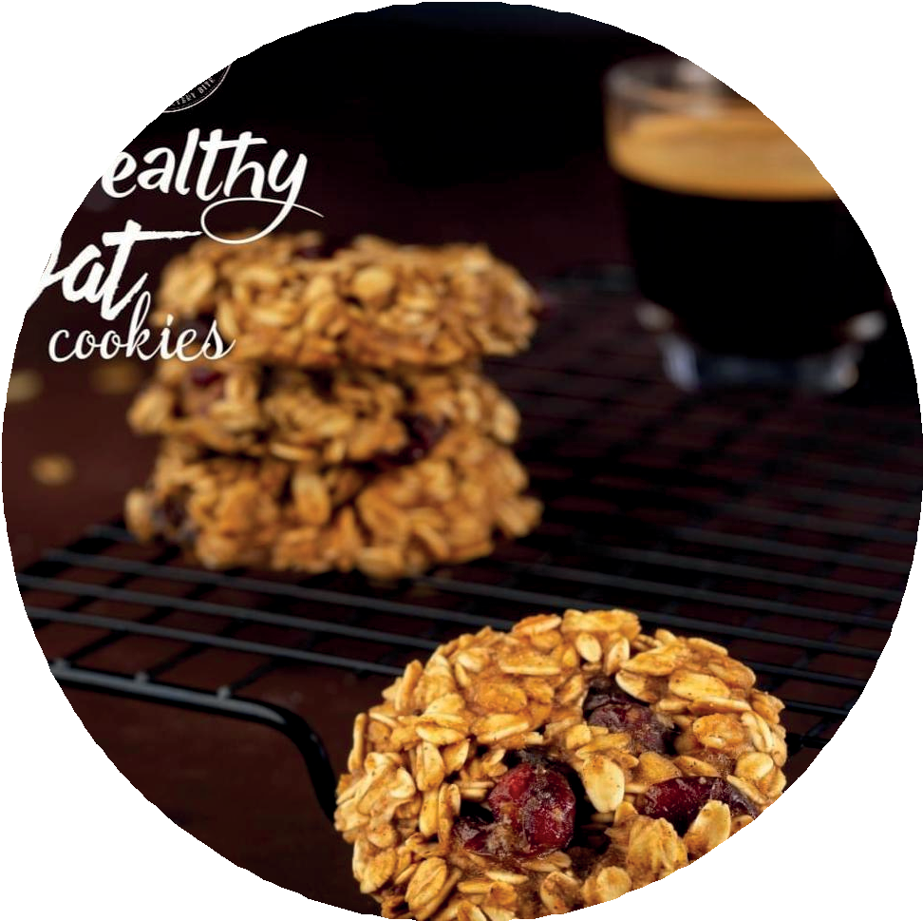
Design Choices
Design Principles:
User-friendly and fast. Consistent with brand identity. SEO-optimized.
Fully responsive.
Color Scheme:
Green as the main color to represent health, trust, and freshness.

Slide 9
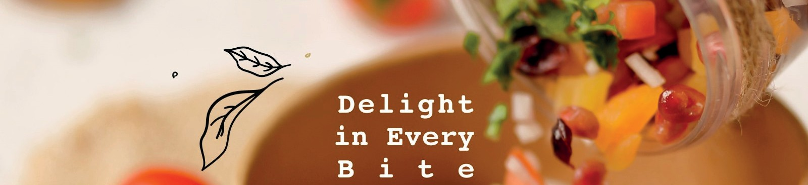
Functional Requirements
View menu with nutritional details.
Submit your order and track its status.
Add products to cart.
Use a chatbot to answer questions.

Slide 10
Non-Functional Requirements
Speed: Load time 1.5 seconds
Usability: Simple and intuitive design
Stability: No unexpected crashes
Maintainability: Easy to update and modify

Slide 11
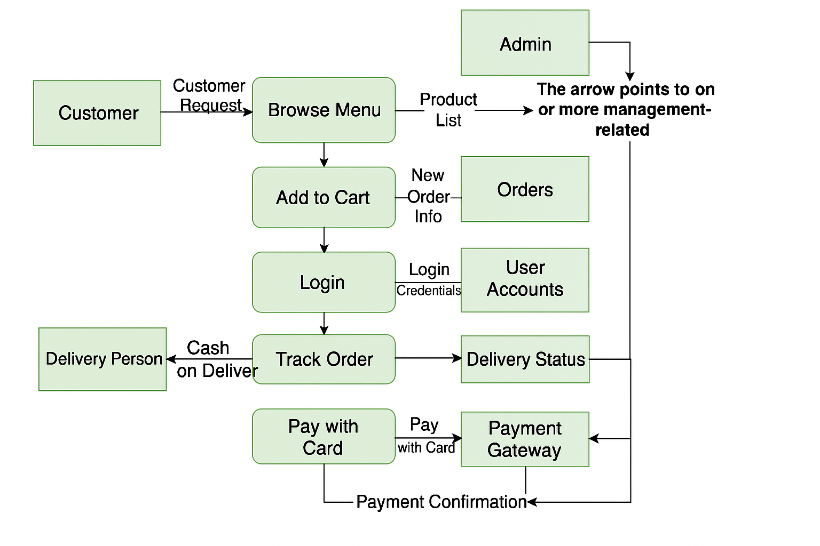
Data Flow Diagram for Pita Bite

Slide 12
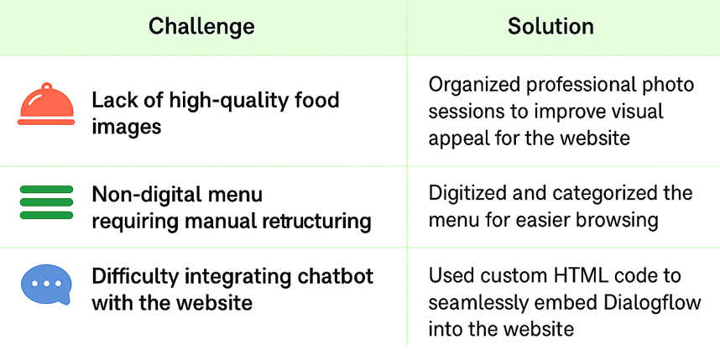






Key Challenges and Solutions

Slide 13
Future Plans
Launch a mobile app for easier access.
Upgrade chatbot intelligence.
Apply data mining for better decisions and marketing.

Slide 14

Thanks!!
website showcase

