Slide 1

Faculty of Engineering
Building Engineering Department
Design for office building
(Sudah Center)
(Graduation Project 2)
Supervisor : Dr.Muhnnad Haj Hussein
Ahmad Younis Yazan Kalbouneh Yousef Omar

Slide 2
Presentation outline :
1.Introduction
7.Electrical Design
2.Earlier Studies
5.Environmental Design
8.Quantity & Cost Estimation
4.Structural Design
3.Architectural Design
6.Mechanical Design

Slide 3
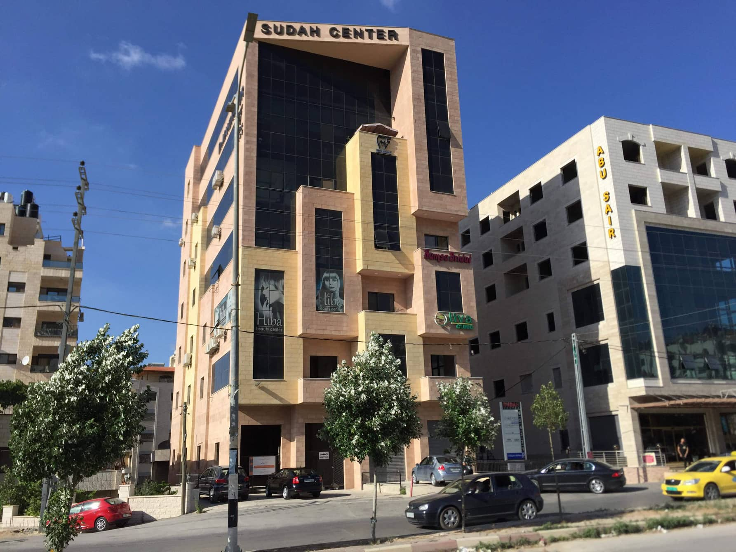

Slide 4
1.
Introduction
Let’s start with the first set of slides

Slide 5
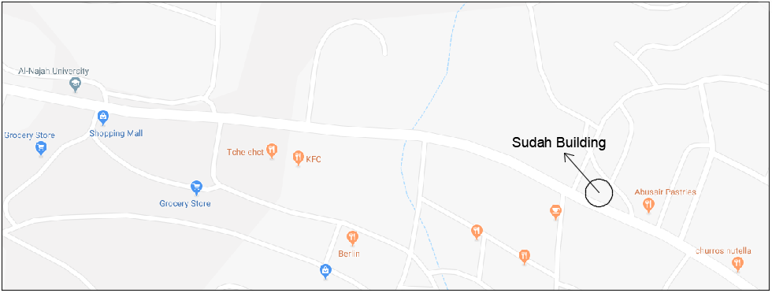
Site And Location
It’s located in Main Street of Rafedea near to Al-Jnaid Prison Nablus-Palestine.

Slide 6
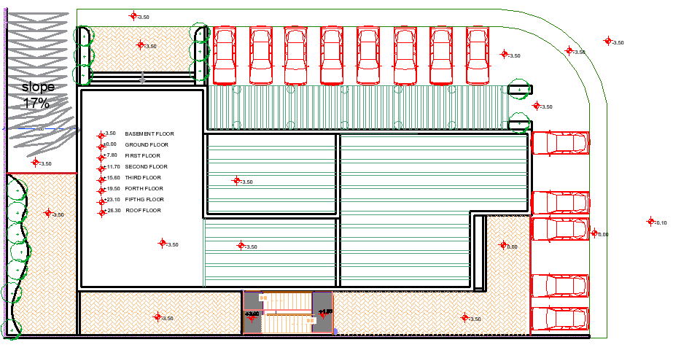
Site And Location
-Site has a total area of 760 m².
-Serviceable main street width equals 30m.

Slide 7
Site Pros and Cons.
Pros.
-Good Southern view.
Good solar gain form the south.
Its located near to Al Najah University which is good to transportation.
Cons.
The main elevation of the building is facing south.
-The site is blocked from east & north.
Has a high surrounding noise

Slide 8
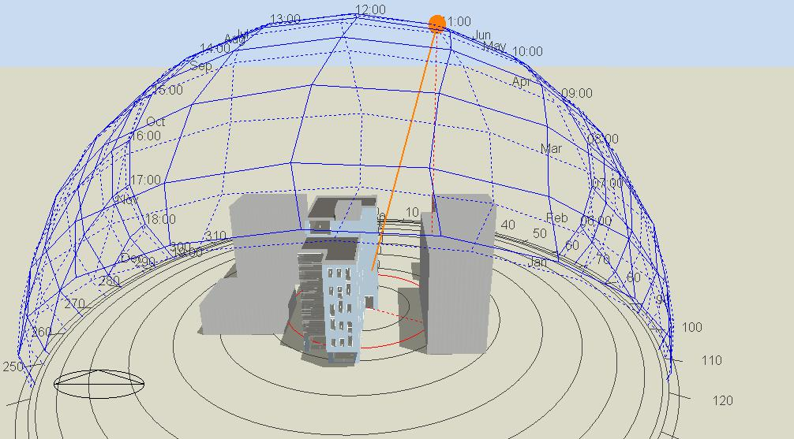
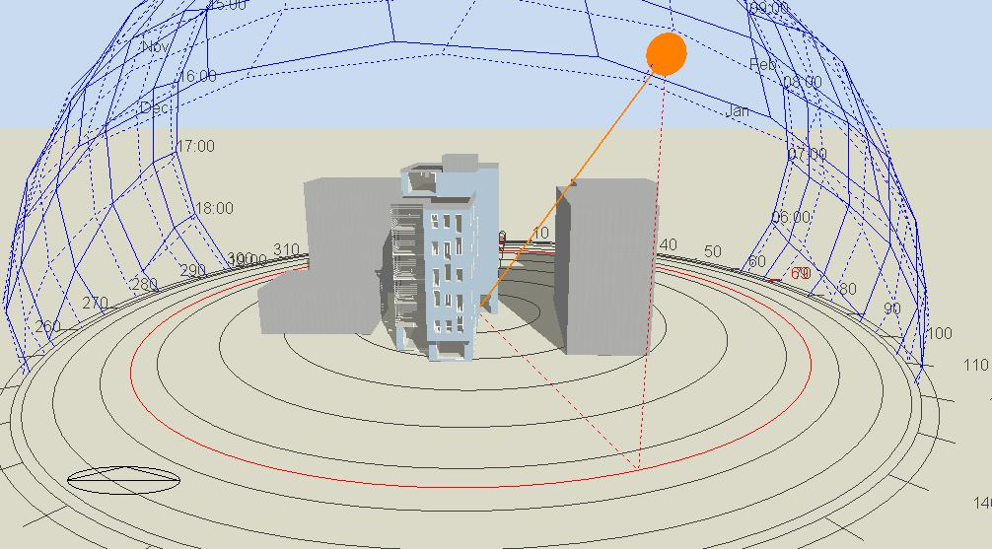
2. Earlier Studies:
2.1 Solar Analysis
In a Summer Day:
√ The Site is fully exposed to sun.
In a Winter Day:
√ in the morning hours the site is shaded,
√ in the midday, it is fully exposed to sun.

Slide 9
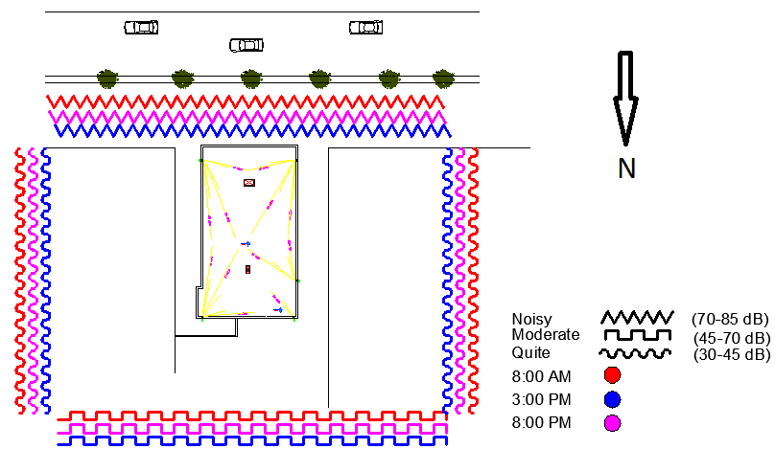
2.2 Noise Analysis
Highest value exceed 80 dB due to Rafedea street .

Slide 10
3.
Architectural
Re-design

Slide 11
Usage of the building:
The building is an office building.
Normal Working hours for the offices from 8:00 am to 3:00 pm.
Used by 13 offices , 3 shops and a restaurant .

Slide 12
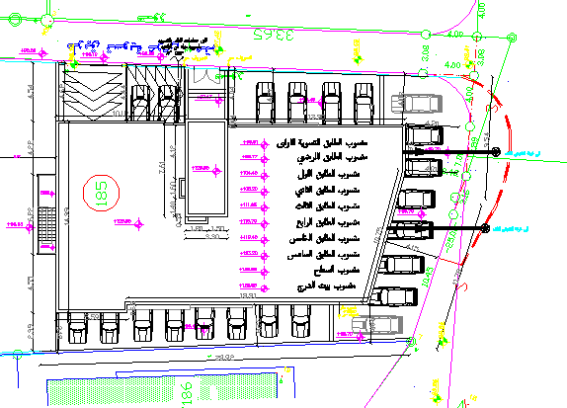
Existing Site:
Redesigned Site:

Slide 13
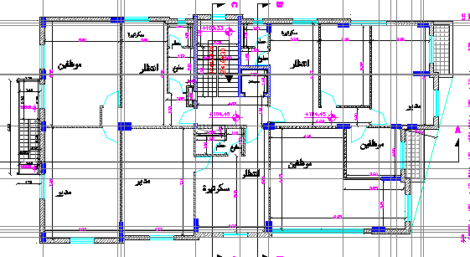
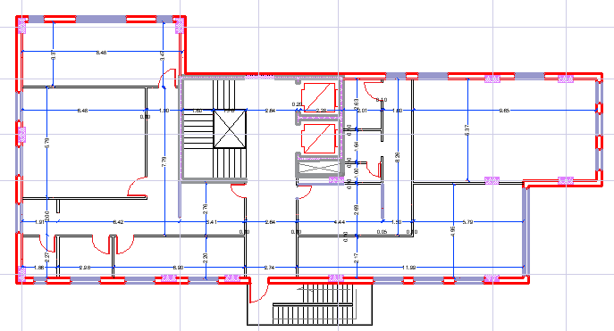
Old Design Plans:
First Floor:
New Design:

Slide 14
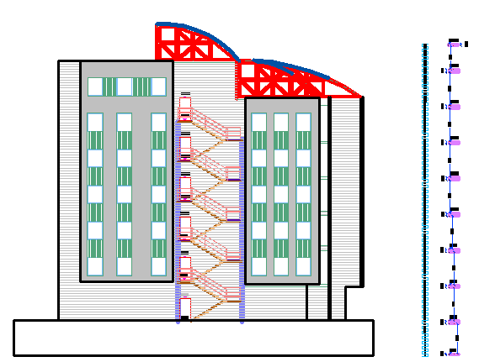
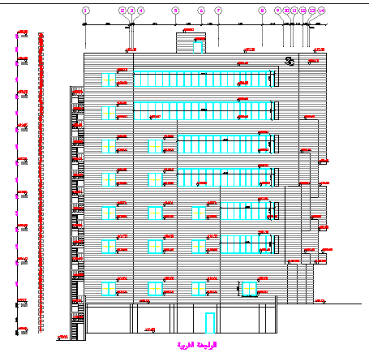
Old Design West
Elevation
New Design West
Elevation

Slide 15
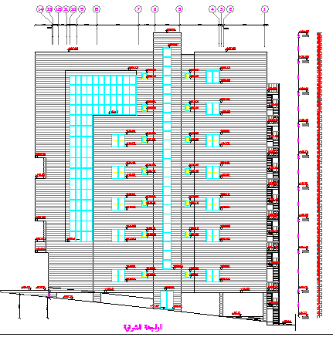
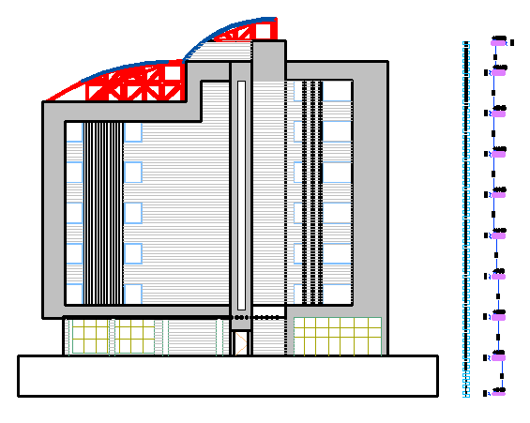
Old Design East
Elevation
New Design East
Elevation

Slide 16
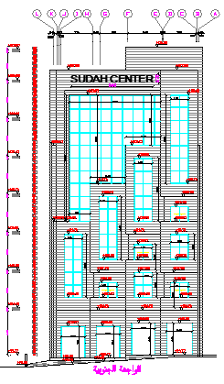
Old Design main
Elevation
New Design main
Elevation

Slide 17
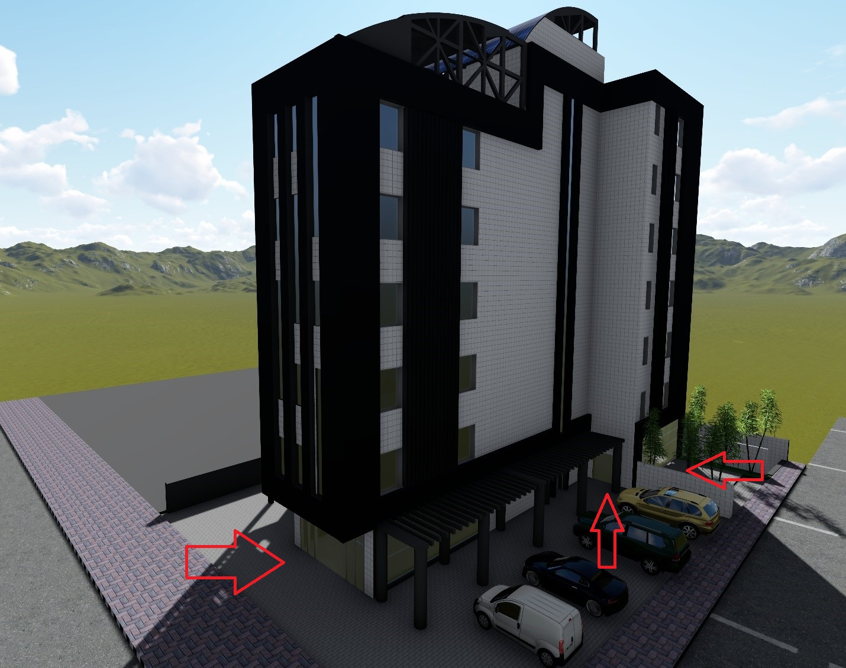
Design Modifications:
1- Entrances :

Slide 18
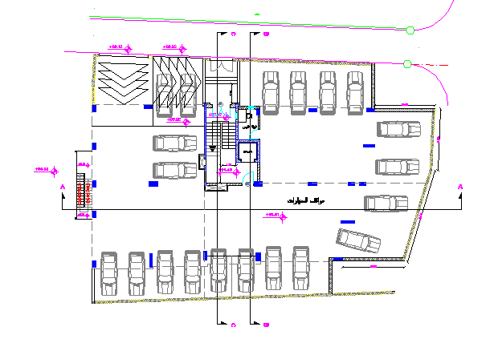
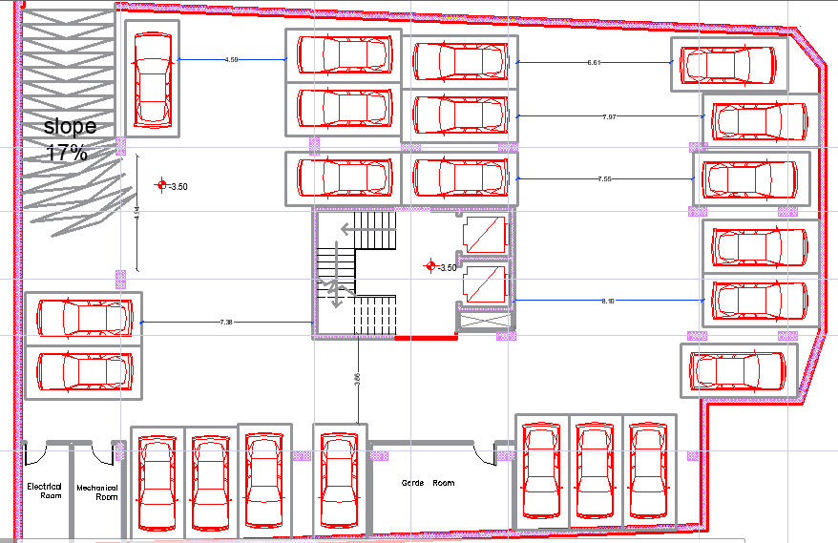
Design Modifications:
2- Parking :
Old Parking Design:
New Design:

Slide 19
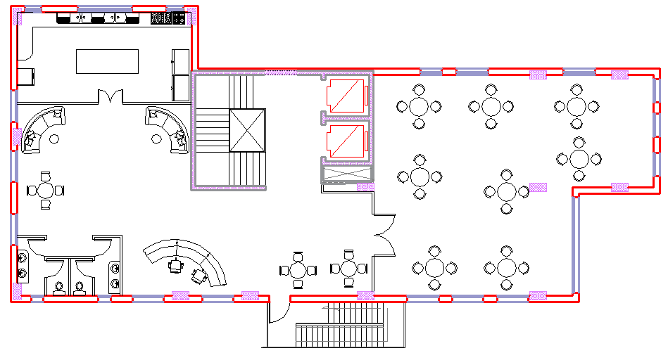
Design Modifications:
Restaurant:
Larger space and facilities.
External terrace is provided.

Slide 20
Architectural plans (GF) :

Slide 21
Architectural plans (First Floor):

Slide 22
Table of Areas :
Floor | Total Area(m2)
Basement one | 755
Ground Floor | 313
First Floor | 346
Second Floor | 346
Third Floor | 346
Fourth Floor | 346
Fifth Floor | 346
Sixth Floor | 346
Sum | 3144

Slide 23
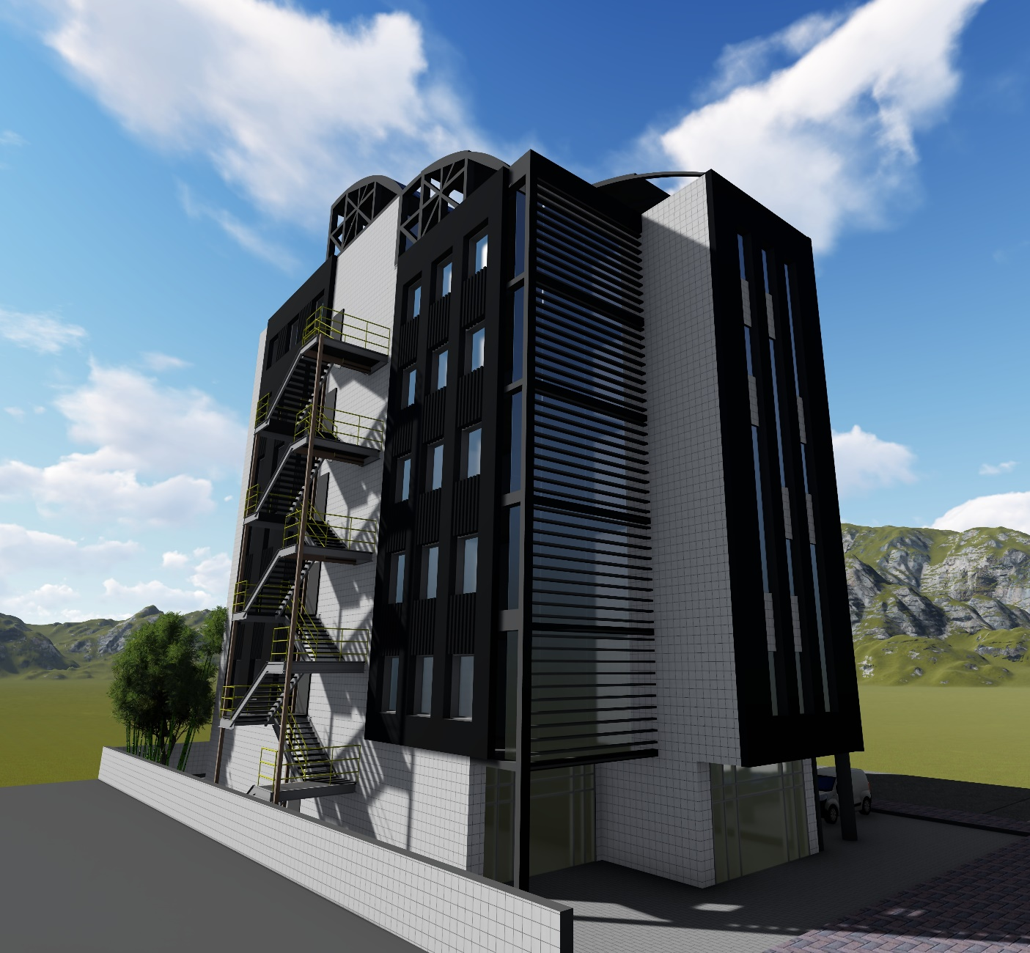
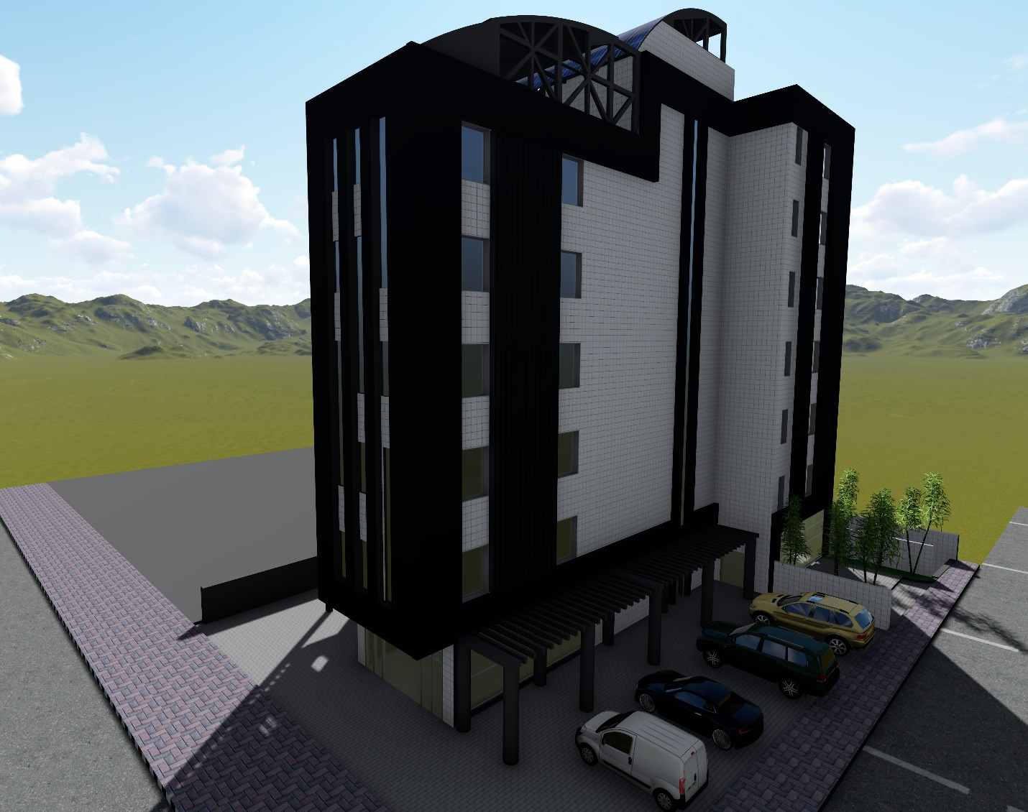
Final Design Photos:

Slide 24
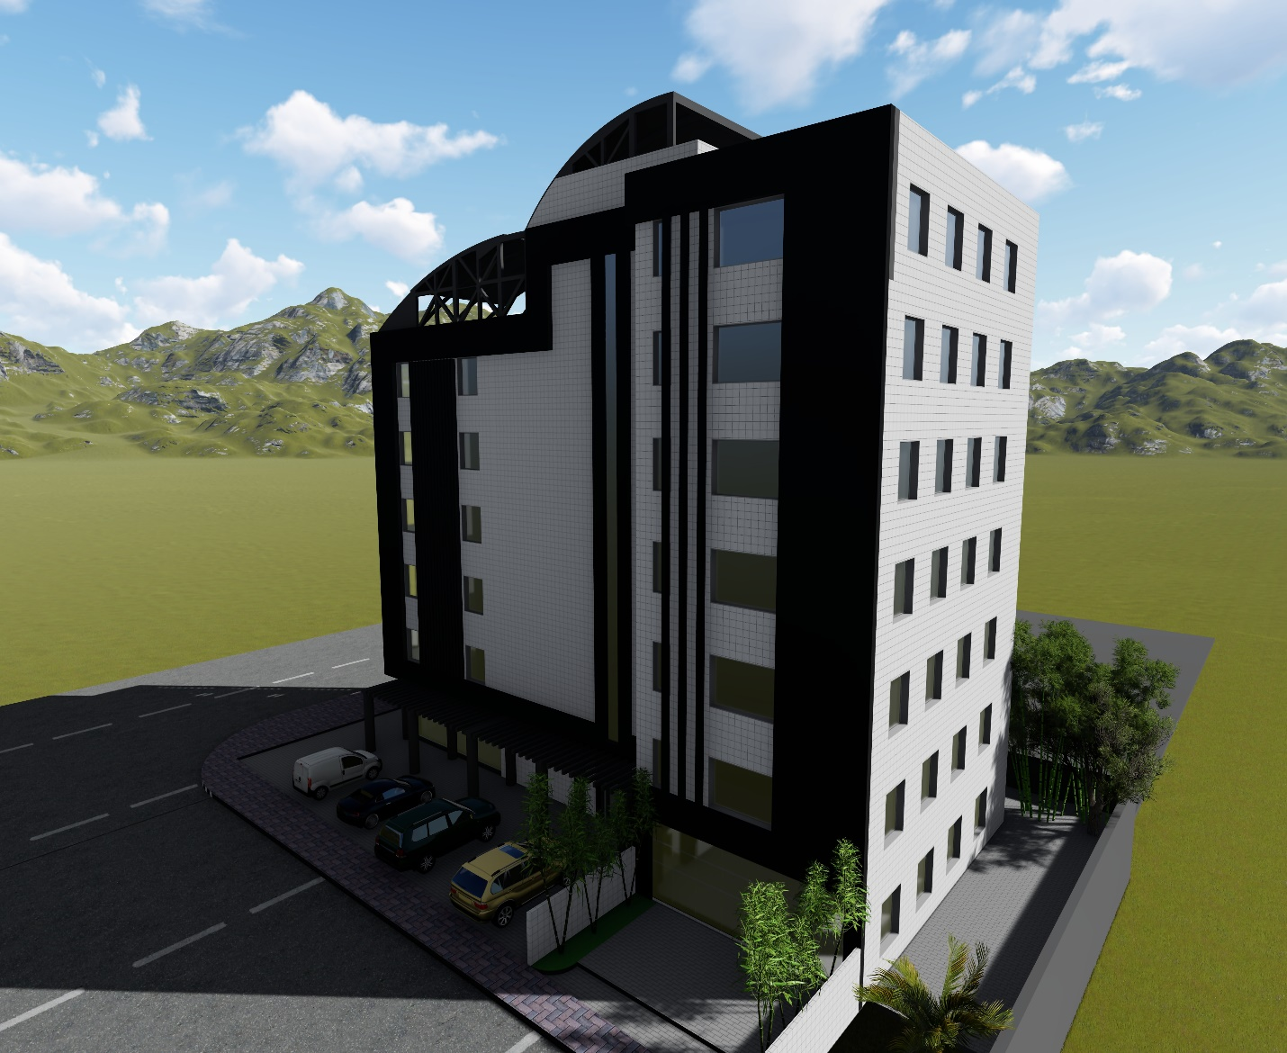
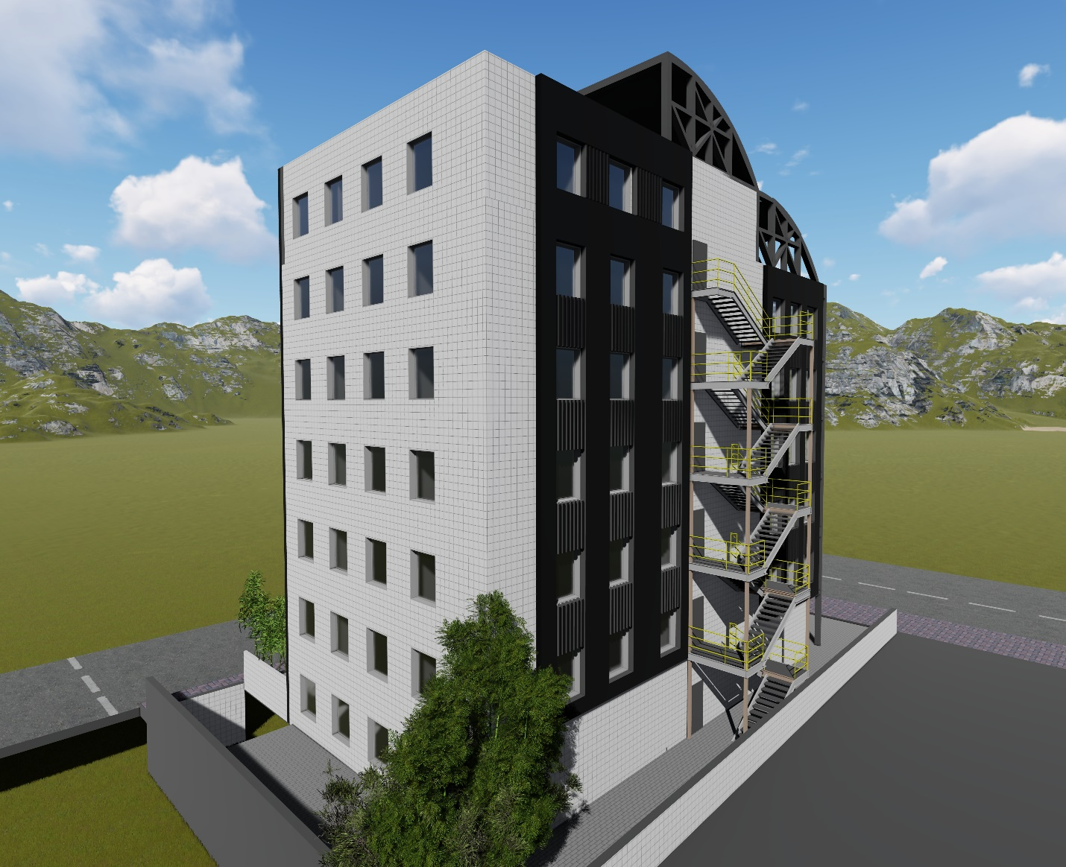
Final Design Photos:

Slide 25
4. Structural Design

Slide 26
Design Codes
ACI -318-08 (American Concrete Institution) for reinforced concrete structural design.
UBC-97 (Uniform Building Code) for earthquake load computations.
ASCE (American Society Of Civil Engineers) for design loads.

Slide 27
Building Description
Consists of 8 Floors (Including Basement).

Slide 28
Reinforced Concrete Compressive Strength (fc’)
Structural Item | Compressive Strength
Slab, Beams & cantilever walls | (B300)
Columns, walls & Foundations | (B300)
Blinding | (B250)

Slide 29
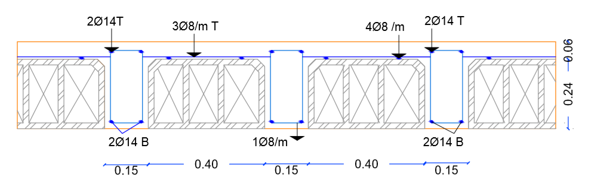
Structural System
Beam Girder System.
The system of the slab is one way ribbed slab(30 cm thickness) with Drop beams.

Slide 30
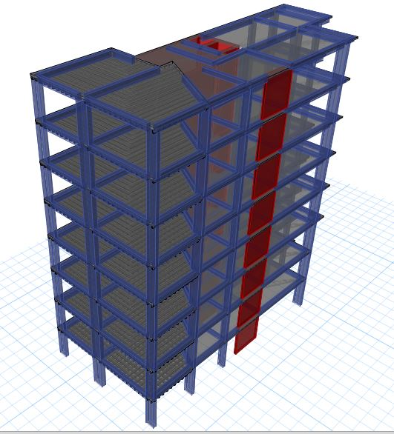
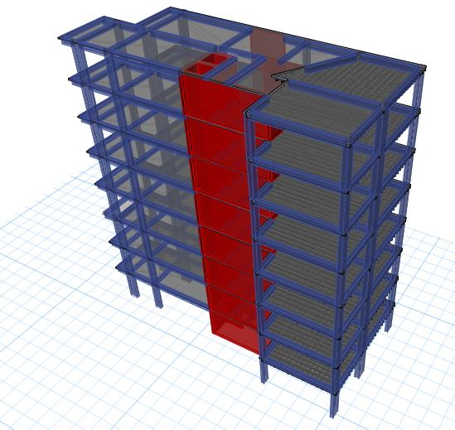
Building Modeling:

Slide 31
Program Input:
Loads:
Type of load | Load KN/m²
Live load | 4
Super imposed dead load | 4
Exterior walls | 25 KN/m
Modifiers:
Structural Item | Modifier
Beams | 0.35
Slabs | 0.25
Walls | 0.70

Slide 32
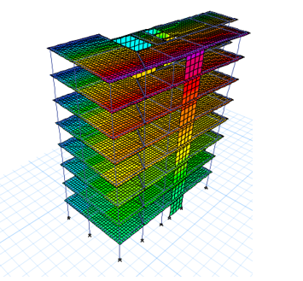
Model Validation Checks :
Compatibility Check :

Slide 33
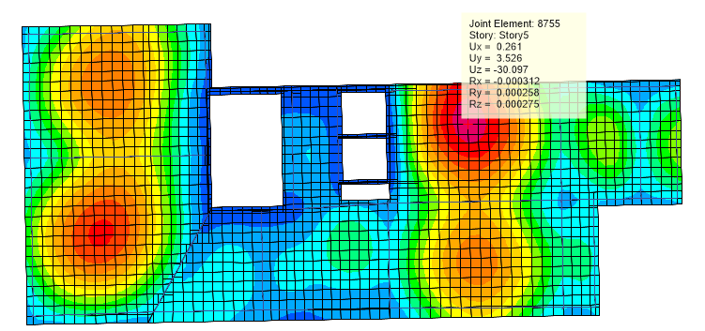
Model Validation Checks :
Deflection Check:
Deflection Doesn’t exceed the limitation.

Slide 34
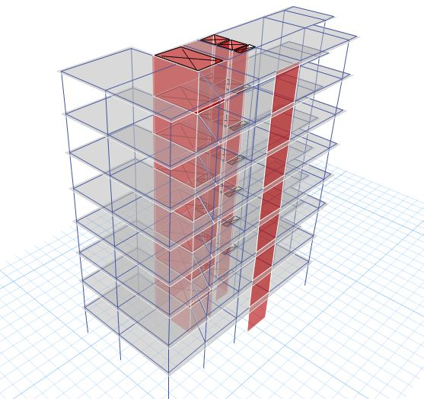
Model Validation Checks :
Base reaction (Equilibrium) Check :
Load | Manual | ETABS | Error
Dead load | 22250 KN | 22262 KN | 0.01 %
Live load | 10006 KN | 10012 KN | 0.01 %
Super imposed | 30954 KN | 30825 KN | 0.01 %

Slide 35
Model Validation Checks :
Internal Forces Check :
Done for 2 samples of slab strip, beams and columns within difference less than 10%

Slide 36
Period Check:
T(A) for building = 0.66 sec with 40% increase = 0.92 sec.
T(Bx) = 0.89 sec , T(By) = 0.52 sec
The period is OK.

Slide 37
Base Shear Check:
Total weight of building = 55589 kN ‘D+0.25 L’
Load Case/Combo | FX | FY
 | kN | kN
EQX Max | 2223 | 877
EQY Max | 1552 | 3909

Slide 38
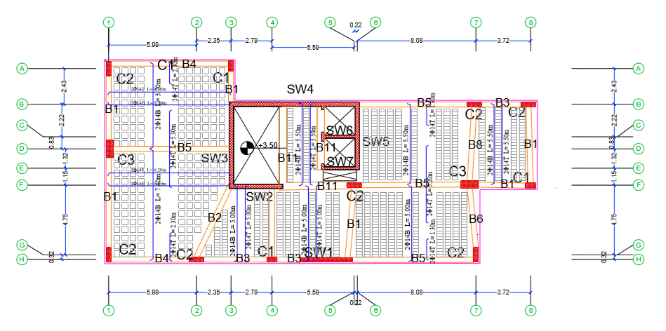
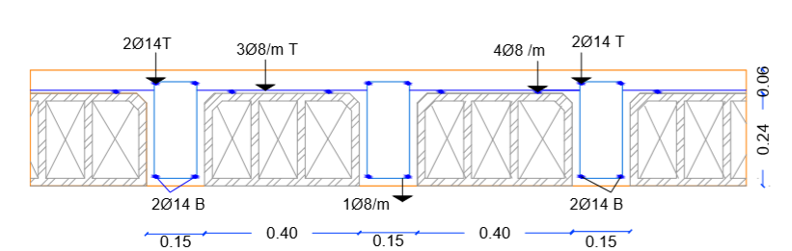
Slab Design

Slide 39
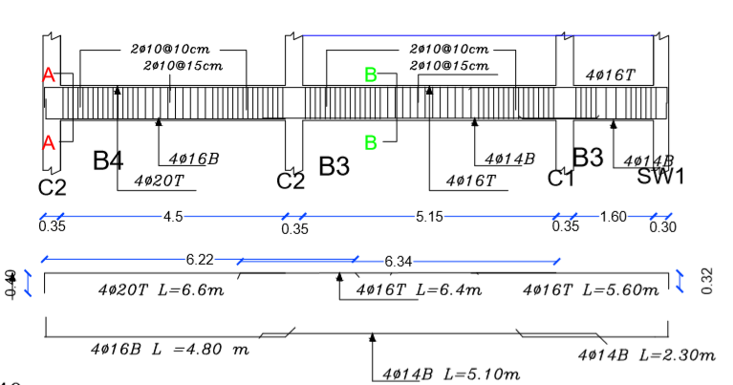
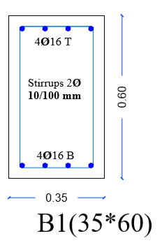
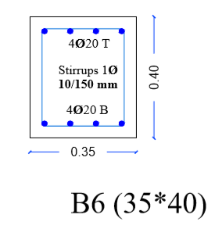
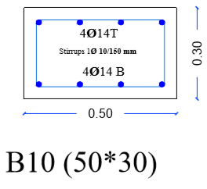
Beams Design

Slide 40
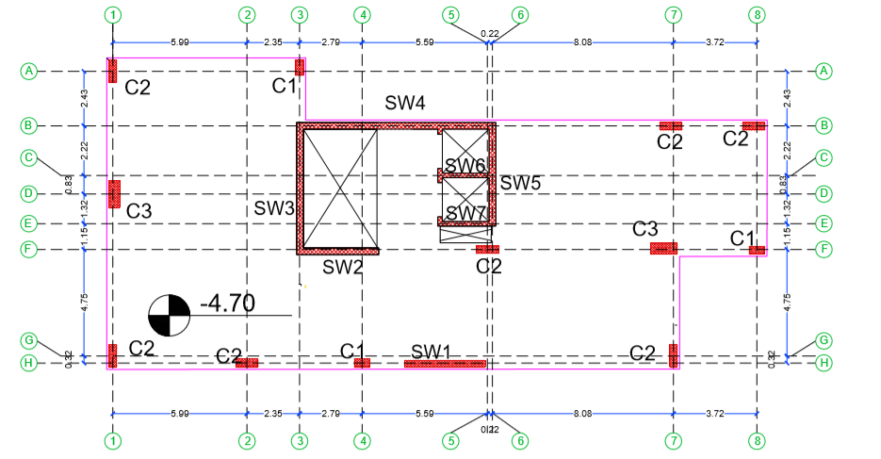
Columns Design

Slide 41
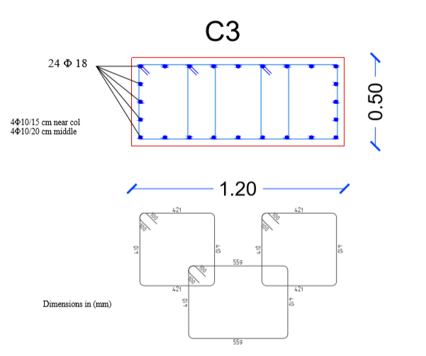
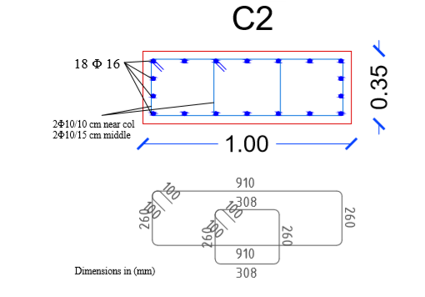
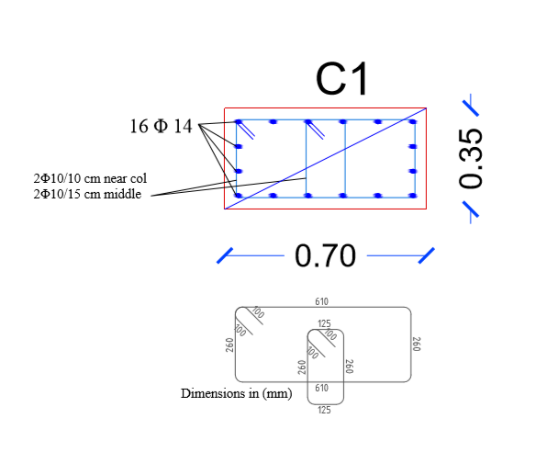
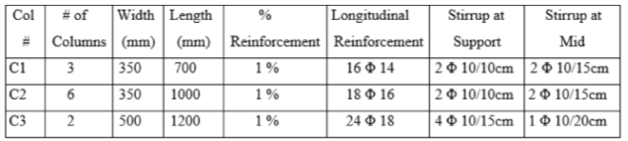
Columns Design

Slide 42
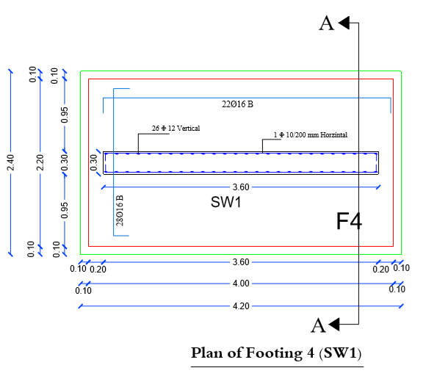
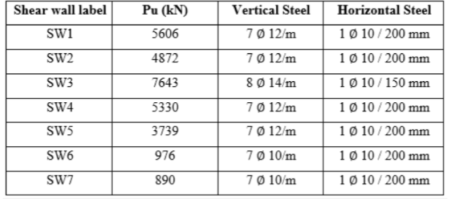
Shear Wall Design

Slide 43
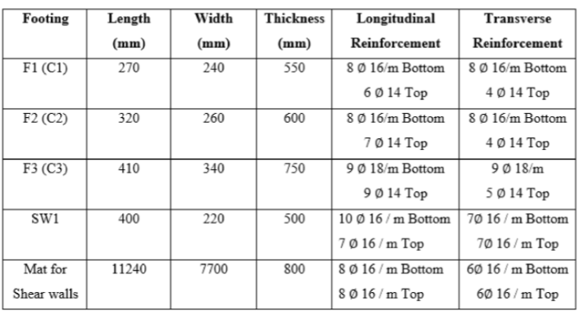
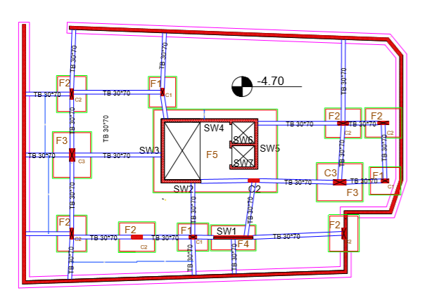
Footing Layout:

Slide 44
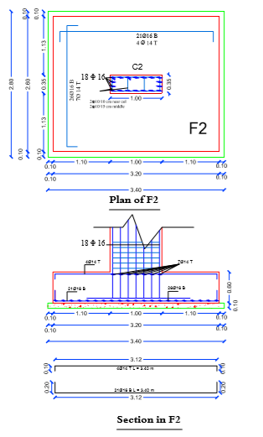
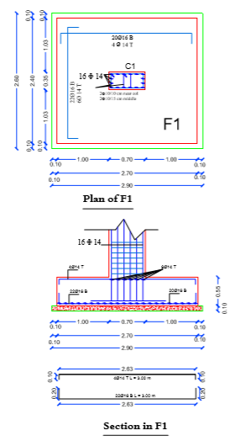
Footing Layout:

Slide 45
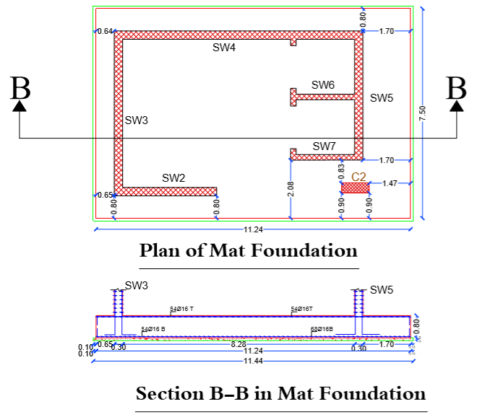
Footing Layout:

Slide 46
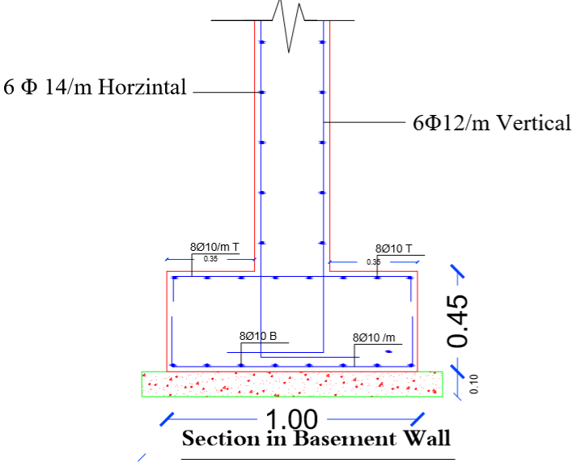
Basement Reinforcement

Slide 47
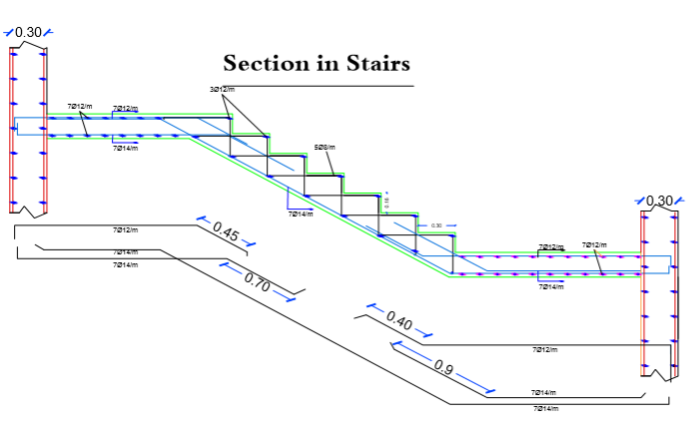
Stairs Reinforcement

Slide 48
5.
Environmental Design
College building Concrete Skeleton

Slide 49
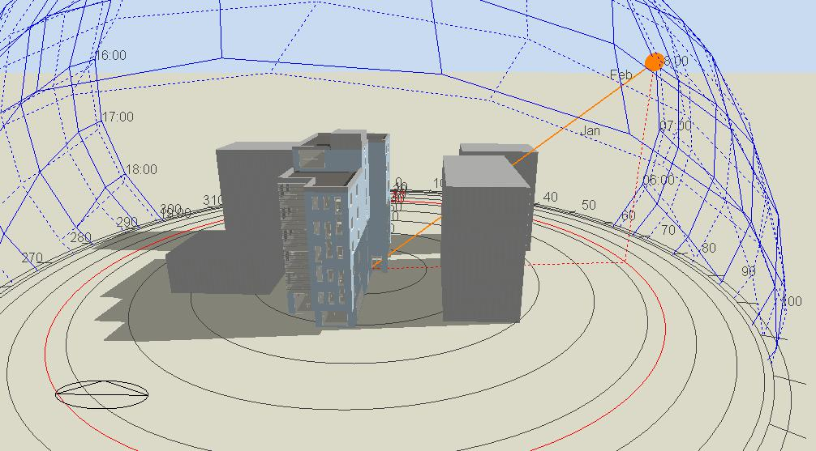
Solar Analysis
In a Summer day:
Building Shadow at 8:00 am on 21th July
Building Shadow at 12:00 pm on 21th July

Slide 50
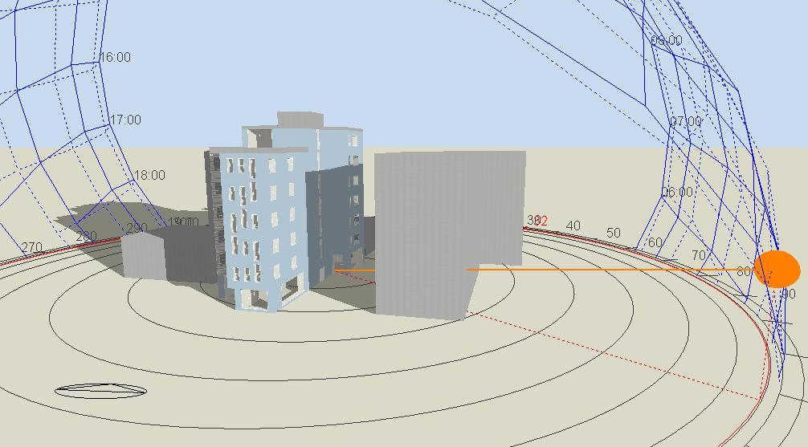
Solar Analysis
In A Winter day:
Building Shadow at 8:00 am on 21th January
Building Shadow at 12:00 pm on 21th January

Slide 51



Solar Analysis
Daylight factor & Shading:
Daylight Factor exceeds limit
Louvers or steel covering

Slide 52


Environmental design:
Heating and cooling calculations:
U-value Improvements:
Part | U value before (W/m².K) | U value after (W/m².K)
External walls | 1.16 | 0.52
Roof | 1.7 | 0.491
Window | 2.1 | 1.96
External wall section
Roof Section

Slide 53

Heating and Cooling Load
Total Heating Capacity = 111 kW
Total Cooling Capacity = 125 kW

Slide 54

Thermal Comfort
PMV Set

Slide 55

Energy Consumption
Total site energy =150 Kwh/ m2

Slide 56

Acoustical analysis (RT60):
- Classroom:
Acceptable range for Classrooms= (0.6-0.8) sec .
- Before(empty space) :
RT60 at 500 Hz=1.84 s
RT60 at 1000 Hz=1.90 s
RT60 at 125 Hz=1.28 s
RT60 at 250 Hz=1.37 s
- After(empty space):
RT60 at 500 Hz=0.70 s
RT60 at 1000 Hz=0.61 s
RT60 at 250 Hz=0.60 s
RT60 at 125 Hz=0.64 s

Slide 57


Acoustical analysis (RT60):
- Library:
Acceptable range for Libraries = (0.55-0.95) sec .
- Case : (empty space)
RT60 at 125 Hz=0.65 s
RT60 at 250 Hz=0.59 s
RT60 at 500 Hz=0.69 s
RT60 at 1000 Hz=0.63 s
RT60 at 2000 Hz=0.60 s

Slide 58



Acoustical analysis (RT60):
- Auditorium:
Acceptable range for Auditoriums= (0.80-1.20) sec .
- Case : (empty space)
RT60 at 125 Hz=1.0 s
RT60 at 250 Hz=0.89 s
RT60 at 500 Hz=0.93 s
RT60 at 1000 Hz=0.80 s
RT60 at 2000 Hz=0.68 s
Statistical Reverberation time curves
RT60 at 4000 Hz=0.56 s
RT60 at 8000 Hz=0.57 s

Slide 59


Acoustical analysis (STC):
- Classrooms:
STC shall be >40 dB to avoid unwanted noise in space
STC =45 dB

Slide 60



Acoustical analysis (STC):
- Library:
STC shall equal from45-55 dB or higher to avoid unwanted noise in space
STC =45 dB
Wall layers

Slide 61

Acoustical analysis (STC):
- Auditorium:
STC shall equal 50 dB or higher to avoid noise traveling to adjacent spaces.
STC =51 dB

Slide 62


Acoustical analysis (IIC):
Concrete Slab
IIC =34 dB

Slide 63


Loudspeakers :
For Corridors
PRO-180RPC In-ceiling speaker
Speakers Distribution

Slide 64


Loudspeakers :
For Auditorium
Ci3160RL-THX Ultra 2 certified in wall speakers.
Ecotect Model for Auditorium

Slide 65

Loudspeakers :
For Auditorium
In wall Speakers Distribution

Slide 66

Loudspeakers :
For Auditorium
Ceiling Small Speakers Distribution

Slide 67
6.
Mechanical Design
College building Concrete Skeleton

Slide 68
Mechanical Design Includes:
1.Water Supply Systems.
2. Drainage Water Systems Design.
3. HVAC system.

Slide 69


Water Supply SYSTEM:
First Floors

Slide 70

Water Supply SYSTEM:
Water Tanks:
Vertical = steel pipe
Horizontal = UPVC pipe
Branch = UPVC pipe

Slide 71


Drainage Systems design:
First Floor Toilets

Slide 72
HVAC System Design:
VRF System
Air flow (L/S) | Design capacity Cooling (Kw) | Design capacity Heating (Kw)
Varies from a space to another | 125 | 111 | All floors

Slide 73


HVAC System Design:
VRF System
Outdoor selected from LG company and its capacity
Outdoor unit capacity
Cooling capacity = 112 kw
Heating capacity = 126 kw

Slide 74


HVAC System Design:
VRF System
Fan coil selection ,which is depending on volumetric flow rate in each zone

Slide 75

First floor HVAC (duct) system layout

Slide 76
7.
Electrical Design

Slide 77



Artificial Lighting:
- Manager office :
Lamp used: Philips Lighting (RC132V)
Power: 34 watt
Power Efficacy: 90lm/W, 110lm/W
CRI >80; CCT: 4000/6500K
Lighting level : 500 lux
Mounting height: 3.2 m
E.avg and U0 are accepted.

Slide 78


- Manager office :
Area of calculation for UGR
From the figures shown before the UGR is accepted (< 19)

Slide 79

Artificial Lighting:
Employee office:
Lamp used: Philips Lighting (RC132V)
Power: 34 watt
Power Efficacy: 90lm/W, 110lm/W
CRI >80; CCT: 4000/6500K
Lighting level : 500 lux
Mounting height: 3.2 m
E.avg and U0 are accepted.

Slide 80


Employee office 3D:
Maneger office 3D:

Slide 81

Artificial Lighting:
Lighting luminaries layout offices floor:

Slide 82
Distribution of sockets:

Slide 83
8.
Quantity and Cost Estimation
College building Concrete Skeleton

Slide 84
B.O.Q :
Final BOQ
Item | Descriptions | Total (NIS)
Bill No.1 | Earth work | 291,036
Bill No.2 | Structural work | 2,298,876
Bill No.3 | Finishing work | 283,167
Bill No.4 | Mechanical | 1,138,578
Bill No.5 | Electrical | 307,395
Grand Total (NIS) |  | 4,319,050
The total area for building = 3145 m2
The total cost of the project is = 4,319,050 NIS
The unit cost for the project = 1374 NIS/m²

Slide 85
9.
Safety Considerations
College building Concrete Skeleton

Slide 86

-Emergency Stair Case:

Slide 87

-Fire Detectors (Flame Detectors):

Slide 88

-Fire Detectors (Smoke Detectors):

Slide 89

Restaurant Smoke Detectors:

Slide 90

-Evacuation Paths
Office Floor

Slide 91

-Evacuation Paths
Restaurant Floor

Slide 92
THANK YOU !

