Slide 1

Study of Smart Warehouse Management System based on IoT
Submitted by:
Balsam Abdelrazeq
Moreed Jabaji
Nidal Karsou
Hana Haqash
Yasmeen Nabulsi
Supervisor:
Dr. Muawia Ramadan

Slide 2
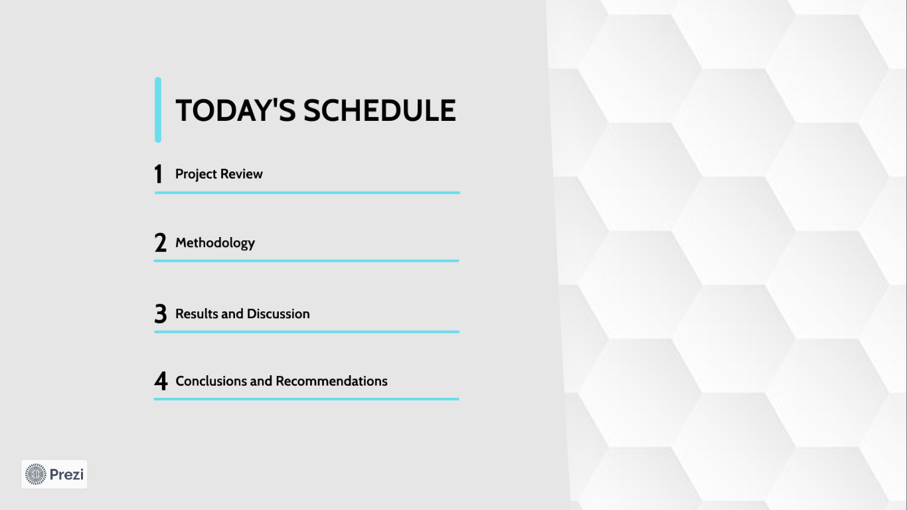

Slide 3
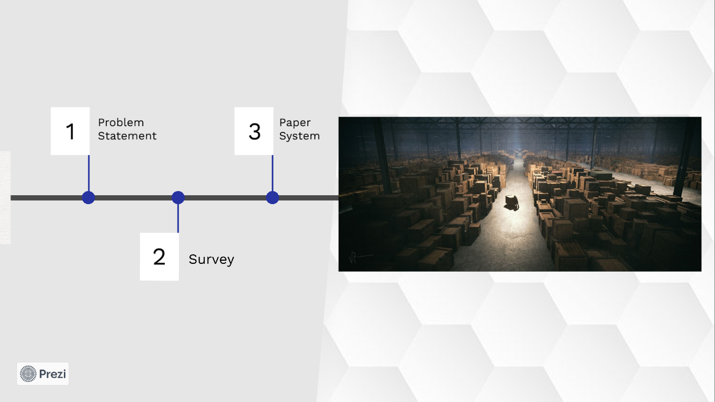

Slide 4
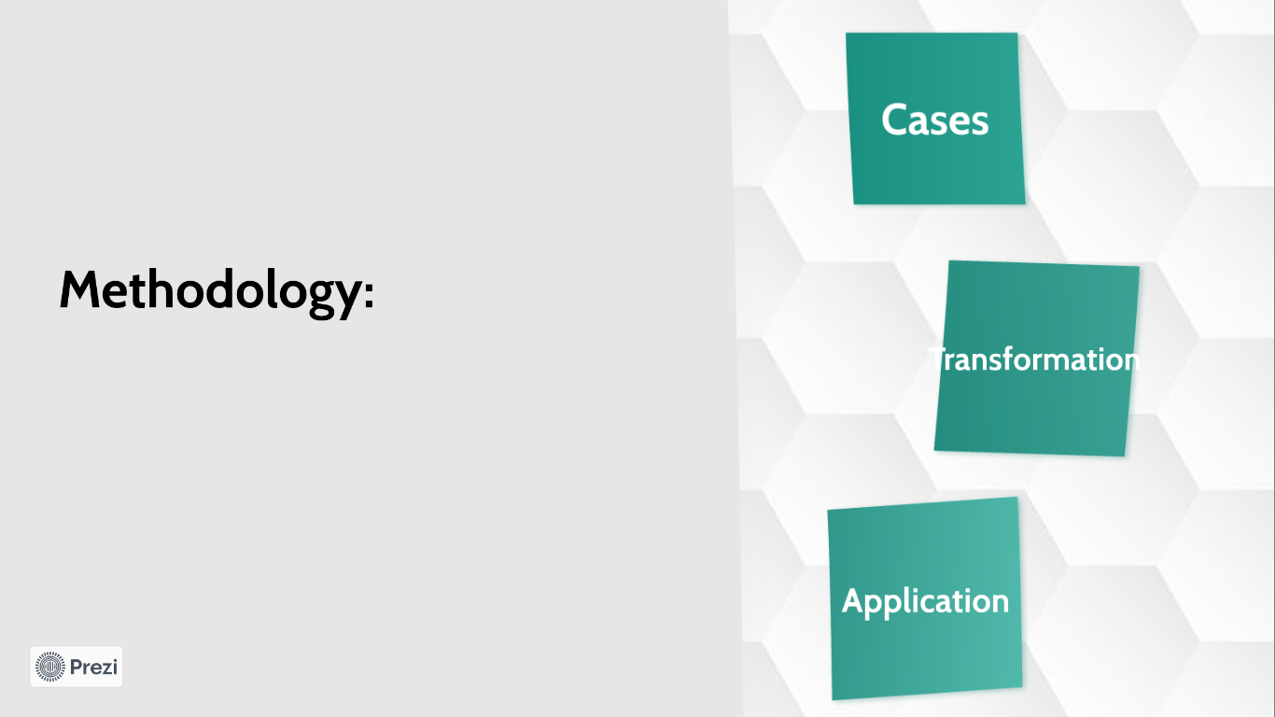

Slide 5


Slide 6


Slide 7
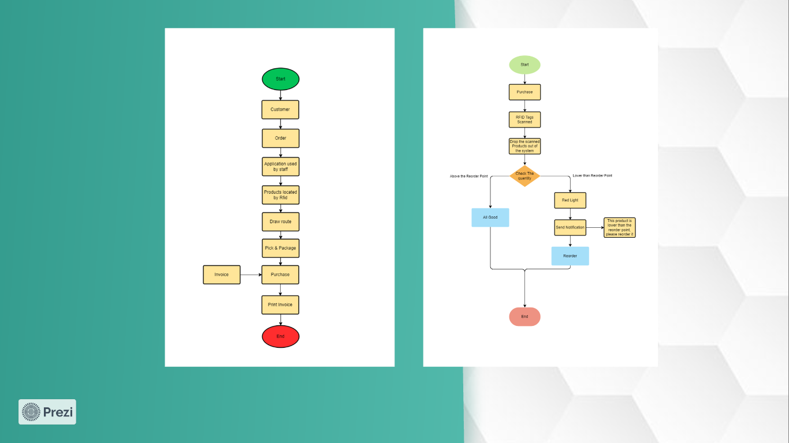

Slide 8
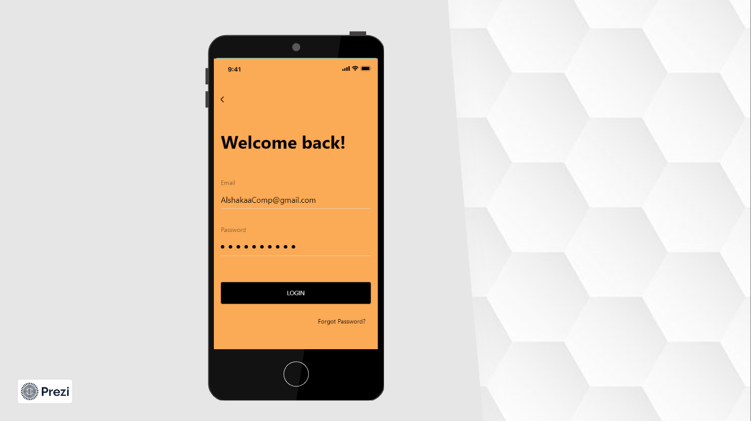

Slide 9


Slide 10
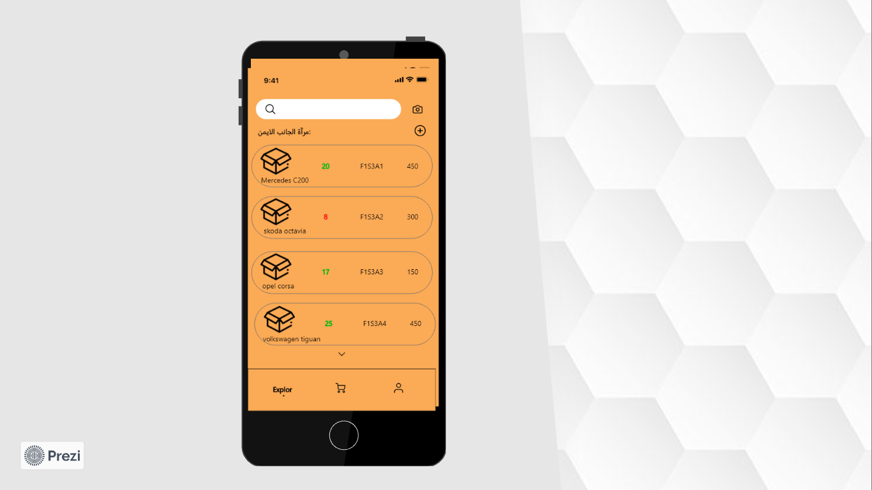

Slide 11
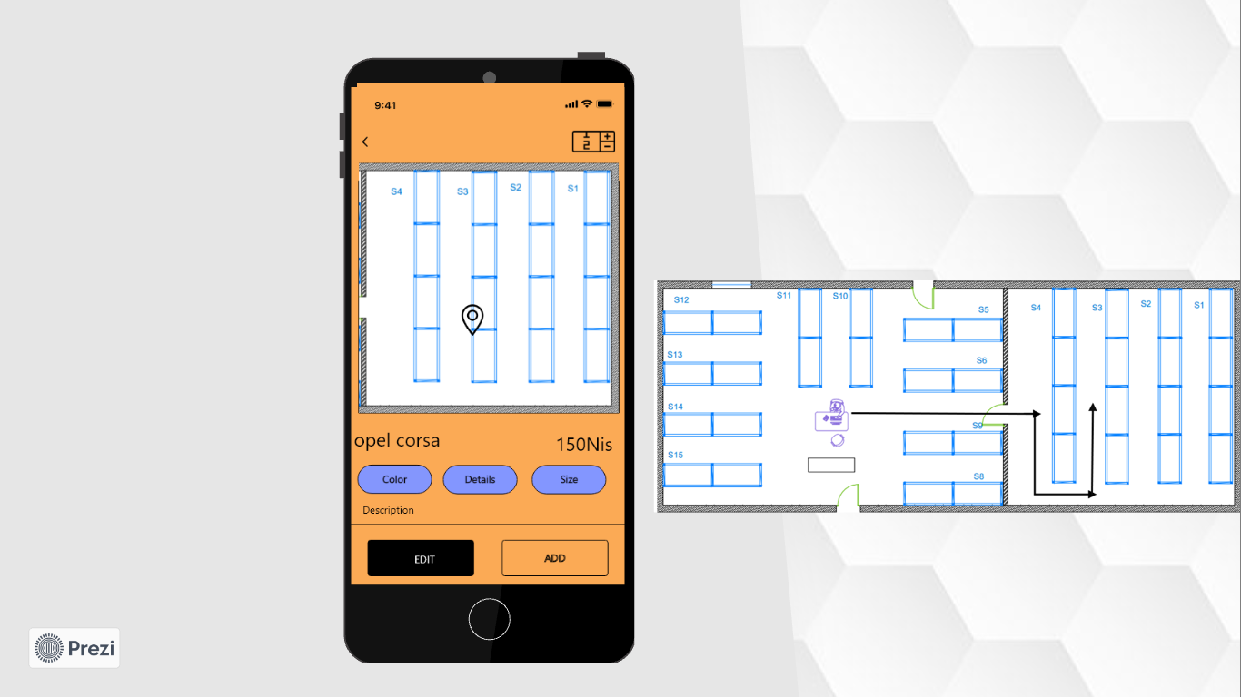

Slide 12
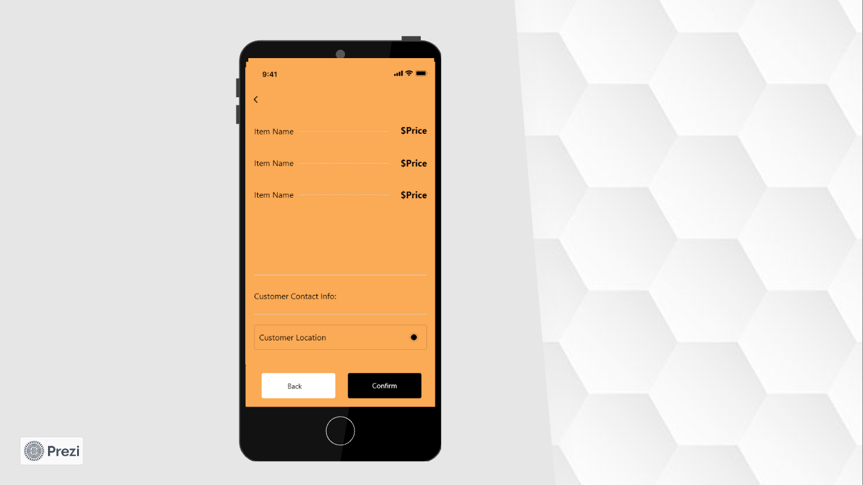

Slide 13


Slide 14
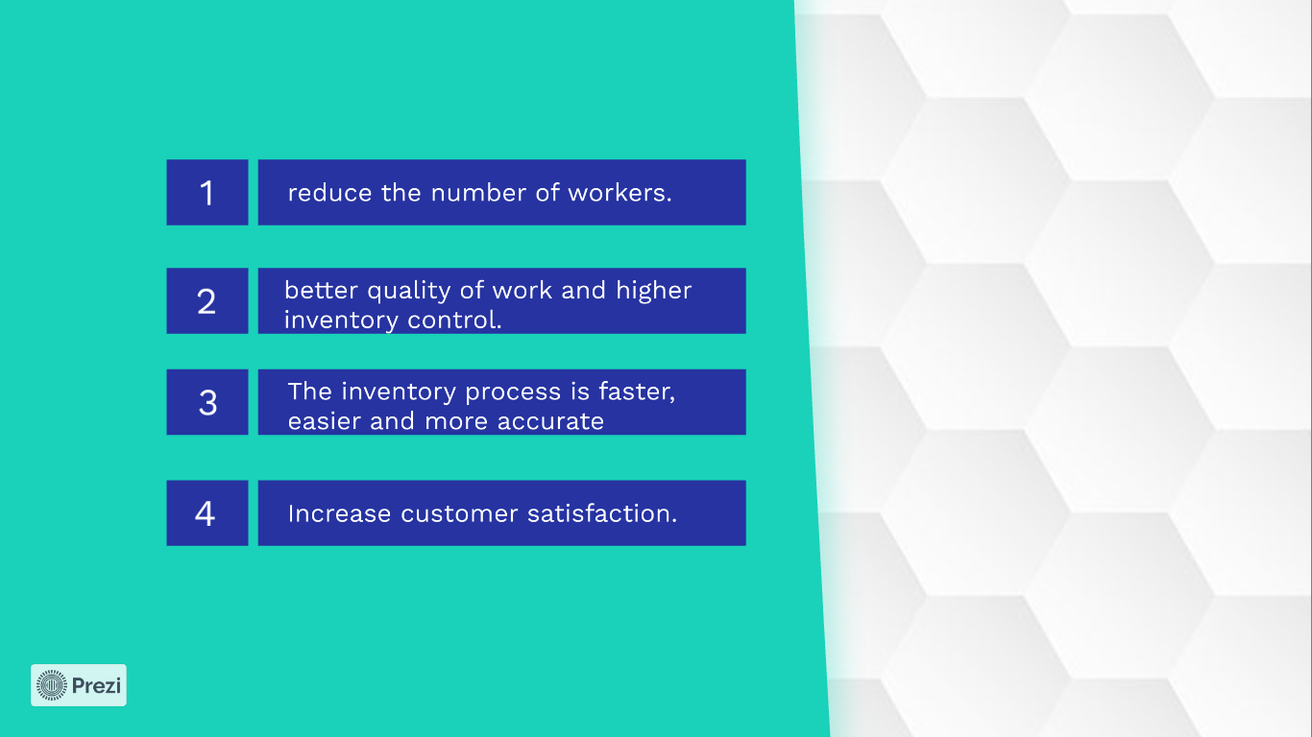

Slide 15


Slide 16
