Slide 1

An-Najah National University
Faculty of Engineering
Civil Engineering Department
Improvement of Al-Salam Intersection wadee Awwad Tawfiq Jarrar
Jamal Shehadeh
Submitted to:
Eng. Hussin Abu-Zanet
Saturday, December 24, 2016

Slide 2
Project Outline
Introduction.
Project objectives.
Data collection.
Data analysis and results.

Slide 3
Introduction
General Background.
Problem Definition.
Objectives.

Slide 4
Introduction
General Background:
Nablus City is a vital city in Palestine, and the city has a real importance due its location as a center of the North sector of the west bank.
And it considered as the node between the North and South of west-bank, and central governorates.

Slide 5
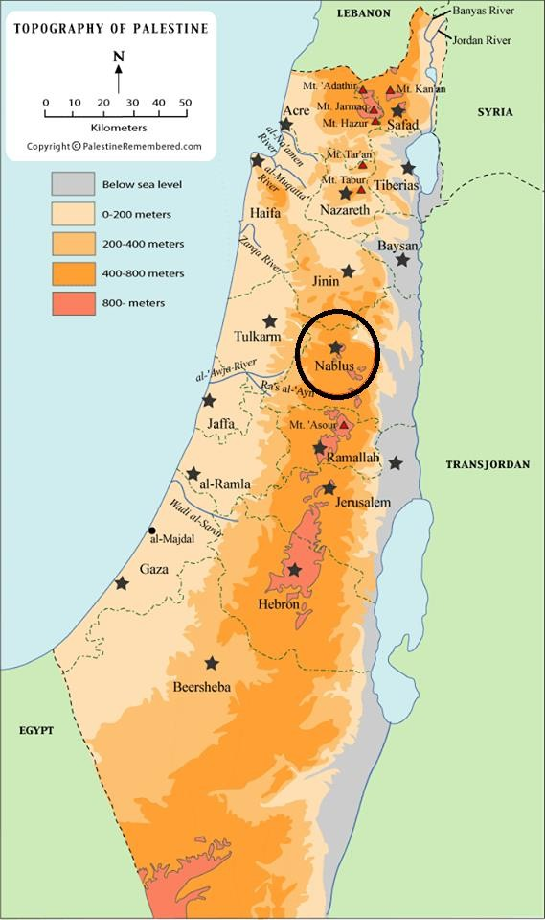
Introduction
Map of Palestine showing the central location of Nablus City:

Slide 6
Introduction
The study area in the project was Al-Salam road network which including nine intersections.

Slide 7
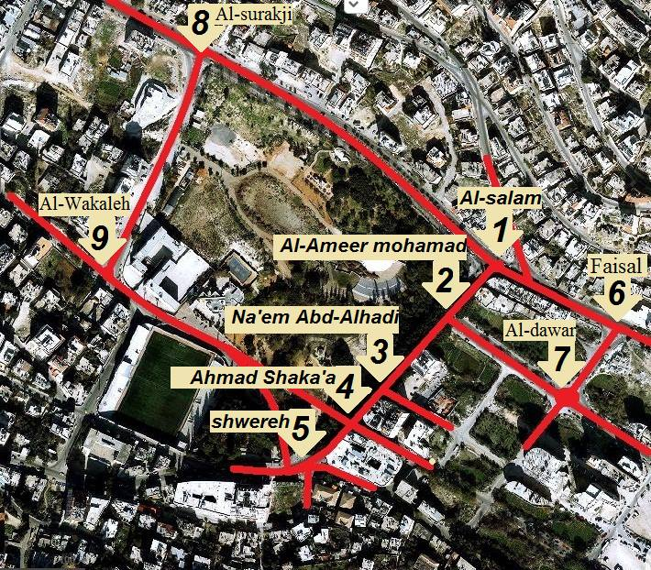
Introduction
Aerial photo represents the area of study

Slide 8
Introduction
Problem Definition:
The study area facing major traffic problems and it expected to be increased in the future, and the main problems are:
- Congestion Problems.
- Traffic Delays.

Slide 9
Introduction
Congestion Problems: is the first major problem that can be clearly seen in the study area, since the traffic demand is so high; that caused slower speeds, longer trip time, and increased vehicular queuing.
Traffic Delays: is the second major problem, it’s the additional travel time that experienced by drivers, as a result of traffic congestion at intersections.

Slide 10
Introduction
Objective of the study:
The main objective is to improve Al-Salam Intersection level of service (LOS) to enhance at least an “E” LOS or more with the minimum impact on the other intersections.

Slide 11
Methodology

Slide 12
Methodology
Selection of study area
Data collection
Data analysis & results
Test each solution
Select the best alternative
Conclusions & Recommendations
Create solutions

Slide 13
Site Description
Site description: the study area is located to the west of Nablus’s CBD, and it is a vital area that have a high traffic volumes.
Selection of study area: the area of study are selected based on Al-Salam Int. and intersections that affected on or effected by Al-Salam Int. and it consist of nine intersections.

Slide 14
Data Collection
Data collection: the parameters that effecting on operation of the system and should be measured are:
Traffic counts: numbers and classifications of vehicles.
Timing for signalized Int.
Inventory study: physical characteristics used in analyzing network.

Slide 15
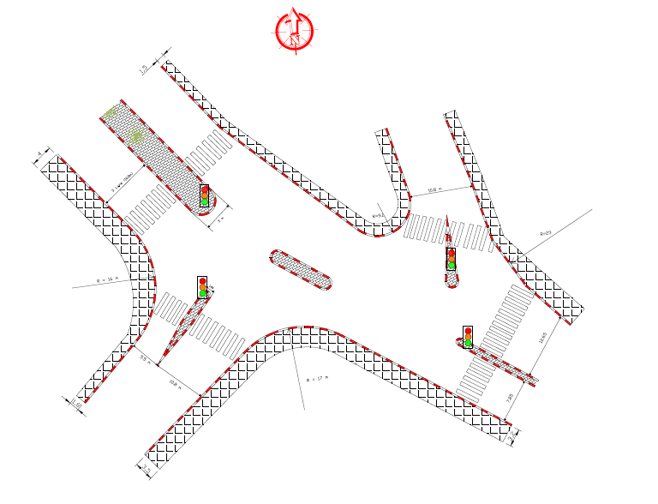
Data Collection
Inventory study for Al-Salam Int.

Slide 16
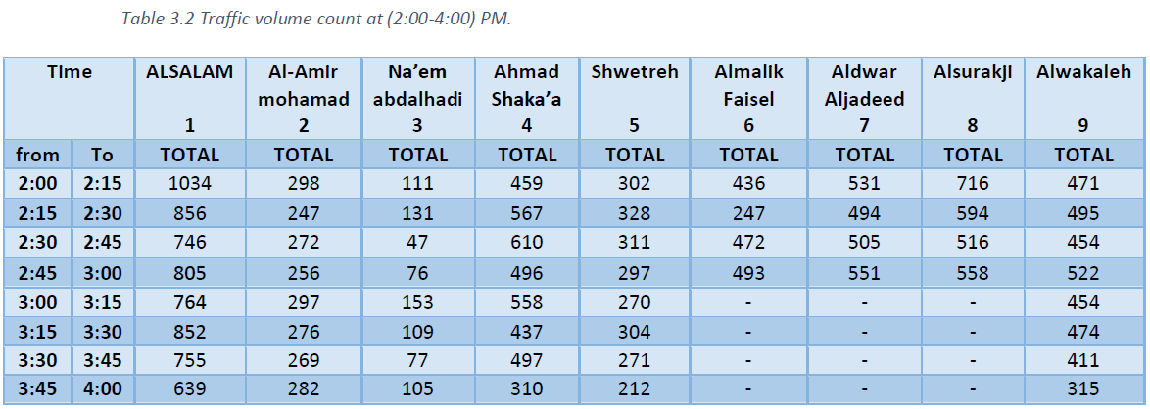
Data Collection
Traffic Count

Slide 17
Data Analysis and Results
After coding and establishing data by Synchro program the output results were in form of LOS and average delay for the intersections in general.

Slide 18
Data Analysis
Introduction to Level of Service:
Definition: level of service (LOS) is a qualitative measure used to relate the quality of traffic service.
It ranges from “A” to “F” LOS depending on traffic flow speed, delay, volume-capacity ratio, atc.

Slide 19
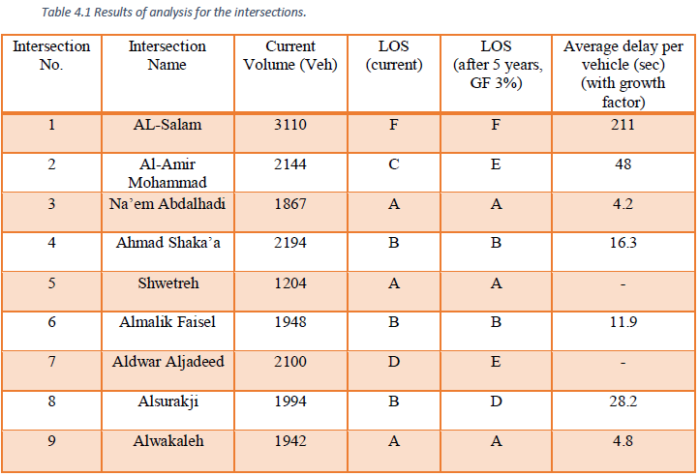
Analyzing Results
LOS and Average Delay

Slide 20
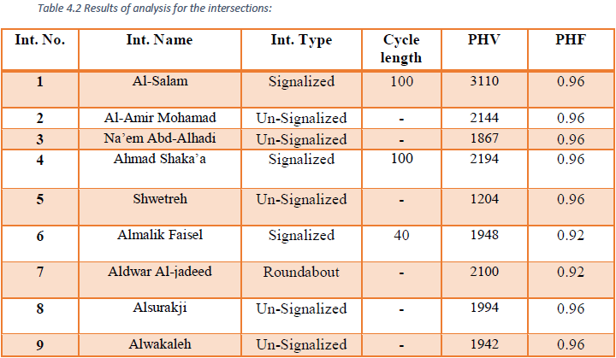
Analyzing Results
PHV, PHF and Cycle Length Values

Slide 21
Proposed Solutions
Two ways to solve the LOS and delay problems for Al-Salam Int. was adopted in this project and they are:
Geometrical solution.
Directional movements solution.

Slide 22
Geometric Solution
Geometrical solution summarized in adding additional lanes or changing the geometry of the intersections or links.
In this alternative 3 lanes ware added to west-approach (through)
Anther 3 lanes on south-approach: tow lanes to the left-turning movement, and one lane to the through movement

Slide 23
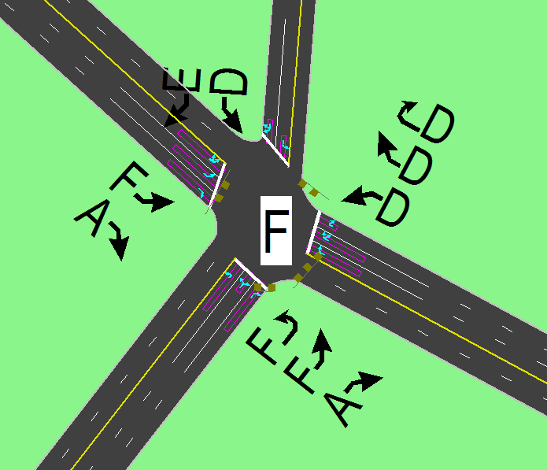
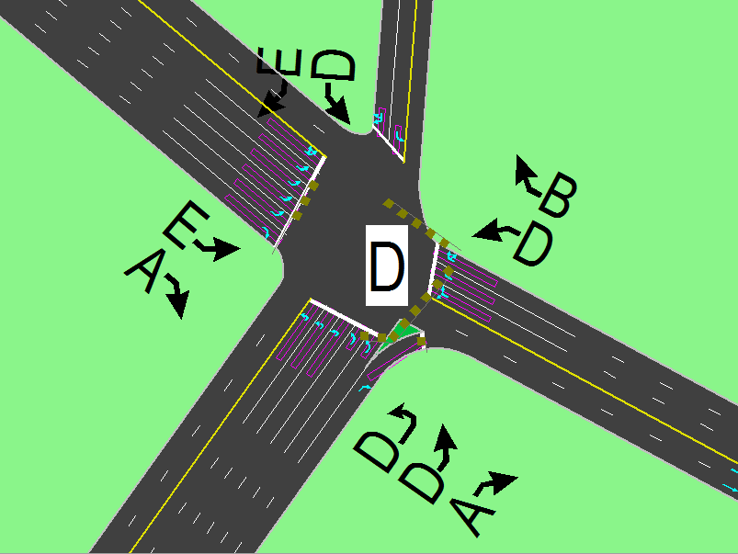
Geometric Solution
Al-Salam geometry and LOS by Synchro
Before
After

Slide 24
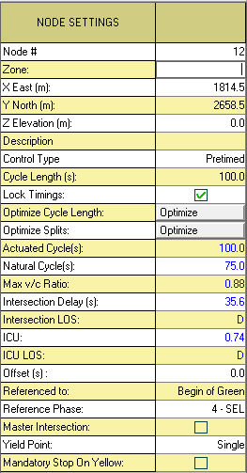
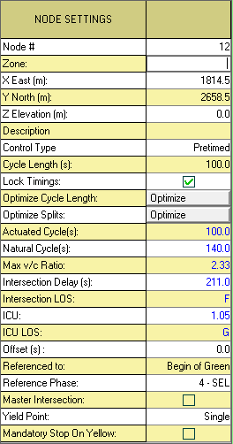
Node setting for Al-Salam Int.
Before
After

Slide 25
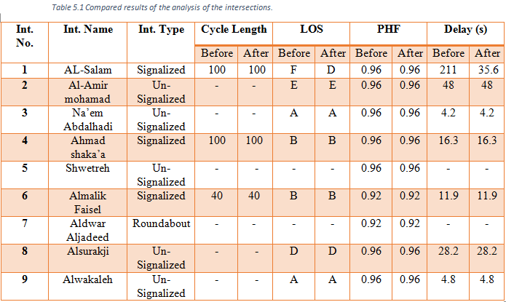
Geometric solution

Slide 26
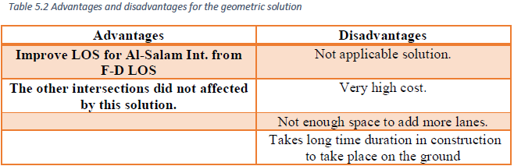
Geometric solution

Slide 27
Directional Solution
It concern in changing, prohibiting, or allowing some traffic movements going into and out of the intersections.
So some movements had been prohibited to improve Al-Salam Int. LOS

Slide 28
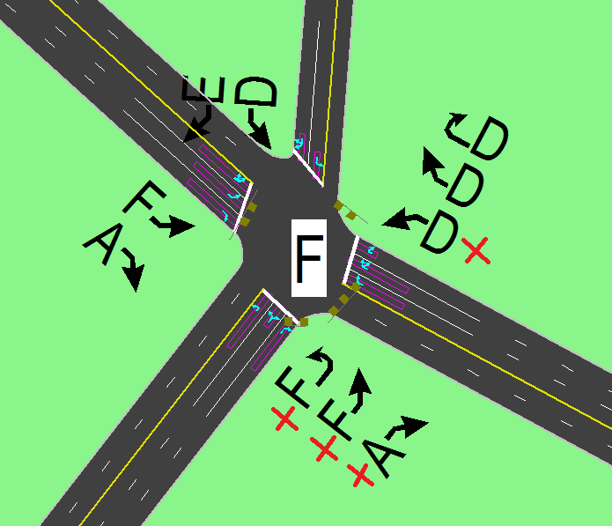
The prohibited movements on Al-Salam Int.

Slide 29

A) North-East Bound of Al-Salam Intersection (Right-Turn):

Slide 31

B) North-East Bound of Al-Salam Intersection (Through):

Slide 33
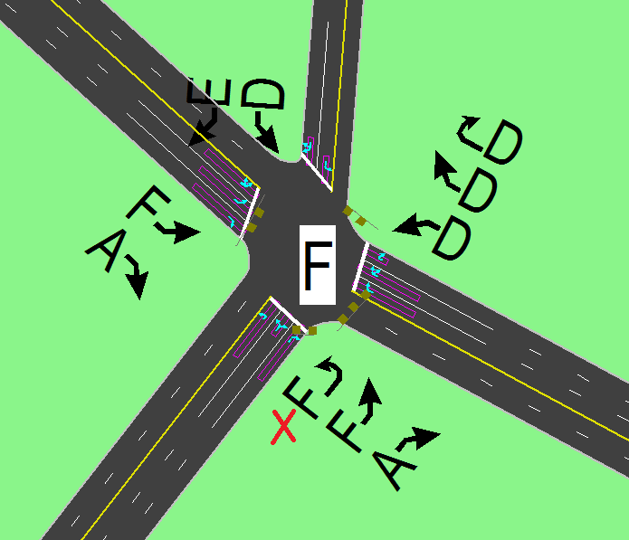
C) North-East Bound of Al-Salam Intersection (Left-Turn):

Slide 35

D) West-Bound left turn prohibition:

Slide 37
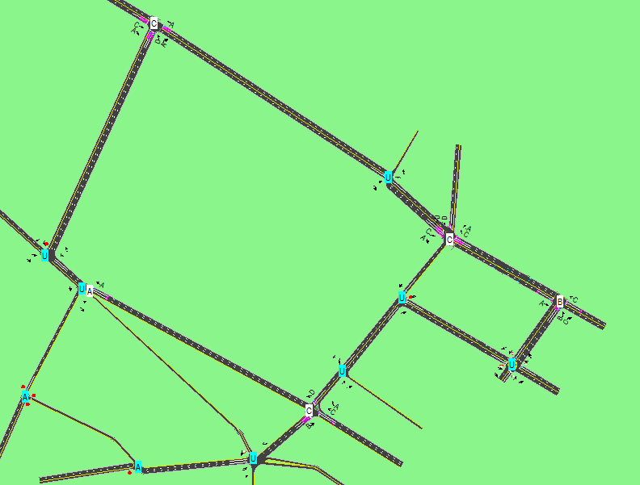
The network after redact and distribute the traffic volumes

Slide 38
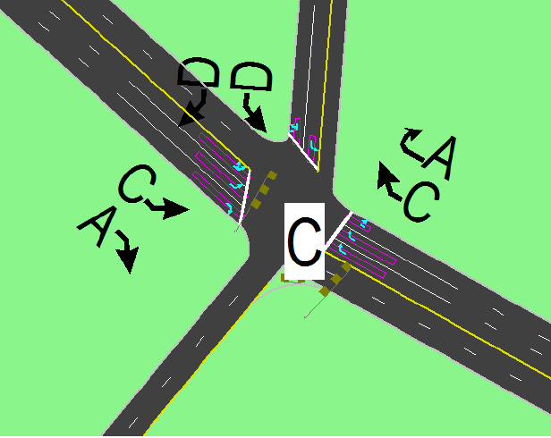
LOS for Al-Salam Int.
Before
After

Slide 39
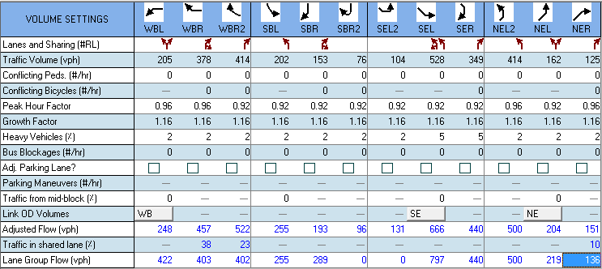
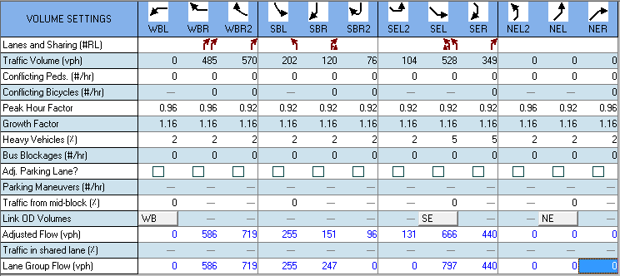
Volume settings for Al-Salam Int.

Slide 40
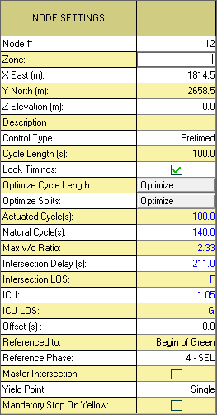
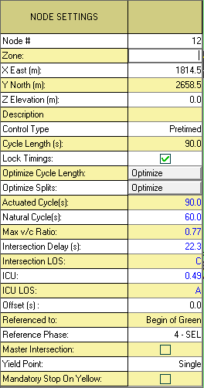
Node settings for A-Salam Int.
Before
After

Slide 41
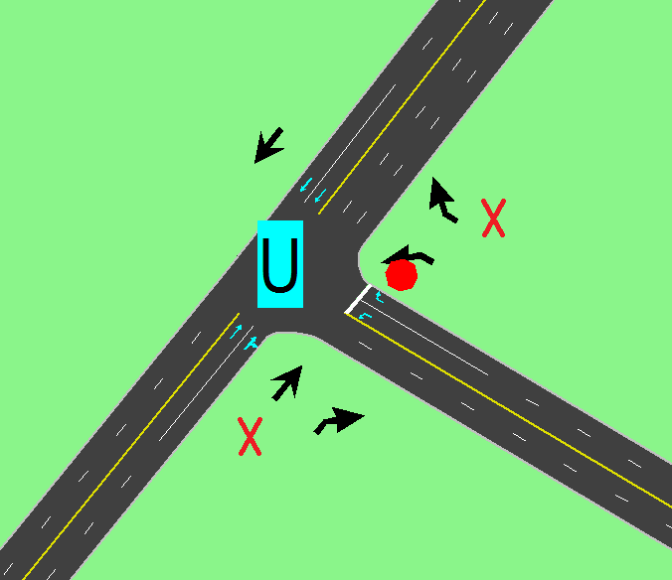
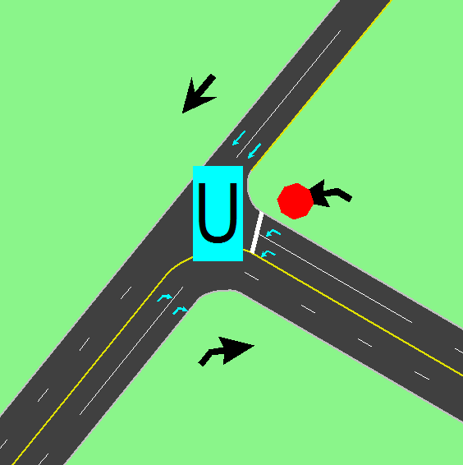
Al-Amir Mohammad Int.
Before
After

Slide 42
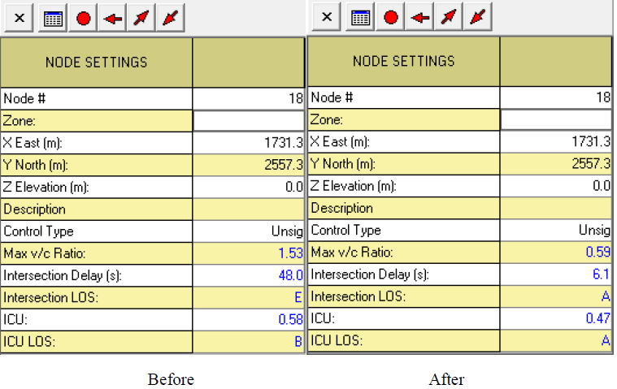
Node settings for Al-Amir Mohammad Int.

Slide 43
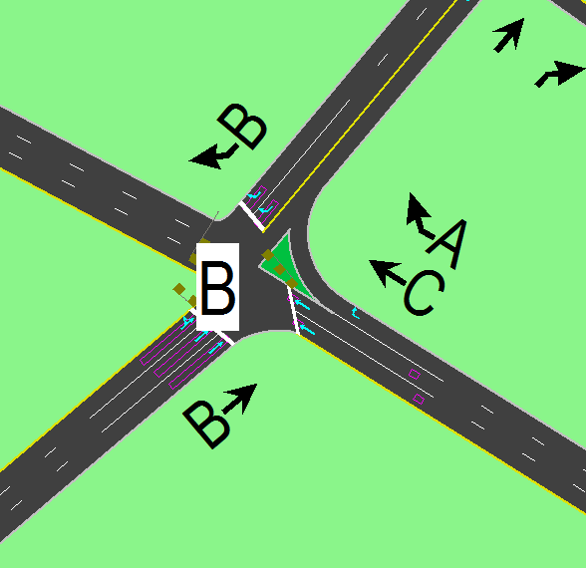
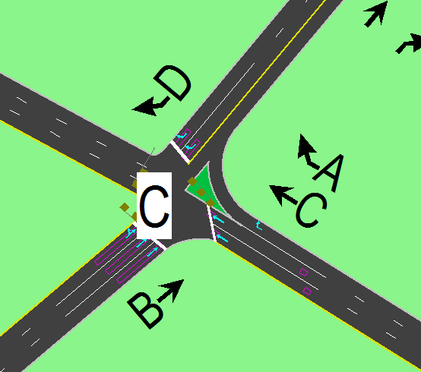
LOS for Ahmad Al-Shaka’a Int.
Before
After

Slide 44
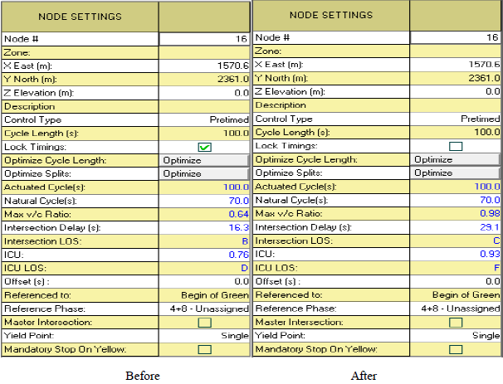
Node settings for Ahmad Al-Shaka’a Int.

Slide 45
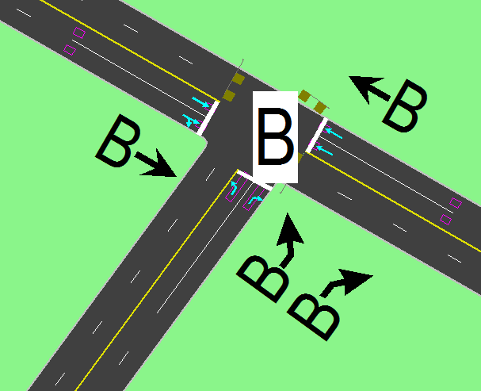
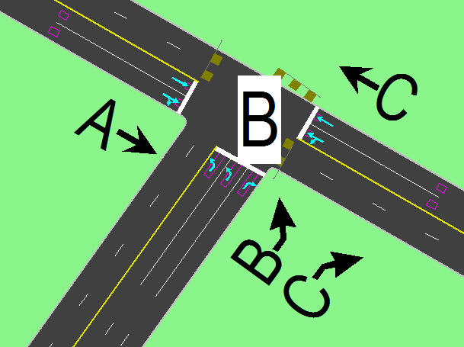
LOS for Al-Malik Faisal Int.
Before
After

Slide 46
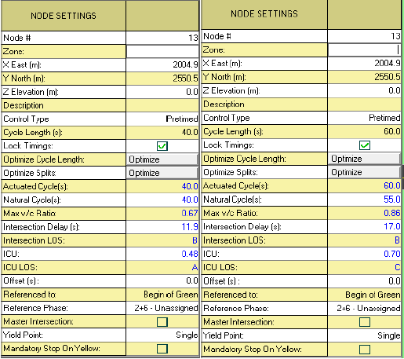
Node settings for Al-malik Faisal Int.
Before
After

Slide 47
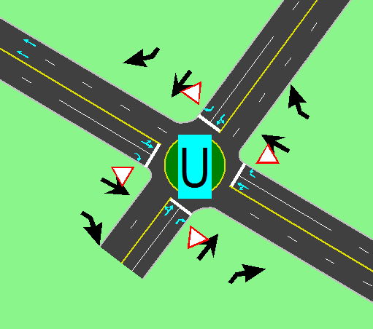
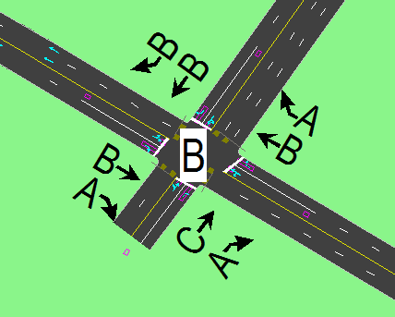
Al-Dawar Al-Jadid Int.
Before
After

Slide 48
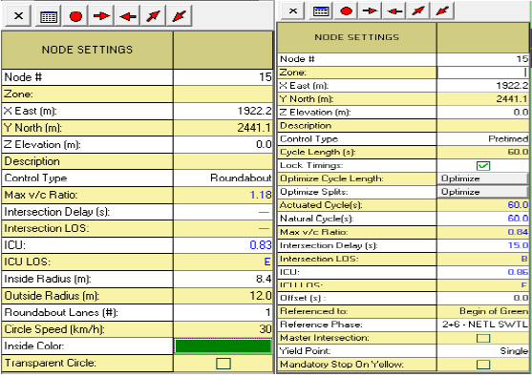
Node settings for Al-Dawar Al-Jadid Int.
Before
After

Slide 49
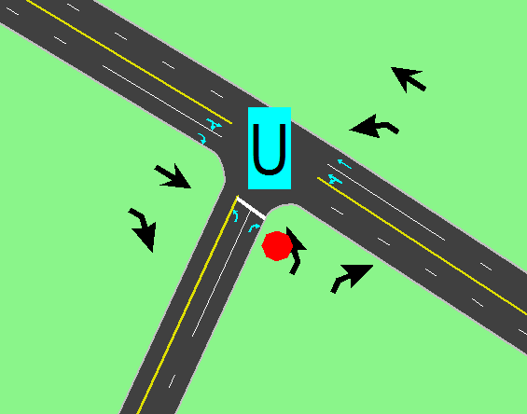
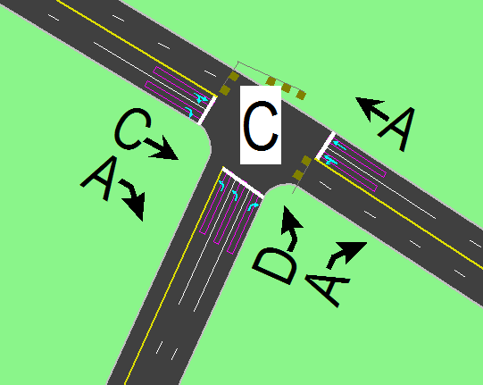
LOS for Al-Surakji Int.
Before
After

Slide 50
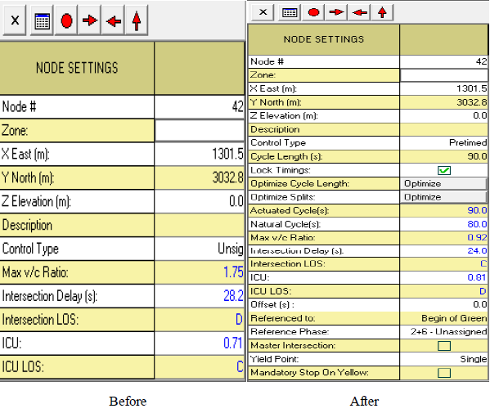
Node settings for Al-Surakji Int.

Slide 51
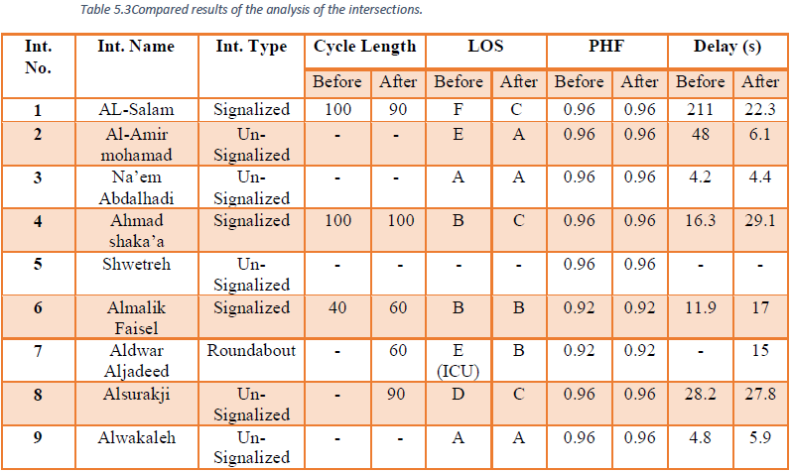
Directional Solution

Slide 52
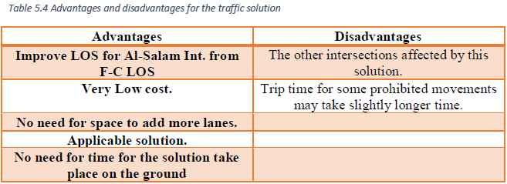
Directional Solution

Slide 53
Thank you

