Slide 1

Planning and Design of Al-baqiea International Airport

Slide 2

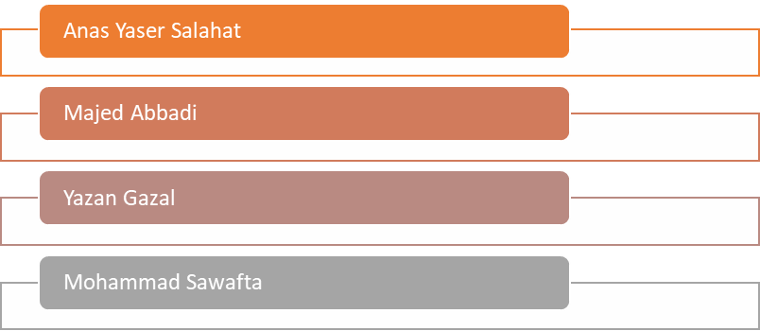
Planning and Design of Al-baqiea International Airport

Slide 3

Table of Content
Reviewing from project 1
Design of the Runways
Design of the taxiways
Design of the Terminal Area
Lighting, Marking, Signage
Cost Estimation
Sustainable Airport

Slide 4

Planning and Design of Al-baqiea International Airport
Data Collection
Site Selection
Data Analysis
Imaginary Surface
Critical Aircraft
Gate Capacity
Airport Configuration

Slide 5
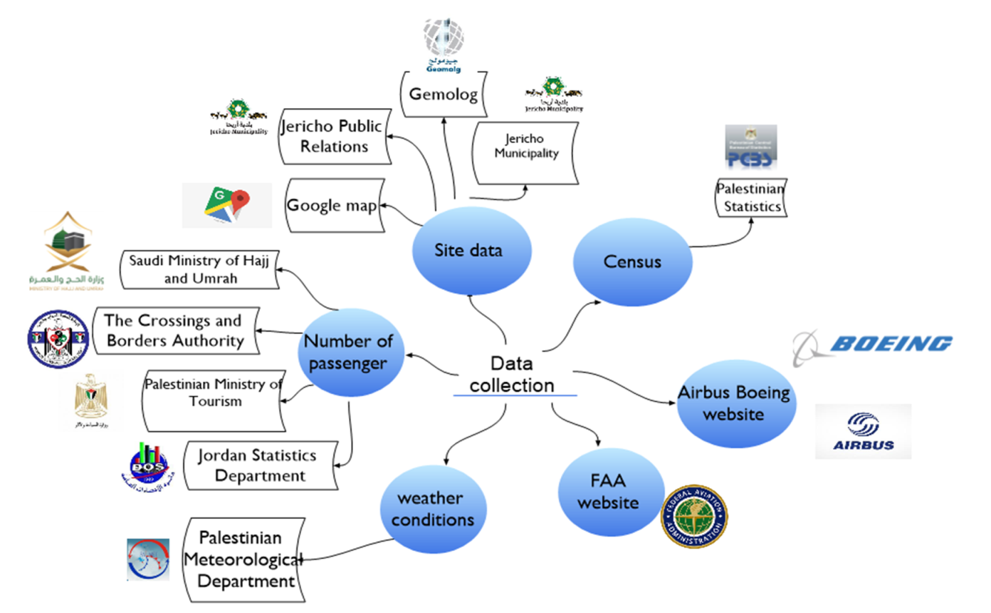
Planning and Design of Al-baqiea International Airport
Data Collection:

Slide 6
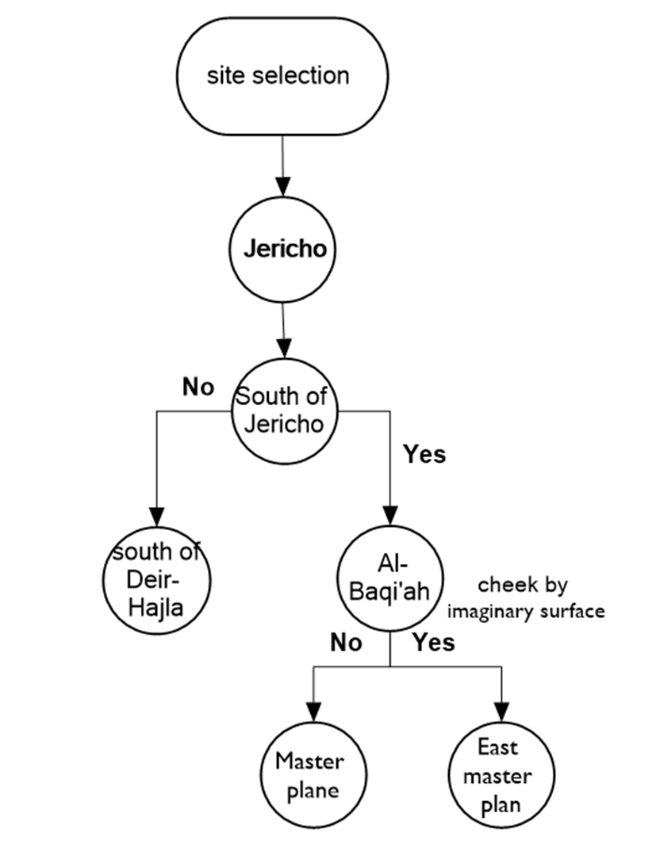
Planning and Design of Al-baqiea International Airport
Site selection:

Slide 7
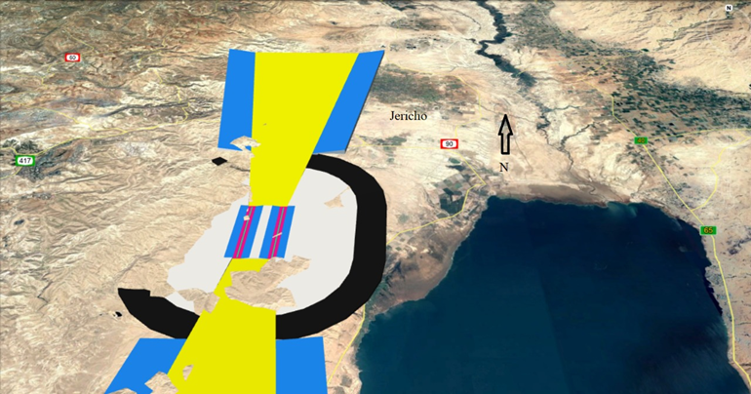
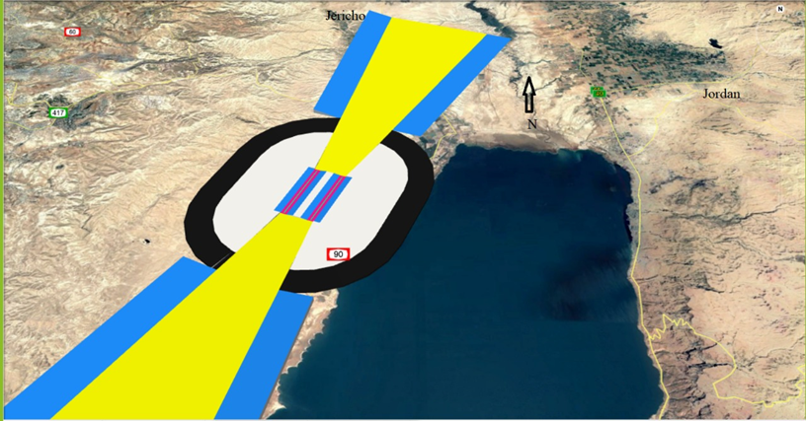
Planning and Design of Al-baqiea International Airport
Imaginary Surface :

Slide 8
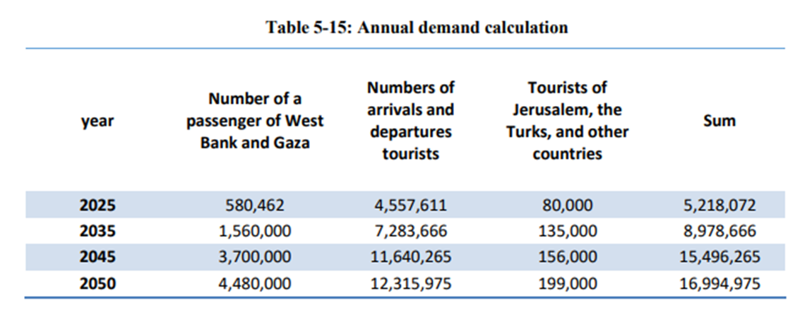
Planning and Design of Al-baqiea International Airport
Data Analysis:

Slide 9
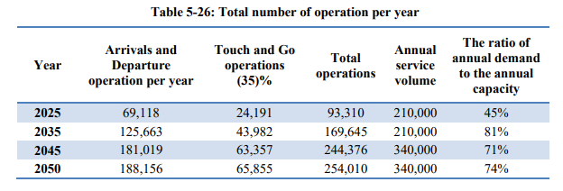
Planning and Design of Al-baqiea International Airport
Runway Configuration: Parallel Runway

Slide 10
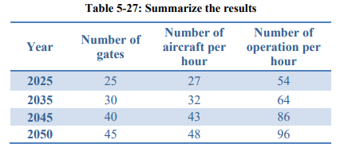
Planning and Design of Al-baqiea International Airport
Gate capacity:

Slide 11
Planning and Design of Al-baqiea International Airport
AIRPORT CONFIGURATION:
1) Airport Classification
- the critical aircraft is Boeing 747-400.
Airport Reference Code (ARC) provided by FAA as D-V.
Based on ICAO classification , it provided by ICAO as 4E.
2) Runway Orientation : the allowable crosswind is considered to be 16kn (18.5 mi/hr) .also according to wind ross there isn't wind speed more than 16Kn. Allowable crosswind component
(North northeast).
Runway length:
the required runway length for Take-off operation is approximately 11,100 ft. (3383 m).

Slide 12
Planning and Design of Al-baqiea International Airport
Runway Design
Alignment + Profile +Assembly
Design of Pavement
Dimensions
Site Analysis
Runway Design :
.

Slide 13
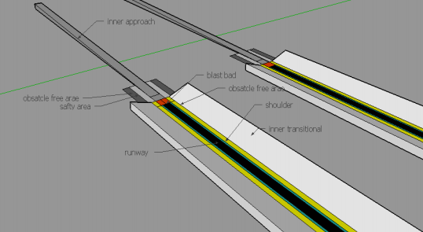
Planning and Design of Al-baqiea International Airport
Dimensions:

Slide 14
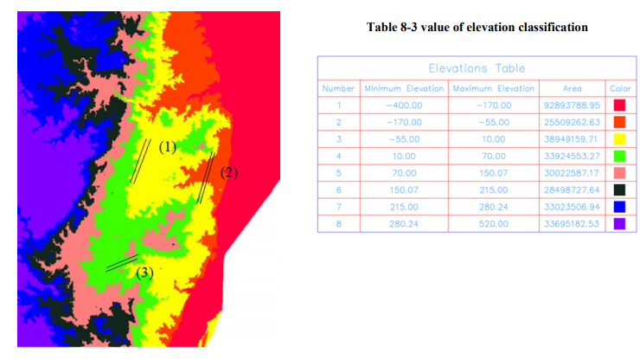
Planning and Design of Al-baqiea International Airport
Site Analysis:

Slide 15
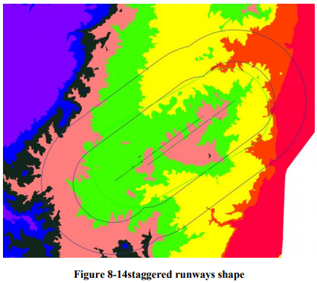
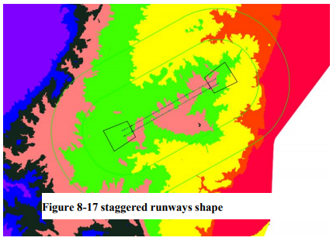
Planning and Design of Al-baqiea International Airport
Design alignment of Runway and Profile:

Slide 16
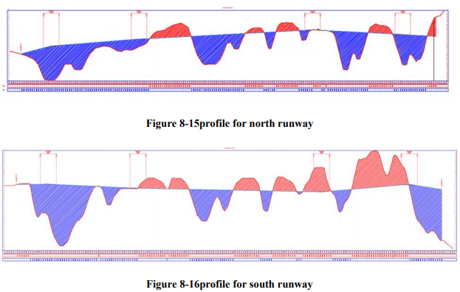
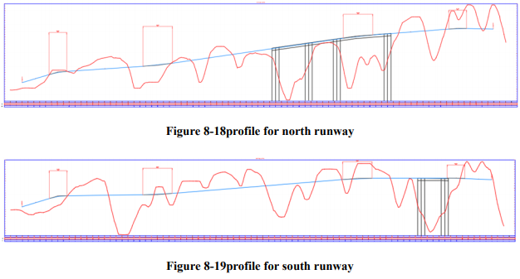
Planning and Design of Al-baqiea International Airport
Sustainable Transportation Systems
Prepared by: Fady Hassouna

Slide 17
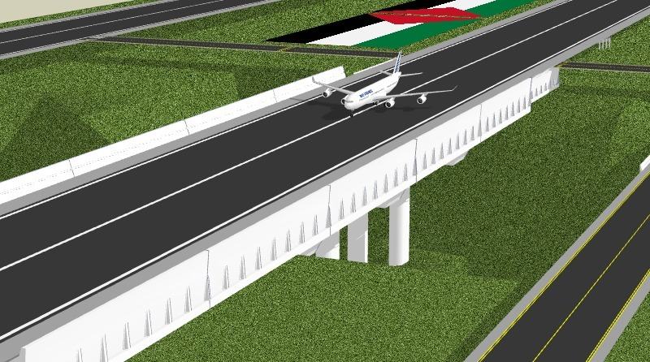
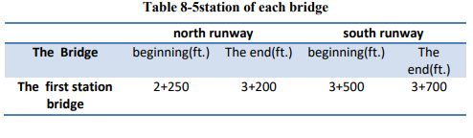
Planning and Design of Al-baqiea International Airport
Location of Bridges:

Slide 18
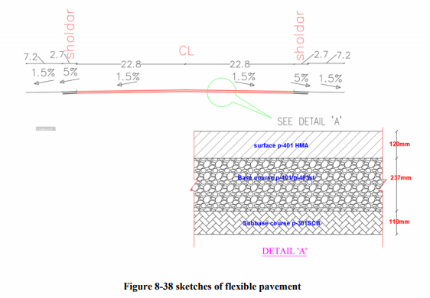
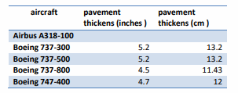
Planning and Design of Al-baqiea International Airport
Manual design of flexible pavement.
The suitable thickness of the aircraft is equal to 4.7 inches (12 cm)
Design flexible pavement using “FAARFIELD v 1.42”.
The suitable thickness of the aircraft is equal to 4 inches (10.16 cm)
Design of Flexible pavement:

Slide 19
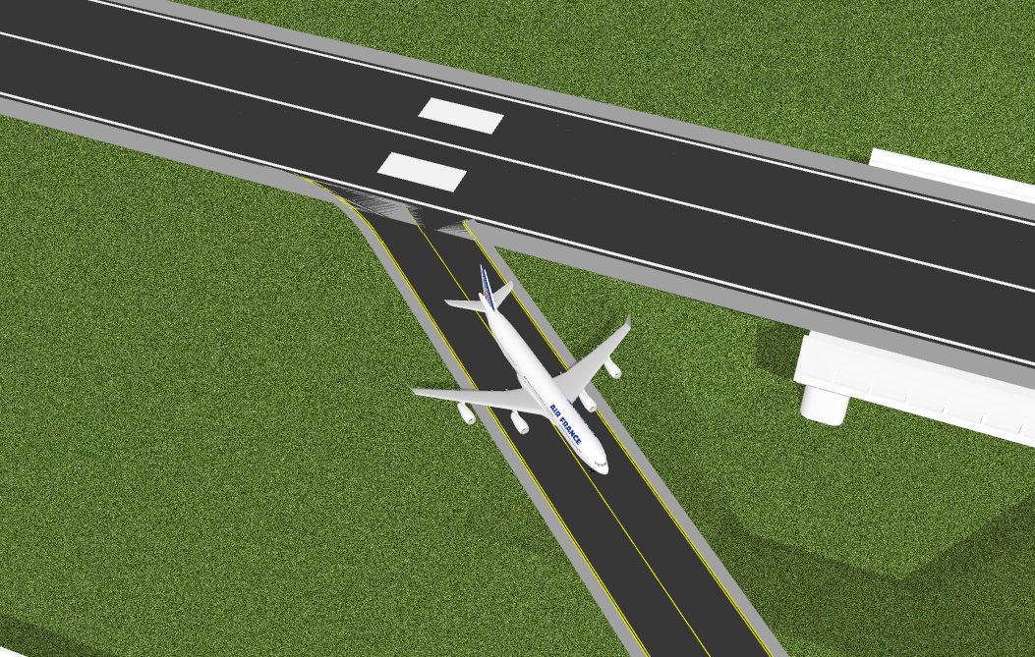
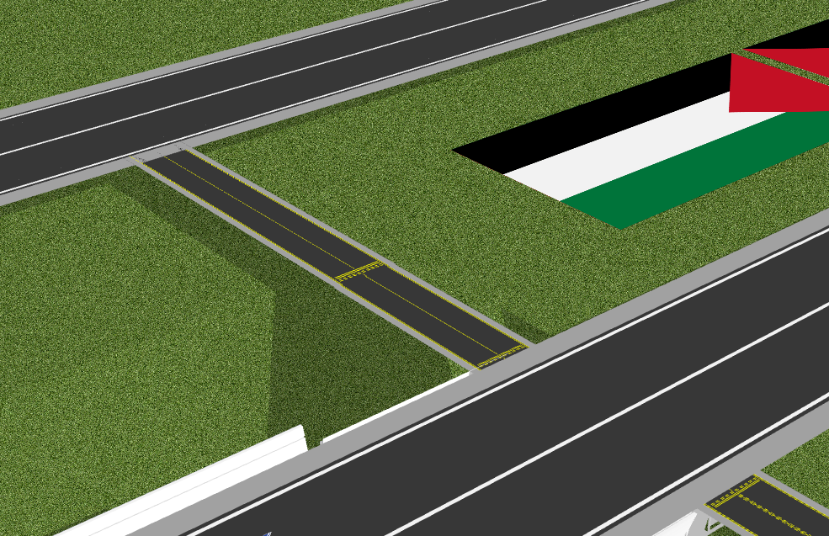
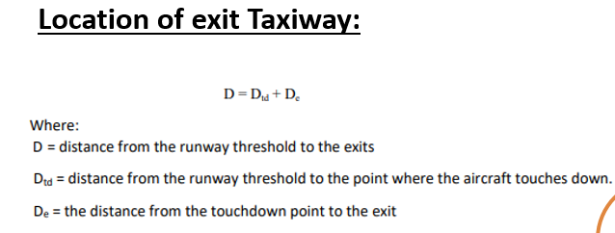
Planning and Design of Al-baqiea International Airport
Case 1
Case 2
high exit speed
Regular Exit
Taxiway Design :is the part connection between the runway and apron area
Taxiway Design
Alignment + Profile +Assembly
Exit Taxiways location
Dimensions & Taxiways curve Design
Shape of Taxiway

Slide 20
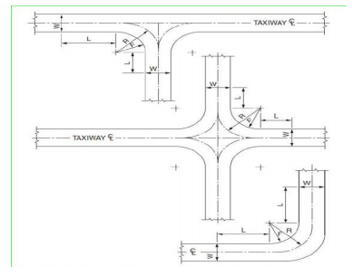
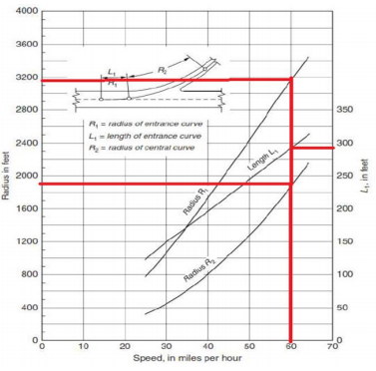
Planning and Design of Al-baqiea International Airport
Dimensions & Taxiways curve Design
The width of the taxiway is 75 ft. and the shoulder is 35 ft.
The radius of the taxiway turn is equal to 150 ft.
With speed = 60 mi/hr, the radius of entrance curve (R1) = 3180 ft. radius of central curve (R2) = 1820 ft, and the length of entrance curve ( L) = 290 ft.

Slide 21
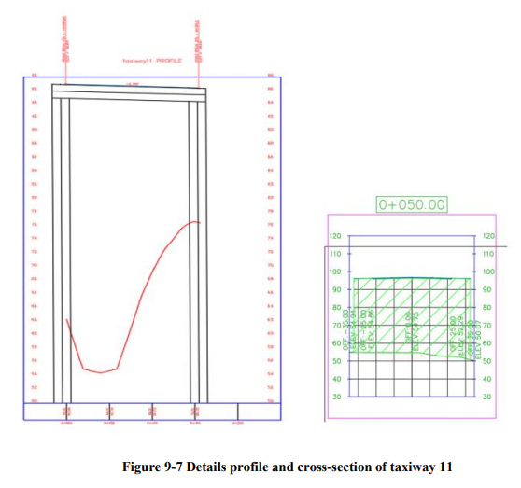
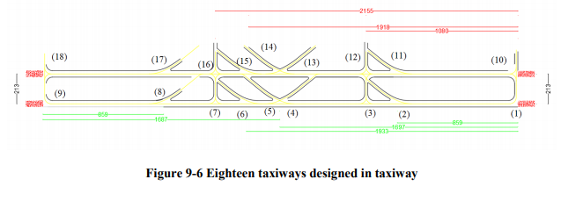
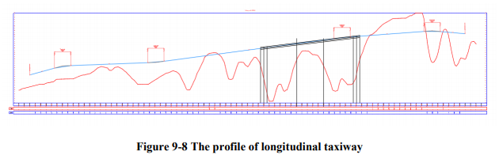
Planning and Design of Al-baqiea International Airport
Alignment of taxiway and profile:
-One way runway direction but the suppose is different

Slide 22
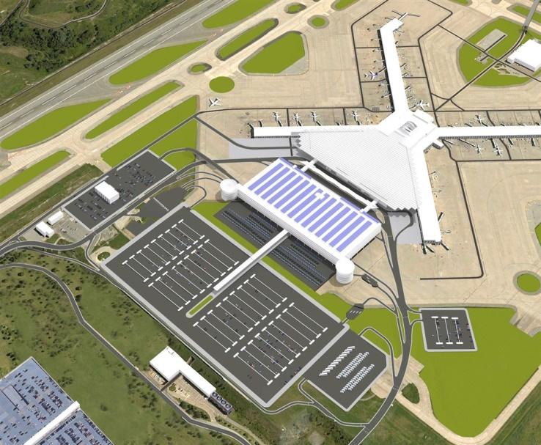
Planning and Design of Al-baqiea International Airport
Terminal Building:
Terminal Building
Concept of Development
Aircraft Parking Type
Apron area design

Slide 23
Planning and Design of Al-baqiea International Airport
Concept Development
Aircraft Parking Type
Piers or Finger concept
Nose-In Parking
Advantages
Disadvantages
Advantages
Disadvantages
Availability to expand , Economical
long walking distance, lack of a direct curb front
Requires the smallest gate area, lower noise levels,
Need for towing equipment, nose is too far from the building

Slide 24
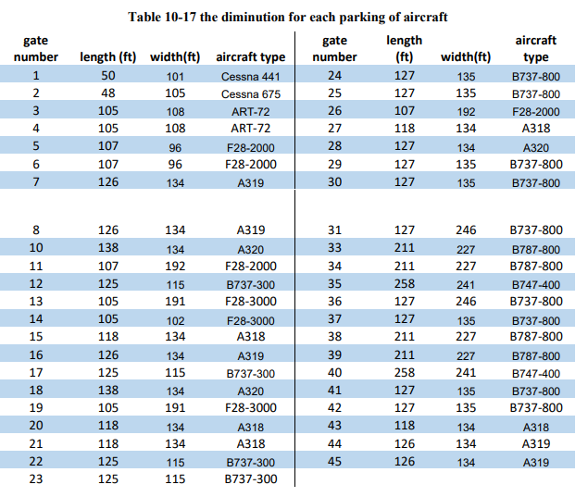
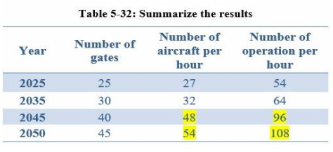
Planning and Design of Al-baqiea International Airport
Apron area design

Slide 25
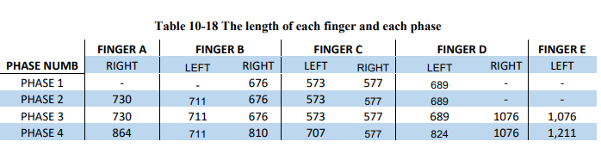
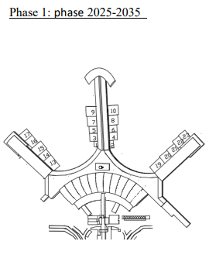
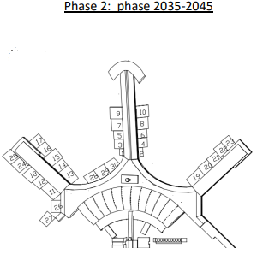
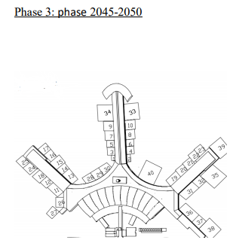
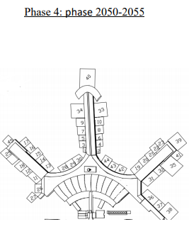
Planning and Design of Al-baqiea International Airport

Slide 26
Lighting
Lighting system
Airport beacon
Height information
Runway lighting
Taxiway lighting
Planning and Design of Al-baqiea International Airport
Airport Lighting, Marking and Signing:
Approach
edge
Edge
Threshold
Centerline &Touchdown zone
Centerline

Slide 27
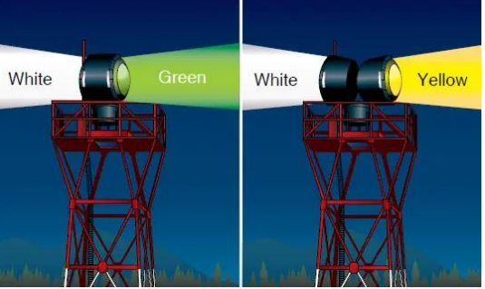
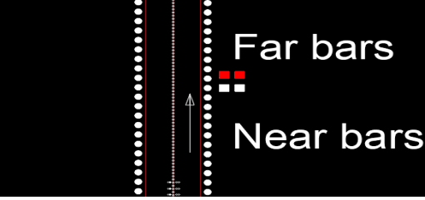
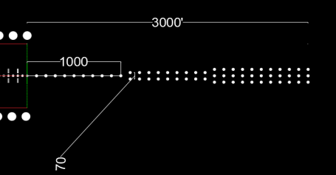
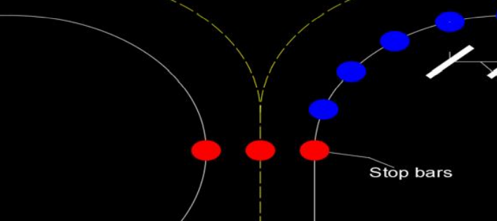
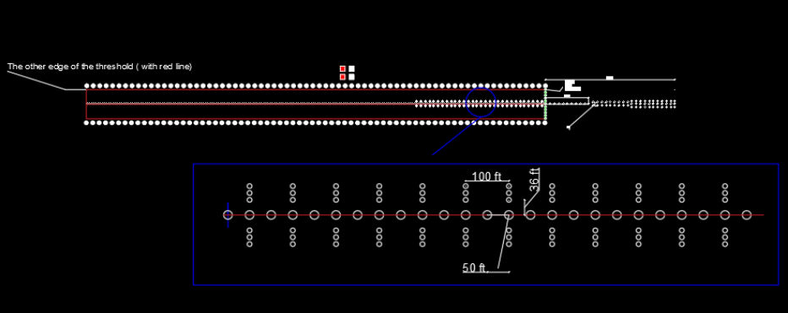
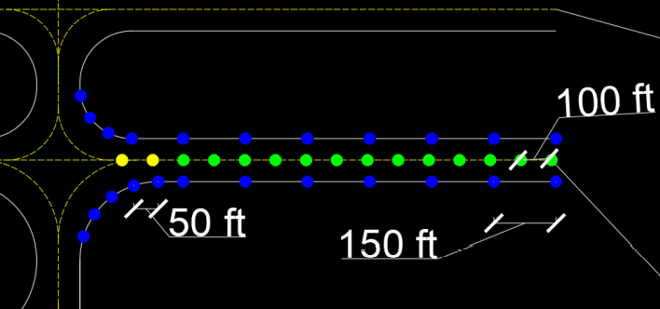
Planning and Design of Al-baqiea International Airport

Slide 28
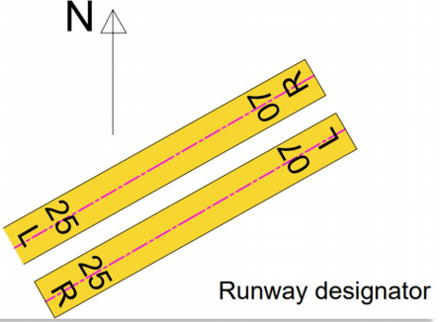

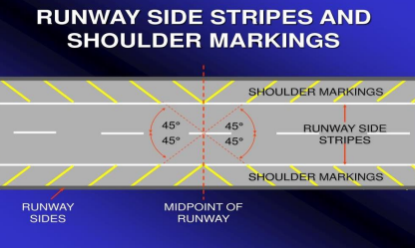
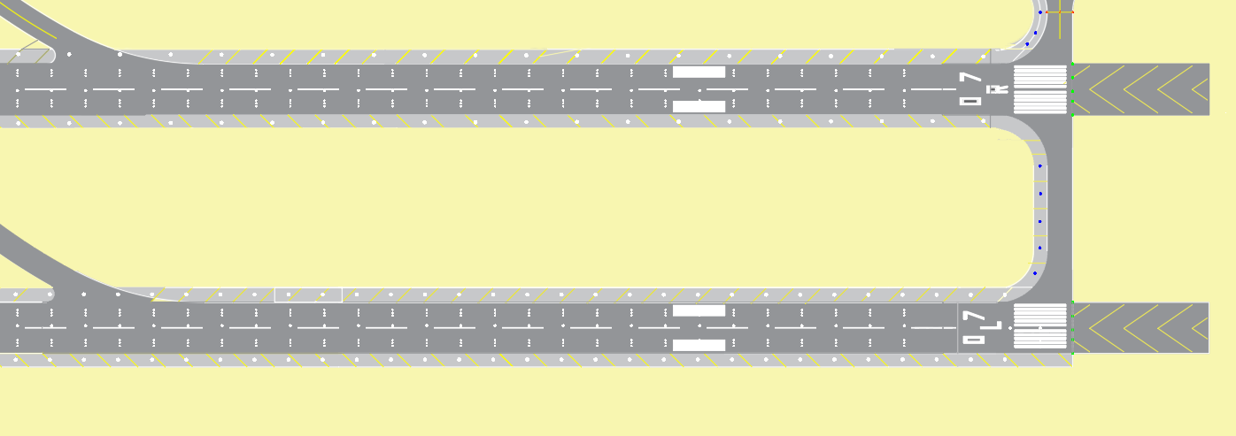
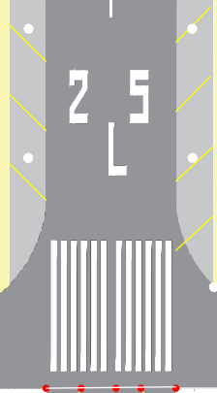
Marking
Planning and Design of Al-baqiea International Airport
Runway
Designator
Threshold
Taxiway
Centerline and edge
Holding position
Blast pad
Aiming Point
Centerline and edge
Side Stirrups
Shoulder

Slide 29
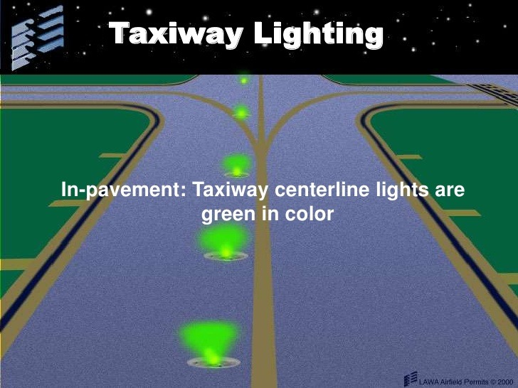
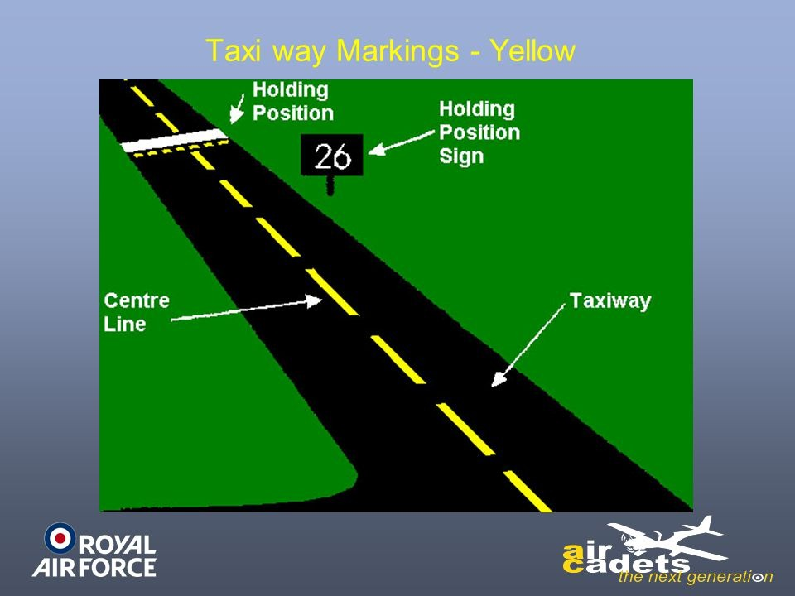
Planning and Design of Al-baqiea International Airport

Slide 30
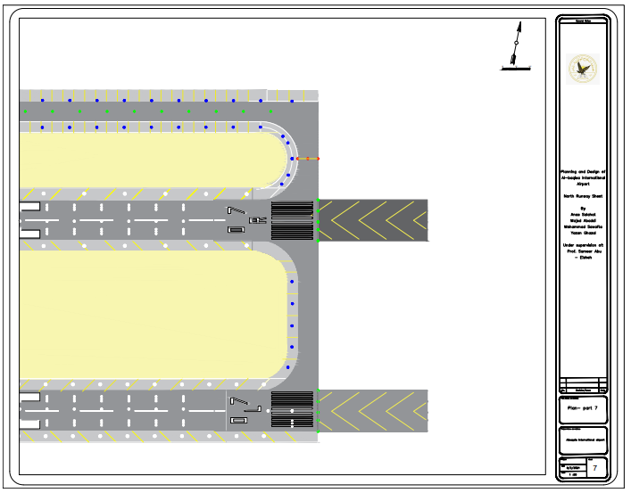
Planning and Design of Al-baqiea International Airport

Slide 31
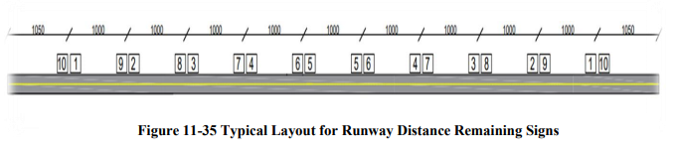
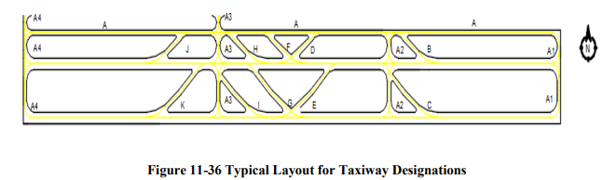
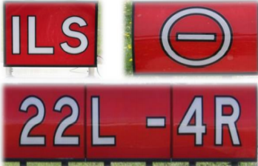




Signage
Planning and Design of Al-baqiea International Airport
Runway Distance Remaining Signs
Taxiway Designations
Airfield Signing

Slide 32



Slide 33


Element of constraction
North runway
South Exit Taxiway
Nourth Exit Taxiway
South Runway
Parallel Taxiway
Apron area
Planning and Design of Al-baqiea International Airport
Estimation Cost :
clause
earthwork
Bridges
pavement
Net fill need export

Slide 34




sumation Total cost in 2050 is $292,643,082

Slide 35


Planning and Design of Al-baqiea International Airport
Sustainable Airport:
GOVERNANCE, VISION & STRATEGY

Slide 36






Planning and Design of Al-baqiea International Airport
Urban Planning

Slide 37




Urban Planning

Slide 38




Aircraft Noise
Renewable energy

Slide 39



