Slide 1

Project Title:
Board Game Solver
Presented by:
Ameed Sayeh & Raslan Kiwan
Supervised by:
Dr. Samer Arandi

Slide 2
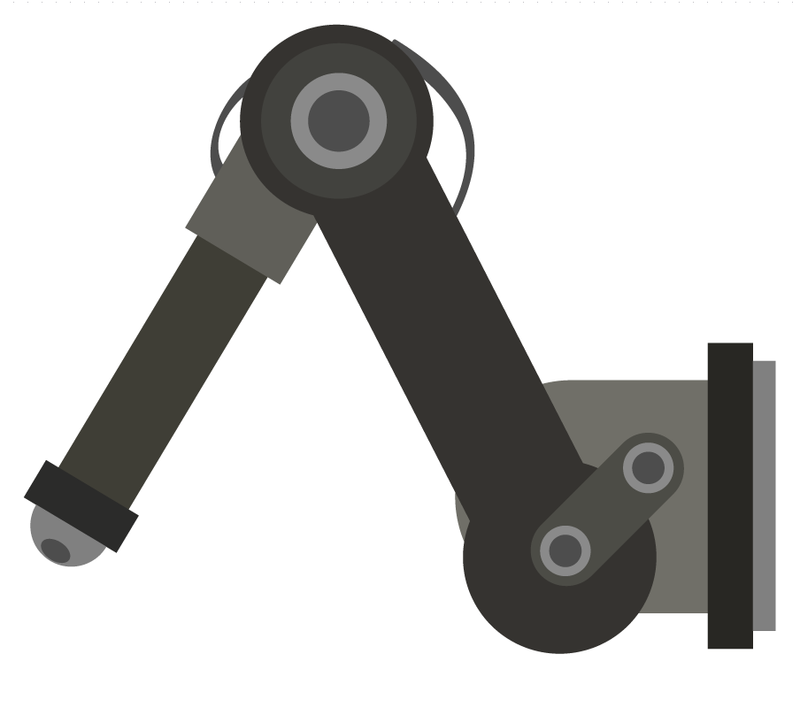
Outlines:
Overview
Idea
Hardware
Work Done
Demo
Constraints
Future work
Notes:
In overview we talk in general about replacing humans with robots, in games.

Slide 3
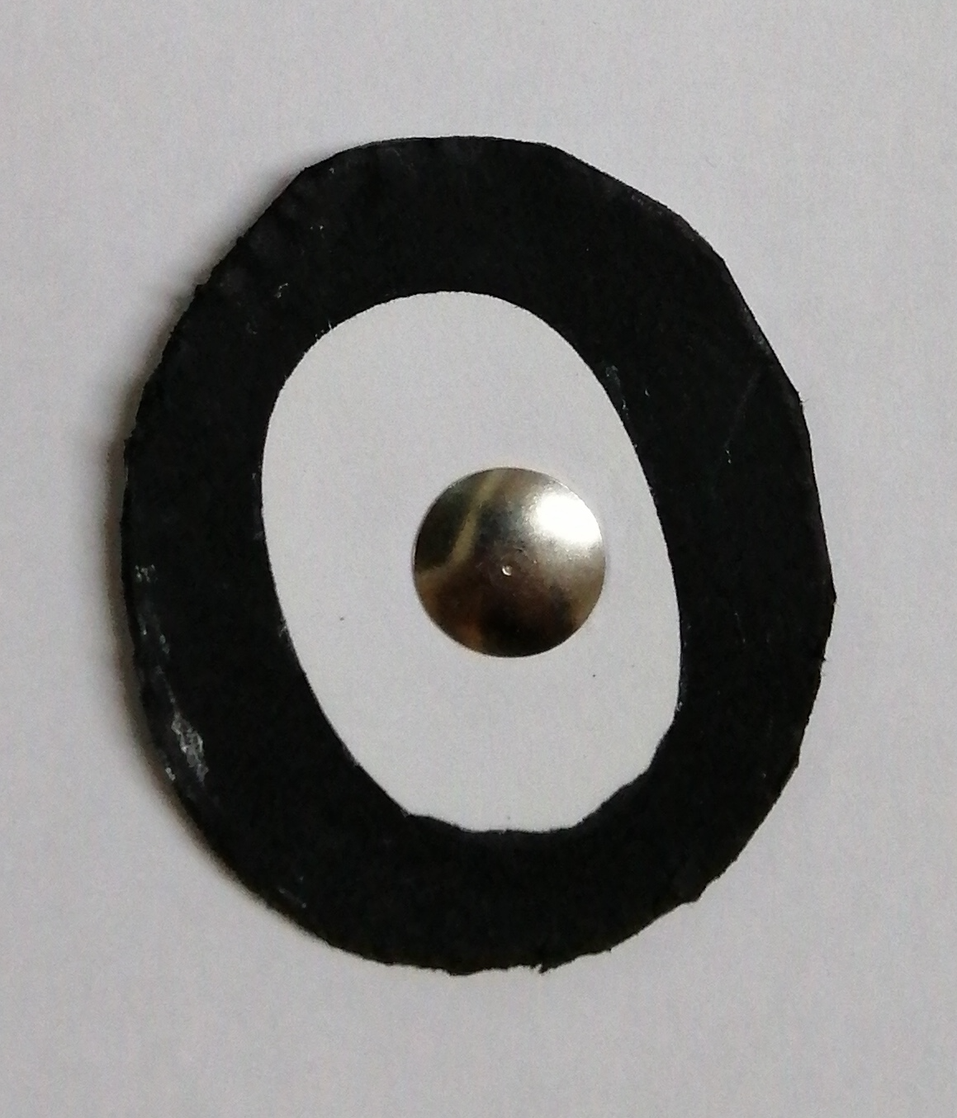
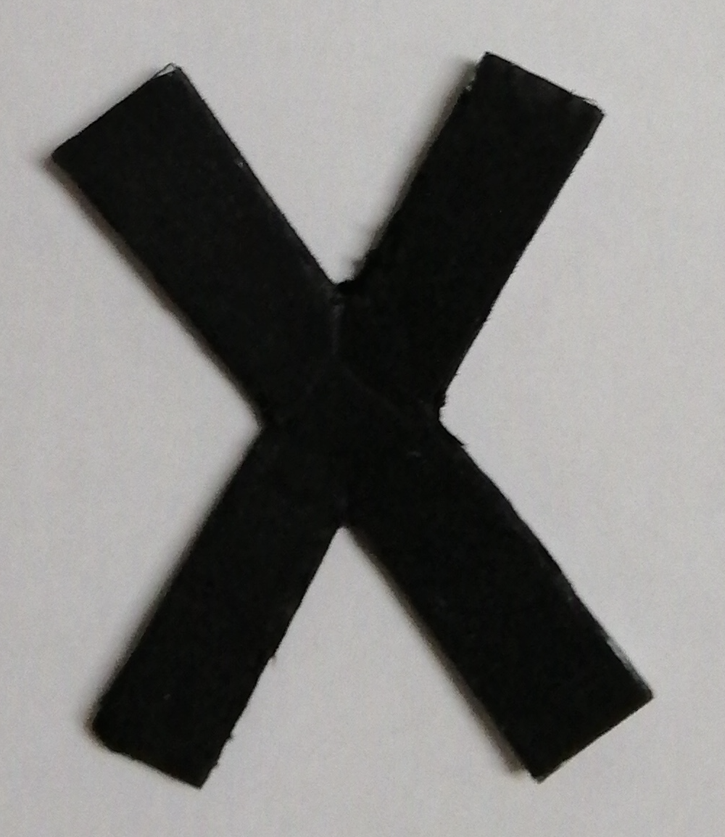
Idea:
Tic Tac Toe Arm player
Notes:
The idea is to create a robot arm that is able to play the game and move objects, and detect the status of the board:
It uses image processing to recognize the board.
Using minimax algorithm it determines the best move.
Arduino is used to move the arm that performs the move.

Slide 4
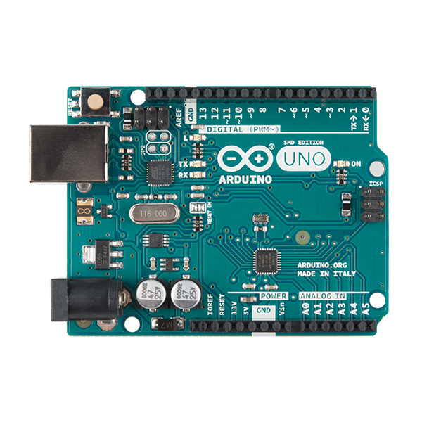
Hardware: p1
Arduino UNO 3
Notes:
Provides 6 PWM outputs which helps us in controlling Servo motors as well as 7 digital outputs.
which is more than enough, also easy programming language and apis for controlling hardware

Slide 5

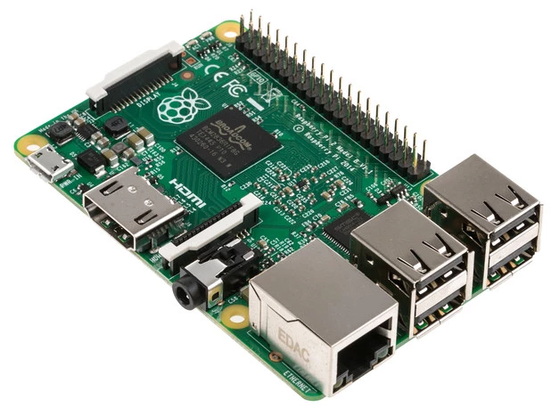
Hardware: p2
Raspberry Pi 2
Notes:
Has around 26 GPIO pins, allows us control things in high level language, all you need is to write python script. And .. move to the next slide, processing speed of 900 MHz (not bad)

Slide 6
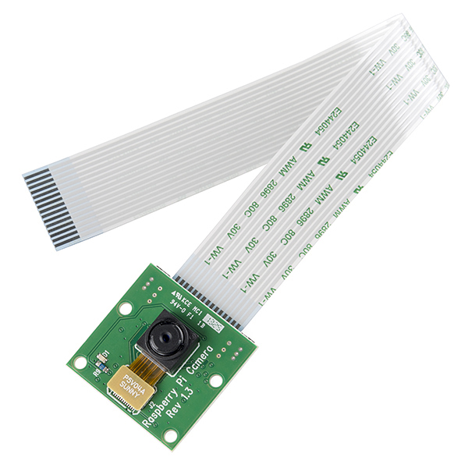
Hardware: p3
Raspberry Pi Camera 5 MP
Notes:
Related to the previous slide: this is also a major reason why raspberry was our choice. easily interfaced with raspberry pi, configured, and it provides images with 5 megapixel with high quality (2592 x 1944).
And fully customized you can control shutter speed, ISO, sharpness, contrast, brightness, saturation

Slide 7
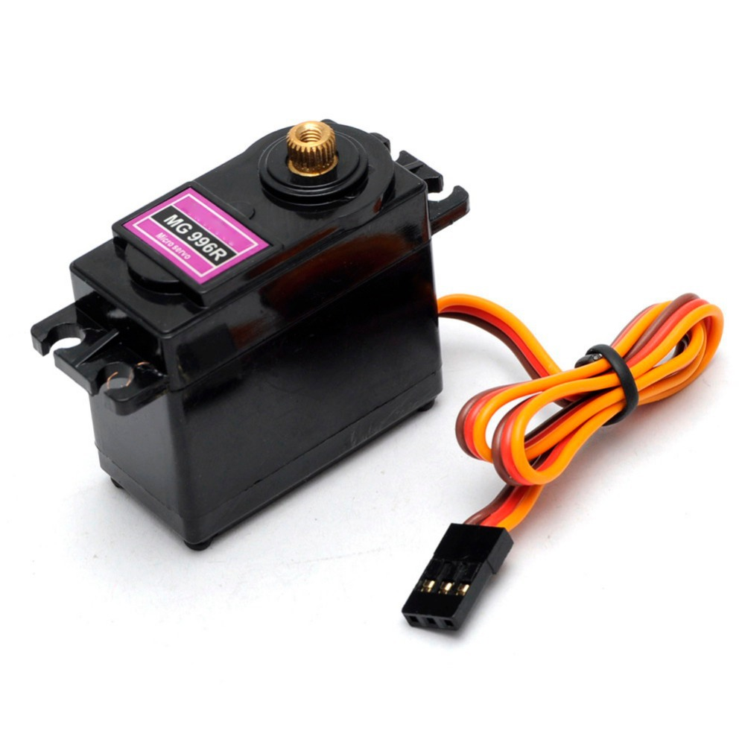
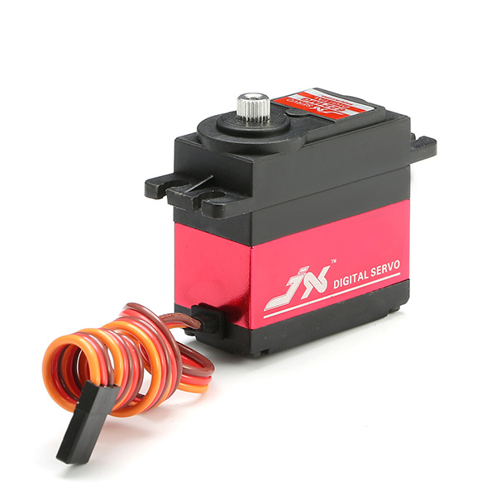
Hardware: p4
Two Types of Servos
MG996R (Up to 15 KG.cm)
6221MG (Up to 20 KG.cm)
Notes:
We used two types of servos, since we have an arm, the pressure on the servos near the base is more than the pressure on the end servos.

Slide 8
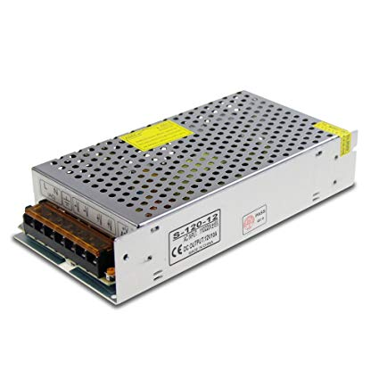
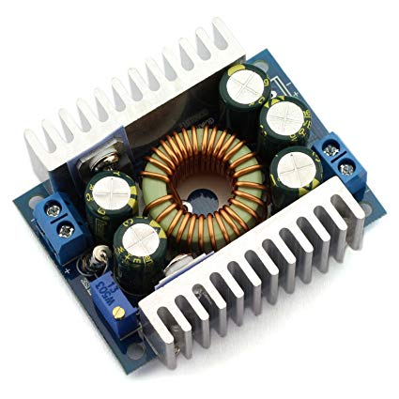
Hardware: p5
Power Supply 12V 10A
Buck convertor
Notes:
We used power supply to convert from AC to DC with 10 V and high current.
Buck is used to step down voltage and step up current (allowed us to have large current with lower voltage)
Each servo needs 2.5 A in the hard case.
7.5 V was applied

Slide 9
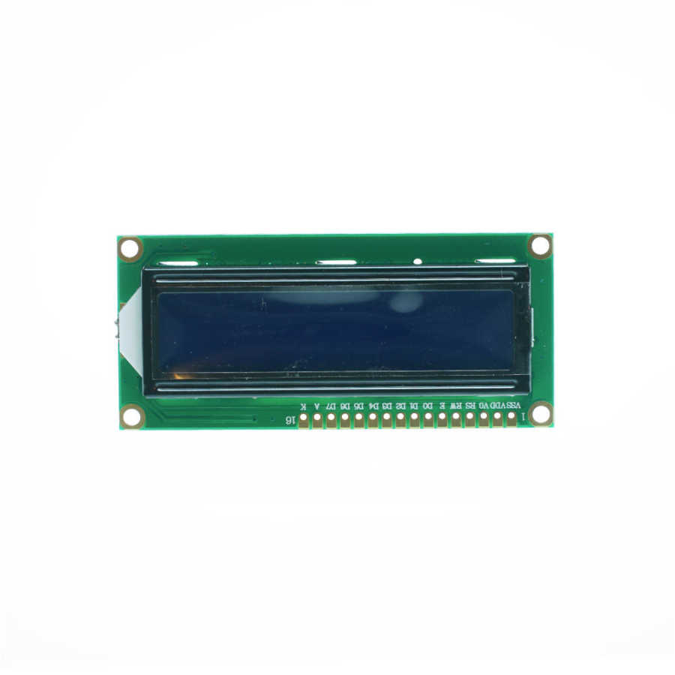
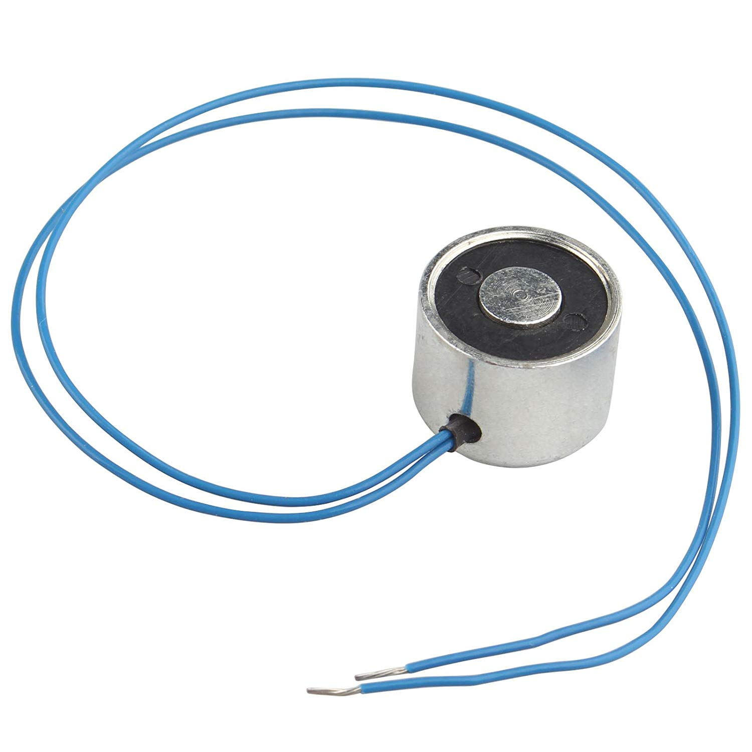
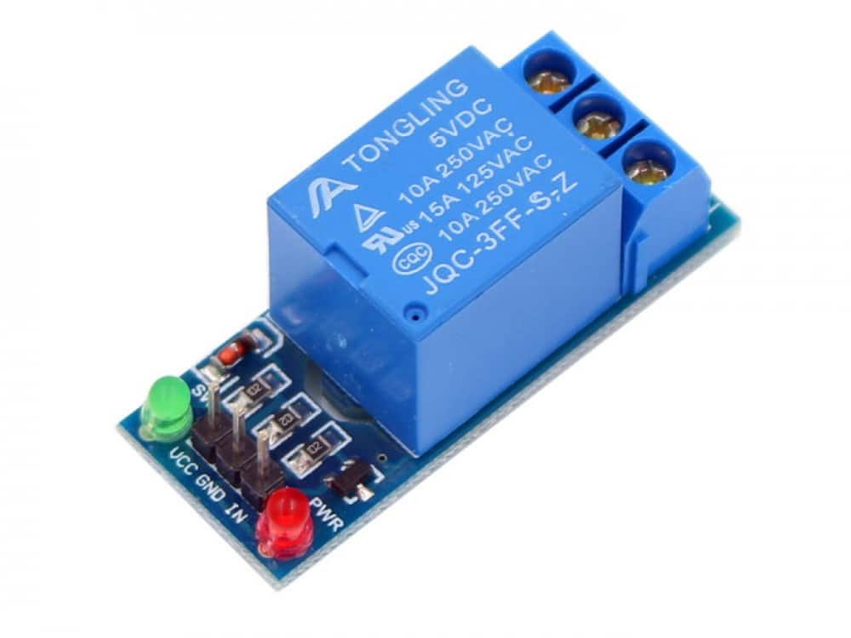
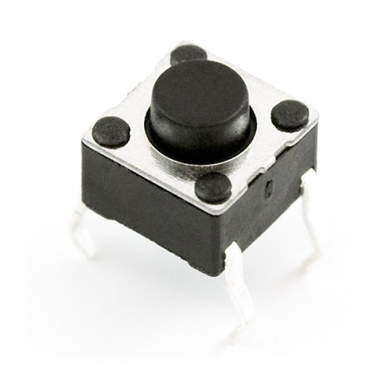
Hardware: p6
LCD 2x16
Electromagnet sucker
Relay
Push button
Notes:
Relay to drive the magnet with high voltage
Push button to send feed back or response to the system

Slide 10
Work Phases:
Board Detection
Decide next move
Move Arm and pick/drop objects

Slide 11
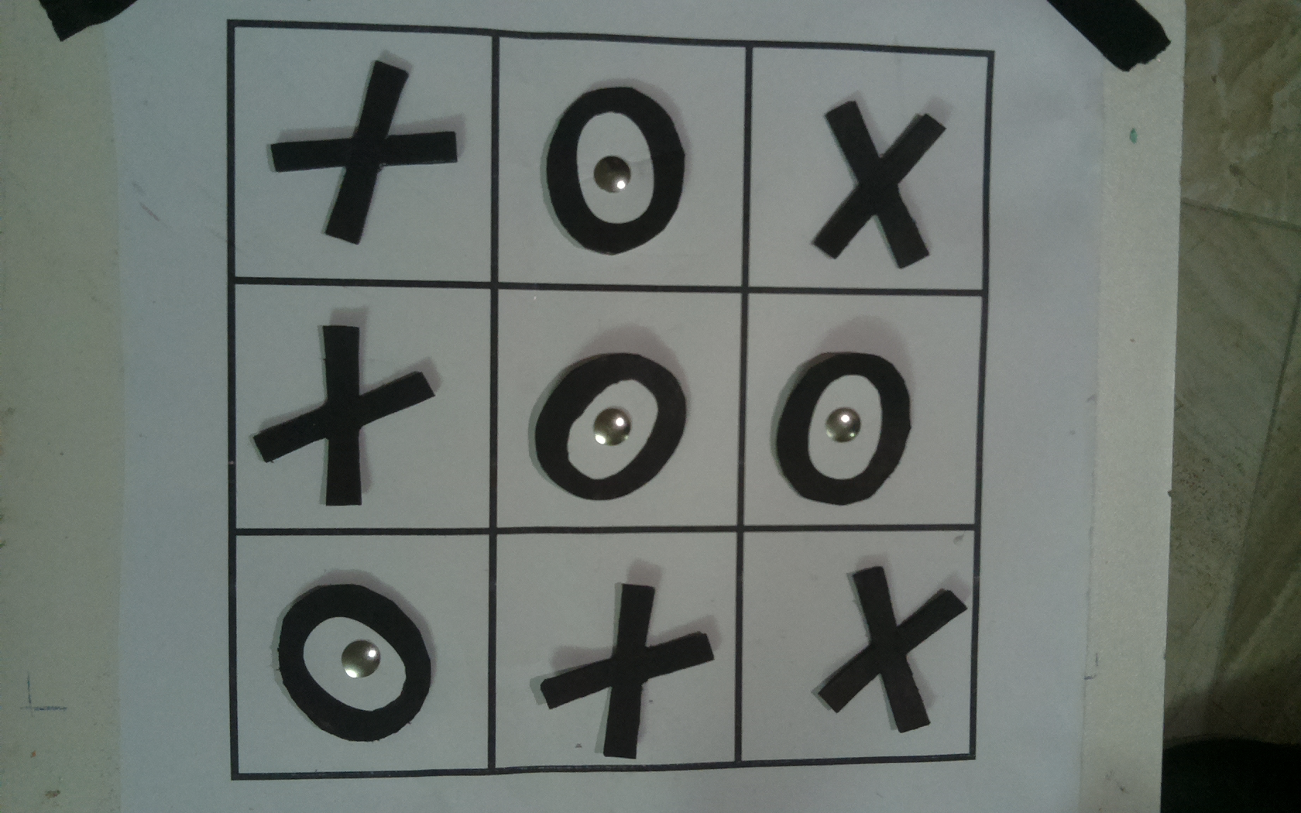
Board Detection
“XOXXOOOXX”
Filters
Contours
Squares
Eliminate extreme values
Eliminate duplicate squares
Sort vertically and horizontally
Crop
Contours
Guess the shape

Slide 12
Decide next step:
The state of the board is processed by a minimax algorithm.
If the state is final (Win or Draw) the game ends and result is displayed on screen.
The algorithm produces a tree with all the possible moves and the result of each move. The move that gives the optimal value is the one the robot plays.
Repeat.

Slide 13
Moving Arm :
When the move is determined, the Raspberry sends the position of the move to arduino through the serial port.
The arduino writes the position of the object basket to the motors to pick up an object.
The arduino finds the angels of the next move and writes them to the servos.
When the arm reaches the destination, it drops the object.

Slide 14
Exceptional cases
Wrong moves.
Wrong transactions between states/rounds.
Raspberry couldn’t extract the board state

Slide 15
Demo (Video)

Slide 16
Constraints:
Power problems.
Servo Motors.
Camera Issues.
Algorithm constraints.
Notes:
Time Constraint: The short time of the summer semester was the biggest challenge we faced.
Power problems: We needed high power source to drive the four servo motors, so we used a 12v, 10A power source with a buck converter to reach the suitable power supply.
Motor Problems: We had some issues regarding the operating of the motors, first we used motors that can lift up to 15kg/cm. However, that was not enough and it did not give the arm the power to lift the object and we faced accuracy problems. We resolved this by replacing the motors with ones that can lift up to 20kg/cm.
Camera Issues: The camera captures were affected by shadow so we used a flashlight to resolve this problem and get clear photos of the board.
Algorithm constraints We have tried multiple image processing algorithms to recognize the object from the image until we reached a good result

Slide 17
Future Work
Add other games to the robot and make the user decide which game.
Add difficulty levels (Easy, Medium, Hard).

