Slide 1


PROCESS IMPROVEMENT OF AL-REYAD COMPANY
Aya Nazzal
Kawkab Raddad
Mais Azaar
Yasmin Moqadi
Supervisor:
Eng. Suleiman Duafi.

Slide 2

OUT LINE
INTRODUCTION.
PROBLEM STATEMENT.
PROJECT BENEFITS.
LITRETURE REVIEW.
IMPLEMENTATION METHODOLOGY.
EXISTING SITUATION.
DEVELOPMENT.
CONCLUSION.
RECOMMENDATION.

Slide 3
INTRODUCTION
Process improvement is often a fundamental requirement and continuous effort for any organization that wishes to succeed in today’s environment of change and challenge, it has an important role in the advancement of any company, whether those processes are industrial or administrative. Al-Reyad Company one of the furniture companies that seeking to improvement in its processes.

Slide 4
PROPLEM STATMENT
Random plant layout.
Have not clear organizational structure and job description
No available operation management system.
Have not documentation and archiving systems.
There is no forms for contracts.
No available production planning management.

Slide 5
IMPLEMENTATION METHODOLOGY
Literature review
Review the literatures relating to all topics contained in furniture factories.
Assess and evaluate the current situation
By using gap analysis we:
1.Compare the actual situation with desired situation
2.Analyze the results and decide the required improvements

Slide 6
LITRETURE REVIEW
Facility layout:
Local furniture manufacturing company in Chiang Mai, Thailand
They used a layout design technique to reduce operations steps and average time.
using ARENA program, the best layout was found to significantly cut down movement from155 m to 47 m, resulting in a reduction of average operation time from 260 to 245 min .

Slide 7
LITRETURE REVIEW
Maintenance
Preventive Maintenance Development: A Case Study in Furniture Company.
In this case, preventive maintenance instructions were developed; its allocation by three technicians and their planning throughout the year. And the result is reduce the difference between technician with the most and the lowest workload from 187 hours to 15 hours and increase the percentage of implementation from 21% to 29%.

Slide 8
AL-REYAD FURNITURE COMPANY EXISTING SITUATION
Organization structure and job description
* No clear organization structure that help to define the roles .
* All workers work at random way without Assign specific responsibilities.
* Using family business management style.
Production planning
* No scientific method to organize their production operation, they work at random way.
* Bad time management system.
Documentation system
No Achieving system or documentation technique for orders or for any action that done inside it.

Slide 9
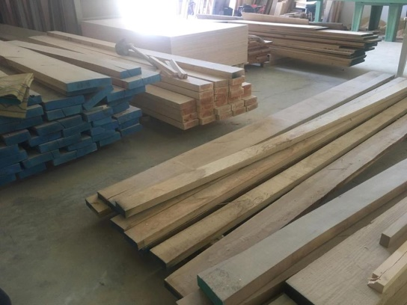
AL-REYAD FURNITURE COMPANY EXISTING SITUATION
Time management planning
In the company the main problem is the lack of experience in time management techniques, that causing delay in delivering goods to the customers that may cause a lot of complaints.
Inventory management
The company doesn’t have any system to manage its inventory, so it stores the furniture and raw material in random ways.

Slide 10
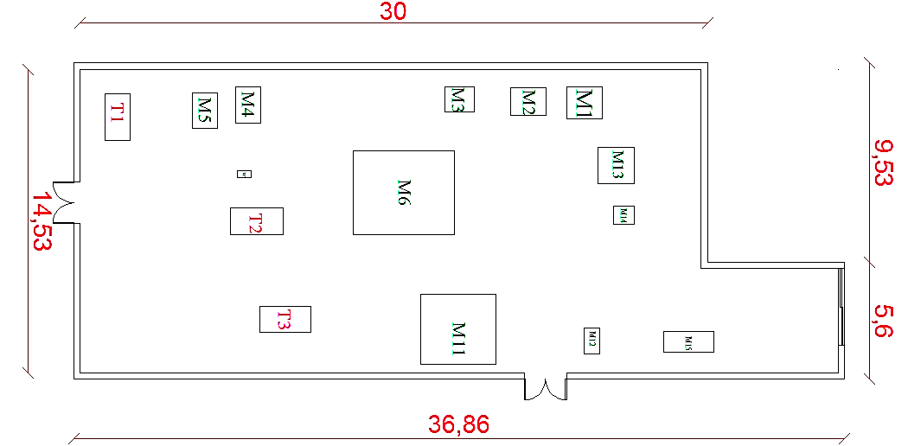
AL-REYAD FURNITURE COMPANY EXISTING SITUATION
Machines layout
machines was distributed in random way as shown in the figure

Slide 11
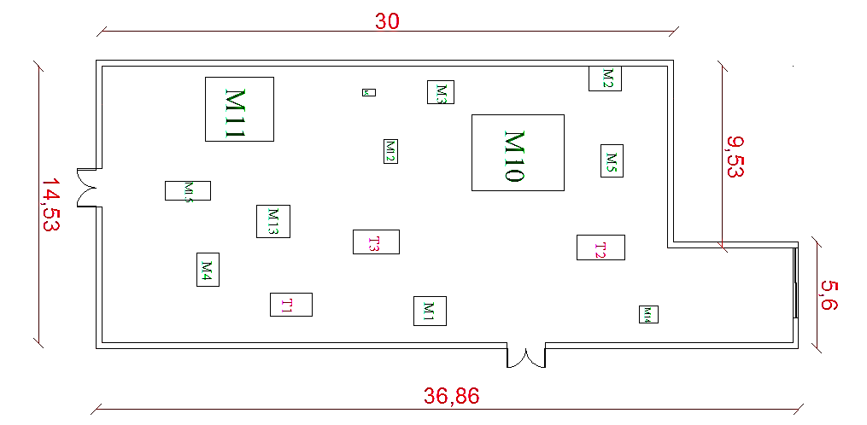
DEVELOPMENT
New machine layout

Slide 12
DEVELOPMENT
Organization structure
General Management
Quality department
Engineering department
Administrative Affairs department
Financial department
Production department
Gallery
Project management
Marketing
Maintenance
R & D
Safety and risk management
Assembly and packaging
Planning
UpholsteryDivision
Inventory management
Cabinet work section
Human resource
Purchas
Paint department
Sales

Slide 13

DEVELOPMENT
Designing a logo for the company.

Slide 14
DEVELOPMENT
Designing Procedures and forms for the departments.
Production department.
Maintenance department.
Purchasing department.
Quality department.
Human resource department.
Warehousing department.
Financial department.

Slide 15
DEVELOPMENT
Example:
Purchasing flow chart that summarize the purchasing procedures.
Warehouse department
Purchase request form
Purchasing department
Estimate order cost
No
Cost > 1000 NIS
Yes
Purchasing department
Purchasing department
Prepare purchase order
Request of proposal form
Contact with supplier to purchase the order
Request of proposal form
Inform Letter about implement purchasing process
General management

Slide 16
No
End process
Approved?
Warehouse department
Yes
Inform that the material arrived
Purchasing department
Send request of proposal form to the suppliers
Purchasing department
Inspect the order and its matching to the requirements
Prepare summary of request of proposal form after prices arrival
No
Match?
Purchasing department
Summary of request of proposal
Yes
Send the invoice to the Finance department, and save a copy of it at purchasing department
General management
Contact with supplier to take an action
Adopt on of the request of proposal
Inform letter to receipt the order
Purchasing department
Warehouse department

Slide 17
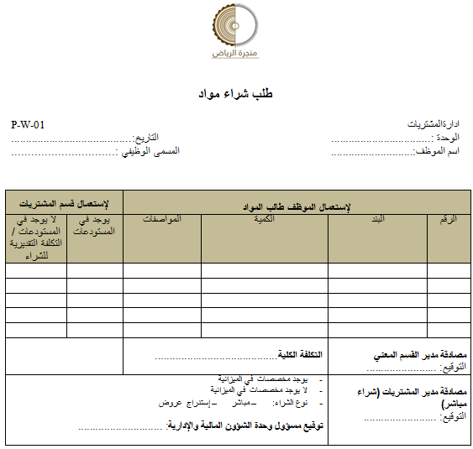
DEVELOPMENT
Example:
One of forms that designed in purchasing procedures.

Slide 18
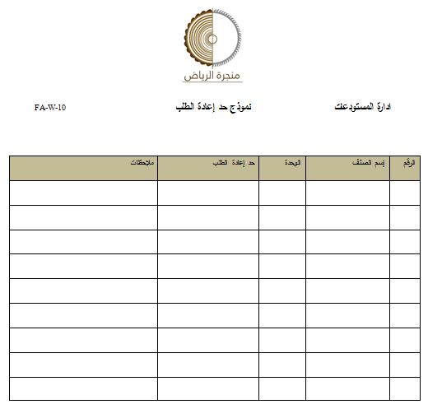
DEVELOPMENT
Example:
One of forms that designed in warehouses procedures.

Slide 19
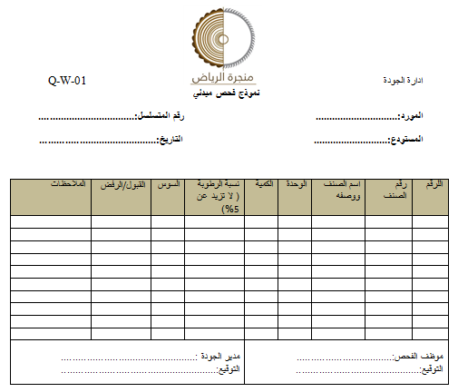
DEVELOPMENT
Example:
One of forms that designed in quality procedures.

Slide 20
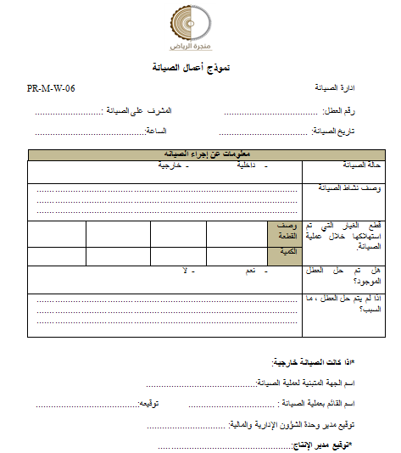
DEVELOPMENT
Example:
One of forms that designed in maintenance procedures.

Slide 21

DEVELOPMENT
Archiving and data management system.
A special file cabinet has been adopted; Each file has a number refers to it; To make archiving process easier a symbol has been given to each department.
This pattern will adopt to give numbers to the file: (The file number / envelope number / the department symbol / number for the paper itself)
File name | File no. | #
Customer | 01 | 1
Sales | 02 | 2
Purchasing | 03 | 3
Financial | 04 | 4
Employee | 05 | 5
Maintenance | 06 | 6
Inventories | 07 | 7
Symbols | Department
S | Sales
P | Purchasing
PR | Production
F | Financial
HR | Human resources

Slide 22
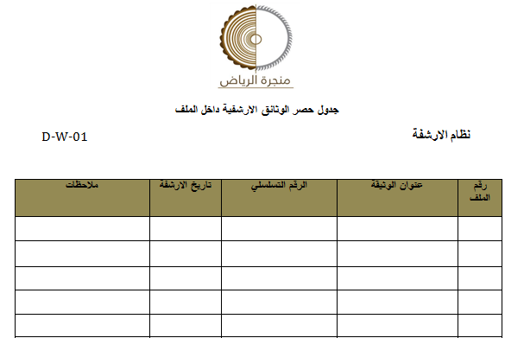
DEVELOPMENT
Archiving and data management system.
In the beginning of each file there is a form that include the name of all documents in this form and other information about it.

Slide 23
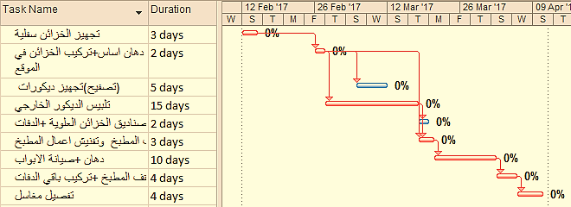
DEVELOPMENT
Time management planning
Case study: we take an order as a sample to schedule it, this order include kitchen cabinet and some decors. By using MS project the following Gantt chart resulted, the duration of the order is 50 days.

Slide 24
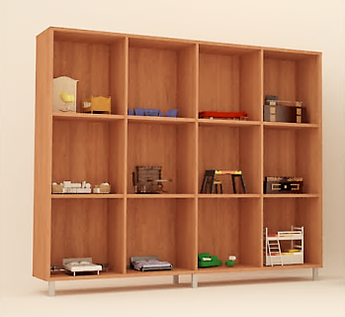
DEVELOPMENT
Gallery section.
There is three ways to show their products:
1. Using Catalogs.
2. Displays their products photos on the office walls.
3. Using product showcase to show Miniatures from products as next figure.

Slide 25
DEVELOPMENT
Warehouses management
There are three categories of inventory inside the company, for each one special system have been suggested as the next figure show.
Raw material
ABC & Drive-in
Finished product
stickers
Paint and accessories
5 S

Slide 26
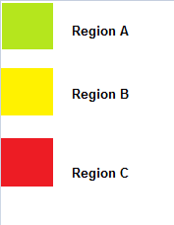
DEVELOPMENT
Warehouses management ( raw material inventory)
ABC system:
High annual demand A
Medium annual demand B
Low annual demand C
اسم الصنف | نوعه
1-الواح خشب المهجون | اخضر
2-الواح خشب البلوط الامريكي | اخضر
3-الواح خشب الزان | اخضر
4-الواح خشب الMDF بقشرة | اخضر
5-الواح خشبMDF بدون قشرة | اخضر
6-الواح خشب سندوش ملبس فورمايكا | اخضر
7-الواح خشب بلوط اوروبي | اصفر
8-الواح خشب السويد | اصفر
9-الواح الخشب الابيض | اصفر
10-الواح خشب الميبل | اصفر
11-الواح خشب التك | احمر
12-الواح خشب القطران | احمر
13-الواح خشب الجوز | احمر
14-الواح خشب الديكت | احمر
15-الواح خشب البنيل ( الاتيه ) | احمر

Slide 27
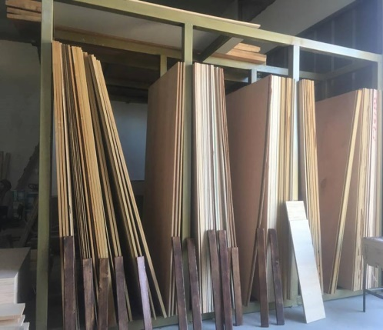
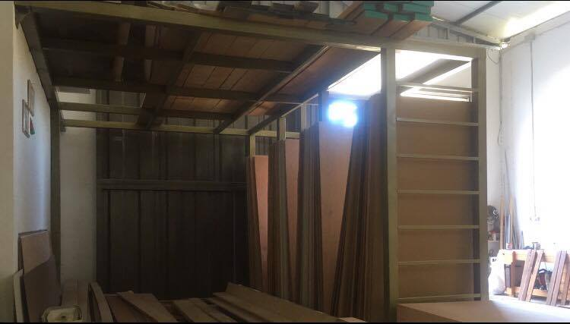
DEVELOPMENT

Slide 28
DEVELOPMENT
Warehouses management ( finished product inventory)
Using stickers (label) for each product.
منجرة الرياض رقم الطلبية :......................................... اسم الزبون : ........................................ تاريخ التسليم : ...................................... وصف البند : ....................................... العنوان : ............................................

Slide 29
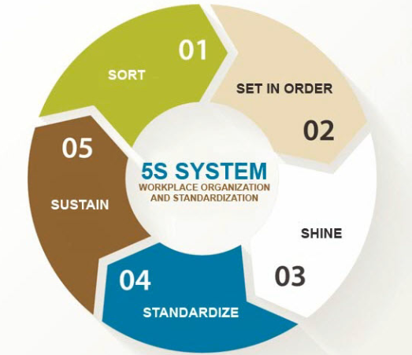
DEVELOPMENT
Warehouses management (Paint and accessories inventory)
Apply 5S system is the best way for this type of inventory

Slide 30
CONCLUSION
Applying the principals of industrial engineering to make continues operational improvement inside the company in order to increase operational efficiency , productivity ,eliminate redundancy and improve the ability to make production plan ,clear organization structure , job description , maintenance system and the best layout for the company, also evaluated the current situation by using gab analysis to reach the desired situation and take some actions, Also we try to make sure that the products fit their purpose and meet the customer needs.

Slide 31
RECOMENDATIONS
Try to change the layout to the new one that was nominated.
Arrange their job by using clear procedure , forms and scheduling their works.
Recruit at least an engineer who can also build a new organization structure for company.
make a documentation system for all processes that done inside the company which help to track the operations to increase the efficiency and achieve the company objectives.
Try to implement the suggested improvement methods that discussed in this project.

Slide 32
THANK YOU

