Slide 1


Slide 2
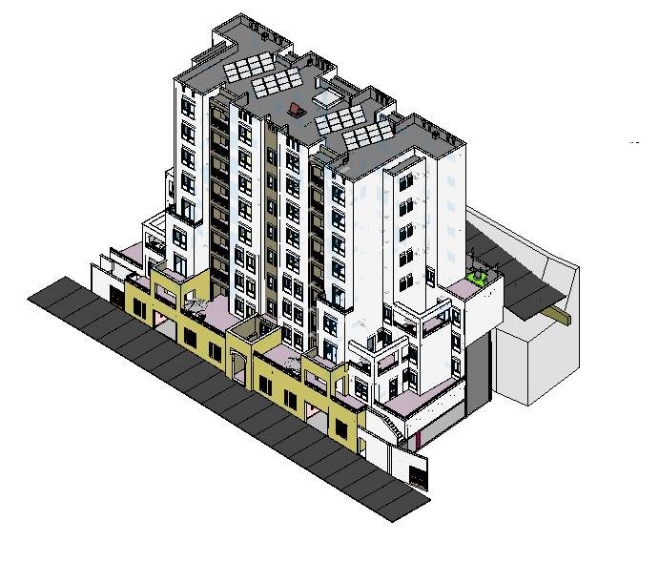

Slide 3


Graduation project
Project
Residential building

Slide 4
Introduction
Rawabi building is residential building a located in Rawabi city; it consists of eight floors , with total area of 2850 m².
Structural elements will be designed as reinforced concrete members according to strength and serviceability criteria as specified in ACI 318, for seismic design UBC-97 code will be used.

Slide 5

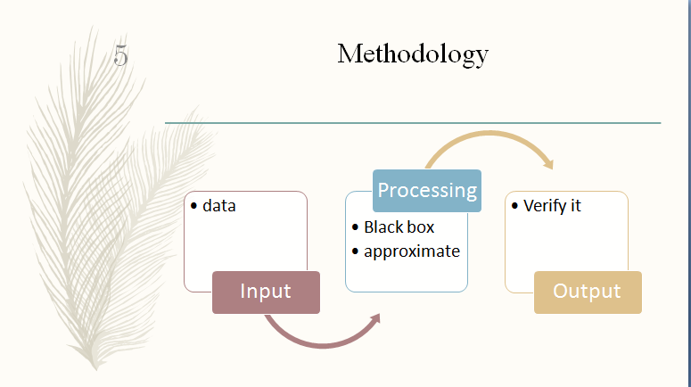
Methodology
Input
data
Processing
Black box
approximate
Output
Verify it

Slide 6
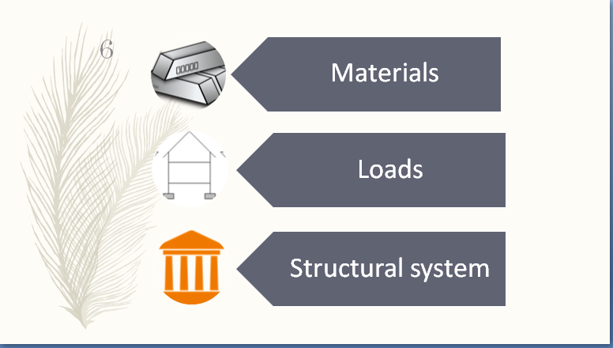
Materials
Loads
Structural system

Slide 7
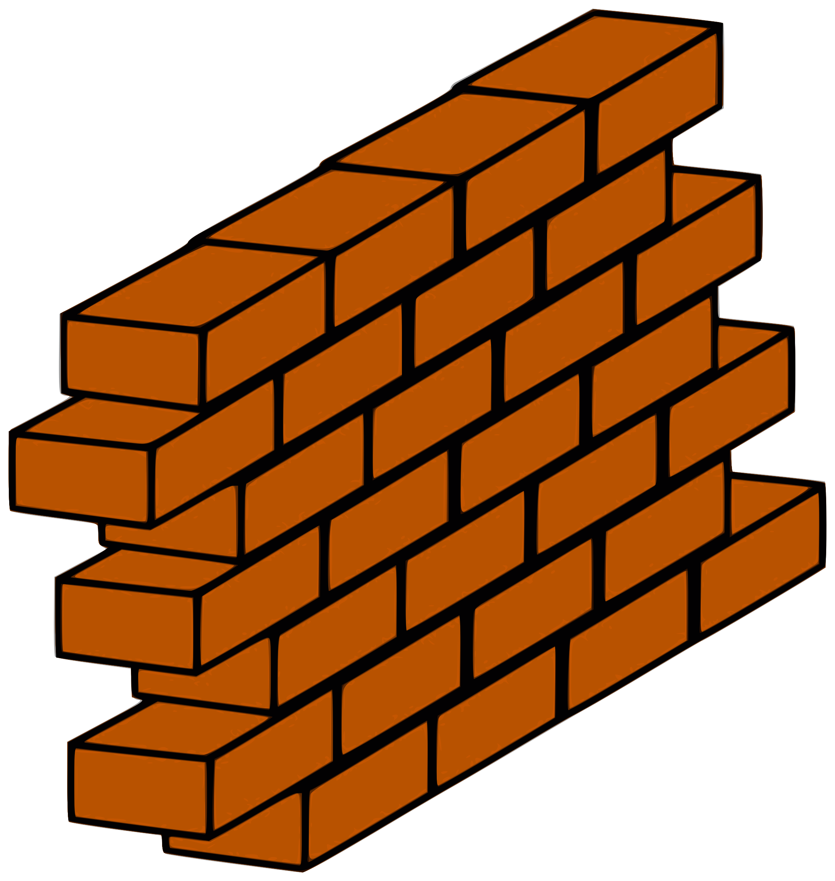
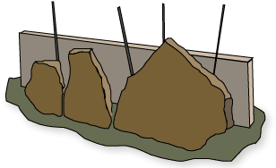
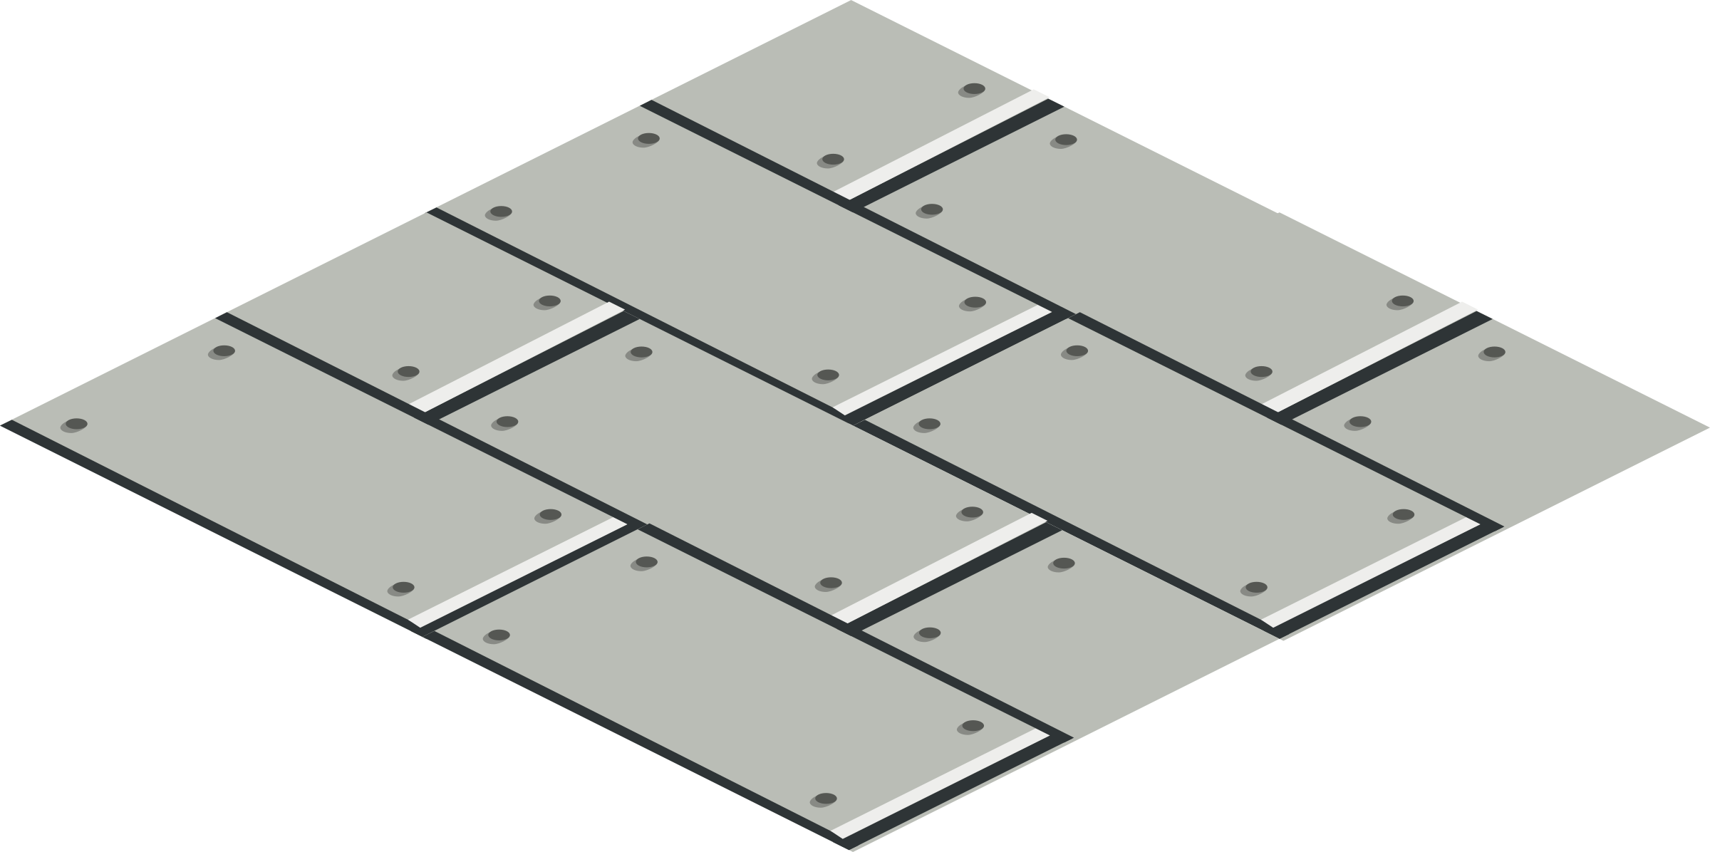
materials
Concrete
F’c =32MPa
Steel Fy=414Mpa
Non-structural material
masonry stones
Blocks
Tile
Mortar
insulation
Filling material
Marble

Slide 8


Soil properties
From the report soil the foundation of building is rock - rock is the common foundation in Rawabi - and the allowable bearing capacity for rock is 400 kN/m².

Slide 9
Loads:
Gravity
Dead
Lateral
Live
Soil pressure

Slide 10
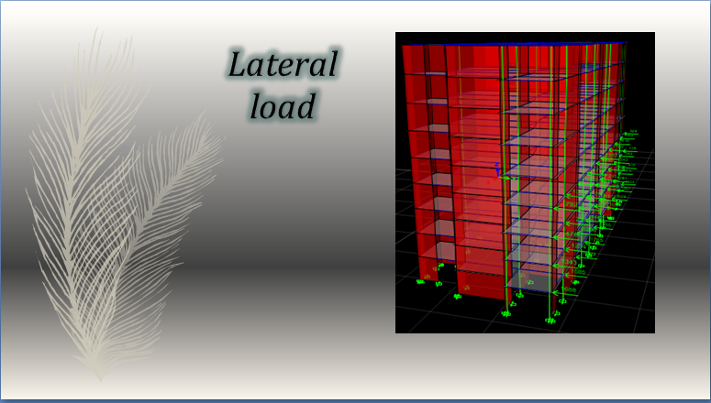
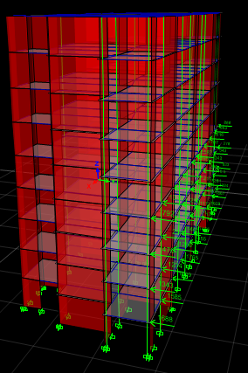
Lateral load

Slide 11

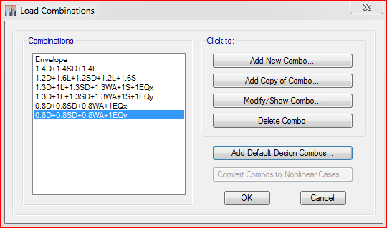
Load Combinations

Slide 12



Design Criteria
Serviceability
Economy
Strength and safe

Slide 13

Structural System

Slide 14

Structural system
Ribbed slab system ?
 | Ribbed Slab
Safety | less weight
Economy | For medium and long span
Serviceability | Good for sound Insulation

Slide 15

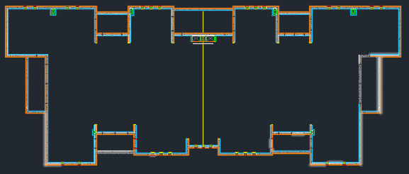
Plan

Slide 16





Dimensions and design
a variable
for drop beams = 45*30 cm
For hidden beams = 25*60cm
Dimension for all Blocks
55*30 cm
25 cm

Slide 17
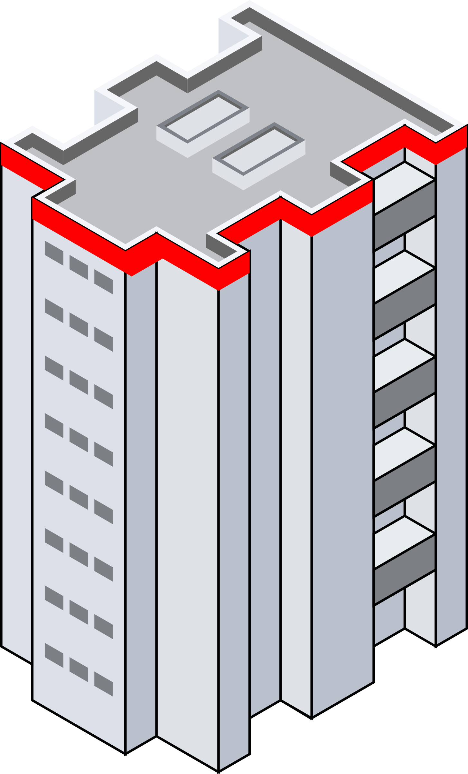
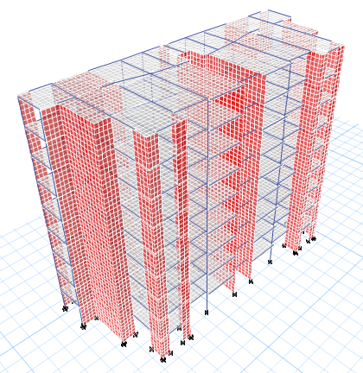
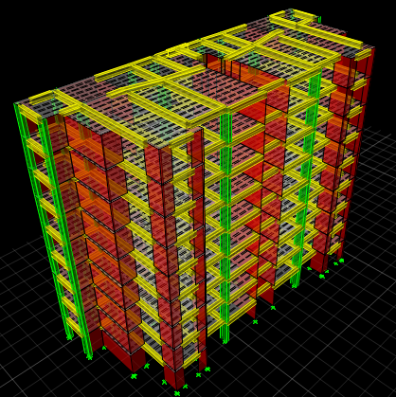
3-D model in ETABS

Slide 18
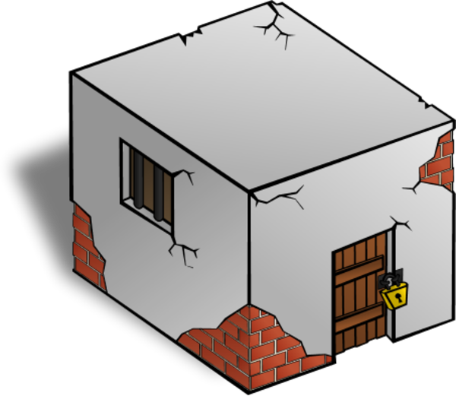


Modifiers
Just as a reminder:
Crack modifiers.
Fake modifiers.

Slide 19

Checks
Checks
Compatibility
Stress-Strain
Equilibrium
Period

Slide 20

Seismic Design
Structure period
check period by using Method A formula:
T = 0.0731* (25.2) ^{¾}
T=0.82 sec
T = C_{t}*H^{3/4}
Where: C_{t} = 0.0731 for moment resistant concrete frames

Slide 21
Seismic Design
Structure period
Results: period from ETABS should be ≤ 1.3 T= 1.06 sec
Period(Tn sec) In y-direction | Period(Tn sec) In x-direction | Block .
From ETABS | From ETABS
0.403 | 0.634 | 1

Slide 22

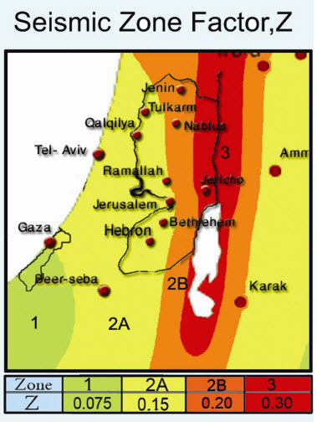
Seismic Design parameters
Using Response Spectrum
Design according to UBC-97 code.
Soil profile type: Rock S_{B}
Zone factor: By using Palestine seismic map the zone factor Z for Rawabi city is 2B thus, Z=0.2
Seismic coefficients: C_{a} and C_{v}
C_{a} =0.20 Table 16-Q in UBC
C_{v} = 0.20 Table 16-R in UBC

Slide 23
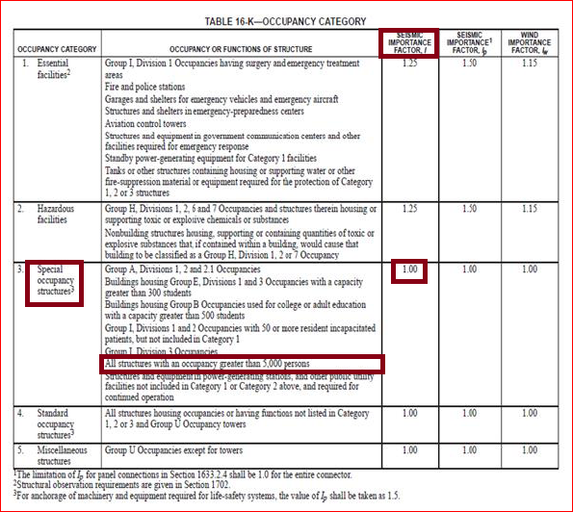

Seismic Design parameters
Importance factor [I]: I=1

Slide 24
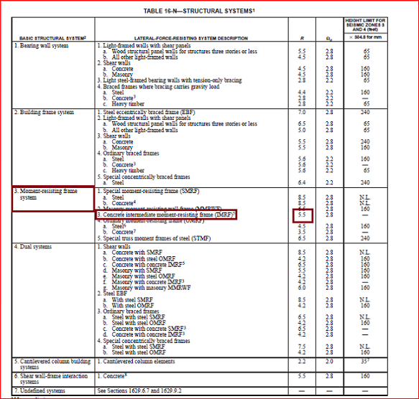

Slide 25
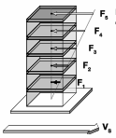
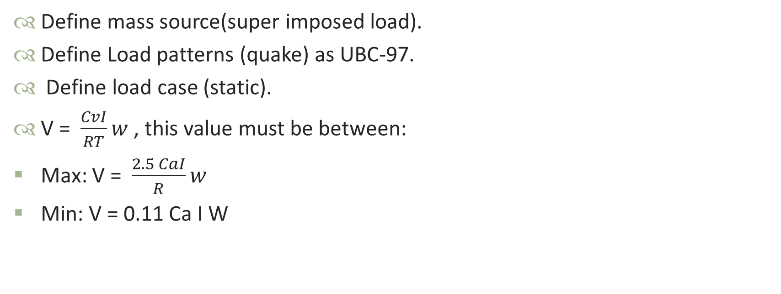
Seismic Design
Determine of Base shear
Define mass source(super imposed load).
Define Load patterns (quake) as UBC-97.
Define load case (static).
V = $\frac{CvI}{RT}w$ , this value must be between:
Max: V = $\frac{2.5 CaI}{R}w$
Min: V = 0.11 Ca I W

Slide 26
Seismic Design
Determine of Base shear
Take block as an example of calculation:
(Tn)x =0.634sec
(Tn)y = 0.403sec
Total weight =49100 kN
V = 2.5 * 0.2 * 1 * 49100 / 5.5 = 4464 kN
Ca = 0.2
Cv = 0.2
I=1
R = 5.5

Slide 27

Seismic Design
Determine of Base shear
Base Shear for Block:
V_{min}=2089 Kn
V _{max} =4464 Kn
Base shear in y-direction (Kn) | Base shear in x-direction (Kn) | Block No.
3092 | 2121 | 1

Slide 28

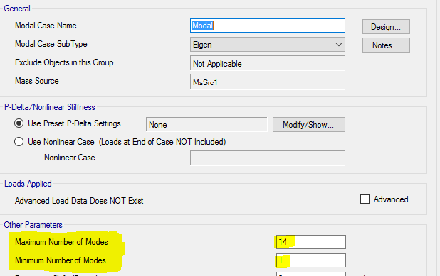
Modal Analysis
Response spectrum
Maximum and Minimum Number of Modes :

Slide 29

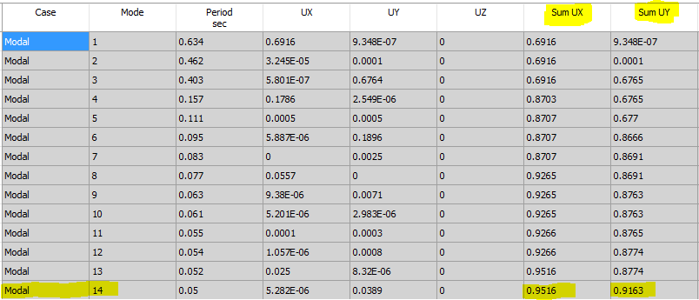
Modal Analysis
Response Spectrum
Mass Participation Ratio:

Slide 30

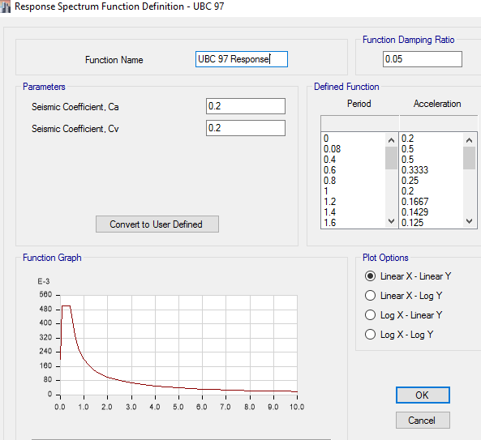
Modal Analysis
Defining Response Spectrum
Ca = 0.2
Cv = 0.2

Slide 31


Modal Analysis
Defining Response spectrum
Scale factor : g*I/R
I: Importance factor = 1
g: Gravity acceleration = 9.81 m/s²
R: Response Modification Coefficient
Note : for each direction there must be a component
of 30% from the perpendicular direction.

Slide 32
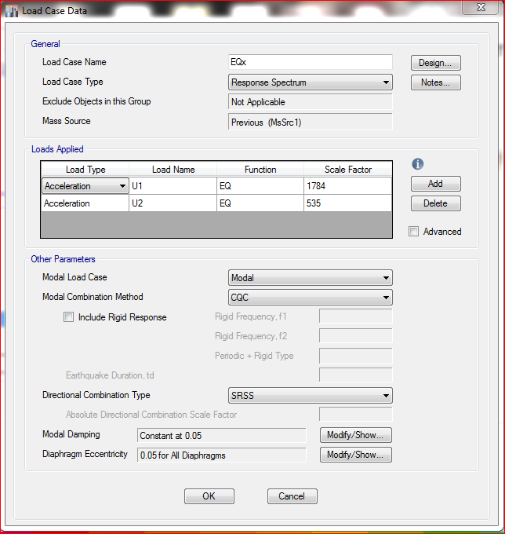
Modal Analysis
Defining Response spectrum
response spectrum in x-direction

Slide 33


Modal Analysis
Base shear from Response spectrum
Base shear from response differ than that in equivalent static.
As a requirement from UBC-97 : response spectrum base shear is (85- 100) percent of the base shear determined in equivalent static method.
so, modify scale factor:
scale factor = ((I g / R) * static base shear / response-spectrum base shear)

Slide 34

Modal Analysis
Base shear from Response spectrum
Block. | Base shear in x-direction (kN) |  |  | Base shear in y-direction (kN)
 | From static V_{ES} | From response V_{RS} | Scale factor V_{ES} / V_{RS} | From static V_{ES} | From response V_{RS} | Scale factor V_{ES} / V_{RS}
1 | 2089 | 2121 | 1.7 | 2089 | 3091 | 1.2

Slide 35


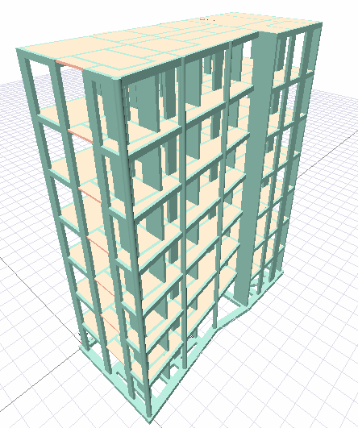
Design and detailing
Structural elements:
Slab
Beams
Shear wall
Columns
Stairs
Footing

Slide 36

Design and detailing
Slab design
Check Slab thickness

Slide 37
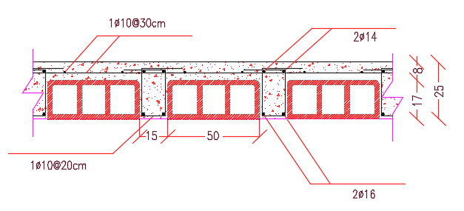
Design and detailing
Slab design
Slab Detailing :

Slide 38
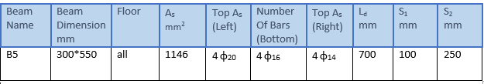
Design and detailing
Beam design
Beam :

Slide 39
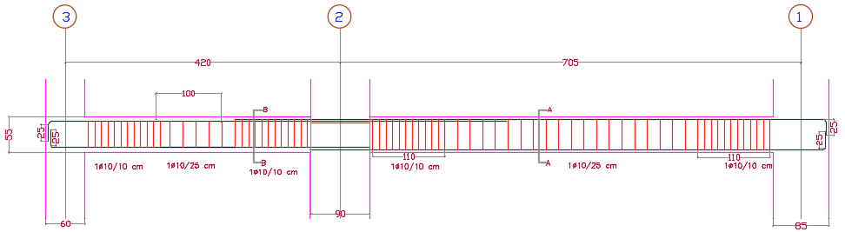
Design and detailing
Beam design
Beam detail :

Slide 40
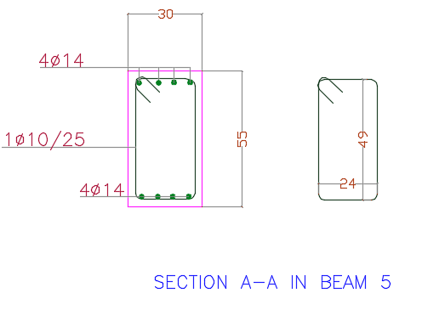
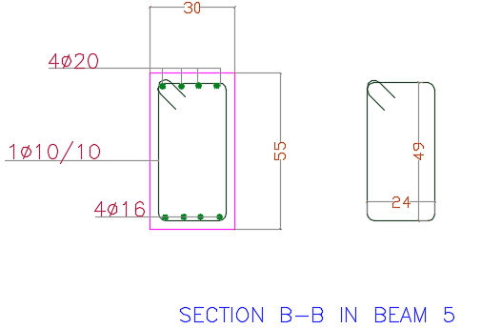
Design and detailing
Beam design
Beam detail :

Slide 41
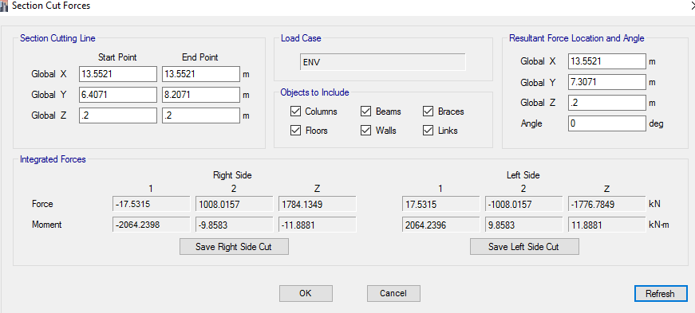
Design and detailing
Shear wall design
Internal forces:
section cut in shear wall 1

Slide 42
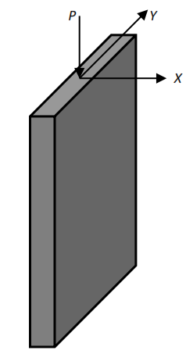
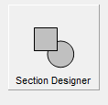
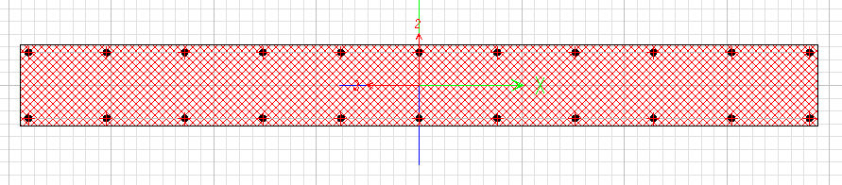
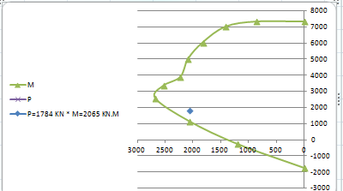
Design and detailing
Shear wall design
Design:
  Axial and Flexural: interaction diagram is obtained by ETABS

Slide 43
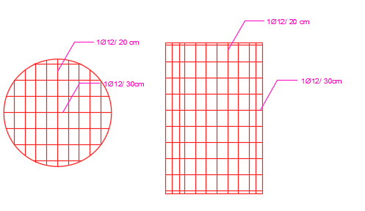
Design and detailing
Shear wall design
Detailing shear Wall :

Slide 44
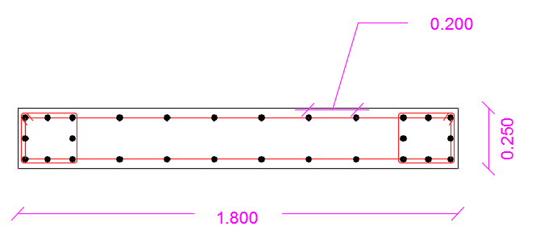


Design and detailing
Shear wall design

Slide 45
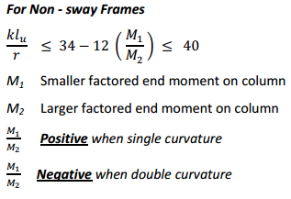

Design and detailing
Columns Design
Sample calculation :

Slide 46
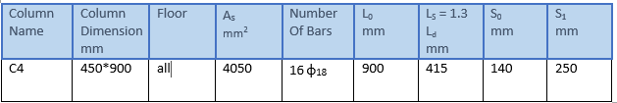
Design and detailing
Columns
Column detail:

Slide 47
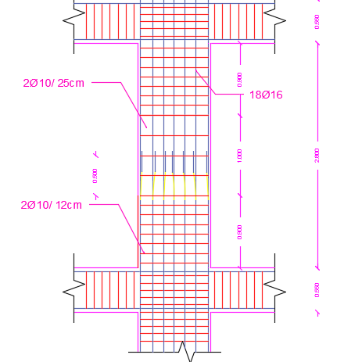
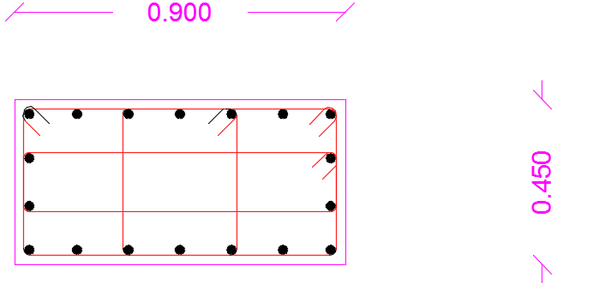
Design and detailing
Columns
Column detail:

Slide 48
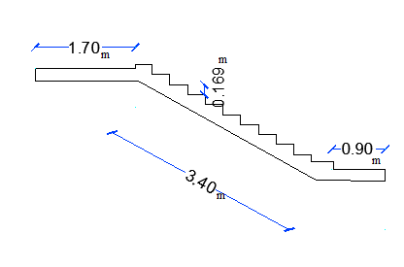

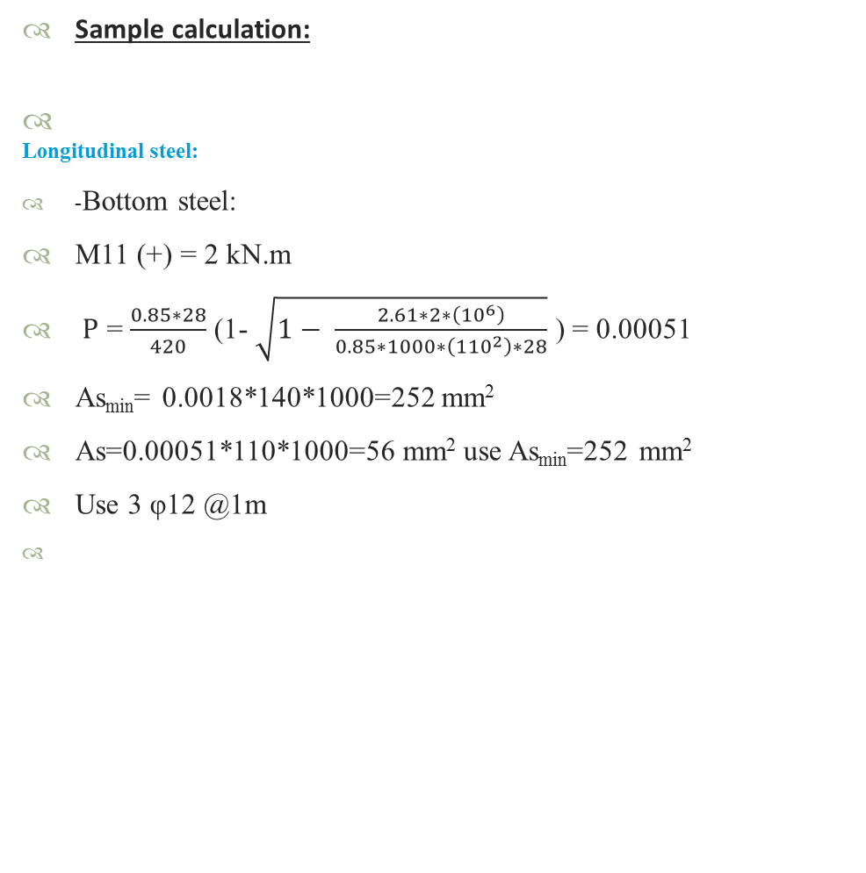
Design and detailing
Stairs
Sample calculation:
Longitudinal steel:
-Bottom steel:
M11 (+) = 2 kN.m
Ρ = $\frac{0.85∗28}{420}$ (1- $\sqrt{1− \frac{2.61∗2∗\left({10}^{6}\right)}{0.85∗1000∗\left({110}^{2}\right)∗28}}$ ) = 0.00051
As_{min}= 0.0018*140*1000=252 mm²
As=0.00051*110*1000=56 mm² use As_{min}=252 mm²
Use 3 φ12 @1m

Slide 49
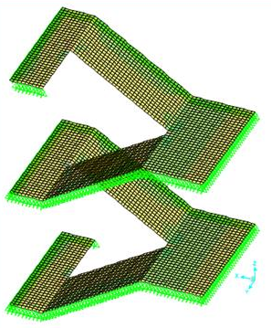
Design and detailing
Stairs

Slide 50
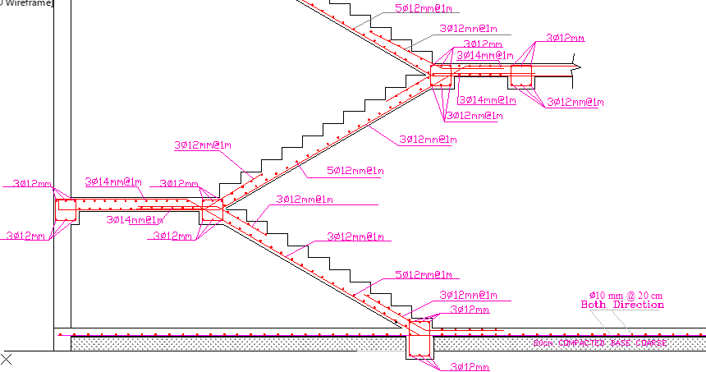
Design and detailing
Stair
Stair detail:

Slide 51


