Slide 1

AN- NAJAH NATIONAL UNIVERSITY
FACULTY OF ENGINEERING & INFORMATION TECHNOLOGY
MECHANICAL AND MECHATRONICS ENGINEERING DEPARTMENT
GRADUATION PROJECT 2
GENERAL PURPOSE
SEMI- AUTONOMOUS MOBILE ROBOT
DONE BY:
Hossam Mahasneh
Omar Afouneh Mohammed Shakhsheer Noor Daraghmeh
SUPERVISOR:
Dr. Bashir Nouri

Slide 2

OUTLINE
MOBILE ROBOT.
MECHANICAL DESIGN. ELECTRICAL PART.
CONTROL.
PRACTICAL PART

Slide 3


MOBILE ROBOT
HISTORY.
TYPES.

Slide 4

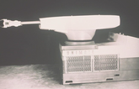


History

Slide 5
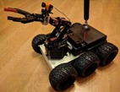

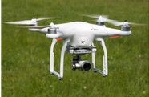
TYPES OF MOBILE ROBOT
WHEELED MOBILE ROBOT.
TRACKED MOBILE ROBOT. AERIAL MOBILE ROBOT.

Slide 6
MECHANICAL DESIGN
Timing
Robot’s
Pulleys
Platform
Bearing
Timing
Manipulator
Belts
Warm
Gripper
Planetary Gears
Gears

Slide 7
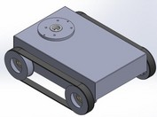

ROBOT’ S PLATFORM
Function.
Material selection.

Slide 8
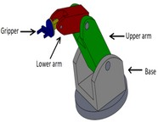
MANIPULATOR
Structural.
Degrees of freedom.

Slide 9
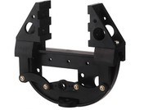
GRIPPER
Some of gripper features :
Lightweight design.
Lift round and square objects. Completely retractable .

Slide 10
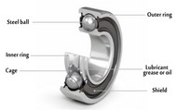
BEARINGS
There are two types of ball bearing : Axial load.
Radial load.

Slide 11
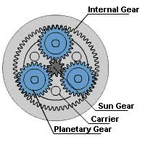
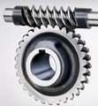
WORM AND PLANETARY GEARS

Slide 12
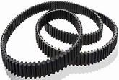
TIMING BELTS
Some of its features :
Light weight.
Reduced noises and vibrations .

Slide 13
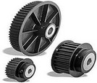
TIMING PULLEYS
There are many features of these pulleys including :
More accurate . No slipping occur. High efficiency.

Slide 14

ELECTRICAL PARTS
Dc Motors
Voltage
Regulator
Servo
Limit switches
Motors
Stepper
Power Supply
Motors

Slide 15

DC MOTORS
The current electrical motors type of WM6132 DC motor in our project to move the car , presents in Figure was used .
This motor was used because of its features , which are : Efficiency.
High Torque .
Easy to Control. Less Expensive.

Slide 16
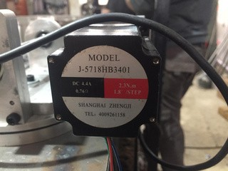
STEPPER MOTOR
A stepping motor converts digital information into proportional mechanical motion , The number of steps per revolution is 200, resulting in a 1.8° step size..
We used 3 type of stepper motor which are :
Nema 23 - j 5718HB3401 to move the gripper.

Slide 17
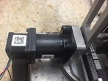
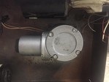
NIDEC kp56RM2G-010 to move lower arm and base .
STEPPER MOTOR
Nema 17 to move upper ar^{m .}

Slide 18
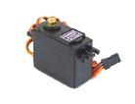
SERVO MOTORS
A servo is an electromechanical system , is commonly used to rotate the objects at some specific angles or distance .
In our project the servo motor MG996R was used for Gripper.

Slide 19
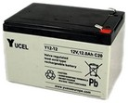
POWER SUPPLY
The lead–acid battery as shown in figure was used in this project to give the power which are rechargeable .

Slide 20
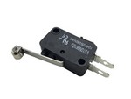
LIMIT SWITCH
Limit switch is an electromechanical system, used to limit body movement and sense if these limits are exceeded

Slide 21
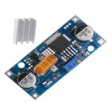
VOLTAGE REGULATOR
In our project we used XL4015 Voltage Regulator .

Slide 22
CONTROL DESIGHN
THIS PART INCLUDES :
Types Of Control Electronic Chips SOFTWARE

Slide 23

CONTROL SYSTEM
The control system is the basis of the robot and it is very important , which it manages the movement of different parts of the robot and regulates its behavior , includes mechanical , electrical parts and software systems.
In our project, the open loop was relied on for the control process

Slide 24
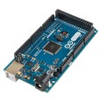
ARDUINO
Arduino Mega 2560 is a type of Arduino board, and it has been used for several reasons including :
Inexpensive.
Simple programming environment. Open source .

Slide 25
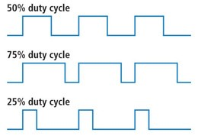
PULSE WIDTH MODULATION

Slide 26

H- BRIDGE

Slide 27
CONTROLLING THE DC MOTORS

Slide 28
DIFFERENTIAL DRIVE ROBOT

Slide 30
INVERSE KINEMATICS
The robot is a series of links that connect its by joints , the robot movement is divided into :
Forward kinematics : 𝐹(𝜃1 , 𝜃2 , 𝜃3 , … . 𝜃𝑛) = [𝑥, 𝑦, 𝑥, 𝑅] Inverse kinematics : 𝐹(𝑥, 𝑦, 𝑥, 𝑅) = 𝜃1 , 𝜃2 , 𝜃3 , … . 𝜃𝑛

Slide 31
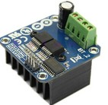
DRIVERS
Dc motor driver :
BT-2 has an integrated system to control the speed and direction of the DC motor

Slide 32
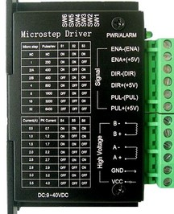
DRIVERS
Stepper motor driver :
iIts control how a stepper motor operates, commonly used excitation modes for stepper motors .

Slide 33
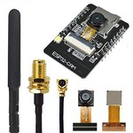
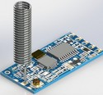
CAMERA & WIRELESS MODULE
ESP32-CAM 2MP CAMERA WIFI .
Hc-12 wireless module.

Slide 34
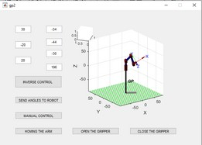
MATLAB

Slide 35

PRACTICAL PART

Slide 36
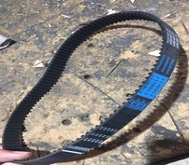
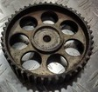
Choosing components :
Belt
PRACTICAL PART
Pulley

Slide 37
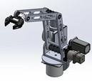
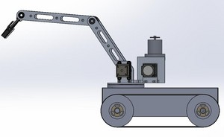
PRACTICAL PART
Re-design
The final design of the robot by the solid work , as shown in the following figures .

Slide 38
FUTURE VISION

Slide 39
Thanks

