Slide 1
Analysis and Design of Qarresh and Qutub Center
Prepared by:
Abdulrahman sawalmeh
Basil Al-maani
Reham Thaher
Supmited to:
Dr. Imad Al-Qasim

Slide 2
Outline
Background Information.
Preliminary Design.
Project Modeling.
Model Checks.
Design.

Slide 3
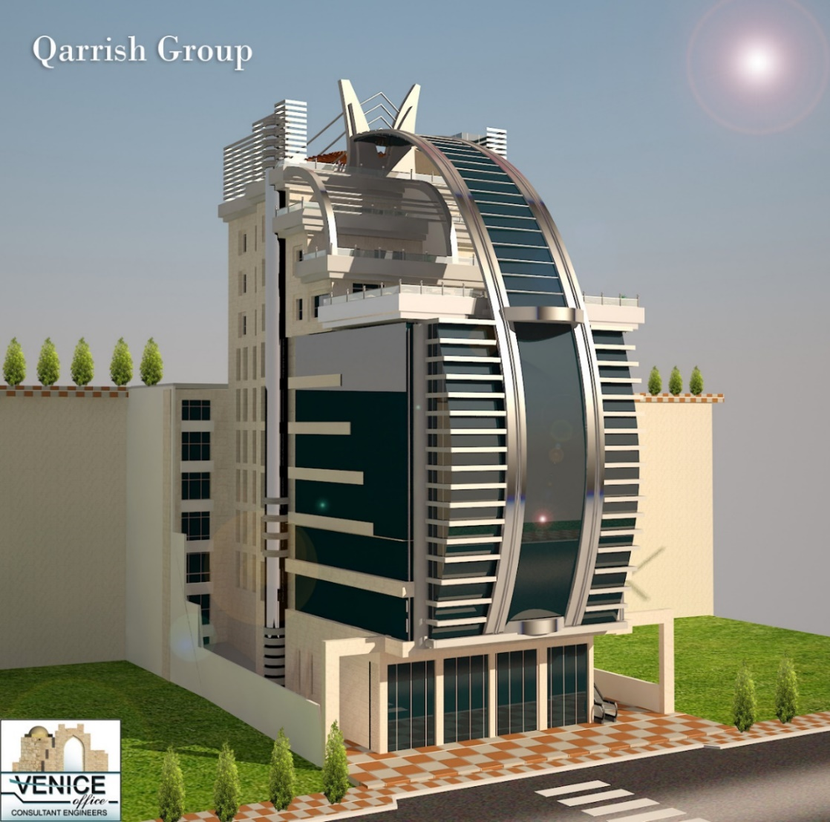
Qarresh and Qutub Center

Slide 4
Information about building
2 blocks .
Total area = 10026 m2.
There is a structural break.
Located in Nablus.

Slide 5
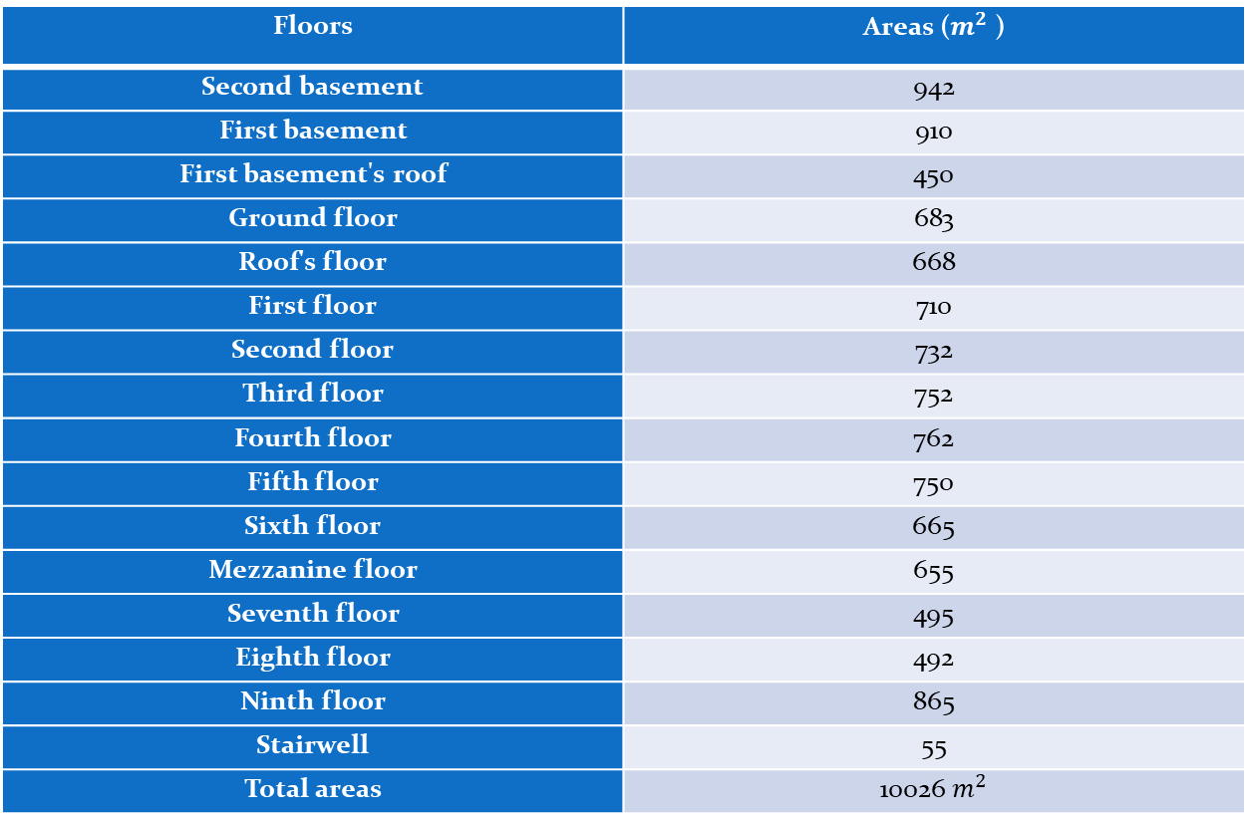
Floors and areas of the Center
Floors | Areas ($m^{2}$ )
Second basement | 942
First basement | 910
First basement's roof | 450
Ground floor | 683
Roof's floor | 668
First floor | 710
Second floor | 732
Third floor | 752
Fourth floor | 762
Fifth floor | 750
Sixth floor | 665
Mezzanine floor | 655
Seventh floor | 495
Eighth floor | 492
Ninth floor | 865
Stairwell | 55
Total areas | 10026 $m^{2}$

Slide 6
Codes
1. American concrete institute (ACI 318-14).
2. International Building Code (IBC 2015).

Slide 7
Materials
Reinforced Concrete
Structural type | Fc' ( MPa )
Slab | 24
Column | 28
Beam | 24
footing | 24

Slide 8
Reinforcement Steel
Yielding strength (Fy) = 420MPa.
Modulus of elasticity (Es) = 200GPa

Slide 9
Non-structural material
Material | Density KN/m³
Masonry | 26
Sand | 16
Block | 12
Plaster | 23
Tile | 26

Slide 10
Loads:
Loads
Gravity
Lateral
Dead
Live
Seismic
Soil

Slide 11
  Gravity Load:
I. Dead Load:
  Slab superimposed dead load= 4.5 KN/m².
II. Live Load:
  The maximum value of the live load which was obtained from table 4-1 in ASCE7-10 is 4.8 KN/m², But we used a live load value of 5 KN/m²

Slide 12
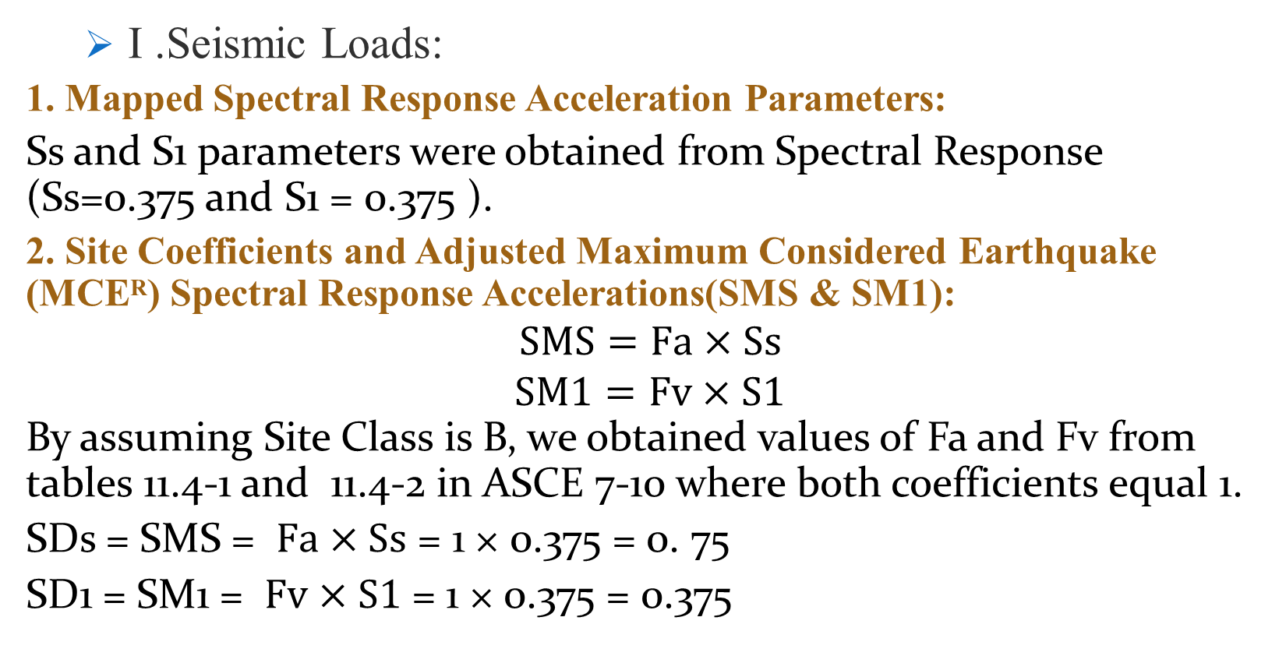
  Lateral load:
  I .Seismic Loads:
1. Mapped Spectral Response Acceleration Parameters:
Ss and S1 parameters were obtained from Spectral Response (Ss=0.375 and S1 = 0.375 ).
2. Site Coefficients and Adjusted Maximum Considered Earthquake (MCEᴿ) Spectral Response Accelerations(SMS & SM1):
$$SMS=Fa×Ss$$
$$SM1=Fv×S1$$
By assuming Site Class is B, we obtained values of Fa and Fv from tables 11.4-1 and 11.4-2 in ASCE 7-10 where both coefficients equal 1.
SDs = SMS = $Fa×Ss$ = 1 × 0.375 = 0. 75
SD1 = SM1 = $Fv×S1$ = 1 × 0.375 = 0.375

Slide 13
3.Importance Factor (Ie) and Risk Category:
The risk Category was decided to be Ш from table 1.5-1 in ASCE7-10, so the Importance Factor is equal 1.25 according to table 1.5-2 in ASCE7-10.
4. Seismic Design Category:
According to the tables 11.6-1 and 11.6-2 in ASCE7-10, Since the value of SDs= 0.75, and the Risk Category is Ш. So, it’s found that the seismic design category is D.

Slide 14
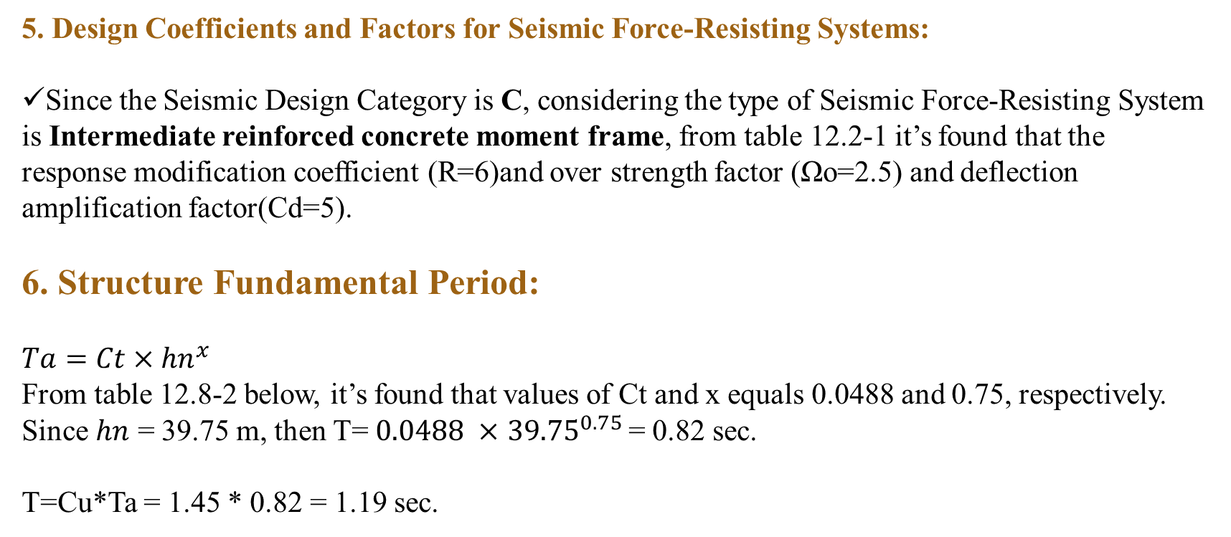
5. Design Coefficients and Factors for Seismic Force-Resisting Systems:
Since the Seismic Design Category is C, considering the type of Seismic Force-Resisting System is Intermediate reinforced concrete moment frame, from table 12.2-1 it’s found that the response modification coefficient (R=6)and over strength factor (Ωo=2.5) and deflection amplification factor(Cd=5).
6. Structure Fundamental Period:
$$Ta=Ct×{hn}^{x}$$
From table 12.8-2 below, it’s found that values of Ct and x equals 0.0488 and 0.75, respectively.
Since $hn$ = 39.75 m, then T= $0.0488 ×$ ${39.75}^{0.75 }$= 0.82 sec.
T=Cu*Ta = 1.45 * 0.82 = 1.19 sec.

Slide 15

Preliminary Design

Slide 16
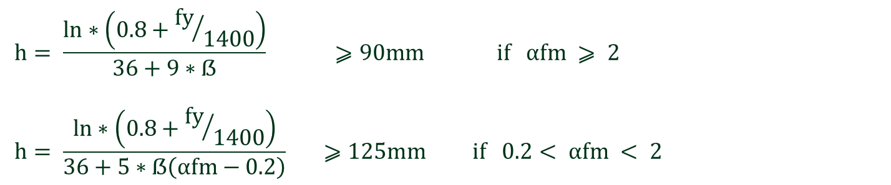
Preliminary design for Block A
The structural system used is two way solid slab
$$h= \frac{ln∗\left(0.8+{fy}/{1400}\right)}{36+9∗ẞ} ⩾90mm if αfm ⩾ 2$$
$$h= \frac{ln∗\left(0.8+{fy}/{1400}\right)}{36+5∗ẞ\left(αfm−0.2\right)} ⩾125mm if 0.2< αfm < 2$$
Slab thickness =250 mm

Slide 17
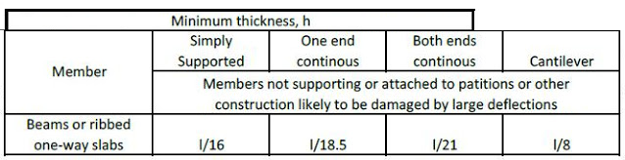
Beams
Beam | Dimensions (mm)
Block A | 500*700
Block B | 600*800

Slide 18
Columns
Columns dimensions are shown in the table:
Group No. | Dimensions (mm)
G1 | 600*600
G2 | 850*850
G3 | 1100 × 1100

Slide 19
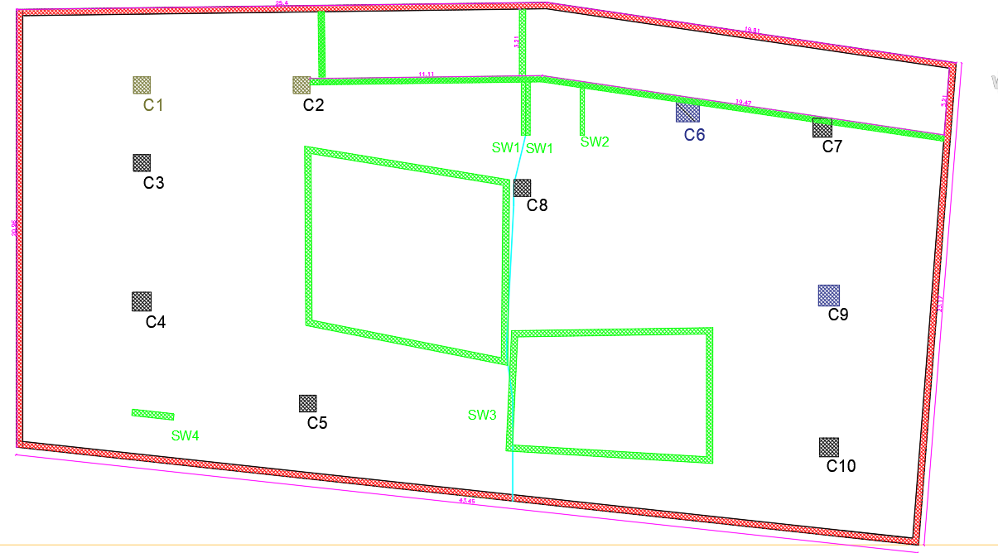
The following figure shows the distribution of columns

Slide 20
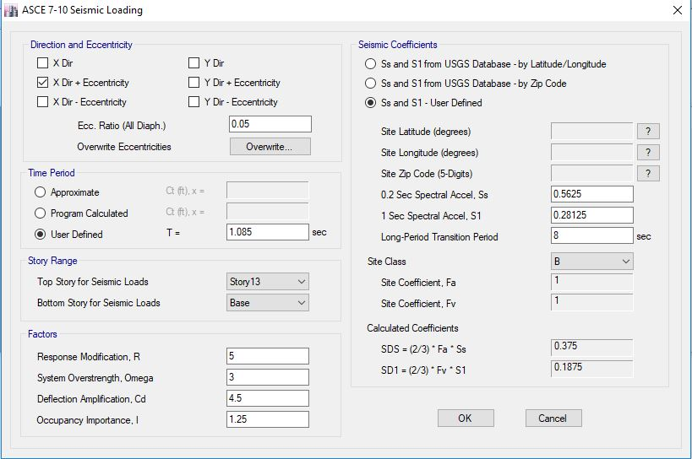
Seismic loading data according to Equivalent Static Method .
X-direction:

Slide 21
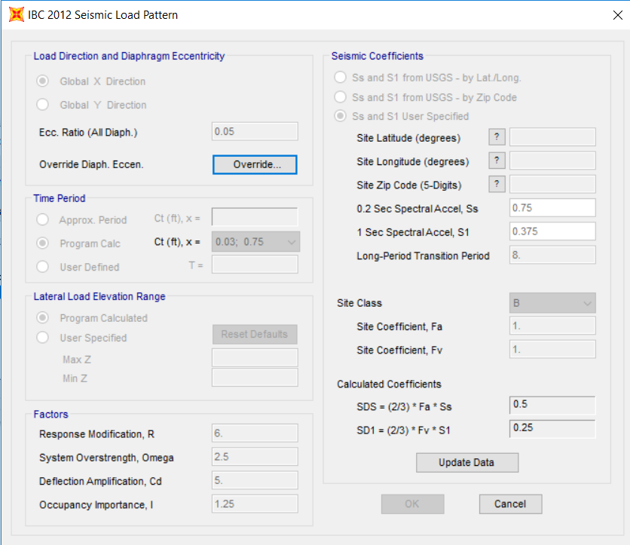
Response Spectrum Function
X-direction

Slide 22
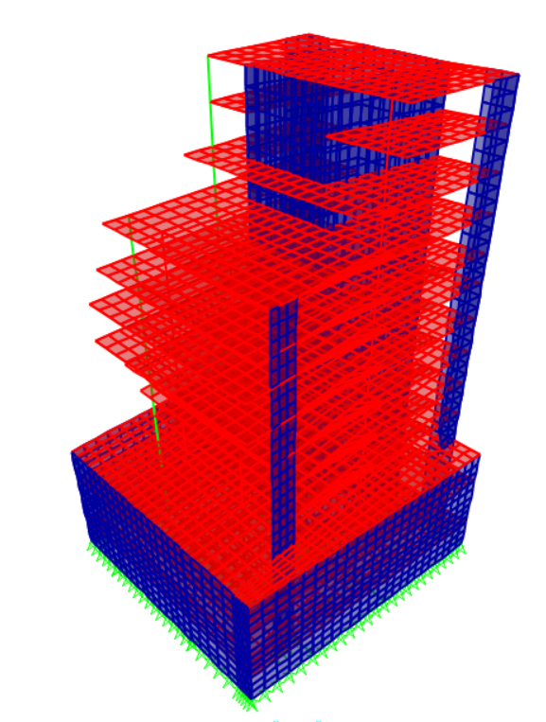
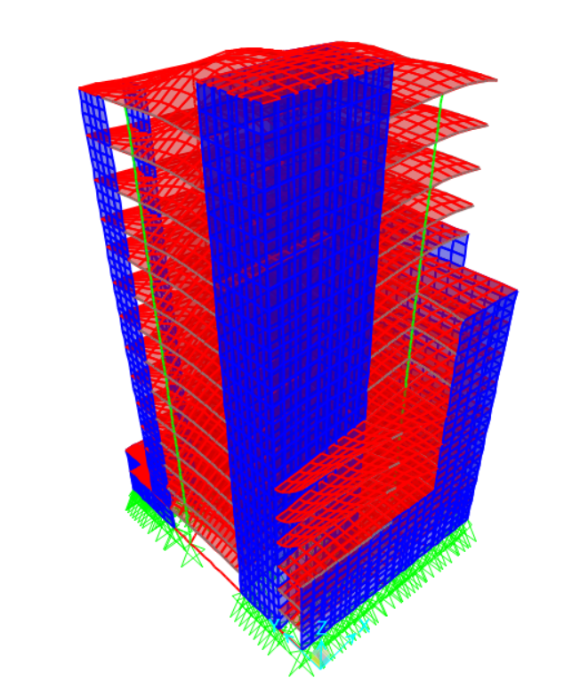
Model Checks
Compatibility Check:
To ensure that the model will behave as one static unit.

Slide 23
Equilibrium Checks:
To ensure that the model is satisfied Newton’s Law for statics and equilibrium objects. The checks for block A are in the figure below:
Load Type | Hand Cal. (KN) | SAP2000 Results(KN) | Difference %
SD | 20349 | 20228 | 0.6
Live | 22119 | 21987 | 0.59

Slide 24
Equilibrium Checks:
To ensure that the model is satisfied Newton’s Law for statics and equilibrium objects. The checks for block A are in the figure below:
Load Type | Hand Cal. (KN) | SAP2000 Results(KN) | Difference %
SD | 25369 | 25223 | 0.38
Live | 27575 | 27416 | 0.384

Slide 25
Design
After building the 3D model using SAP2000 and make the checks, then we can make the design process and preparing the detailing sheets for all members.

Slide 26
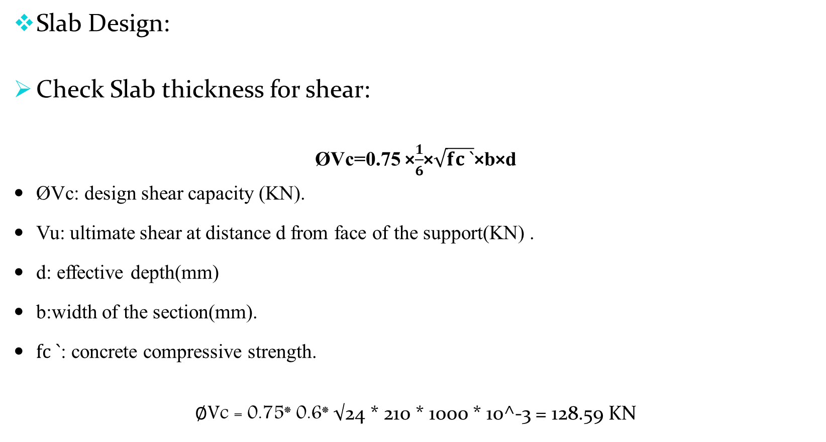
Slab Design:
Check Slab thickness for shear:
ØVc=0.75 ×$\frac{1}{6}$×$\sqrt{fc `}$×b×d
ØVc: design shear capacity (KN).
Vu: ultimate shear at distance d from face of the support(KN) .
d: effective depth(mm)
b:width of the section(mm).
$fc `$: concrete compressive strength.
$∅$Vc = 0.75* 0.6* √24 * 210 * 1000 * 10^-3 = 128.59 KN

Slide 27
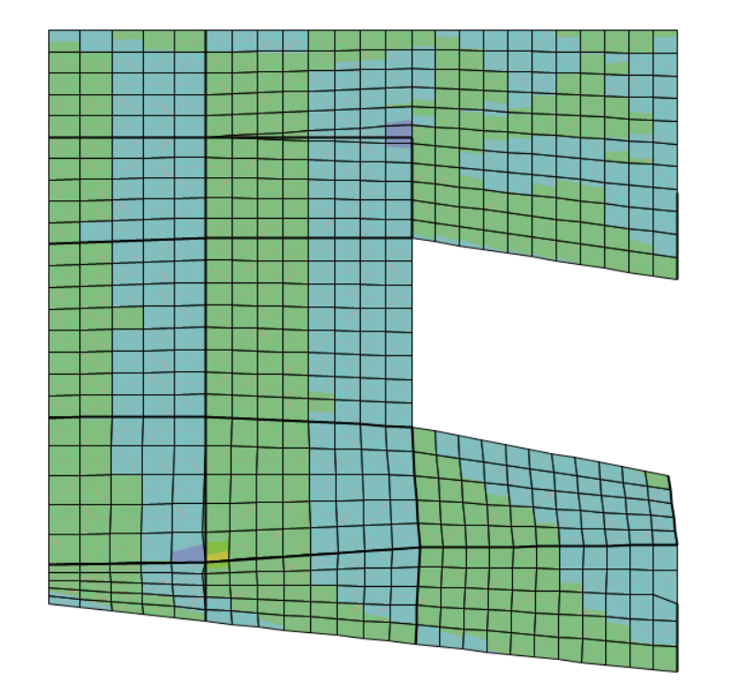
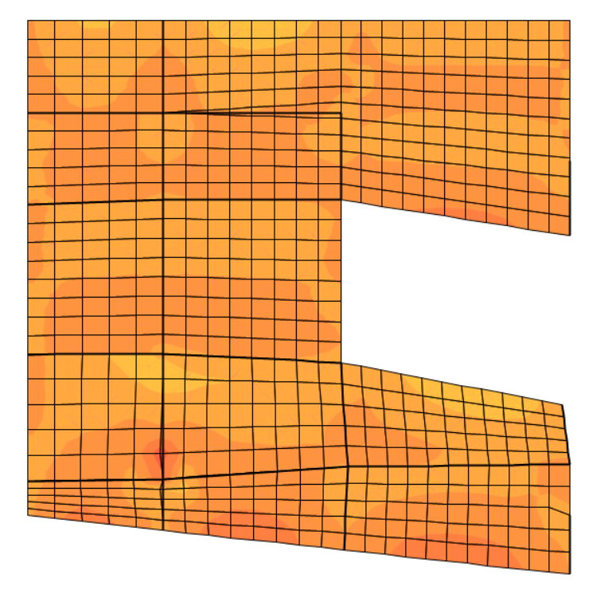
Shear Values:
Maximum value of V13 V23 in block A

Slide 28
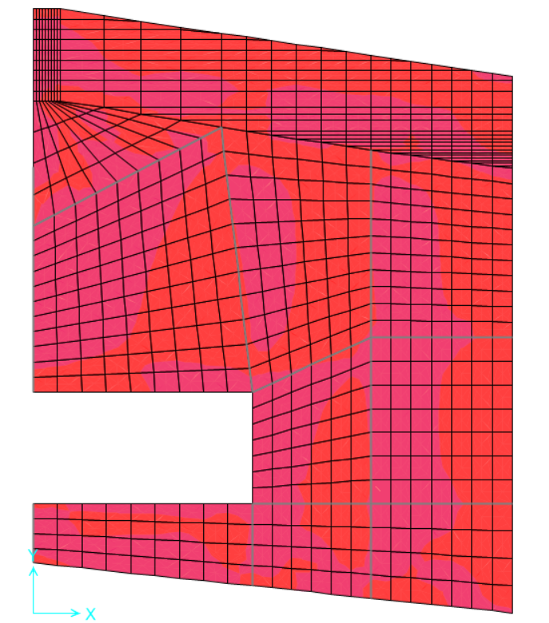
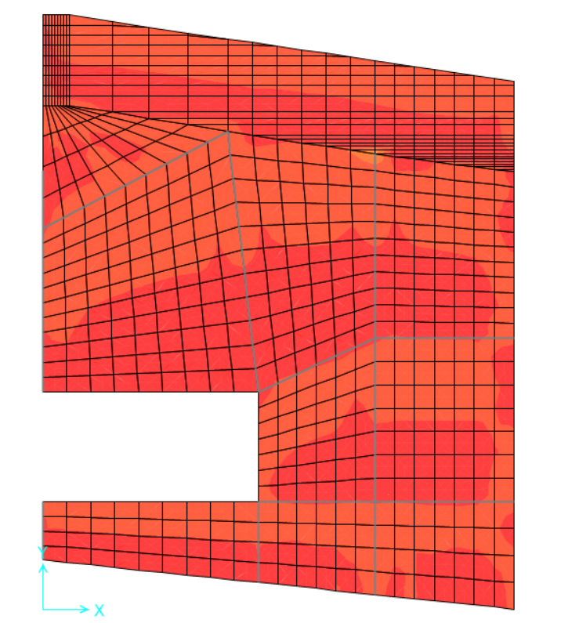
Shear Values:
Maximum value of V13 V23 in block B

Slide 29
The maximum shear value of the slab equals 40 kN
ØVc = 128.59 kN > Vu=40 kN ➔ The slab thickness is adequate to resist shear.

Slide 30
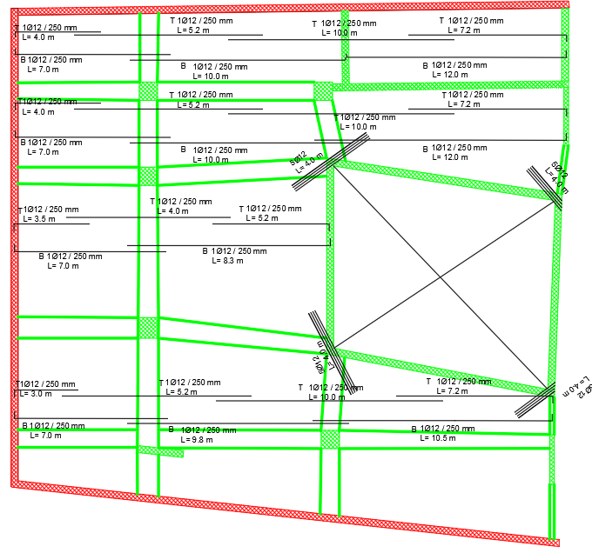
Design for flexure in block A in X- direction

Slide 31
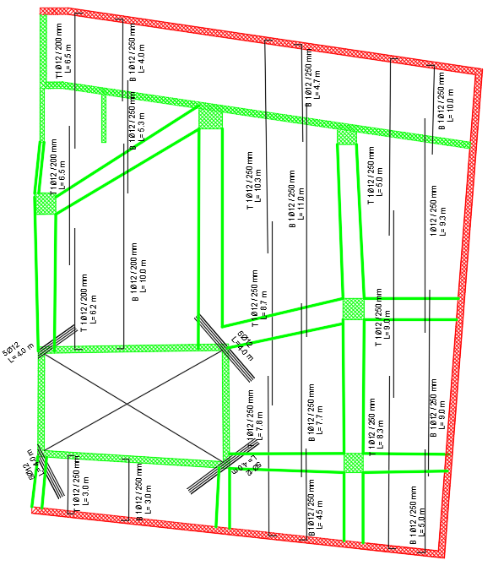
Design for flexure in block A in X- direction

Slide 32
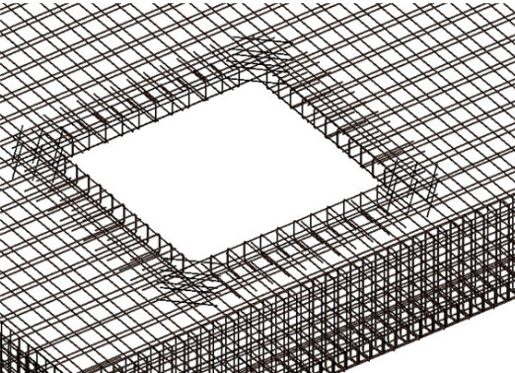

Openings:
Minimum area of steel was added in the corners of the openings due to the concentrated load over it
As_{min} =0.0018$×1000×250$ = 450 mm².
450/112 = 4.2 → use 5Ø12

Slide 33
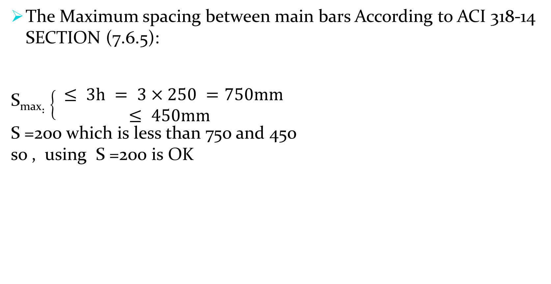
The Maximum spacing between main bars According to ACI 318‐14 SECTION (7.6.5):
S_{max}$:\left\{\begin{aligned} ≤ 3h = 3×250 =750mm \\ ≤ 450mm\end{aligned}\right.$
S =200 which is less than 750 and 450
so , using S =200 is OK

Slide 34
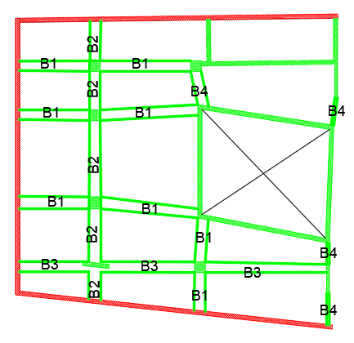
Beam Design.
Design for Flexure:
The value of moment of beam ( B1) shown in Figure is taken as sample calculation for block A.

Slide 35

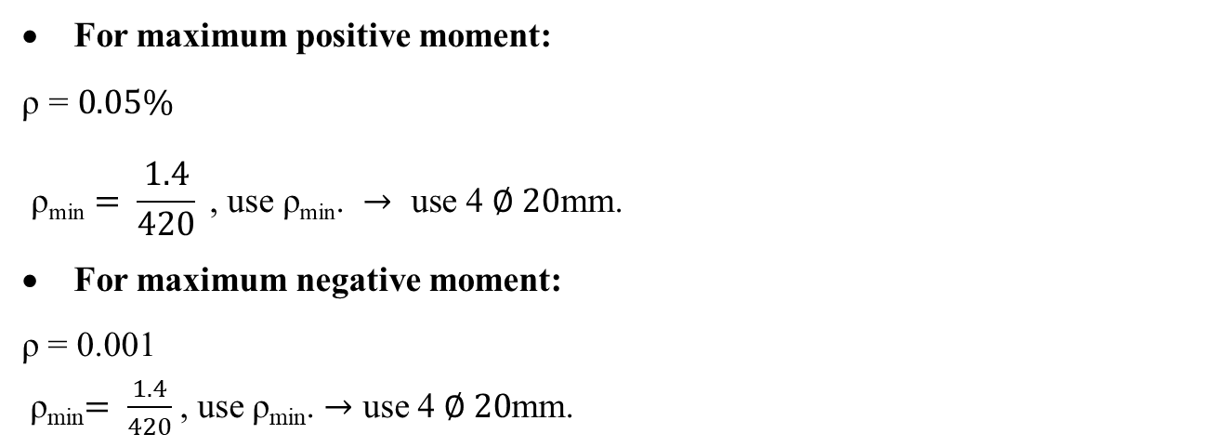
For maximum positive moment:
$$\text{ρ}\text{ = }0.05\text{\%}$$
$$\text{ρ}\text{min}= \frac{1.4}{420} \text{, }\text{use} \text{ρ}\text{min}\text{.} → \text{use}\text{ 4 }∅ 20\text{mm}\text{.}$$
For maximum negative moment:
ρ = 0.001
ρ_{min}$= \frac{1.4}{420}$, use ρ_{min}. $→$ use 4 $∅ 20$mm.

Slide 36
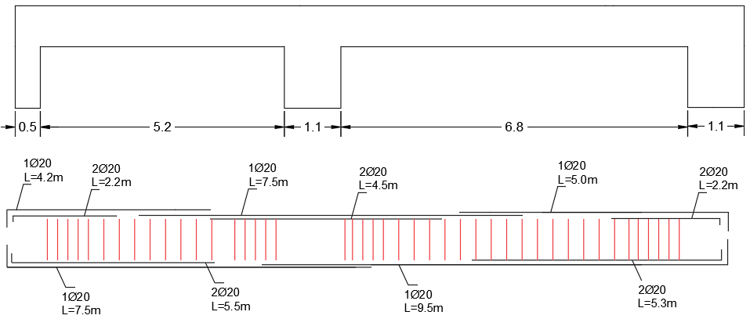
Cross Section for Beam:

Slide 37
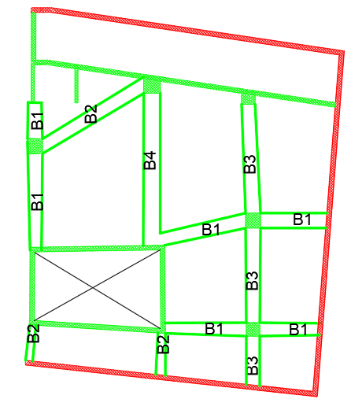
Beam Design.
Design for Flexure:
The value of moment of beam ( B3) shown in Figure is taken as sample calculation for block B

Slide 38
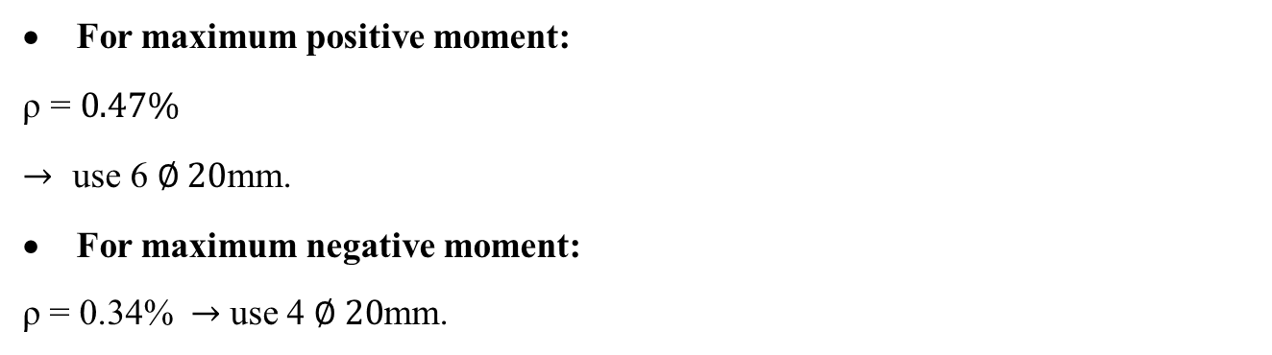
For maximum positive moment:
$$\text{ρ}\text{ = }0.\text{47}\text{\%}$$
$$→ \text{use}\text{ 6 }∅ 20\text{mm}\text{.}$$
For maximum negative moment:
ρ = 0.34% $→$ use 4 $∅ 20$mm.

Slide 39
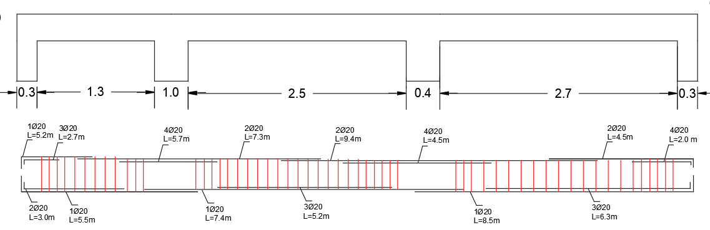
Cross Section for Beam:

Slide 40
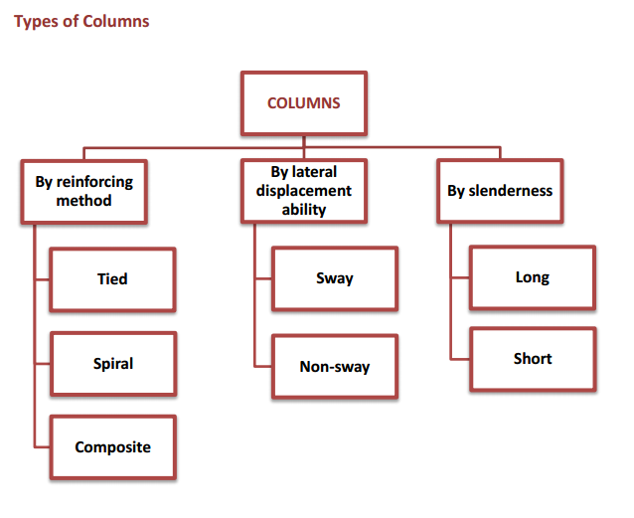
Column Design:
According to ACI Code, a structural element with a ratio of height-to-least lateral dimension exceeding three used primarily to support compressive loads is defined as column.

Slide 41
Column Layout:

Slide 42
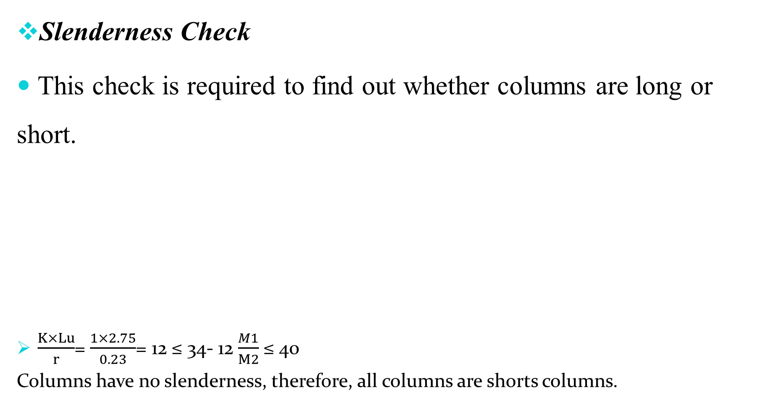
Slenderness Check
This check is required to find out whether columns are long or short.
$\frac{K×Lu}{r}$= $\frac{1×2.75}{0. 23}$= 12 ≤ 34- 12$\frac{M1}{M2}$ ≤ 40
Columns have no slenderness, therefore, all columns are shorts columns.

Slide 43
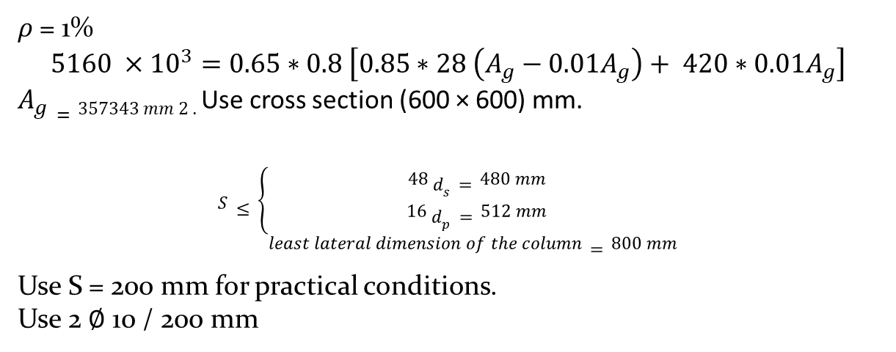
Column 1
𝜌 = 1%
$$5160 ×{10}^{3}=0.65∗0.8 \left[0.85∗28 \left(A_{g}{− 0.01A}_{g}\right)+ 420∗0.01A_{g}\right]$$
$A_{g}=357343 mm 2$ . Use cross section (600 × 600) mm.
$$S≤\left\{\begin{aligned}48{ d}_{s}=480 mm \\ 16 d_{p}=512 mm \\ least lateral dimension of the column=800 mm \end{aligned}\right.$$
Use S = 200 mm for practical conditions.
Use 2 $∅$ 10 / 200 mm

Slide 44
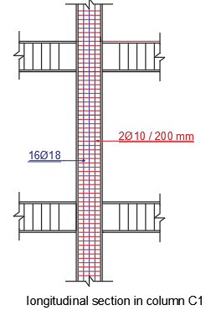
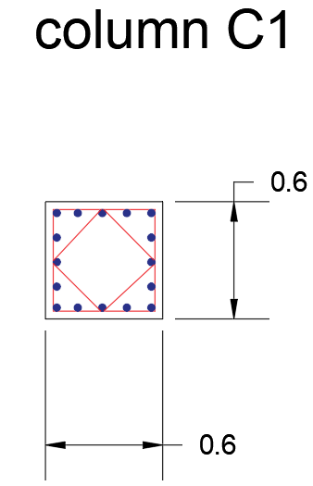

Slide 45
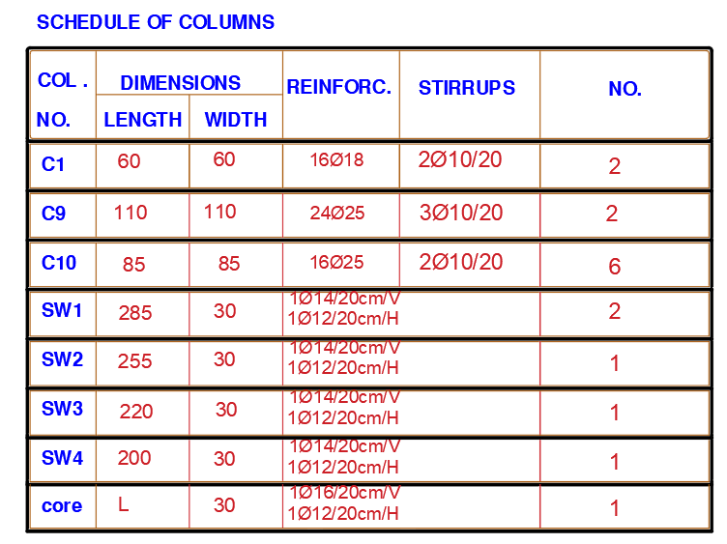

Slide 46
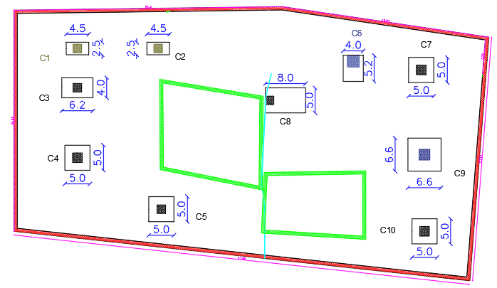
Design of footings

Slide 47

Calculation of footing for C8
$P_{service}$= 9880 KN, $q_{all}$ = 300 MPa, $P_{ultimate}$= 12785 KN
Dimension of Footing
Area of Footing = $\frac{P_{service}}{q_{all}}$ = $\frac{9880}{300}$ = 33 m²
Dimension = 5.8m*5.8m
300 = $\frac{−P}{A}±\frac{Mc}{I}= \frac{−9880}{4∗B}±\frac{27664×3.5}{(\frac{{5.8}^{3}}{12}×B)}$
The new dimension = 8*5 m

Slide 48

Thickness
Check Shear
ᴓ $V_{c}$ = ᴓ $\frac{1}{6}$ * $\sqrt{f_{c}}$ * $b_{w}$*d = 0.75 * $\frac{1}{6}$ * $\sqrt{28}$ * 1000 * d = 661.43 d
$V_{u }$ = $q_{u }$(L-d) =320* (6.9-d)
Then d=2.3m, h=2.4 m
Check punching shear
$V_{u,p }$ = $p_{u}$ - $q_{u }$*$A_{o}$ = 12785 – (320*7.65) = 10337 KN/m
ᴓ $V_{c,p}$= ᴓ $\frac{1}{3}$ * $\sqrt{f_{c}}$ * $b_{o}$*d
ᴓ $V_{c,p}$= 34382 KN/m
$V_{u,p }$ < $V_{c,p}$ , so it’s acceptable

Slide 49
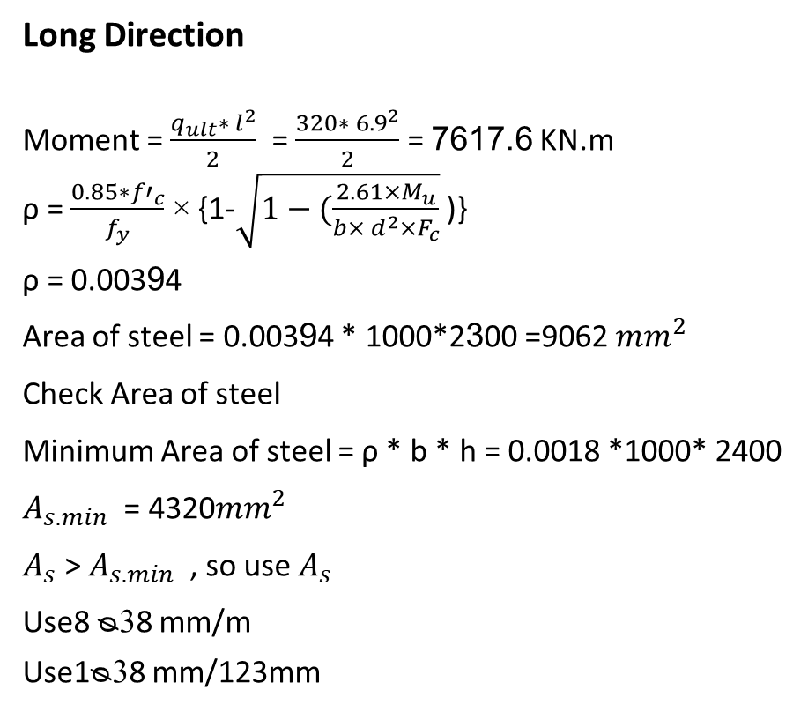
Long Direction
Moment = $\frac{q_{ult}∗ l^{2}}{2}$ = $\frac{320∗ {6.9}^{2}}{2}$ = 7617.6 KN.m
ρ = $\frac{0.85∗{f′}_{c}}{f_{y}}$ × {1-$\sqrt{1−(\frac{2.61×M_{u}}{b× d^{2}×F_{c}}}$ )}
ρ = 0.00394
Area of steel = 0.00394 * 1000*2300 =9062 ${mm}^{2}$
Check Area of steel
Minimum Area of steel = ρ * b * h = 0.0018 *1000* 2400
$A_{s.min}$ = 4320${mm}^{2}$
$A_{s}$ > $A_{s.min}$ , so use $A_{s}$
Use8 ᴓ38 mm/m
Use1ᴓ38 mm/123mm

Slide 50

Short Direction
Moment = = $\frac{q_{ult}∗ l^{2}}{2}$ = $\frac{320∗ {3.9}^{2}}{2}$ = 2433.6 KN.m
ρ = $\frac{0.85∗{f′}_{c}}{f_{y}}$ × {1-$\sqrt{1−(\frac{2.61×M_{u}}{b× d^{2}×F_{c}}}$ )}
ρ = 0.001228
Area of steel = 0.001228 * 1000*2300 =2824.5 ${mm}^{2}$
Check Area of steel
Minimum Area of steel = ρ * b * h = 0.0018 *1000* 2400
$A_{s.min}$ = 4320${mm}^{2}$
$A_{s}$ < $A_{s.min}$ , so use $A_{s.min}$ .
Use 4320${mm}^{2}$
Use 5 ᴓ35 mm/m
Use 1 ᴓ35 mm/196mm

Slide 51
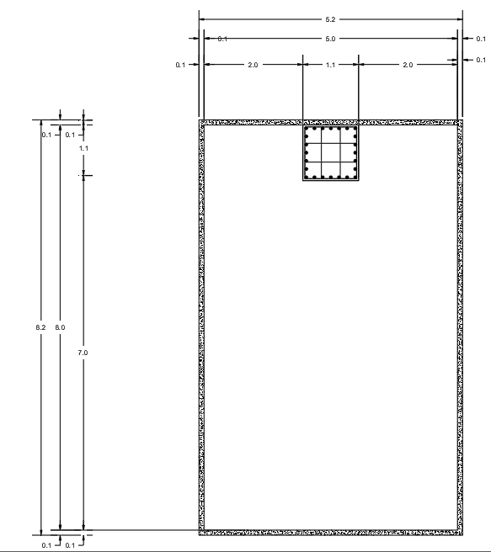

Slide 52
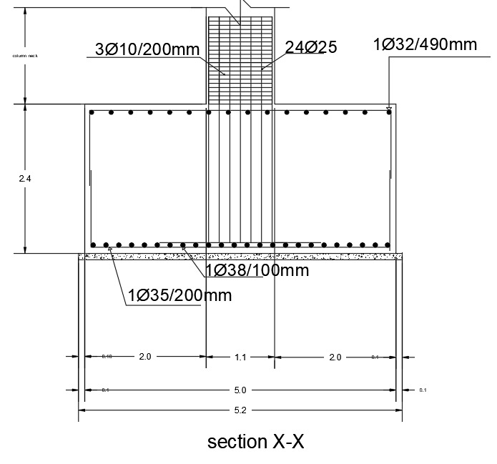
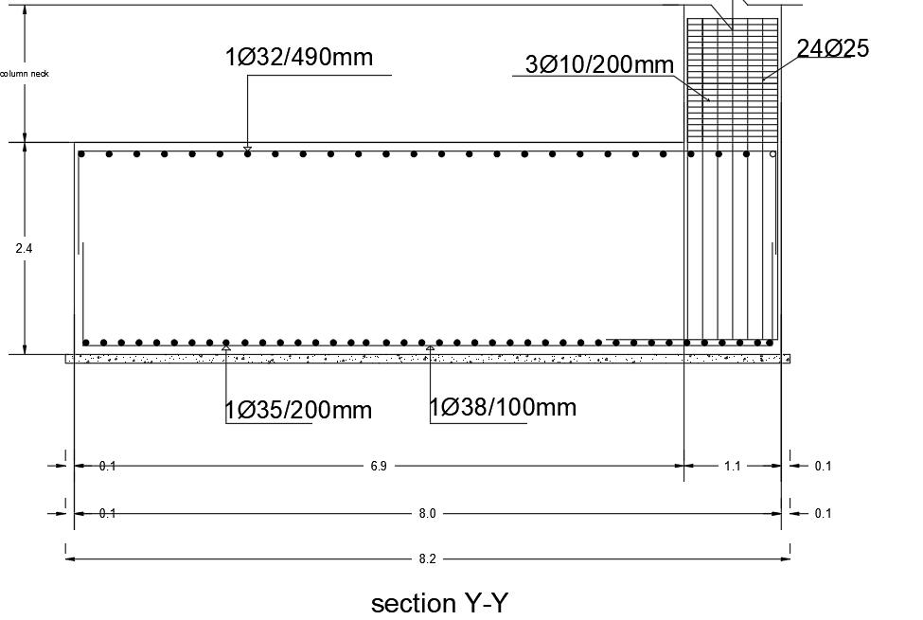

Slide 53
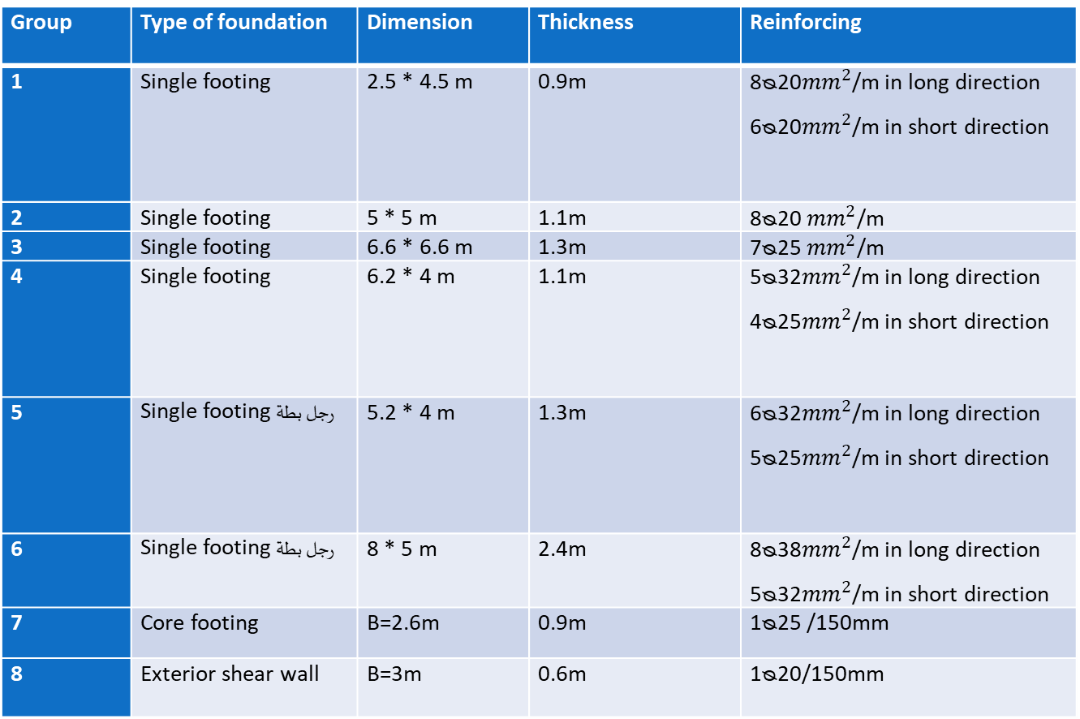
Group | Type of foundation | Dimension | Thickness | Reinforcing
1 | Single footing | 2.5 * 4.5 m | 0.9m | 8ᴓ20${mm}^{2}$/m in long direction 6ᴓ20${mm}^{2}$/m in short direction
2 | Single footing | 5 * 5 m | 1.1m | 8ᴓ20 ${mm}^{2}$/m
3 | Single footing | 6.6 * 6.6 m | 1.3m | 7ᴓ25 ${mm}^{2}$/m
4 | Single footing | 6.2 * 4 m | 1.1m | 5ᴓ32${mm}^{2}$/m in long direction 4ᴓ25${mm}^{2}$/m in short direction
5 | Single footing رجل بطة | 5.2 * 4 m | 1.3m | 6ᴓ32${mm}^{2}$/m in long direction 5ᴓ25${mm}^{2}$/m in short direction
6 | Single footing رجل بطة | 8 * 5 m | 2.4m | 8ᴓ38${mm}^{2}$/m in long direction 5ᴓ32${mm}^{2}$/m in short direction
7 | Core footing | B=2.6m | 0.9m | 1ᴓ25 /150mm
8 | Exterior shear wall | B=3m | 0.6m | 1ᴓ20/150mm

Slide 54


