Slide 1

Graduation Project 2
Structural Analysis and Design of Zayed College for Nursing and Optics
An-Najah National University
Faculty of Engineering
Civil Engineering Department
Supervisor: Dr. Mahmoud Dwaikat
Prepared By:
Maha Sharei Amal Sabbah Jumana Khatib

Slide 2
  Work Plan
3D Modeling
Seismic Load Definition
Design & Reinforcement Details

Slide 3
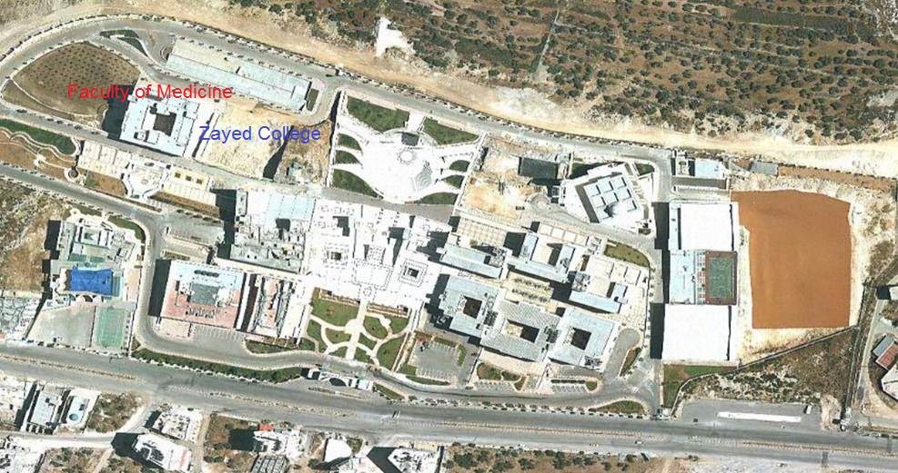
  Project Description:
  Zayed College for Nursing and Optics is located at An-Najah National University’s new campus- next to the faculty of medicine.

Slide 4
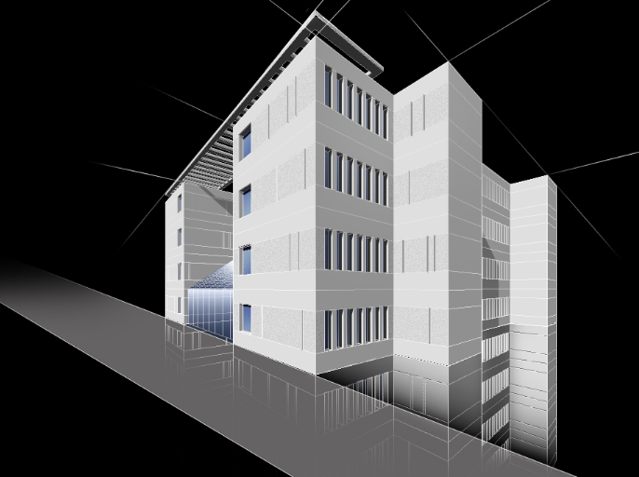
The building has a total area of 6665m² and consists of seven floors.
An-najah National university

Slide 5
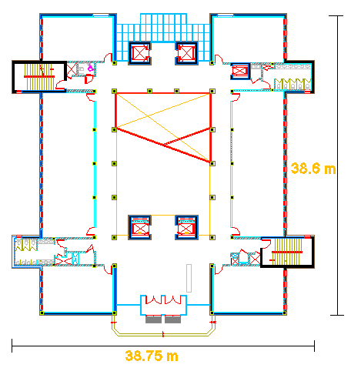
  E.g. : Ground floor

Slide 6
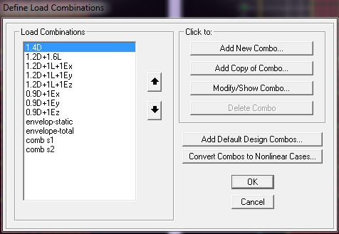
  Assumptions for Design:
Analysis and design are according to ACI-318-08.
ASCE 7- CODE for live load determination.
UBC 97 code for seismic loads (Using response spectrum)
Load combinations :
Loads are gravity and seismic loads.
6

Slide 7
    Structural Materials:
Concrete:
Slabs and beams → fc` = 25 MPa
Columns and footing → fc` = 30 MPa
Steel (Rebar, shrinkage mesh and stirrups):
Yielding strength (Fy) = 420 MPa
Soil Properties:
Allowable bearing capacity of 4 Kg/cm²
7

Slide 8
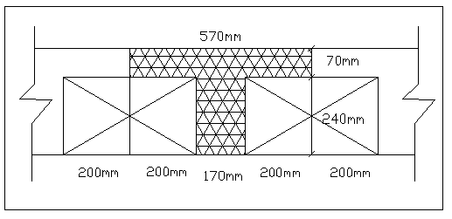
Load Assumptions:
8
Dead Load:
Slab own weight: 5.54 KN/m²

Slide 9
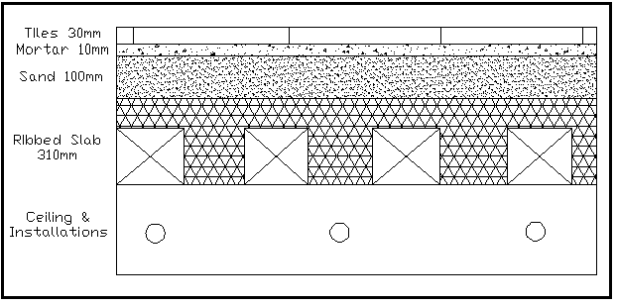
Superimposed dead load:
9
Total superimposed dead load = 4.8 KN/m2

Slide 10
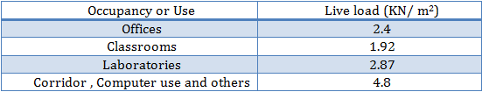
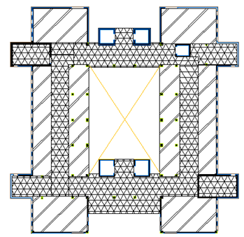
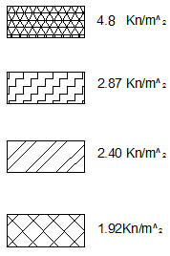
Live Load
10
An-najah National university

Slide 11
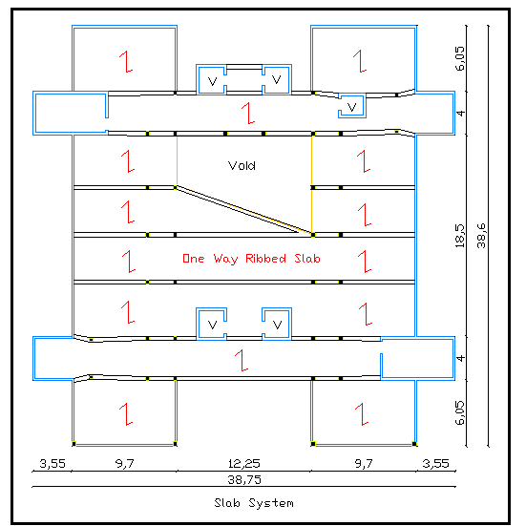
Slab structural system

Slide 12
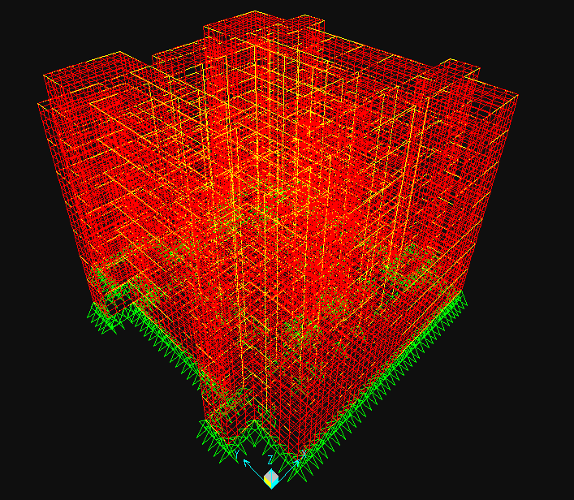
3D Model

Slide 13
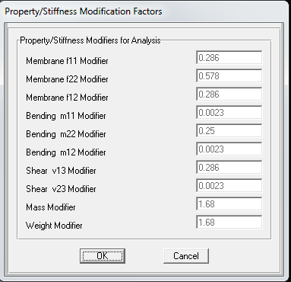
Slab modifiers
Modification Factors

Slide 14
Also, for beams and columns the modifiers are as follows:
Beams:
Torsional constant: 0.35
Moment of inertia about 2 axis: 0.35
Moment of inertia about 3 axis: 0.35
Columns:
Torsional constant: 0.7
Moment of inertia about 2 axis: 0.7
Moment of inertia about 3 axis: 0.7

Slide 15
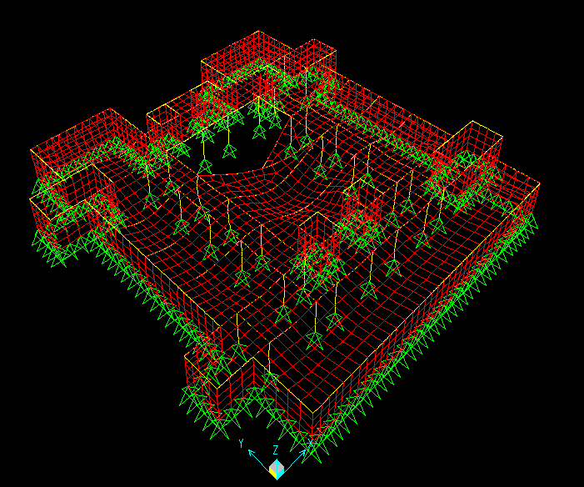
Sap Verifications
Compatibility
Compatibility check

Slide 16

Equilibrium
Total live load manually = 3306.3 KN.
Live load from sap

Slide 17

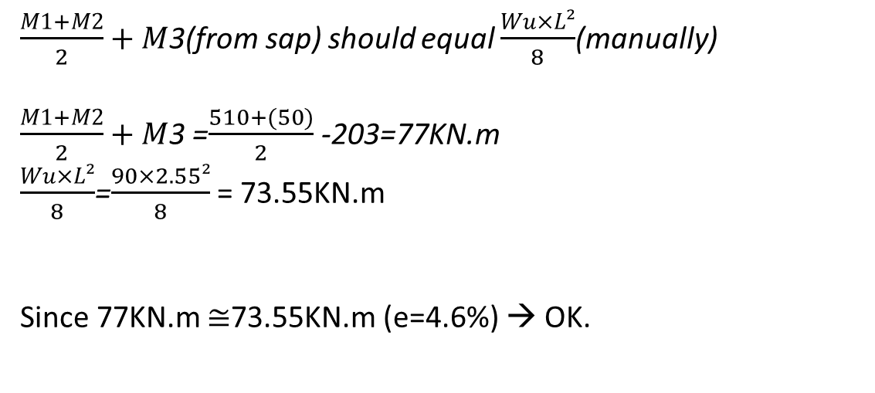
Stress strain relationship check
$\frac{M1+M2}{2}+M$3(from sap) should equal $\frac{Wu×L²}{8}$(manually)
$\frac{M1+M2}{2}+M$3 =$\frac{510+(50)}{2}$ -203=77KN.m
$\frac{Wu×L²}{8}$=$\frac{90×2.55²}{8}$ = 73.55KN.m
Since 77KN.m $≅$73.55KN.m (e=4.6%) → OK.

Slide 18
Dynamic Analysis (seismic loads)
UBC 97 code
Response spectrum analysis method
Response spectrum: an elastic dynamic analysis utilizing the peak dynamic response of all modes having a significant contribution to total structural response.

Slide 19
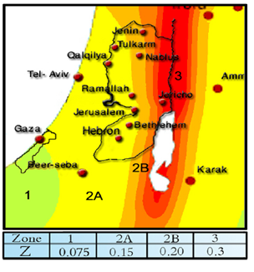
Main factors according to UBC 97 code:
Nablus city (Zone 2B); Z= 0.2
Seismic Zone Factor, Z

Slide 20
I= importance factor, I= 1
R = 4.2 (Dual system Concrete shear walls with OMRF)
R = 6.5 (Dual systems concrete shear walls with IMRF)
Soil is rock …soil profile type SB
Ca=acceleration seismic coefficient, Ca=0.2
Cv= velocity seismic coefficient, Cv=0.2

Slide 21
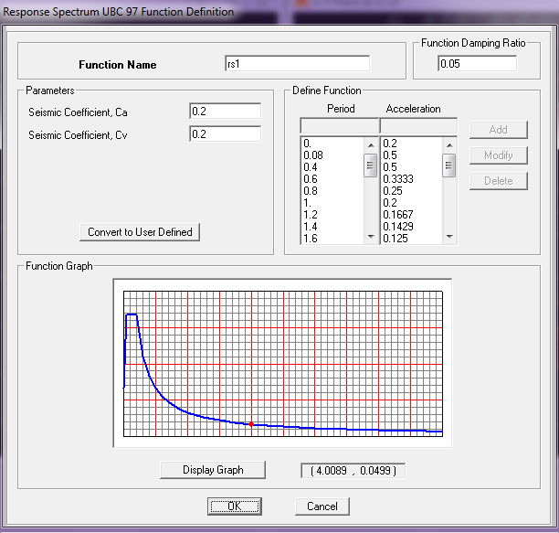
Definition of response spectrum function:
Response Spectrum UBC 97 Definition

Slide 22
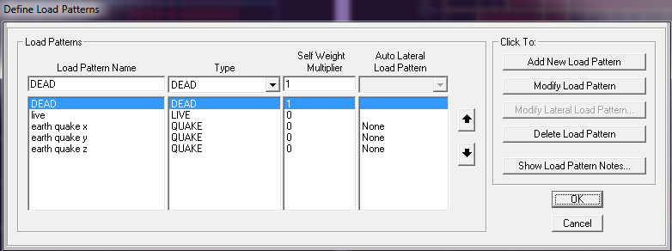
Load patterns:

Slide 23
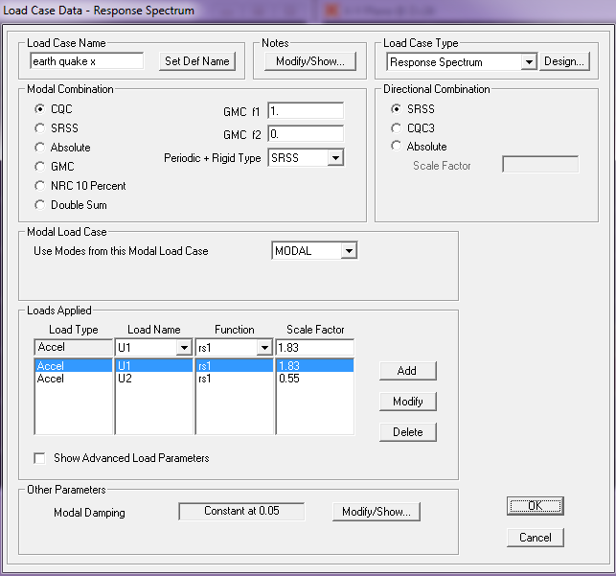
Load cases:
Scale factor= $\frac{gI}{R}$ =1.83 for U1 U2: 1.83×0.3= 0.55
Earth quake –x

Slide 24
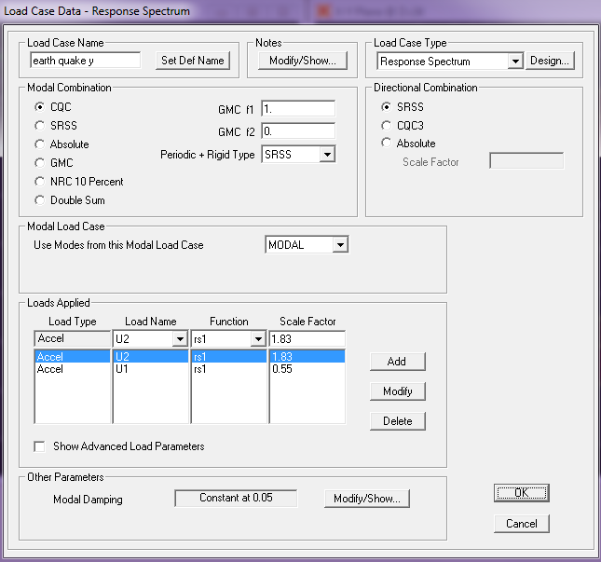
Load cases:
Scale factor= $\frac{gI}{R}$ =1.83 for U2 U1: 1.83×0.3= 0.55
23
Earth quake –y
An-najah National university

Slide 25
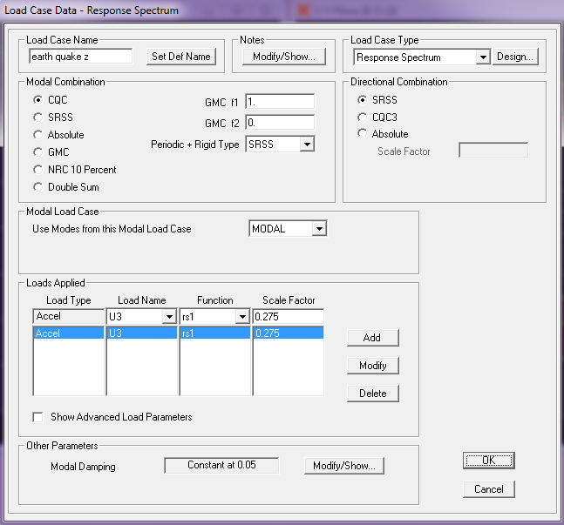
Load cases:
Scale factor= $\frac{gI}{R}$ =1.83 U3: 1.83×0.15= 0.275
Earth quake –z
An-najah National university
25
An-najah National university

Slide 26
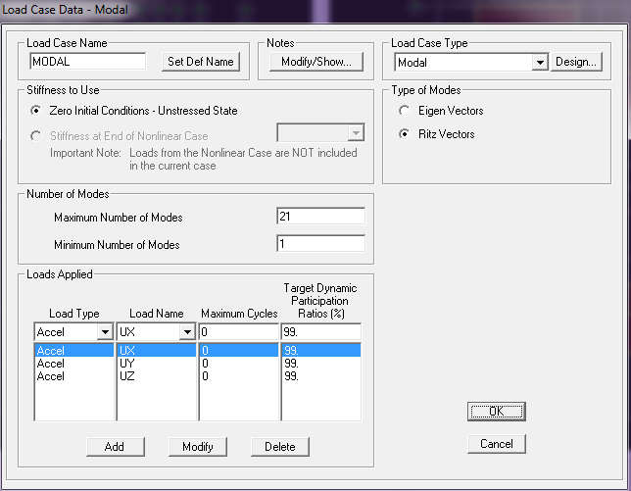
Load cases:
Eigen Vectors analysis needs more than 700 modes
Ritz Vectors analysis needs only 21 modes to reach 90% participating mass ratios
Modal case
An-najah National university
An-najah National university
An-najah National university

Slide 27
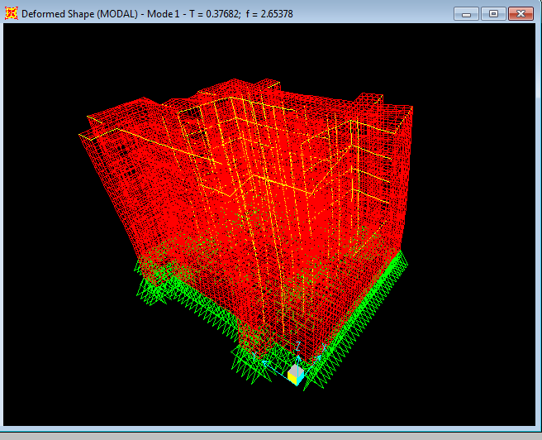
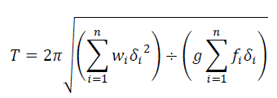
Period T Check
T =0.377 seconds as shown:
T= Ct (hn)^{3/4} .. Ct = 0.0488 … T= 0.6 seconds
… T= 0.45 seconds

Slide 28
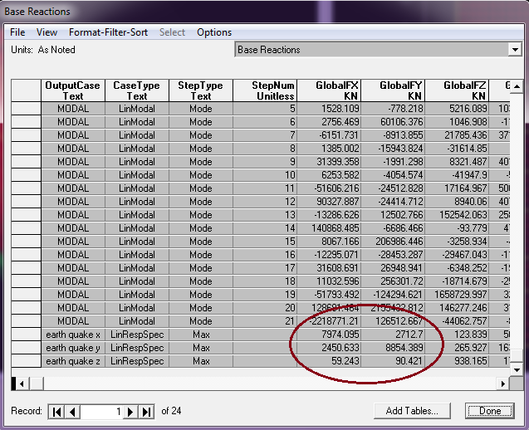
  Total base shear V check
Base shear in x & y directions:
Base Reactions

Slide 29


V max:
Substitute Wd = 133367 KN, Cv = 0.2, Ca= 0.2, I=1, T =0.45 s
For R =6.5 ￫ V = 9120 KN< Vmax (10260 KN)
For R =4.2 ￫ V = 14113 KN< Vmax (15877 KN)
Vx & Vy values from the previous figure are close to manual calculations.

Slide 30
Footing Design
Single Footing
Combined Footing
Wall Footing

Slide 31
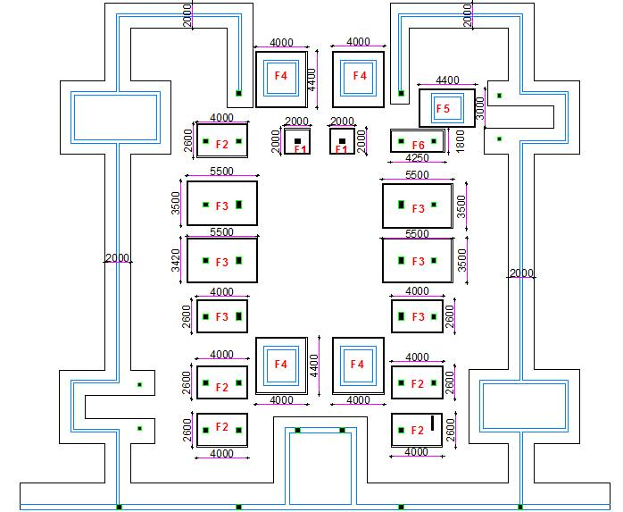


Slide 32
Single Footing
q all = 400 KN/m2
It has a dimensions of 2*2 m
Thickness = 450 mm
Shear Checks :
Wide Beam Shear Ø Vc ≥ Vu → 507 KN > 406 KN → Ok
Punching Shear Շ ≤ Ø Vc → 0.00141 < 1.373 → Ok
Reinforcement
6 Ø16 / m in both directions.

Slide 33
Combined Footing
q all = 400 KN/m2
It has a dimensions of L = 4m , B = 2.6m .
Thickness = 800 mm
Shear Checks :
Wide Beam Shear Ø Vc ≥ Vu → 1170 KN > 419 → Ok.
Punching Shear Ø Vc ≥ Vu →4416.8 KN> 419 KN → OK.
Check for deflection → ∆SAP < ∆Max. →0.0096 < 0.01m → OK.
Check maximum stress → σ = 363.75 KN < q all → OK

Slide 34
Combined Footing
Longitudinal Reinforcement
As = 2056 mm² < As _{min} = 6240 mm²
→Use As _{min} → 13 Ø 25
Transverse reinforcement
As = 4004mm²→13 Ø 20

Slide 35
Wall Footing
q all = 400 KN/m²
It has a dimensions of B = 2m
Thickness = 550 mm
Reinforcement
Longitudinal Reinforcement → As _{min} = 990 mm²/m →7 Ø 14 /m
Transverse reinforcement → As = 1034 mm²/m→ 6Ø 16 / m

Slide 36
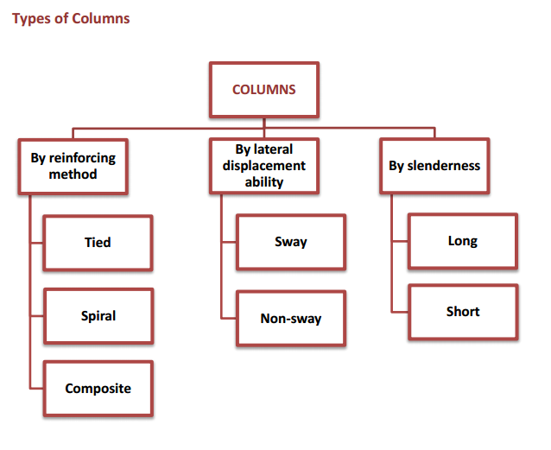
Design of columns

Slide 37

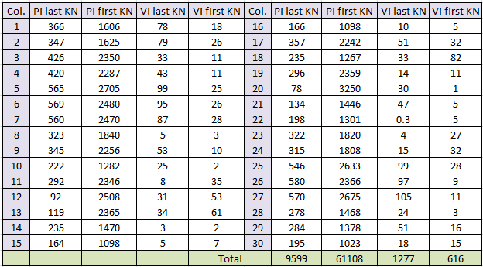
Sway –Non sway Check
The check is done for both x and y direction for first and last floors
Columns’ Shear and Vertical loads

Slide 38
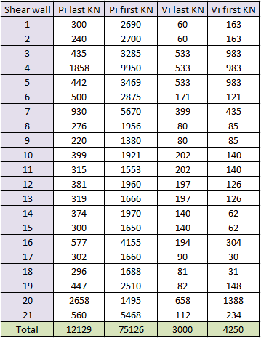
Sway –Non sway Check
38
By applying Q index equation in x , Q index = 0.0021 <0.05
…non sway
Shear Walls’ Shear and Vertical loads
An-najah National university

Slide 39
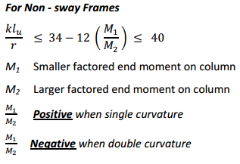
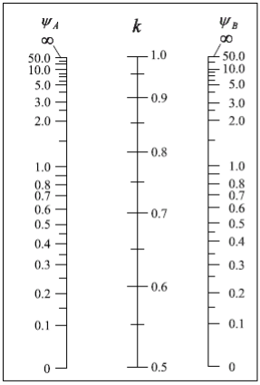
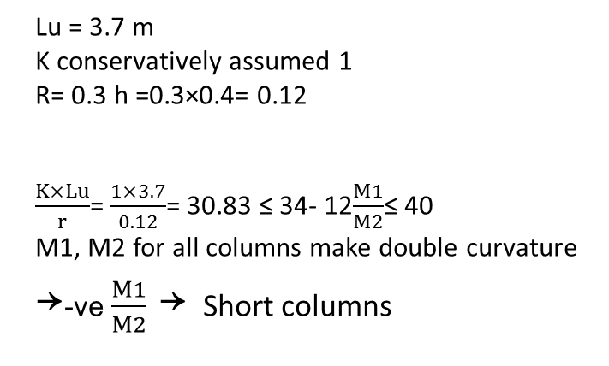
Slenderness Check
In project1, columns were assumed short. 3D model is used to recheck that assumption.
Lu = 3.7 m
K conservatively assumed 1
R= 0.3 h =0.3×0.4= 0.12
$\frac{K×Lu}{r}$= $\frac{1×3.7}{0.12}$= 30.83 ≤ 34- 12$\frac{M1}{M2}$≤ 40
M1, M2 for all columns make double curvature
￫-ve $\frac{M1}{M2}$ ￫ Short columns
Alignment chart for non-sway frames

Slide 40
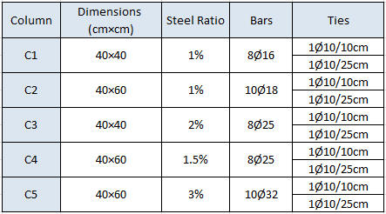
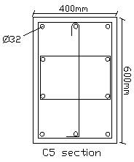
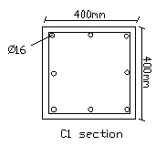
  Columns Design
Columns Design Summary

Slide 41
Design Of Beams
41
All beams in the building are drop and multi-span beams.
For the preliminary design , loads are calculated using tributary area method and 1-D structural model for each beam is analyzed and designed using SAP2000.
Final output was taken from 3-D model.

Slide 42
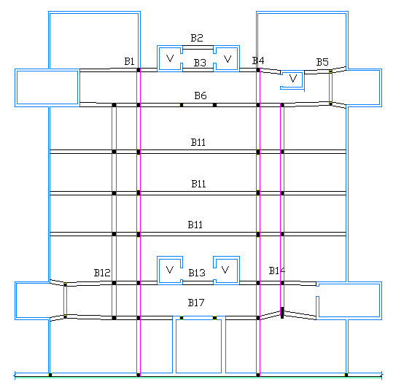
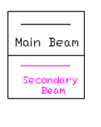
42
Plan of beams for third basement

Slide 43
  Preliminary dimensions of Beams
Depth of beams was found according to ACI-318-08 (Deflection limitation) .
For beam 1 it has rectangular section with
Depth = 70 cm
Width = 40 cm

Slide 44
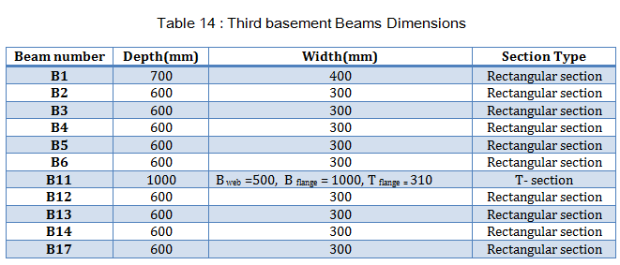
Design of Beams Using Sap2000
Dimensions of beams

Slide 45
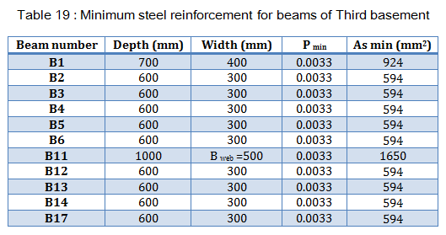
  Steel reinforcement
Minimum steel reinforcement

Slide 46
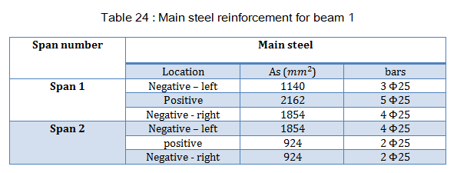
  Steel reinforcement
Main steel reinforcement

Slide 47
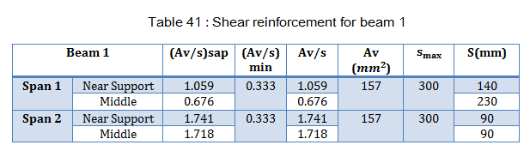
  Steel reinforcement
Shear reinforcement
Concerning shear reinforcement of beams, it is recommended to unify shear reinforcement spaces for each beam near the supports due to not high shear forces in the region. In the middle we can reduce the spacing for practical and economical purposes.

Slide 48
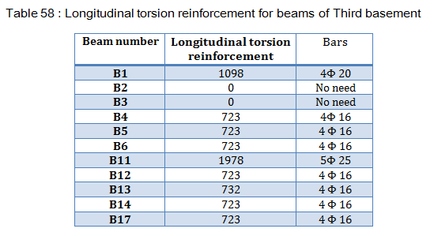
  Steel reinforcement
Torsion reinforcement

Slide 49
Design of Transverse Beams
It has a dimensions of 30*30 cm
It has area of steel minimum :
As _{min} = p _{min}*b*h = 0.0033*300*300 =297 mm² → Use 3 φ 12

Slide 50
Design of slabs
The structural system of Zayed College is one way ribbed slab(31 cm ) with drop beams.
The ribs in the slab are analyzed using sap 2000 program..

Slide 51
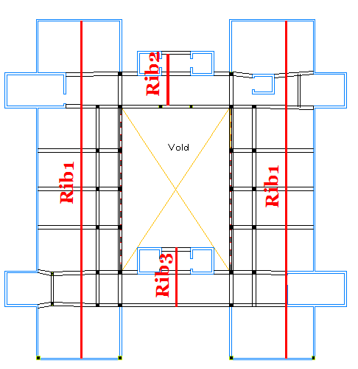
Ribs distribution in the first floor

Slide 52
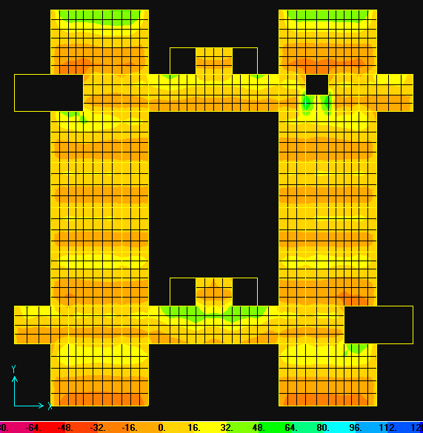
Analysis and design of rib2
Check for shear
Shear force contours

Slide 53
The maximum shear force at distance d/2 from face of support =48KN*.57 = 27.3 KN.
ØVc =29.2 KN
Vu =27.3 KN
ØVc=29.2>Vu=27.3 →no need for shear reinforcement , but use 1ø8/20 cm for bar fixation .

Slide 54
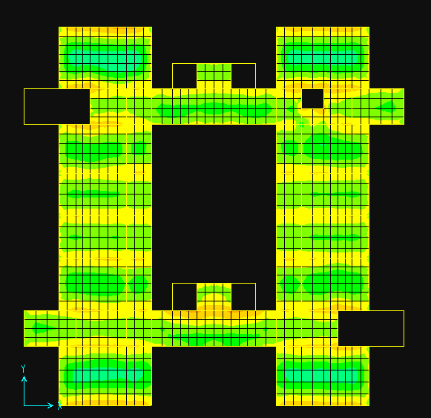
Analysis and Design for flexure
M22 contours diagram

Slide 55
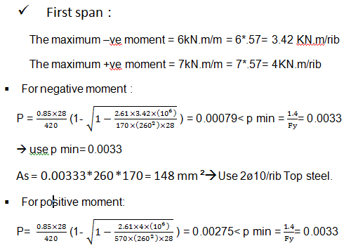
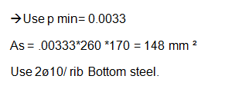

Slide 56
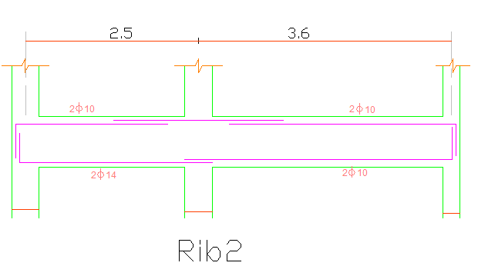
Reinforcement details for rib2

Slide 57
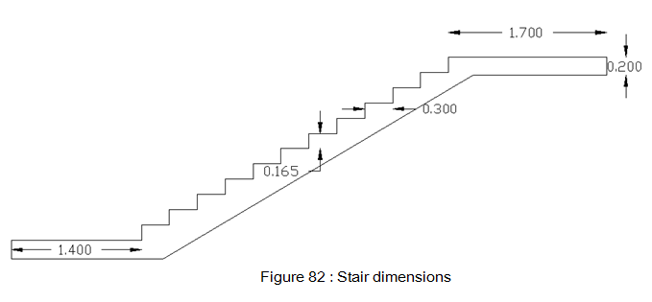
Stairway Design
Stair dimensions
Going = 30 cm
Riser = 16.5 cm
Slab thickness = 20 cm

Slide 58
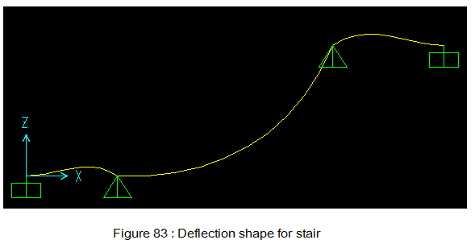
Stairway Design
Stair Loading
Dead load = 14.1 KN/m
Live Load = 7.9 KN/m
Check for deflection
Deflection limitation:-
- ∆L ≤ L/360 → Ok
- ∆ L _{T}≤ L/480 → Ok

Slide 59
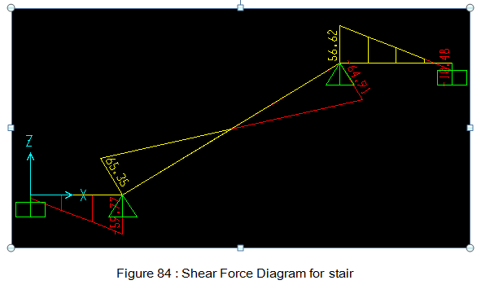
Stairway Design
Check for shear
ØVc > Vu → Ok

Slide 60

Stairway Design
Design for flexure

Slide 61

Stairway Design
Area of steel from sap

Slide 62

Design for stair beam
Dimensions ( depth = 20 cm , Width = 40 cm )
Design of beam for flexure

Slide 63

Design for stair beam
Main steel reinforcement
Minimum steel reinforcement
As _{min} = 264 mm² →Use 2 φ 14

Slide 64

Design for stair beam
Design of beam for shear

Slide 65

Shear wall design
Bending m11 modifier: 0.25, m22 modifier: 0.25 ,m12 modifier: 0.25

Slide 66


Since Pu<0.1 Aw f’c, shear walls are considered as beams in design.
Where: Aw= Lw x tw , Lw is wall width , tw is wall thickness
Since Pu< 0.1 Aw f’c and
< 1, no need for boundary zone elements.
For all shear walls Vu ≤ ØVn, so minimum reinforcement is used in horizontal direction with ρ= 0.0025

Slide 67
(ρ= 0.0025)
As min= 0.0025×1000×300= 750mm²
Use 5Ø10/m& 5Ø10/m in both horizontal and vertical directions

Slide 68




