Slide 1
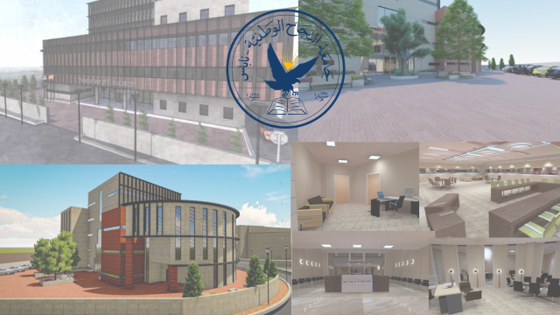
Design of Directorate of Education In Nablus
Building Engineering Department
Graduation project II
Students:
Mohamed Saqf Al-Heat Murad Mohamed Hasan Deaa Namrouti
Supervisor:
Dr. Moyad Salhab.

Slide 2
Contents:
Architectural Aspects
Structural Aspect
Environmental Aspect
Quantity surveying & Cost Estimate

Slide 3
Contents:
Architectural Aspects
Structural Aspect
Environmental Aspect
Quantity surveying & Cost Estimate

Slide 4
Architectural Aspects
Architectural Aspects
Architectural standards
Site analysis
Architectural modifications

Slide 5
Architectural standards
Architectural Aspects
Architectural standards
Site analysis
Architectural modifications

Slide 6


Architectural standards:
local requirements
based on the requirements of the Palestinian Directorate of Education
Ttypes of rooms required
number of people assigned to each room
International standards
taken from the-Metric-Handbook-Architecture.
Minimum requirement space

Slide 7
Site analysis
Architectural Aspects
Architectural standards
Site analysis
Architectural modifications
Project Site
Entrances

Slide 8
Site analysis
Architectural Aspects
Architectural standards
Site analysis
Architectural modifications
Project Site
Entrances

Slide 9
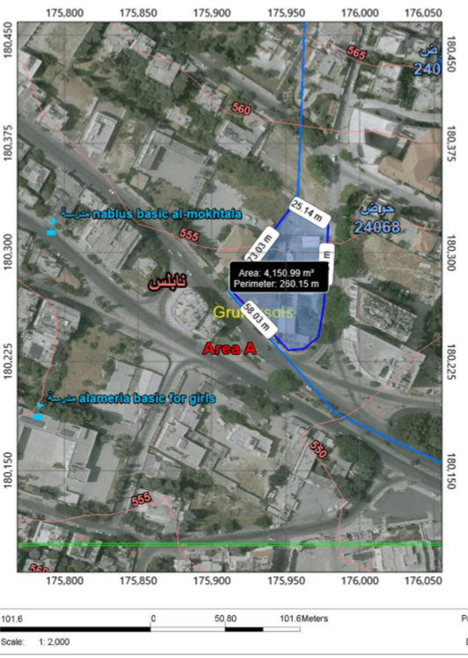
Project Site:
The project is located in Nablus next to the old Directorate building on Faisal Street on the south side and Rawda Street on the east side

Slide 10
Site analysis
Architectural Aspects
Architectural standards
Site analysis
Architectural modifications
Project Site
Entrances

Slide 11
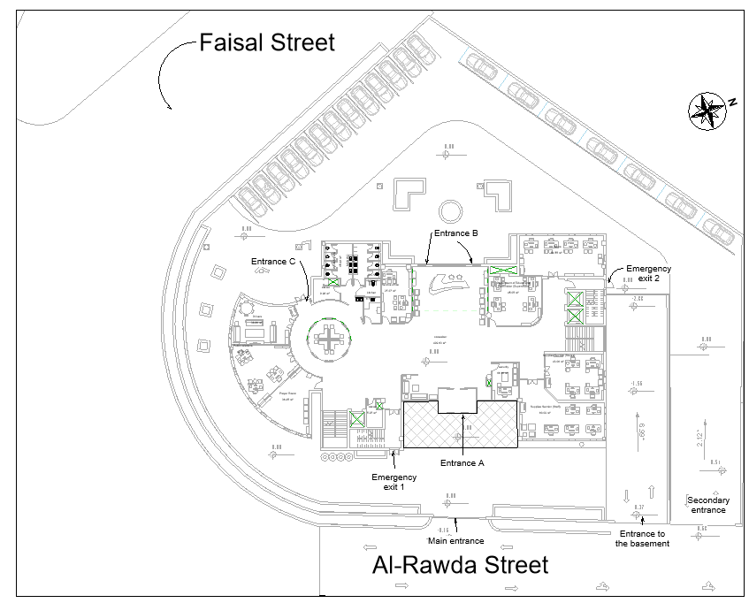
Entrances to the project:
The project site has three entrances and the building itself has three entrances and two emergency exits,

Slide 12
Architectural modifications
Architectural Aspects
Architectural standards
Site analysis
Architectural modifications
Before and After
Substantial modifications

Slide 13
Architectural modifications
Architectural Aspects
Architectural standards
Site analysis
Architectural modifications
Before and After
Substantial modifications

Slide 14
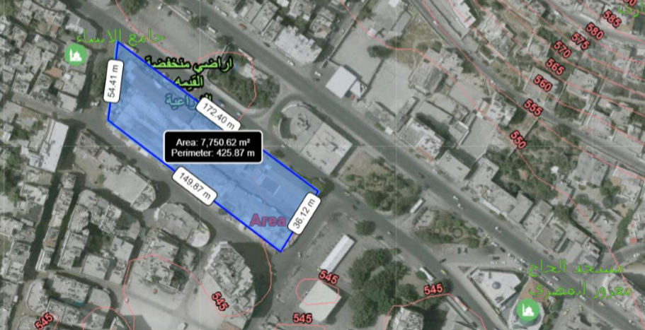
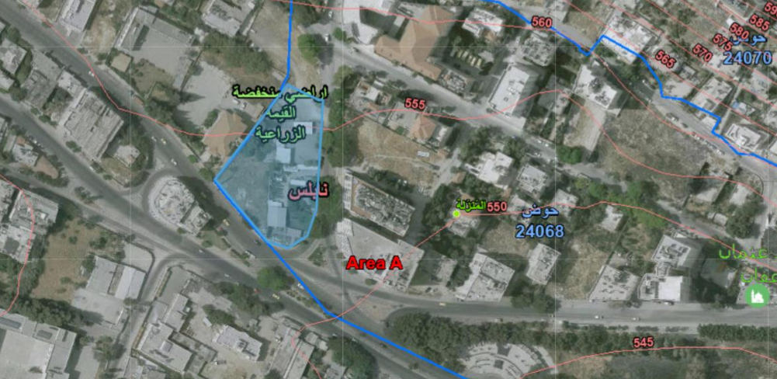
Substantial modifications:
Selection of the project site:
The previous site for the project
The new site for the project

Slide 15
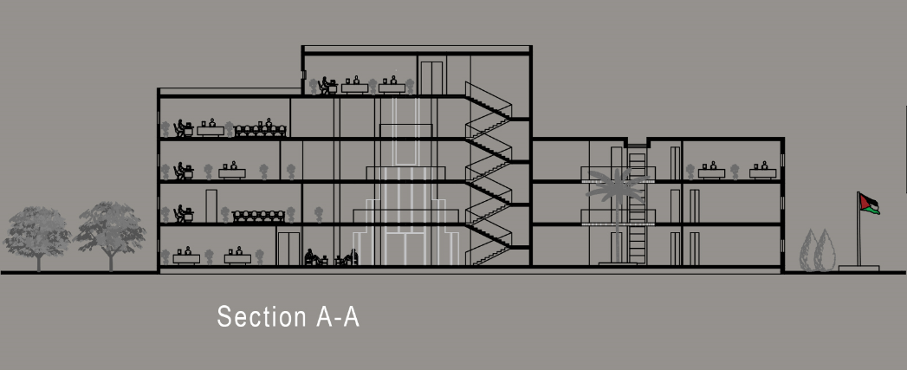
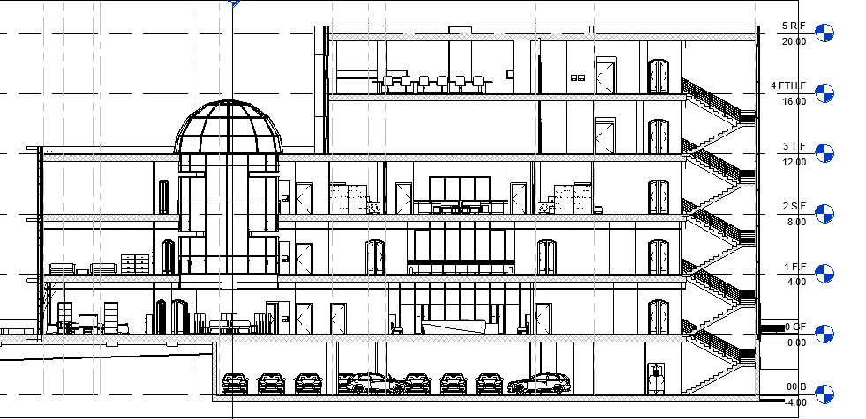
Substantial modifications:
Add a new floor:
The previous proposal
Floor number | Floor name | Floor area (m2)
1 | ground floor | 932
2 | first floor | 1122
3 | second floor | 1145
4 | Third Floor | 590
5 | fourth floor | 302
 | total area | 4091
The new proposal
Floor number | Floor name | Floor area (m2)
1 | Basement | 1180
2 | ground floor | 964
3 | first floor | 1122
4 | second floor | 1145
5 | Third Floor | 590
6 | fourth floor | 352
 | total area | 5353

Slide 16
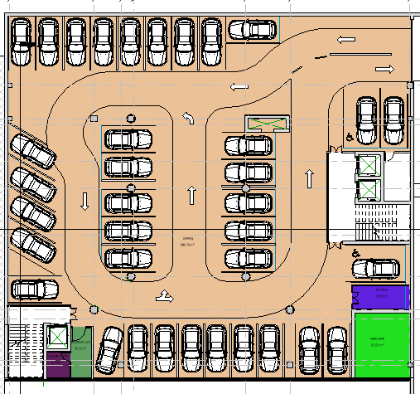
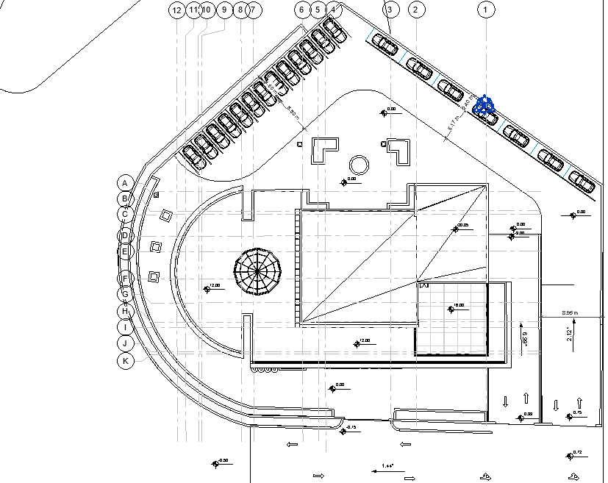
Substantial modifications:
Add car parking:
Internal car parking
External car parking
consists of 36 cars
consists of 20 cars

Slide 17
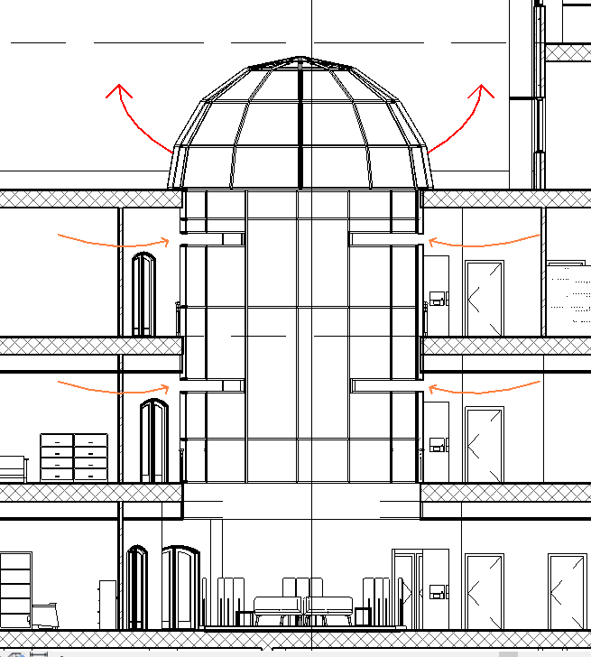
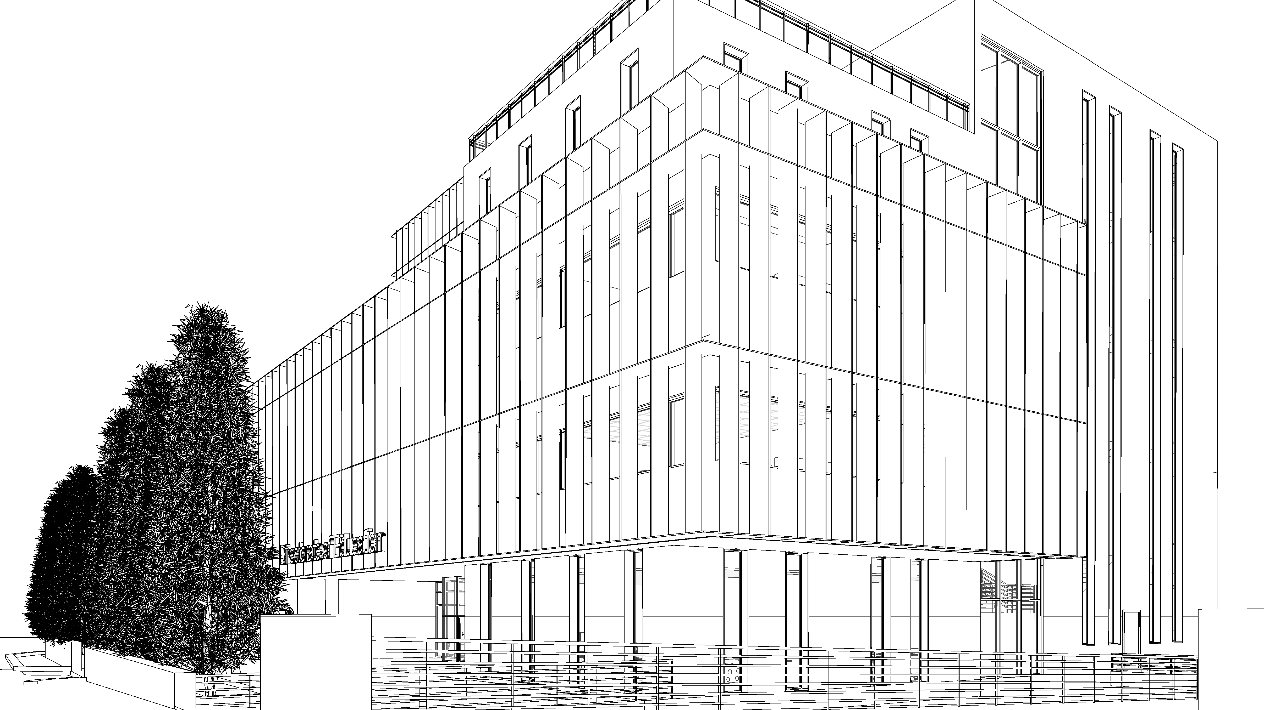
Substantial modifications:
Add environmental systems:
Sheading systems
Ventilation systems

Slide 18
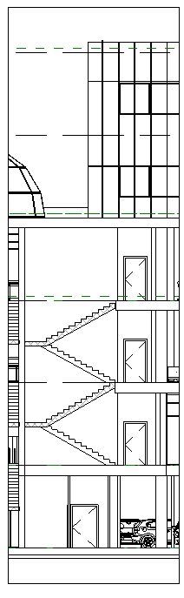
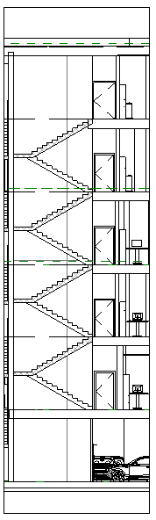
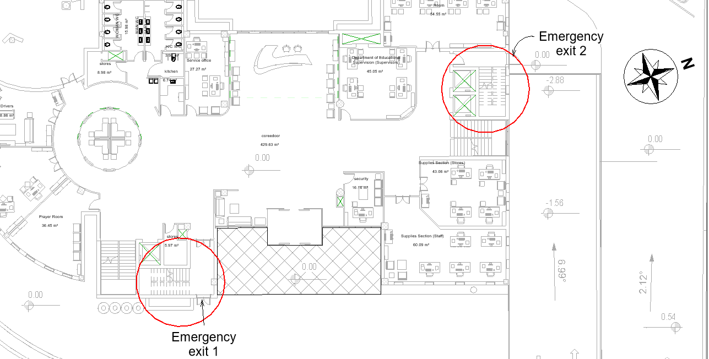
Substantial modifications:
Add emergency stairs:
Emergency stairs
Emergency stairs 1
Emergency stairs 2

Slide 19
Architectural modifications
Architectural Aspects
Architectural standards
Site analysis
Architectural modifications
Before and After
Substantial modifications:

Slide 20
Architectural modifications
Architectural Aspects
Architectural standards
Site analysis
Architectural modifications
Before and After
Outside
Inside
Substantial modifications:

Slide 21
Architectural modifications
Architectural Aspects
Architectural standards
Site analysis
Architectural modifications
Before and After
Outside
Inside
Substantial modifications:

Slide 22
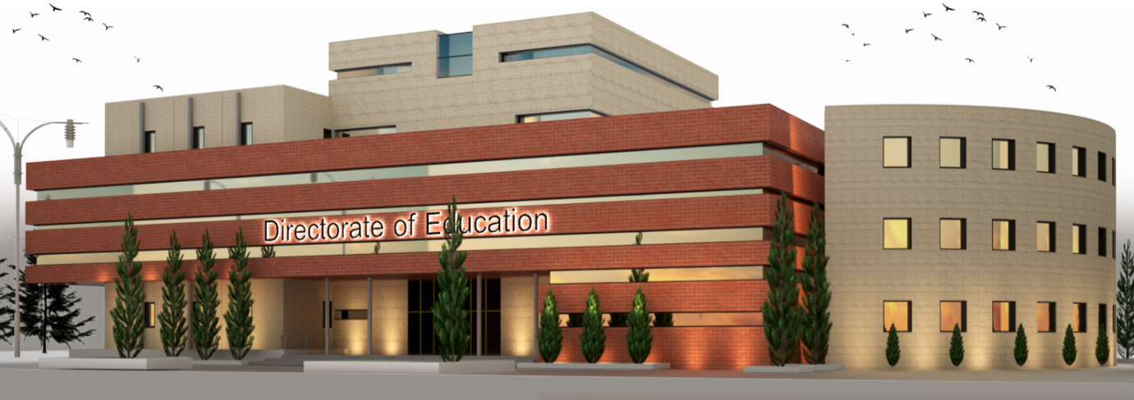
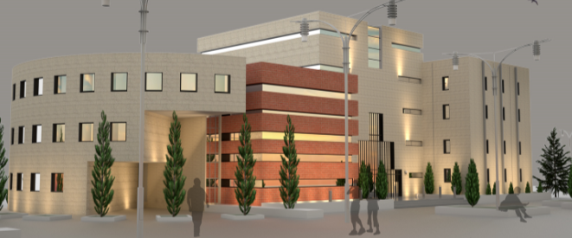
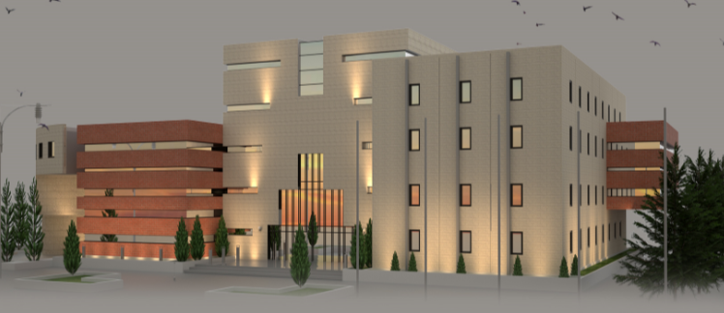
The project before modification(Outside)

Slide 23
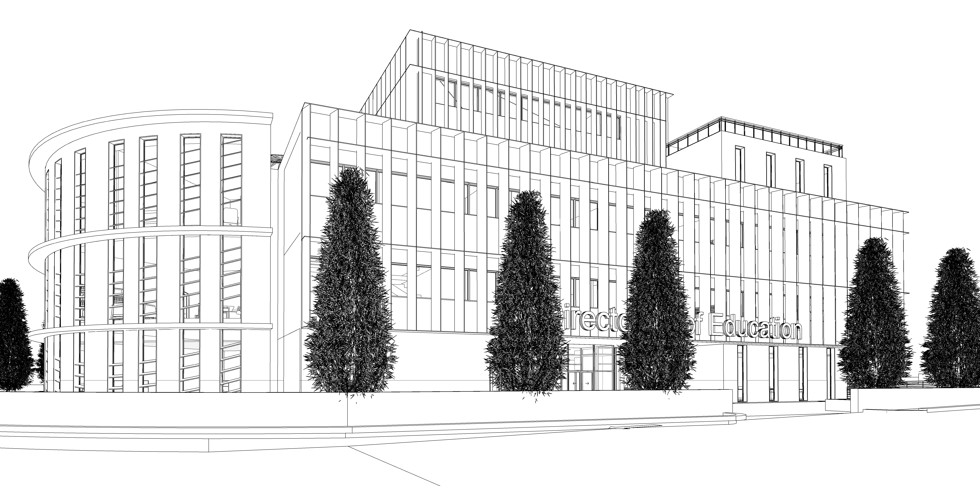
The project after modification (Outside)

Slide 24
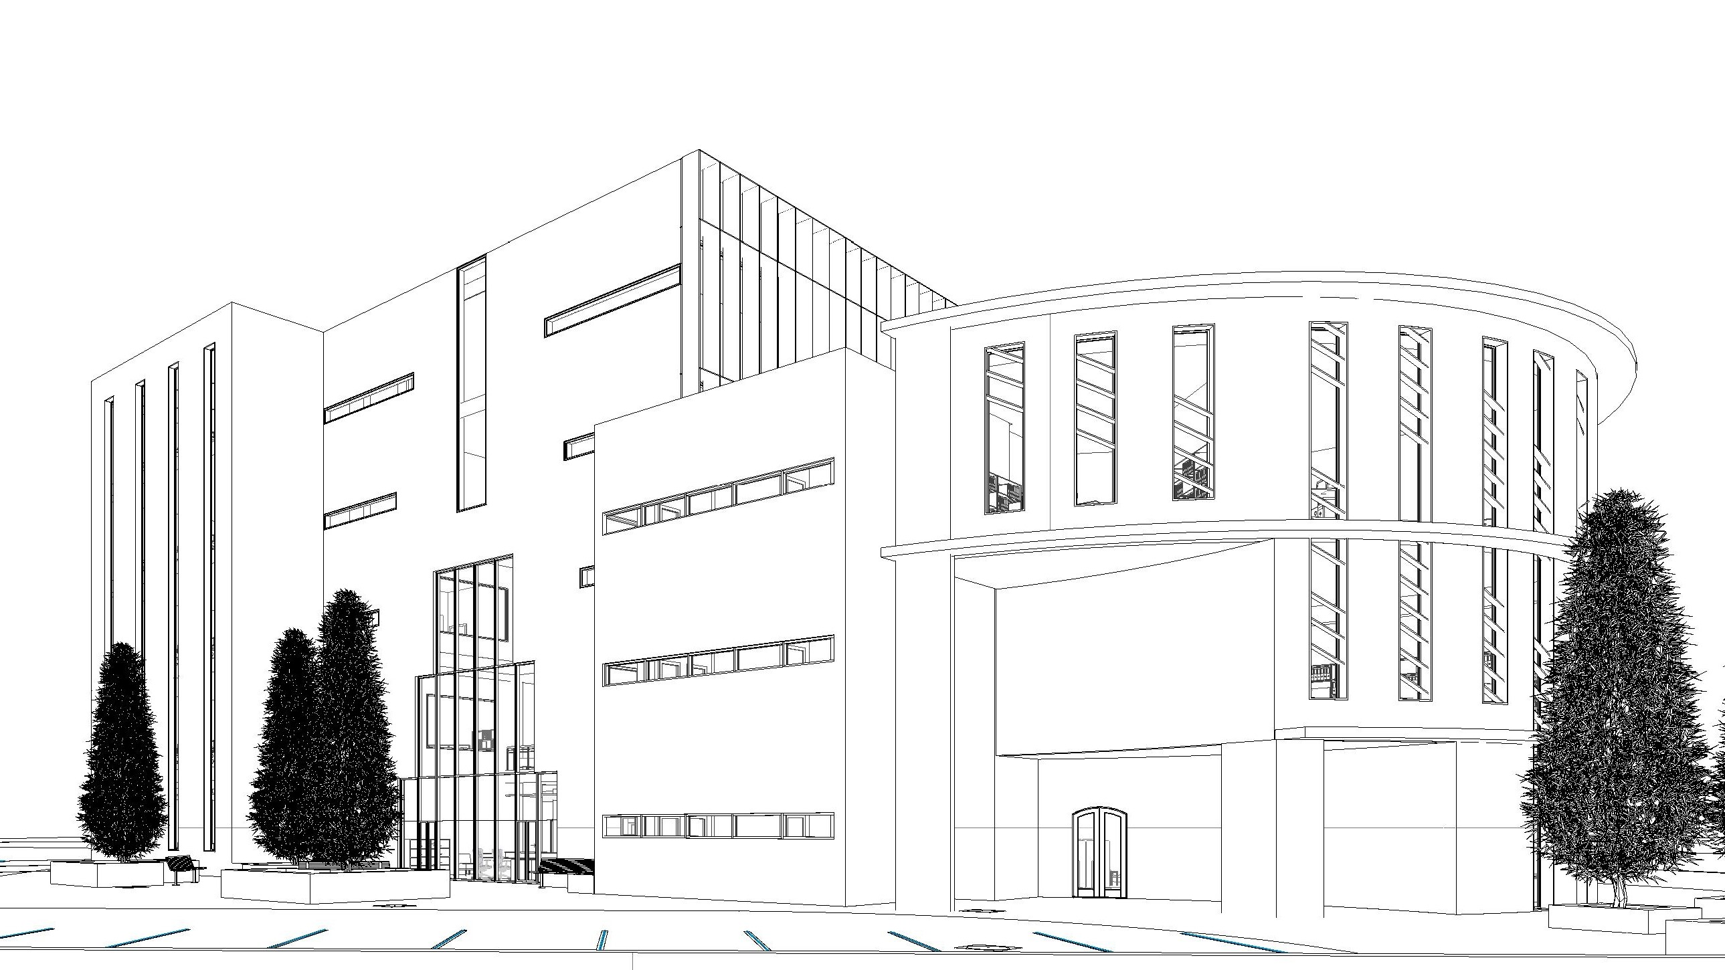
The project after modification (Outside)

Slide 25
Architectural modifications
Architectural Aspects
Architectural standards
Site analysis
Architectural modifications
Before and After
Outside
Inside
Substantial modifications:

Slide 26
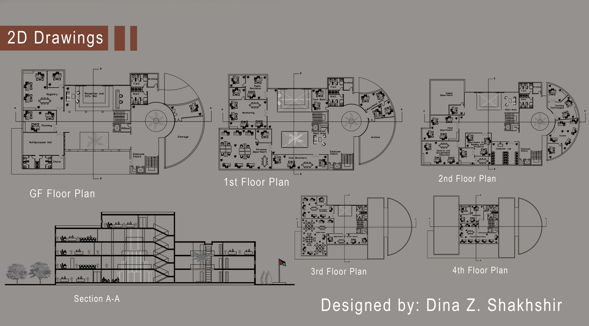
The project before modification (Inside)
The project before modification (Inside)
The project after modification (Inside)

Slide 27
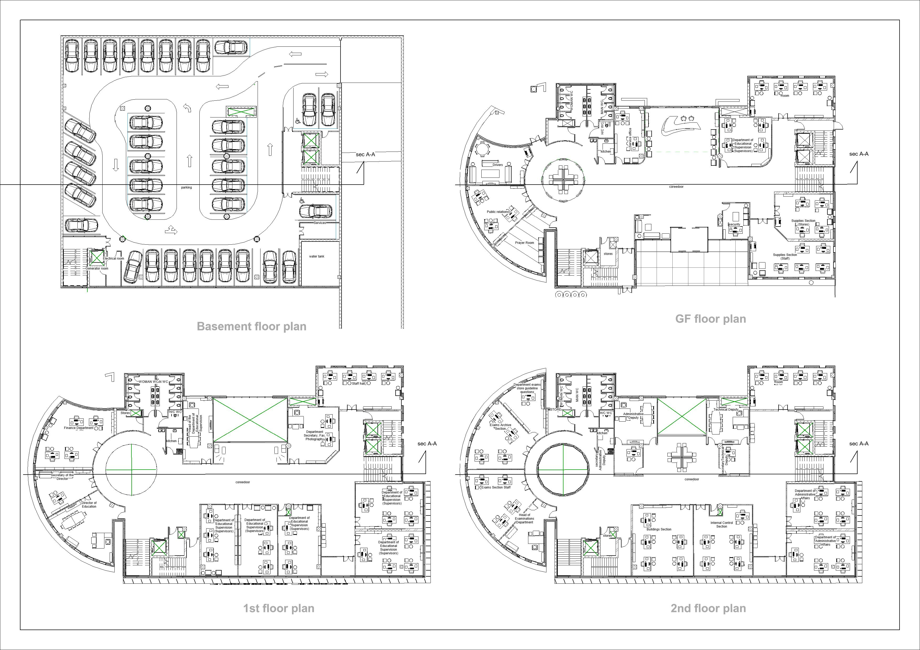
The project after modification (Inside)

Slide 28
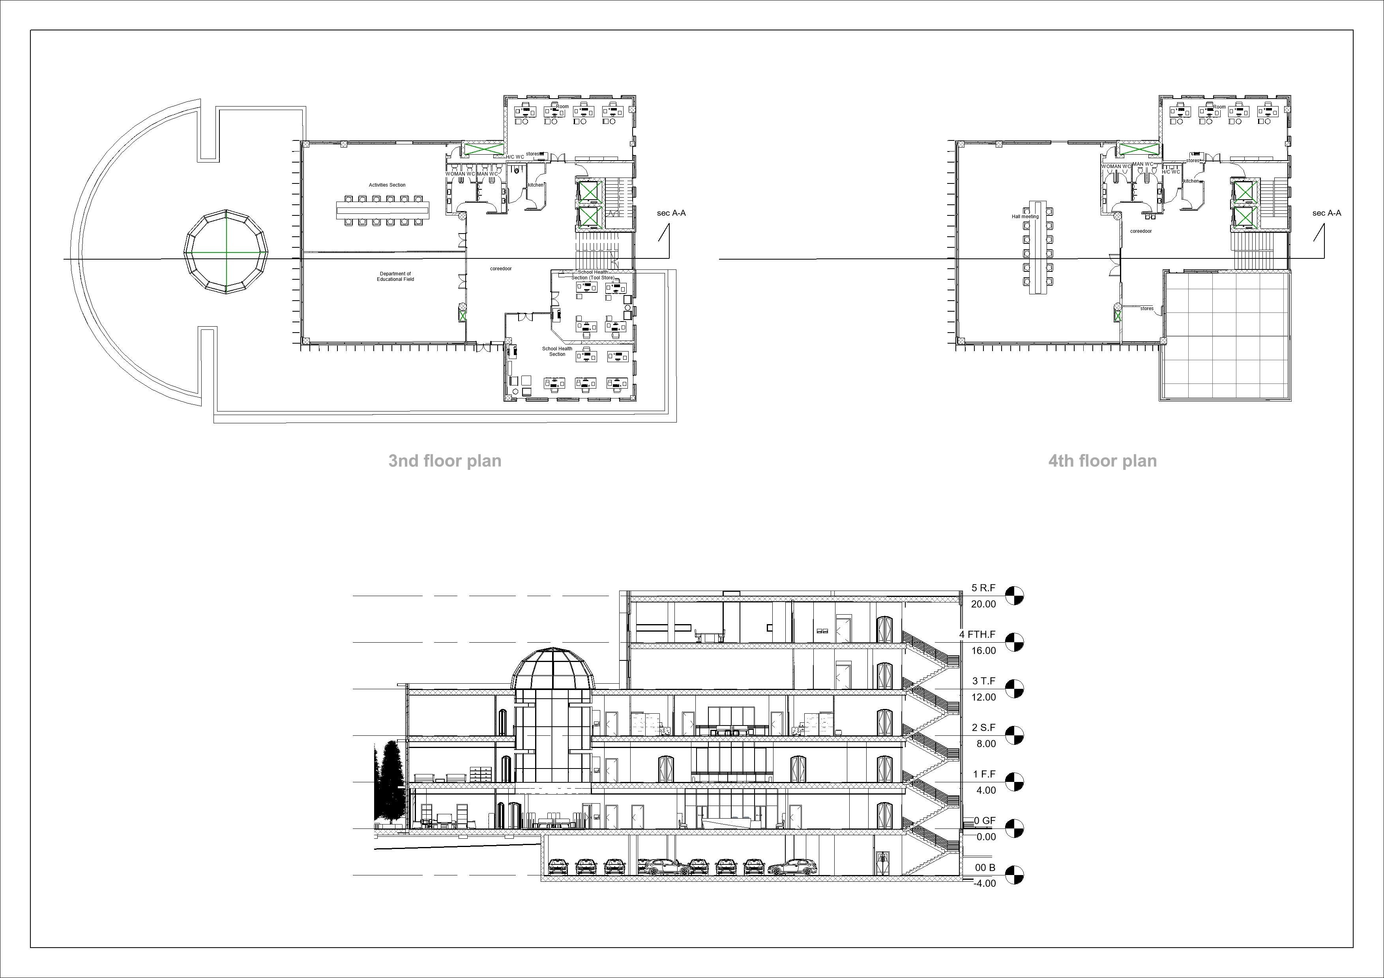
The project after modification (Inside)

Slide 29
Contents:
Architectural Aspects
Structural Aspect
Environmental Aspect
Quantity surveying & Cost Estimate

Slide 30
Contents:
Architectural Aspects
Structural Aspect
Environmental Aspect
Quantity surveying & Cost Estimate

Slide 31
Structural Aspects
Materials
Concrete with compressive strength of 28 MPa (B350)
And Concrete with compressive strength of 40 MPa(B500)
Code
The parameters for seismic analysis
Loads
ACI 318-14
AISC360-10 for steel analysis
Seismic design UBC 97
ASCE for load design
Mass source: 100% for dead loads and SID , 25% for live loads
Seismic zone : The directorate is located in Nablus city Therefore, the seismic zone is 2B and the Z value is equal to 0.20.
Soil profile: The soil type is clay so the soil profile is SE .
Force Reduction Factor R = 5.5 (Building Frame System - shear wall)
Importance Factor I = 1
Acceleration-Dependent Seismic Coefficient Ca = 0.34
Velocity-Dependent Seismic Coefficient Cv = 0.64
Response spectrum scale factor = $\frac{I×g}{R}$ = $\frac{1∗9810}{5.5}$ = 1783
Response spectrum scale factor = (𝐼×𝑔)/𝑅 = (1∗9810)/5.5 = 1783
Live load = 3 kN/m²
SID load = 4 kN/m²

Slide 32
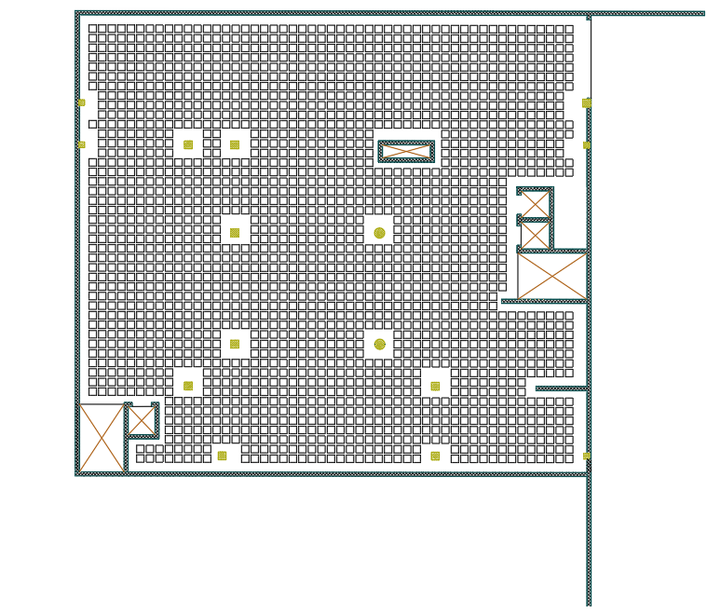
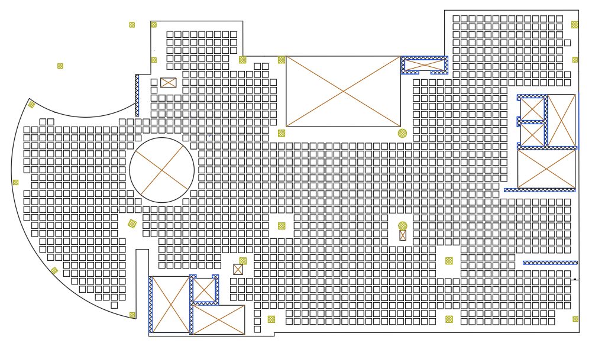
Ground and First floors
Ground Floor
First Floor

Slide 33
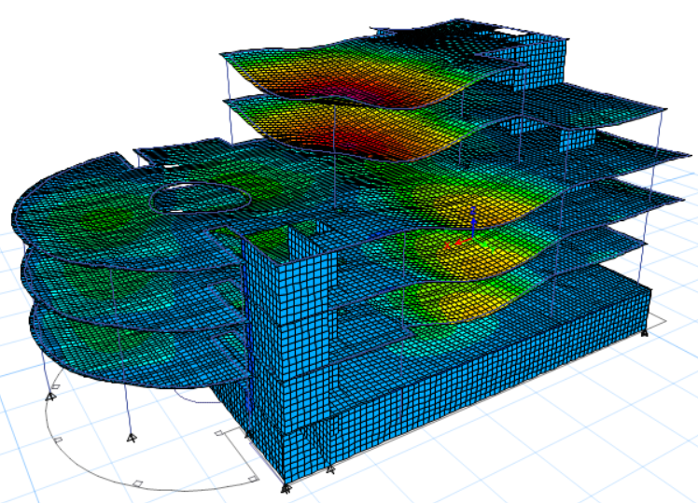
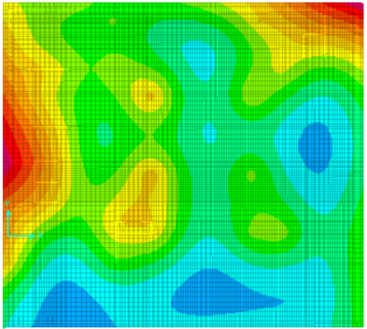
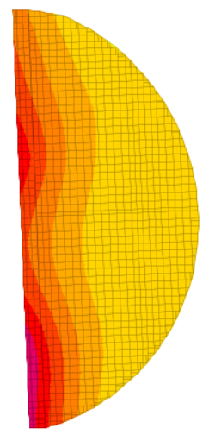
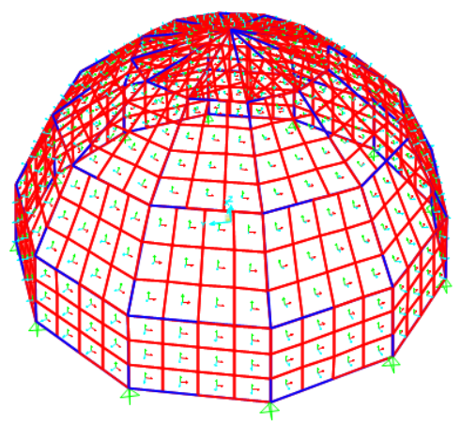
Models for design
Etab model for concrete structure
safe models for basement mat
safe models for Ground mat
sap model for dome steel

Slide 34
Seismic design checks
Drift check
story | height | Dis X | Dis Y | Drift X(ΔS) | Drift Y(ΔS) | Delta x(ΔM) | Delta y(ΔM) | limit
 | mm | mm | mm | mm | mm | mm | mm | mm
0 |  | 0 | 0 | 0 | 0 | 0 | 0 | 80
1 | 4 | 8.8 | 9.5 | 8.8 | 9.5 | 6.16 | 6.65 | 80
2 | 4 | 18.5 | 19.3 | 9.7 | 9.8 | 6.79 | 6.86 | 80
3 | 4 | 29 | 31 | 10.5 | 11.7 | 7.35 | 8.19 | 80
4 | 4 | 42.8 | 42.7 | 13.8 | 11.7 | 9.66 | 8.19 | 80
5 | 4 | 62 | 49 | 19.2 | 6.3 | 13.44 | 4.41 | 80
base shear check
Load Case/Combo | Etab calculation |  | manual calclation
 | FX | FY | FX | FY
 | kN | kN | kN | kN
EQx Max | 15956.4 | 2630.21 | 16222.83 | 16222.83
EQy Max | 3221.01 | 15986 | 16222.83 | 16222.83
Time period check
Time period from mode 1 = 0.74 sec < 0.74 sec, the check is ok.
Time period from mode 2 = 0.688 sec < 0.74 sec, the check is ok.
Model mass participating check
The sum of ux =0.92, uy=0.95 large then 0.9

Slide 35
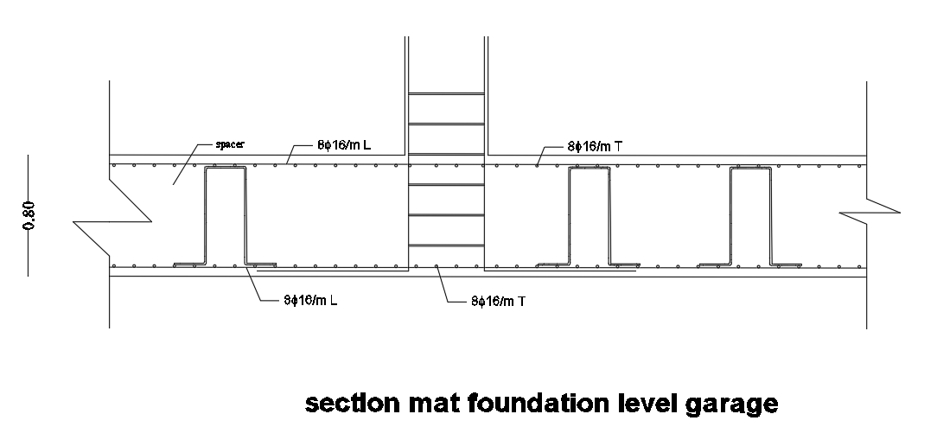
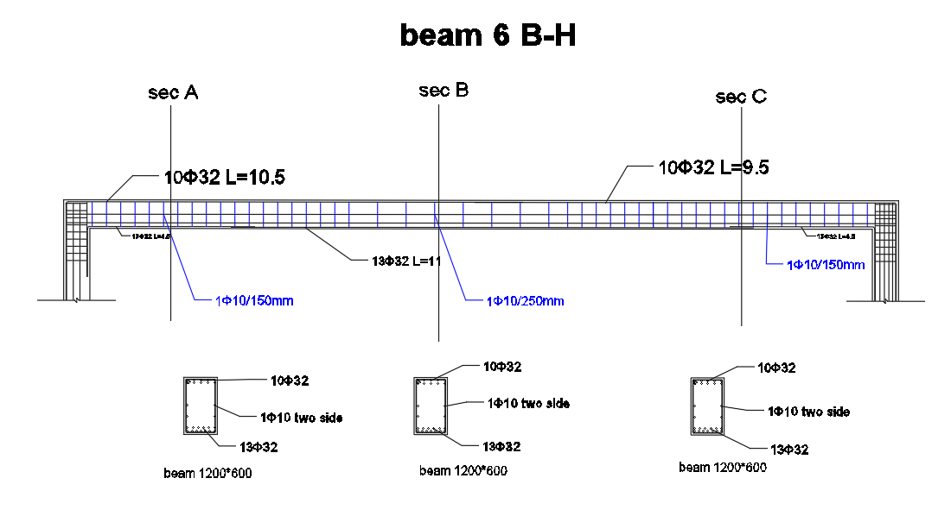
Beam section and mat section

Slide 36
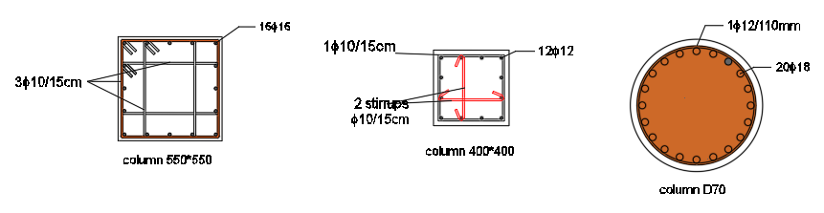
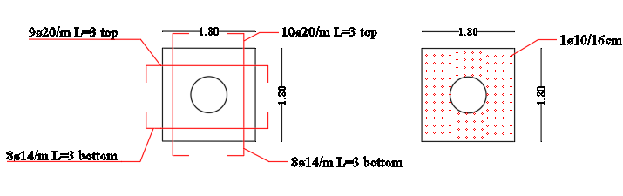
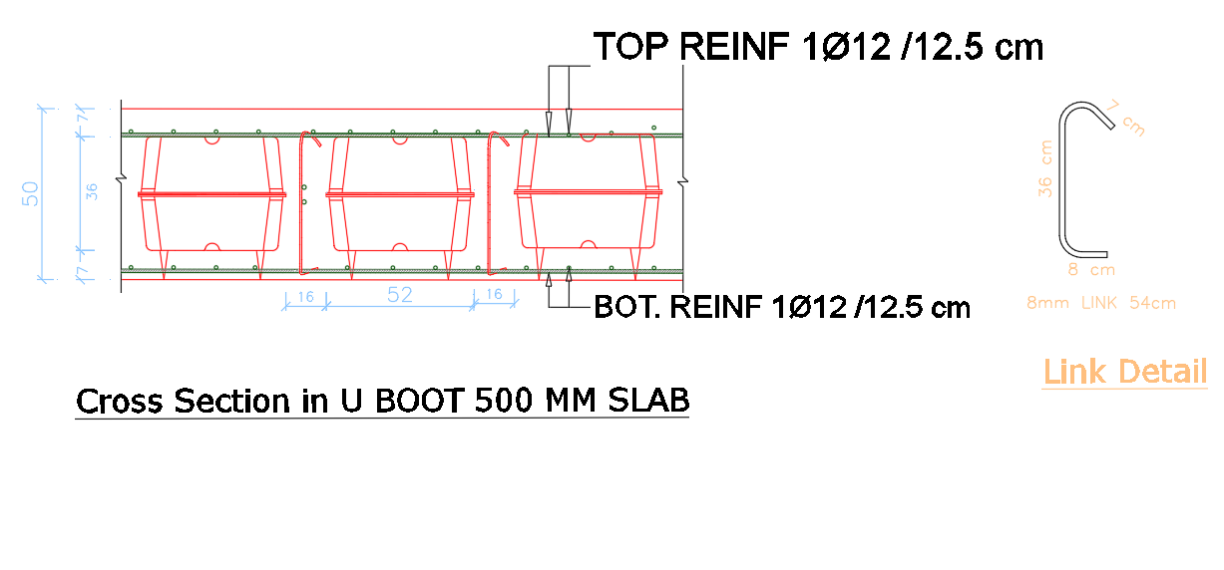
section using in design

Slide 37
Contents:
Architectural Aspects
Structural Aspect
Environmental Aspect
Quantity surveying & Cost Estimate

Slide 38
Contents:
Architectural Aspects
Structural Aspect
Environmental Aspect
Quantity surveying & Cost Estimate

Slide 39
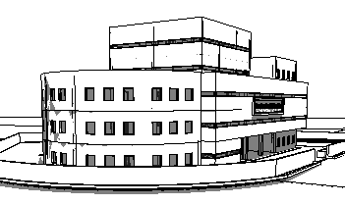
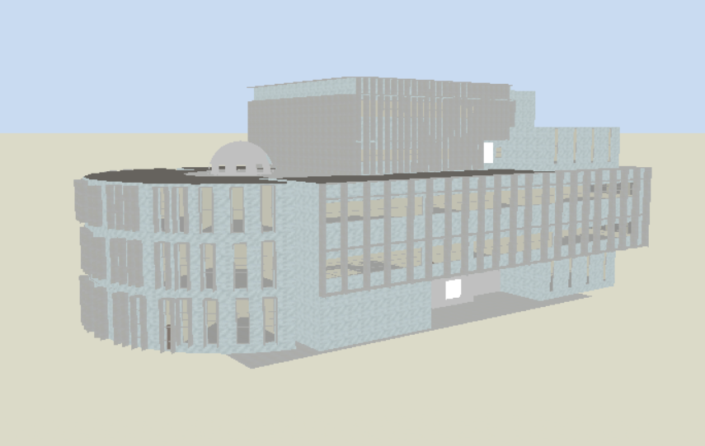
Environmental Aspect
Before
after
Main modifications using after editing
1-changing the window shape.
2-adding lovers
3-changing the Court center of building to court siphonage

Slide 40
Environmental Aspect
Environmental Aspect
Checking and validation
Artificial lighting design
Power design
Acoustical design
Fire alarm and Firefighting systems
Vertical transportation
HVAC design
Water supply
Drainage

Slide 41
Environmental Aspect
Environmental Aspect
Checking and validation
Artificial lighting design
Power design
Acoustical design
Fire alarm and Firefighting systems
Vertical transportation
HVAC design
Water supply
Drainage

Slide 42
Checking and validation
Day lighting
Thermal
Ventilation analysis

Slide 43
Checking and validation
Day lighting
Thermal
Ventilation analysis

Slide 44
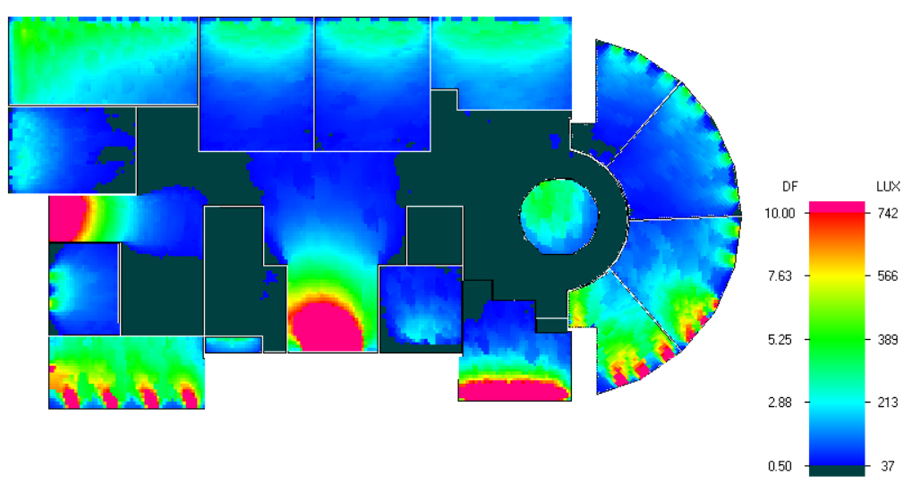
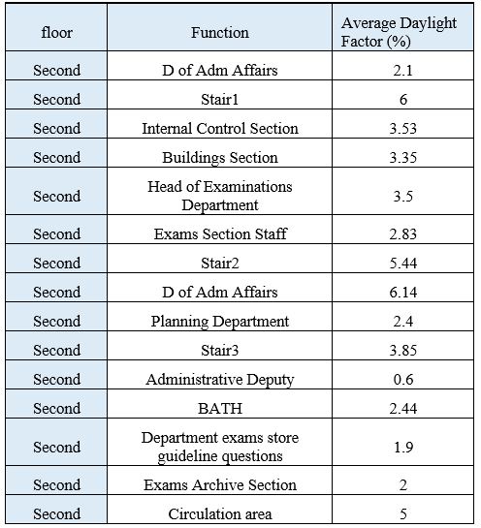
Day lighting
Day lighting for second floor

Slide 45
Checking and validation
Day lighting
Thermal
Ventilation analysis

Slide 46
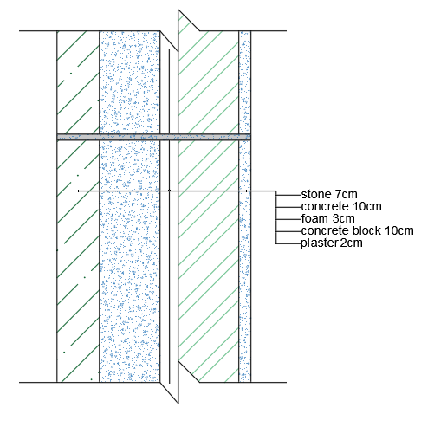
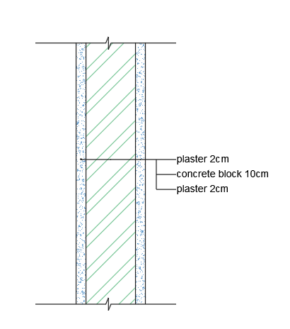
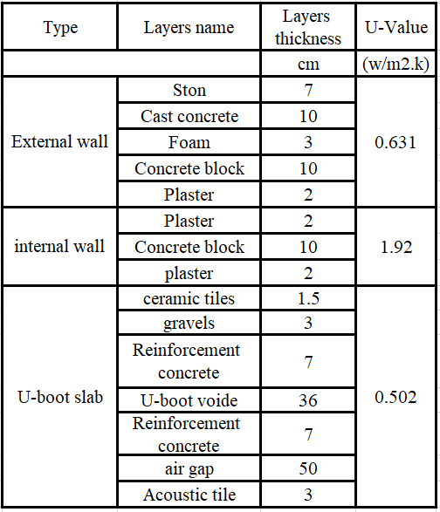
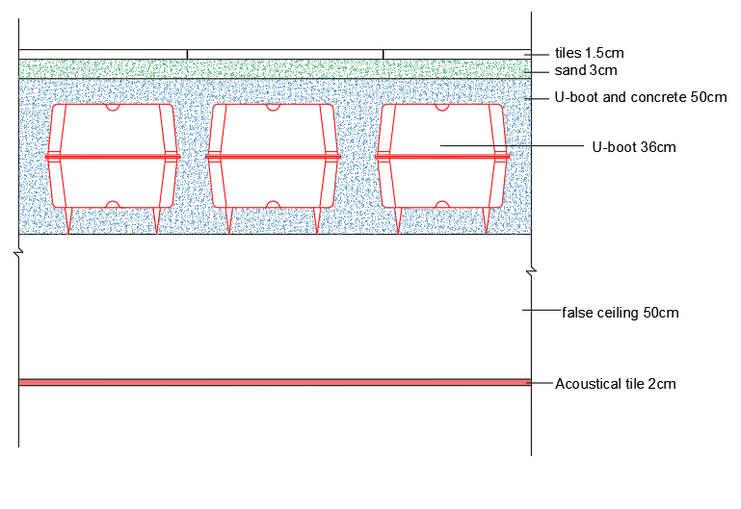
Thermal design

Slide 47
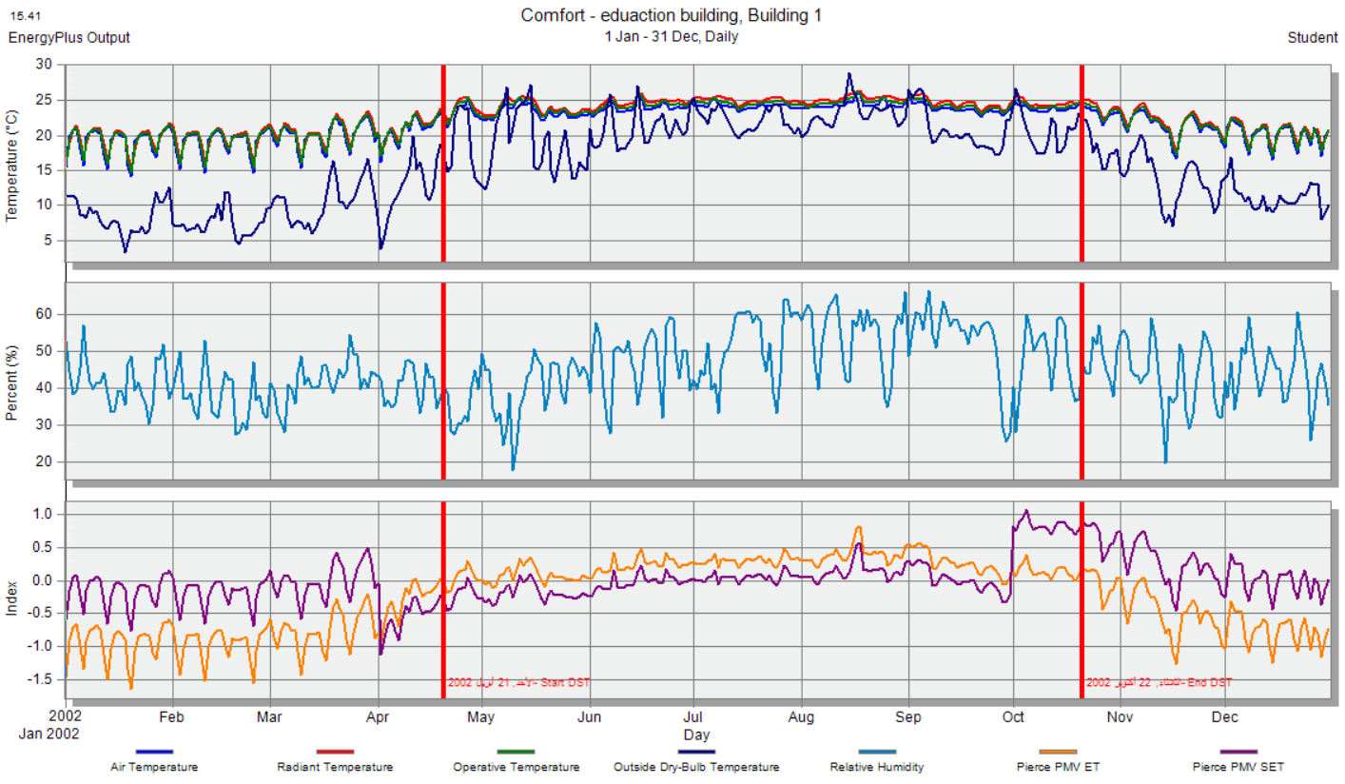
The comfort graph for the Directorate from Design Builder

Slide 48
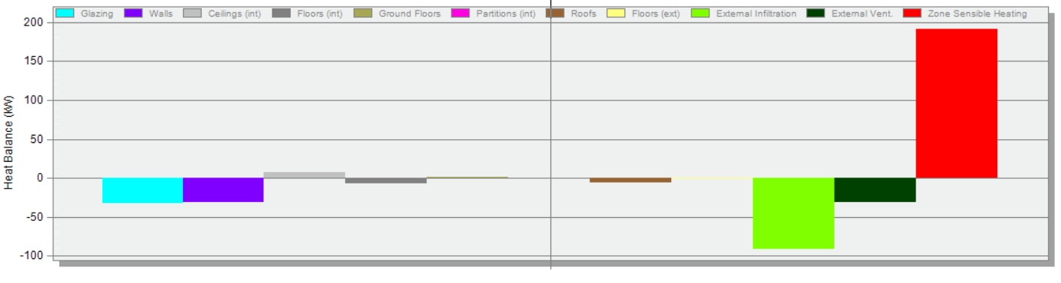
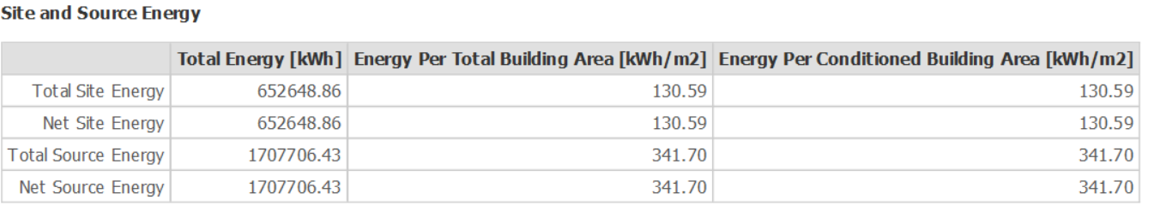
Temperature and heat loss
Total site and source energy

Slide 49
Checking and validation
Day lighting
Thermal
Ventilation analysis

Slide 50
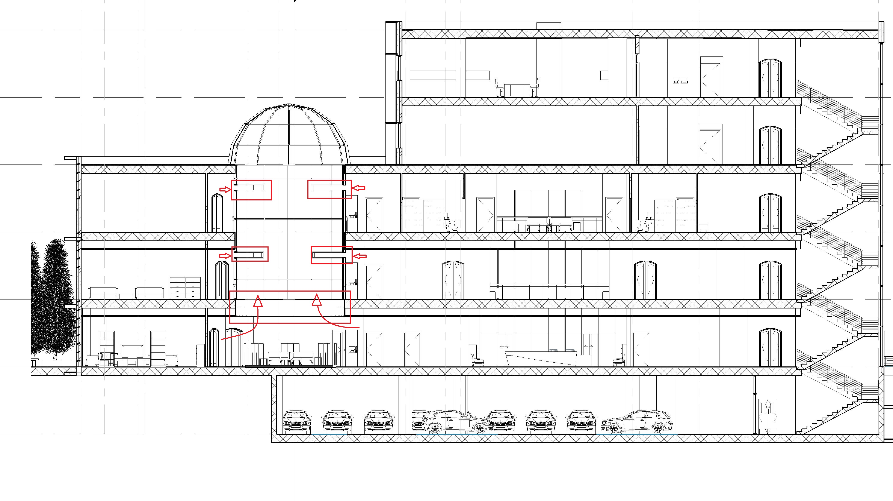
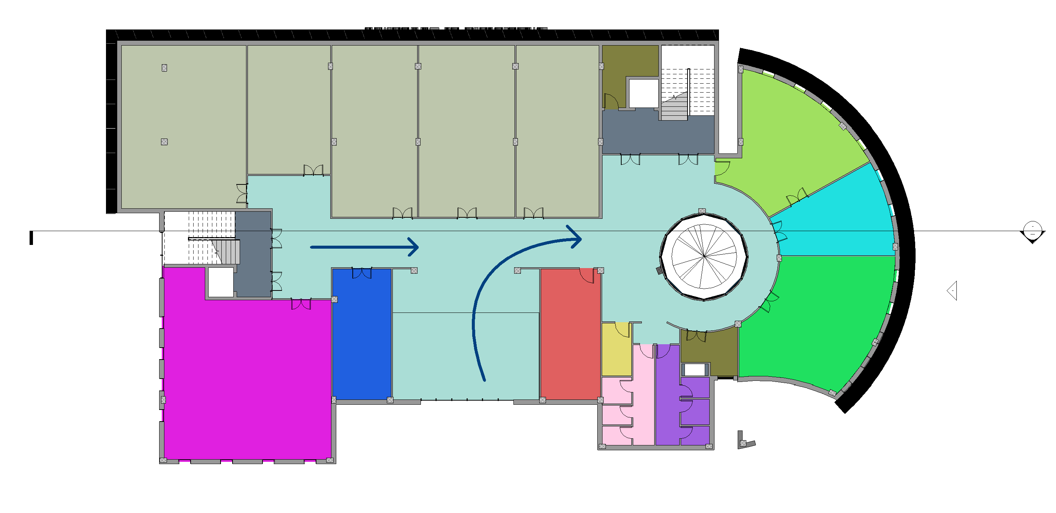
Ventilation analysis
Direction of wind
Section of Court siphonage

Slide 51
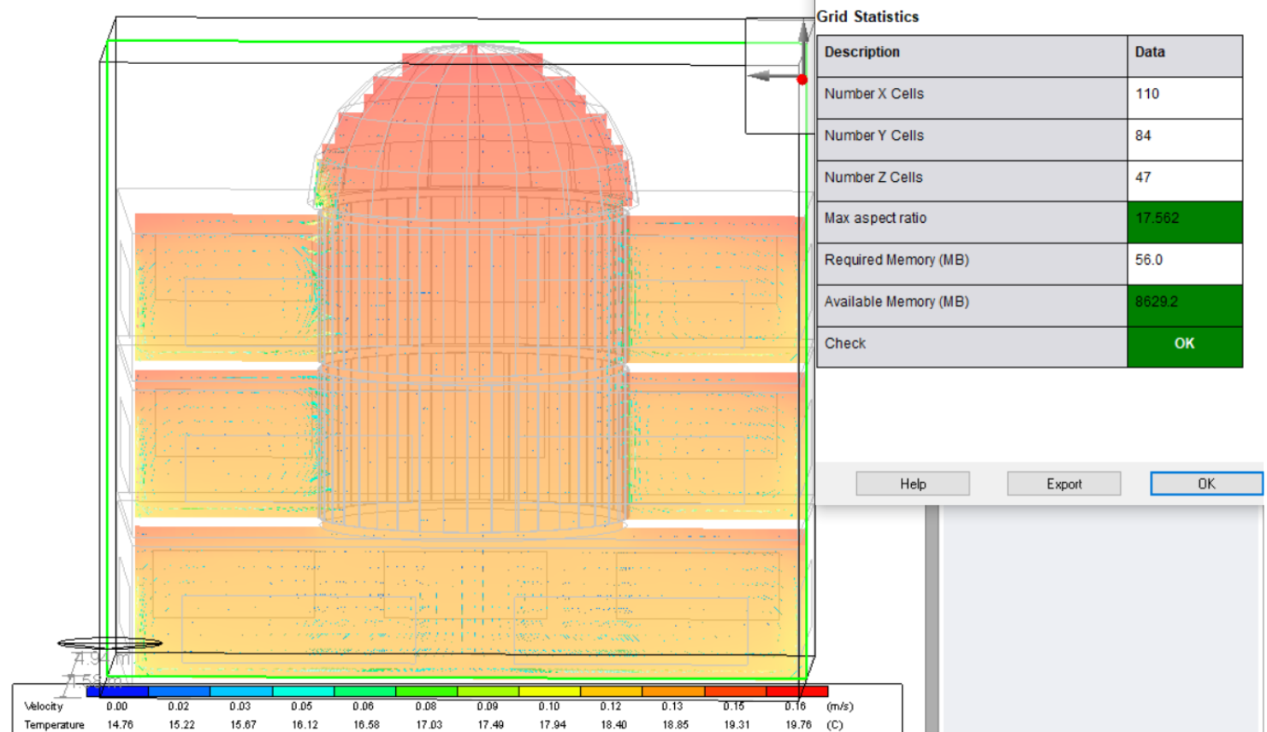
Checking the ventilation in Court

Slide 52
Environmental Aspect
Environmental Aspect
Checking and validation
Artificial lighting design
Power design
Acoustical design
Fire alarm and Firefighting systems
Vertical transportation
HVAC design
Water supply
Drainage

Slide 53
Environmental Aspect
Environmental Aspect
Checking and validation
Artificial lighting design
Power design
Acoustical design
Fire alarm and Firefighting systems
Vertical transportation
HVAC design
Water supply
Drainage

Slide 54
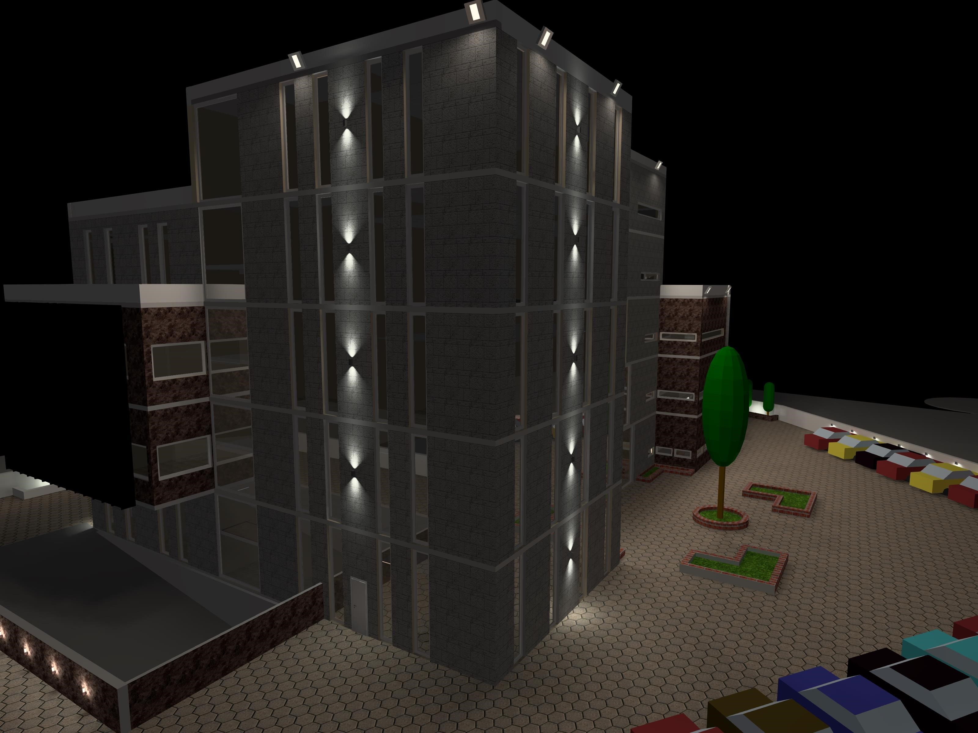
Environmental Aspect
Environmental Aspect
Checking and validation
Artificial lighting design
Power design
Acoustical design
Fire alarm and Firefighting systems
Vertical transportation
HVAC design
Water supply
Drainage
Inside
Outside

Slide 55
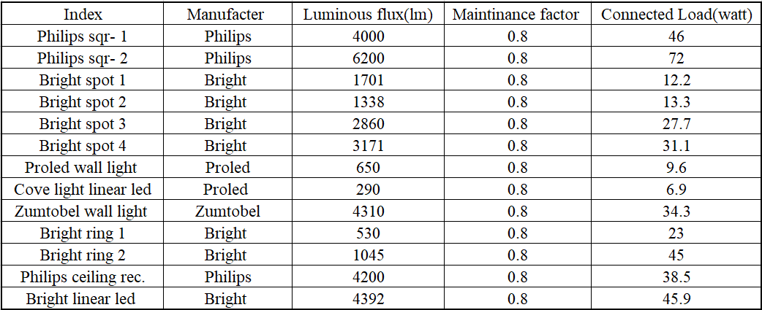

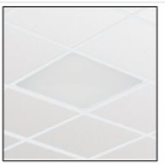











Inside the building :
The selected luminaires
Philips sqr- 1
Philips sqr- 2
Bright spot 1
Bright spot 2
Bright spot 3
Bright spot 4
Proled wall light
Cove light linear led
Zumtobel wall light
Bright ring 1
Bright ring 2
Philips ceiling rec.
Bright linear led

Slide 56



Lighting with switches

Slide 57




Ground floor
Illuminance result from DIALUXevo for the security room

Slide 58







Ground floor
Drivers room
Room 3
Result from DIALUX evo form artificial only
Double volume
Reception
Result from DIALUX evo for dimming 80%.
WC corridor
Stair

Slide 59







Outside the building :
The selected luminaires
bright side wall outside 2
bright side wall outside 3
bright side wall outside 1
Philips outdoor roof
bright floor outside

Slide 60






Outside the building :
3D views

Slide 61
Environmental Aspect
Environmental Aspect
Checking and validation
Artificial lighting design
Power design
Acoustical design
Fire alarm and Firefighting systems
Vertical transportation
HVAC design
Water supply
Drainage

Slide 62
Environmental Aspect
Environmental Aspect
Checking and validation
Artificial lighting design
Power design
Acoustical design
Fire alarm and Firefighting systems
Vertical transportation
HVAC design
Water supply
Drainage

Slide 63


Ground floor
Sockets plan for the Supply sections

Slide 64



Ground floor
The electrical load of power and lighting system in the ground floor
Main distribution board of circuit breaker in the ground floor
Distribution of circuit breaker in DB1

Slide 65



The electrical load of power and lighting in the MDB building
The electrical load of elevators and HVAC system in MDB HVAC and elevators

Slide 66




Specification for Generator and UPS

Slide 67
Environmental Aspect
Environmental Aspect
Checking and validation
Artificial lighting design
Power design
Acoustical design
Fire alarm and Firefighting systems
Vertical transportation
HVAC design
Water supply
Drainage

Slide 68
Environmental Aspect
Environmental Aspect
Checking and validation
Artificial lighting design
Power design
Acoustical design
Fire alarm and Firefighting systems
Vertical transportation
HVAC design
Water supply
Drainage

Slide 69


Acoustical design
The spaces that were designed acoustically in the building
1- Director private room
2- Small offices
3- Large offices
4- Meeting room
The absorption coefficient for the finished material in offices
The absorption coefficient for the finished material in meeting room

Slide 70




Reverberation time(RT60):
The reverberation time for the director room according to Sabine
The reverberation time for the large offices according to Sabine

Slide 71


Sound Transmission Loss (STC)
The sound transmission loss (STC) for the internal walls between different spaces
The sound transmission loss (STC) for the internal walls between different spaces in the faculty is more than the limit = 45 dB

Slide 72


Sound Transmission Loss (STC)
The OITC for the external
The OITC for the external walls = 54dB more than the standard = 37 dB, so it is ok for the external walls

Slide 73


Impact Insulation Class (IIC)
The layers for the ceiling
The IIC = 66 dB between 60dB and 70 dB , so it’s excellent.

Slide 74




Loud speaker for meeting room
Sound pressure level (SPL) :
The direct SPL is between 75 dB and 85 dB , so it’s ok
Articulation loss % :
The maximum AL% in the room = 3.81% and the minimum value of AL% = 1.63 % , so its excellent .

Slide 75


Loud speaker for meeting room
Noise Level
Speech transmission index (STI) :
The recommended noise level for high conference meeting room = 35 dB
The minimum STI = 0.7 and the maximum STI = 0.86 , so it’s excellent .

Slide 76
Environmental Aspect
Environmental Aspect
Checking and validation
Artificial lighting design
Power design
Acoustical design
Fire alarm and Firefighting systems
Vertical transportation
HVAC design
Water supply
Drainage

Slide 77
Environmental Aspect
Environmental Aspect
Checking and validation
Artificial lighting design
Power design
Acoustical design
Fire alarm and Firefighting systems
Vertical transportation
HVAC design
Water supply
Drainage

Slide 78





Part of firefighting plan for the ground floor
Fire alarm and Firefighting systems
The symbols of the suppression system in the plans
Part of firefighting plan for the fourth floor
The symbols for the detection and notification system.
The emergency lights and signs

Slide 79










The different types of sprinkler in the building
The different types of the extinguisher
manual alarm fire system
heat detector
Ultraviolet flame detector
smoke detector
extinguisher Shape
emergency lighting
exit sign
standpipe in site
Flood sprinkler
hose station

Slide 80




Drop panel for the double volume
FM200 system
Wet chemical sprinkler

Slide 81

The evacuation plan for the second floor

Slide 82

Reflected false ceiling for second floor

Slide 83
Environmental Aspect
Environmental Aspect
Checking and validation
Artificial lighting design
Power design
Acoustical design
Fire alarm and Firefighting systems
Vertical transportation
HVAC design
Water supply
Drainage

Slide 84
Environmental Aspect
Environmental Aspect
Checking and validation
Artificial lighting design
Power design
Acoustical design
Fire alarm and Firefighting systems
Vertical transportation
HVAC design
Water supply
Drainage

Slide 85


Vertical and horizontal transportation

Slide 86
Environmental Aspect
Environmental Aspect
Checking and validation
Artificial lighting design
Power design
Acoustical design
Fire alarm and Firefighting systems
Vertical transportation
HVAC design
Water supply
Drainage

Slide 87

HVAC system design for heating and cooling
Why VRF(Cassette unit):
1. Ultimate Flexibility, Multi-Port Change-Over Boxes Multiply the Options.
2. Precise Solutions, More Outdoor Units for Right-Sized Systems.
3. Efficient Performance, the Cost-Effective, Energy-Efficient Choice.
4. Absolute Control, Choose from Several Control Options.

Slide 88

HVAC system design for heating and cooling
Selecting the system components:
Outdoor Units:
Four machines, three of which are 16 tons, and one of which is 12 tons, are placed on the roof of the building, were selected to meet the project's need of 57 tons
*system components selected from the YORK ® Company

Slide 89


HVAC system design for heating and cooling
Selecting the system components:
Indoor Units:4-way Cassette unit
Change-Over Boxes
*system components selected from the YORK ® Company

Slide 90



Second floor (HVAC system)

Slide 91
Environmental Aspect
Environmental Aspect
Checking and validation
Artificial lighting design
Power design
Acoustical design
Fire alarm and Firefighting systems
HVAC design
Water supply
Drainage
Vertical and horizontal transportation

Slide 92

Water supply system:
The System used:
The best system that can meet the requirements is basement tank and roof tank and pump.
Roof tanks*: Three tanks with a capacity of 5000 liters for each tank so the total capacity on roof will be 15 cubic meters.
basement tank**: The location of the tank in the basement floor and the size of this tank depends on the rate of water consumption is 100 cubic meters
*Roof tanks is a plastic tanks from ROYAL company.
** basement tank is a square RC tank.

Slide 93

Water supply system:
The System used:
basement tank

Slide 94
Environmental Aspect
Environmental Aspect
Checking and validation
Artificial lighting design
Power design
Acoustical design
Fire alarm and Firefighting systems
Vertical and horizontal transportation
HVAC design
Water supply
Drainage

Slide 95



Drainage system:
Group A:

Slide 96


Drainage system:
Group B:

Slide 97
Contents:
Architectural Aspects
Structural Aspect
Environmental Aspect
Quantity surveying & Cost Estimate

Slide 98
Contents:
Architectural Aspects
Structural Aspect
Environmental Aspect
Quantity surveying & Cost Estimate

Slide 99
Quantity surveying & Cost Estimate
The total cost of the building is 8693828 NIS and the total area of the building is 5353m² ,which means that the total unit cost per m² is 1625 NIS/m².
Earth work = 529000 NIS
Foundation Work = 758246 NIS
Retaining Wall = 164260 NIS
Super Structure = 2216368 NIS
Finishes Work = 2495552 NIS
Electrical work = 512065 NIS
Safety work = 139920 NIS
Mechanical work = 1511650 NIS
Site Work = 365267 NIS

Slide 101

Thanks for listening

