Slide 1

AN-Najah National University
DEPARTMENT OF CIVIL ENGINEERING
NABLUS, Palestine
AN-Najah National University
DEPARTMENT OF CIVIL ENGINEERING
NABLUS, Palestine
Graduation Project II
DEVELOPMENT OF PAVEMENT MANAGEMENT SYSTEM
FOR SELECTED ROADS IN NABLUS CITY
Prepared by:
Ahmad Jamal Marshoud (11211741)
Anas Yusuf Zidan (11211838)
Waleed Kamal Odeh (11243961)
Yusuf Mohammad Theeb (11243714)
Under Supervision of: Dr. Amjad ISSA.
MAY 25, 2017

Slide 2
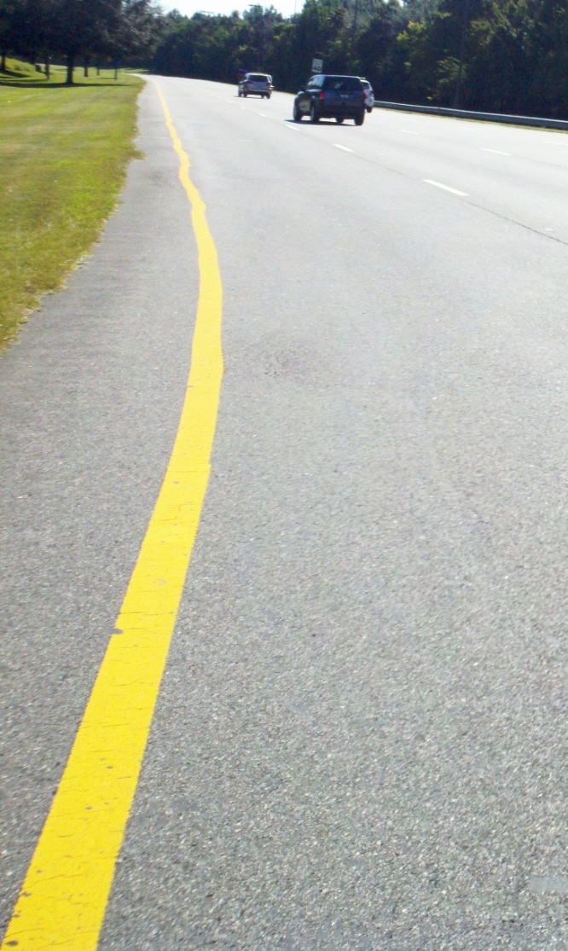
Outlines
Introduction.
Methodology.
Data Collection.
Data Calculation.
Result and Discussions.
Conclusion and Recommendations.

Slide 3
INTRODUCTION

Slide 4
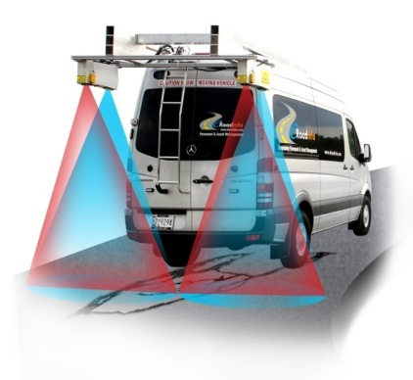


What is PMS?
Pavement Management System – it is a scientific tool for managing the pavements so as to make the best possible use of resources available or to maximize the benefit for society.
Thus, PMS can be used in directing and controlling maintenance resources for optimum benefits.

Slide 5
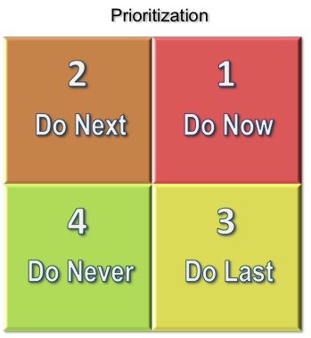
Uses of PMS
a) Road inventory
b) Developing Maintenance Budgets
c) Prioritization

Slide 6
PMS Theory
Do the right thing at
the right time in the right place.
  Make timely maintenance repairs
  Avoid more expensive, extensive repairs
And then…
Do it in the right WAY !

Slide 7
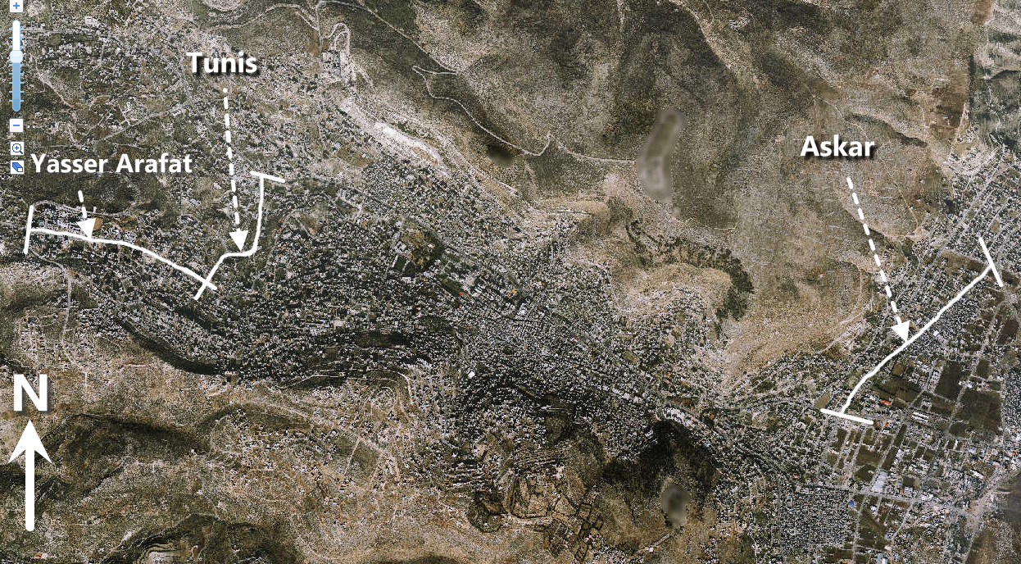
Study Area
The study will be conducted on three main roads in Nablus city:

Slide 8
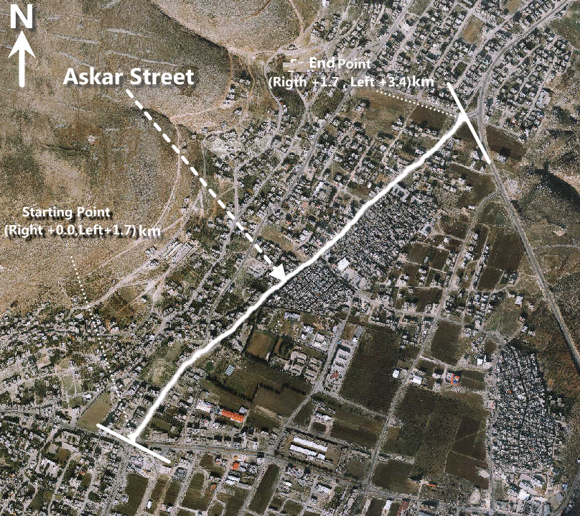
Study Area (Continue…)
Askar Street
Characteristics
Length | 1.7 km
Directions | 2 Direction
# of lanes in each direction | 2 lanes
Median | Yes
Functional classification | Arterial
Each Direction Width (average) | 10m

Slide 9
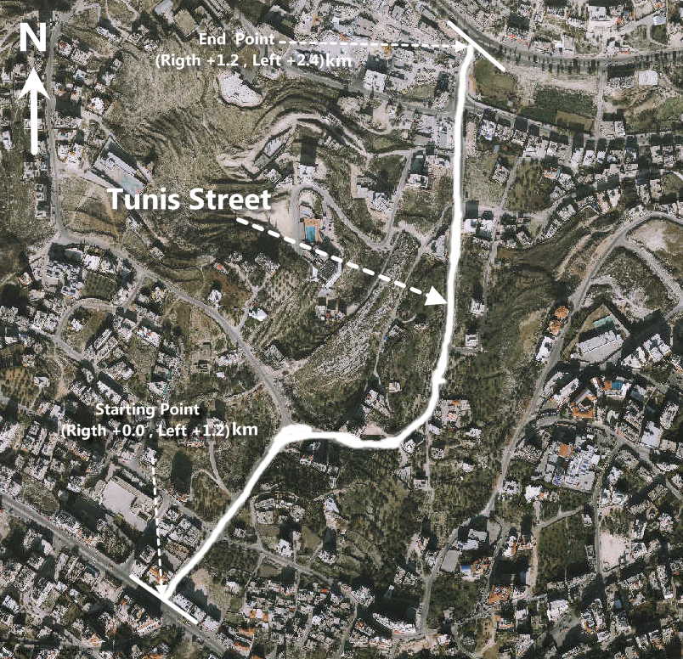
Study Area (Continue ….)
Tunis Street
Characteristics
Length | 1.2 km
Directions | 2 Direction
# of lanes in each direction | 1 lane
Median | No
Functional classification | Arterial
Each Direction Width (average) | 8.5 m

Slide 10
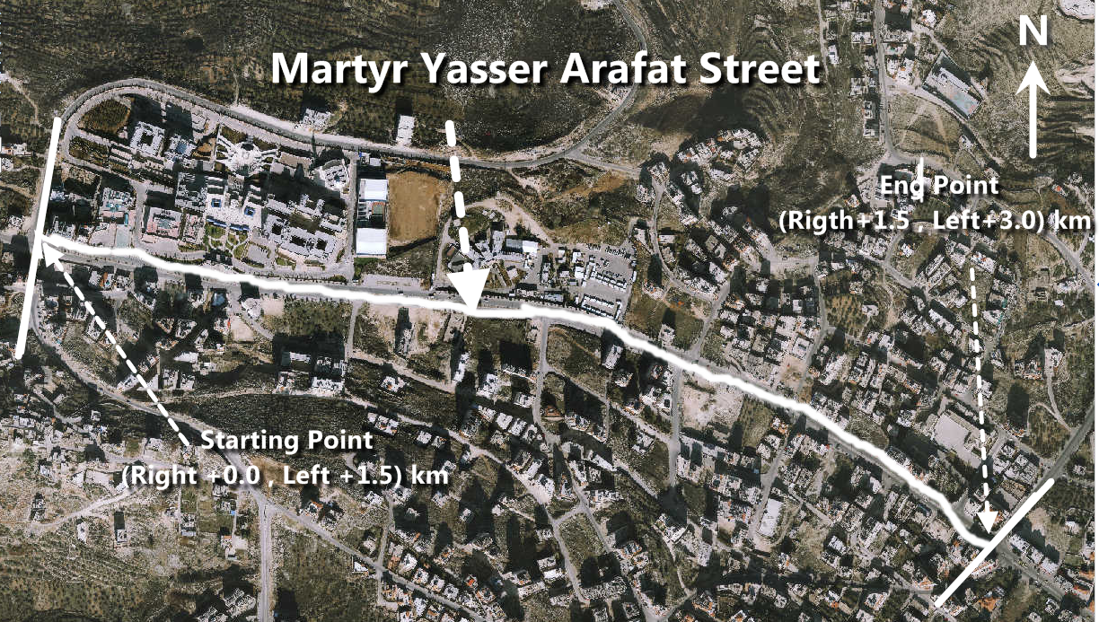
Study Area (Continue ….)
Martyr Yasser Arafat Street.
Characteristics
Length | 1.5 km
Directions | 2 Direction
# of lanes in each direction | 2 lanes
Median | Yes
Functional classification | Arterial
Each Direction Width (average) | 11.5m

Slide 11
Aims and Objectives
The main goal of this research is to develop a Pavement Management System, which provides a systematic process of maintaining, upgrading and operating Nablus city pavements and tools to facilitate a more flexible approach of making the decisions necessary to achieve the road user's expectations with maximum benefits and lowest cost.

Slide 12
METHODOLOGY

Slide 13
Definitions of Some Terms
  Pavement Section: a pavement area having uniform construction, maintenance, usage history, and condition. A section should have the same traffic volume and load intensity.
  Pavement Condition Index (PCI): a numerical rating of the Pavement condition that ranges from (0) to (100) with (0) being the worst possible condition and 100 being the best possible Condition.
  Pavement Condition Rating: a verbal description of pavement condition as a function of the PCI value that varies from “failed” to “excellent” .
  Pavement Distress: external indicators of pavement deterioration caused by loading, environmental factors, construction deficiencies, or a combination of there. Typical distresses are cracks, rutting, and raveling of the pavement surface.
  Corrective Deduct Value: value subtracted from 100 to determine the PCI.

Slide 14
Definitions of Some Terms
Prioritization: it's a composite index method used for the selection of the pavement maintenance priority ranking procedure.

Slide 15
Work Procedure
The work was divided into the following steps:
• Sections identification.
• Visual inspection .
• Data collection.
• Distresses weights.
• Pavement Condition Index (PCI).
• Rating.
• Priority Index (PI).

Slide 16
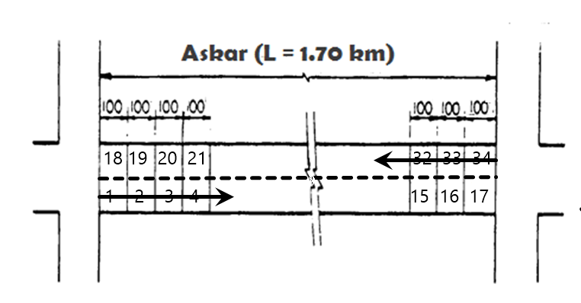
Section Identification

Slide 17
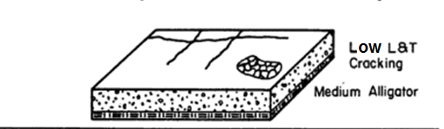
Visual Inspection

Slide 18
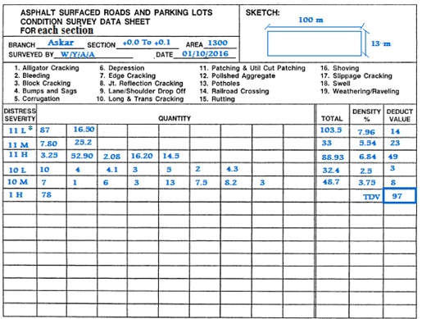
Data Collection and Distresses Weights.
* 11L stands for: 11 Distresses Number, L: Low Severity Level.

Slide 19
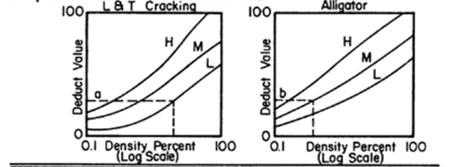
Deduct Value
Deduct Value Curve

Slide 20
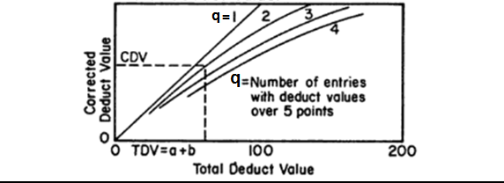
Corrective Deduct Value (CDV)
TDV = a+b.
q = Number of deduct values greater than 5.

Slide 21
Determination of PCI
PCI for each section
PCI = 100-CDV

Slide 22
Sections Rating and Proper Treatments
All sections was rated based on [PASER 2002]
Condition Category | Pavement Condition Index |  | General Treatments Strategy
 | Lower Limit | Upper Limit
Excellent | 90 | 100 | Do Nothing
Excellent | 80 | 90 | Apply Hot sand and Roll
Very good | 70 | 80 | Hot Seal/Seal Coat
Good | 60 | 70 | Crack Sealing
Good | 50 | 60 | Surface Patching
Fair | 40 | 50 | Deep Patching
Fair | 30 | 40 | Slurry Seal
Poor | 20 | 30 | Milling and Repave
Very Poor | 10 | 20 | Base Repair and Repave
Failed | 0 | 10 | Structural Overlay

Slide 23
Determination of PI
PI for each section
PI = ∑ Fi * Wi
Where:
Fi: Priority Factors
Wi: Priority Factor Weights.

Slide 24
Work procedure Flow-Chart

Slide 25
Data Collection

Slide 26

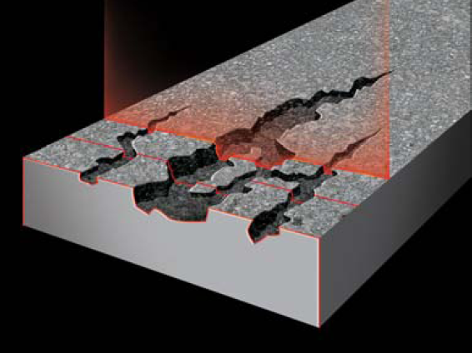
Data collection
Data collection methods
Manual .
Automated.

Slide 27
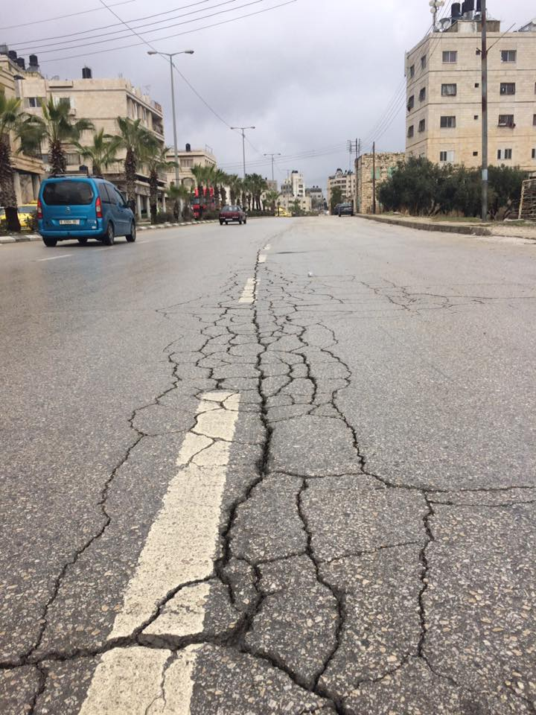
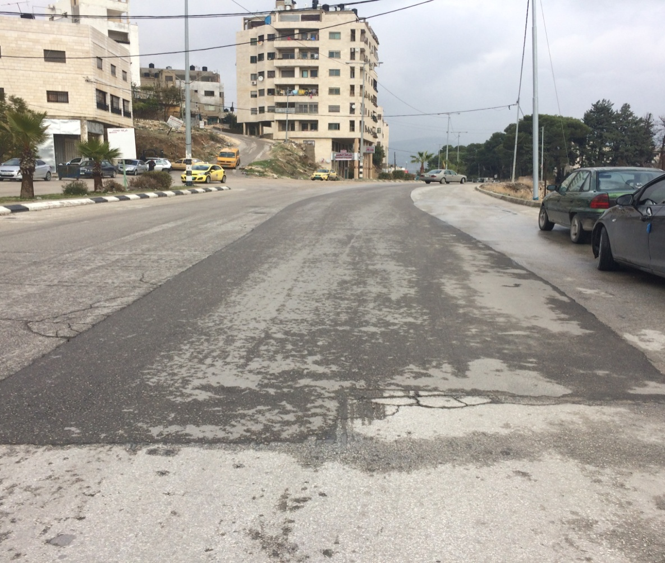
Some distresses
Alligator crack Patching

Slide 28
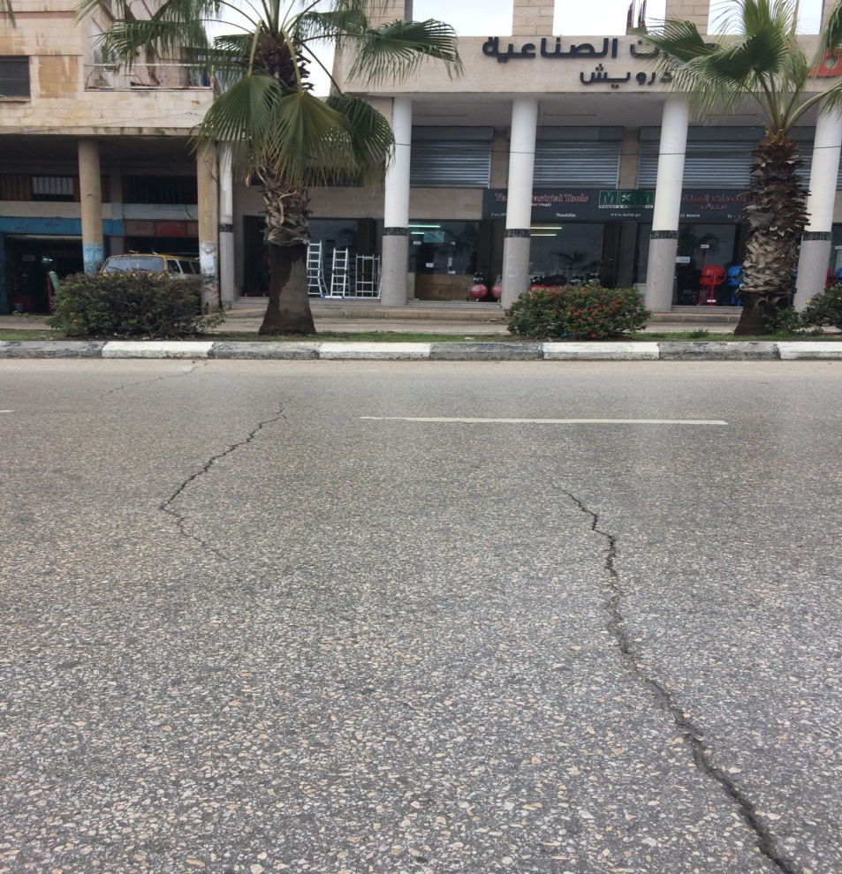
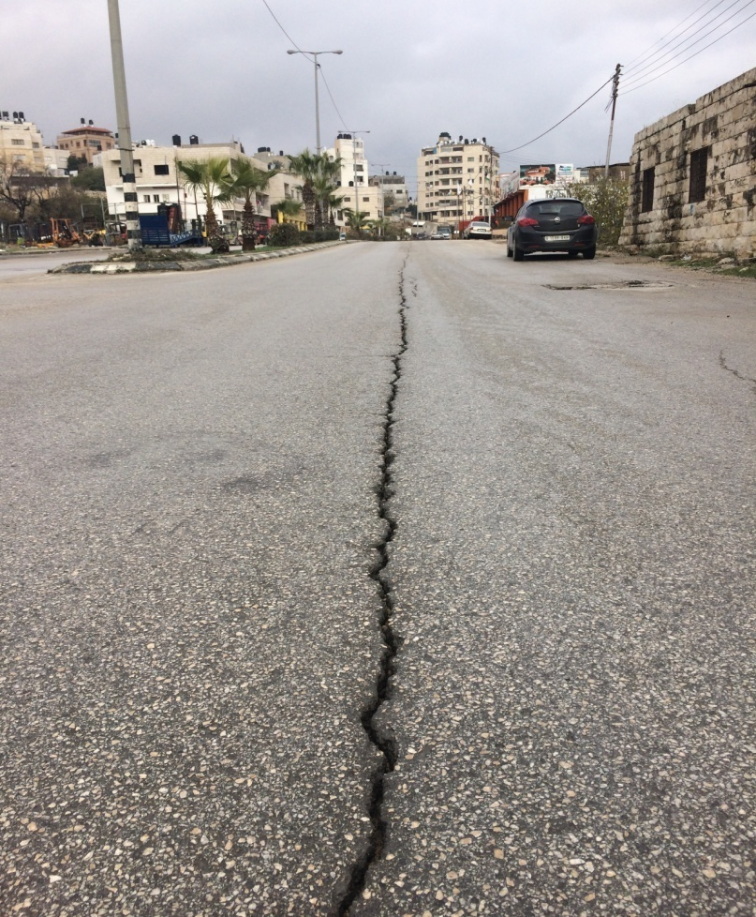
Some distresses
Longitudinal and Transverse Cracking

Slide 29
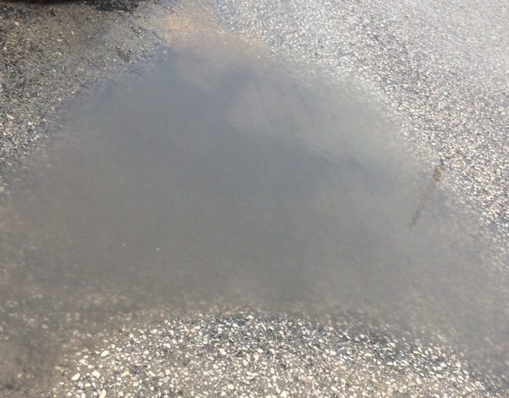
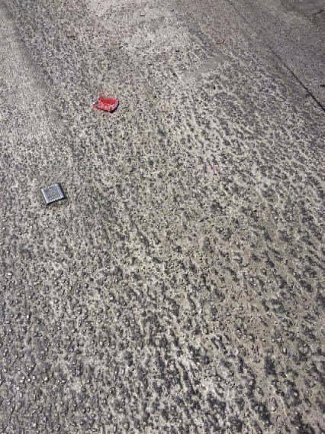
Some distresses
Depressions Raveling

Slide 30
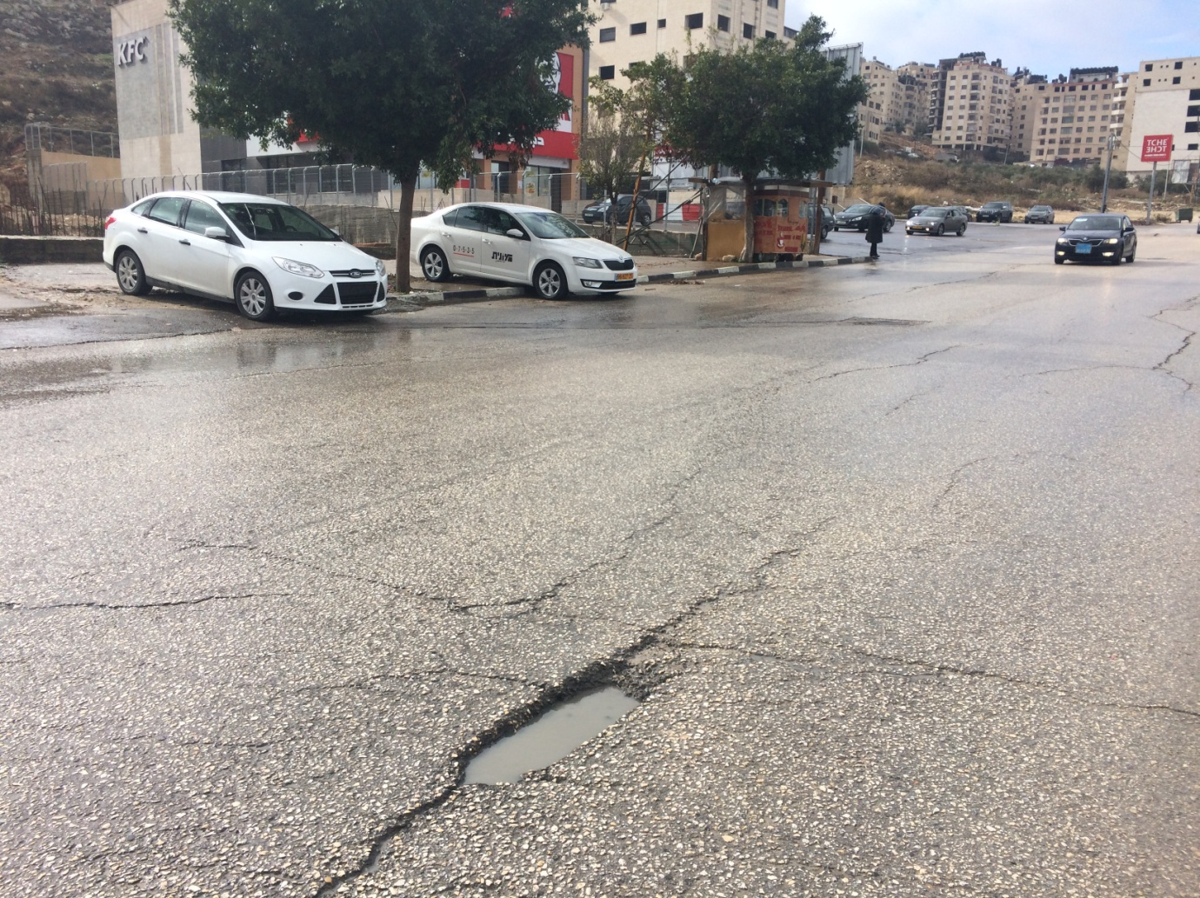
Some distresses
Potholes

Slide 31
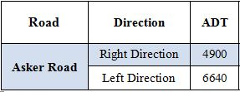
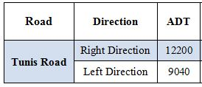
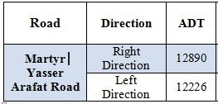
PI Factors Collection
ADT:

Slide 32

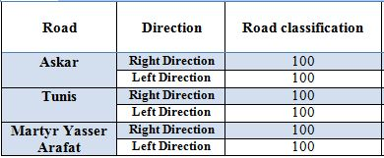
PI Factors Collection
Road Functional Classification:

Slide 33

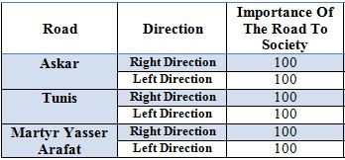
PI Factors Collection
Road Importance to Society:

Slide 34

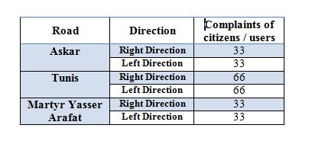
PI Factors Collection
Citizens Complaints:

Slide 35
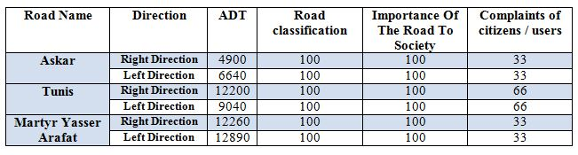
PI Data Collection
Summary:

Slide 36
PI Factors Weights
Element | Weights (W)
Road condition | 0.45
Road classification | 0.13
Traffic Volume | 0.12
Importance Of The Road To Society | 0.20
Complaints of citizens / users | 0.10
Total | 1.00

Slide 37
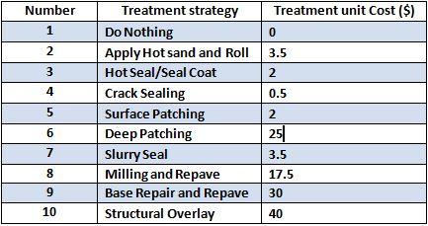
Treatments Cost

Slide 38
Drainage Evaluation
Municipality: Nablus | Street: Askar | Functional classification: Arterial
Main section length : 500m | Section Number: 1 | Date: 18.4.2017
From: +0.0 km | To: +0.5 km | Weather: | Dry | Rainy
: Street surface Type | Interlock Tile | Soil | Asphalt | Other
Sub-Section (100m) | 1 |  |  |  | 2 |  |  |  | 3 |  |  |  | 4 |  |  |  | 5
Direction | Right |  | Left |  | Right |  | Left |  | Right |  | Left |  | Right |  | Left |  | Right |  | Left
Side discharge / Rainwater catch / ascidental discharge | 1 | 2 | 1 | 2 | 1 | 2 | 1 | 2 | 1 | 2 | 1 | 2 | 1 | 2 | 1 | 2 | 1 | 2 | 1 | 2
 | 3 |  | 3 |  | 3 |  | 3 |  | 3 |  |  |  | 3 |  | 3 |  | 3 |  | 3
1: Weak. , 2:Meduim , 3: Good

Slide 39
Data calculation

Slide 40
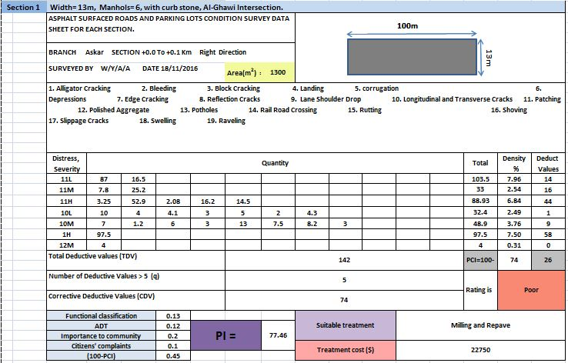
Askar Road Calculation
The first section in right direction

Slide 41
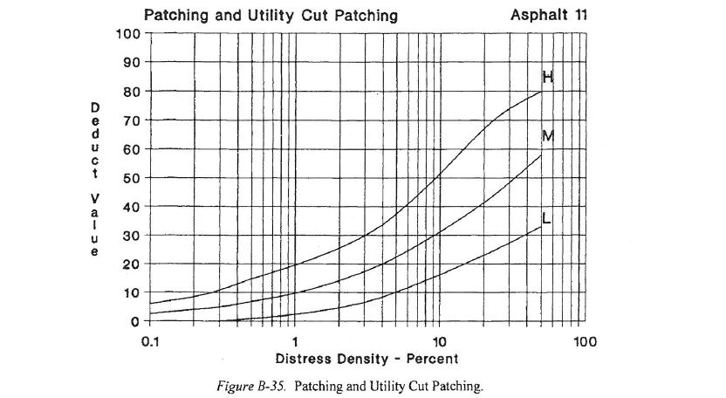
Askar Road Calculation
Deduct Value

Slide 42
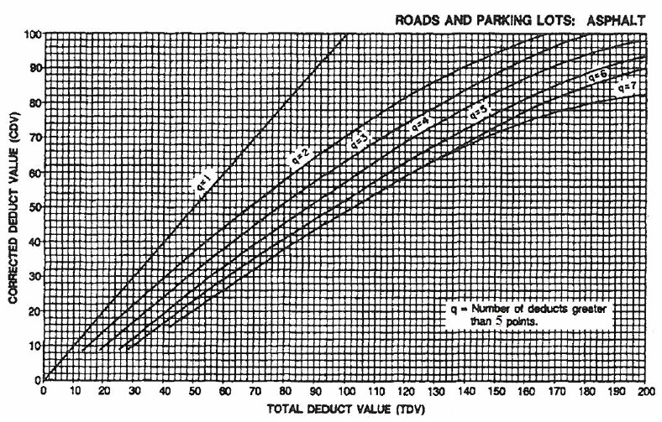
Askar road calculation
Corrective Deduct Value

Slide 43
Section Rating
Condition Category | Pavement Condition Index |  | General Treatments Strategy
 | Lower Limit | Upper Limit
Excellent | 90 | 100 | Do Nothing
Excellent | 80 | 90 | Apply Hot sand and Roll
Very good | 70 | 80 | Hot Seal/Seal Coat
Good | 60 | 70 | Crack Sealing
Good | 50 | 60 | Surface Patching
Fair | 40 | 50 | Deep Patching
Fair | 30 | 40 | Slurry Seal
Poor | 20 | 30 | Milling and Repave
Very Poor | 10 | 20 | Base Repair and Repave
Failed | 0 | 10 | Structural Overlay

Slide 44
Results and Discussion
MAY 25, 2017

Slide 45
Askar Road Results
 |  |  |  |  |  |  |  |  |  | Askar Street , Right Direction.
Treatment Cost ($) | Unit Cost ($) | Suitable Treatment | PI | W | People Complaints | W | Importance to community | W | Functional classification | W | ADT | W | 100-PCI | PCI | Section ID | Section Number
39000 | 30 | Base Repair and Repave | 82.41 | 0.1 | 66 | 0.2 | 100 | 0.13 | Arterial | 0.12 | 4900 | 0.45 | 85 | 15 | As02 | 2
14875 | 17.5 | Milling and Repave | 79.26 | 0.1 | 66 | 0.2 | 100 | 0.13 | Arterial | 0.12 | 4900 | 0.45 | 78 | 22 | As16 | 16
14875 | 17.5 | Milling and Repave | 77.91 | 0.1 | 66 | 0.2 | 100 | 0.13 | Arterial | 0.12 | 4900 | 0.45 | 75 | 25 | As17 | 17
22750 | 17.5 | Milling and Repave | 77.46 | 0.1 | 66 | 0.2 | 100 | 0.13 | Arterial | 0.12 | 4900 | 0.45 | 74 | 26 | As01 | 1
2975 | 3.5 | Slurry Seal | 75.21 | 0.1 | 66 | 0.2 | 100 | 0.13 | Arterial | 0.12 | 4900 | 0.45 | 69 | 31 | As11 | 11
2975 | 3.5 | Slurry Seal | 73.86 | 0.1 | 66 | 0.2 | 100 | 0.13 | Arterial | 0.12 | 4900 | 0.45 | 66 | 34 | As08 | 8
2975 | 3.5 | Slurry Seal | 73.41 | 0.1 | 66 | 0.2 | 100 | 0.13 | Arterial | 0.12 | 4900 | 0.45 | 65 | 35 | As15 | 15
2975 | 3.5 | Slurry Seal | 72.96 | 0.1 | 66 | 0.2 | 100 | 0.13 | Arterial | 0.12 | 4900 | 0.45 | 64 | 36 | As13 | 13
2975 | 3.5 | Slurry Seal | 72.06 | 0.1 | 66 | 0.2 | 100 | 0.13 | Arterial | 0.12 | 4900 | 0.45 | 62 | 38 | As03 | 3
21250 | 25 | Deep Patching | 70.26 | 0.1 | 66 | 0.2 | 100 | 0.13 | Arterial | 0.12 | 4900 | 0.45 | 58 | 42 | As04 | 4
21250 | 25 | Deep Patching | 70.26 | 0.1 | 66 | 0.2 | 100 | 0.13 | Arterial | 0.12 | 4900 | 0.45 | 58 | 42 | As07 | 7
30000 | 25 | Deep Patching | 69.81 | 0.1 | 66 | 0.2 | 100 | 0.13 | Arterial | 0.12 | 4900 | 0.45 | 57 | 43 | As05 | 5
1700 | 2 | Surface Patching | 66.66 | 0.1 | 66 | 0.2 | 100 | 0.13 | Arterial | 0.12 | 4900 | 0.45 | 50 | 50 | As09 | 9
1700 | 2 | Structural Overlay | 66.66 | 0.1 | 66 | 0.2 | 100 | 0.13 | Arterial | 0.12 | 4900 | 0.45 | 50 | 5 | As12 | 12
1700 | 2 | Surface Patching | 65.31 | 0.1 | 66 | 0.2 | 100 | 0.13 | Arterial | 0.12 | 4900 | 0.45 | 47 | 53 | As10 | 10
22000 | 2 | Surface Patching | 64.86 | 0.1 | 66 | 0.2 | 100 | 0.13 | Arterial | 0.12 | 4900 | 0.45 | 46 | 54 | As06 | 6
1700 | 2 | Surface Patching | 64.41 | 0.1 | 66 | 0.2 | 100 | 0.13 | Arterial | 0.12 | 4900 | 0.45 | 45 | 55 | As14 | 14
207675 | Overall Treatment Cost ($)

Slide 46
Askar Road Results
 |  |  |  |  |  |  |  |  |  | Askar Street , left Direction.
Treatment Cost ($) | Unit Cost ($) | Milling and Repave | PI | W | People Complaints | W | Importance to community | W | Functional classification | W | ADT | W | 100-PCI | PCI | Section ID | Section Number
34500 | 30 | Base Repair and Repave | 86.28 | 0.1 | 66 | 0.2 | 100 | 0.13 | Arterial | 0.12 | 6640 | 0.45 | 90 | 10 | As19 | 19
34500 | 30 | Base Repair and Repave | 82.68 | 0.1 | 66 | 0.2 | 100 | 0.13 | Arterial | 0.12 | 6640 | 0.45 | 82 | 18 | As18 | 18
14875 | 17.5 | Milling and Repave | 80.88 | 0.1 | 66 | 0.2 | 100 | 0.13 | Arterial | 0.12 | 6640 | 0.45 | 78 | 22 | As32 | 32
9297 | 25 | Deep Patching | 79.98 | 0.1 | 66 | 0.2 | 100 | 0.13 | Arterial | 0.12 | 6640 | 0.45 | 58 | 42 | As27 | 27
14875 | 17.5 | Milling and Repave | 79.08 | 0.1 | 66 | 0.2 | 100 | 0.13 | Arterial | 0.12 | 6640 | 0.45 | 74 | 26 | As30 | 30
4025 | 3.5 | Slurry Seal | 76.38 | 0.1 | 66 | 0.2 | 100 | 0.13 | Arterial | 0.12 | 6640 | 0.45 | 68 | 32 | As20 | 20
2975 | 3.5 | Slurry Seal | 75.03 | 0.1 | 66 | 0.2 | 100 | 0.13 | Arterial | 0.12 | 6640 | 0.45 | 65 | 35 | As33 | 33
2975 | 3.5 | Slurry Seal | 74.13 | 0.1 | 66 | 0.2 | 100 | 0.13 | Arterial | 0.12 | 6640 | 0.45 | 63 | 37 | As26 | 26
2975 | 3.5 | Slurry Seal | 73.68 | 0.1 | 66 | 0.2 | 100 | 0.13 | Arterial | 0.12 | 6640 | 0.45 | 62 | 38 | As34 | 34
27500 | 25 | Deep Patching | 70.98 | 0.1 | 66 | 0.2 | 100 | 0.13 | Arterial | 0.12 | 6640 | 0.45 | 56 | 44 | As23 | 23
33000 | 25 | Deep Patching | 70.08 | 0.1 | 66 | 0.2 | 100 | 0.13 | Arterial | 0.12 | 6640 | 0.45 | 54 | 46 | As24 | 24
21250 | 25 | Deep Patching | 70.08 | 0.1 | 66 | 0.2 | 100 | 0.13 | Arterial | 0.12 | 6640 | 0.45 | 54 | 46 | As31 | 31
21250 | 25 | Deep Patching | 69.18 | 0.1 | 66 | 0.2 | 100 | 0.13 | Arterial | 0.12 | 6640 | 0.45 | 52 | 48 | As28 | 28
1700 | 2 | Structural Overlay | 66.93 | 0.1 | 66 | 0.2 | 100 | 0.13 | Arterial | 0.12 | 6640 | 0.45 | 47 | 3 | As29 | 29
1700 | 2 | Surface Patching | 66.48 | 0.1 | 66 | 0.2 | 100 | 0.13 | Arterial | 0.12 | 6640 | 0.45 | 46 | 54 | As25 | 25
1700 | 2 | Surface Patching | 64.68 | 0.1 | 66 | 0.2 | 100 | 0.13 | Arterial | 0.12 | 6640 | 0.45 | 42 | 58 | As22 | 22
425 | 0.5 | Crack Sealing | 61.08 | 0.1 | 66 | 0.2 | 100 | 0.13 | Arterial | 0.12 | 6640 | 0.45 | 34 | 66 | As21 | 21
229522 | Overall Treatment Cost ($)

Slide 47
Tunis Road Results
 |  |  |  |  |  |  |  |  |  | Tunis Street , Right Direction.
Treatment Cost ($) | Unit Cost ($) | Suitable Treatment | PI | W | People Complaints | W | Importance to community | W | Functional classification | W | ADT | W | 100-PCI | PCI | Section ID | Section Number
2450 | 3.5 | Slurry Seal | 79.76 | 0.1 | 66 | 0.2 | 100 | 0.13 | Arterial | 0.12 | 9040 | 0.45 | 64 | 36 | Tu09 | 9
2450 | 3.5 | Slurry Seal | 78.86 | 0.1 | 66 | 0.2 | 100 | 0.13 | Arterial | 0.12 | 9040 | 0.45 | 62 | 38 | Tu10 | 10
17500 | 25 | Deep Patching | 77.51 | 0.1 | 66 | 0.2 | 100 | 0.13 | Arterial | 0.12 | 9040 | 0.45 | 59 | 41 | Tu07 | 7
1400 | 2 | Surface Patching | 70.76 | 0.1 | 66 | 0.2 | 100 | 0.13 | Arterial | 0.12 | 9040 | 0.45 | 44 | 56 | Tu08 | 8
350 | 0.5 | Crack Sealing | 68.96 | 0.1 | 66 | 0.2 | 100 | 0.13 | Arterial | 0.12 | 9040 | 0.45 | 40 | 60 | Tu06 | 6
300 | 0.5 | Crack Sealing | 67.16 | 0.1 | 66 | 0.2 | 100 | 0.13 | Arterial | 0.12 | 9040 | 0.45 | 36 | 64 | Tu02 | 2
400 | 0.5 | Crack Sealing | 67.16 | 0.1 | 66 | 0.2 | 100 | 0.13 | Arterial | 0.12 | 9040 | 0.45 | 36 | 64 | Tu03 | 3
400 | 0.5 | Crack Sealing | 66.71 | 0.1 | 66 | 0.2 | 100 | 0.13 | Arterial | 0.12 | 9040 | 0.45 | 35 | 65 | Tu04 | 4
375 | 0.5 | Crack Sealing | 63.77 | 0.1 | 66 | 0.2 | 100 | 0.13 | Arterial | 0.12 | 9040 | 0.45 | 35 | 65 | Tu11 | 11
1400 | 2 | Hot Seal/Seal Coat | 62.66 | 0.1 | 66 | 0.2 | 100 | 0.13 | Arterial | 0.12 | 9040 | 0.45 | 26 | 74 | Tu05 | 5
1500 | 2 | Hot Seal/Seal Coat | 60.86 | 0.1 | 66 | 0.2 | 100 | 0.13 | Arterial | 0.12 | 9040 | 0.45 | 22 | 78 | Tu01 | 1
750 | 2 | Hot Seal/Seal Coat | 60.86 | 0.1 | 66 | 0.2 | 100 | 0.13 | Arterial | 0.12 | 9040 | 0.45 | 22 | 78 | Tu12 | 12
29275 | Overall Treatment Cost ($)

Slide 48
Tunis Road Results
 |  |  |  |  |  |  |  |  |  | Tunis Street , left Direction.
Treatment Cost ($) | Unit Cost ($) | Suitable Treatment | PI | W | People Complaints | W | Importance to community | W | Functional classification | W | ADT | W | 100-PCI | PCI | Section ID | Section Number
17500 | 25 | Deep Patching | 76.16 | 0.1 | 66 | 0.2 | 100 | 0.13 | Arterial | 0.12 | 12200 | 0.45 | 56 | 44 | Tu22 | 22
17500 | 25 | Deep Patching | 71.42 | 0.1 | 66 | 0.2 | 100 | 0.13 | Arterial | 0.12 | 12200 | 0.45 | 52 | 48 | Tu19 | 19
1400 | 2 | Surface Patching | 70.52 | 0.1 | 66 | 0.2 | 100 | 0.13 | Arterial | 0.12 | 12200 | 0.45 | 50 | 50 | Tu21 | 21
350 | 0.5 | Crack Sealing | 65.12 | 0.1 | 66 | 0.2 | 100 | 0.13 | Arterial | 0.12 | 12200 | 0.45 | 38 | 62 | Tu18 | 18
450 | 0.5 | Crack Sealing | 64.67 | 0.1 | 66 | 0.2 | 100 | 0.13 | Arterial | 0.12 | 12200 | 0.45 | 37 | 63 | Tu16 | 16
350 | 0.5 | Crack Sealing | 64.22 | 0.1 | 66 | 0.2 | 100 | 0.13 | Arterial | 0.12 | 12200 | 0.45 | 36 | 64 | Tu20 | 20
450 | 0.5 | Crack Sealing | 63.32 | 0.1 | 66 | 0.2 | 100 | 0.13 | Arterial | 0.12 | 12200 | 0.45 | 34 | 66 | Tu14 | 14
350 | 0.5 | Crack Sealing | 63.32 | 0.1 | 66 | 0.2 | 100 | 0.13 | Arterial | 0.12 | 12200 | 0.45 | 34 | 66 | Tu17 | 17
1600 | 2 | Hot Seal/Seal Coat | 61.52 | 0.1 | 66 | 0.2 | 100 | 0.13 | Arterial | 0.12 | 12200 | 0.45 | 30 | 70 | Tu13 | 13
1500 | 2 | Hot Seal/Seal Coat | 60.62 | 0.1 | 66 | 0.2 | 100 | 0.13 | Arterial | 0.12 | 12200 | 0.45 | 28 | 72 | Tu23 | 23
2800 | 3.5 | Apply Hot sand and Roll | 56.57 | 0.1 | 66 | 0.2 | 100 | 0.13 | Arterial | 0.12 | 12200 | 0.45 | 19 | 81 | Tu15 | 15
0 | 0 | Do Nothing | 49.82 | 0.1 | 66 | 0.2 | 100 | 0.13 | Arterial | 0.12 | 12200 | 0.45 | 4 | 96 | Tu24 | 24
44250 | Overall Treatment Cost

Slide 49
Martyr Yasser Arafat Results
 |  |  |  |  |  |  |  |  |  | Martyr Yasser Arafat Street , Right Direction.
Treatment Cost ($) | Unit Cost ($) | Suitable Treatment | PI | W | People Complaints | W | Importance to community | W | Functional classification | W | ADT | W | 100-PCI | PCI | Section ID | Section Number
20125 | 17.5 | Milling and Repave | 83.41 | 0.1 | 33 | 0.2 | 100 | 0.13 | Arterial | 0.12 | 12890 | 0.45 | 72 | 28 | YA12 | 12
2300 | 2 | Surface Patching | 73.51 | 0.1 | 33 | 0.2 | 100 | 0.13 | Arterial | 0.12 | 12890 | 0.45 | 50 | 50 | YA13 | 13
2300 | 2 | Surface Patching | 72.61 | 0.1 | 33 | 0.2 | 100 | 0.13 | Arterial | 0.12 | 12890 | 0.45 | 48 | 52 | YA14 | 14
2300 | 2 | Surface Patching | 71.71 | 0.1 | 33 | 0.2 | 100 | 0.13 | Arterial | 0.12 | 12890 | 0.45 | 46 | 54 | YA10 | 10
575 | 0.5 | Crack Sealing | 68.56 | 0.1 | 33 | 0.2 | 100 | 0.13 | Arterial | 0.12 | 12890 | 0.45 | 39 | 61 | YA11 | 11
575 | 0.5 | Crack Sealing | 67.21 | 0.1 | 33 | 0.2 | 100 | 0.13 | Arterial | 0.12 | 12890 | 0.45 | 36 | 64 | YA08 | 8
575 | 0.5 | Crack Sealing | 66 | 0.1 | 33 | 0.2 | 100 | 0.13 | Arterial | 0.12 | 12890 | 0.45 | 32 | 68 | YA04 | 4
575 | 0.5 | Crack Sealing | 64.96 | 0.1 | 33 | 0.2 | 100 | 0.13 | Arterial | 0.12 | 12890 | 0.45 | 31 | 69 | YA01 | 1
2300 | 2 | Hot Seal/Seal Coat | 62.71 | 0.1 | 33 | 0.2 | 100 | 0.13 | Arterial | 0.12 | 12890 | 0.45 | 26 | 74 | YA07 | 7
2300 | 2 | Hot Seal/Seal Coat | 62.71 | 0.1 | 33 | 0.2 | 100 | 0.13 | Arterial | 0.12 | 12890 | 0.45 | 26 | 74 | YA15 | 15
2300 | 2 | Hot Seal/Seal Coat | 61.5 | 0.1 | 33 | 0.2 | 100 | 0.13 | Arterial | 0.12 | 12890 | 0.45 | 22 | 78 | YA09 | 9
2300 | 2 | Hot Seal/Seal Coat | 60.91 | 0.1 | 33 | 0.2 | 100 | 0.13 | Arterial | 0.12 | 12890 | 0.45 | 22 | 78 | YA02 | 2
2300 | 2 | Hot Seal/Seal Coat | 60.91 | 0.1 | 33 | 0.2 | 100 | 0.13 | Arterial | 0.12 | 12890 | 0.45 | 22 | 78 | YA03 | 3
2300 | 2 | Hot Seal/Seal Coat | 60.91 | 0.1 | 33 | 0.2 | 100 | 0.13 | Arterial | 0.12 | 12890 | 0.45 | 22 | 78 | YA06 | 6
4025 | 3.5 | Apply Hot sand and Roll | 59.56 | 0.1 | 33 | 0.2 | 100 | 0.13 | Arterial | 0.12 | 12890 | 0.45 | 19 | 81 | YA05 | 5
47150 | Overall Treatment Cost

Slide 50
Martyr Yasser Arafat Results
 |  |  |  |  |  |  |  |  |  | Yasser Arafat Street , Left Direction.
Treatment Cost ($) | Unit Cost ($) | Suitable Treatment | PI | W | People Complaints | W | Importance to community | W | Functional classification | W | ADT | W | 100-PCI | PCI | Section ID | Section Number
4025 | 3.5 | Slurry Seal | 80.4 | 0.1 | 33 | 0.2 | 100 | 0.13 | Arterial | 0.12 | 12260 | 0.45 | 64 | 36 | YA22 | 22
28750 | 25 | Deep Patching | 77.7 | 0.1 | 33 | 0.2 | 100 | 0.13 | Arterial | 0.12 | 12260 | 0.45 | 58 | 42 | YA20 | 20
28750 | 25 | Deep Patching | 75.9 | 0.1 | 33 | 0.2 | 100 | 0.13 | Arterial | 0.12 | 12260 | 0.45 | 54 | 46 | YA28 | 28
575 | 0.5 | Crack Sealing | 67.35 | 0.1 | 33 | 0.2 | 100 | 0.13 | Arterial | 0.12 | 12260 | 0.45 | 35 | 65 | YA27 | 27
575 | 0.5 | Crack Sealing | 66.9 | 0.1 | 33 | 0.2 | 100 | 0.13 | Arterial | 0.12 | 12260 | 0.45 | 34 | 66 | YA21 | 21
575 | 0.5 | Crack Sealing | 66.45 | 0.1 | 33 | 0.2 | 100 | 0.13 | Arterial | 0.12 | 12260 | 0.45 | 33 | 67 | YA26 | 26
575 | 0.5 | Crack Sealing | 66 | 0.1 | 33 | 0.2 | 100 | 0.13 | Arterial | 0.12 | 12260 | 0.45 | 32 | 68 | YA30 | 30
2300 | 2 | Hot Seal/Seal Coat | 64.2 | 0.1 | 33 | 0.2 | 100 | 0.13 | Arterial | 0.12 | 12260 | 0.45 | 28 | 72 | YA23 | 23
2300 | 2 | Hot Seal/Seal Coat | 63.3 | 0.1 | 33 | 0.2 | 100 | 0.13 | Arterial | 0.12 | 12260 | 0.45 | 26 | 74 | YA18 | 18
2400 | 2 | Hot Seal/Seal Coat | 62.85 | 0.1 | 33 | 0.2 | 100 | 0.13 | Arterial | 0.12 | 12260 | 0.45 | 25 | 75 | YA17 | 17
2300 | 2 | Hot Seal/Seal Coat | 61.5 | 0.1 | 33 | 0.2 | 100 | 0.13 | Arterial | 0.12 | 12260 | 0.45 | 22 | 78 | YA16 | 16
2300 | 2 | Hot Seal/Seal Coat | 61.5 | 0.1 | 33 | 0.2 | 100 | 0.13 | Arterial | 0.12 | 12260 | 0.45 | 22 | 78 | YA25 | 25
1700 | 2 | Hot Seal/Seal Coat | 60.91 | 0.1 | 33 | 0.2 | 100 | 0.13 | Arterial | 0.12 | 12260 | 0.45 | 22 | 78 | YA24 | 24
4025 | 3.5 | Apply Hot sand and Roll | 60.15 | 0.1 | 33 | 0.2 | 100 | 0.13 | Arterial | 0.12 | 12260 | 0.45 | 19 | 81 | YA19 | 19
4025 | 3.5 | Apply Hot sand and Roll | 57 | 0.1 | 33 | 0.2 | 100 | 0.13 | Arterial | 0.12 | 12260 | 0.45 | 12 | 88 | YA29 | 29
85175 | Overall Treatment Cost

Slide 51
Treatment Cost
Road Name` | Worst Section Condition |  | Section Treatment Cost ($) | Overall Direction Treatment Cost ($)
Askar | Right | As02 | 39000 | 207675
 | Left | As19 | 34500 | 229522
Tunis | Right | Tu09 | 2450 | 29257
 | Left | Tu22 | 17500 | 44250
Martyr Yasser Arafat | Right | YA12 | 20125 | 47150
 | Left | YA22 | 4025 | 85175
 |  | All Roads Treatments Cost (S) |  | 643029

Slide 52
Conclusions
The main aim of the study was to develop a pavement management system for road network maintenance to serve as a decision support tool to assist to improve the efficiency of making decisions, provide feedback as to the consequences of these decisions, ensure consistency of decisions made at different levels and improve the effectiveness of all decisions in terms of efficiency of results.
The current pavement management maintenance process for Nablus pavements is traditional and does not follow a systematic procedure. Accordingly, they can't help decision makers for ranking the maintenance activities in the city to match the actual needs for maintenance. A strong need for comprehensive PMMS is required.
Pavement Condition Index (PCI) has been selected as a tool for the selected roads in Nablus Municipality. The PCI expresses the rating for each section of 100m length considering PASER Manual.
Each section in selected roads in Nablus city pavement branches has a maintenance priority according to the section’s surface condition.
The most cost effective maintenance strategy is the preventive maintenance.

Slide 53
Conclusions
6. The cost of maintenance is doubled if the right maintenance does not apply for the right section and at the right time.
7. The ranking of pavement sections for maintenance using prioritization is an effective, simple and practical procedure.

Slide 54
Recommendations
The pavement should be rehabilitated to enable the road function based to the expected required level of service. It would also help to renew the pavement and increase its life span. Ranking the section based on the PI value and identifying proper treatment and cost for each one.
Expand existing preventive maintenance program, it is recommended that the City expands its preventive maintenance program to all asphalt-surfaced pavements that are in adequate condition and that are exhibiting pavement distresses that required preventive maintenance.
Applying the PI concept criterion to setup maintenance priorities, maintenance cost, and pavement management programs to other roads and even headquarters.
Encouraging other Municipalities in the West Bank and Gaza Strip to use such effective maintenance procedure considering the PI and related five priority factors.

Slide 55


