Slide 1


AutoCoat: Autonomous Wall-Coating Robot
ASMAA LAHLABAT & RAND JOHARI

Slide 2
Table of contacts:
  Project overview.
  Problem & Motivation.
  Hardware Architecture.
  Software Architecture.

Slide 3
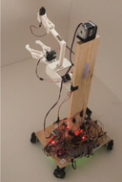
  Autonomous robot for indoor wall coating
  Stages: Mapping → Scanning → No-Paint Zones → Printing
  Hardware + Software + 3D Scanning

Slide 4
Why an Autonomous Wall-Coating Robot?
  Manual wall painting is:
- Time-consuming and labor-intensive
- inconsistent.
  Need for an automated, repeatable solution.

Slide 5

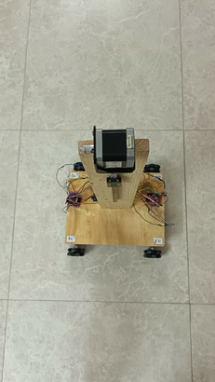
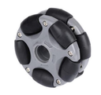

Hardware Architecture - Base
Wooden base and vertical support.
X-drive with 4 DC gear motors + encoders (JGB37)

Slide 6
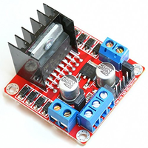
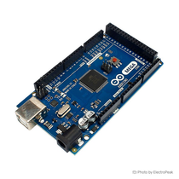
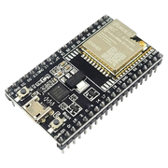
Hardware Architecture
Motor drivers: L298N
Controller: Arduino Mega 2560
Communication: ESP32 Wi-Fi bridge

Slide 7
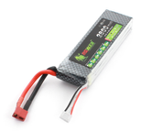
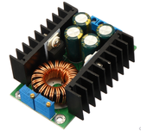
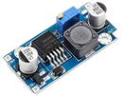

Hardware Architecture - Power
3S battery
Buck converters: XL4015
LM2596
9A 300W

Slide 8
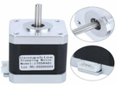
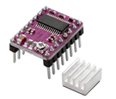

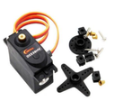
Hardware Architecture - Actuators
NEMA stepper
DRV8825
40 kg servo
DS558HV

Slide 9
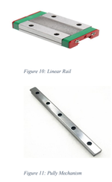


Hardware Architecture
Sensors: ultrasonic sensors
Linear Actuator

Slide 10
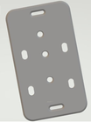
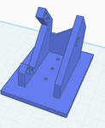
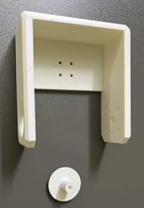
Hardware Architecture- 3D-Printed

Slide 11
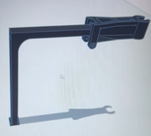
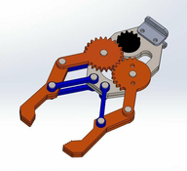

Hardware Architecture- 3D-Printed

Slide 12
Software Architecture
  Arduino Mega firmware:
- State machine: mapping, center, scan, print.
- Encoders + ultrasonics + servos + stepper control.
  ESP32 firmware:
- TCP ↔ Serial bridge (port 3333)
  PC UI (Python / Matplotlib):
- live_map.py for live map and command buttons
  3D Scan Processing (Python):
- Scaniverse + CloudCompare.
- PLY + CSV processing for no-paint zones

Slide 13
Project Stages:
  Stage 1: Perimeter Mapping.
- Live Mapping UI.
  Stage 2: Scan.
- Move to Room Center.
- 3D (Scaniverse + CloudCompare).
- Converting to No-Paint Rectangles.
  Stage 3: Printing / Coating Stage.
- Multi-Wall Logic & Heading.
- Center Return & STOP Logic.
- Vertical Axis & 40 kg Servo Logic.

Slide 14
Stage 1: Room Perimeter Mapping.
  Robot starts from a fixed corner.
  Moves forward until it “hits” first wall (front ultrasonic).
  Follows path: forward, right, back, left.
  Uses encoders for odometry and sonars for wall detection.
  Sends live POS,x,y,theta and SONARS messages to PC.

Slide 15
- Live Mapping & Visualization
  Python live_map.py UI
  Buttons: Connect, Start Map, Start Scan, Start Print, Wall 1–4
  Real-time plot of:
- Robot path.
- Sonar points (front/back/left/right).
  Automatic path closure and wall labeling.

Slide 16
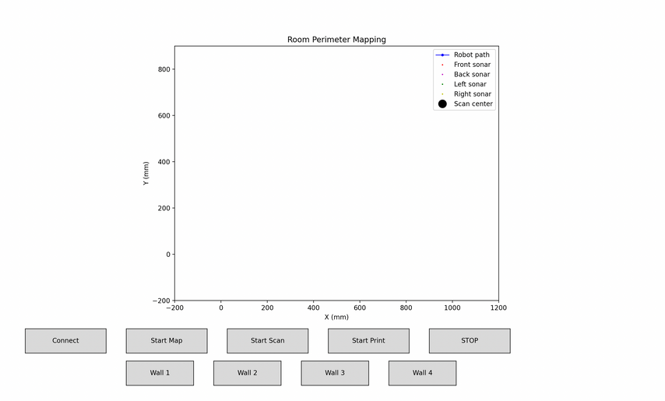

Slide 17
Stage 2: Scan.
  Robot performs a controlled scan from the room center.
  Arm servo moves to a safe MID position.
  Gripper behavior:
- Open 90° for 5 s, then 60° and hold
  Robot backs toward a wall using back sonar (target distance)
  Performs yaw scan (rotate right → center → left → center)
  Repeats for the opposite wall.

Slide 18
- Move to Room Center.
  Center of the room computed from mapped rectangle.
  Robot moves from last mapping point to center.
  Fixed by center offset:
- Real robot reference is its geometric center, not front edge.
  Uses encoder-based straight segments to reach target.

Slide 19
- 3D (Scaniverse + CloudCompare).
  Use smartphone app (e.g., Scaniverse) to scan each wall.
  Export wall as PLY file.
  Open PLY in CloudCompare.
  Use Point Picking to:
- Select 4 window/door corner points.
- Select 3 wall reference points (left base, right base, floor/height).
  Export points as CSV.

Slide 20
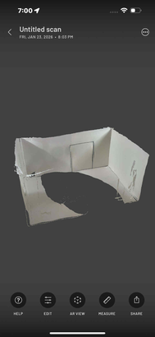
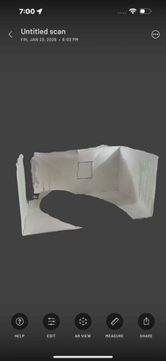

Slide 21
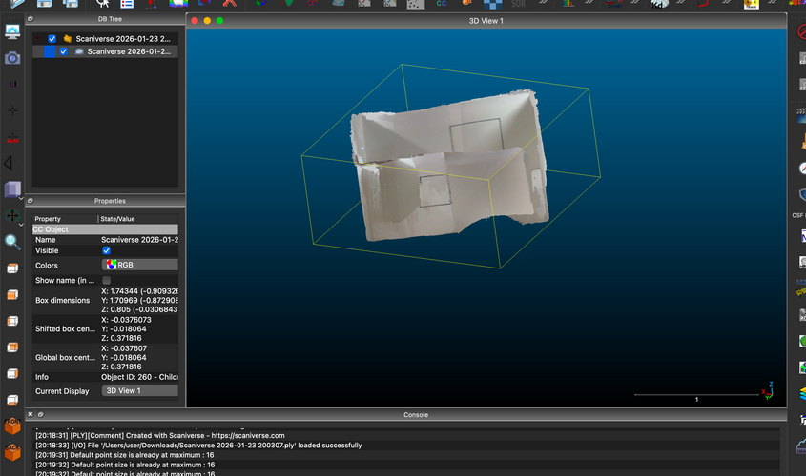

Slide 22
- From 3D Points to 2D No-Paint Rectangles:
  Python script:
- Builds a 2D wall coordinate frame from 3 reference points.
- Projects any picked 3D corner into 2D (u, v coordinates).
  Generates configuration:
- List of rectangles: xMin, yMin, xMax, yMax
- One list per wall (wall1..4).
  Sends configuration to robot over TCP/ESP32.

Slide 23
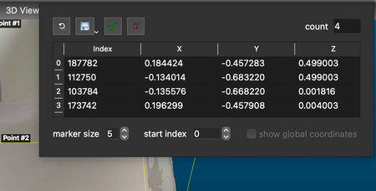

Slide 24
Stage 3: Printing / Coating Stage.
  Start from room center in Print Mode.
  PC sends WALL,id to select wall.
  Robot:
- Rotates to face wall.
- Moves to a fixed distance from wall (front sonar).
- Sets side offset, then slides sideways along wall.
  At each coating point:
- Check if point is inside any no-paint rectangle.
- If inside → skip spraying.
- If outside → activate sprayer (future integration).

Slide 25
- Multi-Wall Logic & Heading:
  During mapping, we define 4 walls in order around the rectangle:
- First wall hit → Wall 1, then Wall 2, Wall 3, Wall 4
  After the scan, we fix a reference heading and assign each wall an angle:
- e.g. Wall 1 = 90°, Wall 2 = 180°, Wall 3 = 270°, Wall 4 = 0°
  The robot keeps an internal heading variable robotHeadingDeg
  When the PC sends WALL,id:
- The Mega looks up the target angle for that wall.
- Computes the angle difference = target − robotHeadingDeg.
- Normalizes it to (−180°, +180°] to find the shortest rotation.
- Uses timed rotations (90° / 180°) to turn CW or CCW.
- Updates robotHeadingDeg to the new wall heading.

Slide 26
- Center Return & STOP Logic
  STOP button in the PC UI:
- Can be pressed at any time during printing along a wall
- Robot immediately stops lateral motion next to the wall
  Center defined mathematically from mapping:
- During perimeter mapping, we compute the room center (Cx, Cy) from the rectangle corners
- The robot also tracks its current center-based position (x, y) using encoder-based odometry
  Tracking print offset:
- When printing, every move from the center is integrated as an offset:
- Forward/back → change in X
- Left/right → change in Y
  We always know how far we are from the room center:
- dx = x − Cx, dy = y − Cy
  Return-to-center sequence (after STOP or end of wall):
- Step 1: Slide sideways to cancel dy (bring lateral offset back to zero)
- Step 2: Move forward/backward to cancel dx (return to center along X)
- Step 3: Keep the same heading using robotHeadingDeg
- When dx ≈ 0 and dy ≈ 0 → robot is back at the mathematical center

Slide 27
- Vertical Axis & 40 kg Servo Logic.
  NEMA stepper + DRV8825 driving a pulley/linear axis.
  Safe current tuning and driver protection.
  40 kg servo for arm angle:
- Defined safe microsecond range (MIN / MID / MAX).
- Specific sequences:
- After 20 cm up: MID → MIN → MID
- After 40 cm down: MID → MAX → MID
  Designed to simulate coating passes in vertical direction

Slide 28
Challenges & Fixes

Slide 29
1) Odometry with Omni Wheels & Damaged Encoder Wire:
  Challenge:
- Odometry was drifting and straight lines were not straight because one encoder wire was damaged and wheel speeds were not perfectly matched.
  Fix / Tuning:
-Calibrated each wheel with a 6-second straight-line test.
- Applied per-motor PWM trims (TRIM_M1..M4) so all wheels produce the same linear speed.
- Result: straighter paths and more stable odometry even with omni wheels.

Slide 30
2) Electrical Noise, 12 V Injection & ESP Disconnects
  Challenge:
- Injecting 12 V and 5 V on the same board ground path created noise from the DC motors.
The noise caused ESP32 Wi-Fi disconnects and unstable serial communication.
  Fix / Tuning:
- Separated the 12 V motor power from the logic path; only 5 V enters the control board.
- Used a buck converter to generate clean 5 V for Mega + ESP32.
- Added a large electrolytic capacitor on the 5 V rail to absorb transients.
- Result: ESP32 stopped randomly disconnecting and the link became stable.

Slide 31
3) 40 kg Servo & Timer Conflicts (Pins 44–47 Disabled).
  Challenge:
- Attaching the 40 kg servo on a Mega pin that uses Timer5 unintentionally disabled PWM on pins 44–47, which were already used for other components (motor ENA, etc.).
  Fix / Tuning:
- Identified the Timer5 conflict by observing that these PWM pins stopped working after servo attach.
- Reassigned PWM outputs and servo pins to avoid sharing the same hardware timer
- Updated the pin map in the firmware and documentation.
- Result: both the 40 kg servo and all PWM channels work correctly with no hidden timer conflicts.

Slide 32
4) Stepper Drivers, Overheating & Current Capability
  Challenge:
- The first stepper driver setup couldn’t supply stable current: the driver overheated, vibrated instead of moving smoothly, and in one case burned (VMOT–GND short).
  Fix / Tuning:
- Switched to a properly wired DRV8825 with correct coil pairing
- Set Vref based on the motor’s rated current (≈0.45–0.55 V for ~0.9–1.1 A/phase).
- Started with slow step rates and ensured cooling (heatsink + airflow).
- Result: clean, repeatable motion on the vertical axis with no thermal shutdown.

Slide 33
5) Servo Power Decoupling: Big Capacitor + 104 Ceramic
  Challenge:
- Fast servo movements caused voltage dips and noise spikes on the 5–6 V rail, which could reset the Mega or stress the buck converter.
  Fix / Tuning:
- Added a large electrolytic capacitor (e.g. 470–1000 μF) near the servo power to handle low-frequency current surges.
- Added a 0.1 μF (104) ceramic capacitor close to the driver/IC to filter high-frequency noise.
- Result: smoother servo behavior, less voltage sag, and more robust power for logic.

Slide 34
Future Work

Slide 35
1- Integrate a real coating / spraying system with on-board camera support
2- Add AI-based 3D perception to detect walls, windows, and doors automatically
3- Improve power design for stable servo power (less voltage sag & noise on logic)

Slide 36
I appreciate your time :)

