Slide 1
NET RACE
A Multiplayer Racing Game
Prepared by:
Ahmad Abu Sa’a
Ibrahim Abdulhaq
Submitted to:
Dr. Raed Al-Qadi
Dr. Hanal Abu Zant
Dr. Haya Samaneh
14/5/2014

Slide 2
Introduction
Mobile Games Market is huge world and it still growing and the value of the games can reach millions of dollars.
The idea of the game is Multiplayer cars game running on Android smartphones and tablets.
The multiplayer mode implementation is done using Wi-Fi modules in the smartphones.
The game also includes single mode, one player can play with him self!!.
The idea behind the multiplayer mode is the exciting it adds to the game.

Slide 3
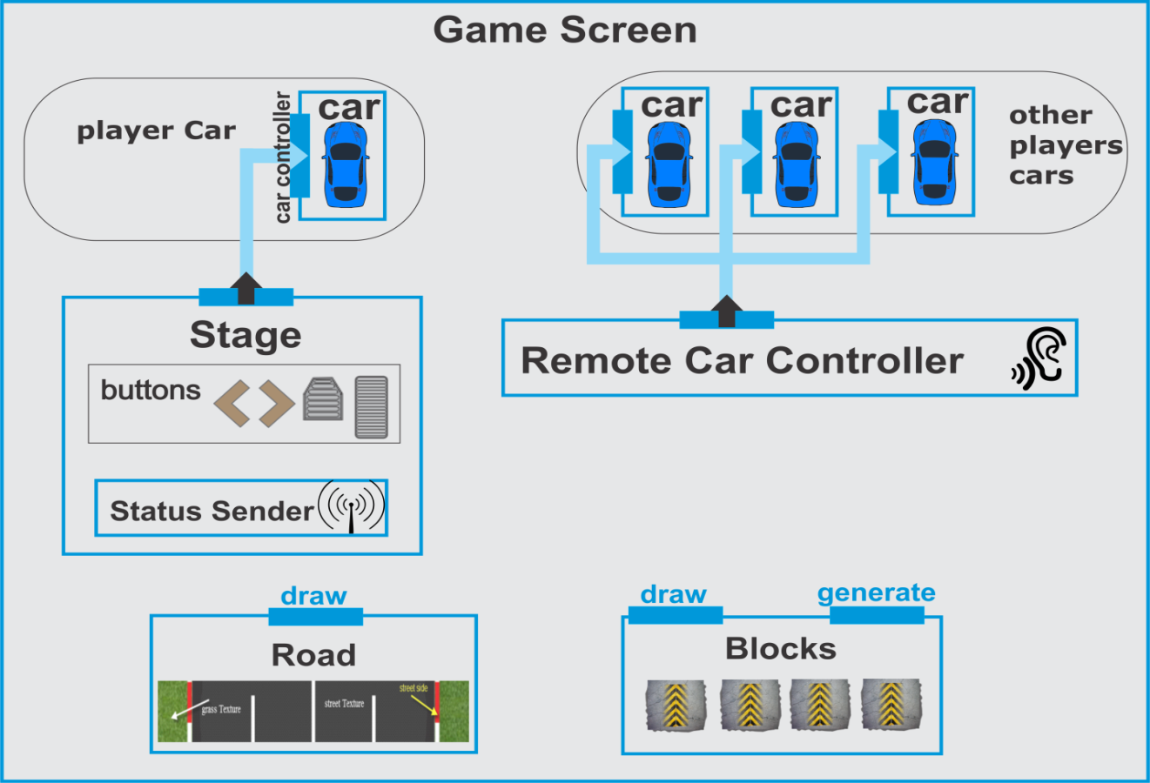
Game Screen
The Main Module, Contains:
Cars
The game Stage
Road
Blocks
Remote Controller
Controls:
Physics world
Orthographic camera

Slide 4
Game Screen – Physics world
The physics world is used to drive the simulation :
  Car movements
  Car collisions
The Box2D world object provides three important attributes that determine the precision of the simulation.
  Time Step
  Velocity iteration
  Position Iteration

Slide 5
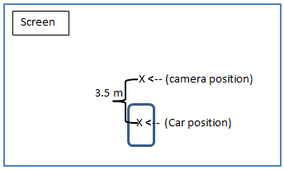
Game Screen – The Orthographic Camera
Acts like a very simple real world camera.
  It could be moved and rotated around, zoom in and out, change the viewport.
Always follows
the player car

Slide 6
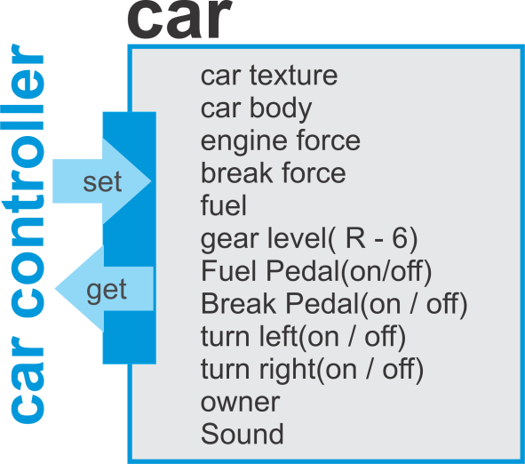
Car module

Slide 7

Car – Forces affect the body
Forces:
  Engine Force
    $$Engine Force= Absolute Engine Force × Gear Level Ratio$$
  Friction Force
    $$friction ratio= \left(4×e^{−v}+0.01\right)×r$$
    Where v is the car speed and r is the road friction ratio
  Other Forces
    Impulses to get rid of the Literal velocity

Slide 8
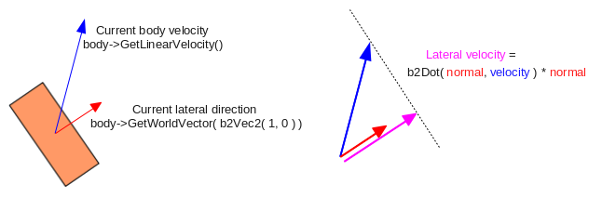
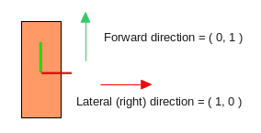
Car – Forces affect the body
Other Force:
  This force applied to get rid of the car slipping movement in the horizontal direction (Lateral Velocity).

Slide 9

Road
Draws the street and its two sides with the buildings and trees on each side
Use a Hash Map to store street auxiliaries
  Store the Randomly generated auxiliaries
  Speed up the retrieving process

Slide 10
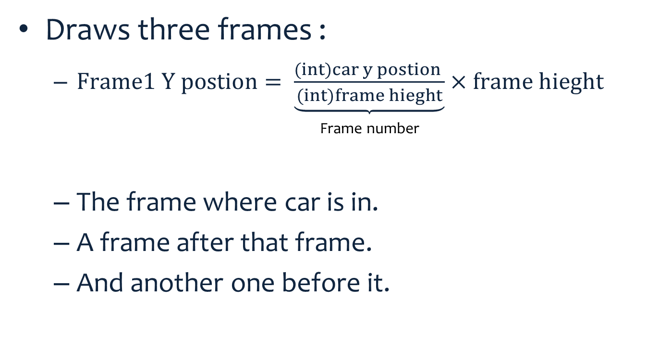
Road
Draws three frames :
  $Frame1 Y postion= \underbrace{\frac{(int)car y postion }{(int)frame hieght}}×frame hieght$
                Frame number
  The frame where car is in.
  A frame after that frame.
  And another one before it.
Frame 3
Frame 1
Where player car is in
Frame 2

Slide 11
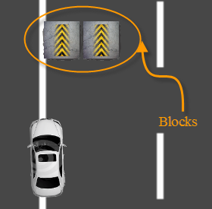
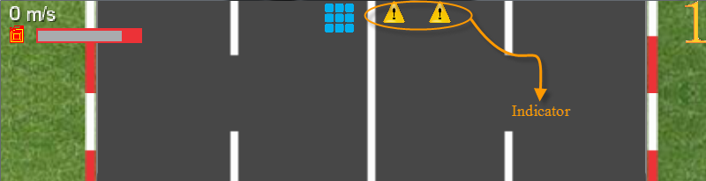
Blocks
Generate blocks body randomly across the road
Store them in a hash map to speed up retrieving.
Provide the indicators to these blocks.
  If distance between player car and block less than 100m.

Slide 12
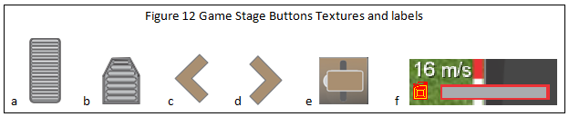
Game Stage
Simply the touch buttons on the screen.
  Gear Box
Speed label , order label , fuel label
Status Sender – broadcast commands upon the network

Slide 13

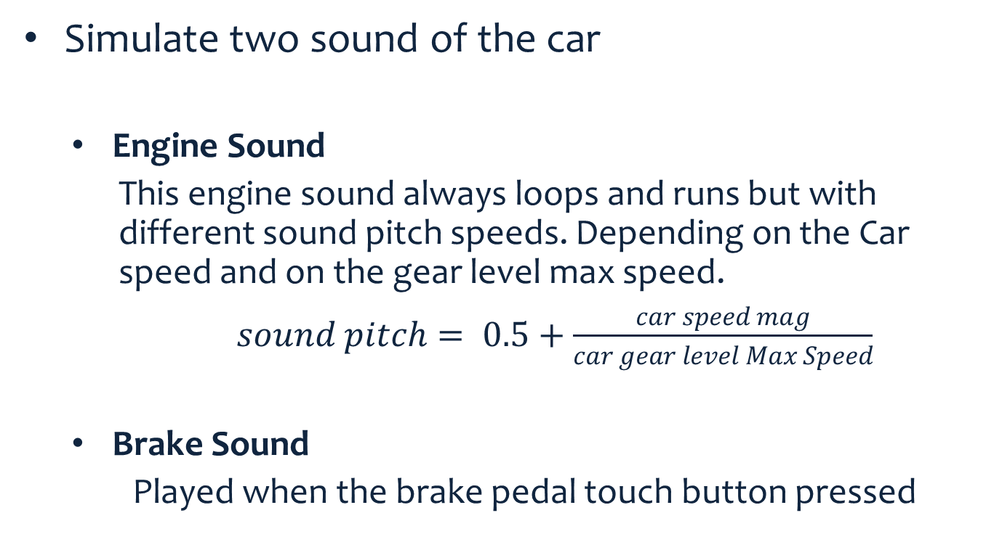
Car Sound
  Simulate two sound of the car
    Engine Sound
    This engine sound always loops and runs but with different sound pitch speeds. Depending on the Car speed and on the gear level max speed.
    $sound pitch= 0.5+\frac{car speed mag}{car gear level Max Speed}$
    Brake Sound
    Played when the brake pedal touch button pressed

Slide 14
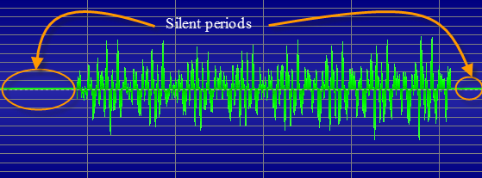
Engine Sound generate a sound that support looping
Generating a sound that supports looping
  Remove silent periods

Slide 15
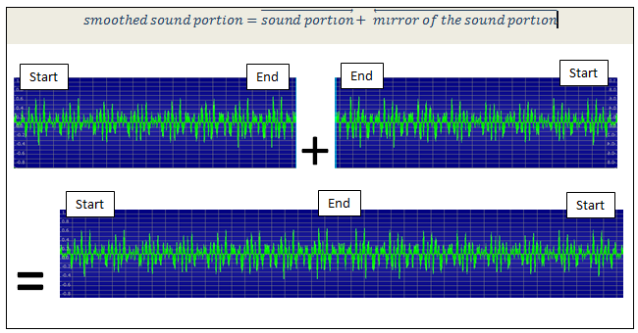
Engine Sound generate a sound that support looping
  smooth the looping process with this sound. make its start spectrums same as the end spectrums

Slide 16
Assets Manager
used to load all resources (images ,sound files).
  The resources loading is done asynchronously.
    display a reactive loading screen while other things are loaded.
  If an asset is needed multiple times, it will actually be shared and only take up memory once.
It guarantees that all assets exists and loaded successfully before the game starts.
  the game launching more stable and reliable and prevent any runtime failure due to assets miss.

Slide 17
Game Networking
The network part is the distinctive part, that distinct the game from others traditional car games.
The players in the game keep exchange the following information: the control pedal statues and the X,Y positions.
Two main modules: the status sender and remote car controller.
The statues sender keep sending the status massages to other players.
The remote car controller receive statues massages from other players and apply it on the game screen.

Slide 18
game networking: massage
The message class has two attribute the Message Type and the message Data.
The Massage type may be one of the following:
  NEW_GAME_OFFER
  JOIN_REQUEST
  PLAYER_INFO
  ID
  START

Slide 19
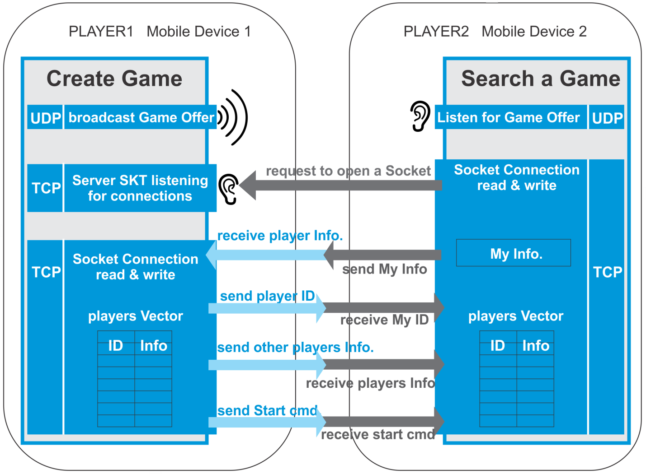
Create-Game and Search-Game Classes

Slide 20
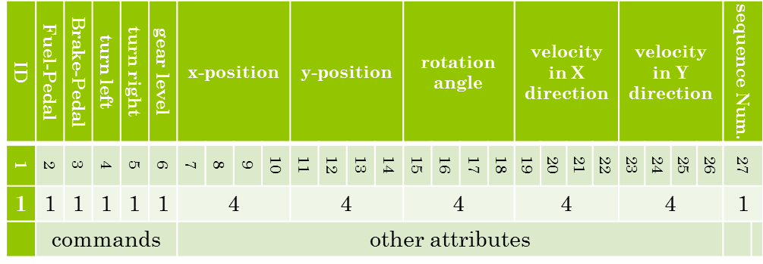
Statues Sender class
This class provides a method that take the player car status attributes and sends them to all other players on the network. It formatted these data in a frame (byte array) as shown in the following figure.

Slide 21
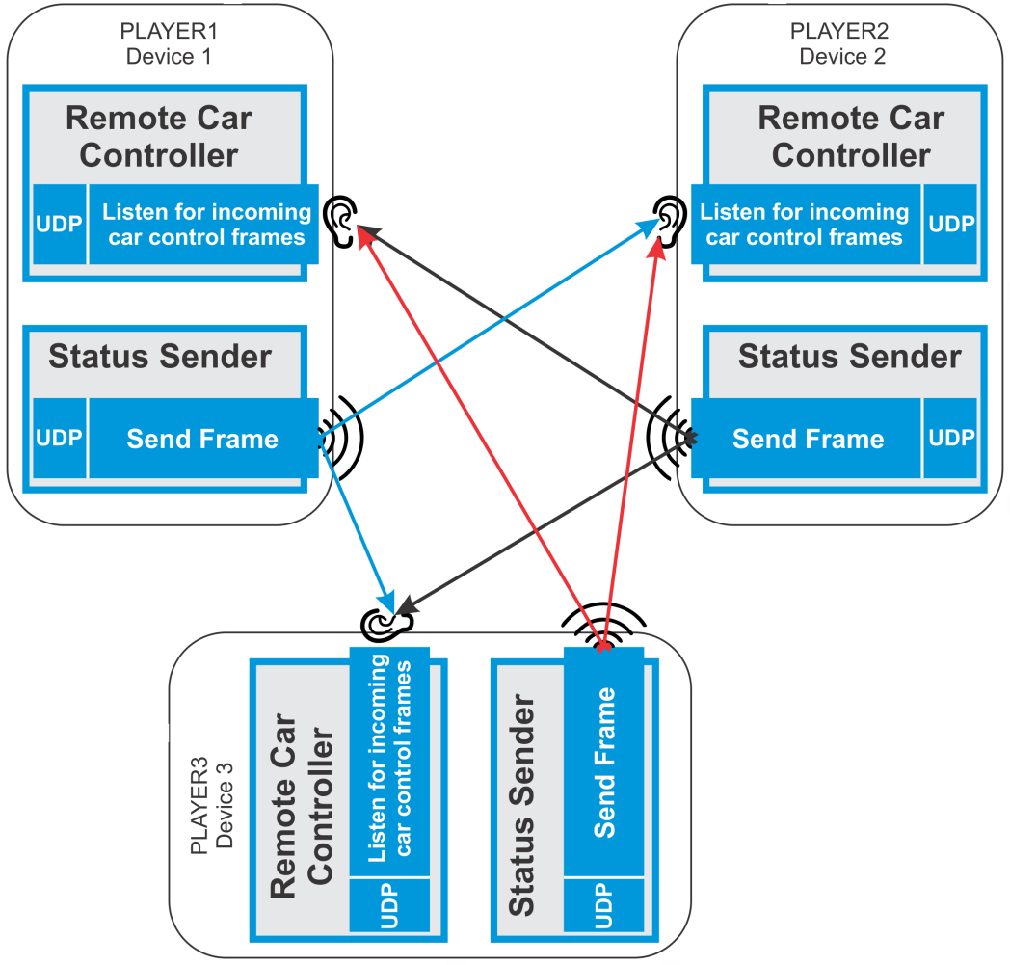
Remote Car Controller
This module is a receiver of the packets that the status sender module in other player devices sends. It receives the data and analyzes it and then decides which car to control and how to control it.

Slide 22
Network Massage content?
The problem is what to exchange between the players and how to apply the exchanged massages?
Two approaches:
  Exchange Commands:
  The players exchange commands between each other such as:
    set Fuel Pedal on or off
    set Brake Pedal on or off
    set Gear Level
    set Turn left or right
  Exchange Car Attributes:
  Players exchange the car position and velocity periodically every 60ms.
    Unfortunately, Depending only on these attributes will cause abrupt changes in the car position which noticed clearly by the players.

Slide 23
Solution!
The hybrid solution is the best one we have:
  The commands are used to simulate the car movement in the rest of the 60ms
  the car positions and velocity are used as a correction factor.
If there is any difference between the current car position and the received position then a small force is applied until the error become zero.

Slide 24

Sharing Intent
Using Android Sharing intent to share the player Achievements using various social media apps.

Slide 25
The Game Flow Chart

Slide 26
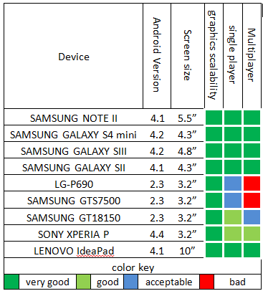
Testing
The game was tested:
  on different android
  Devices.
  different screen sizes
  and on different
  android platforms.

Slide 27
Results
  Game Networking
      4 to 5 players play the same game over a good wireless LAN (802.11g 54Mb/s) .
      No abrupt changes in the cars positions or incorrect car positions.
  Game physics
      Force simulation and Car collisions is very good.
      improving the car physics model.
        inserting two tires to the physics model and not to restrict it into a single rectangle body.
  Game graphics and Audio
      free or we design and draw it.
      As a result the game graphics is pretty simple.

Slide 28
Results
The Game Size
  The game APK size is 5.2 MB.
  The size of installed game is 8.22 MB.
  The needed run time memory (RAM) is approximately 12 MB
  1.5% of CPU time.
The User Friendly of the game:
  Enhance the car gear level.
  Using the proximity sensor of the android device to turn left and right.

Slide 29
Thank you
Any Question ?

