Slide 1
بسم الله الرحمن الرحيم

Slide 2
Development of key performance indicators for the SDIP…
Introduced by:
Sudkey Dweekat
Ameer Risheh
Yasmin Abu Alhala
Majd Mousa
Supervised by : Eng.Sulaiman Daifi.

Slide 3
Contents
Recommendations
Deliverables
Conclusion
Project Scope
Project Objective
Problem Analysis

Slide 4
Strategic development and investment planning (SDIP)
Localized S.P. approach
Identifying local development objectives, priority projects
Aspirations & needs of community, available resources & potential opportunities and challenges.

Slide 5
A five-phase approach:
Where are we now?
Where do you want to go from here?
How do you get from where you are today to where you want to be in the future?
How will you close the gap?
How will we monitor & evaluate?

Slide 6
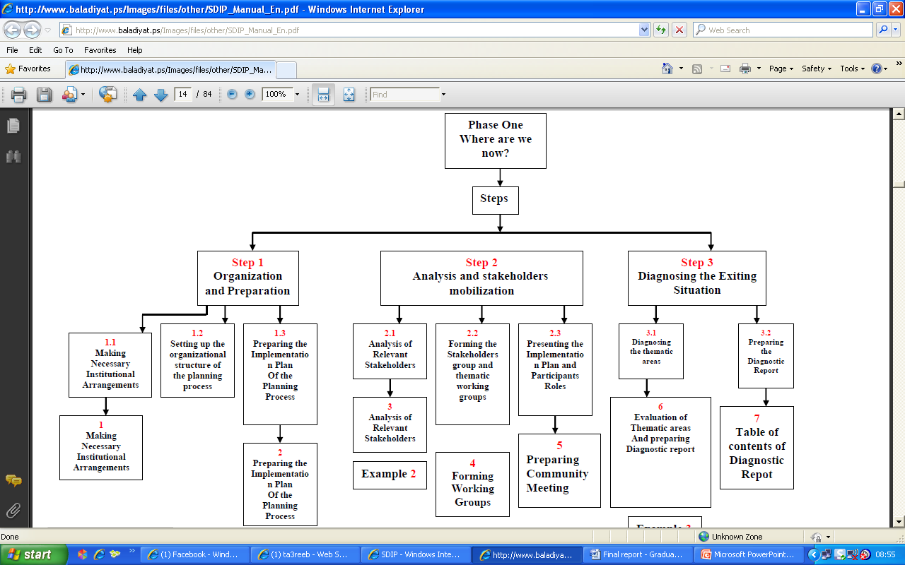
Setting the organizational structure
Experts & (consultants)

Slide 7
Where are we now?
“Consultants’ Job”
Diagnosing the thematic areas
Preparing a diagnostic report

Slide 8
Diagnostic Report of KPI
An important tool to diagnose.
Should follow a certain criteria.

Slide 9
What's going on around?
Different experts are being consulted
Different suggested set of indicators
scattered efforts are regularly implemented
Problem

Slide 10
Unbalanced decision making process.
Decision A
Indicator 1
Indicator 2
Decision B
indicator1
indicator2
indicator3

Slide 11
Problem Statement
The problem of using nonstandard KPIs.
Different evaluations and outputs among consultants.
Variations in points of view, evaluation, plans, and therefore, decisions and actions.
Scattered & wasted efforts.

Slide 12
Project Objective
Project Objective

Slide 13
Project Objective
Investigating the Key Performance Indicators (KPI).
Check validity & reliability of KPI.
Develop current list of KPI.
Conduct standard lists of KPI.

Slide 14
Project Scope
Project Scope
Strategic Planning and KPIs

Slide 15
Project Scope
Health
Education
Transportation
Water
Electricity
Youth
Social Affairs
Agriculture
Civilian Defense
Solid Waste

Slide 16
KPI Should Be
Extracted from deep understanding for the targeted aspect.
Simple, clear, and measurable.
Limited number to facilitate tracking them by decision makers.
Practical and applicable.
Kept for reasonable interval (3-5 years) before replacing.

Slide 17
Deliverables
Deliverables
Methodology & Sectors

Slide 18
Methodology
Select the sector
Literature review
Available KPIs
Meet consultants

Slide 19
Methodology
Initial list
Review
Final list
Feedback & Evaluation

Slide 20
Deliverables
Selected sectors with their indicators

Slide 21
Education Sector
A
B
1st Grade Attendance.
# of teachers/grade.
Repetition rate.
School dropout rate.
Share of school class/ student.
Achievement Level In Mathematics.
Availability of First-Aid Bags.
Availability of Clinic Per School.
# of Rented Classrooms.

Slide 22
Electricity Sector
A
B
Percentage of houses unconnected to electricity.
Average electricity consumption per capita.
Demand factor.
System reliability.
Average time for programmed disconnections per KVA.
Frequency of programmed disconnections per KVA.
Time average of external disconnection in the system.

Slide 23
Social Affairs Sector
Percentage of families below poverty line that received aid.
Percentage of poor students having exemption from school fees.
Percentage of martyrs’ families how receive social aid.
Percentage of children obtaining care and protection.
Percentage of prevalence of violence against children.

Slide 24
Youth Sector
Number of election candidates from youths.
Number of projects managed by youths.
Percentage of unemployment and poverty within youths.
Percentage of budgets customized for investment in youths.
Number of youths with Thalassemia.

Slide 25
Transportation Sector
Lengths of roads for a town (km).
Lengths of roads in the structural plan.
Lengths of main roads for a town (km).
Percentage of paved roads.
Road density (km/km^2).
Percentage of roads in a good condition.

Slide 26
Water Sector
Proportion of people who have water networks.
Average of water quantity available daily for a person.
Proportion of people who have water networks & continuous water pumping.
Average of wasted water.
Percentage of people that their water consumption exceeds 100 litres/ day.

Slide 27
Health Sector
A
B
No. of reported births.
Spending rate on the health sector.
No. of disables per 1000 people.
No. of education and health awareness sessions.
Average of the population increase.
Mortality rate/100 people
No. of public health centres.
No. of TB cases per 1000 people.

Slide 28
Civil Defense Sector
Availability of civil defense center.
Number of firefighters /citizen .
readiness of civil defense buildings.
Conscious about issues of civil defense and disaster management.
infrastructure in fields of accidents investigations.

Slide 29
Waste Water Sector
No. of cesspits.
Proportion of houses connected with waste water networks.
Availability of waste water treatment stations.
No. of complaints related to environmental problems.
Proportion of people served by refinery station.

Slide 30
Agricultural Sector
Agricultural production.
Area of organic lands.
Number of goats.
Area of applicable land for agricultures.
Areas with fruit crops.

Slide 31
Solid Waste Sector
Number of bins in an agglomeration.
Solid waste weight (ton/day).
Quantity of collected wastes from each agglomeration.
Awareness about waste separation.
Number of solid waste's vehicles.

Slide 32
Conclusion
Conclusion

Slide 33
KPIs are used to:
Reduce the number of decisions that are based on instinctive perspectives.
Quantify the goals by setting, monitoring and measuring against a standard or target.
Make decisions based on objectivity and facts.
Compare current state with desired state.

Slide 34
Different KPIs
Different Methodology
Ambivalent opinions

Slide 35
Consultant 2
Consultant 1

Slide 36
Standard KPIs
Standard Methodology
Continual Improvement

Slide 37
Consultant 1
Consultant 2
Consultant 3

Slide 38
Recommendations
Recommendation
What is next?

Slide 39
Recommendations
Cover the rest of the sectors, e.g. economic, women…
Get/set standard values each indicator.
Continue Researching.
Search for and create new indicators.
Update indicators.

Slide 40
What is next?
Adaptation
Apply
Evaluation &
feedback

Slide 41


