Slide 1

Securing Data In The Cloud Through Data Partitioning And Encryption.
By: Rania Salameh & Shahd Mobarak
Supervised By: D. Adnan Slaman

Slide 2
What is cloud computing?
Type of internet-based technologies, which allows users to share data and resources among different cloud service providers and cloud vendors.

Slide 3
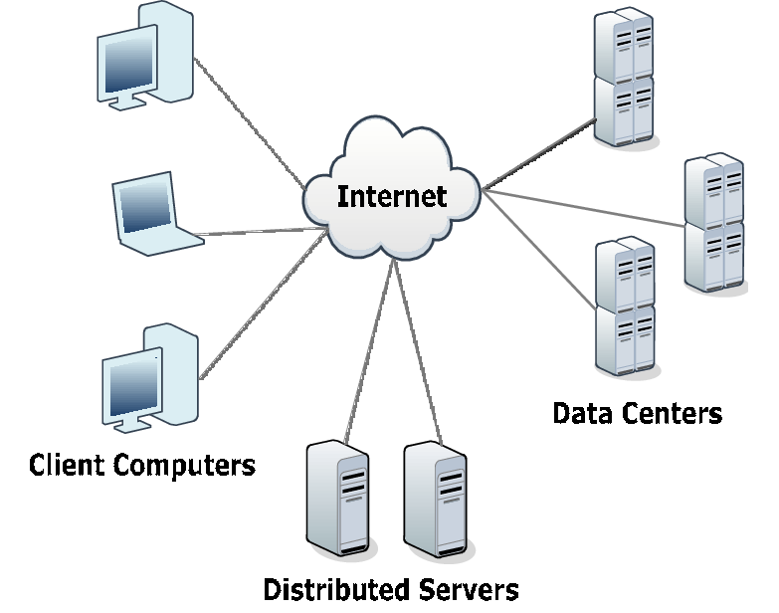
Cloud components:
1- Clients
2- Distributed servers
3-Datacenters

Slide 4
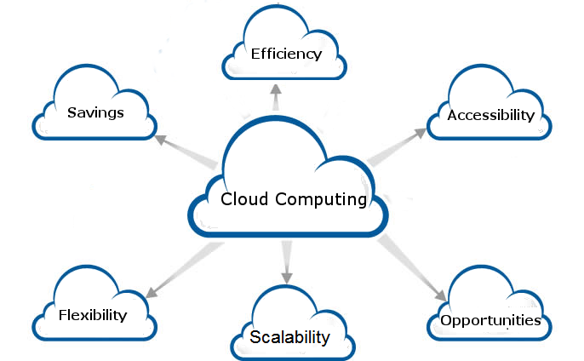
Why cloud computing?

Slide 5
Security Problems Faced By Cloud:
1- Data theft
2- Integrity of data
3- Privacy problems
4- Loss of data

Slide 6
Idea
User’s original data cannot be directly reached by cloud operators

Slide 7
Previous work
SA-EDS model mainly consists of two components:
1- Deterministic Process (DP)
2- Data Distributed Storage Process (D2SP)
Algorithms used to design the model (SA-EDS):
1- Alternative Data Distribution (AD2)
2-Secure Efficient Data Distributions (SED2)
3-Efficient Data Conflation (ED- Con)

Slide 8
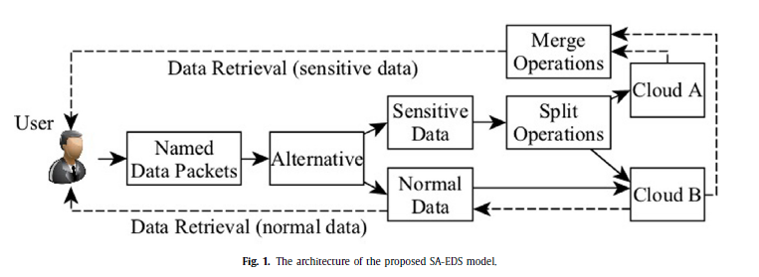
SA-EDS
Security-Aware Efficient Distributed Storage (SA-EDS) Model.[1]
[1]Yibin Li, Keke Gai, Longfei Qiu, Meikang Qiu, Hui Zhao [2017]

Slide 9
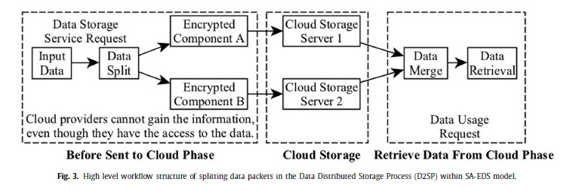
SA-EDS

Slide 10
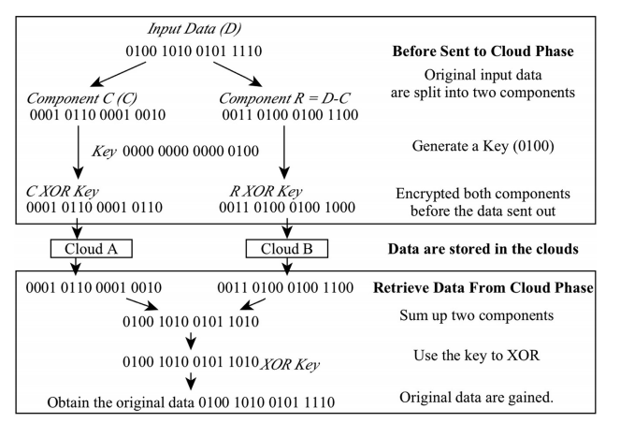
Example:

Slide 11
SOFTWARE :
C/C++
JAVA
DropBox API with java

Slide 12
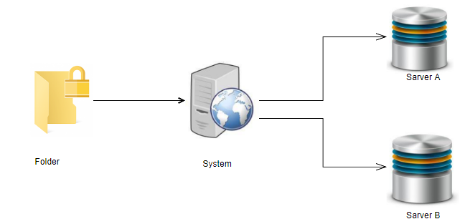
System Architecture

Slide 13
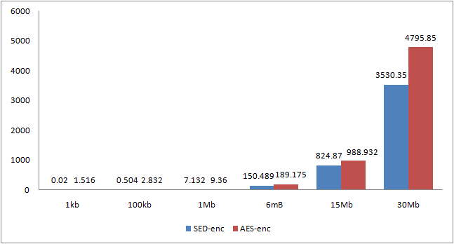
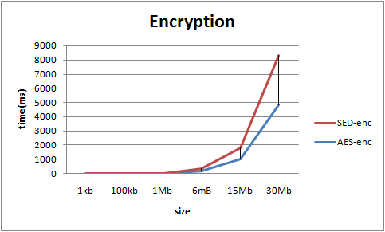
Result for Encryption

Slide 14
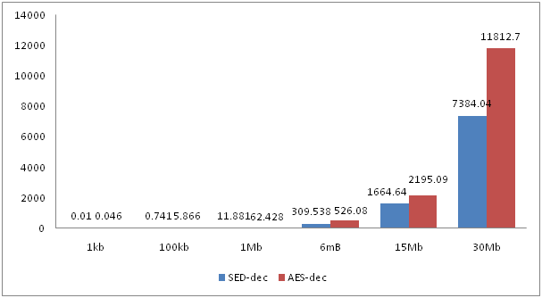
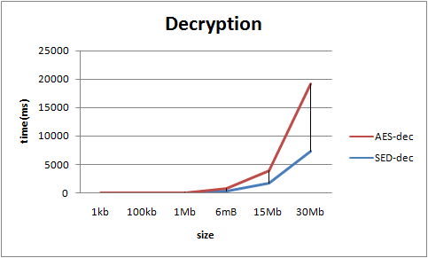
Result for Decryption

Slide 15

THANKS!

