Slide 1
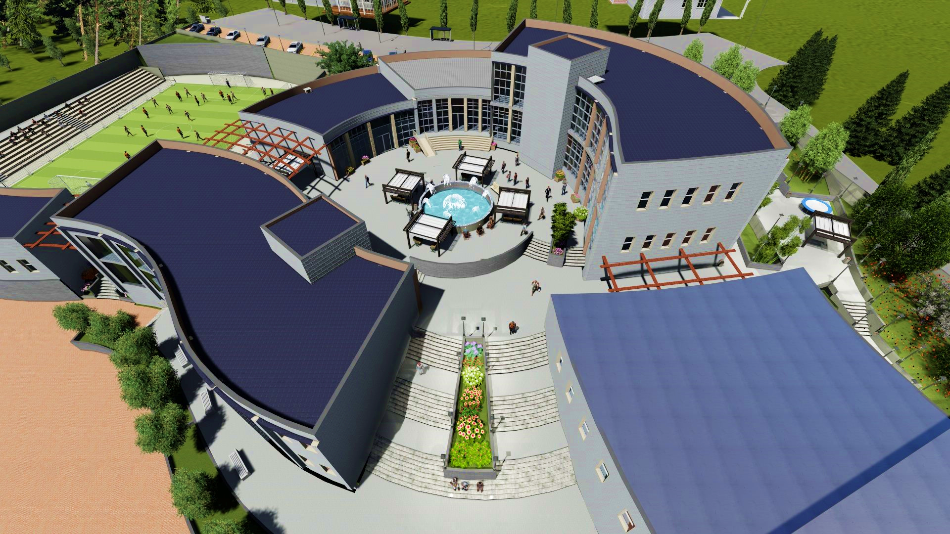

Integrated Design Of A
Youth center
By
Mostafa Yahya
Imran Zaid
Mahmoud Hafnawi
An-Najah National University
Faculty of Engineering
Building Engineering Department
Supervised By
Eng. Haitham Sawalha
1

Slide 2
Introduction
Architectural Design
Environmental Design
Electrical Design
Quantity Surveying and Cost Estimation
Mechanical Design
Structural Design
Outline
2

Slide 3
Introduction
3

Slide 4
Youth center building:
located in Nablus
Nablus city does not have a youth center with a complete design that include all activities.
The goal was to provide an integrated design of a building that takes into account all design aspects
4

Slide 5
Architectural Design
5

Slide 6
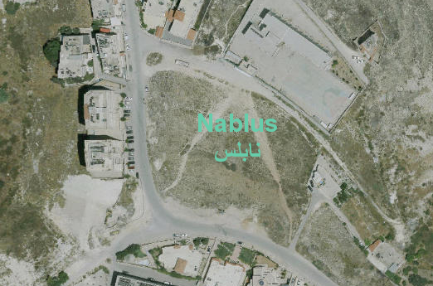
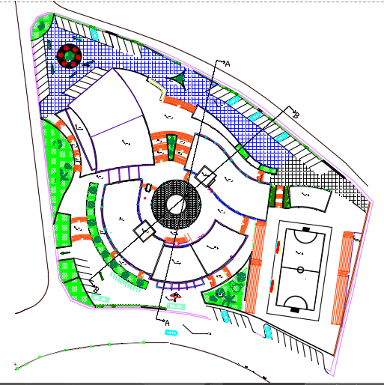
Map of site
N
Site Plan
Total area =4567 m²
6

Slide 7
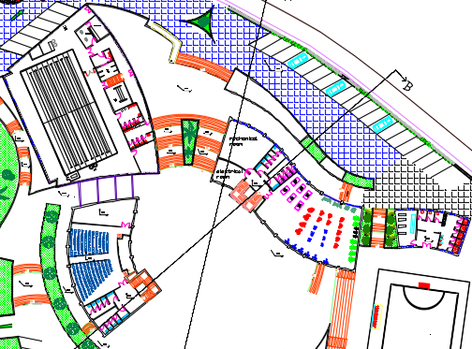
Architectural Design
N
Basement floor
Area =1964m²
7

Slide 8
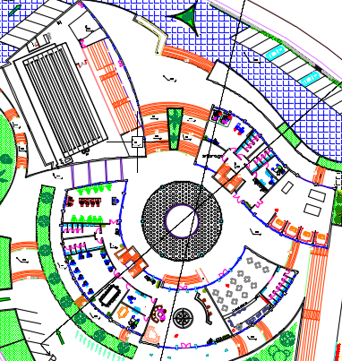
Architectural Design
N
Ground
floor
Area =1550 m²
8

Slide 9
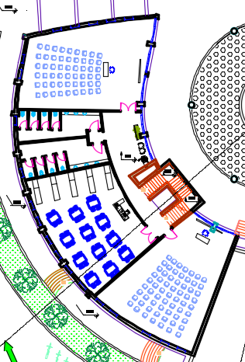
Architectural Design
N
First floor
Area =540 m²
9

Slide 10
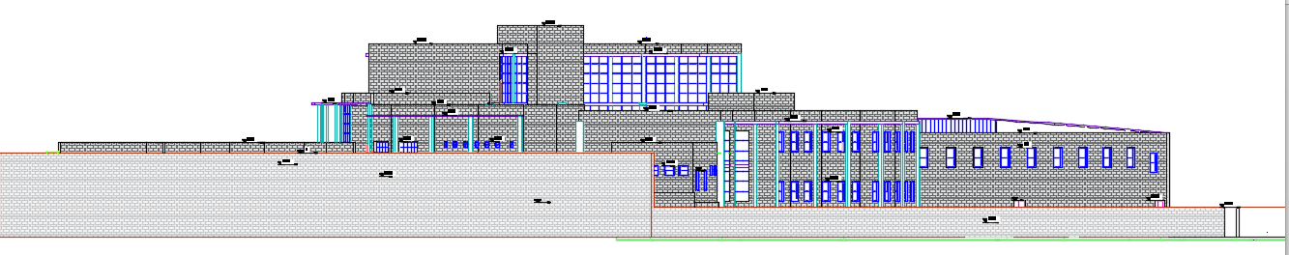
Architectural Design
East Elevation
10

Slide 11
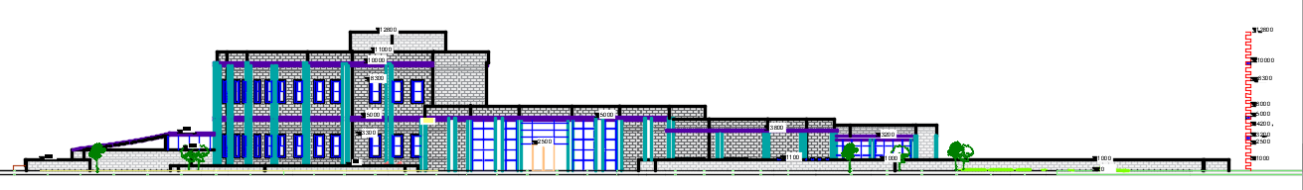
Architectural Design
South Elevation
11

Slide 12
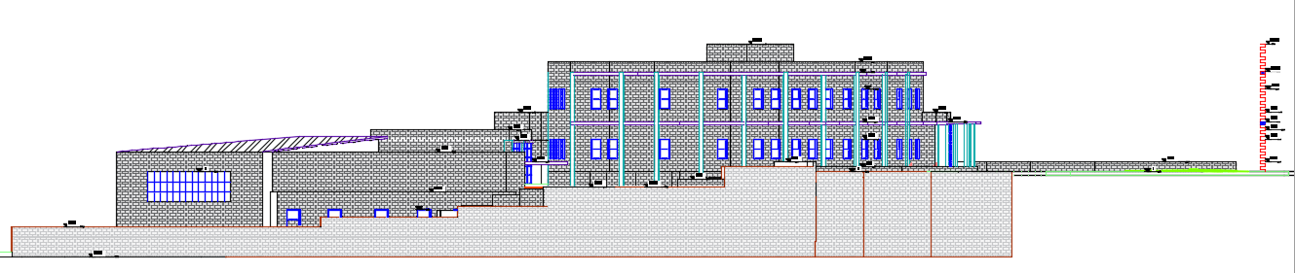
Architectural Design
West Elevation
12

Slide 13
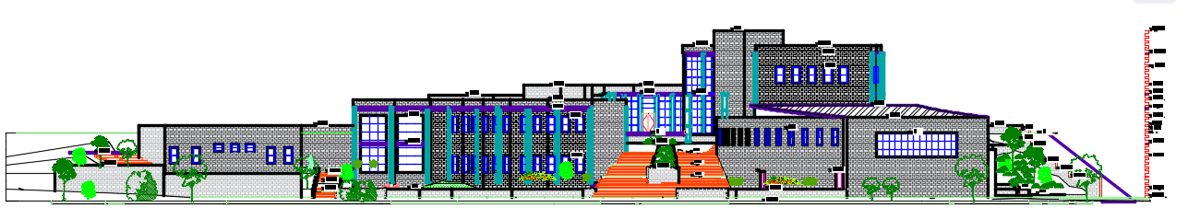
Architectural Design
North Elevation
13

Slide 14
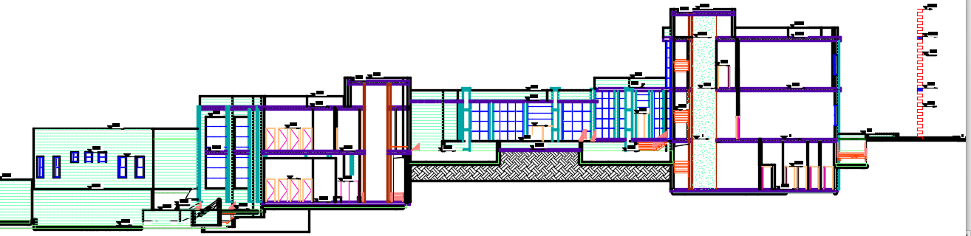
Architectural Design
Section A – A
14

Slide 15
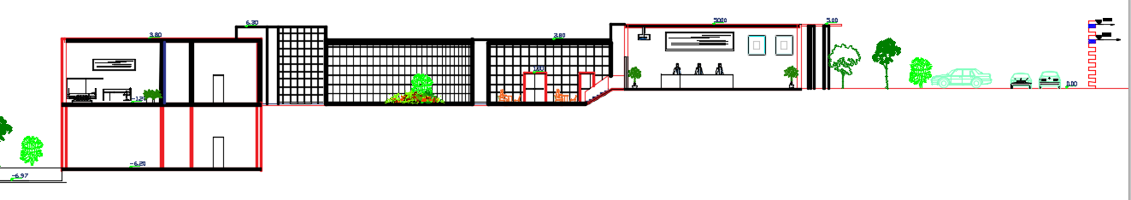
Architectural Design
Section B – B
15

Slide 16
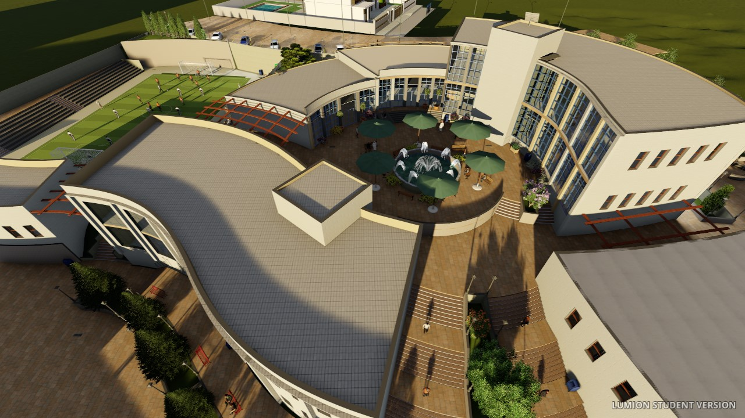
Architectural Design
3D model
16

Slide 17
Environmental Design
17

Slide 18
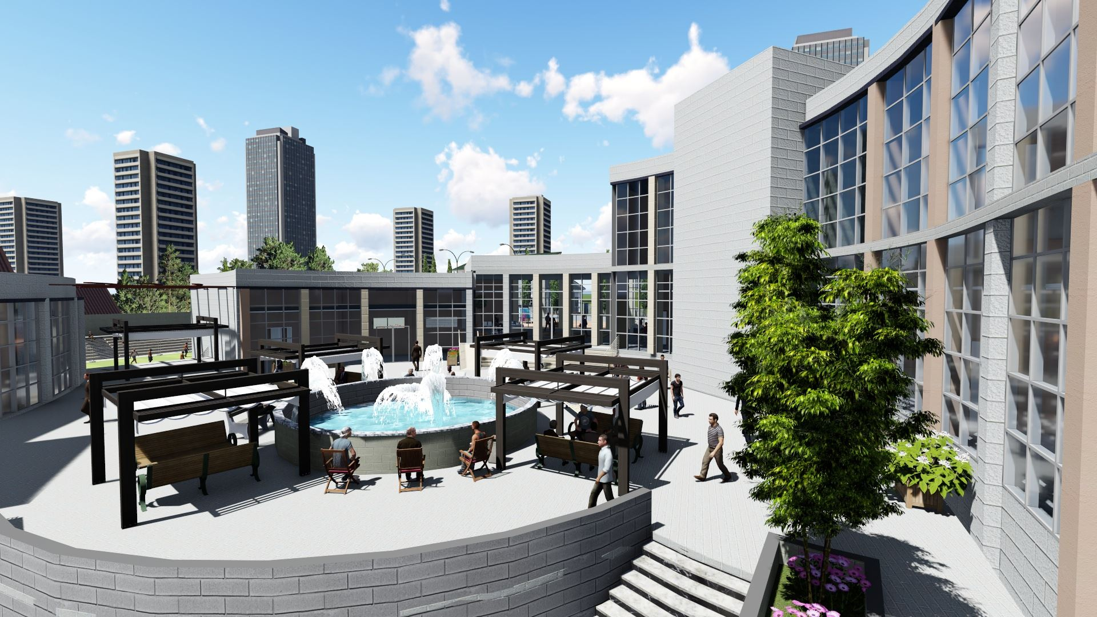
Environmental Design
Shading
Daylight
Thermal Design
Acoustics
18

Slide 19
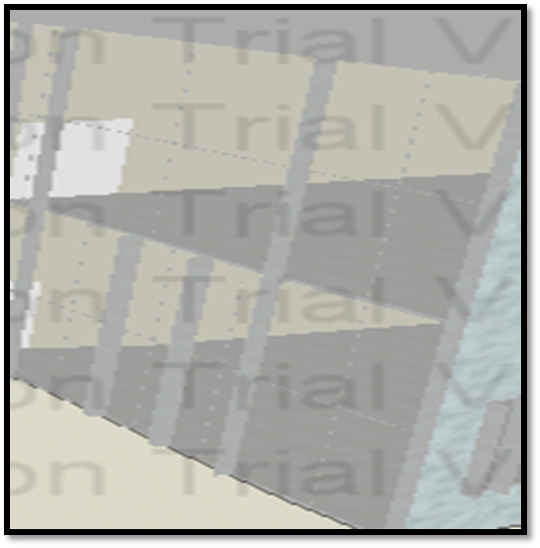
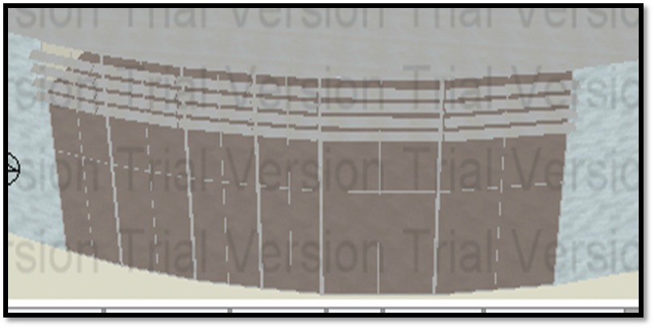
Environmental Design
East windows (vertical shutters)
Shading
South windows (horizontal shutters and cantilever)
19

Slide 20
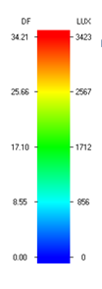
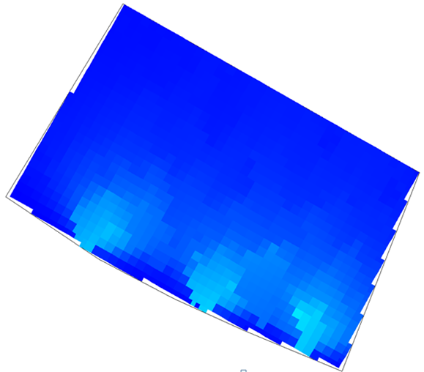
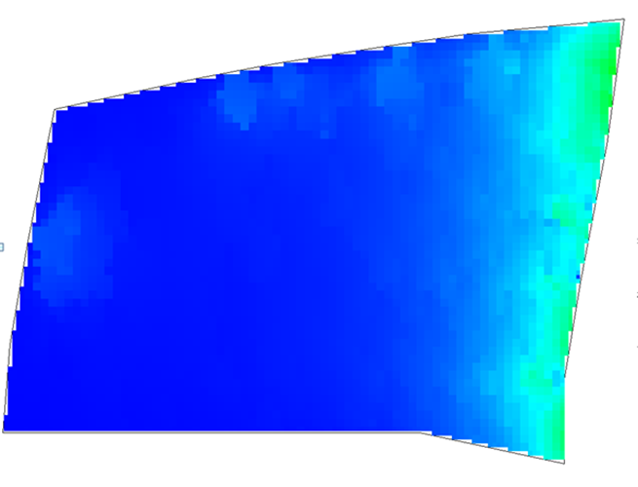

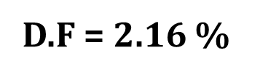
Environmental Design
Daylight
Management Room
Compute room
D.F = 2.83 %
20

Slide 21
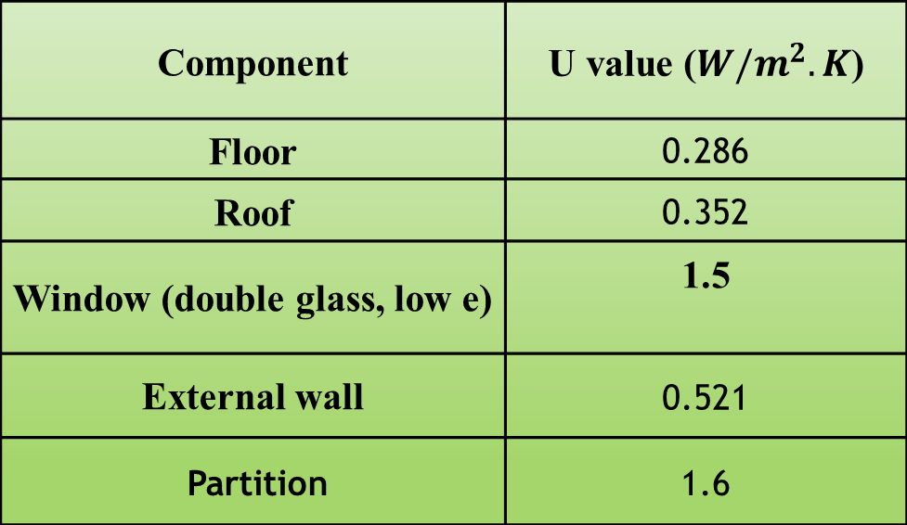
Environmental Design
Thermal Design
U value for building components
The conventional wall was used with specification shown in table
21

Slide 22
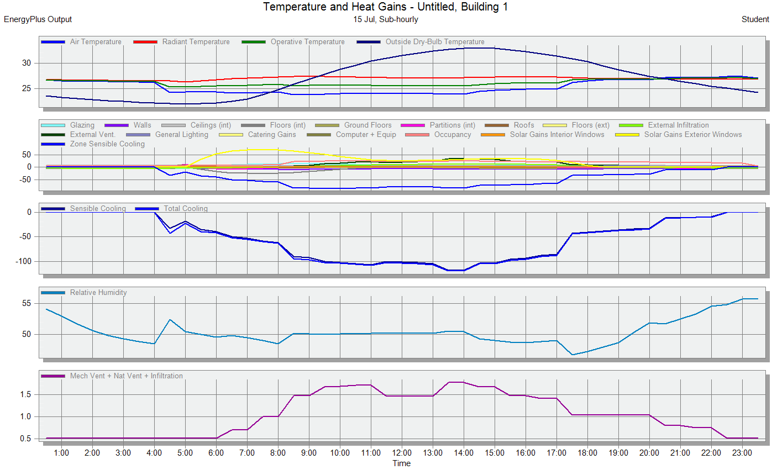
Environmental Design
Thermal Design
Design standards:
There are conditions that must be met in the design:
Maintain operative temperature between:
20.0 to 23.5o C in winter and 22.5 to 26.0o C in summer.
Maintaining Rh between 30 to 60%.
AIR Speed between 0.1 to 0.35 m/s.
Cooling loads
Total cooling load=149.27 kW
22

Slide 23
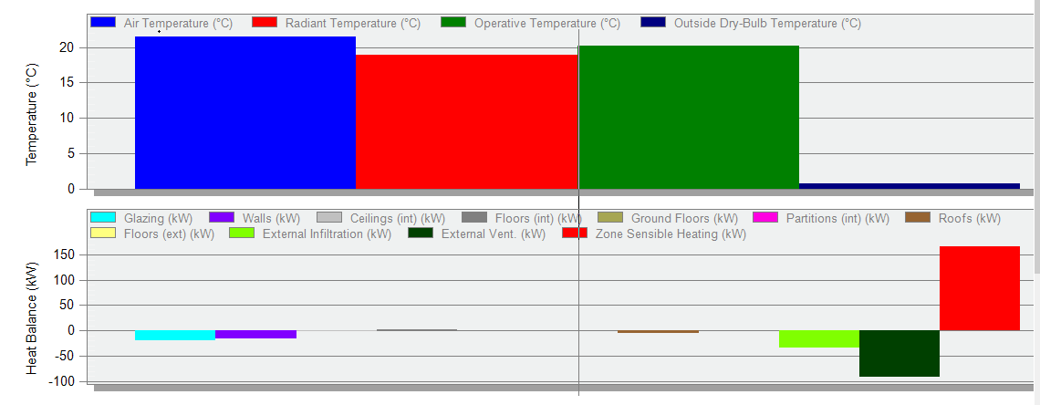
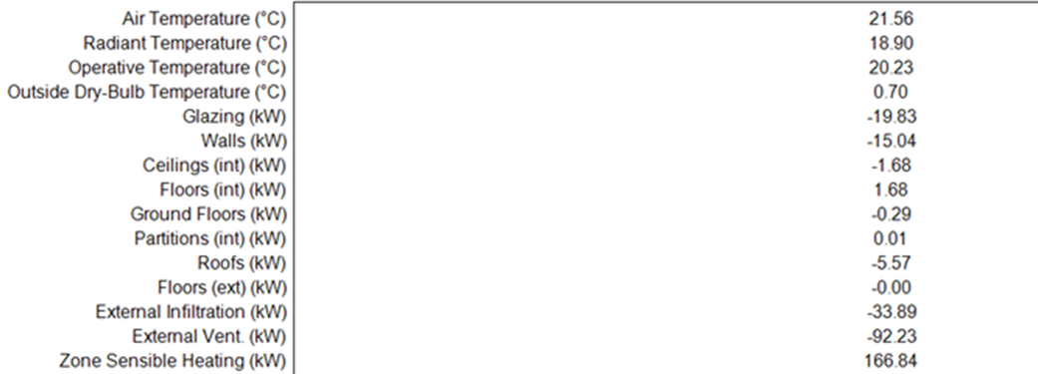
Environmental Design
Thermal Design
Heating loads
Total heating load=208 kW
23

Slide 24
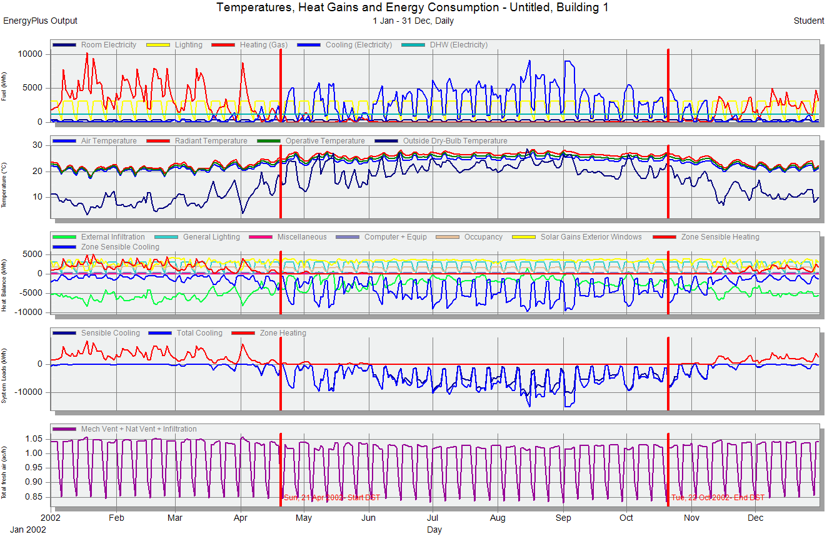
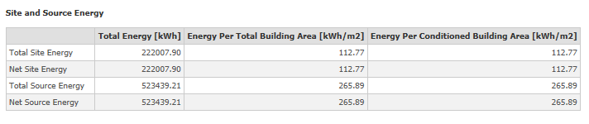
Environmental Design
Thermal Design
Site and source energy=112.77 kwh/m²
24

Slide 25
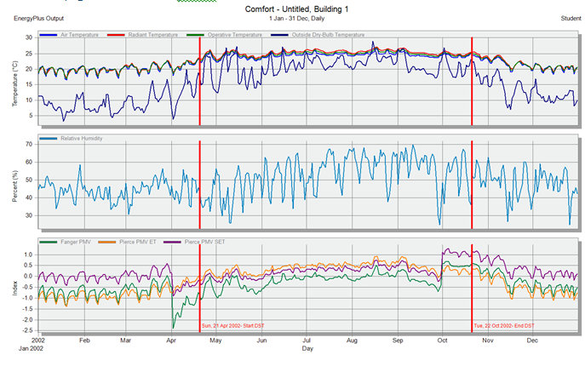
Environmental Design
PPD and PMV
25

Slide 26
Environmental Design
Acoustics
Surface material used in cafeteria
surface | Freq.(HZ) Material | 63 | 125 | 250 | 500 | 1000 | 2000 | 400 | 800 | 16000
wall | Plaster board | 0.11 | 0.12 | 0.09 | 0.07 | 0.05 | 0.05 | 0.04 | 0.05 | 0.04
ceiling | Acoustic Tile Suspended | 0.60 | 0.40 | 0.63 | 0.43 | 0.60 | 0.77 | 0.89 | 0.60 | 0.55
door | Foam Core Plywood | 0.35 | 0.30 | 0.25 | 0.15 | 0.10 | 0.10 | 0.07 | 0.10 | 0.15
floor | terrazzo | 0.02 | 0.01 | 0.01 | 0.02 | 0.02 | 0.02 | 0.02 | 0.03 | 0.03
Windows | Double Glazed | 0.11 | 0.09 | 0.05 | 0.03 | 0.00 | 0.02 | 0.02 | 0.03 | 0.03
26

Slide 27

Environmental Design
Acoustics
Reverberation Time ($RT_{60}$)
Required RT60 in Cafeteria
(0.7-0.9)
 | TOTAL | SABINE | NOR-ER | MIL-SE
FREQ. | ABSPT. | RT(60)(sec) | RT(60)(sec) | RT(60)(sec)
63Hz: | 197.497 | 0.75 | 0.49 | 0.61
125Hz: | 189.069 | 0.78 | 0.41 | 0.62
250Hz: | 196.951 | 0.73 | 0.94 | 0.54
500Hz: | 158.883 | 0.87 | 1.31 | 0.67
1kHz: | 172.944 | 0.79 | 1.61 | 0.52
2kHz: | 202.597 | 0.67 | 1.3 | 0.4
4kHz: | 221.051 | 0.61 | 1.26 | 0.34
8kHz: | 165.236 | 0.69 | 1.19 | 0.54
16kHz: | 173.226 | 0.66 | 1 | 0.52
27

Slide 28
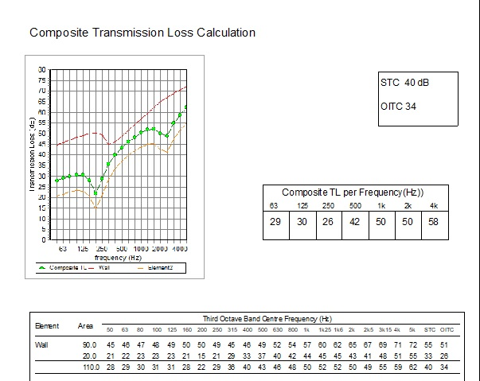
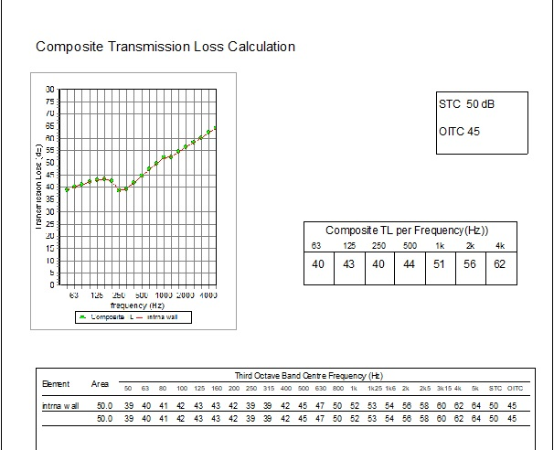
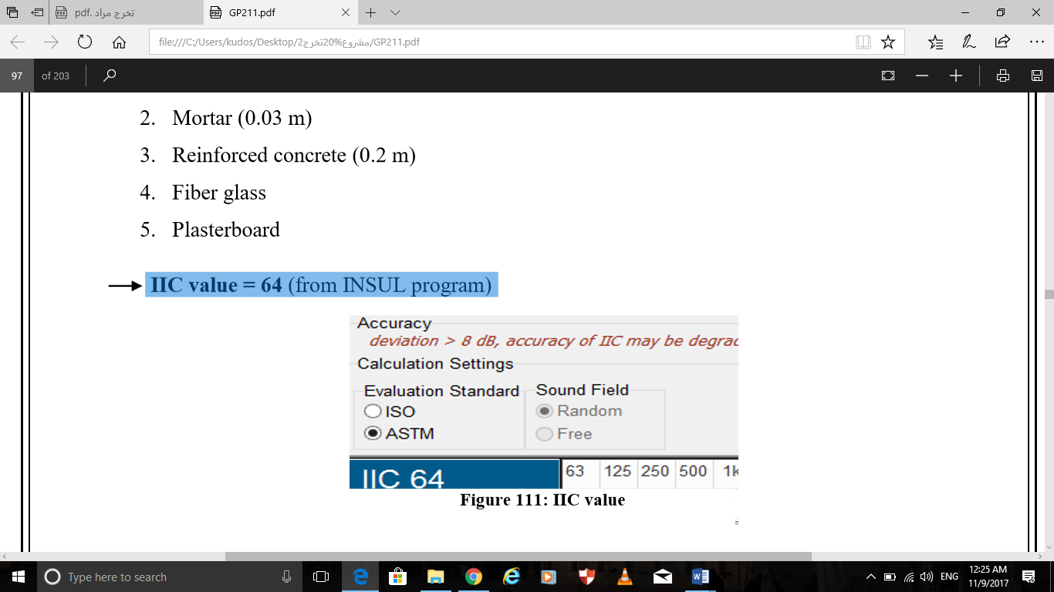
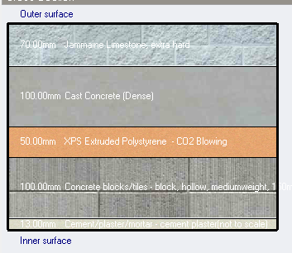
Environmental Design
Acoustics
External wall
TL combined =40 dB
Internal wall
STC =50 dB
Roof
Recommended STC=34
Recommended STC=38
IIC =64 dB
Recommended IIC=50
28

Slide 29
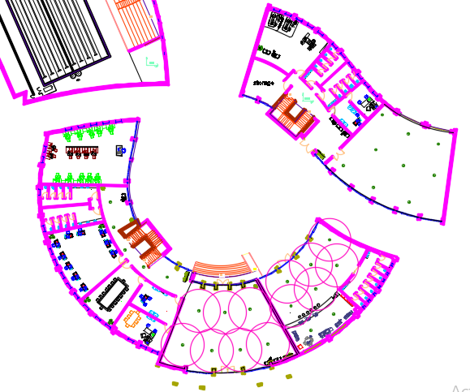
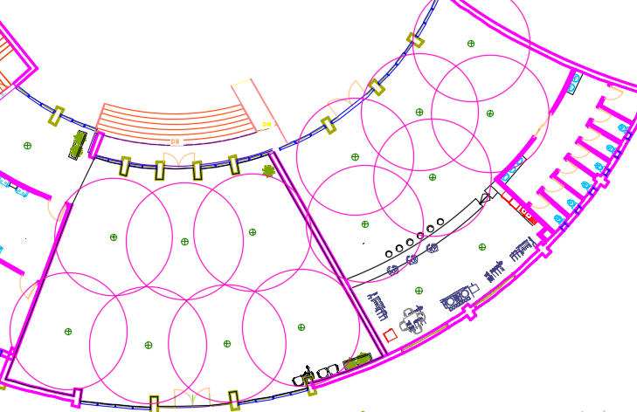
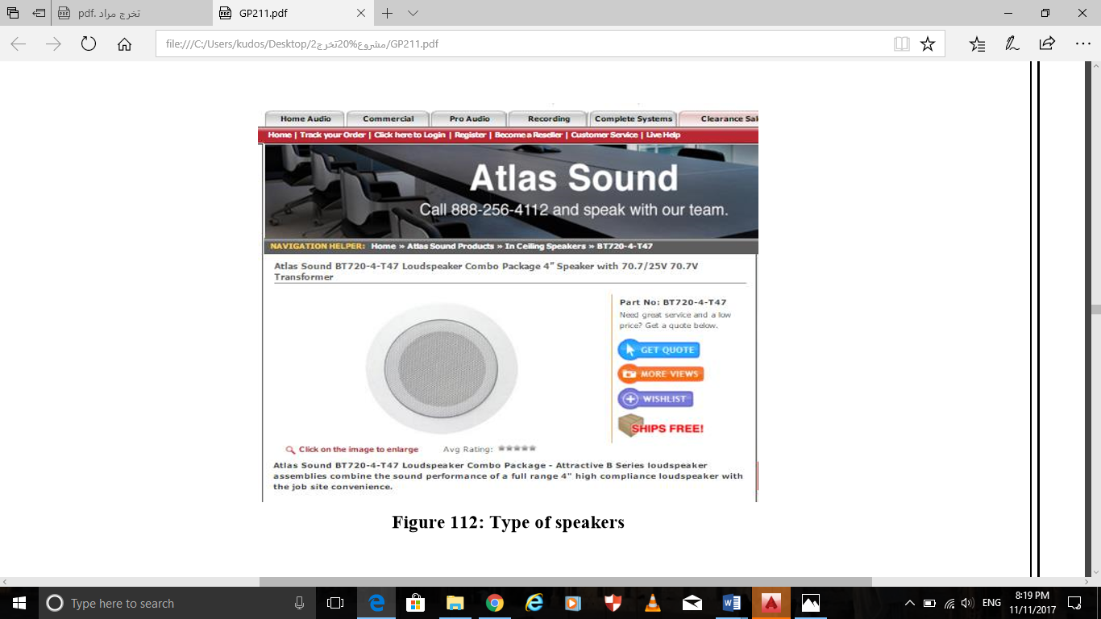
Environmental Design
Acoustics
Sound reinforcing system
Ceiling mounted Speaker
Specifications
Type of speaker | High compliance
Sensitivity | 88 dB
Distance between tow speakers | 6.8m
Coverage angle | 130°
29

Slide 30
Structural Design
30

Slide 31
Structural Design
Codes
(ACI 318-14) for RC Structures Design
(UBC 97) for Earthquake Loads
(ASCE 7 2010) for loads combination
31

Slide 32
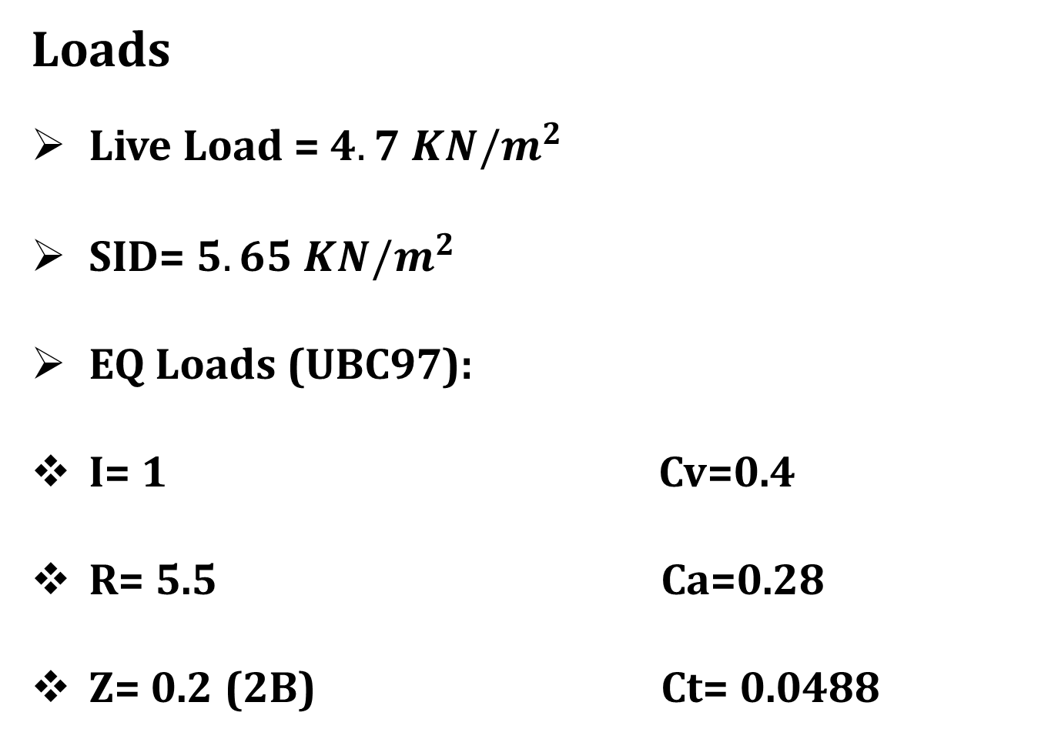
Structural Design
Loads
Live Load = $4.7 KN/m^{2}$
SID= $5.65 KN/m^{2}$
EQ Loads (UBC97):
I= 1 Cv=0.4
R= 5.5 Ca=0.28
Z= 0.2 (2B) Ct= 0.0488
32

Slide 33

Structural Design
Material
Concrete 28,24 (Mpa)
Steel Fy = 420MPa
Final Design Sections
Slabs thickness 0.3 m
Columns(rectangular) (0.8$×$0.4),(0.4$×1.0$ m)
Beams (0.6$×1.2$),(0.7$×1.2$ ),(0.5$×1.2$),(0.3$×$0.5)m
Walls thicknesses 0.3 m
Structural system
One way ribbed slab
33

Slide 34
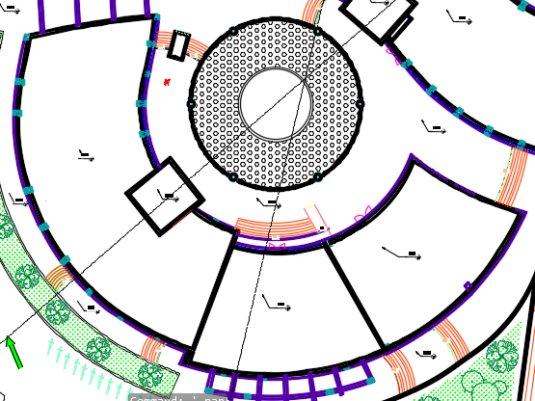
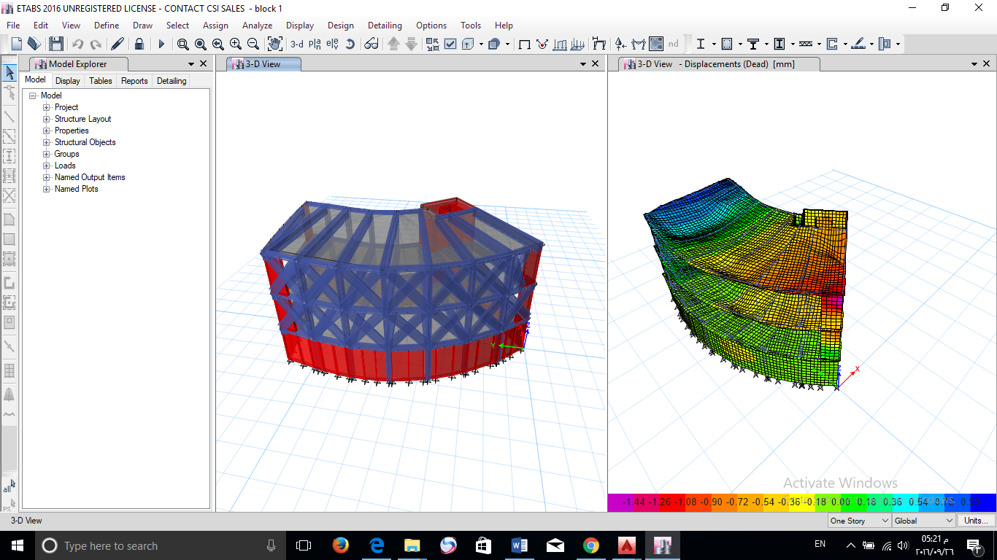
Structural Design
Selected block
3D Modeling
34

Slide 35
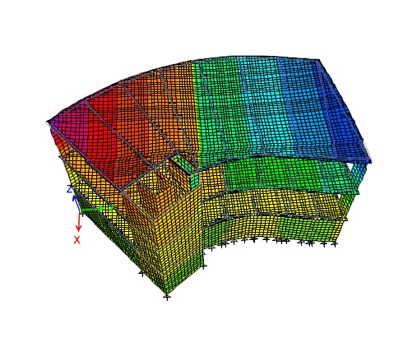
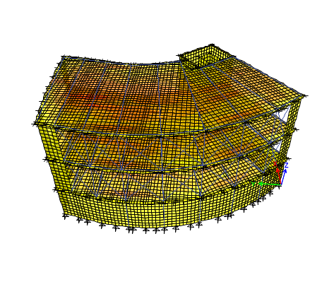
Structural Design
Compatibility Check
35

Slide 36
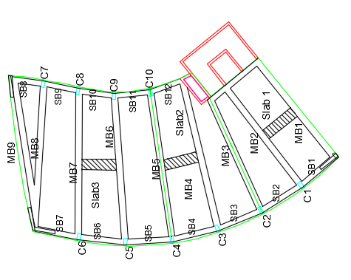
Structural Design
 | Block 1 |  |  | Block 2
Load | Manual Calculation(KN) | Etabs Calculation(KN) | Difference (%) | Manual Calculation(KN) | Etabs Calculation(KN) | Difference (%)
Dead Load | 18702 | 19609 | 4.6 | 7694.05 | 7829.12 | 1.7
Live Load | 5350.95 | 5329.12 | 0.4 | 2402.78 | 2489.07 | 3.4
Super Imposed Load | 9570.2 | 9310.5 | 2.7 | 2896.49 | 2888.45 | 0.27
Equilibrium check
Internal Forces Check
Elements | Hand calculation | Calculation from Etabs | Difference %
Column 8 | 1248.4 | 1203 | 3.6
Strip of slab 3 | 25.5 | 23.75 | 6.86
MB2 | 1401.5 | 1471.91 | 4.78
36

Slide 37
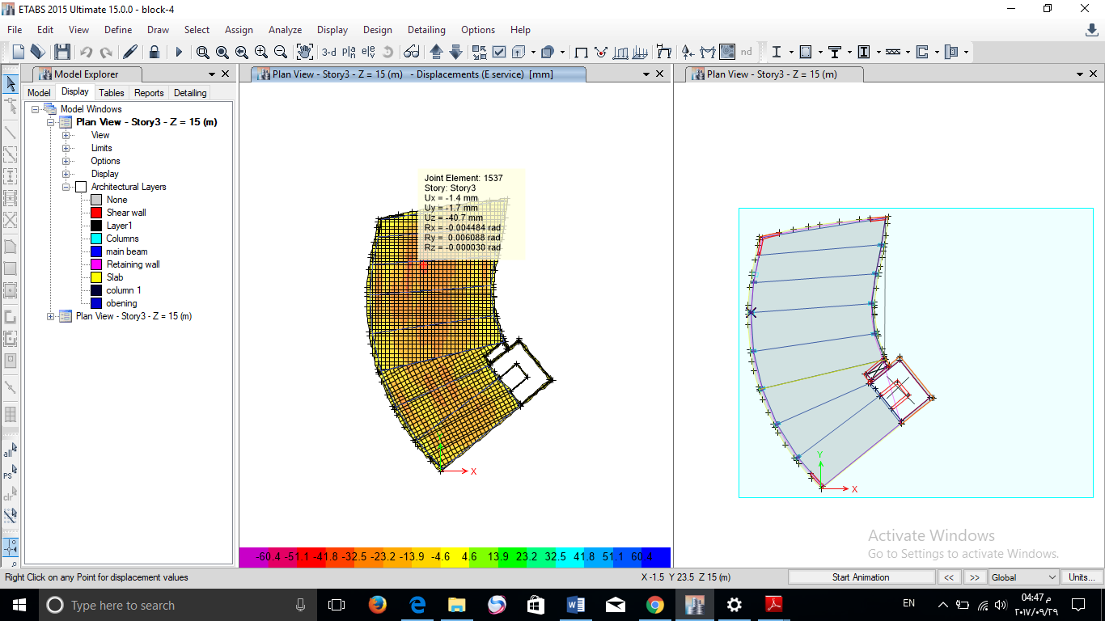
Structural Design
Deflection
Limit = 14500/240 = 60.4 mm
(According to
ACI 318-11)
37

Slide 38
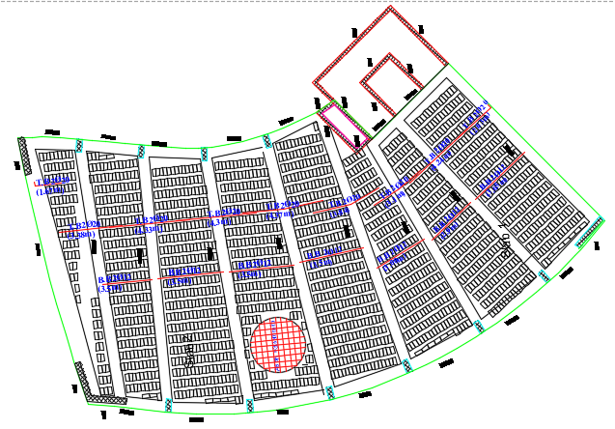
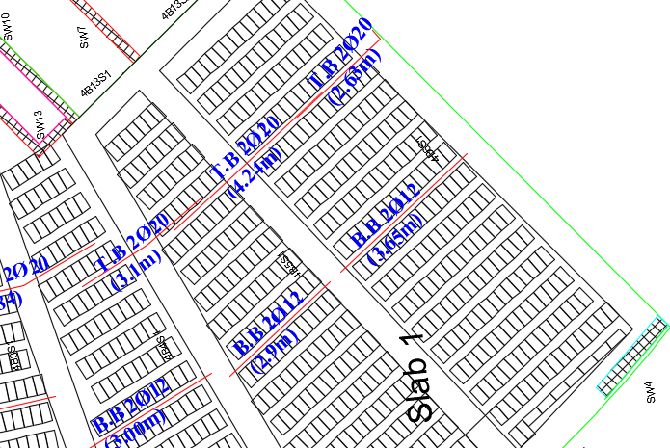
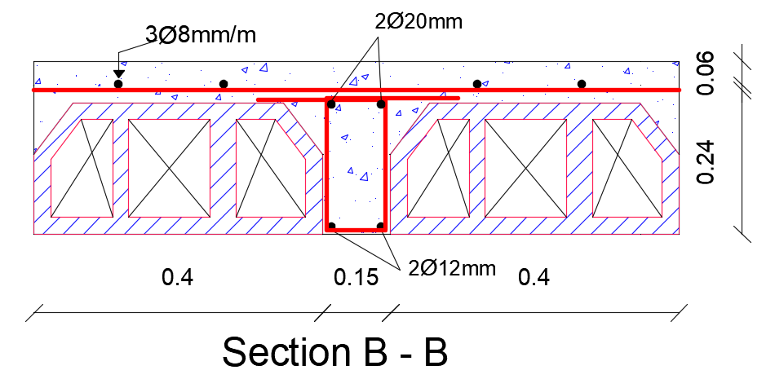
Structural Design
Slab:
one-Way Ribbed Slab
38

Slide 39
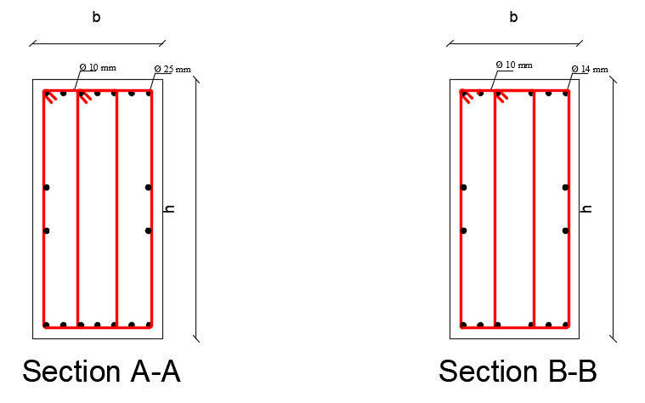
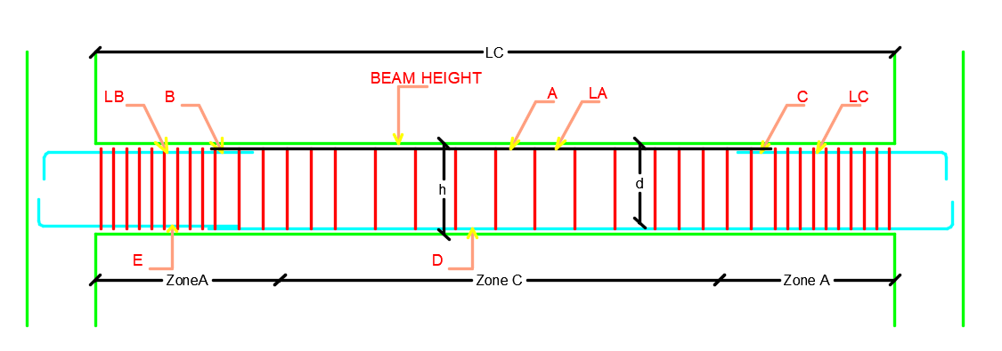
Structural Design
Beam Design
39

Slide 40
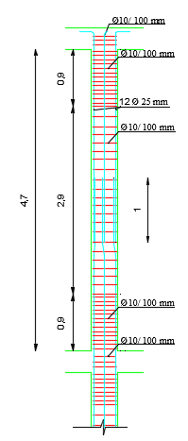
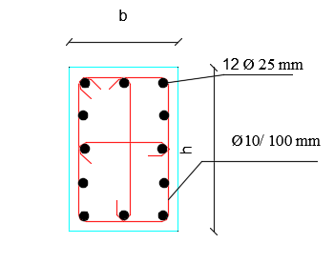
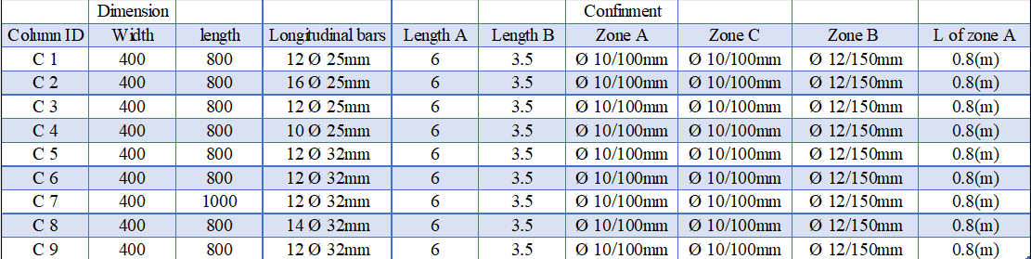
Structural Design
Column Design
40

Slide 41

Structural Design
Footing Design
41

Slide 42


Structural Design
Footing ID | B | L | AS Long. | As Trans.
1 | 3.0 | 2.1 | 9ø16 mm | 10ø16 mm
2 | 3.0 | 2.3 | 12ø16 mm | 15ø16 mm
3 | 3.0 | 2 | 9ø16 mm | 9ø16 mm
4 | 2.0 | 1.3 | 5ø16 mm | 6ø16 mm
5 | 2.0 | 1.6 | 6ø16 mm | 10ø16 mm
6 | 2.0 | 1.3 | 5ø16 mm | 6ø16 mm
7 | 1.5 | 1.4 | 4ø16 mm | 16ø16 mm
8 | 1.5 | 0.8 | 2ø16 mm | 3ø16 mm
9 | 2.0 | 1.1 | 3ø16 mm | 3ø16 mm
10 | 2.0 | 1.1 | 3ø16 mm | 3ø16 mm
11 | 2.0 | 1.2 | 4ø16 mm | 5ø16 mm
Footing Design
Section in footing (F2)
Plan of footing (F2)
42

Slide 43


Structural Design
Shear wall Design
43

Slide 44

Structural Design
Stair Design
44

Slide 45


Structural Design
Prestressed and composite beam Design
45

Slide 46
Structural Design
Cost and optimization for beams
Beam Type | Cost of material
Drop beam | 5572
Prestressed beam | 2774
Composite beam | 8236.6
The optimum design is for prestressed beam
46

Slide 47
Electrical Design
47

Slide 48



Electrical Design
Light scenes 1
Artificial lighting:
Calculation Results
All spaces: ceiling lamps are on.
Required illuminance
(500 lx)
Required uniformity
(>0.60)
Required uniformity
0.6
0.6
0.4
48

Slide 49


Electrical Design
Light scenes 1
Calculation Results
49

Slide 50





Electrical Design
Light scenes
1. Artificial lighting:
50

Slide 51


Electrical Design
Sockets and Lighting
Socket Distribution
Distribution of lighting
51

Slide 52
Mechanical Design
52

Slide 53
Mechanical Design
Water Supply
Drainage System
HVAC Design
Safety Design
53

Slide 54

Mechanical Design
Water Supply System
daily water demand for southern block = 11.84 $m^{3}$
54

Slide 55


Mechanical Design
Drainage System
55

Slide 56



Mechanical Design
Rain Water Drainage
56

Slide 57



Size storage tank.
57

Slide 58



Mechanical Design
HVAC system
VRF system
Ceiling Diffuser
(675*285*575 mm mm)
Air flow 144.76L/s
Noise level 35.8 dBA
Fan coil unit
(42 NH)
(3.7– 12.6 kW) cooling
(5.1– 17.5 kW) heating
Carrier company
Controller (Toshiba company)
35.1KW nominal cooling capacity
Out door
(Toshiba company)
(108kW) heating
(96kW) cooling
58

Slide 59


Mechanical Design
HVAC system (GF floor)
59

Slide 60



Mechanical Design
HVAC system
60

Slide 61






Mechanical Design
Safety Design
Emergency Egress System
Emergency
Fire Protection System
`
61

Slide 62
Quantity Surveying & Cost Estimation
62

Slide 63

Quantity Surveying and Cost Estimation
Total Cost for finishing and Structural Design
= 2,842,059 NIS
Total Cost for Mechanical Design = 539120.5 NIS
Total Cost for Electrical Design including elevators
= 192,948.5 NIS
Total Cost for Southern block =3,891,289 NIS (2000 NIS/$m^{2}$)
63

Slide 64

Thank You

