Slide 1

An-Najah National University
Faculty of Engineering
Communication Department
Target Tracking using Pulse Doppler Radar
Prepared by : -Bara’ Sous, Hasan Khaled, Mohammed Alawneh.
Supervisor : - Dr- Youssef dame
Mr. Jamal Kharosheh

Slide 2
Outline
Introduction .
Radar regulation and frequency band .
Doppler Radar principle .
Distance Measurements .
System Implementation .
Result .
Conclusion and future work.

Slide 3
Introduction
Radar stands for radio detection and ranging. It operates by radiating electromagnetic waves and detecting the echo returned from the targets. The nature of an echo signal provides information about the target range, Speed, direction, and velocity.
The velocity of target is determent from Doppler effect .
The range to the target is found from the time it takes for the transmitted signal to travel to the target and back.
The direction or angular position of the target is determined by the arrival angle of the returned signal. A directive antenna with a narrow beamwidth is generally used to find the direction.

Slide 4
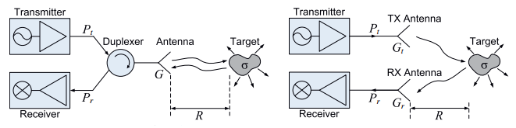
Introduction (Cont.)
Commune radar type :
Transceivers Type :
bistatic radar : two separate antennas are used for transmit and receive .
monostatic radar: the same antenna is used for these functions.
(a) Monostatic radar (b) Bistatic Radar
Signal transmit :
Pulse Wave Radar .
Continues Wave Radar .

Slide 5
Radar regulation
International Telecommunication Union (ITU).
American Institute of Aeronautics and Astronautics(AIAA).
The electronic countermeasures (ECM) .

Slide 6
Radar frequency band
Band Designation | Frequency Range | Typical Usage
VHF | 50-330 MHz | Very long-range surveillance
UHF | 300-1,000 MHz | Very long-range surveillance
L | 1-2 GHz. | Long-range surveillance, enroot traffic control
S | 2-4 GHz. | Moderate-range surveillance, terminal traffic control, long-range weather
C | 4-8 GHz. | Long-range tracking, airborne weather
X | 8-12 GHz. | Short-range tracking, missile guidance, mapping, marine radar, airborne intercept
K _{u} | 12-18 GHz. | High resolution mapping, satellite altimetry
K | 18-27 GHz. | Little used (H₂0 absorption)
K _{a} | 27-40 GHz. | Very high resolution mapping, airport surveillance
mm | 40-100+ GHz. | Experimental
Source: AIAA (American Institute of Aeronautics and Astronautics)

Slide 7
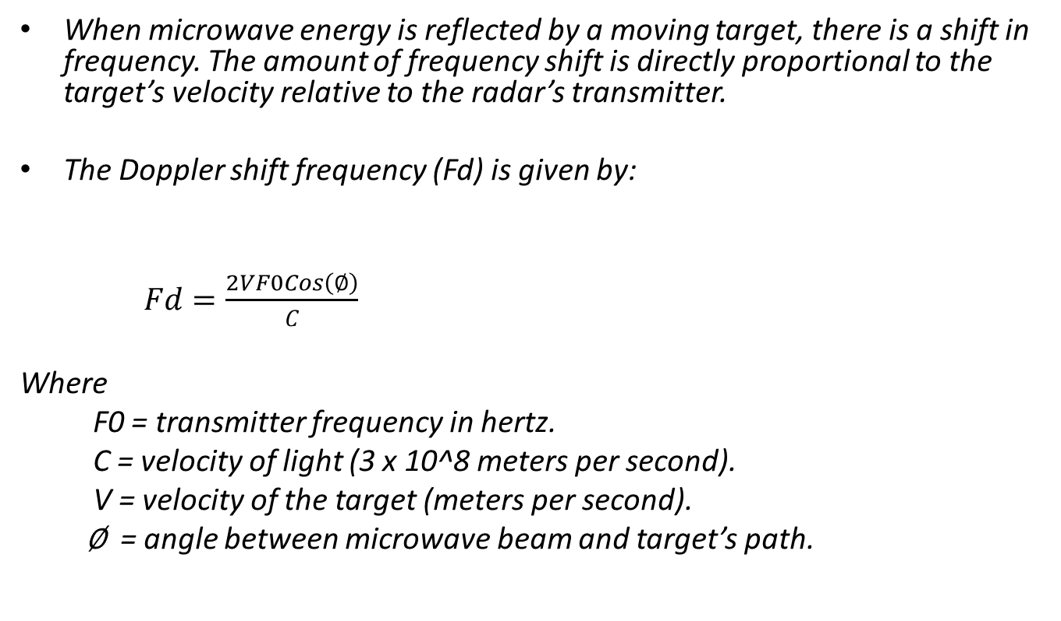
Doppler Radar principle
When microwave energy is reflected by a moving target, there is a shift in frequency. The amount of frequency shift is directly proportional to the target’s velocity relative to the radar’s transmitter.
The Doppler shift frequency (Fd) is given by:
$Fd=\frac{2VF0Cos\left(∅\right)}{C}$
Where
F0 = transmitter frequency in hertz.
C = velocity of light (3 x 10^8 meters per second).
V = velocity of the target (meters per second).
∅ = angle between microwave beam and target’s path.

Slide 8
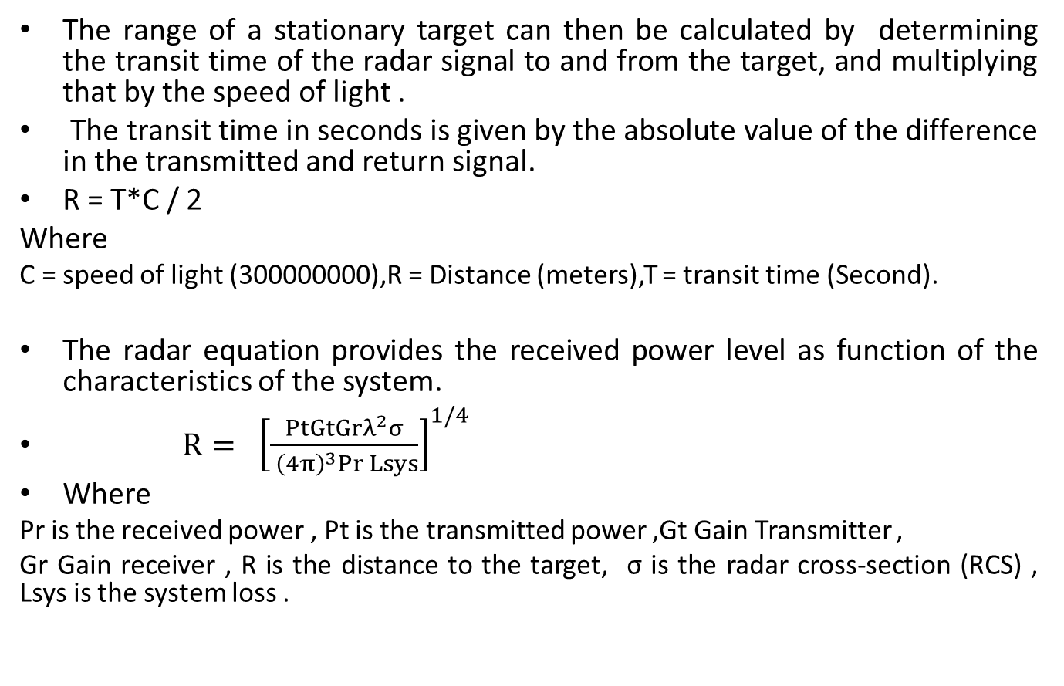
Distance Measurements
The range of a stationary target can then be calculated by determining the transit time of the radar signal to and from the target, and multiplying that by the speed of light .
The transit time in seconds is given by the absolute value of the difference in the transmitted and return signal.
R = T*C / 2
Where
C = speed of light (300000000),R = Distance (meters),T = transit time (Second).
The radar equation provides the received power level as function of the characteristics of the system.
$R{= {\left[\frac{PtGtGrλ^{2}σ}{ {\left(4π\right)}^{3}Pr Lsys}\right]}^{1/4}}$
Where
Pr is the received power , Pt is the transmitted power ,Gt Gain Transmitter ,
Gr Gain receiver , R is the distance to the target, σ is the radar cross-section (RCS) , Lsys is the system loss .

Slide 9
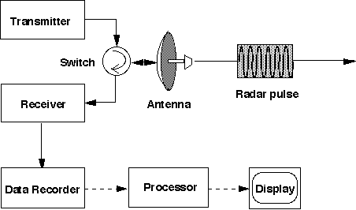
System Implementation

Slide 10
Transmitter
The transmitter task is up converting the Pulse Generator Signal frequency to high frequency at 10.526 GHz by mixing it with carrier frequency at 10.525 GHz.
The original signal is generated by the Pulse Generator at a lower frequency1MHz and then converted to a higher frequency 10.526GHz. Then the RF signal pass through a band pass filter that have a cutoff frequency range 9.5 GHz to 10.5GHz with canter frequency at 10.0GHz, and then radiate the RF signal over the antenna.

Slide 11
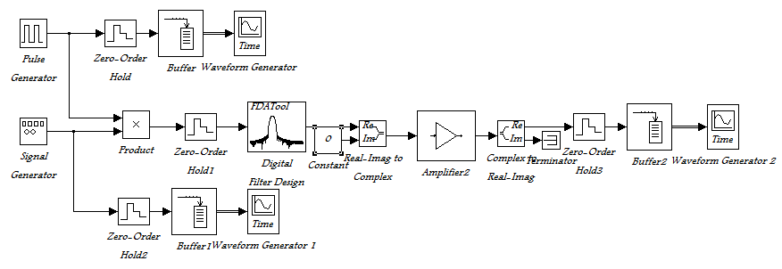
Transmitter Simulink

Slide 12
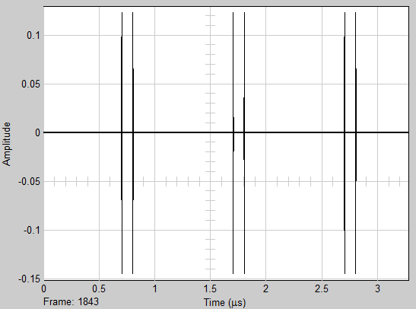
Transmit Signal in Time Domain

Slide 13
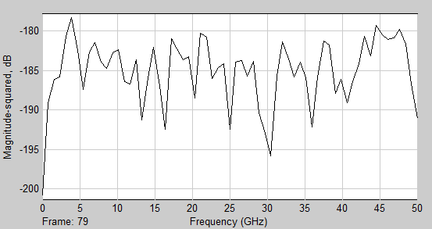
Transmit Signal in Frequency Domain

Slide 14
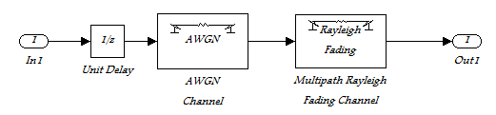
Channel Simulink
The wave propagate in free space , so a lot of effects appear on the signal such as frequency fading(frequency shift due to wave propagation, ignore compare with Doppler frequency), multipath, delay, dispersion and attenuation .but the free space loss is a dominant factor on the channel characteristic , so can ignore anther types off loss .

Slide 15
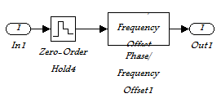
Target Simulink
Wave propagates in free space then intercepted by target, this change in wave characteristics. frequency of signal dependent on the target motion. and power dependent on the distance of target.

Slide 16
Receiver
The task of the receiver is pick up the reflected signal (echo) from the target then down convert it by mixing it with the Pulse Generator signal and the carrier, now the mixer output signal frequency at low frequency represent the Doppler shift frequency that concern us and another one at high frequency, which was rejected.
To select the Doppler frequency, the down-converted signal was passed through a low pass filter (LPF) at cutoff frequency at few kilo Hertz, then we can make some processing on the Doppler frequency to calculate the Range and speed of the target.

Slide 17
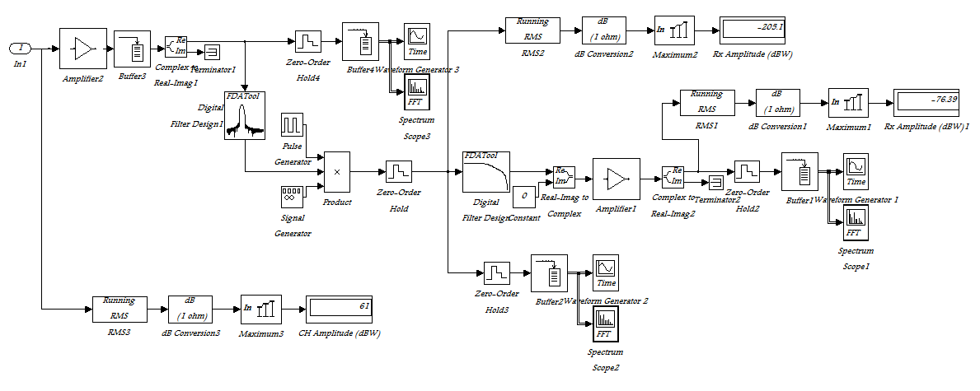
Receiver Simulink

Slide 18
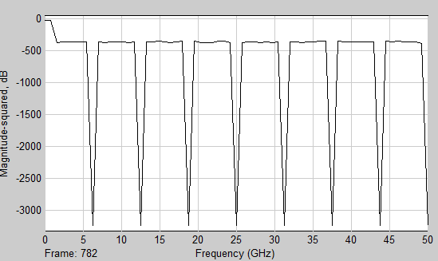
Receive Signal in Frequency domain

Slide 19
Result
Pulse Doppler radar transmitter produce Radio Frequency (RF) signal , and sent it through the media to sense surrounding environment and estimate target information such as velocity and distance. transmit wave operate at canter frequency at 10.525 GHz, on the other hand system produce thermal noise around 3 dB, but in worst case scenario the system keep the C/N as max as possible around 10 dB .
Receiver estimate the echo signal (wave produce due to reflection and scattering wave from the target) .and estimate the change of frequency (Doppler frequency) to predict the target speed . Moreover estimate max power receiver and time duration between transmit and receive pulse to predict the target distance as show in the figure (30).

Slide 20
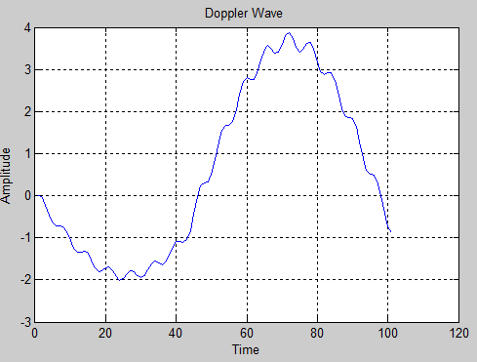
Doppler Wave in Time Domain
Doppler wave after. to predict the target motion (target velocity).

Slide 21
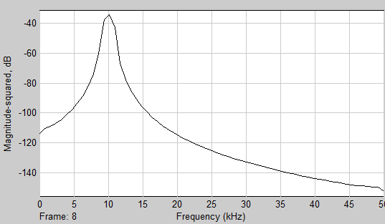
Doppler Wave in Frequency Domain
The Doppler frequency appear at 10KHz, and this frequency used to calculate the motion velocity and the Range.

Slide 22
Result (Cont.)
Deferent Measurements of power ,Doppler Frequency ,Distance and transmit time .
Distance (Meter ) | Transmit Time (MS) | Velocity (M/S) | Doppler Frequency (Hz) | Receive Power (dBm)
1 | 0.0067 | 19.8 | 1410 | 45
10 | 0.067 | 19.6 | 1450 | 30
20 | 0.13 | 20.4 | 1440 | 15
30 | 0.2 | 20.9 | 1145 | -15
To increase receiver sensitivity make the system operate in high C/N ratio (near 10 dB) .
This result true when angel of arrival small ( AoA <= 15)

Slide 23
Conclusion
This project use pulse Doppler radar system to determine the velocity and distance of target, the velocity dependent on the Doppler effect (frequency change due to target motion ),and distance dependent on the power receive .
The main component of the system is a filter (determine the system selectivity), and amplifiers (determine the system sensitivity).
This system operate in X-band frequency (10.525 GHz) because this band is high munity for noes and losses.

Slide 24
Future work
The second steps of this project try to implement the radar system as hardware using HB 100 module. And determine the target information (Velocity, Distance, Angel of Arrival, and Direction of motion).
The final hopes try to connect radar system with WEP to determine location of target, and determine the environment Probabilities.

Slide 25
Thank You
Any Question

