Slide 1

Engineering Faculty – Department of Civil Engineering
Graduation Project II
Causes of Delay in Construction Projects in Palestine.
Presented by:
Ismail Rami Alkhatib.
Nadeen Zughaier.
Ahmad Ali Abu Zuhri.
Under the supervision of Dr. Nabil Dmaidi

Slide 2
Outline
1
Introduction and Problem Statement.
2
Objectives.
3
Success Factors for Construction Projects.
4
Types, Causes, and Effects of Delay.
5
Methodology.
6
Data Analysis and Discussion.
7
Recommendations.

Slide 3
Introduction
11.1 %
Fair and enough management
Several problems affecting the construction industry
Additional Time and Cost

Slide 4


Problem Statement

Slide 5
Objectives
1
Identification of main factors causing delay.
2
Applicable Solutions.

Slide 6


Success Factors for Construction Projects
OUR FOCUS

Slide 7
Types of Delay
Critical delay
Excusable
Non-Compensable
Compensable
Non-Excusable
Non-Compensable

Slide 8
Causes of Delay
Client Related Delay
Contractor Related Delay
Consultant Related Delay
Labor Related Delay
Equipment Related Delay
Material Related Delay

Slide 9
Effects of Delay
Effects of Delay
Time Overrun
Cost Overrun
Dispute
Total Abandonment
Arbitration
Litigation

Slide 10
Methodology
Literature Review
Questionnaire Design and Distribution
Data Analysis and Results
Conclusion and Recommendations
Project Introduction and Objectives

Slide 11
Sample Size
Nablus
90
Ramallah
95

Slide 12
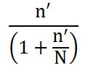
Sample Size =
S.S = 65
75

Slide 13
The sample size for each governorate has calculated using a weighted average.
Governorate | Sample size
Nablus | 37
Ramallah | 38

Slide 14
Questionnaire Content
Possible Causes of Delay
Proposed Actions
General Information

Slide 15
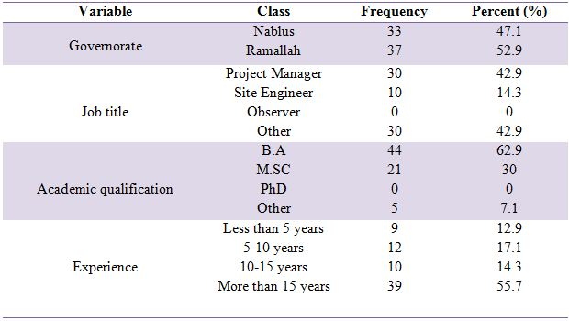
Data Analysis
Respondent Characteristics Analysis:

Slide 18
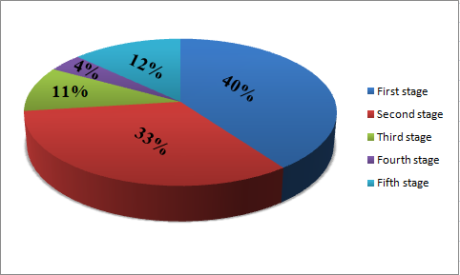
Companies Classification

Slide 19

Relative Importance Index (RII):
RII =
Where:
RII: relative importance index
Pi: respondent’s rating of the item
Ui: number of respondents placing an identical rating on the item
N: sample size

Slide 20
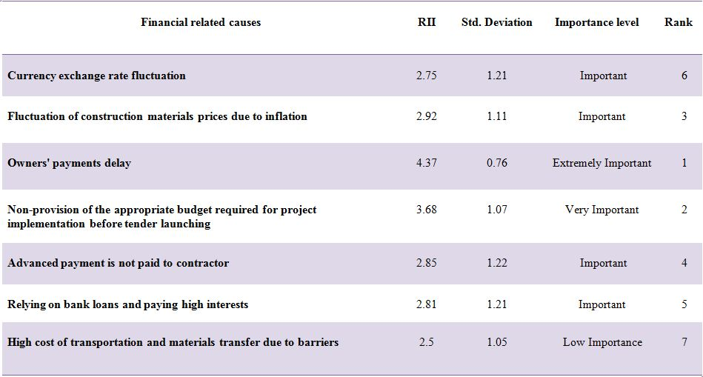
Analysis of Financial Related Causes:

Slide 21
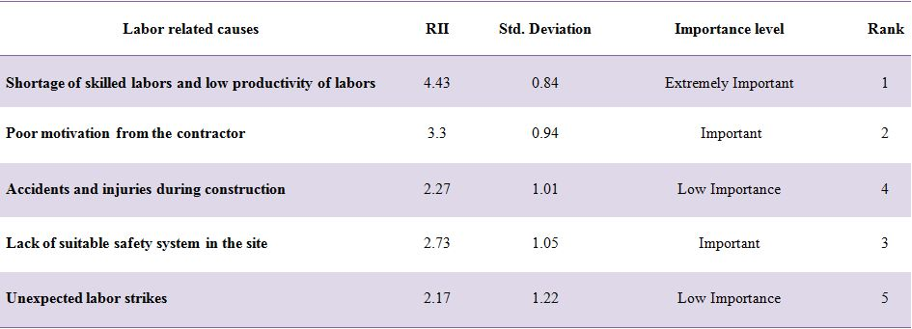
Analysis of Labor Related Causes:

Slide 22
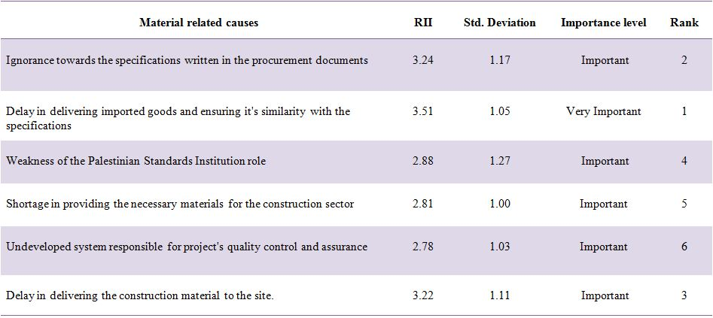
Analysis of Material Related Causes:

Slide 23
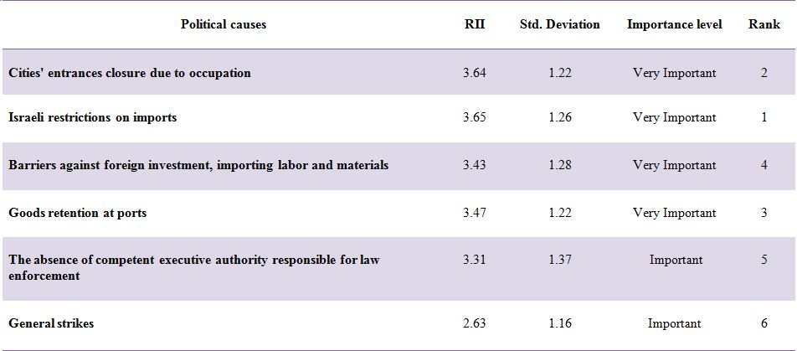
Analysis of Political Causes:

Slide 24
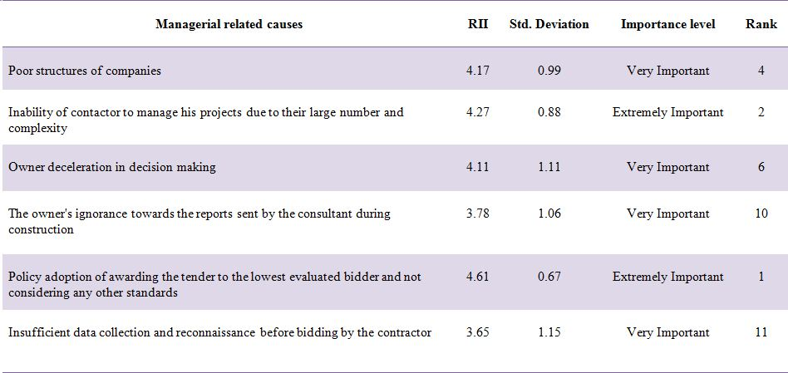
Analysis of Managerial Related Causes:

Slide 25
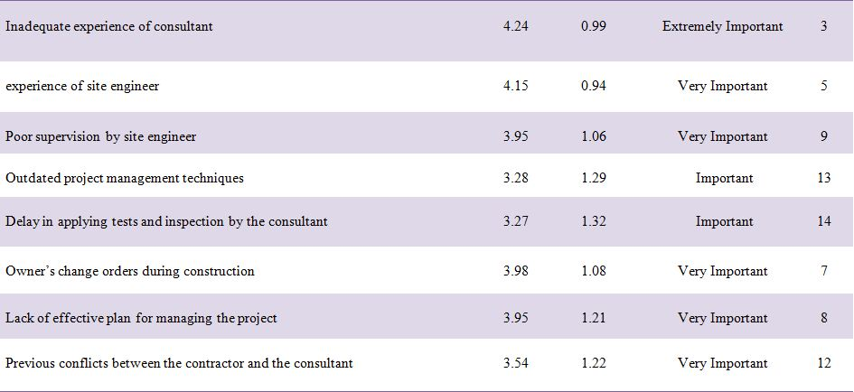

Slide 26
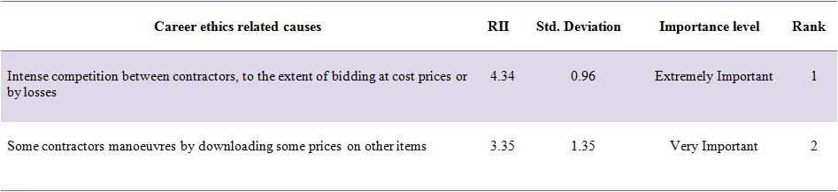
Analysis of Career Ethics Related Causes:

Slide 27
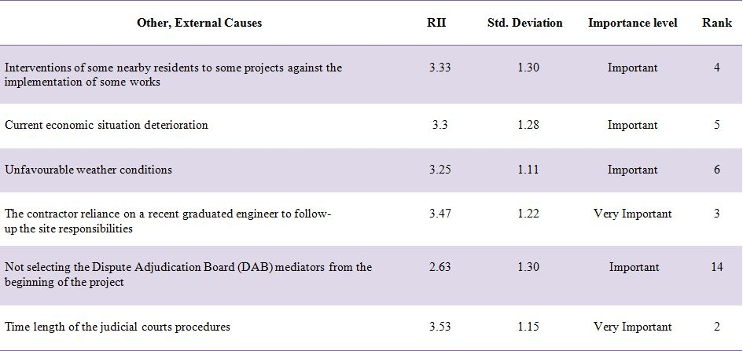
Analysis of other Causes:

Slide 28
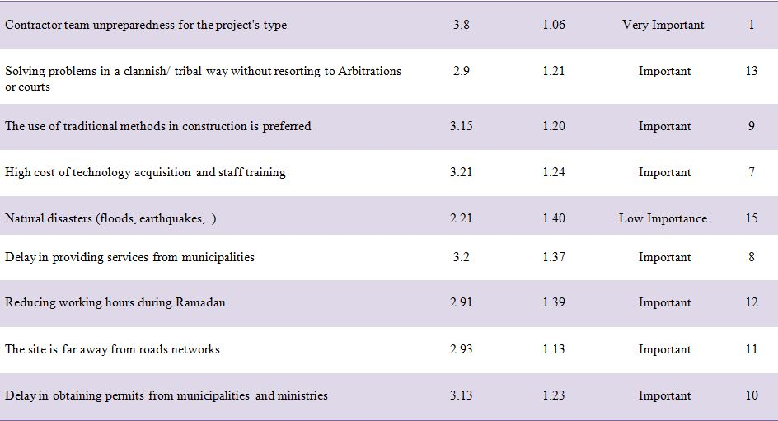

Slide 29
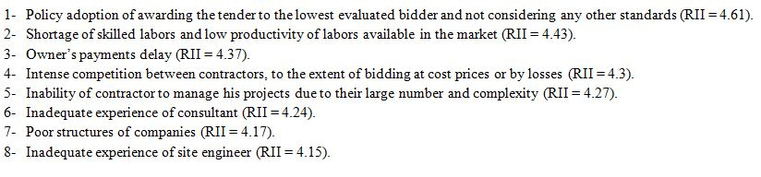
the main eight causes of delay in construction projects are:

Slide 30
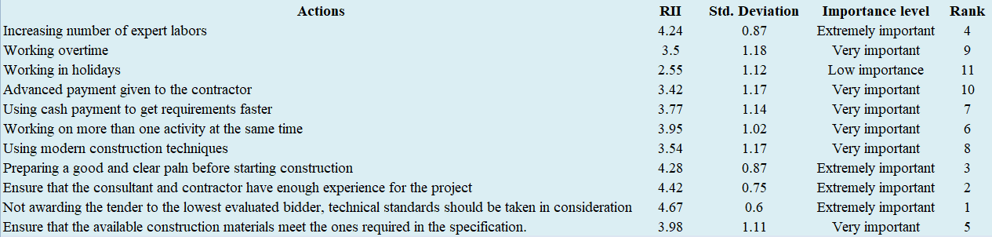
Analysis of Possible Actions:

Slide 31
Recommendations:
Policy adoption of awarding the tender to the lowest evaluated bidder and not considering any other standards:
40% Technical, 60% Financial
2nd High Lower Price
Design-Build Delivery System

Slide 32
Shortage of skilled labor and low productivity of labor:
Increase Wages
Modern Equipments
Training Centers

Slide 33
Owner’s Payment Delay:
Estimated Study
Separate Account for Each Project
Forecasting the Cost, and Cash Flow Diagram
Developing of a simple payment system away from bureaucracy

Slide 34
Intense competition between contractors to the extent of bidding at cost prices or by loss:
Bid in Convenient Prices

Slide 35
Inability of contractor to manage his projects due to their large number and complexity:
Charts
Cost and Quality Control
keep track of the implemented system

Slide 36
Inadequate experience of consultants:
Good Understanding
Decision Making
Adequate Knowledge

Slide 37
Poor structure of companies:
Defining the Required Number of Directing Staff
Defining the Required Number of Technical Staff
Updating and Developing the Equipments Required

Slide 38
Inadequate experience of contractor:
Continuous Educating
Training the Staff

Slide 39


