Slide 1
Thermomechanical Properties of Polymer Matrix composites Based on Cellulose Reinforcements Derived from Biomass
Prepared by:
Bayan Dardouk
Deema Haj-Ahmad
Heyam Walwel
Mohamad Sawalha
Supervisors:
Dr. Shadi Sawalha
Dr. Raed Ma’ali

Slide 2
OUTLINE
Problem
Objective
Definition of Cellulose
Definition of Composite
Literature view
Methodology
Composite characterization
Results
Conclusion
Recommendation

Slide 3
PROBLEM
As known, agriculture produces significant amounts of wastes such as olive waste, wood and agricultural straws, which contain high quantities of organic matter. The agricultural wastes are causing pollution problems specially when they are burned or thrown in landfills.

Slide 4
OBJECTIVES
To extract cellulose fibers or particles from different sources such as olive industry solid waste, agricultural straws (Corn straw) and wood.
To use the extracted cellulose as reinforcement for polyethylene matrix to produce composites.
To investigate the thermal and mechanical properties of the produced composites.

Slide 5
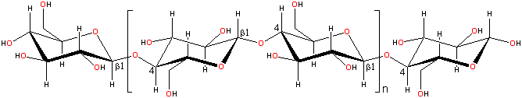
CELLULOSE
Cellulose is a polysaccharide polymer consisting of tens to hundreds to several thousands of the repeating unit anhydroglucose. It is a biopolymer composed of ß-D-glucopyranose units linked together by (1–4)-glycosidic bonds.

Slide 6
COMPOSITE
Two or more distinct materials that do not lose their individual identities but still impart their properties to the product resulting from their combination.
Composite materials consist of two main components:
1- Matrix
2- Reinforcement

Slide 7
LITERATURE VIEW
Hamed et. al. (2013) and Thaib. Sh (2015) extracted cellulose from olive industry solid waste (OISW).
Hattab. R (2016), extracted cellulose powder from Argania Sponia (Stems and seeds) Trees.
F Yan Yan et al (2009), used liquid phase oxidation to extract cellulose from palm kernel cake to separate hemi-cellulose, cellulose and lignin.
J. Mora´n et al (2008), extracted cellulose from sisal fibers.
Graupner. N (2009), studied the mechanical properties of natural and man-made cellulose fiber-reinforced poly(lactic acid) (PLA)

Slide 8
METHODOLEGY
A) Cellulose extraction
Extracting cellulose from wood
Extracting cellulose from agricultural wastes (Corn straw)
Extraction cellulose from olive industry solid waste (OISW)
B) Composite production

Slide 9
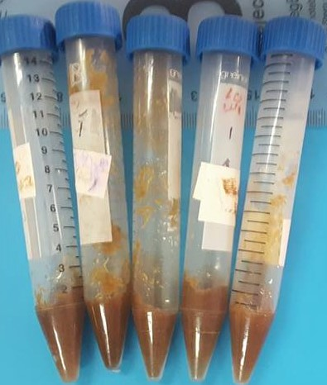
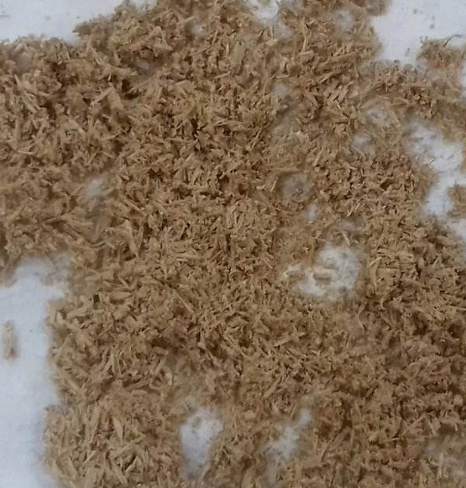
EXTRACTION CELLULOSE FROM WOOD (MODIFIDE DIGLYME-HCL METHOD)
Samples (0.15--0.25 g) of oven-dried (105 °C) ground wood
Two ml of diglyme and 0.5 ml of 10 M HCl was added to each vial and shake for 1 hour in a water bath at 90 °C
Gravity filtration, About 20 ml of methanol was used to rinse the vials and wash the residue on the filter paper

Slide 10
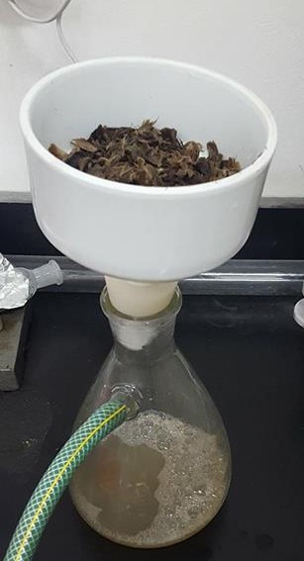
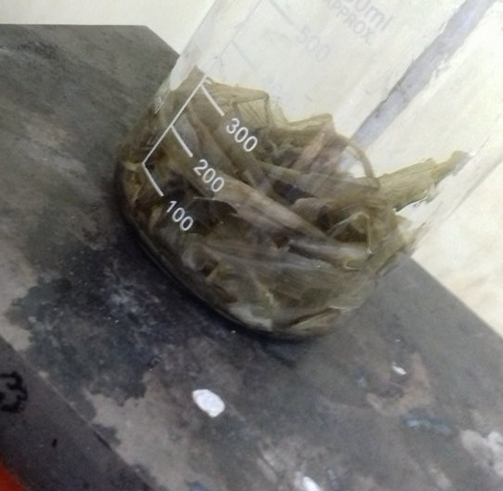
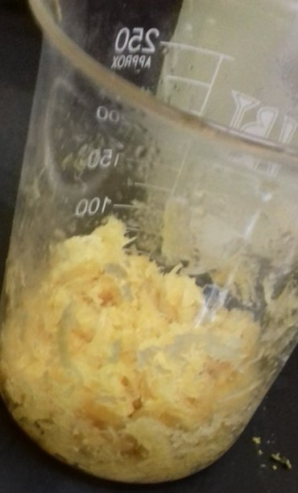
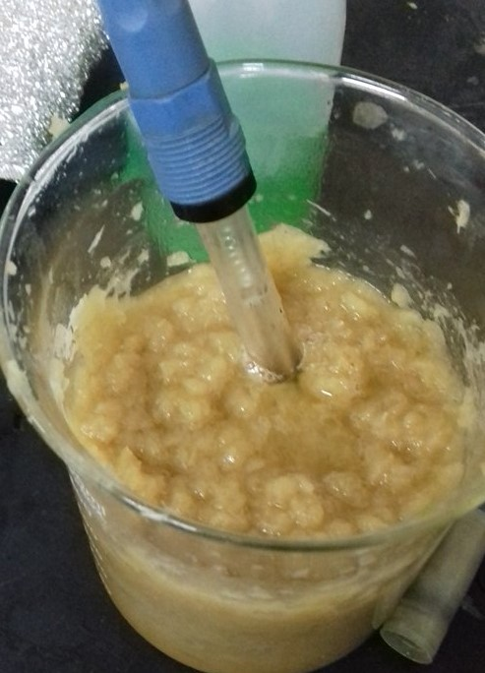
EXTRACTING CELLULOSE FROM AGRICULTURAL WASTE
The corn stalks were refluxed with formic acid on a hot plate for 15 min .
The fibers were filtered in a Buchner funnel and washed with fresh formic acid, followed by hot distilled water.
Bleaching experiments were carried out at 10% pulp concentration. pH was adjusted to 11, by adding the required amount of sodium hydroxide (NaOH).
The formic acid treated mass was further delignified with peroxyformic acid (PFA), at 80 °C.

Slide 11
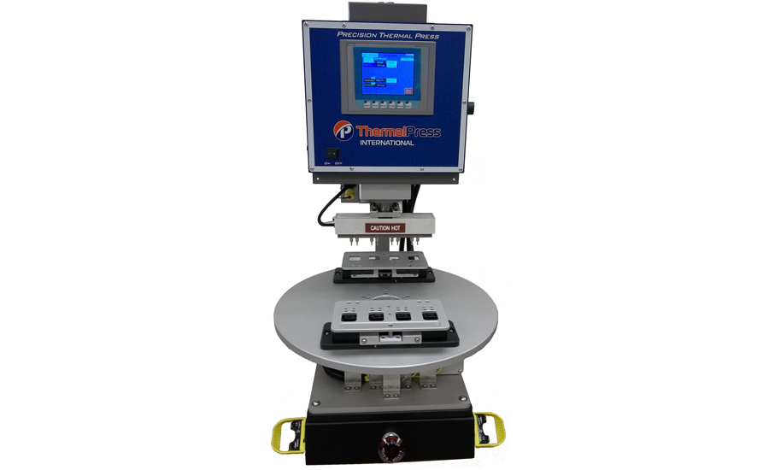
COMPOSITE PREPARATION
Thermal press
At 130 °C for 10 min

Slide 12
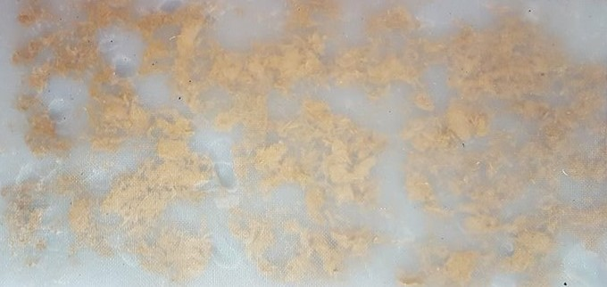
COMPOSITE PREPARATION
Composite preparation by thermal press

Slide 13
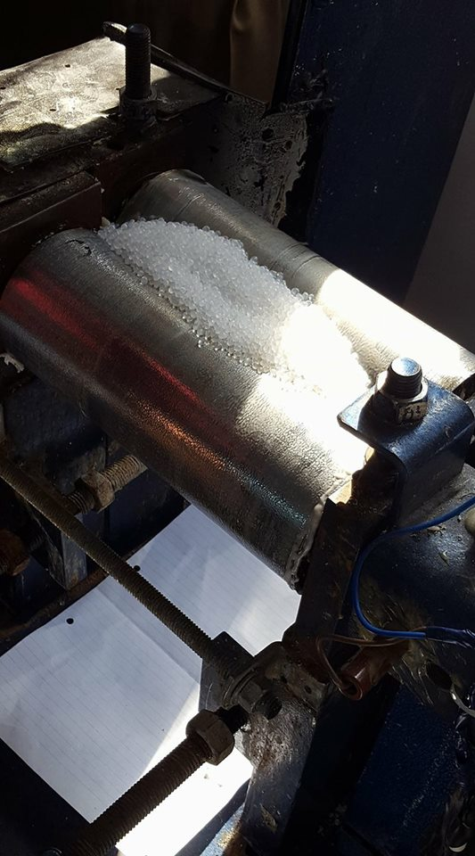
COMPOSITE PREPARATION
Two-Roll mill
140°C for 5 min
Mixing for 1 min

Slide 14

COMPOSITE PREPARATION
Composites were prepared by mixing the cellulose with the LDPE in a two-roller mills
The mixture was produced in a thermal press mold.
The reinforcement (cellulose) was added in different composition (2.5% to 10% v/v) and prepared at a temperature of (130ºC).

Slide 15
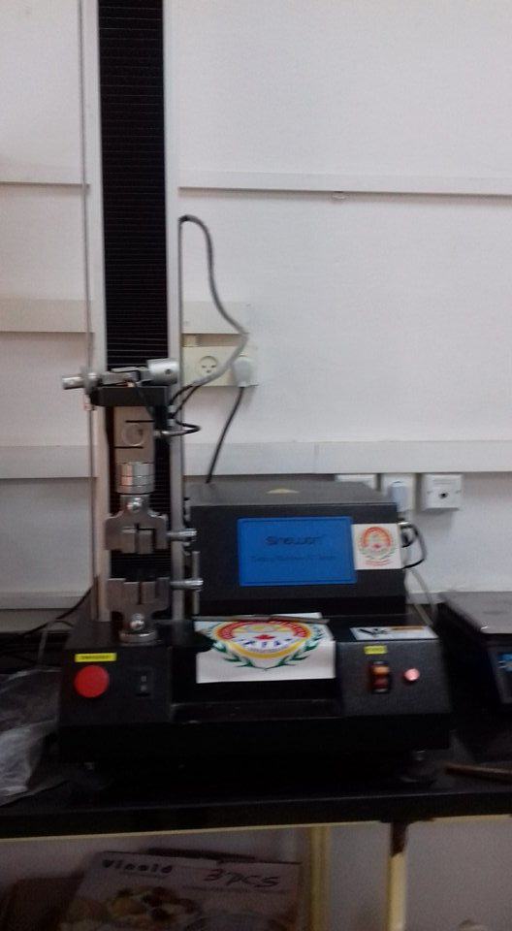
COMPOSITE TESTING
Tensile test: For estimating strength, modulus and ductility by using Universal Testing Machine (UTM) ST Series.
Strain rate : 4 mm/min
Sheet dimensions
70x20x3 mm

Slide 16
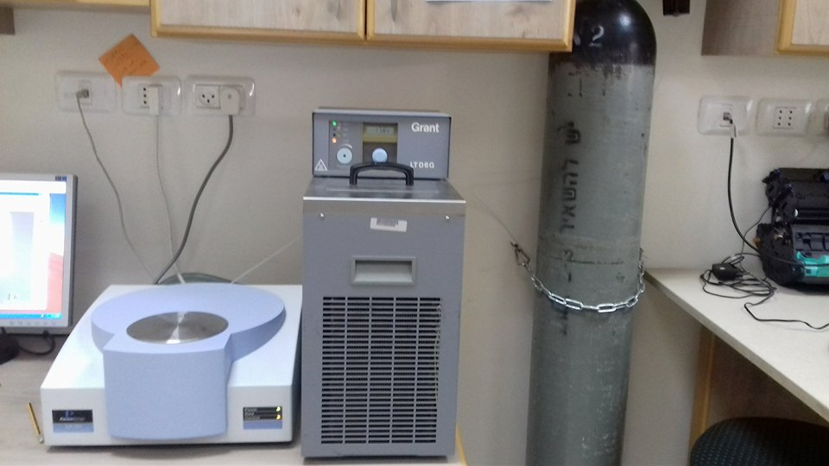
COMPOSITE TESTING
Thermal test: For estimating melting tempreture Tm and crystallinity by using Differential Scanning Calorimeter (Jade DSC).
5-8 mg sample
10°C/min
20 – 200 °C

Slide 17
RESULTS
Mechanical Properties
1- LDPE + Cellulose powder extracted from olive industrial solid waste (OISW)
Ps: small size, fine powder. Poor mixing, agglomeration.

Slide 18
RESULTS
2- LDPE + Cellulose fiber extracted from corn stalks
Fiber volume fraction < Critical fiber volume fraction
Fiber length < Fiber critical length
Poor mixing

Slide 19
RESULTS
3- LDPE + Cellulose powder extracted from wood
Large size powder
Good mixing

Slide 20
RESULTS
4- LDPE-g-MA + Cellulose powder extracted from wood
Low volume fraction
Good mixing

Slide 21
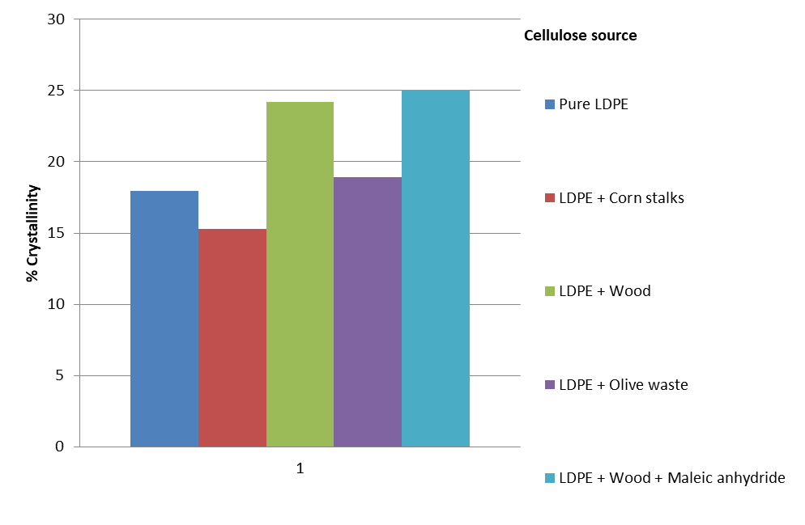
RESULTS
Thermal Properties
The figures below show the results from the differential scanning calorimeter (DSC) for each composite using different reinforcement(cellulose) source:

Slide 22
COUNCLUSION
Cellulose reinforcements were extracted from agricultural waste ( corn stalks) and wood.
Composites were prepared by mixing the cellulose with the LDPE in two-roller mills and then the mixture was produced in a thermal press mold.
The effect of composition on the mechanical and thermal properties was studied by using universal testing machine (UTM) and differential scanning calorimeter (DSC).
The mechanical properties of the produced composites using LDPE and cellulose fibers extracted from corn stalks and OISW at different composition show that the strength of the produced composite decreased by adding cellulose.
The mechanical properties of LDPE and cellulose powder extracted from wood and the wood with the addition of maleic anhydride indicate that the strength of the produced composites increased.
The thermal properties of the composite which contains LDPE and cellulose that was extracted from wood with the addition of maleic anhydride had the highest melting point (112.06°C) and the highest percentage of crystallinity (25%).

Slide 23
RECOMMENDATIONS
Use extruder or internal mixer to produce composites.
Use treatment reinforcement for example alkaline treatment with LDP-g-EMA high content to have better mechanical properties of the composite.
In the case of cellulose powder extracted from wood increase cellulose content more than 10% v/v to have better properties.

Slide 24
Thank You ☺

