Slide 1
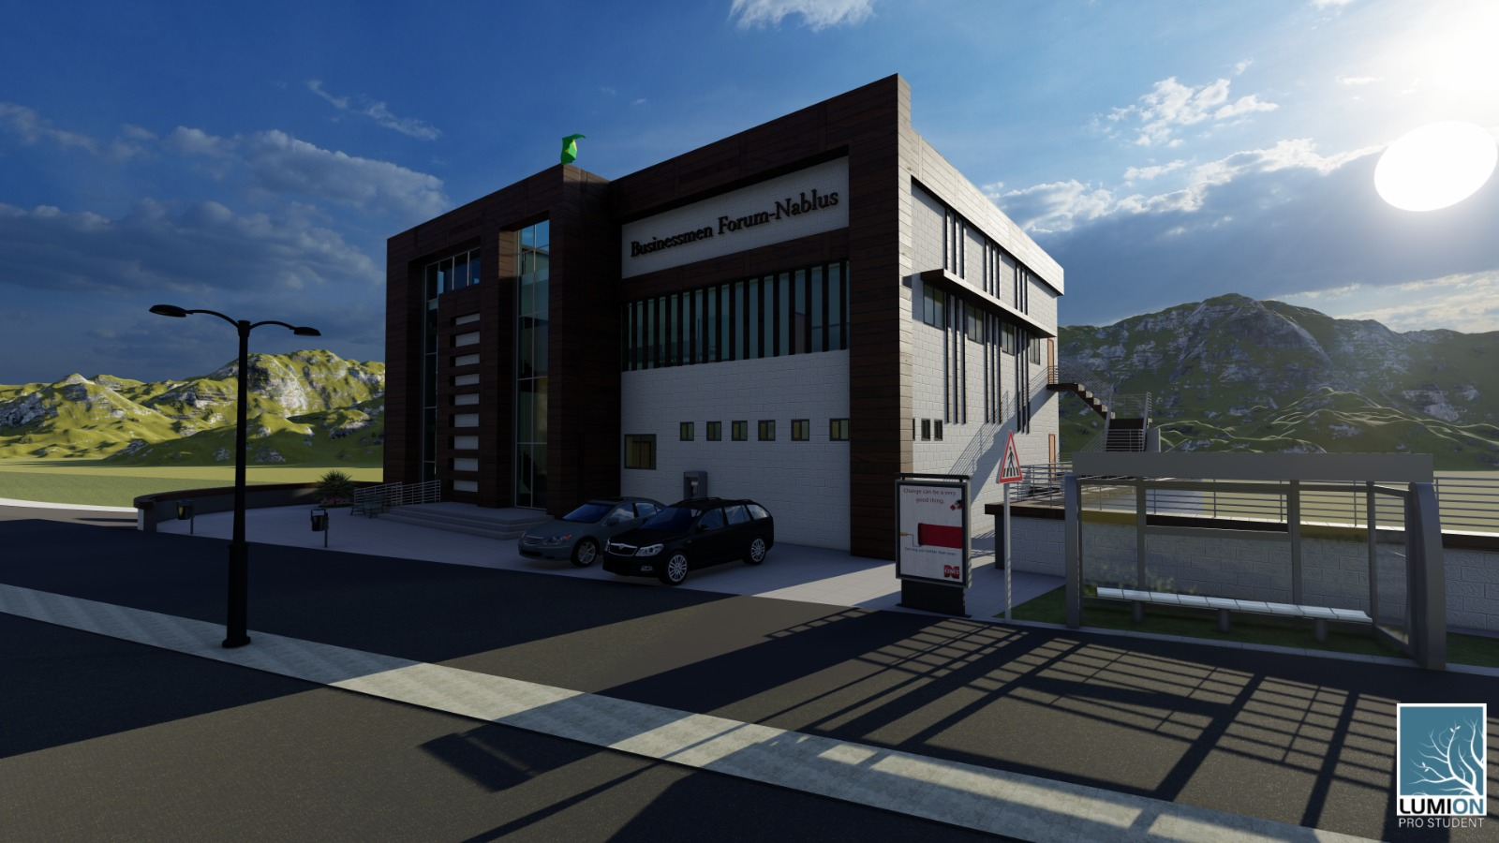
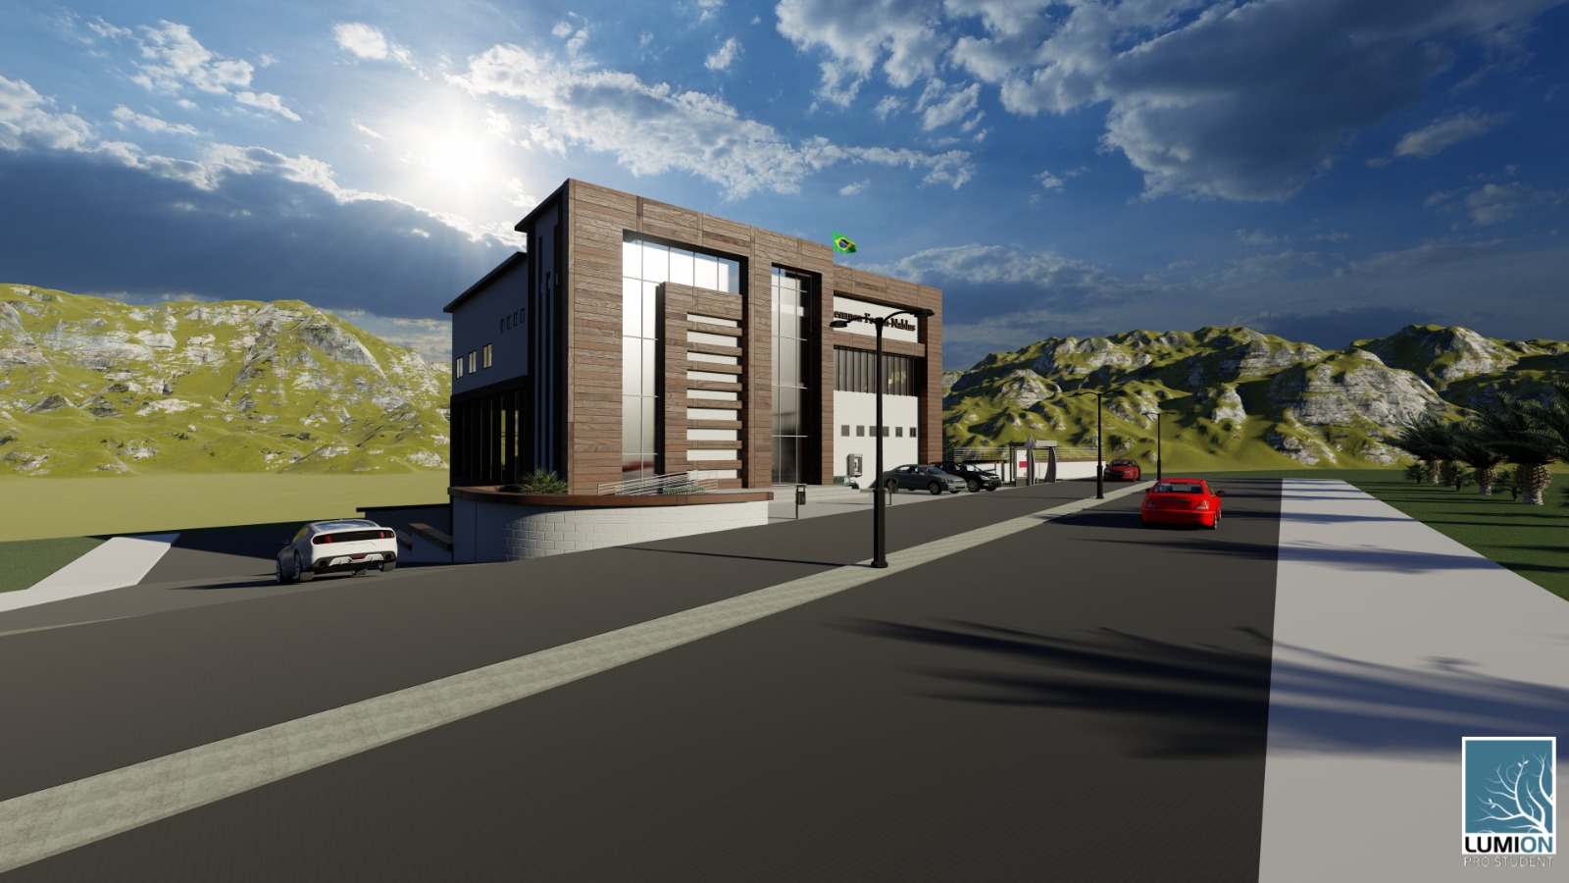

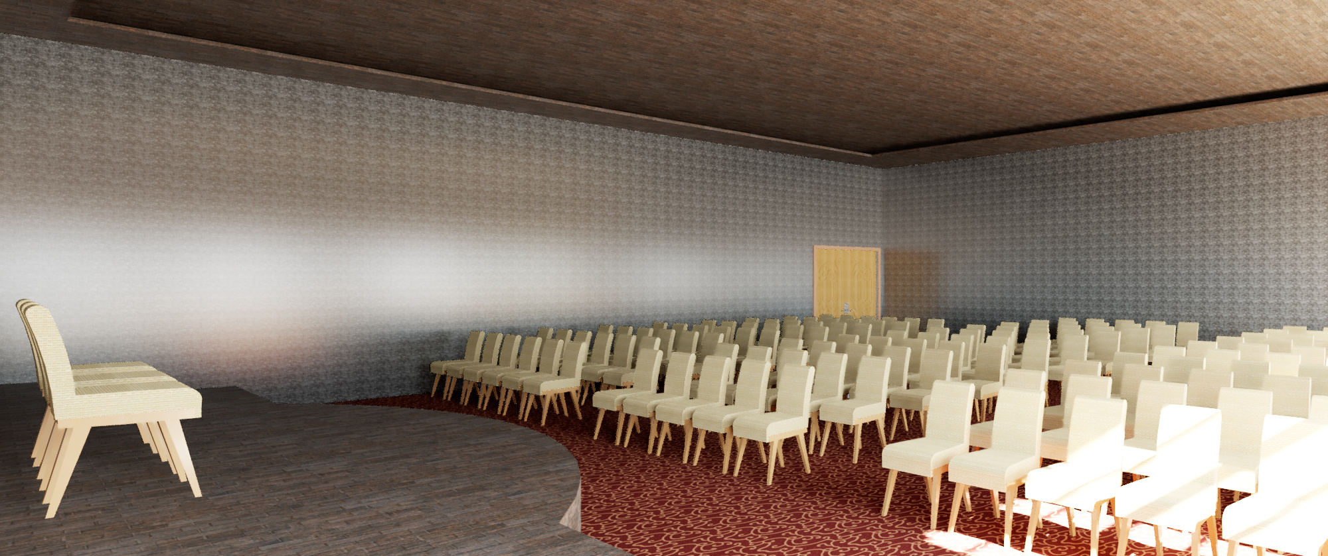
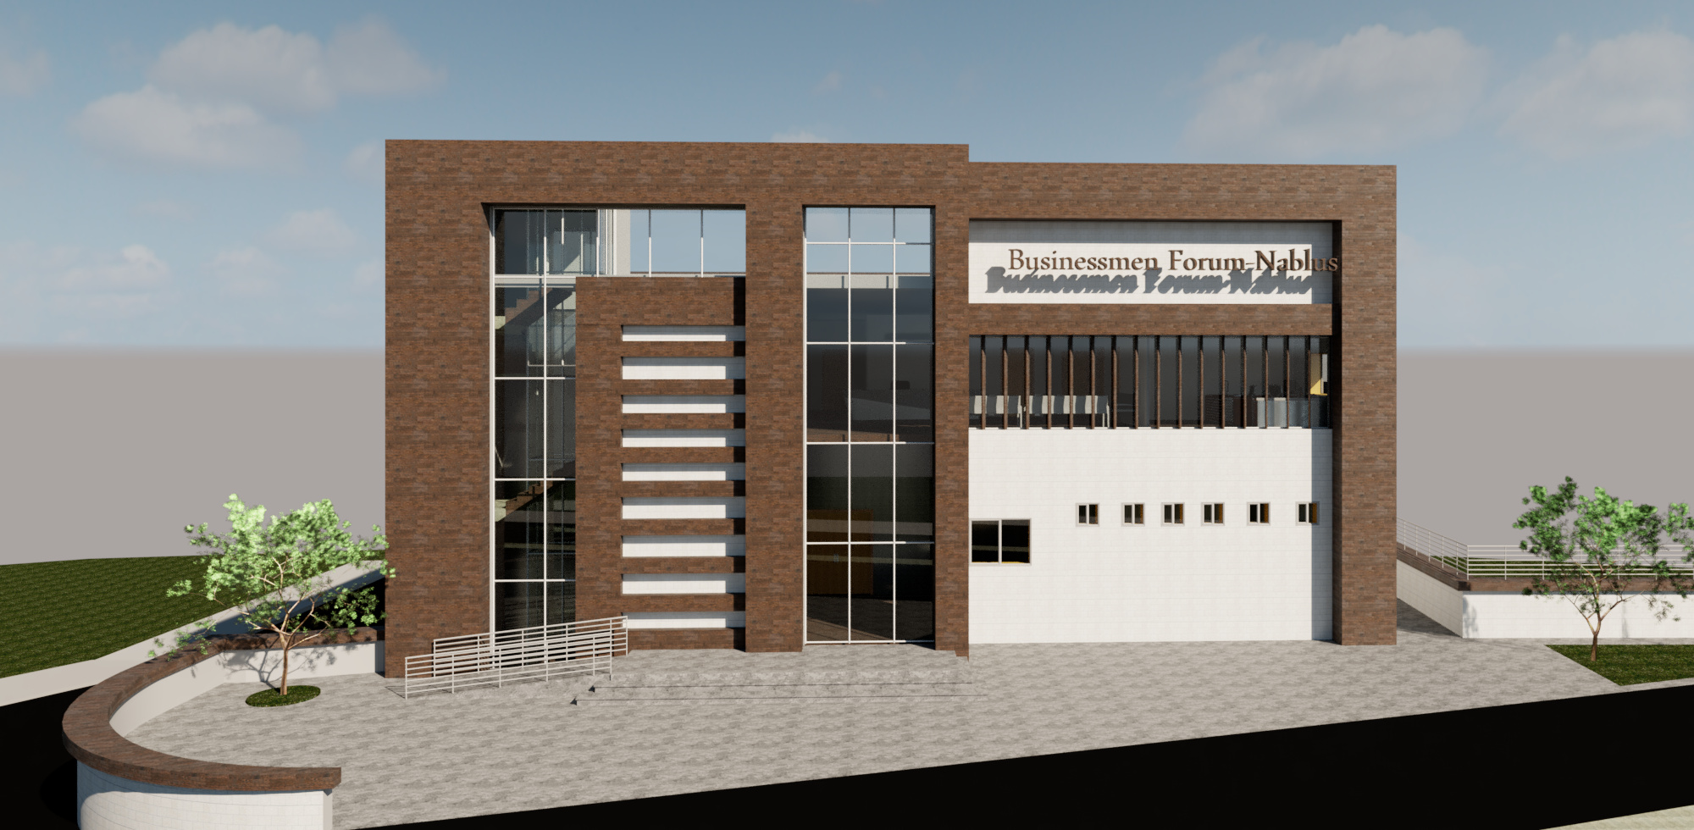
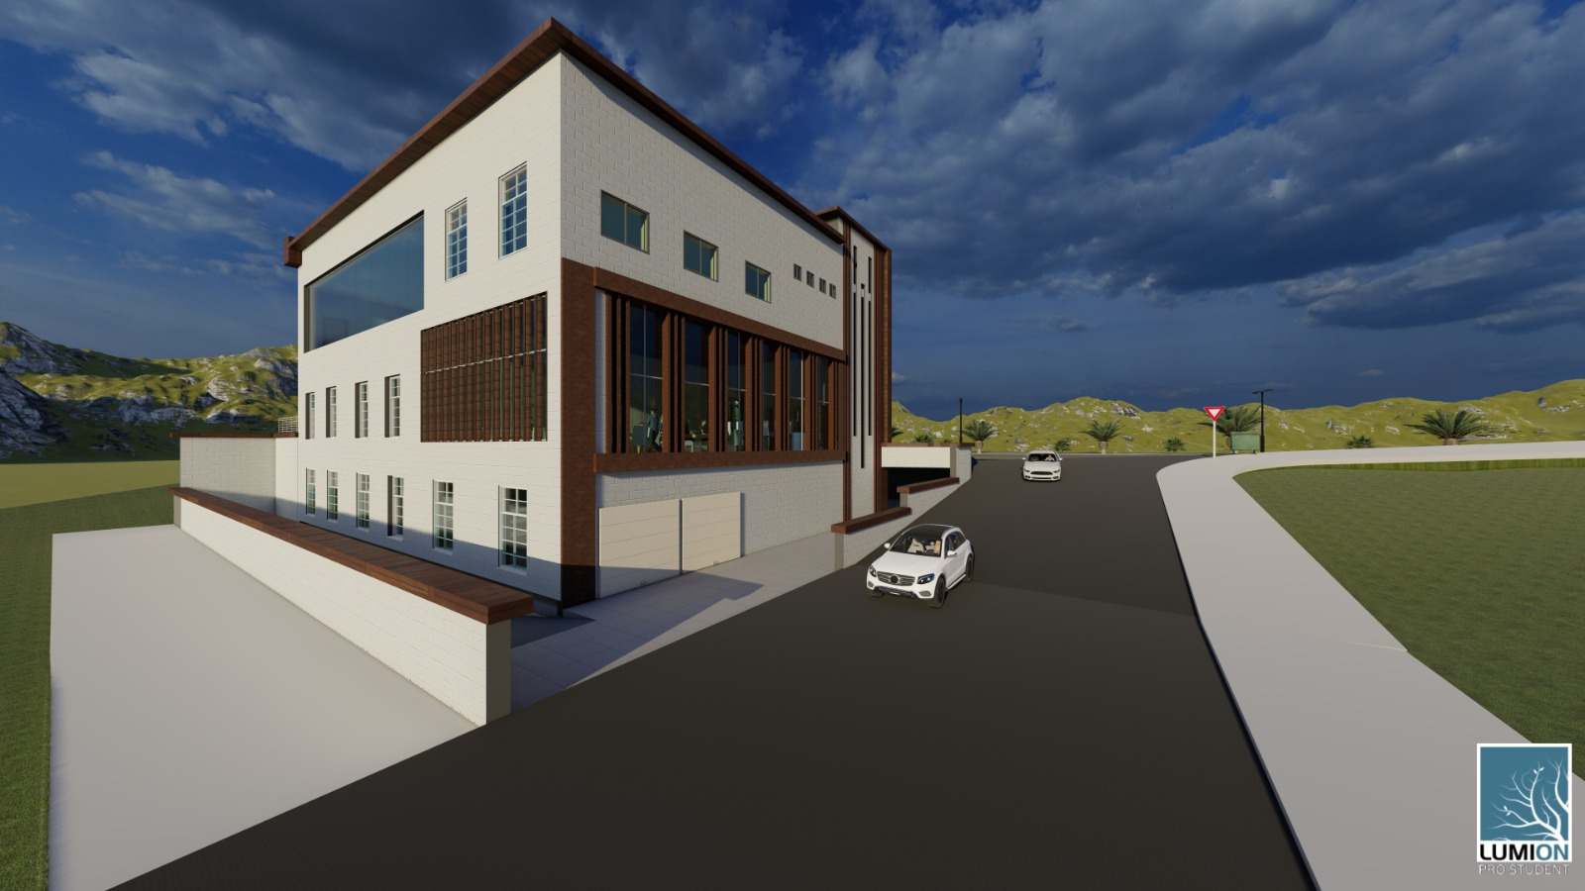
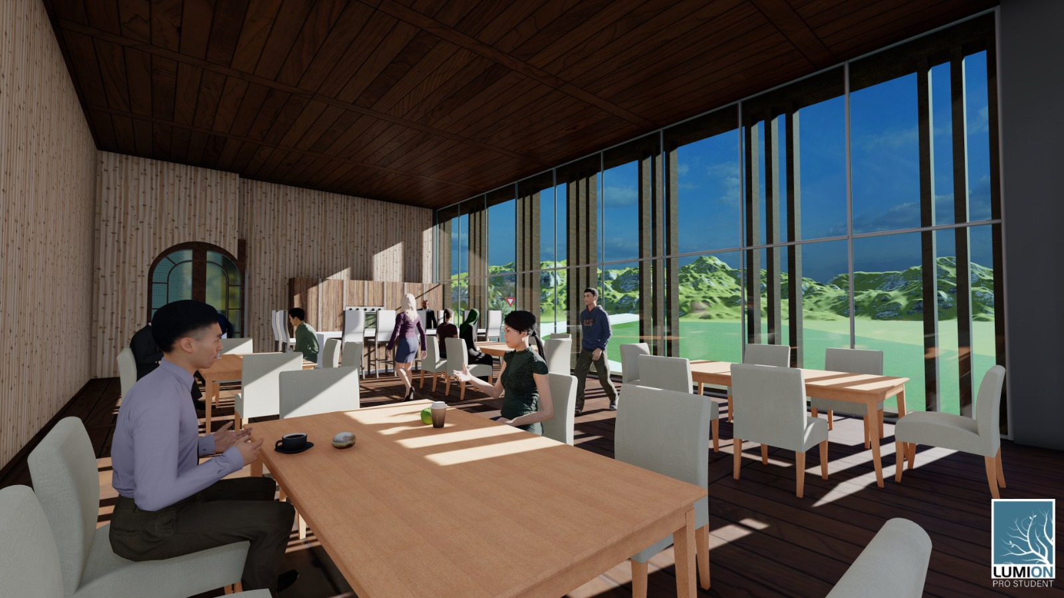
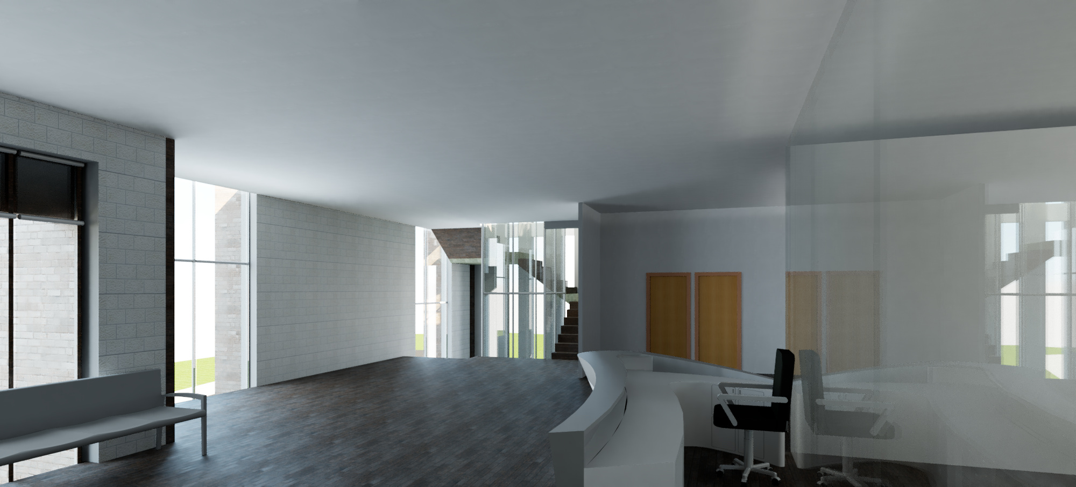
An-Najah National University
Building Engineering Department
Graduation Project – II (10611591)
Re-Design of the Businessmen Forum Building
Submitted By:
Ameed “ Qasem Suliman ”
Abrar Sweileh
Supervisor Name:
Dr. Luay Dwaikat
2019-2020

Slide 2
Contents
Introduction
Site Analysis
Architectural aspects
Environmental aspects
Structural aspects
Electro mechanic aspects
Cost Estimation
Conclusion

Slide 3
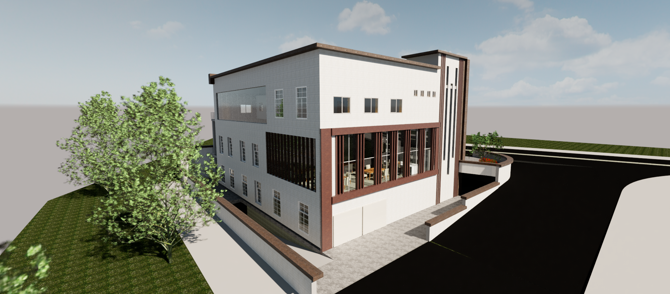
Introduction

Slide 4
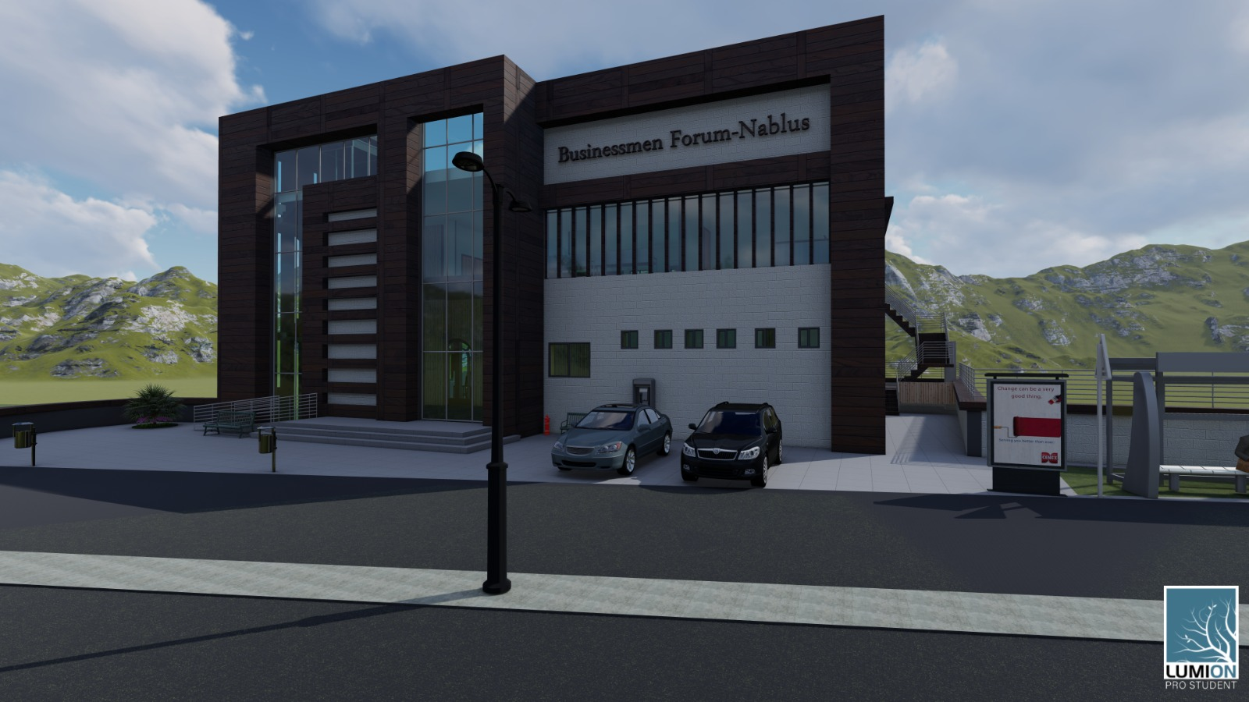
Objectives of the work
Redesigning and development the building, all aspects and engineering systems will be included where all weaknesses and problems of the building will be taken into account during the operation process

Slide 5
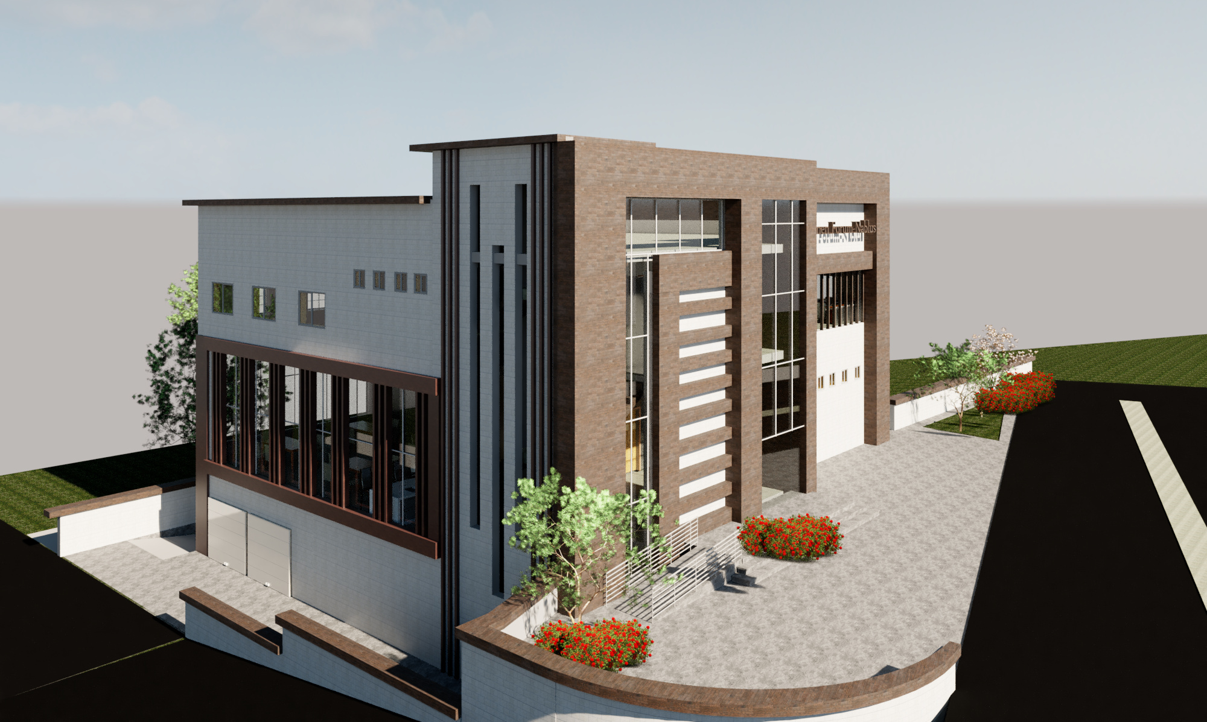
Site analysis

Slide 6
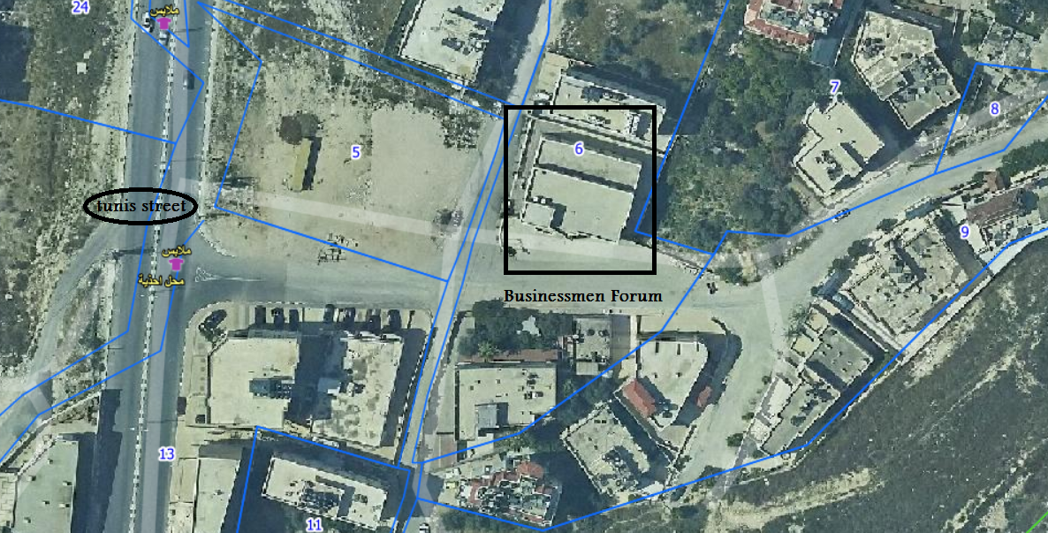
The building is located from the Rafidia district, Tunis Street. The building is surrounded by two streets, the main entrance to the building on the south side .

Slide 7
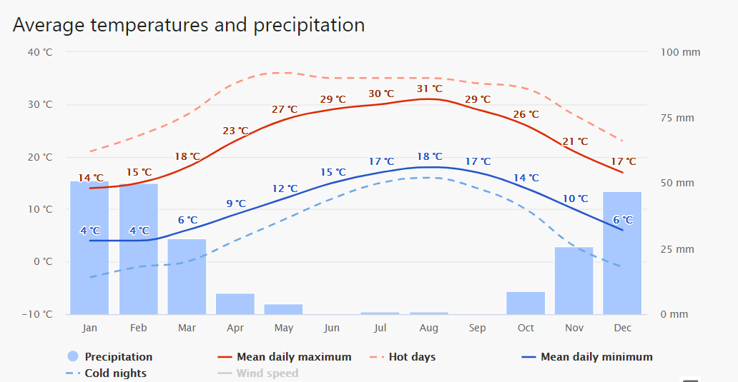
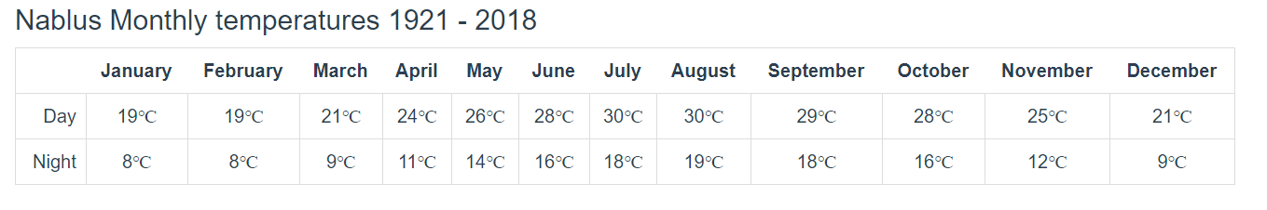
Climatic conditions

Slide 8
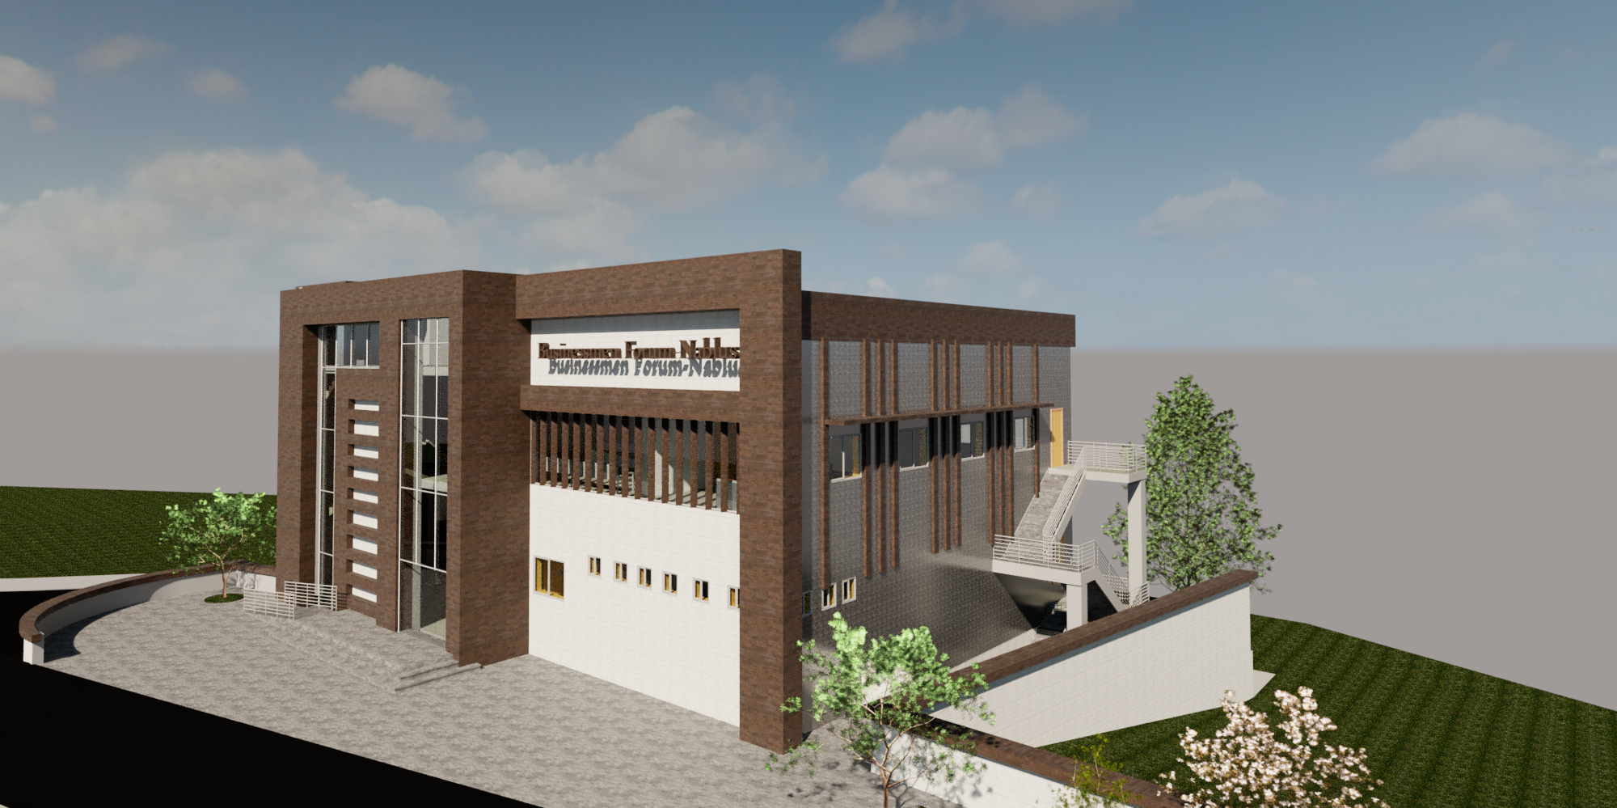
Architectural aspects

Slide 9
South elevation
S-E elevation
N-E elevation
S-W elevation

Slide 10
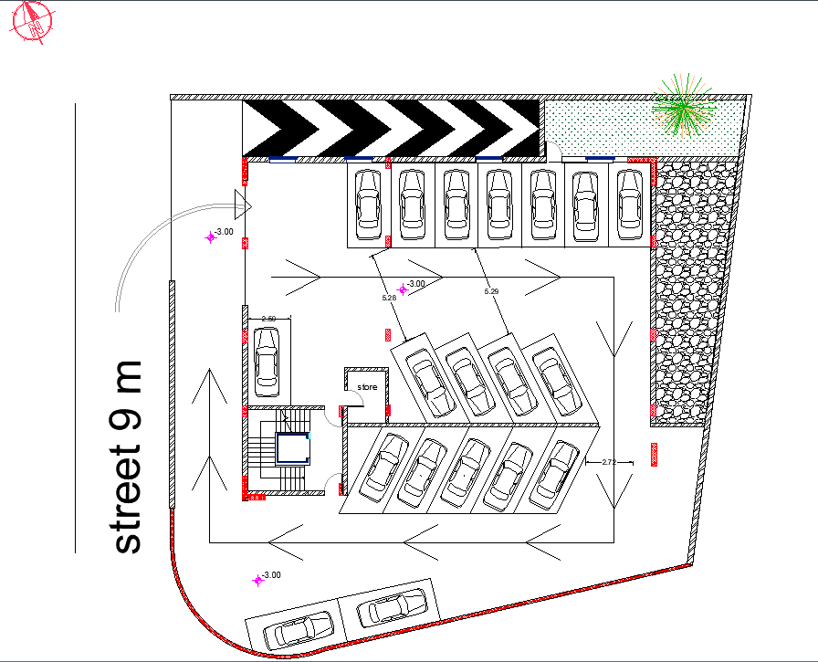
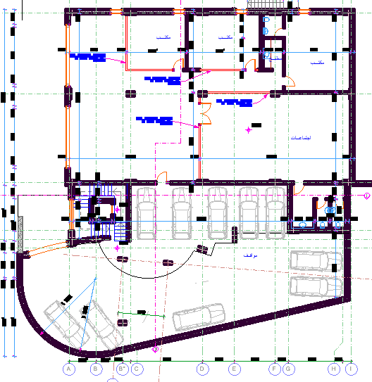
Basement Floor after
Basement Floor before

Slide 11
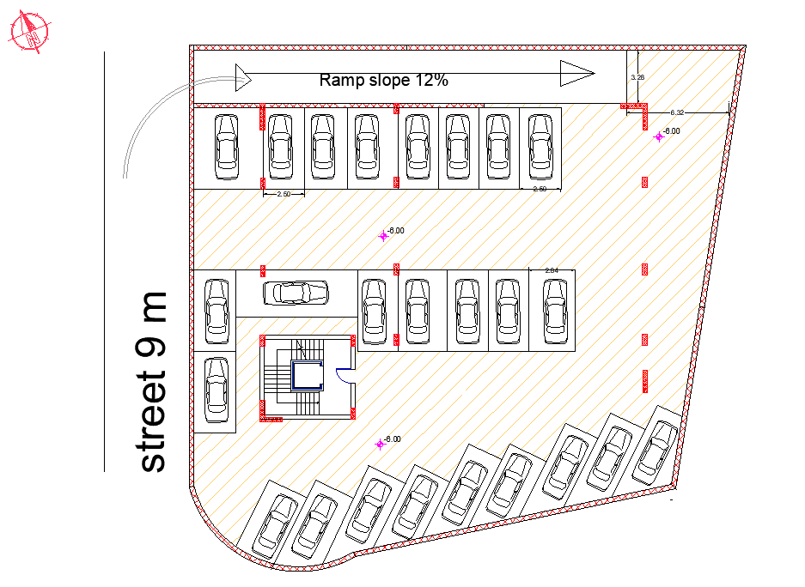
Basement floor 2 new

Slide 12
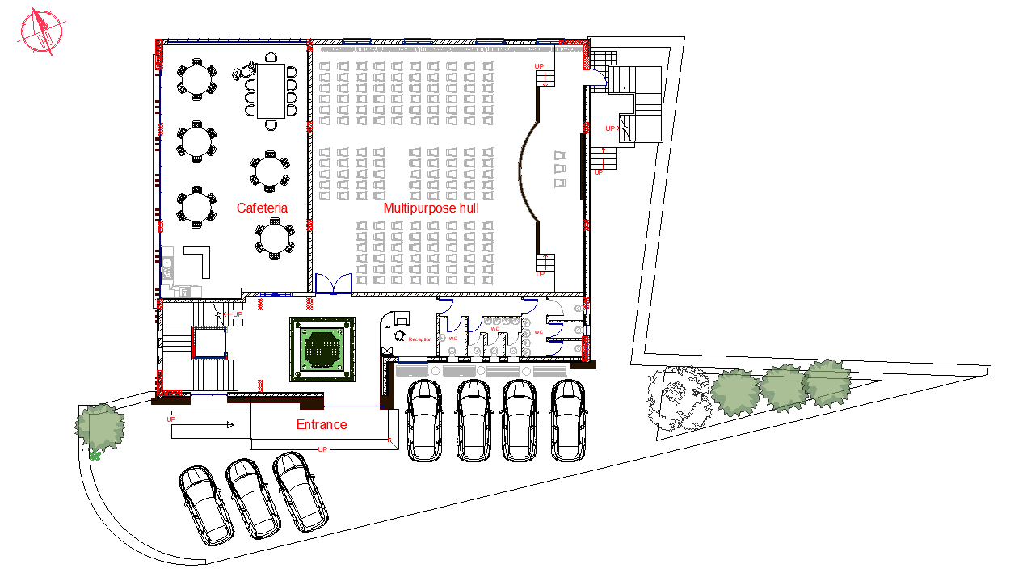
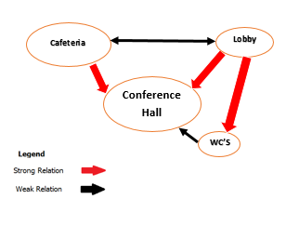
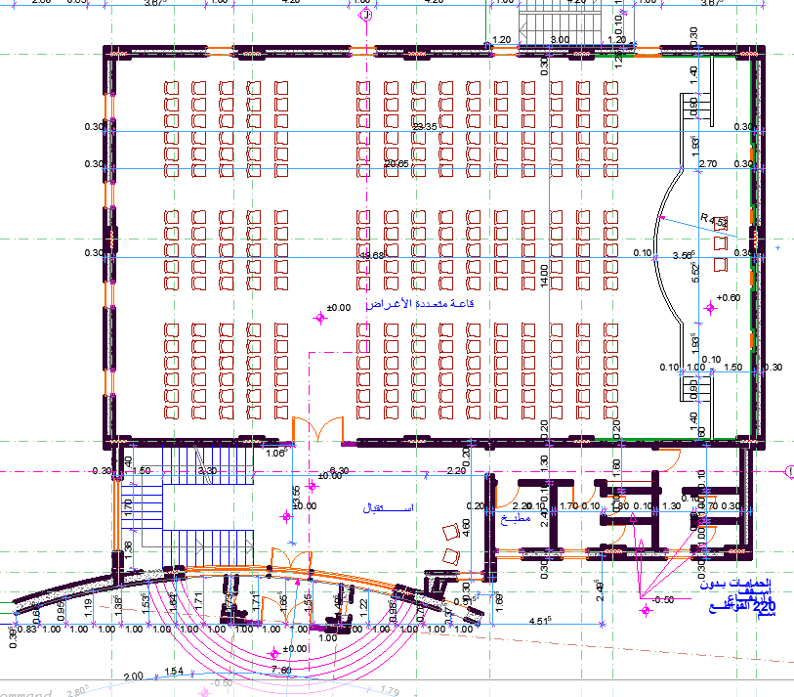
Ground floor after
Ground floor before

Slide 13
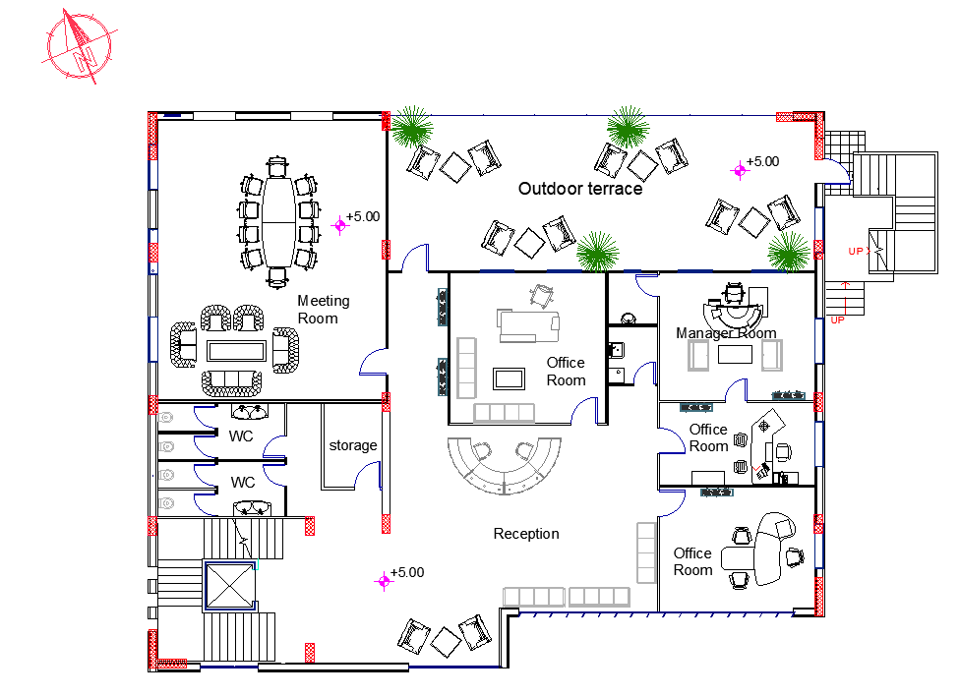
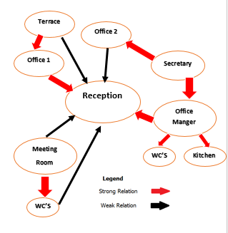
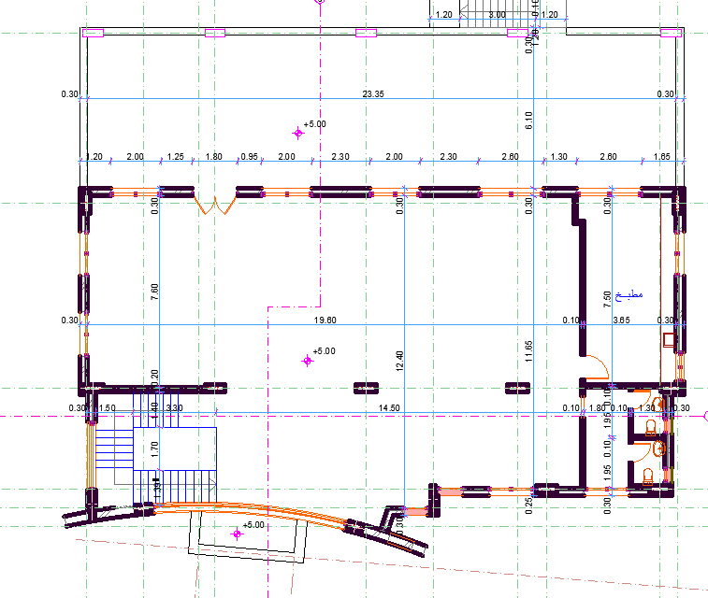
First Floor after
First Floor before

Slide 14
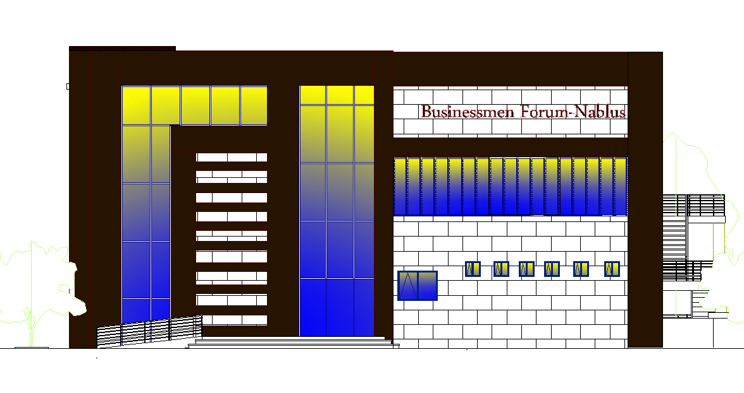
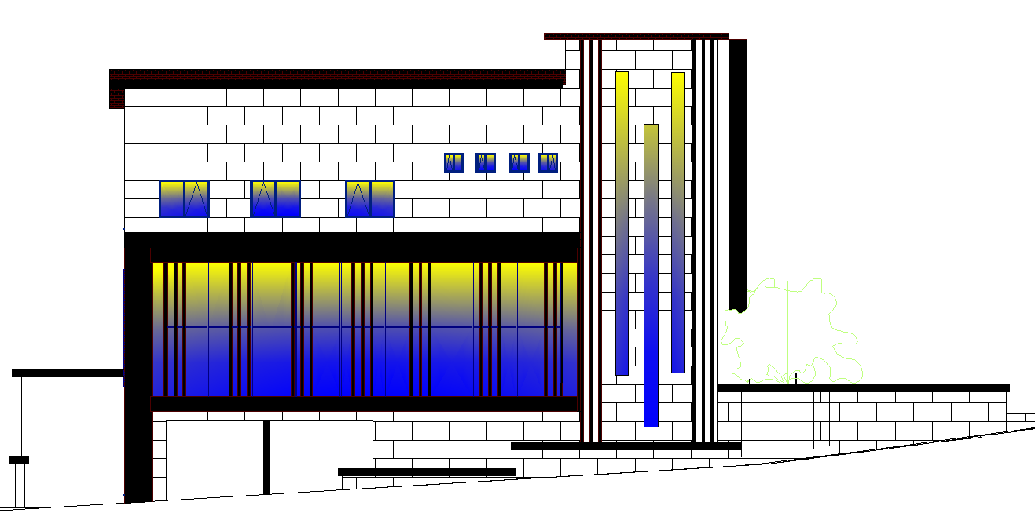
South Elevation
East Elevation

Slide 15
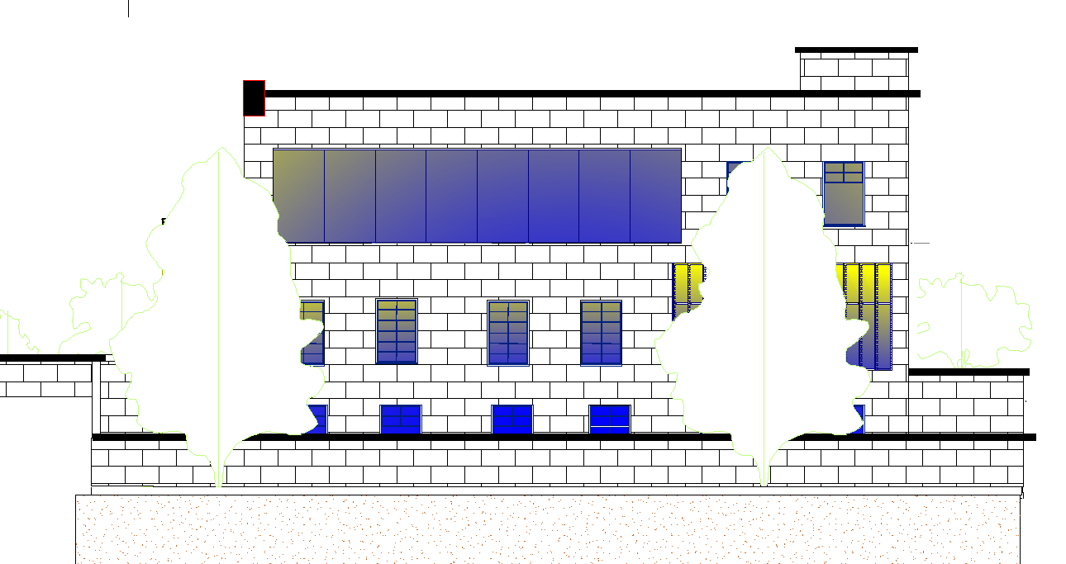
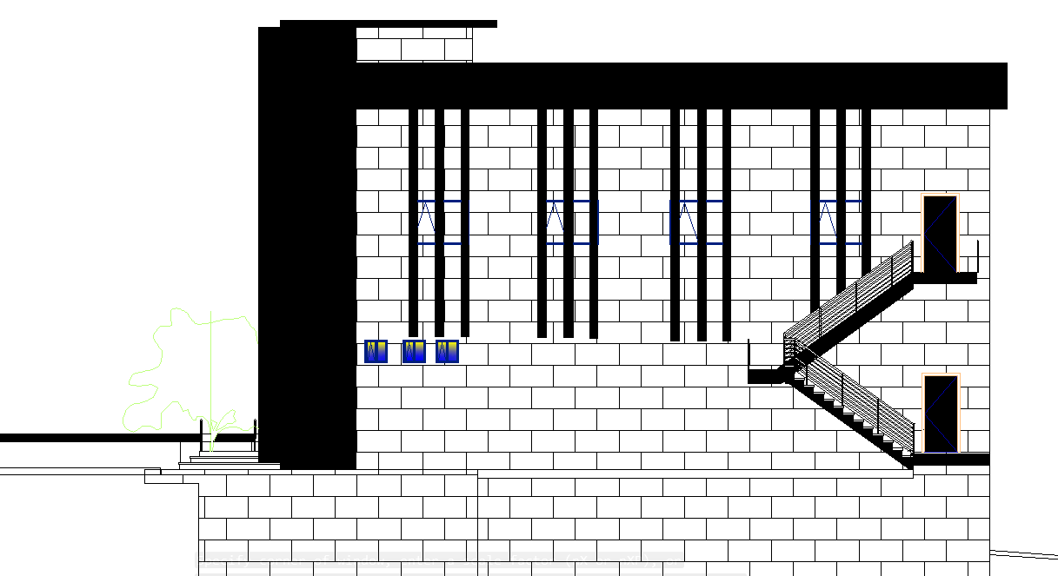
North Elevation
West Elevation

Slide 16
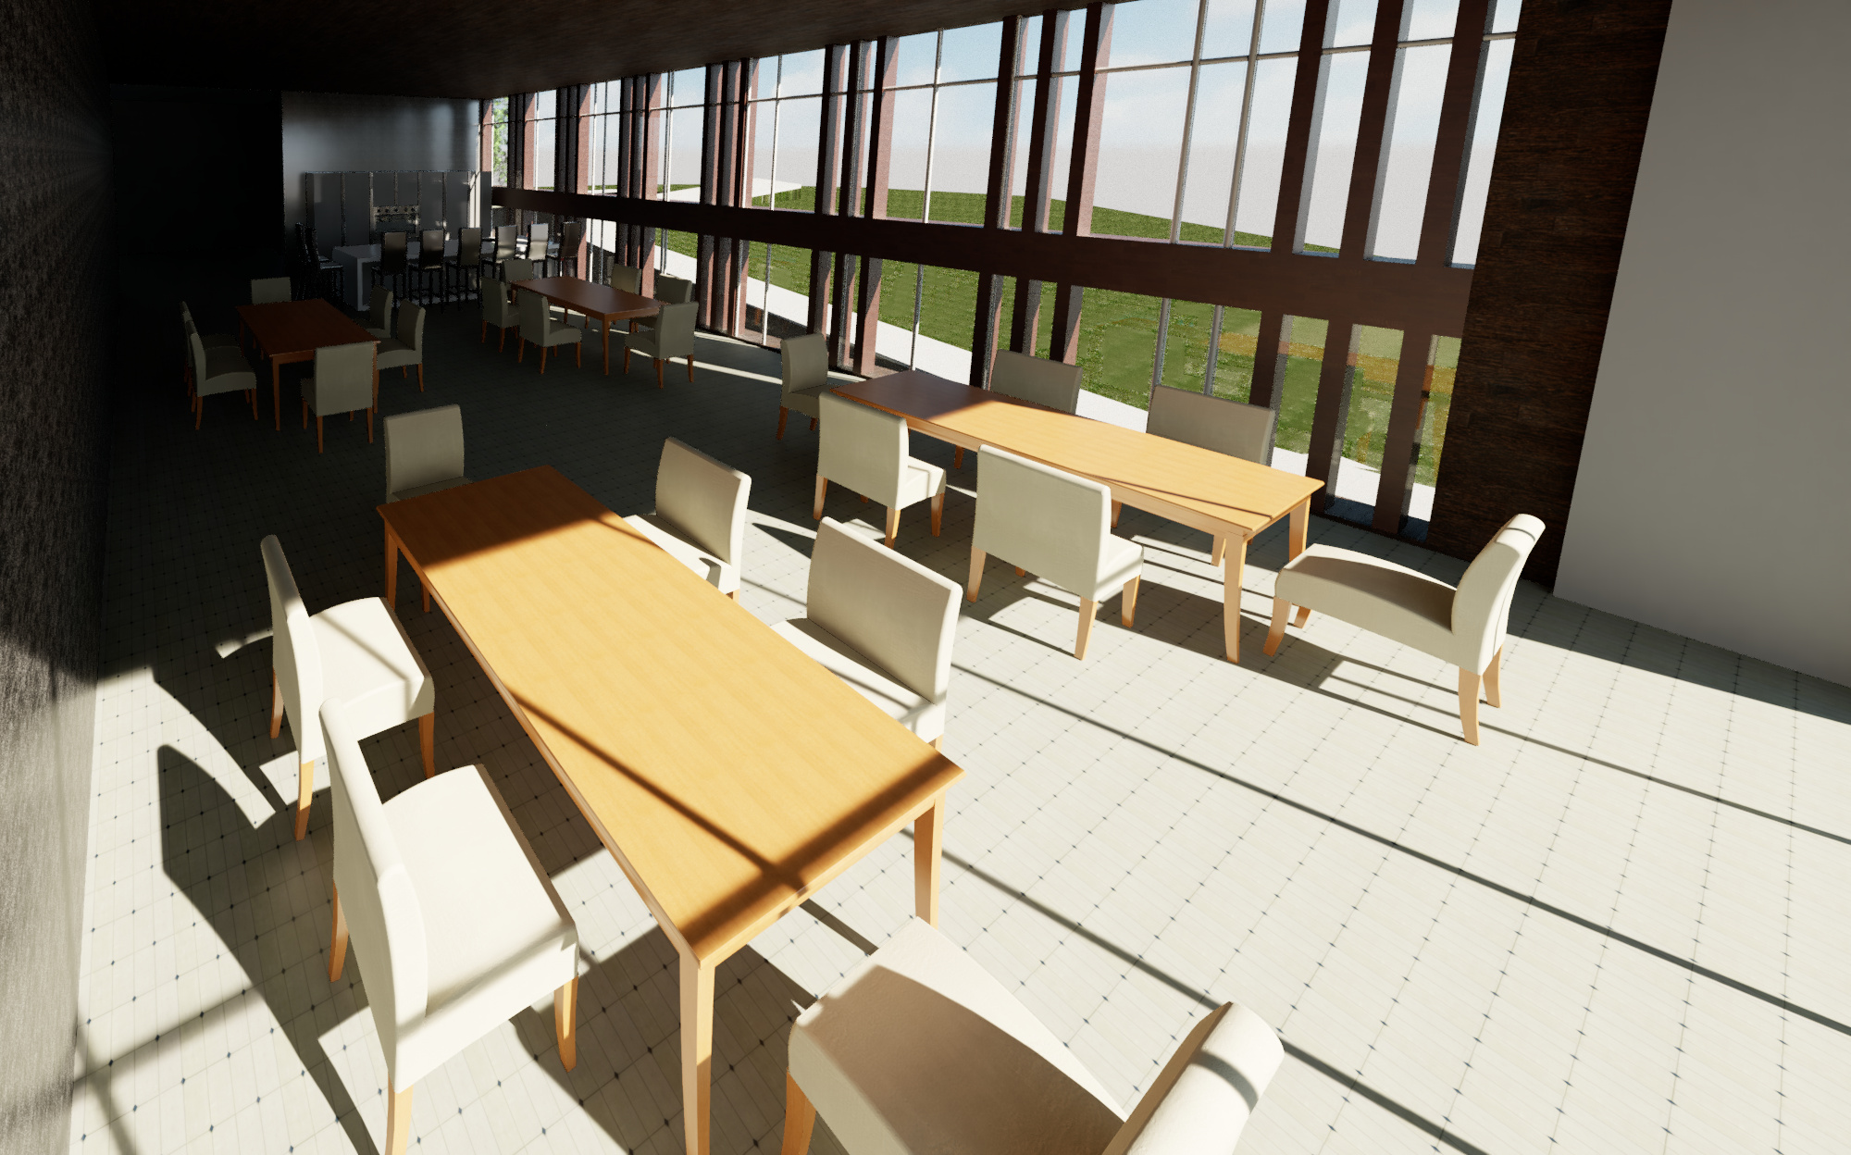
Environmental aspects

Slide 17
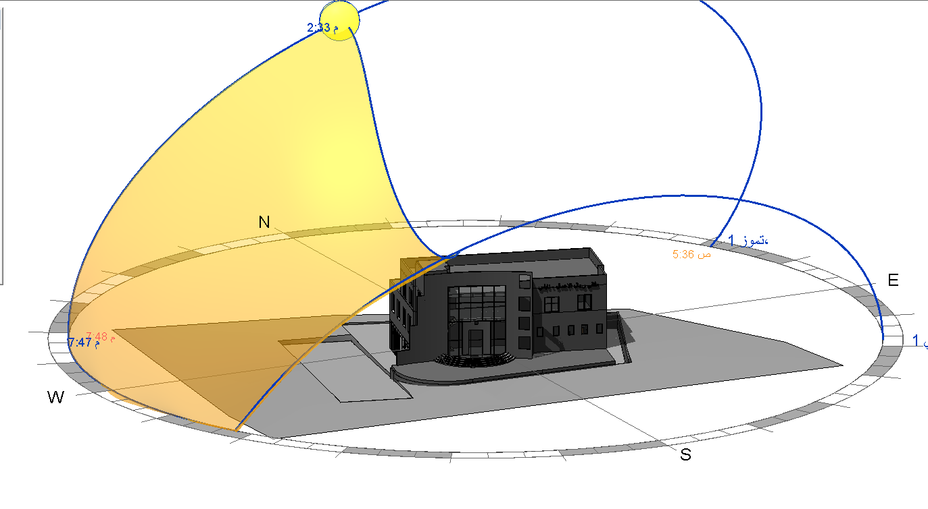
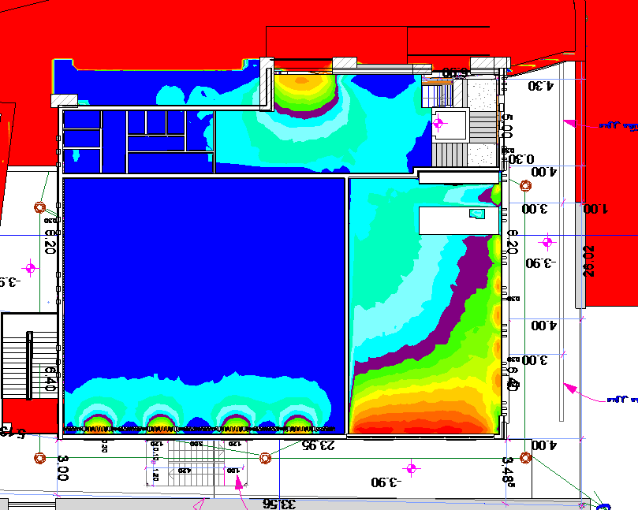
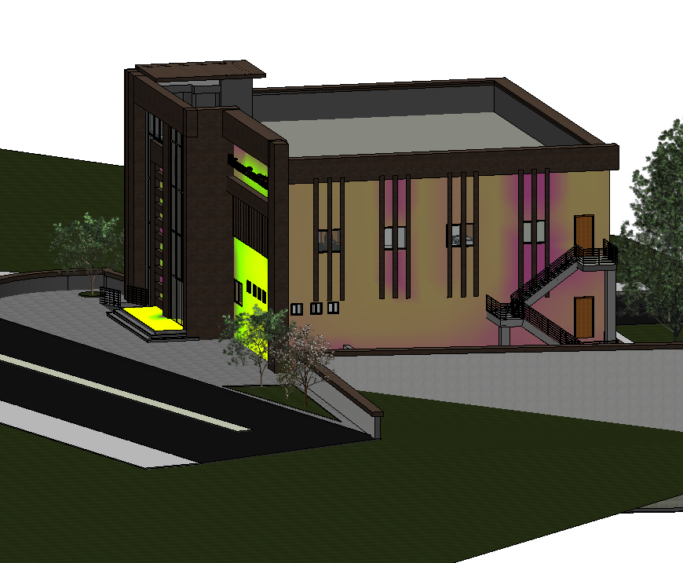
The important parameter of environmental assessment
The orientation of the faculty
Shading
Thermal Design
Daylight factor
Acoustic Design

Slide 18
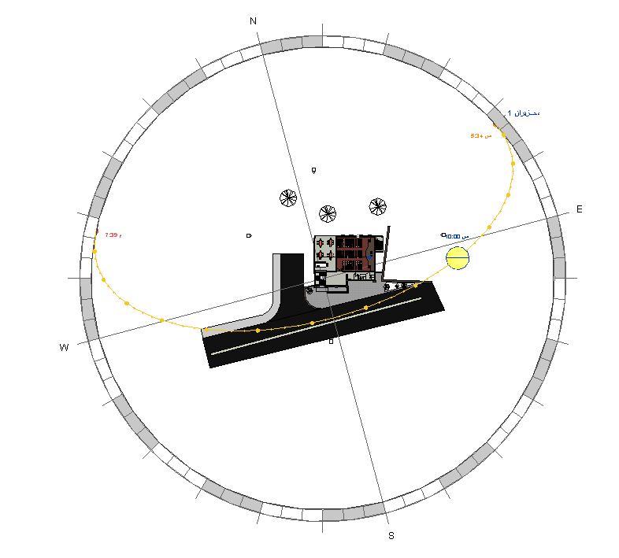
The Orientation and sun path of the faculty

Slide 19
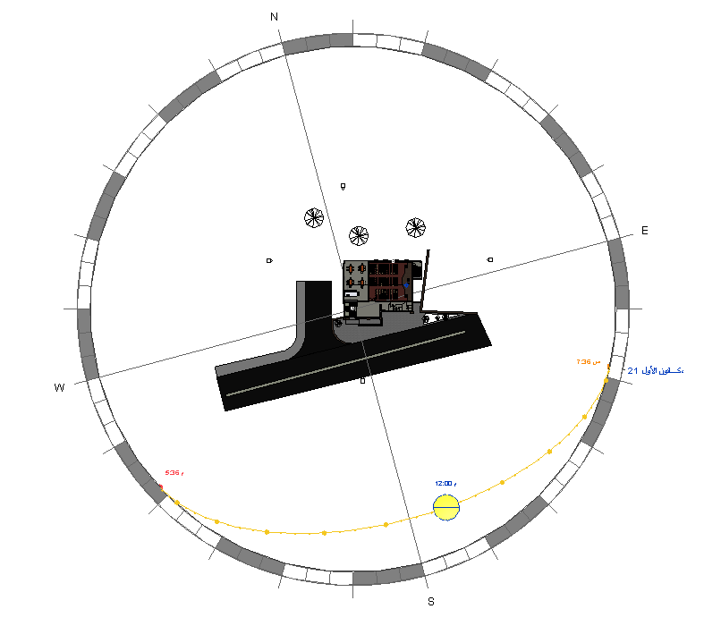
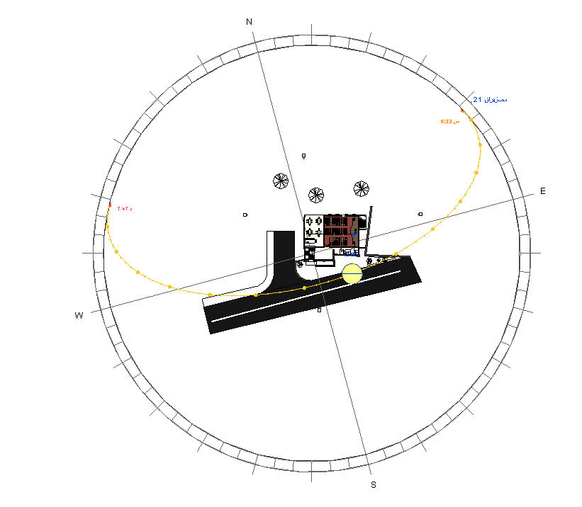
Sun Path
Sun path in winter at 12:00 pm
Sun path in summer at 12:00 pm

Slide 20
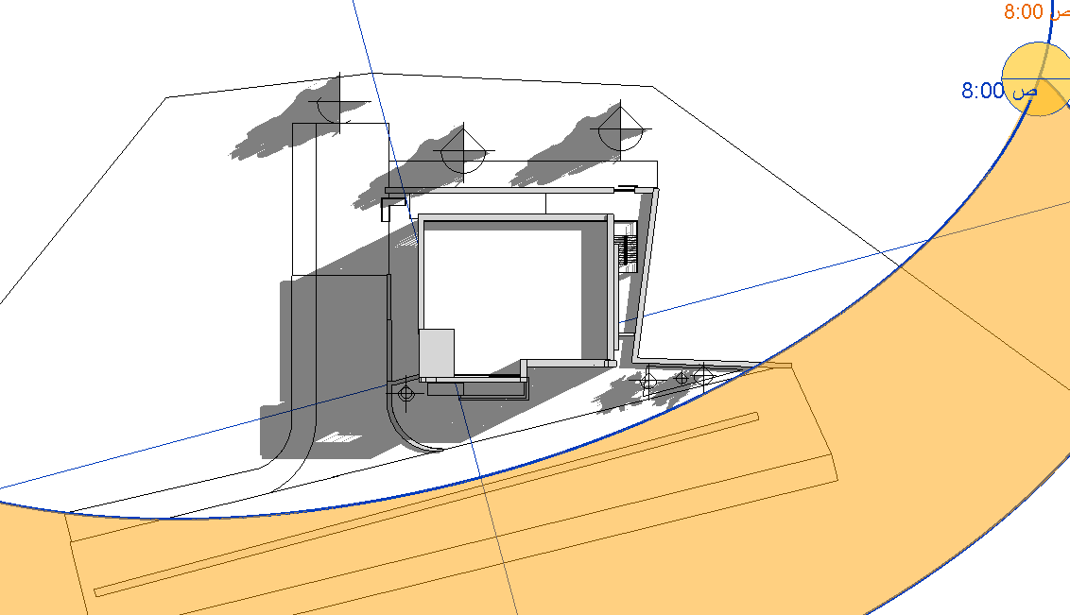
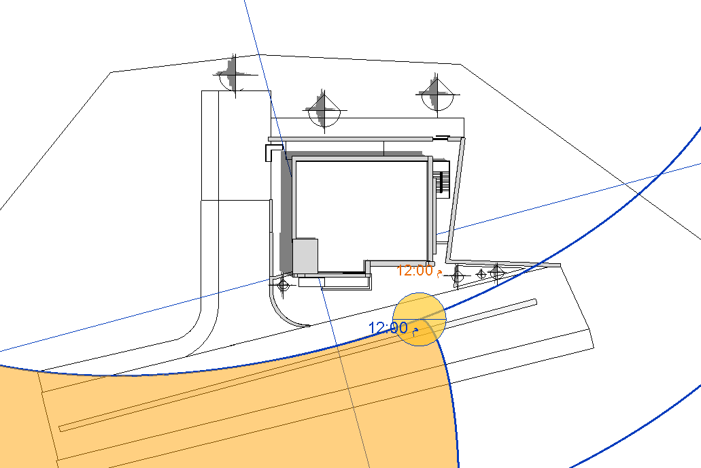
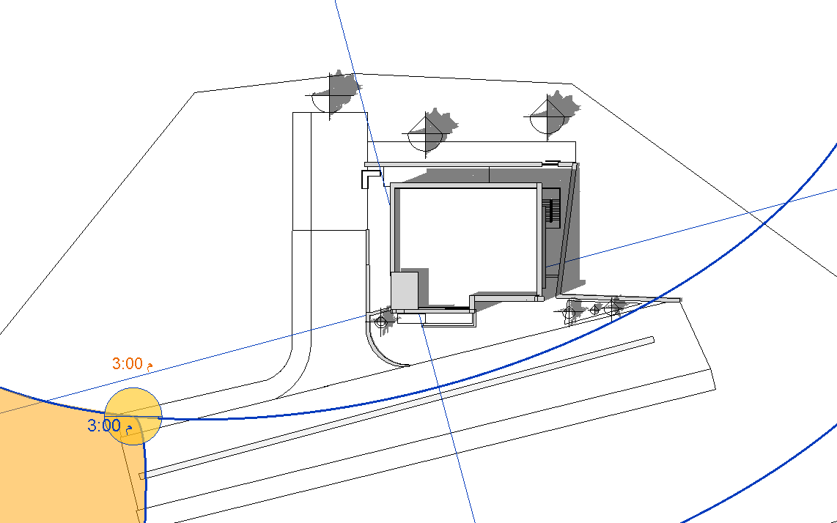
Shading

Slide 21
Thermal Design

Slide 22
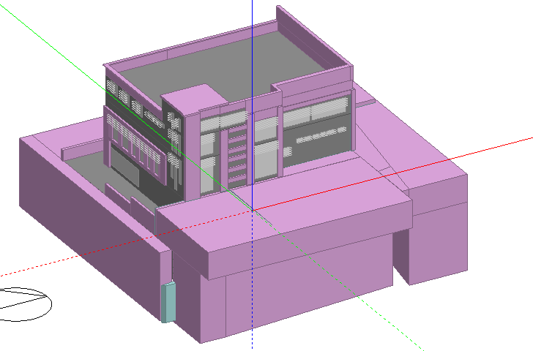
3D Model

Slide 23
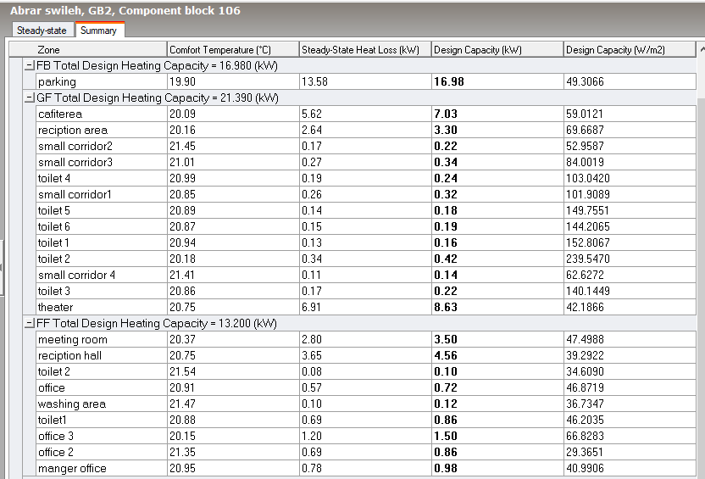
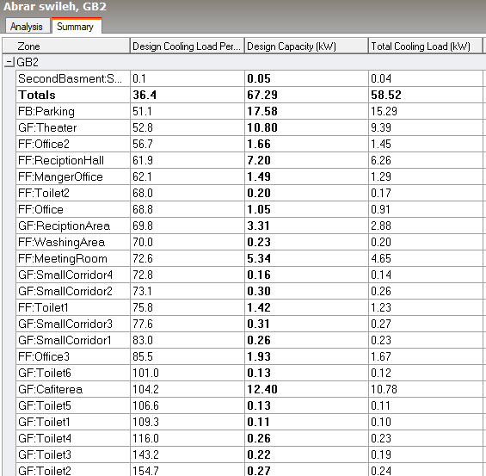

Slide 24
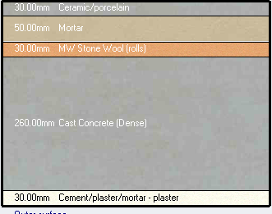
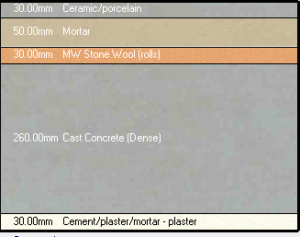
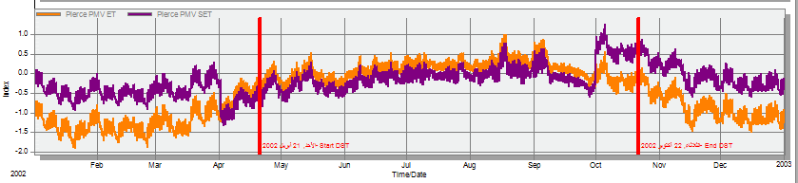
External wall layers
Floor layers
PMV

Slide 25
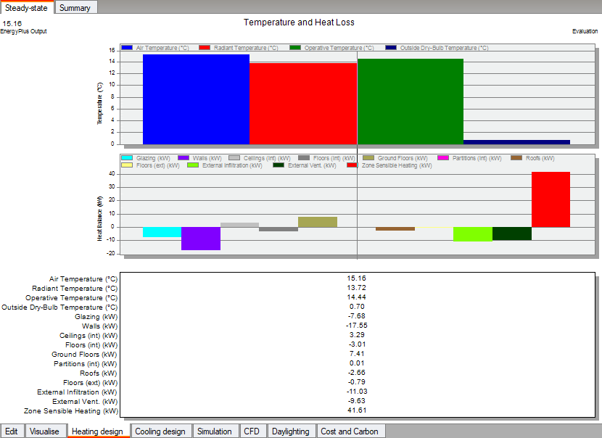

Slide 26
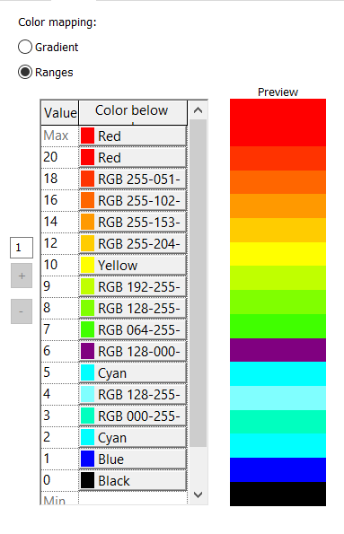
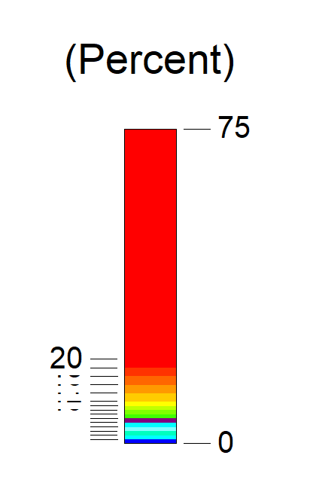
Daylight analysis
Ground Floor
Legend

Slide 27
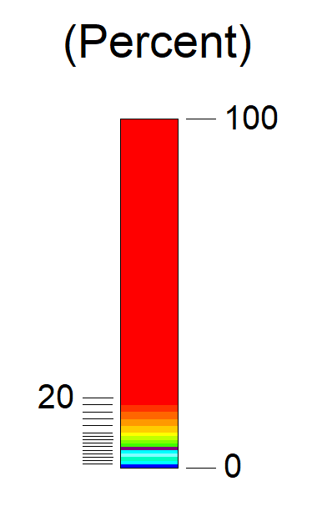
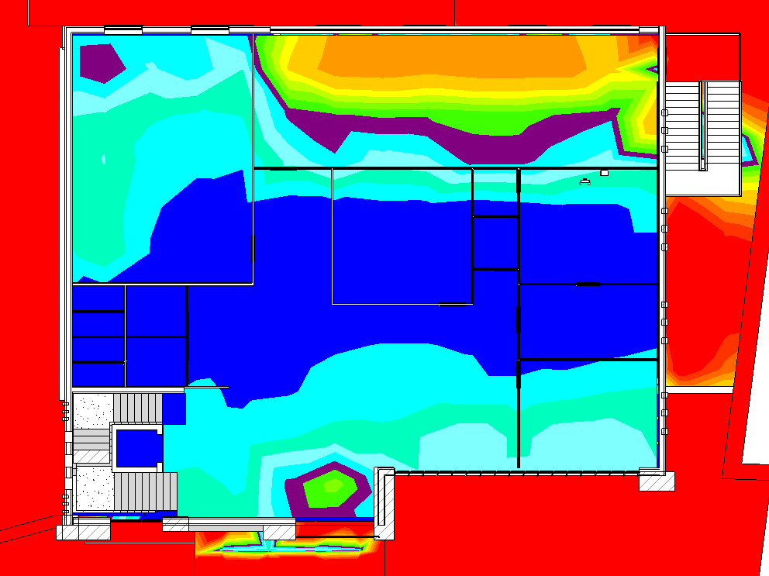
Daylight analysis
First Floor
Legend

Slide 28
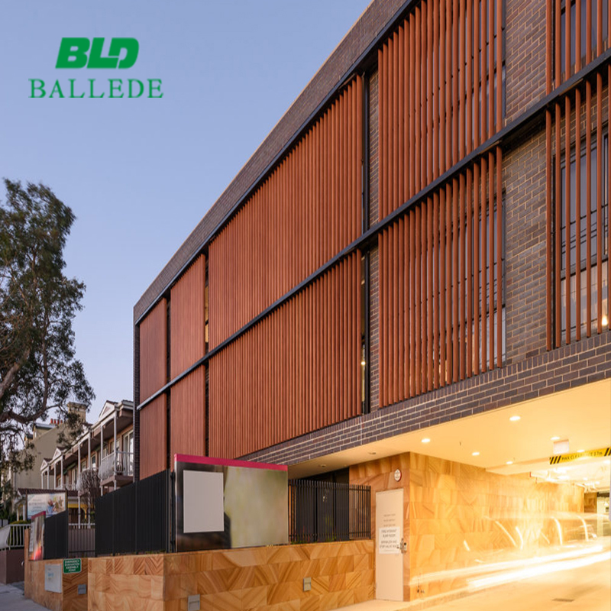
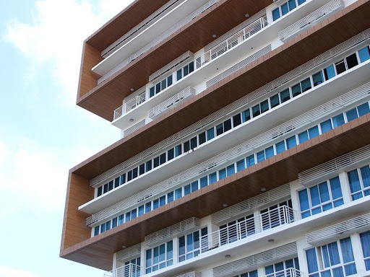
Sun shading will be used in east and south and west elevation

Slide 29


The model after adding vertical and horizontal louvers.

Slide 30



Ventilation

Slide 31


Ventilation Used In The Project

Slide 32
Acoustical Design

Slide 33
Materials and Frequency's
Material Choices
Walls → Wood panel 2 sides + Plaster another sides
Floor → Carpet
Ceiling → Gypsum board
Material | frequency | 63 | 125 | 250 | 500 | 1000 | 2000 | 4000
Wall |  | 0.1 | 0.07 | 0.03 | 0.02 | 0.02 | 0.02 | 0.03
Floor |  | 0.2 | 0.2 | 0.25 | 0.3 | 0.3 | 0.3 | 0.3
Ceiling |  | 0.33 | 0.28 | 0.1 | 0.05 | 0.03 | 0.07 | .09
Window |  | 0.17 | 0.14 | 0.09 | 0.02 | 0.00 | 0.00 | 0.00
Door |  | 0.17 | 0.14 | 0.12 | 0.08 | 0.08 | 0.07 | 0.06

Slide 34

Ecotect program
the values of RT60 in this analysis its in the avg. in the a reverberation time in the range (1.2 to 1.7 )seconds
FREQ. | ABSPT. | RT(60)
63 Hz | 141.711 | 1.08
125 Hz | 122.511 | 1.23
250 Hz | 83.554 | 1.39
500 Hz | 79.588 | 1.42
1000 Hz | 75.082 | 1.45
2000 Hz | 83.434 | 1.24
4000 Hz | 90.285 | 1.15
Shows the RT60 By SABINE

Slide 35


EASE program

Slide 36




Total and direct SPL on seats

Slide 37


ISUL program
The STC used in the offices = 45 and the same of conference room
INSIDE
OUTSIDE
The material used in inside → plaster 2 cm → Block 20 cm → plaster 2 cm
STC = 48 Ok !
The material used in outside → Stone 5cm → concrete 10 cm → Block 10 cm → plaster 2 cm STC = 53 Ok !

Slide 38

Structural aspects

Slide 39
Marital, Codes & Loads
Marital
Design Codes
Concrete with compressive strength of 35 MPa (B450),
Steel rebar with yielding strength of 420 MPa
ACI 318-14, ( Building Code Requirements for Structural Concrete )
IBC 2012: (International Building Code)
ASCE 7-10: ( American Society of Civil Engineering )
AASHTO: ( American Association of State Highway and Transportation Official )
Loads
Live 5 KN/m² For Parking
Live 4 KN/m² For another floors
SID 2.7 KN/m²

Slide 40

Slab System
The one – way ribbed slab with dropped beams between all supports used as the slab system .
Thickness of slab = ln\21 = 5.4/21 = 0.257 m → 30 cm

Slide 41

Footing Design
The type of foundation used is mat foundation
The thickness = expected area of footing / area of building
expected area of footing = 520 m²
area of building = 929 m²
The thickness = 520/929 = 55 cm

Slide 42

Dimensions of Beams
Beams :
The secondary beams assume = 50*30 cm
The girder dimension assume = 65*100 cm

Slide 43


Slab and Beams

Slide 44

The following figure shows the results of program of floor GF & F1 as a sample of results By Etabs

Slide 45

Dimensions of Columns and shear walls
Columns :
C1 = 70*35 cm
C2 = 70*35 cm
Shear walls
L section = 150*30 cm
I section = 150*30 cm

Slide 46

ETABS design the columns, and after finished the design the following results obtained

Slide 47

Detailing of column

Slide 48


Detailing of Shar walls and retaining wall

Slide 49


CIS Detailing of Beams

Slide 50
STAIRCASE

Slide 51

ETABS model

Slide 52

Compatibility check

Slide 53
Equilibrium Checks
Load (KN) | ETABS | MANUAL | % Difference
Live load | 13943.83 | 12770 | 0.95 %
SID load | 7996.48 | 7380 | 4.55%
Dead load | 21376.67 | 21580 | 4.16%
Difference % Doesn’t exceed 5 %

Slide 54

Period and Diaphragm Check
Direction | X |  | Y
Floor | GF | F1 | GF | F1
1st side | 3.78 | 6.25 | 2.48 | 4.00
2nd side | 3.6 | 5.52 | 2.45 | 3.96
Mid. | 3.8 | 5.95 | 2.64 | 4.05
Ang. x2 | 7.38 | 11.77 | 4.93 | 7.96
Type | Rigid | Rigid | Rigid | Rigid
So, the diaphragm is rigid.

Slide 55
Diaphragm Check
Floor: | Height: | Dis. X | Dis. Y | Drift X | Drift Y | Delta X | Delta Y | Delta Limit | Check
B2 | 3000 | 0.01 | 0.07 | 0.01 | 0.07 | 0.04 | 0.28 | 45 | Okay
B1 | 3000 | 0.33 | 0.45 | 0.32 | 0.38 | 1.28 | 1.52 | 45 | Okay
GF | 5000 | 3.78 | 2.48 | 3.45 | 2.03 | 13.8 | 8.12 | 75 | Okay
F1 | 3000 | 6.25 | 4.00 | 2.47 | 1.52 | 9.88 | 6.08 | 45 | Okay
Note: all unit used in the above table in mm.

Slide 56
Electro mechanic aspects

Slide 57

Mechanical aspect
Water Supply System

Slide 58

First Floor

Slide 59



Draining
1. Horizontal pipe for the water closet is 4 ̎
with slope 1%
2. Horizontal pipe for the lavatory is 2 ̎
with slope 2%
3. Horizontal pipe for the kitchen sink is 4 ̎
with slope 2%
4. Vent pipe is 2 ̎
5. The pipe between the manholes is 6 ̎
with slope1%
6. The rain water main vertical stack 4

Slide 60


HVAC System

Slide 61



VRF system
• OUTDOOR UNIT: Unit put in roof
• INDOOR UNIT : Diffuser and Return unit
• FAN COIL: Fresh air source

Slide 62



Fire fighting system

Slide 63




Detectors Types

Slide 64
Electrical aspect

Slide 65



Power Design

Slide 66


Lighting and Switch plan

Slide 67
Artificial Lighting Design

Slide 68



Office Room
Artificial Lighting
Daylight

Slide 69




Result Offices simulation
Luminaire list
Space | Lux | Required Lux | UGR | Required UGR | Type of lighting
Office | 227 | 150 | 10 | 19 | Artificial lighting
 | 666 | 150 | 12.7 | 19 | Artificial lighting +Daylight
 | 212 | 150 | 10 | 19 | Daylight
The recommended and standard for office space equal 150 LUX

Slide 70




Render Artificial and Daylight
Daylight
Artificial Lighting

Slide 71




Luminaire list
Result Offices simulation
Space | Lux | Required Lux | UGR | Required UGR | Type of lighting
Reception | 491 | 400 | 18.8 | 22 | Artificial lighting
 | 974 | 400 | 10 | 22 | Artificial lighting +Daylight
 | 484 | 400 | 10 | 22 | Daylight
The recommended and standard for reception space equal 400 LUX

Slide 72

Quantity surveying & Cost Estimate

Slide 73
Concrete skeleton and finishing work :
floor | Area | Cost for 1 m² | Total cost floor
Basement 1 | 929.8 | 230$ | 213,854$
Basement 0 | 720 | 230$ | 154,330$
Ground floor | 450 | 230$ | 103,063$
First floor | 450 | 230$ | 103,033$
Total | 2497 | 230$ | 574,310$
The total cost for this project expected = 1,423,290 Almost equal = 1,500,000 $
floor | Area | Cost for 1 m² | Total cost floor
Basement 1 | 929.8 | 340$ | 316,132$
Basement 0 | 720 | 340$ | 228,140$
Ground floor | 450 | 340$ | 152,354$
First floor | 450 | 340$ | 152,354$
Total | 2497 | 340$ | 848,980$

Slide 74
TOTAL PROJECT COST
The total cost its less than the expected cost
TOTAL COST ( NIS ) | 3306471
Unit cost (NIS/SM) | 1312
Unit cost ($/SM) | 386
Unit cost (JOD/SM) | 266

Slide 75

Thank you ☺

