Slide 1
Generating power using speed Bumps in Nablus City
Submitted by:
Dawood Khraim
Sanad Shafie
Supervisor:
Dr. Mahmoud Assad

Slide 2
Topics to be explained
Nablus city.
Type of speed bumps.
Methodology used.
Design process.
Prototype manufacturing.
Conclusion and future work.

Slide 3
General background
How much is the annual electricity consumption?
What are the resources of electricity available?
What are the alternative sources of electricity?
What is the point of having bumps?
How can bumps be harnessed in power generation?

Slide 4
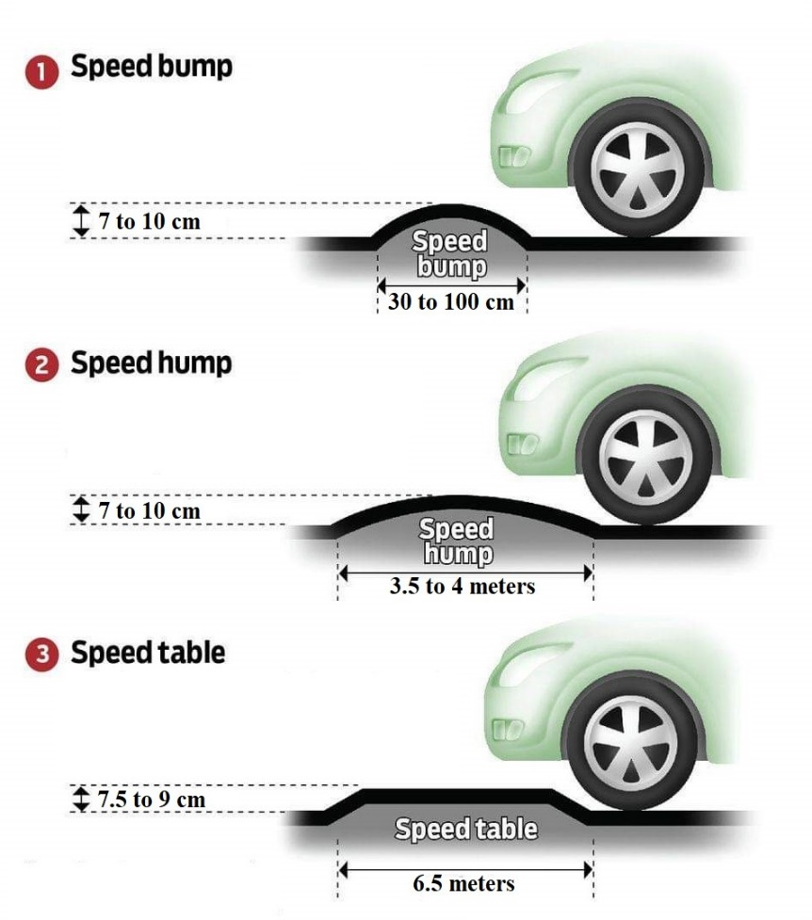
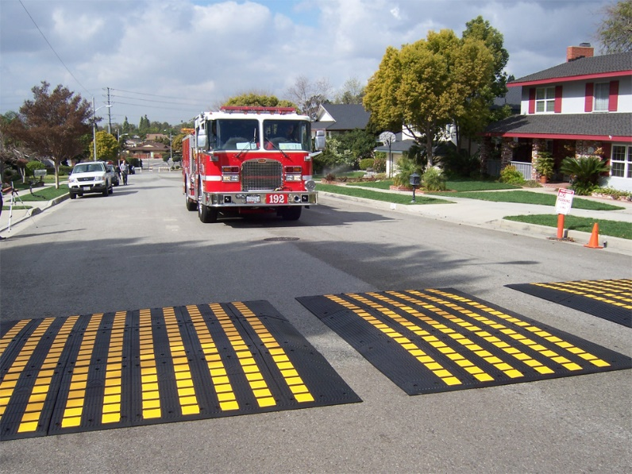
Types of speed breakers
Speed Bumps.
Speed Humps.
Speed Tables.
Speed cushion.

Slide 5
Methodology

Slide 6
Standards and Constraints
Standards:
AGMA.
ASM.
Courtesy of Associated Spring.
Constraints:
Fully sized unit.
Materials and specified dimensions of components.

Slide 7

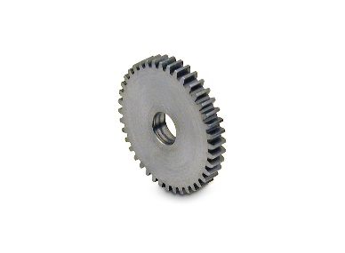
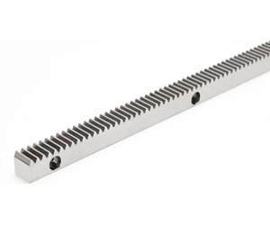
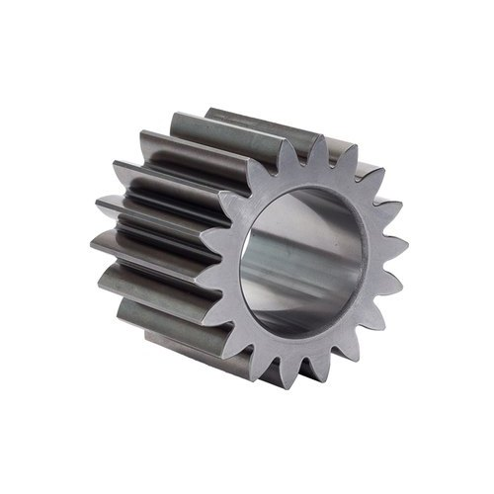
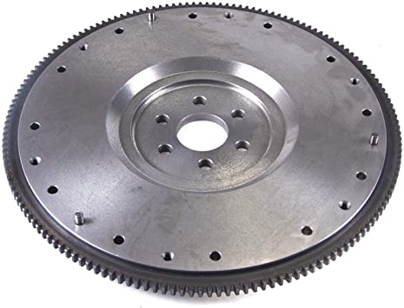
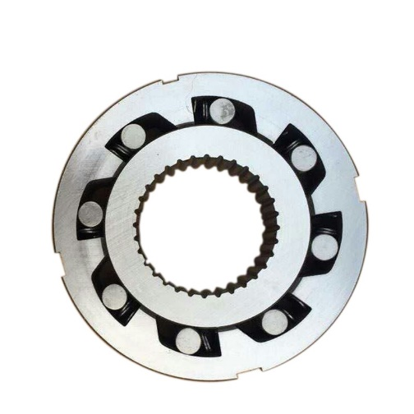

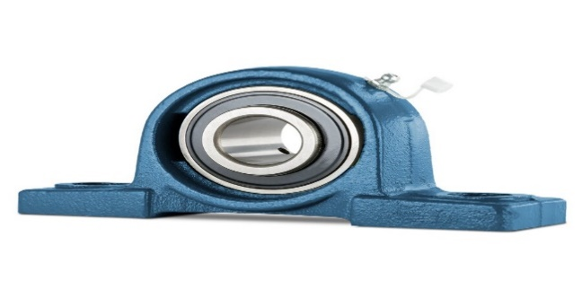
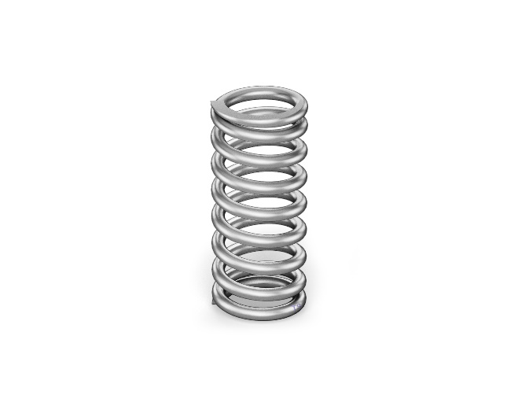
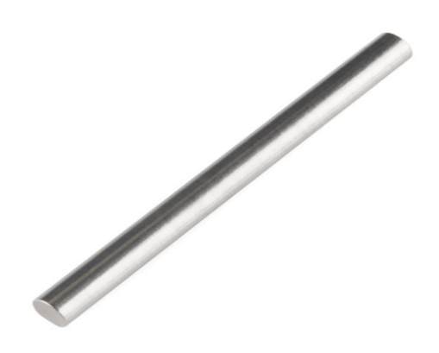
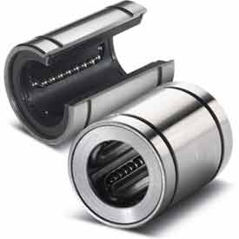
Mechanical system components

Slide 8
Prototype Manufacturing
Designing using solidworks.
Search of components.
Assembling and calibrating.
Results.

Slide 9
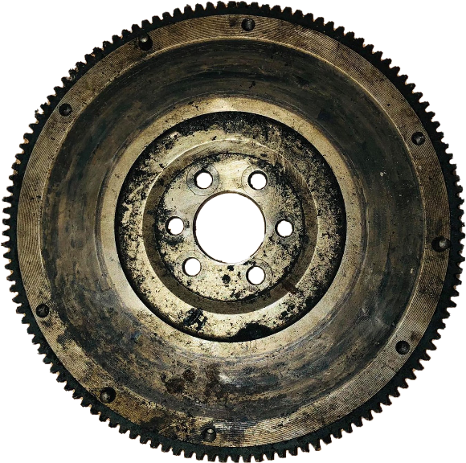
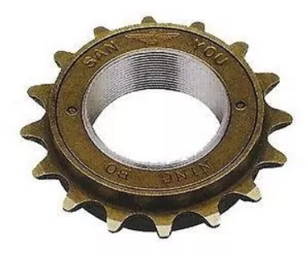
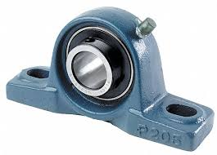
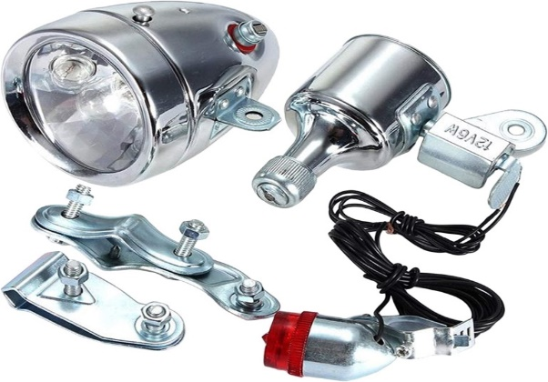
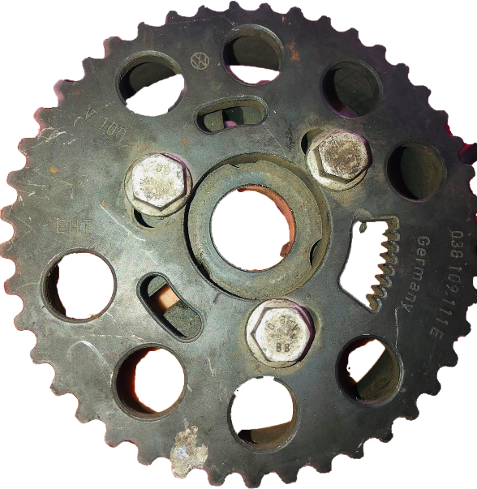
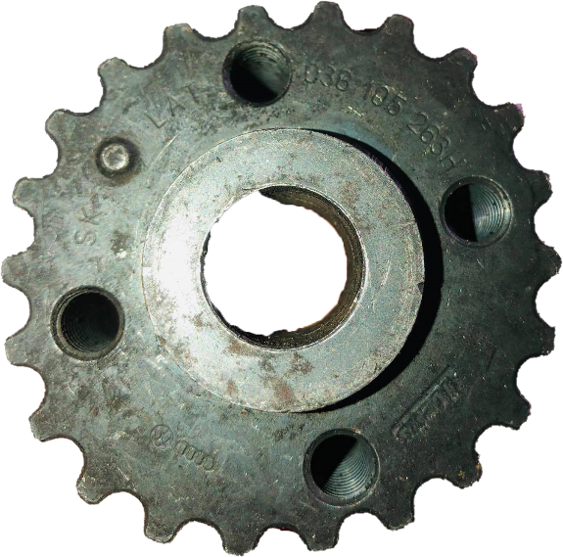
Components

Slide 10
Prototype calculations
Power output (watt) | Rad/s | Time (sec) | Revolutions | Deflection (cm) | Torque output (N.m) | EXP #
13.847 | 6.924 | 3.63 | 4 | 3.5 | 2 | 1
19.968 | 9.984 | 4.72 | 7.5 | 6.2 | 2 | 2
20.944 | 10.472 | 4.2 | 7 | 4.8 | 2 | 3
22.848 | 11.424 | 3.85 | 7 | 6.5 | 2 | 4
25.046 | 12.523 | 5.77 | 11.5 | 8.5 | 2 | 5
25.089 | 12.545 | 5.76 | 11.5 | 9.2 | 2 | 6
Ratio | Revs (Shaft) | Revs (Flywheel)
6.283 | 0.728 | 4
6.651 | 1.364 | 7.5
8.018 | 1.273 | 7
5.921 | 1.273 | 7
7.438 | 2.092 | 11.5
6.872 | 2.092 | 11.5

Slide 11
Future work
New ideas will be added to improve the system.
Supporting the project with solar panels.
Trying to implement the project on the ground.
Submit the project to the municipalities and start it as a commercial project.

Slide 12

