Slide 1

Nablus Vet Care
A Unified Solution for Veterinary Operations
Baker Razi Wael Yaeesh & Yousef Faed Mahmoud Salman
Supervisor: Dr. Hanal Abuzant
An-Najah National University, Faculty of Engineering
Department of Computer Engineering,
January 2026

Slide 2
The authors declare and emphasize that all data (including but not limited to: names of clients, veterinarians, and staff; pet and patient details; medical records; appointments; invoices; financial transactions; contact information; and any associated images) presented within this presentation—whether in system screenshots, diagrams, example outputs, or descriptive scenarios—are entirely synthetic, fictitious, and generated for simulation purposes only (100% Fake/Dummy Data).

Slide 3
CONTENTS
01
05
Implementation Details
Project Overview
02
06
Future Development
System Features
03
07
Conclusion and Thanks
Technical Architecture
04
User Management

Slide 4

01
Project Overview

Slide 5
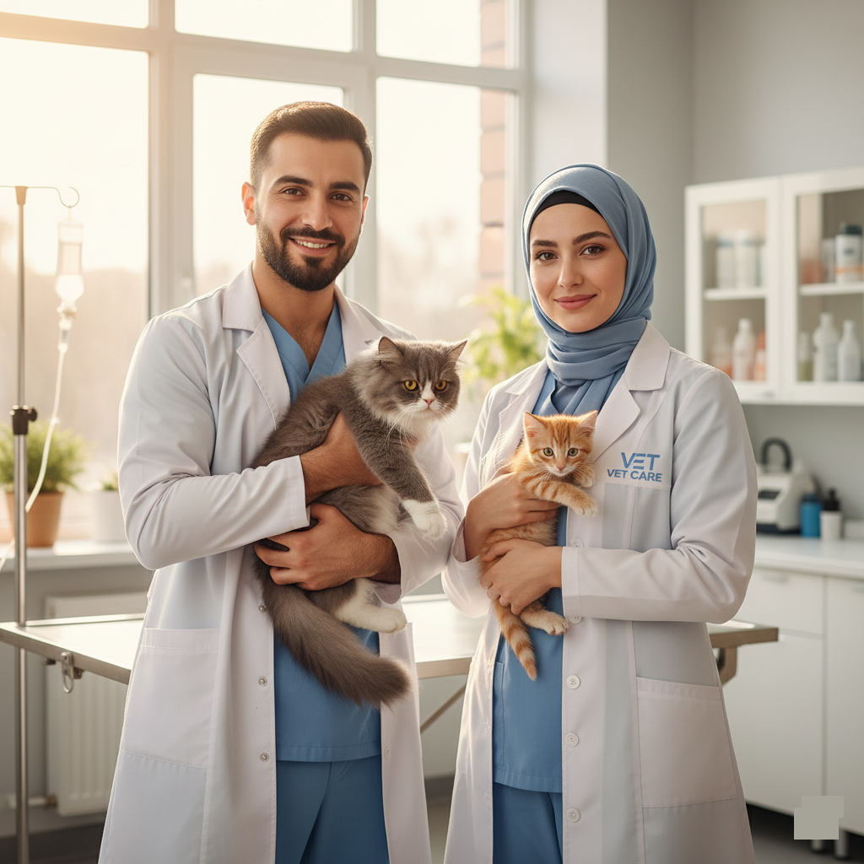
Project Idea & Motivation
Nablus Vet Care is a platform designed to modernize veterinary clinic management. It addresses the critical gap in digital transformation within the veterinary sector, which has lagged behind human healthcare.
Many clinics, especially in regions like Nablus, still rely on manual, paper-based systems for appointments, records, and billing. This leads to operational inefficiencies, scheduling conflicts, and communication gaps, ultimately impacting the quality of pet care.

Slide 6
Main Project Objectives
Automate Tasks
Enhance Coordination
Improve Communication
Streamline scheduling, records, and billing.
Improve collaboration between all staff roles.
Provide pet owners with direct access to services.
Support Decisions
Enable Payments
Facilitate Sharing
Integrate AI-powered diagnostic assistance.
Implement secure online payment processing.
Create a community forum for knowledge exchange.

Slide 7
02
System Features

Slide 8
Key Functional Features
Multi-Role Management
AI Scheduling
Digital Medical Records
Real-Time Communication
Five distinct roles: Admin, Vet, Receptionist, Pet Owner, Accountant.
Intelligent appointment booking with AI-optimized time slots.
Comprehensive electronic health records for all patients.
Integrated chat, voice calls, and a community forum.

Slide 9
Problems Solved & Solutions Provided
Problem: Manual appointment scheduling conflicts and errors.
Solution: Automated, AI-optimized scheduling with conflict detection.
Problem: Inefficient paper-based medical records.
Solution: Centralized, secure, and accessible digital records.
Problem: Communication gaps between staff and pet owners.
Solution: Integrated real-time chat, voice calls, and notifications.

Slide 10
03
Technical Architecture

Slide 11







Technology Stack Overview
Frontend
Backend
Database
React 18 (TypeScript)
Node.js
PostgreSQL
Tailwind CSS
Express.js
Relational Schema
React Native
RESTful API
Real-Time
Payment
AI Integration
Socket.io
Stripe API
Custom AI Assistants
Firebase Cloud Messaging

Slide 12
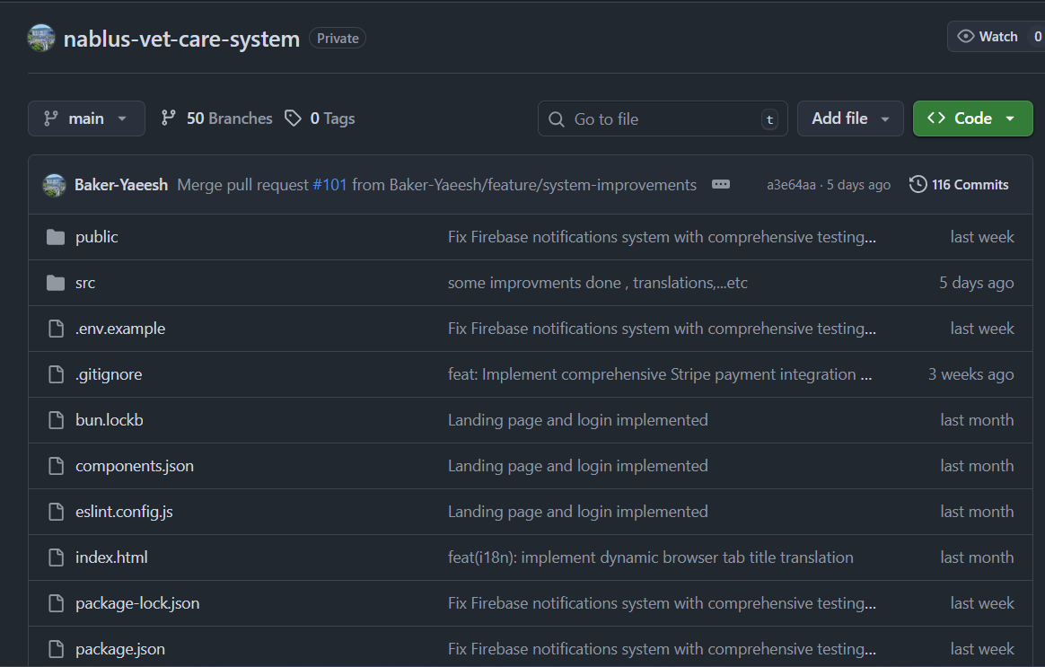
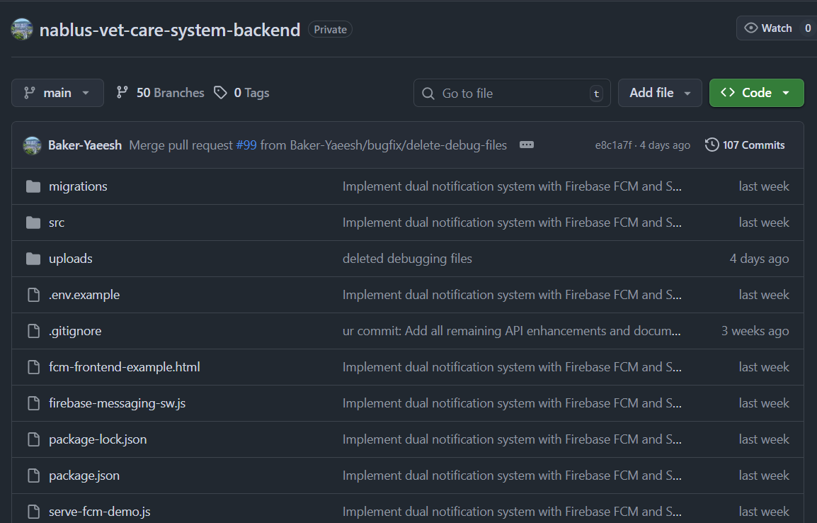
Github

Slide 13
System Architecture Design
→
→
Clients
Backend API
Database
(Web, Mobile)
(Node.js/Express)
(PostgreSQL)
A client-server architecture with a unified API, supporting REST and WebSockets, secured by JWT-based Role-Based Access Control (RBAC).

Slide 14

Database Schema Design
A robust PostgreSQL database ensures data integrity and supports complex clinic operations.
Core Tables: Users, Pets, Appointments, Medical Records, Invoices.
Relationships: Carefully defined foreign keys for data cohesion.
Integrity: Constraints, unique fields, and cascading deletes prevent data anomalies.

Slide 15
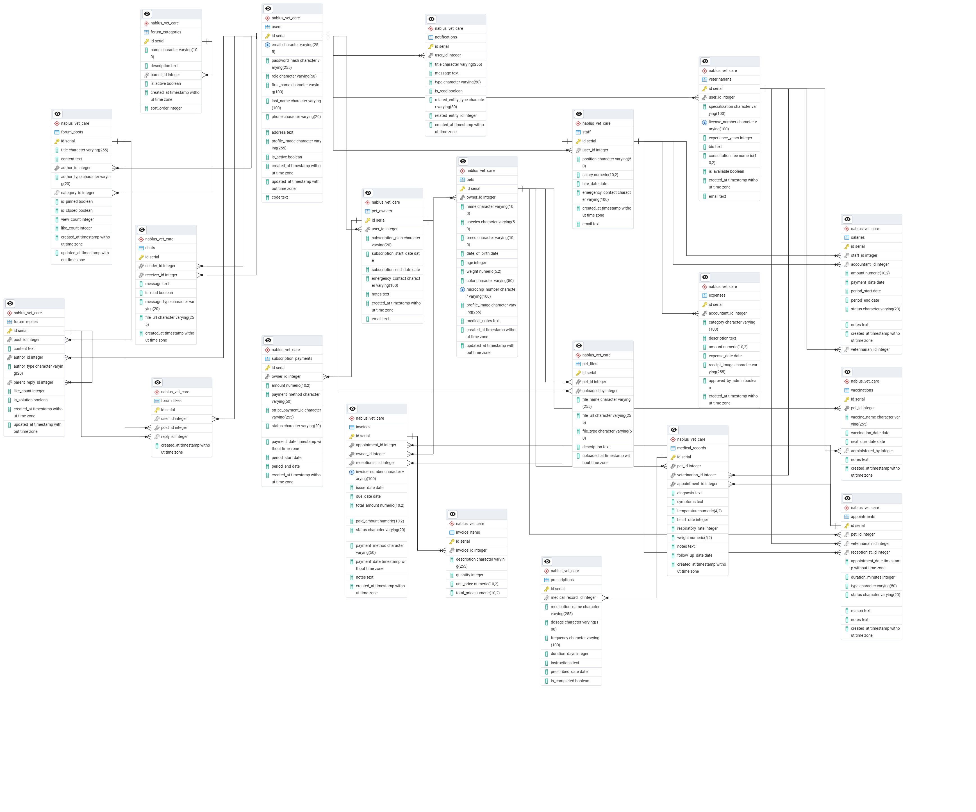

Slide 16
04
User Management

Slide 17
System User Roles Overview
Administrator
Veterinarian
Receptionist
Pet Owner
Accountant
System Oversight
Medical Care
Client Services
Pet Healthcare
Financial Management
Each role has a tailored portal with specialized functionality and granular permissions.

Slide 18
Role Functions & Permissions
Administrator
Manages users, vets, staff, pets, and has full system oversight with access to performance analytics.
Pet Owner
Books appointments, accesses pet medical history, uses AI assistant, and manages subscriptions.
Veterinarian
Accesses appointments, medical records, AI diagnostic tools, and manages pet files.
Accountant
Manages all financial operations including invoices, expenses, salaries, and generates reports.
Receptionist
Schedules appointments, registers new clients, processes payments, and manages invoices.

Slide 19
05
Implementation Details

Slide 20
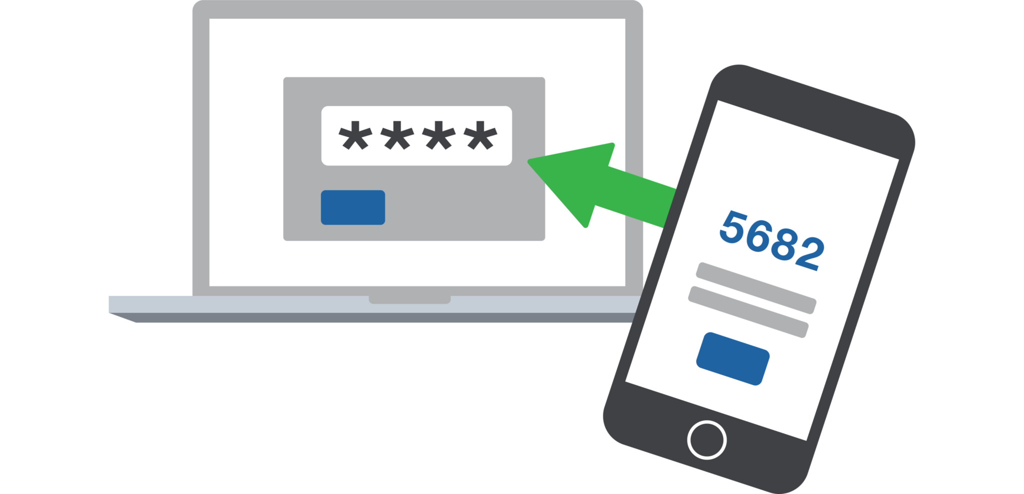




Authentication & Security
Two-Step Auth: Login followed by role-specific portal redirection.
JWT Management: Secure tokens with automatic refresh.
RBAC: Granular, role-based access control for all features.
OAuth Integration: Alternative secure login with Google.
Multi-Layer Validation: Especially for critical financial transactions.

Slide 21
AI-Powered Features
Veterinary AI
Pet Owner AI
Business Intelligence
Clinical decision support, diagnostic assistance, and treatment recommendations.
Care guidance, health monitoring, emergency assistance, and behavioral support.
AI-optimized scheduling, smart forum categorization, and predictive financial analytics.

Slide 22

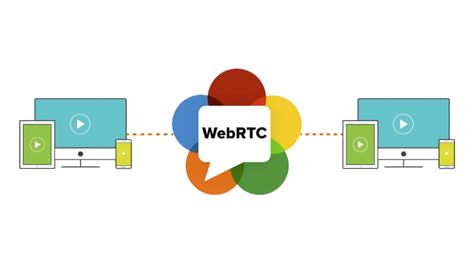

Real-Time Communication
A comprehensive system to keep all users connected and informed.
Multi-User Chat: Real-time messaging with file sharing and history.
Voice Calling: Direct communication via WebRTC integration.
Smart Notifications: Categorized alerts for appointments, payments, etc.
Push Messaging: Cross-platform notifications via Firebase.

Slide 23

Payment & Financial Systems
Secure Payments
Invoice Management
Stripe integration for invoices and subscriptions.
Automated generation and tracking of all invoices.
Salary & Expenses
AI Reporting
Manages staff salaries and clinic operational costs.
Generates comprehensive financial reports and analytics.

Slide 24
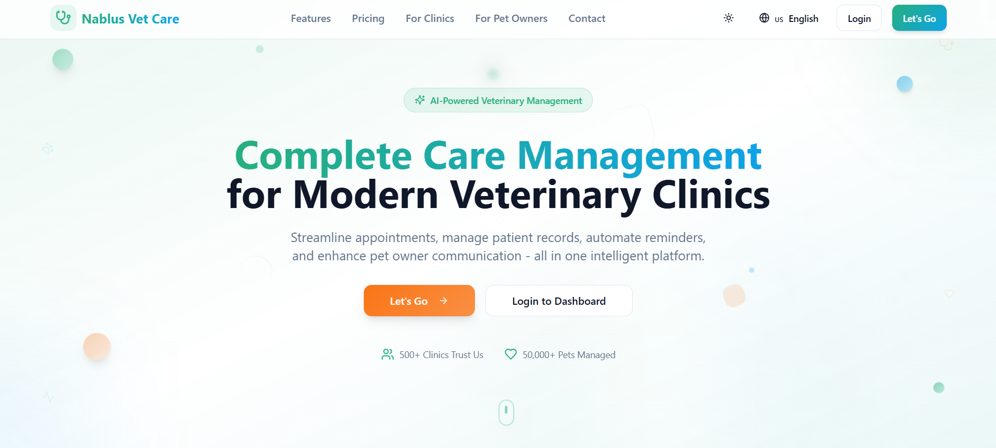
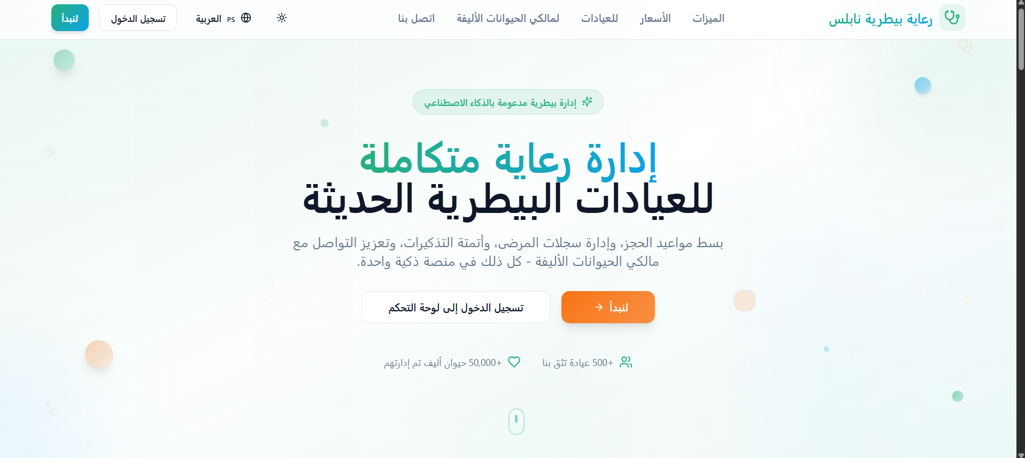
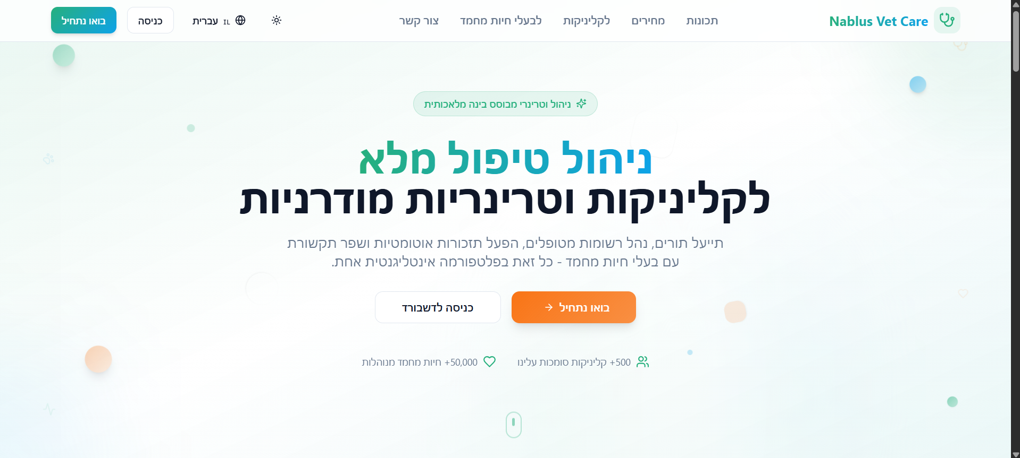
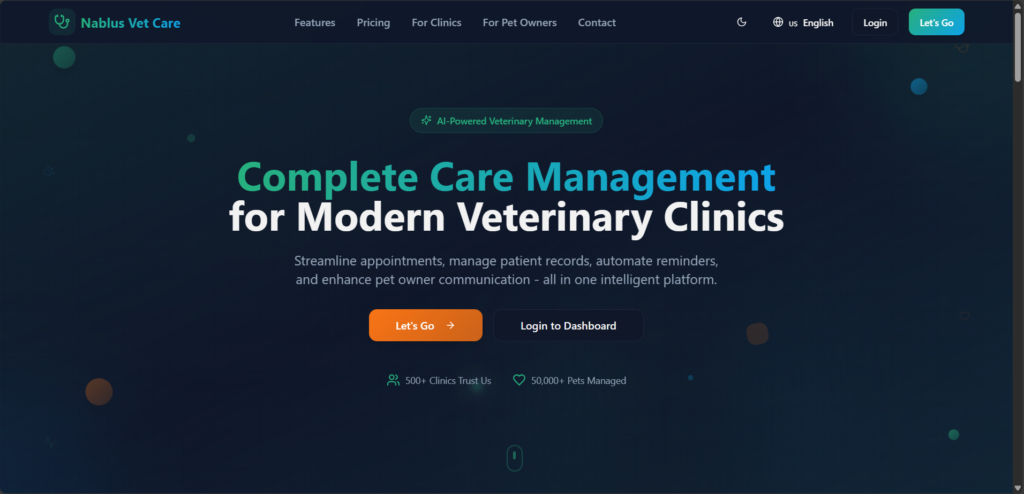
Landing Page

Slide 25
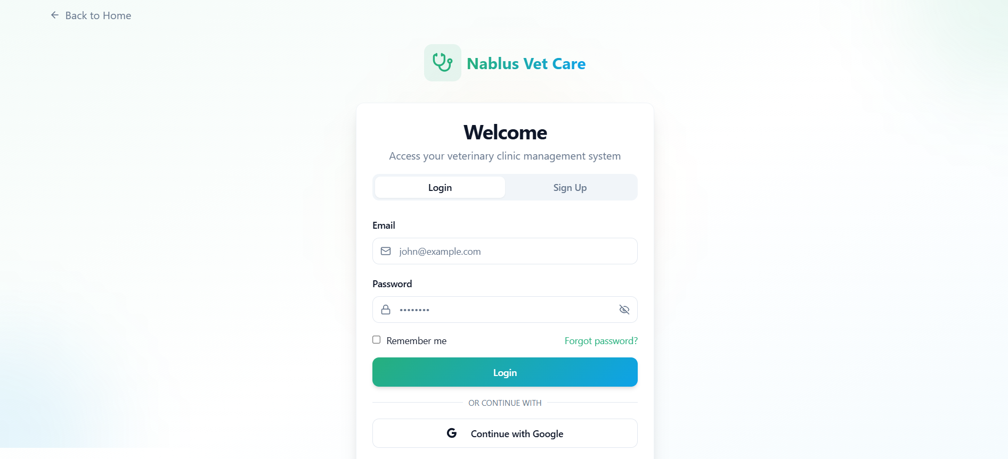
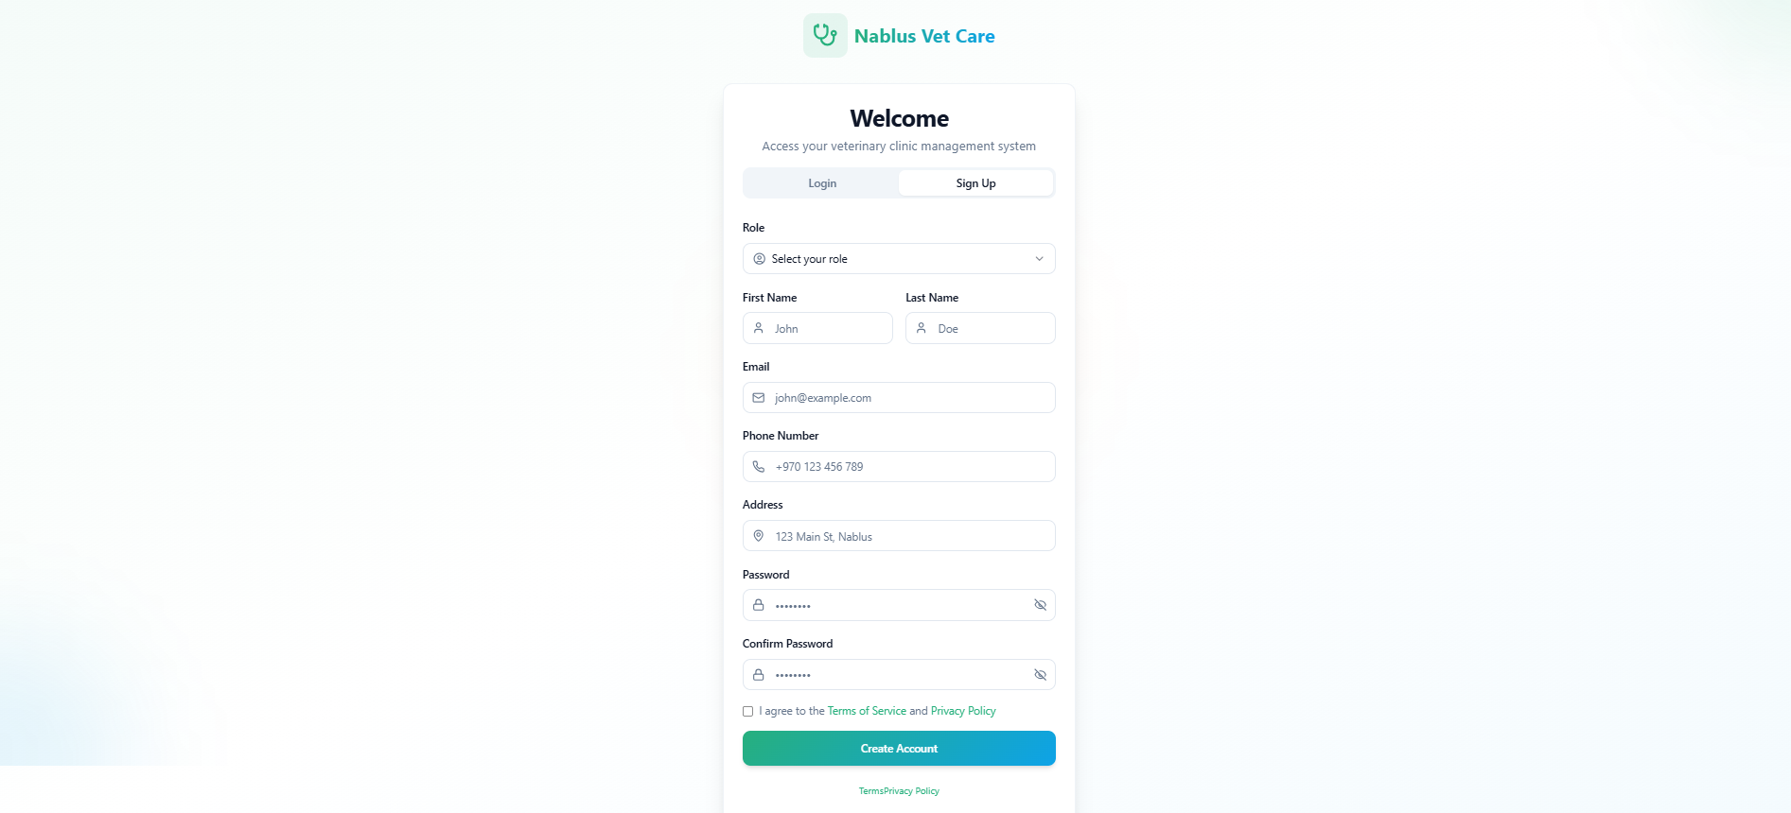
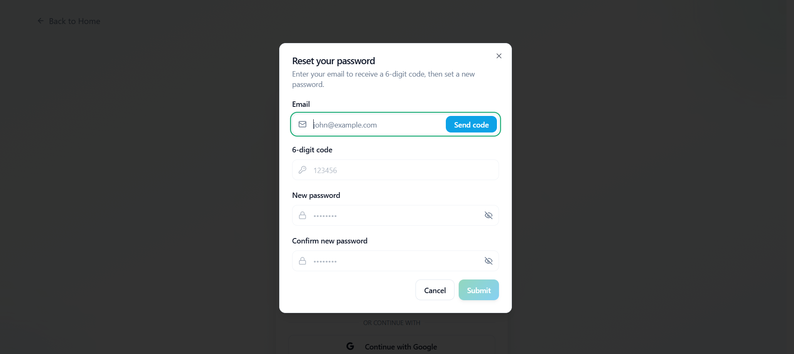
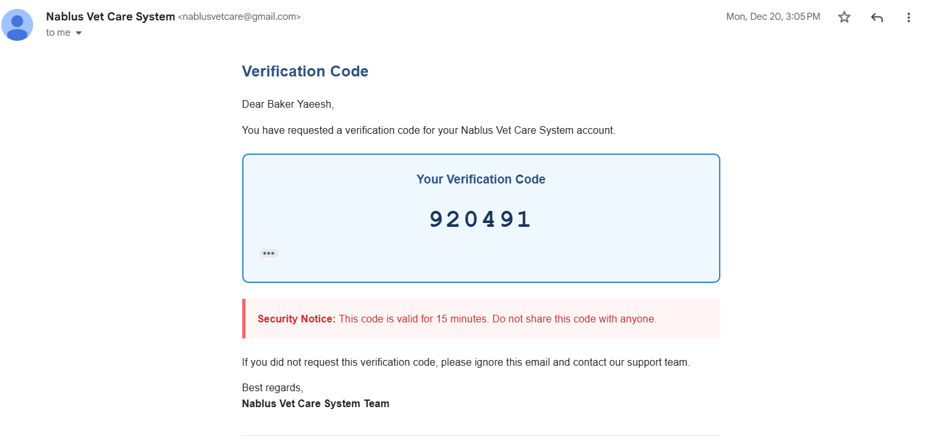
Login and signup

Slide 26
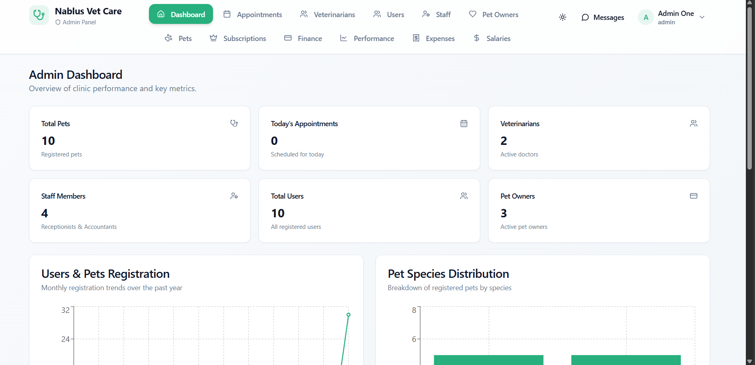
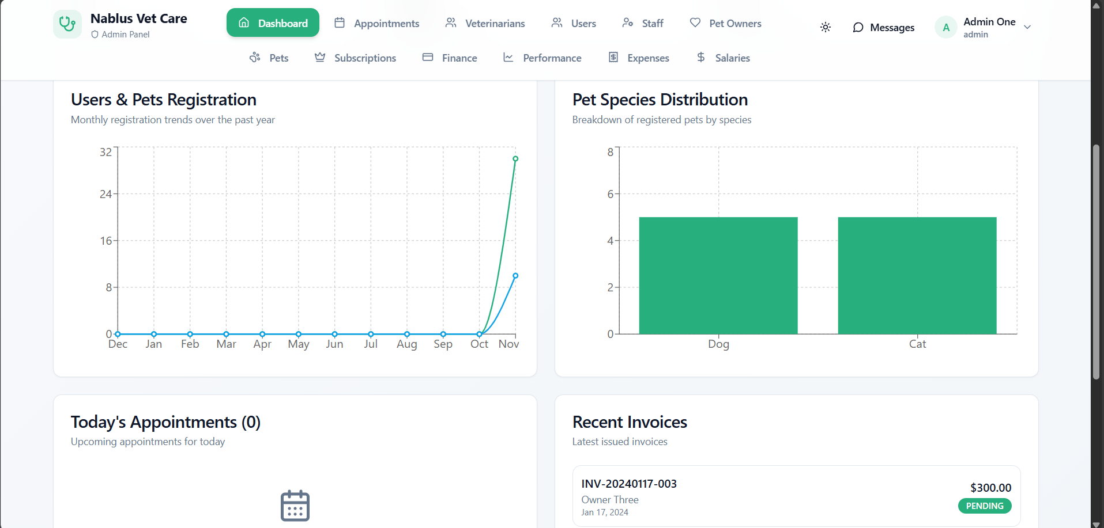
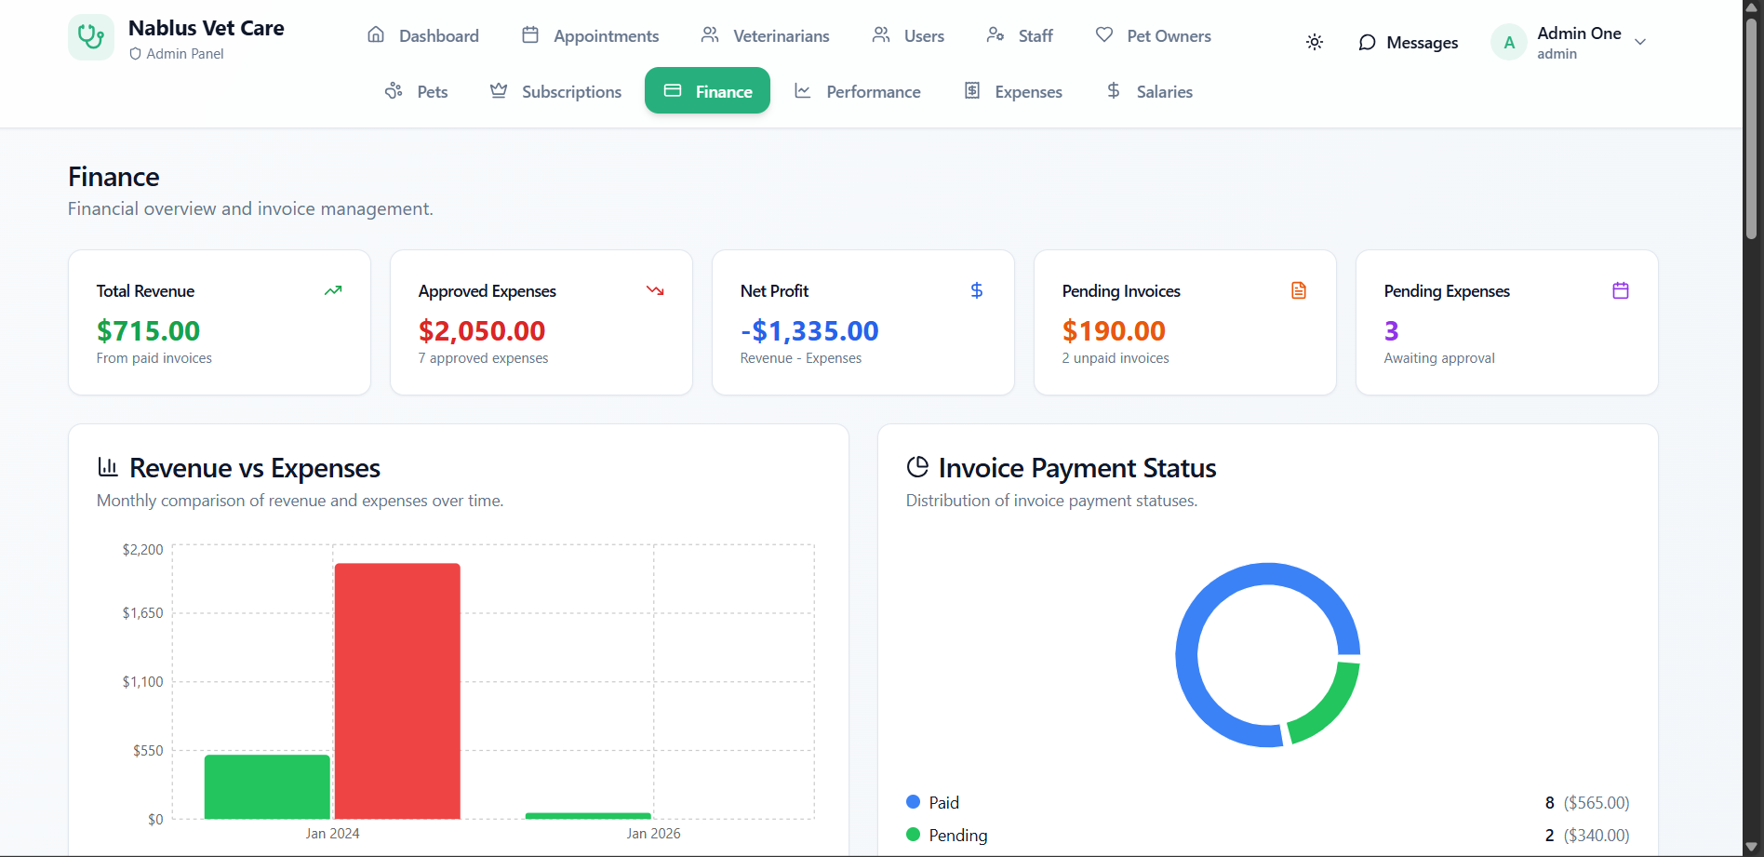
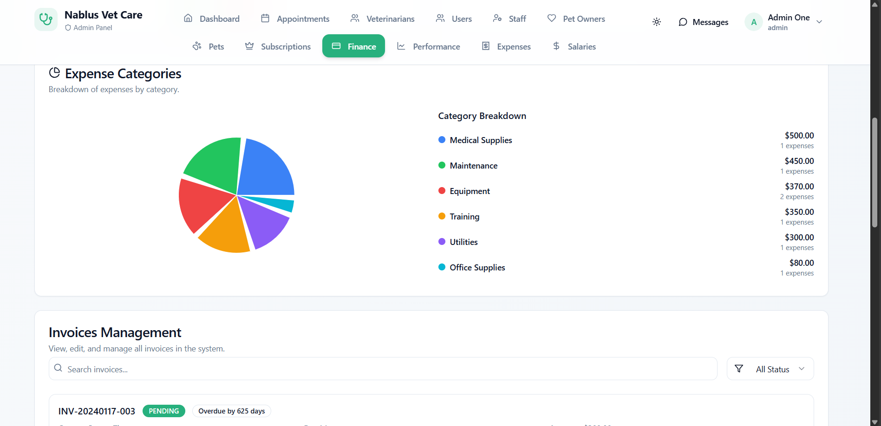
Admin

Slide 27
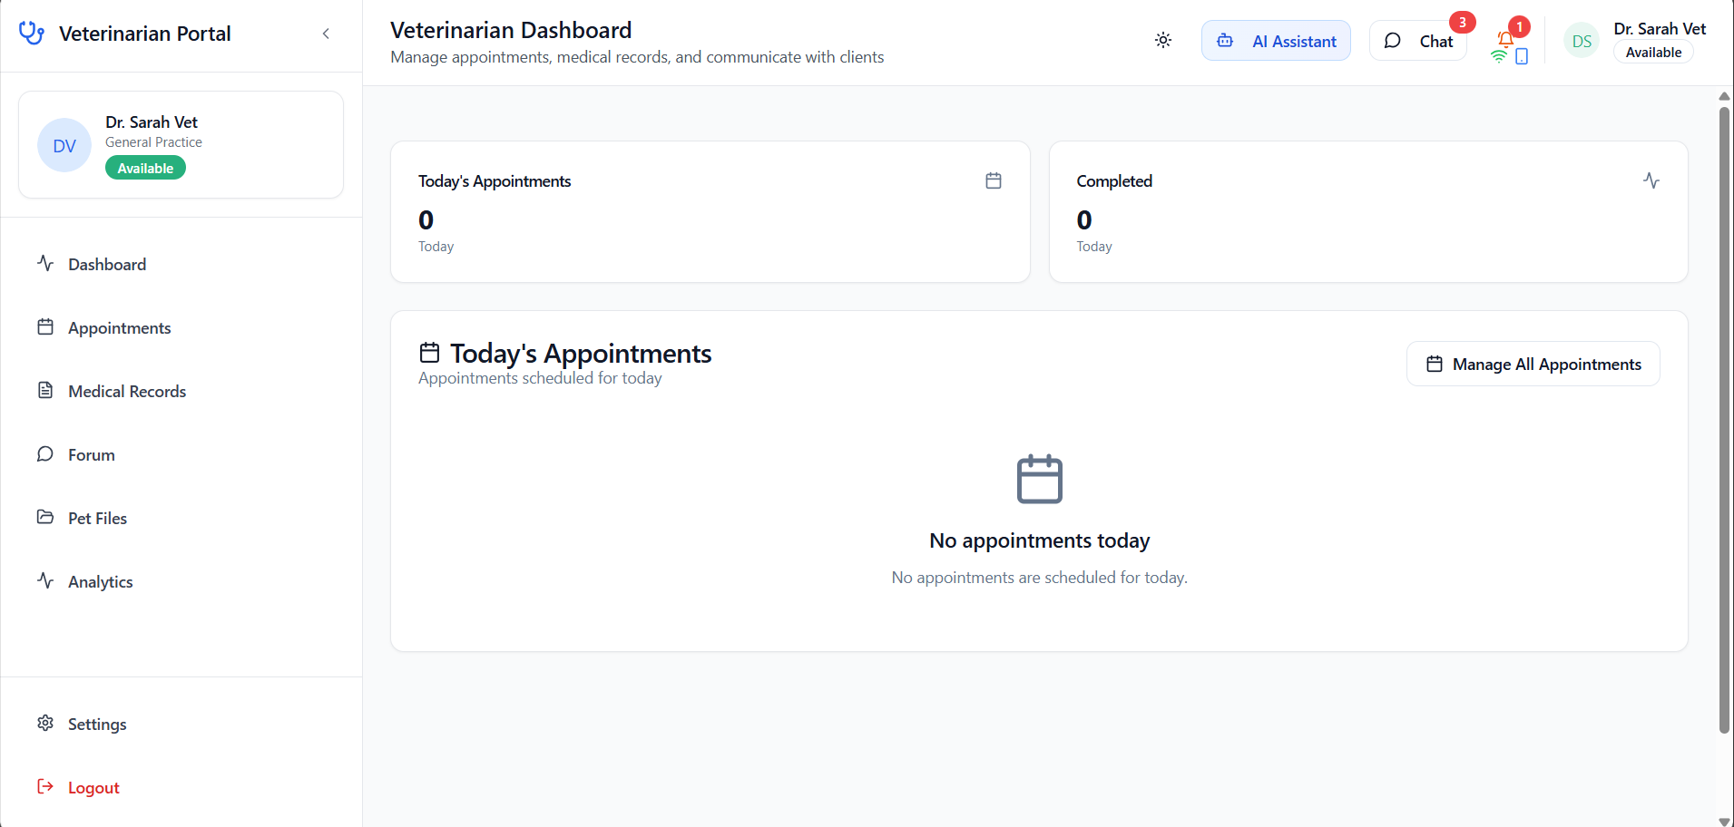
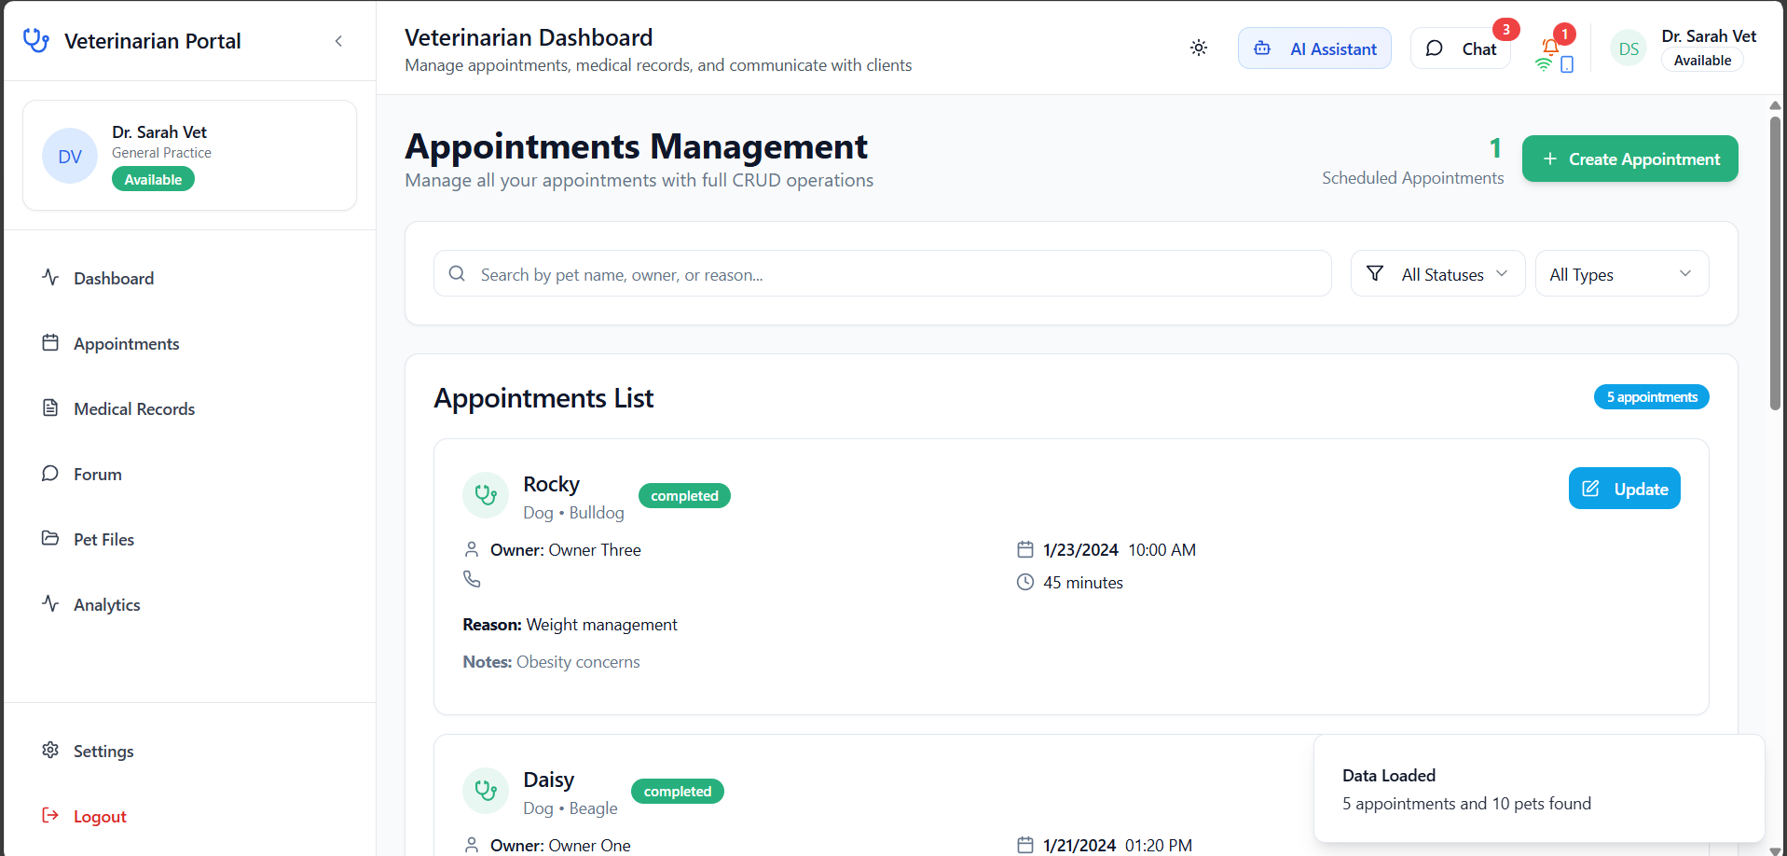
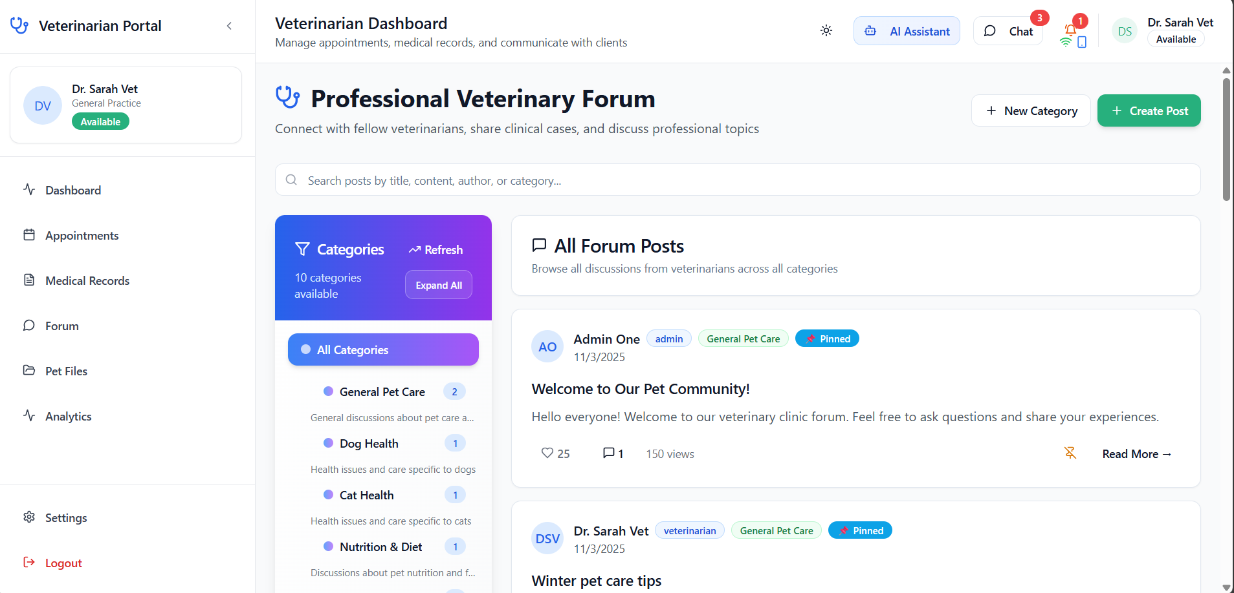
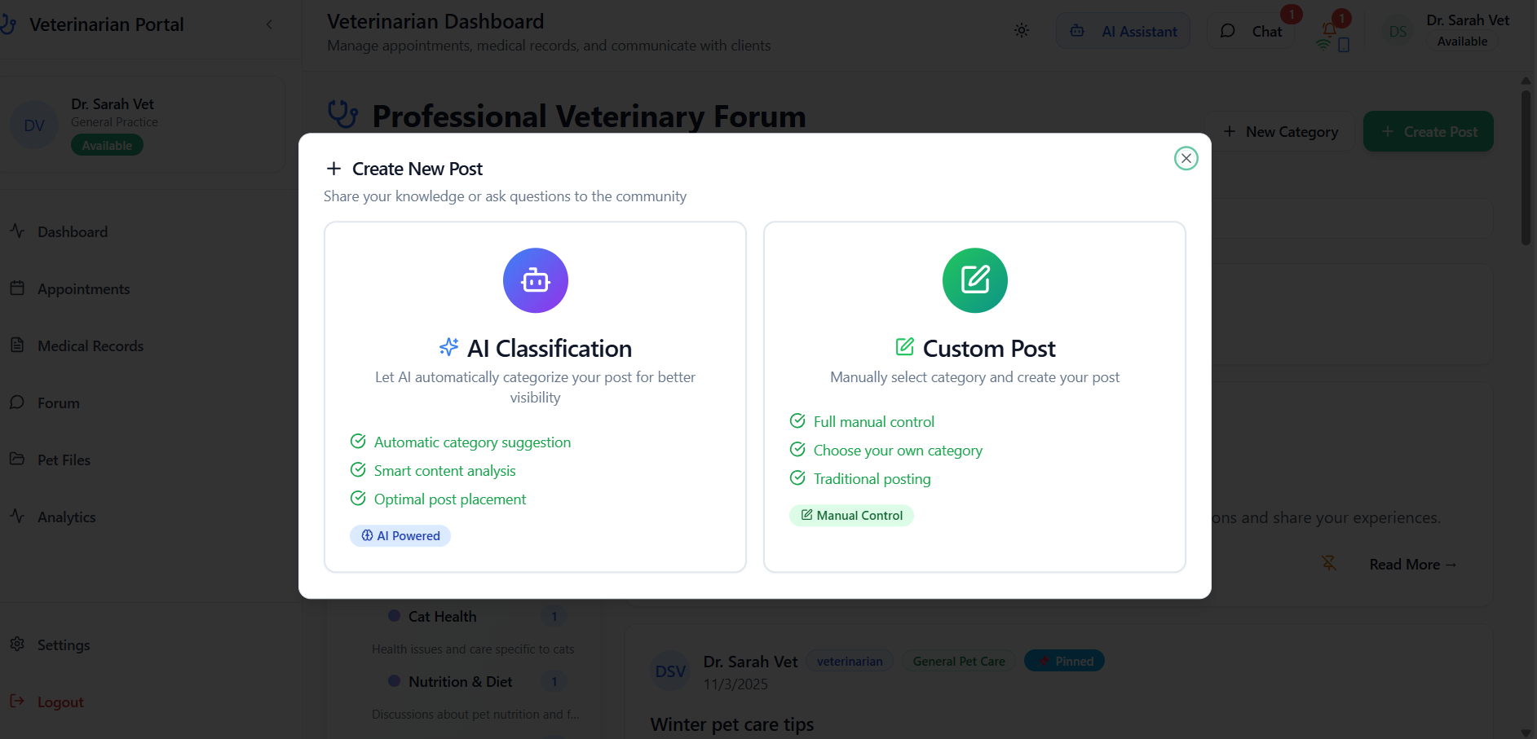
Veterinarian

Slide 28
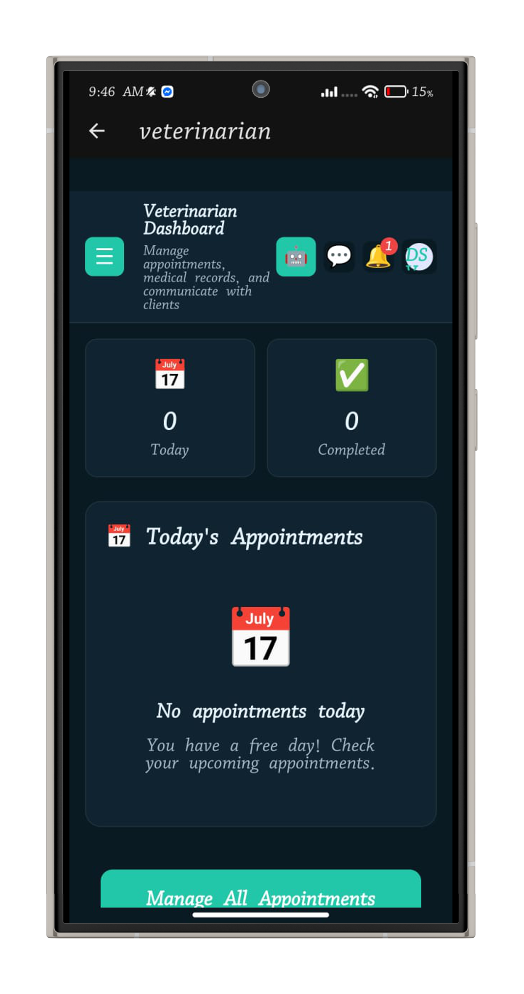
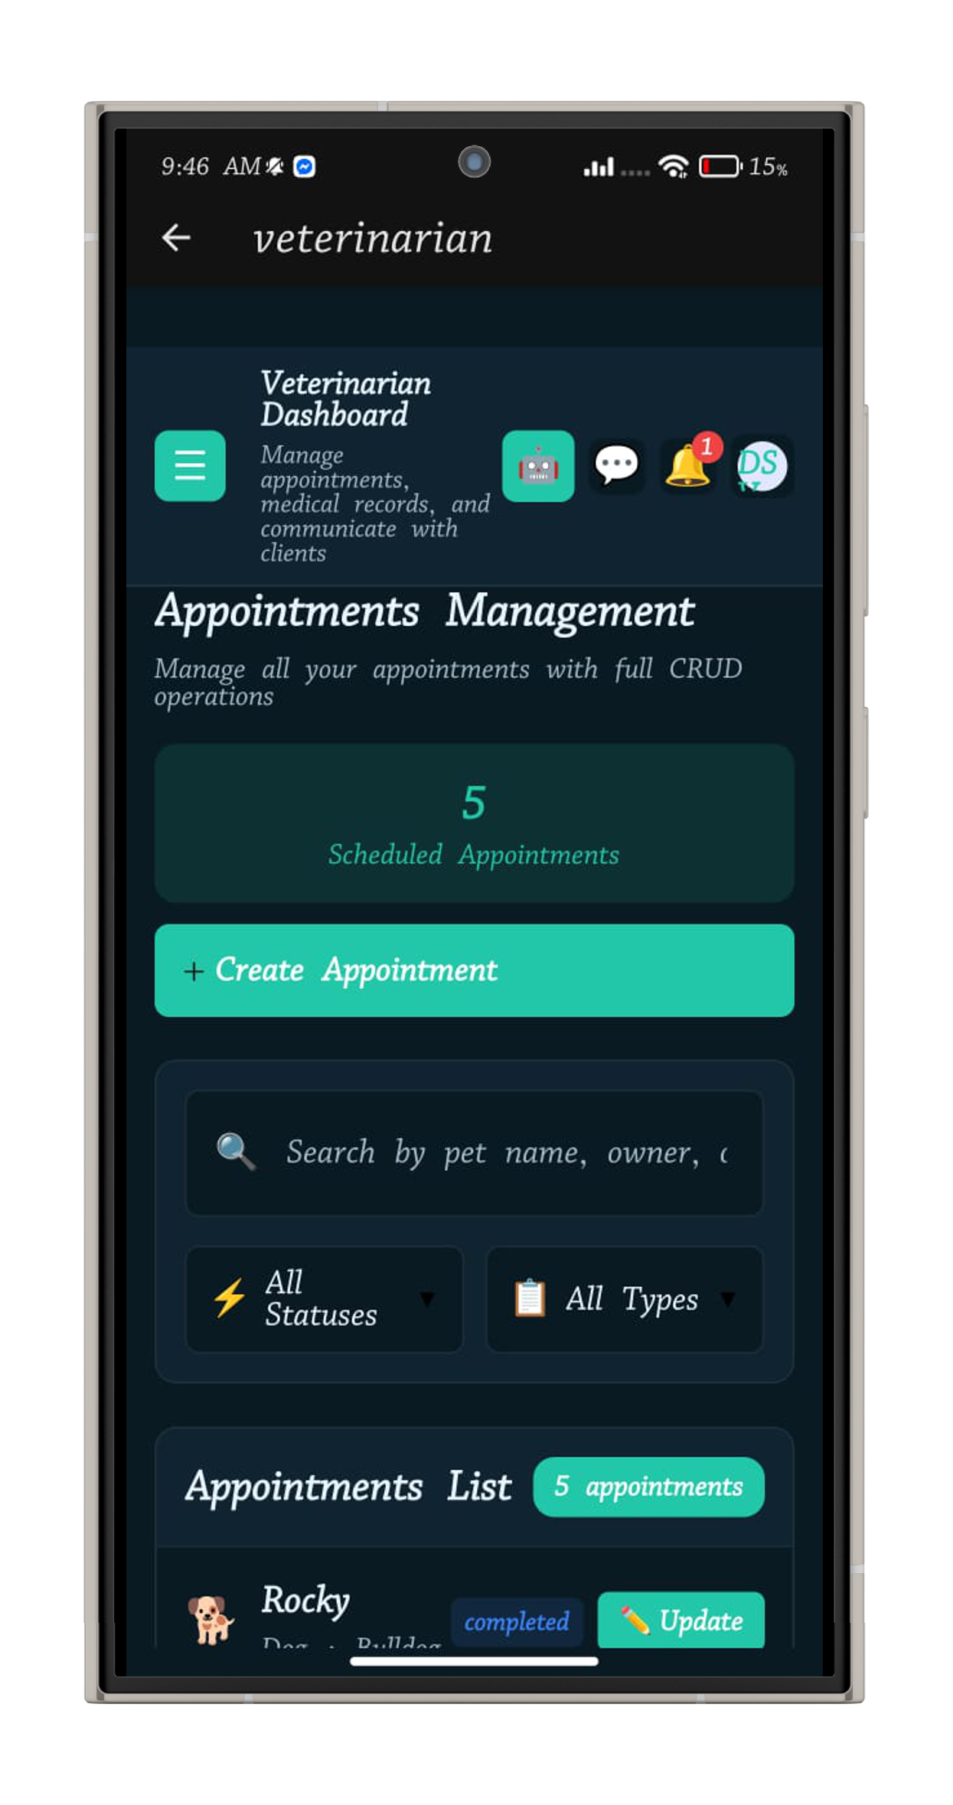
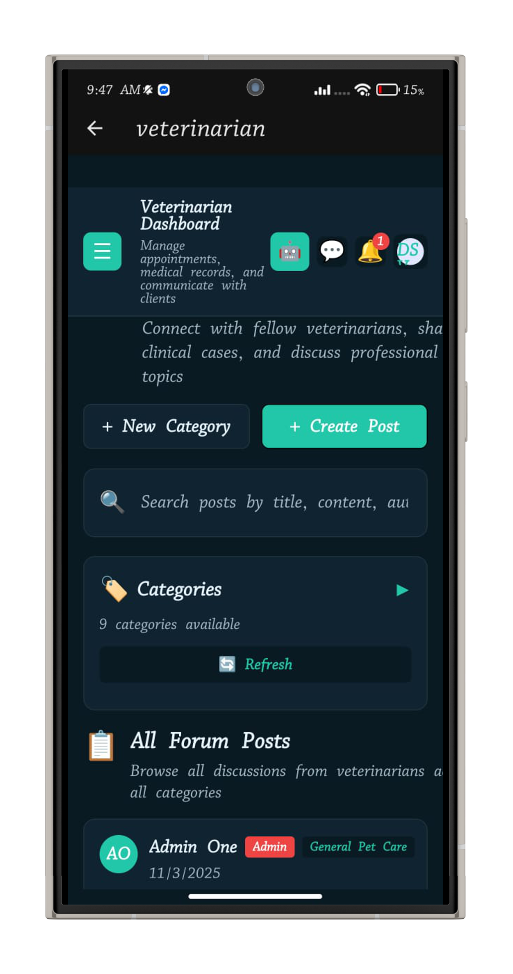
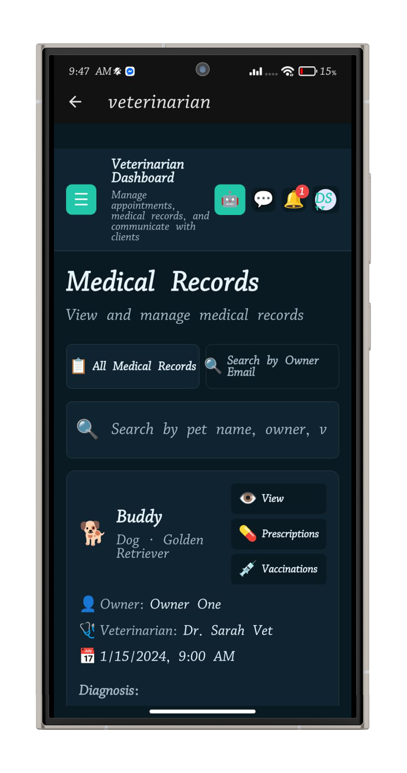
Veterinarian

Slide 29
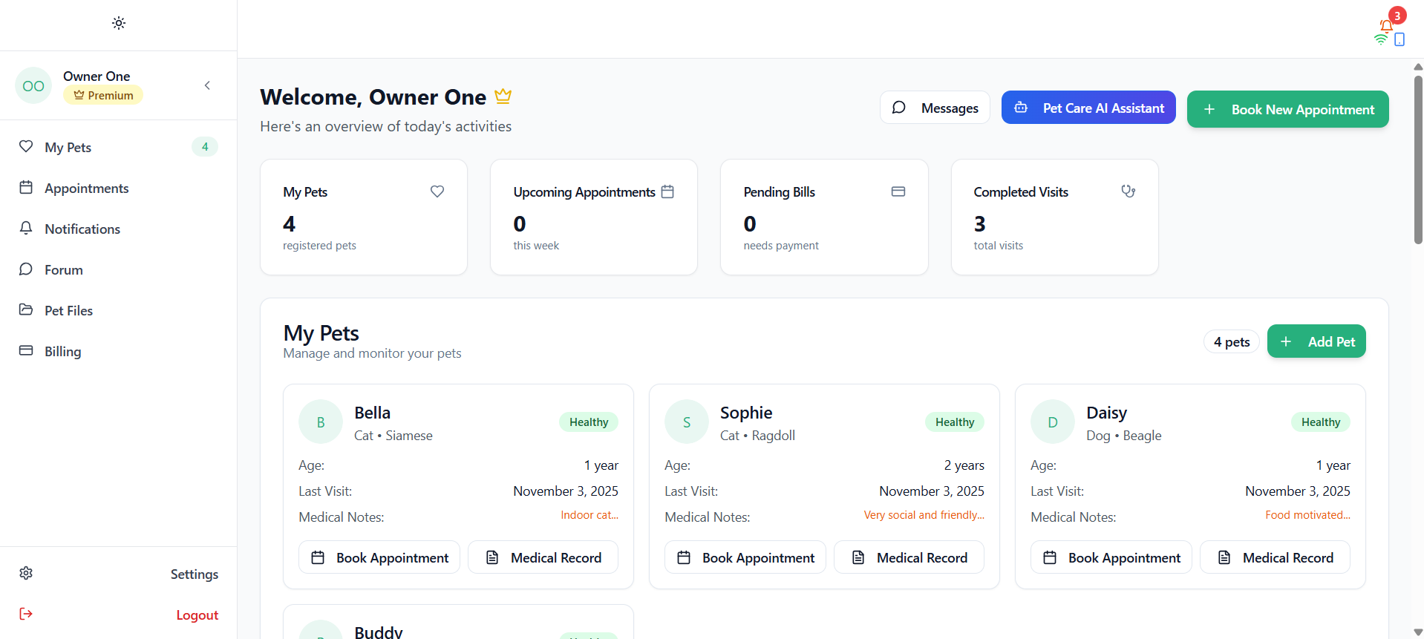
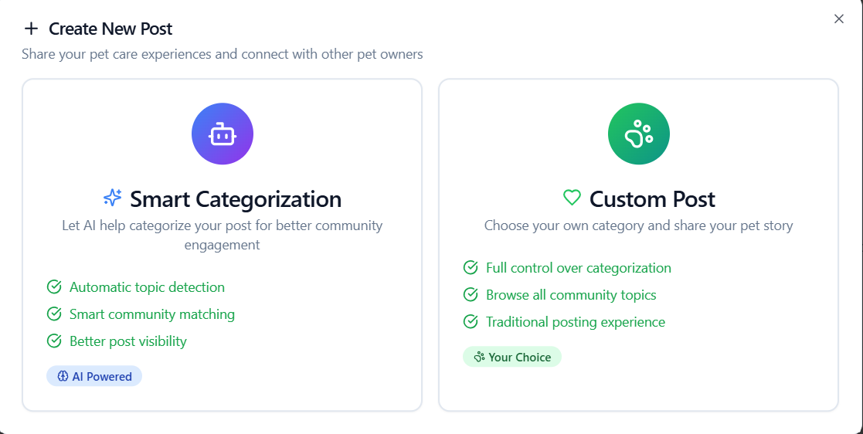
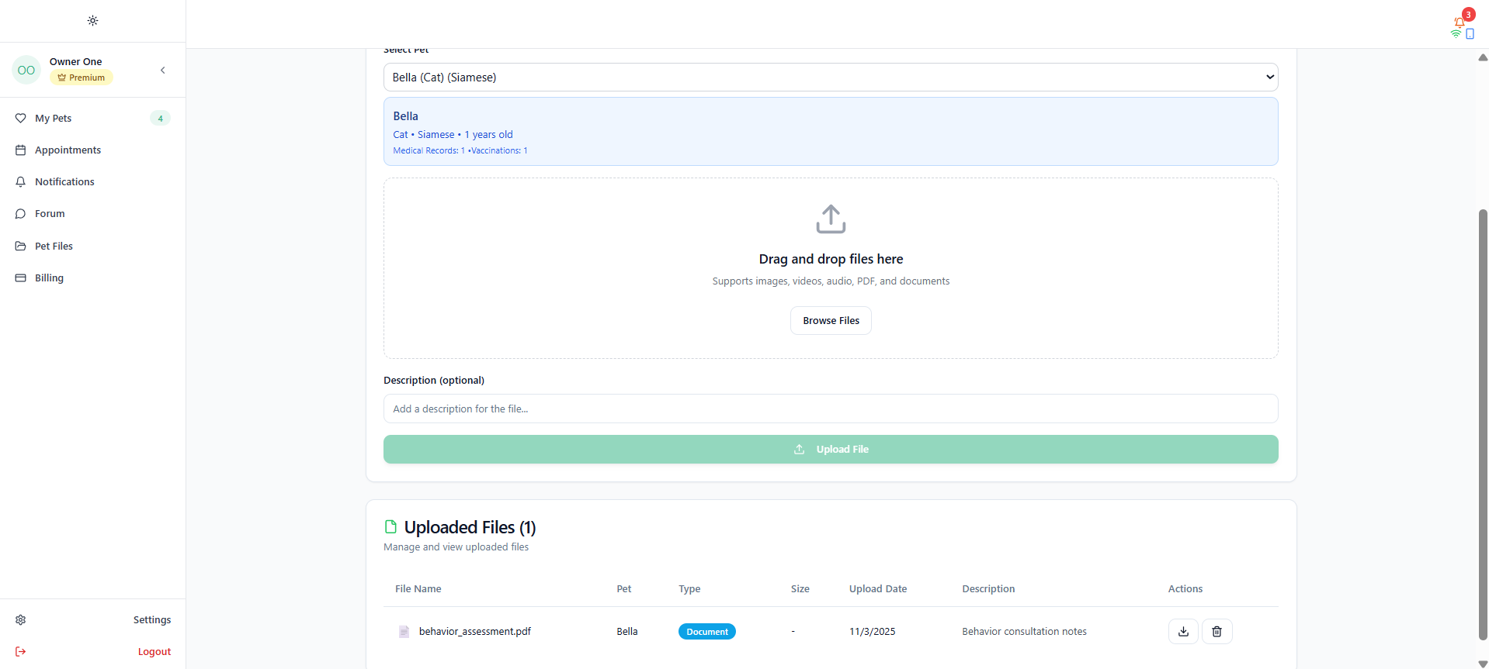
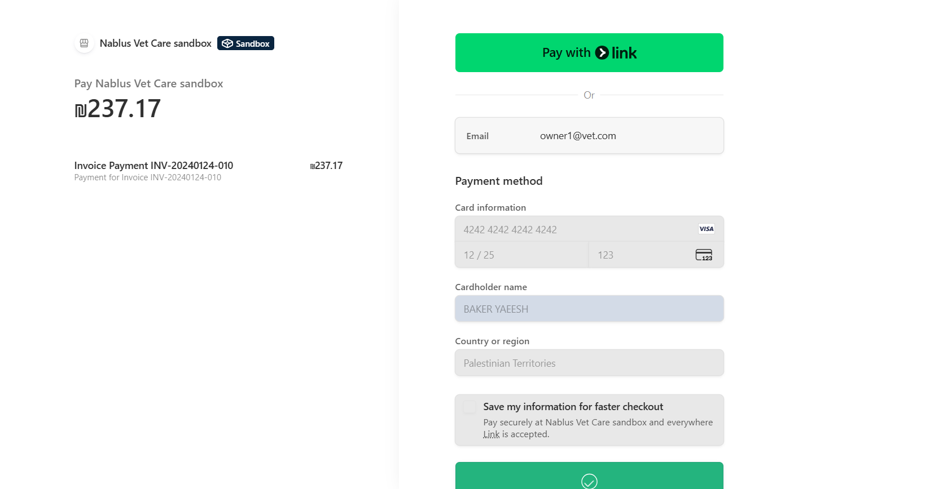
Pet Owner

Slide 30
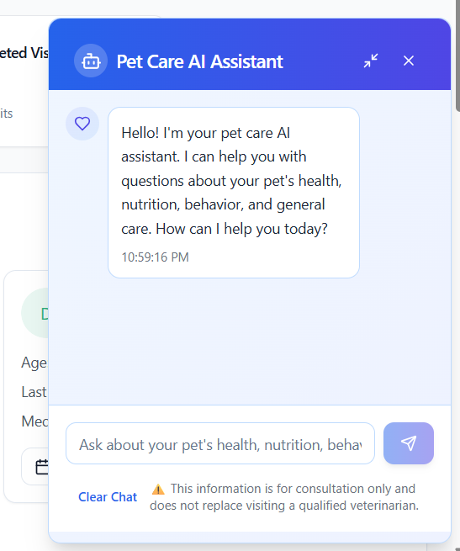
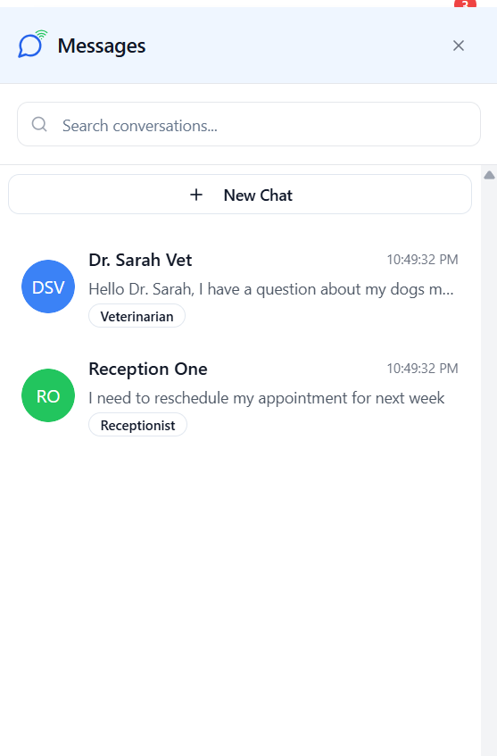
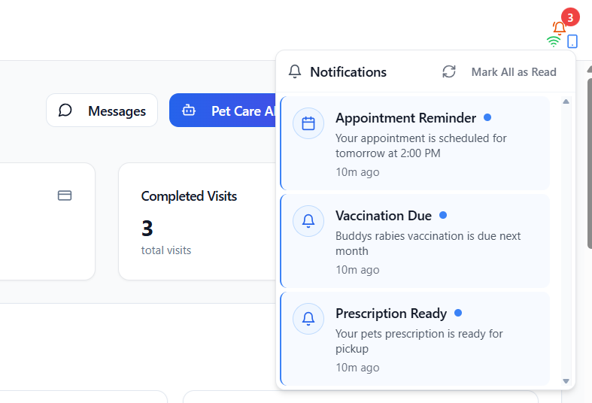
Pet Owner

Slide 31
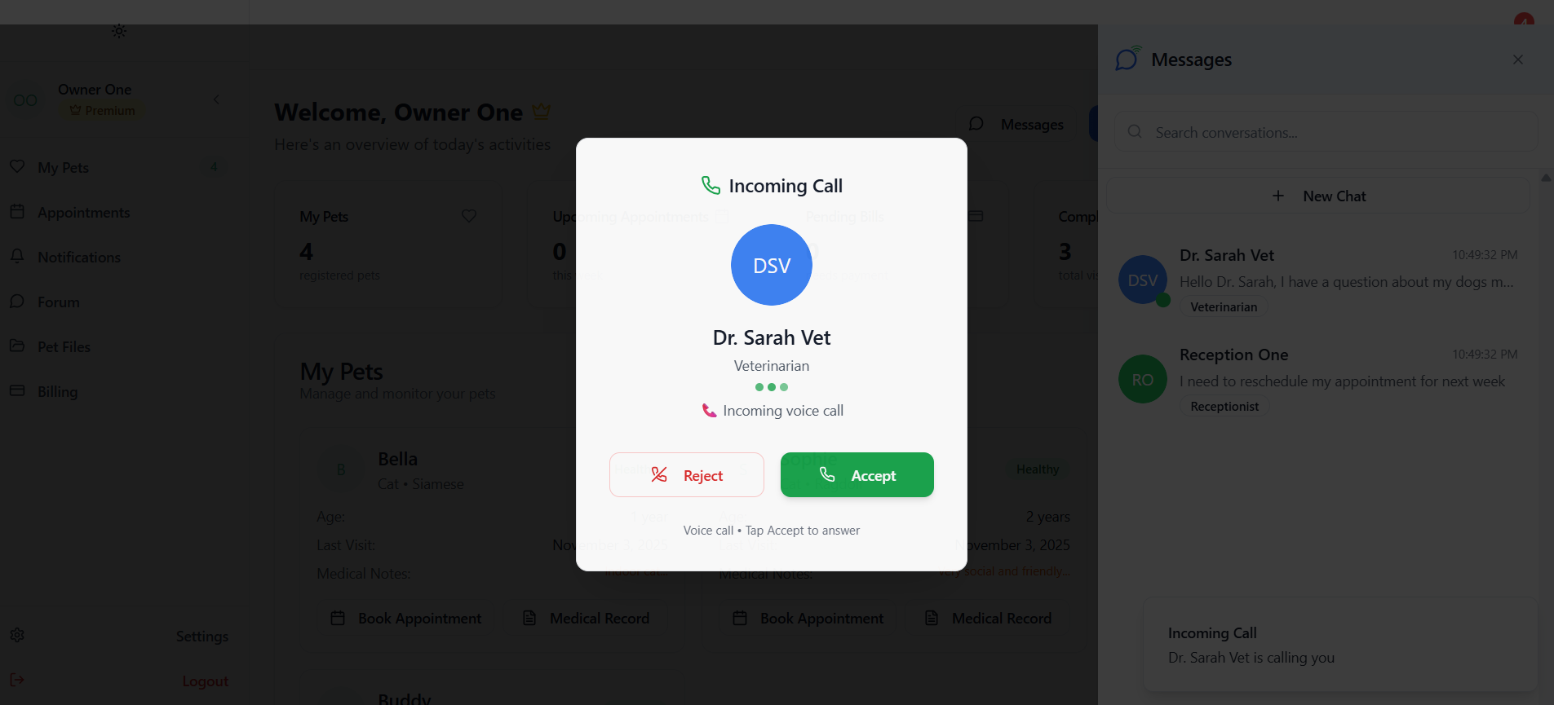
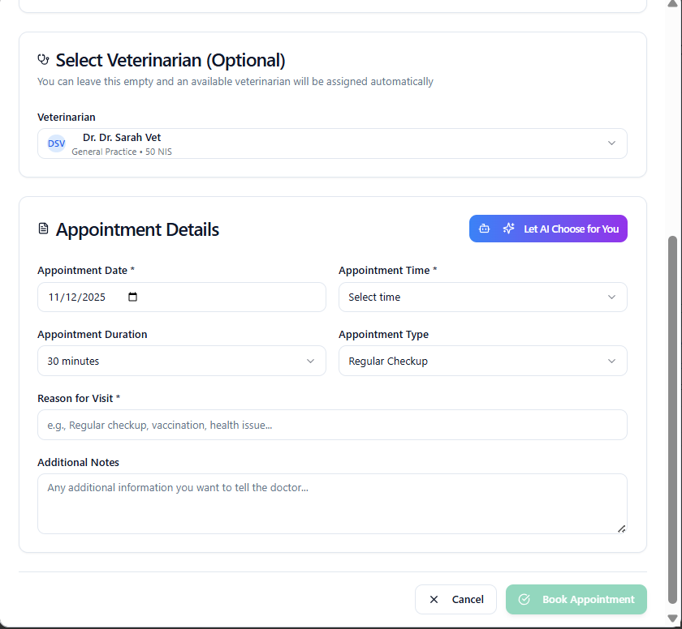
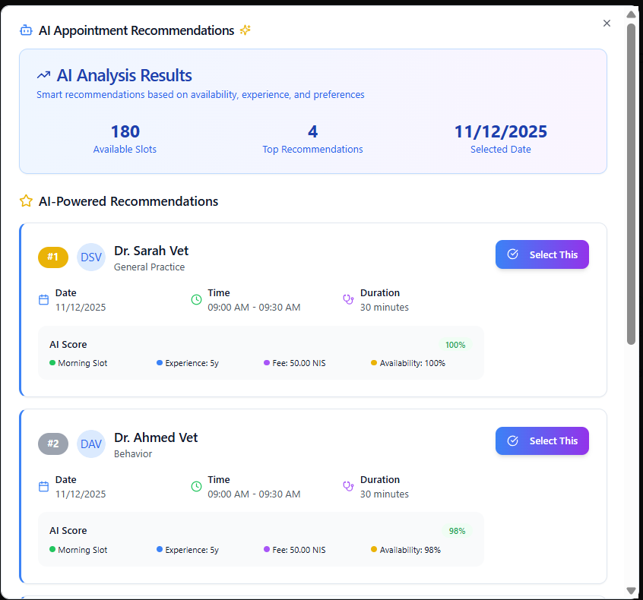
Pet Owner

Slide 32
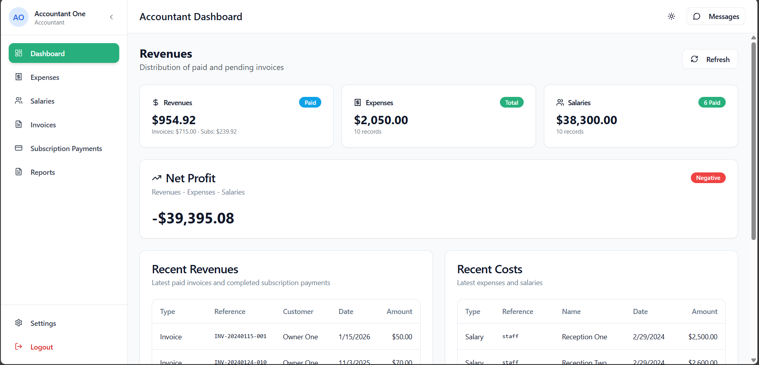
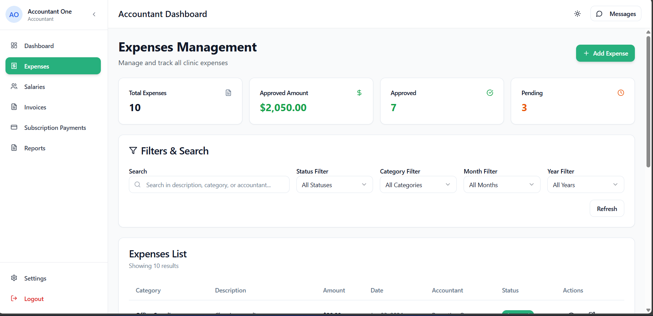
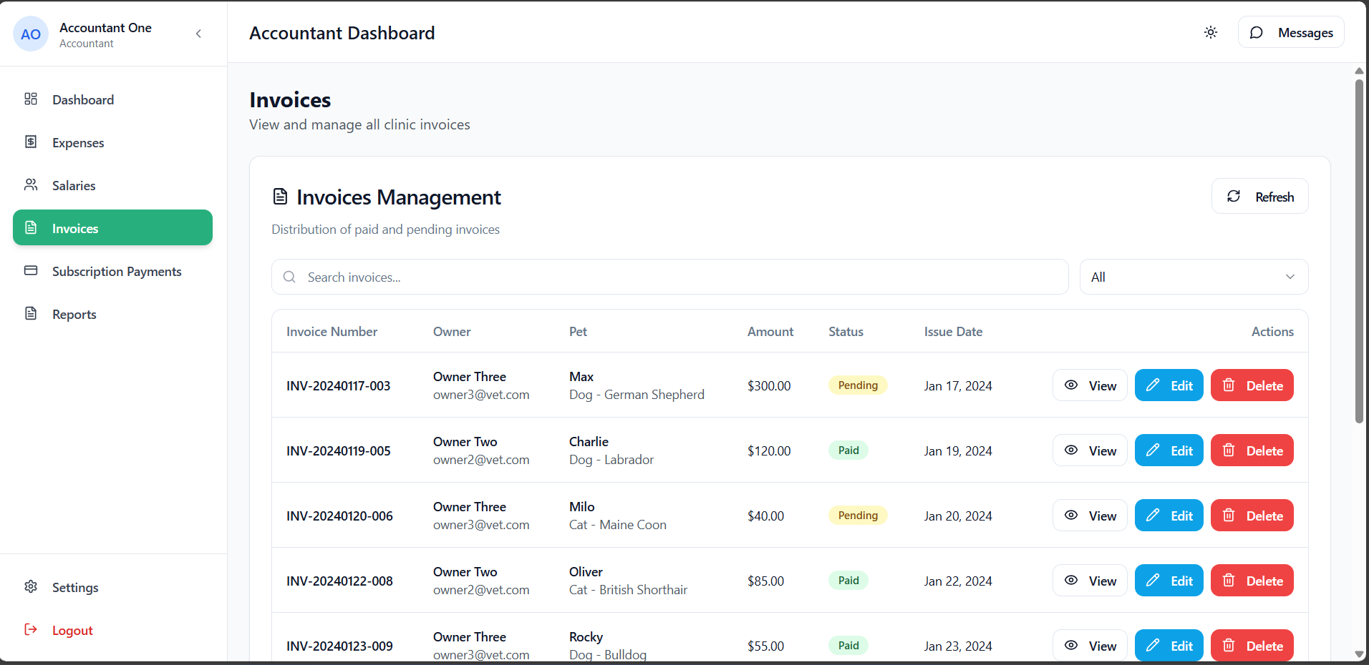
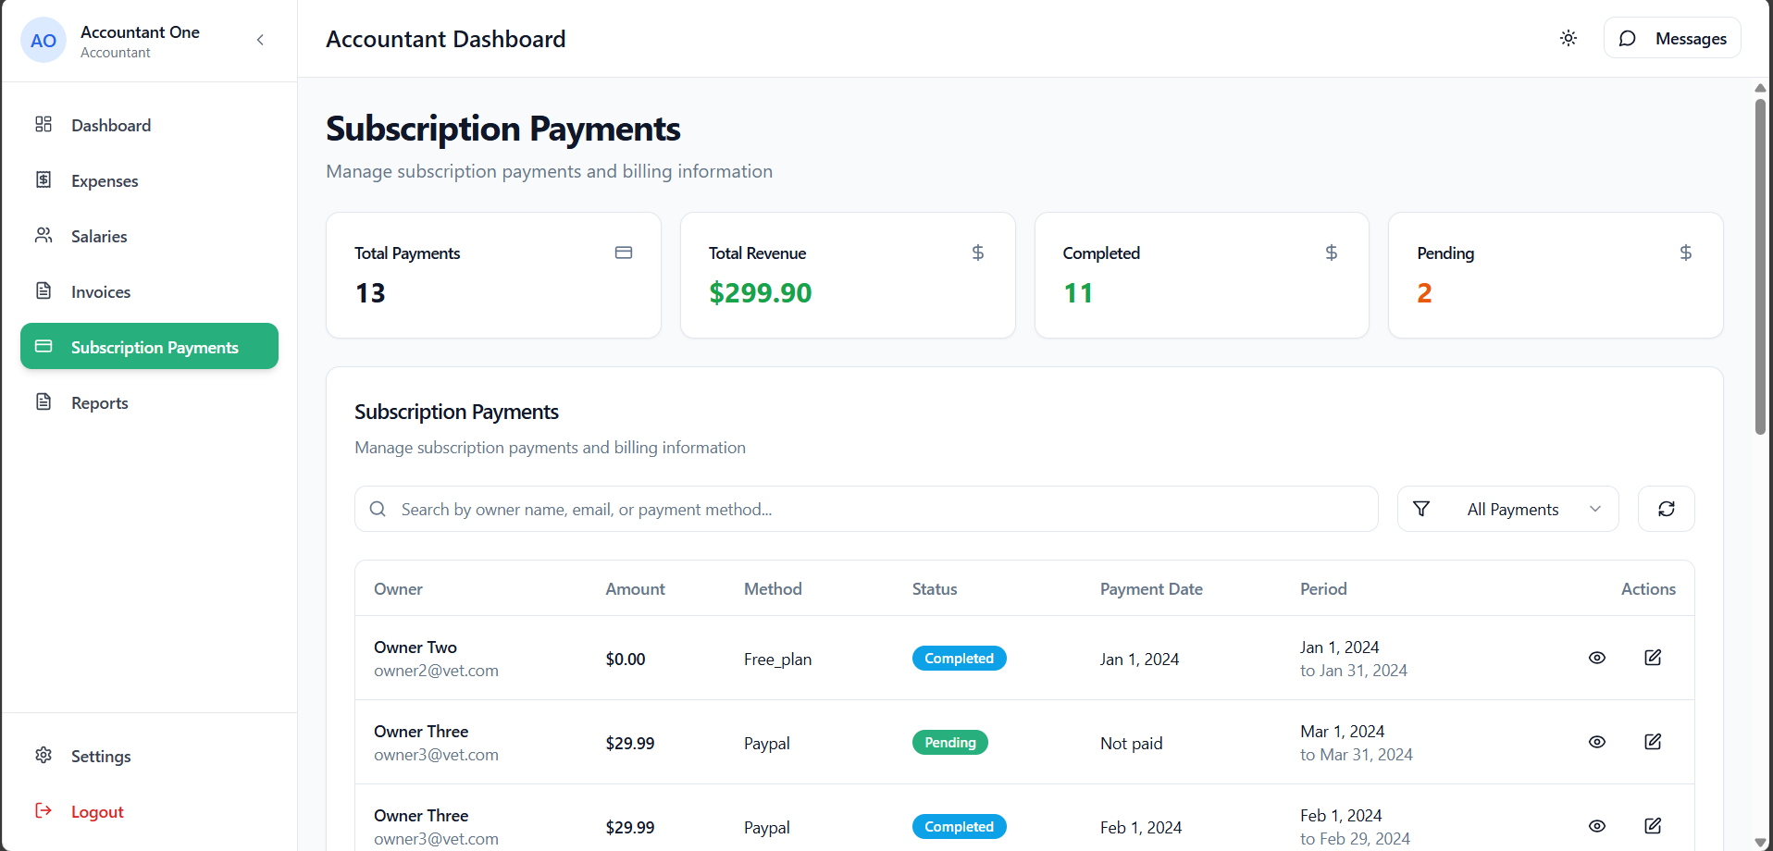
Accountant

Slide 33
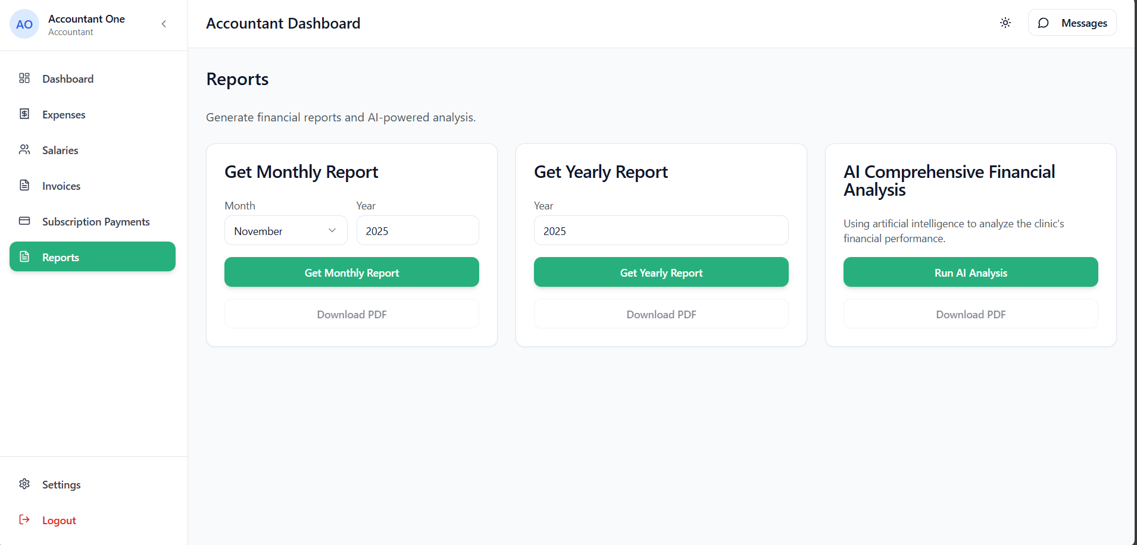
Accountant

Slide 34
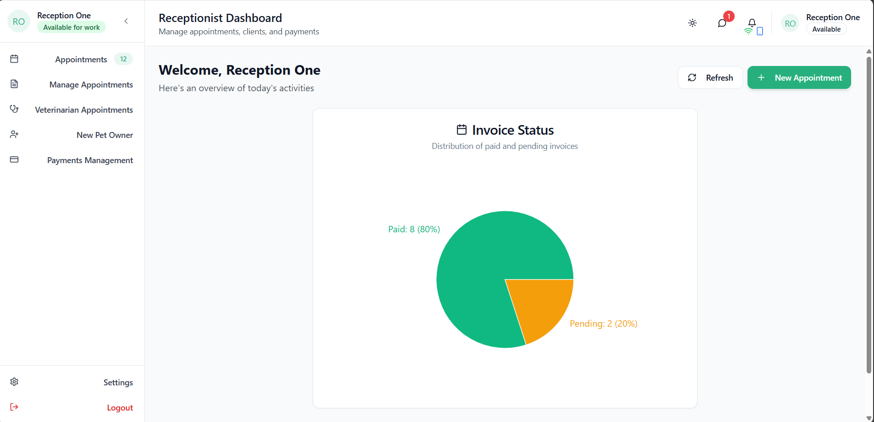
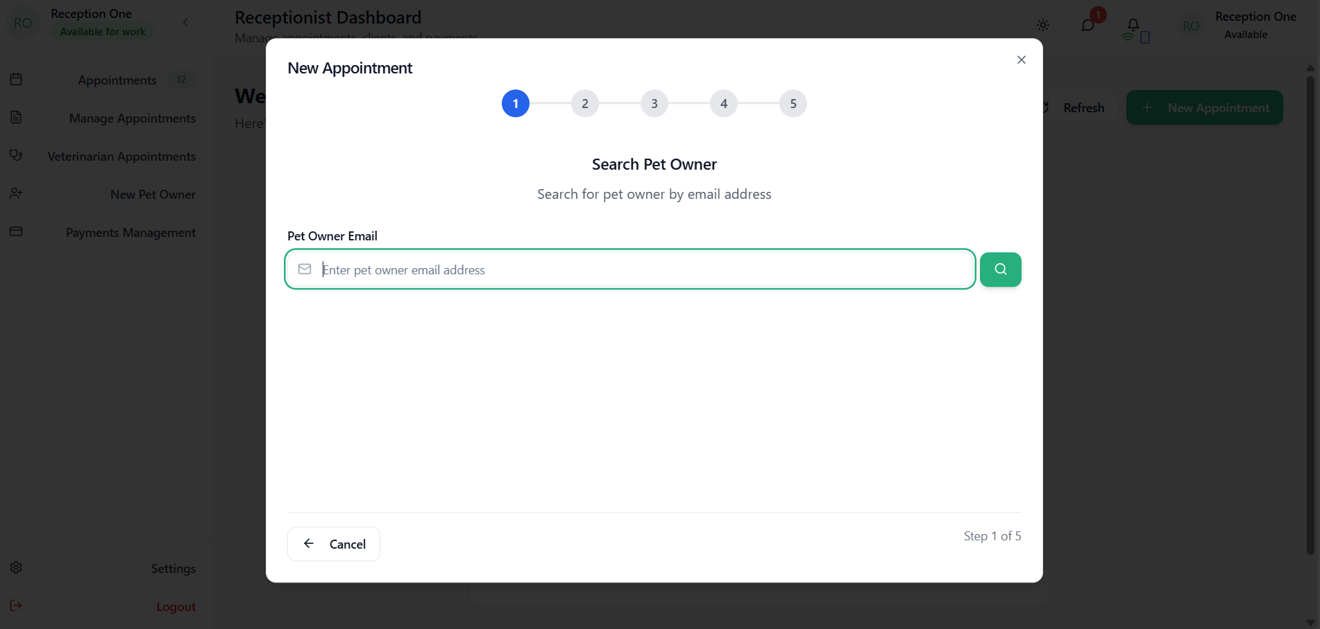
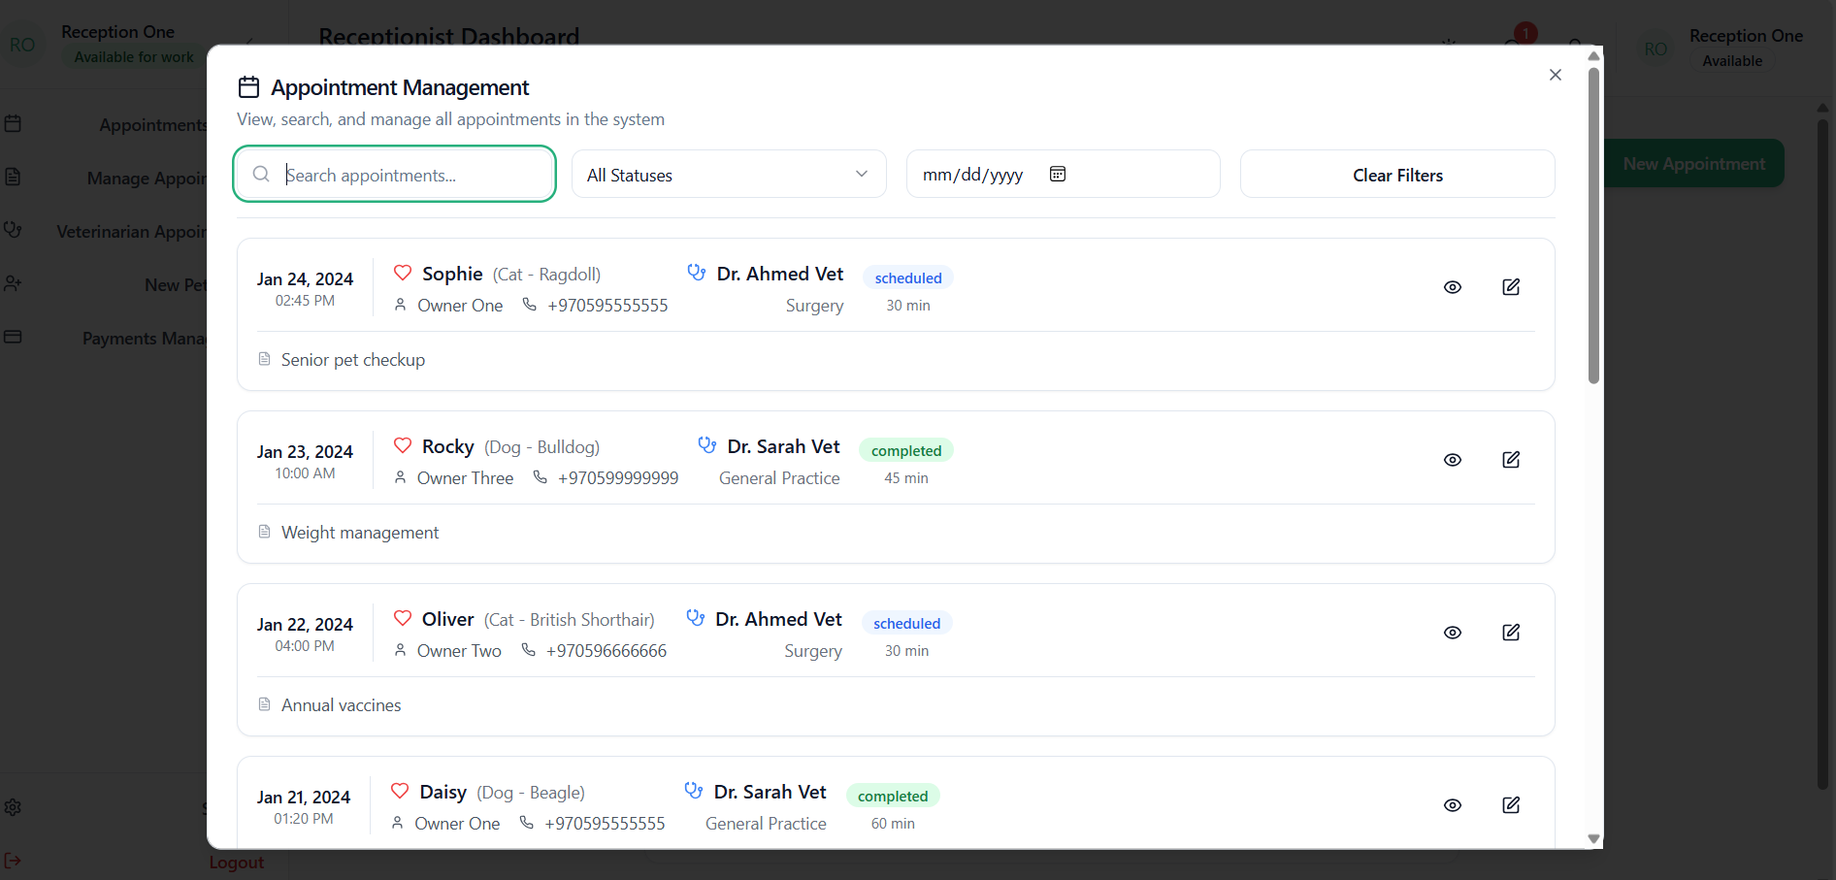
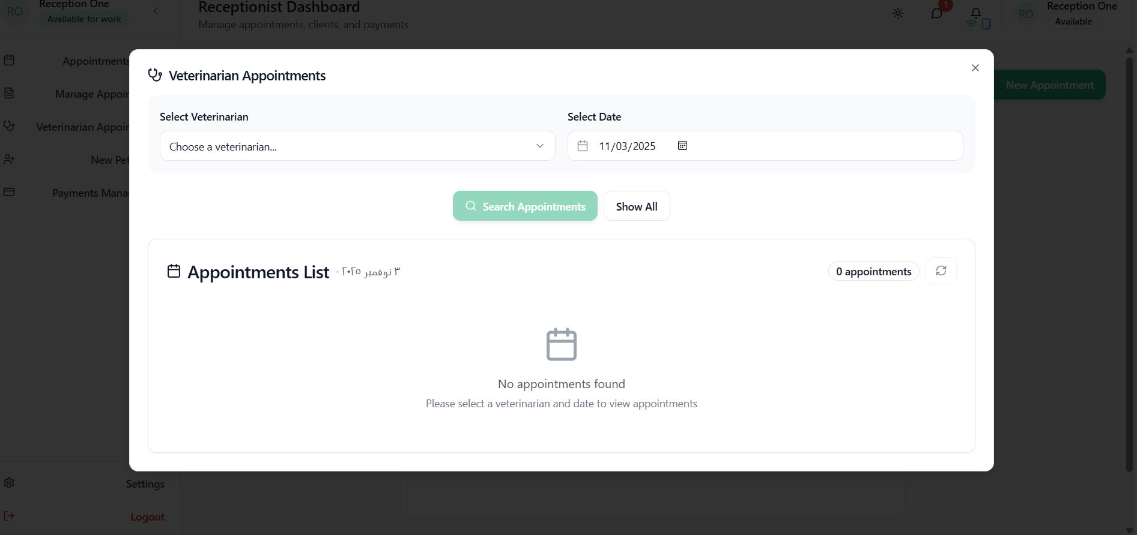
Receptionist

Slide 35
06
Future Development

Slide 36
Suggested Improvements
Predictive Analytics
Expand AI for proactive health monitoring and early interventions.
Enhanced Telemedicine
Add video consultations and remote vital monitoring.
System Interoperability
Integrate with external labs and diagnostic equipment.

Slide 37
Potential Extensions
IoT Integration
Educational Resources
Connect with wearable pet health monitors for real-time tracking.
Add interactive pet care guides and nutritional planning tools.
Blockchain for Records
Expanded Language Support
Explore secure, immutable medical record sharing between clinics.
Add more languages and regional dialects for inclusivity.

Slide 38
07
Conclusion and Thanks

Slide 39
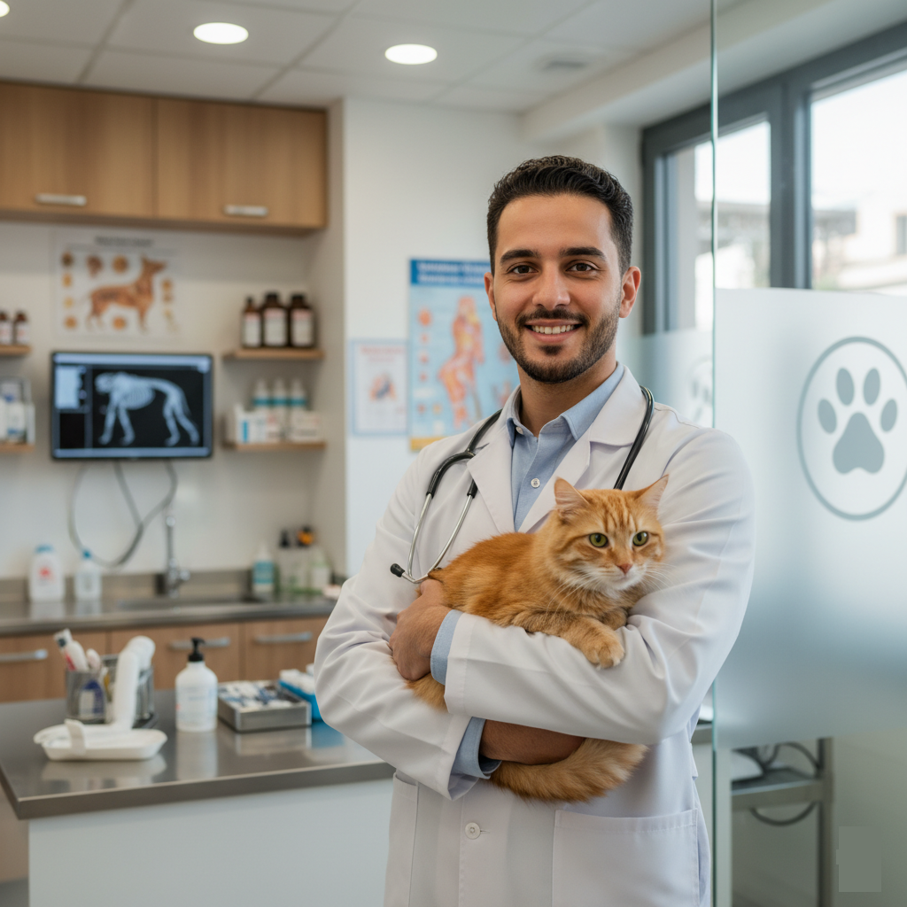
Project Achievements Summary
Nablus Vet Care has successfully delivered a transformative digital platform for veterinary management.
Improved operational efficiency and reduced admin overhead.
Enhanced patient care through AI-assisted diagnostics.
Increased satisfaction for both staff and pet owners.
Created a seamless, organized, and effective veterinary care ecosystem.

Slide 40
Overall Impact & Benefits
For Veterinary Clinics
For Veterinary Staff
Modernizes operations, automates routine tasks, and provides intelligent business insights, positioning them as innovative healthcare providers.
Reduces administrative burden, enhances clinical decision-making with AI, and improves workflow efficiency.
For Pet Owners
For the Industry
Provides convenient access to pet health information, easy appointment booking, and direct communication with their vet.
Represents a significant advancement in veterinary practice management, setting a new standard for care delivery.

Slide 41
🎓 Acknowledgments 🙏
We express our deepest gratitude to Almighty Allah for His guidance and support throughout this project.
Our heartfelt appreciation goes to our supervisor,
🌟 Dr. Hanal Abuzant 🌟
, for his continuous support and invaluable guidance.
We are sincerely thankful to
❤️ our families ❤️
for their unwavering love, patience, and encouragement.
Finally, we thank our friends for their collaboration and positivity throughout this journey.

Slide 42

THANK YOU

