Slide 1
Beehive Robot
Presented by : Bassam A Yaseen & Laila abu kahlifa
Supervisors: Dr.Alaadin Almasry & Dr.Haya Sammaneh

Slide 2
Contents
Introduction
Objectives
Technologies and Methods
Constraints
Future work & recommendation

Slide 3
Introduction
Beehive Robot : is a robot that is capable of collecting the honey frame from beehives controlled by android application via Bluetooth.

Slide 4
Introduction
Problems :
bees are considered dangerous for human lives they can sting and kill humans if they are allergic to it.
Honey is considered one of the most valuable food for humans because it contains a lot of benefits so it’s important to raise bees and get honey.
The job of getting honey from beehives isn’t easy and takes time to wear the protection gear and go to get the frame and move the bees away from it.

Slide 5
Objectives
Reduce the time and effort needed to get honey from beehives
Reduce the human risk
The process of getting honey will be easier

Slide 6
Technologies and Methods
Hardware Components
Car body
12dc 2.5kg electric lifting magnet
Aurduino mega 2560
Linear actuator Motor 200mm Stroke
3* 18650 Li-ion battery
Battery holder 3
12v 60rpm DC Gear motor
Driver L298N

Slide 7
Hardware Components
Wheels
Metal ball caster wheel
Stepper Motor
Driver for the Stepper Motor
Breadboard
Relay Module
8mm rod
Support for 8mm
Linear bearing

Slide 8
Hardware Components
HC-5 Bluetooth
Coupler
Lead Screw

Slide 9
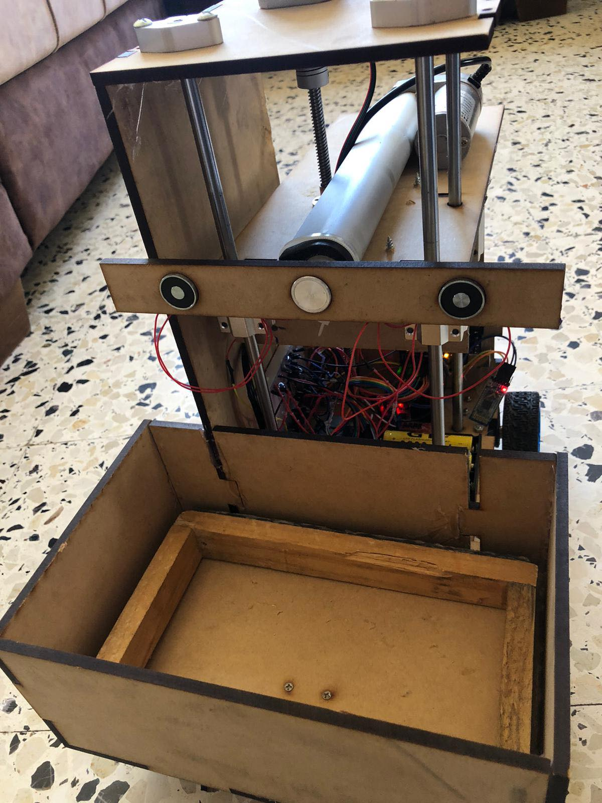
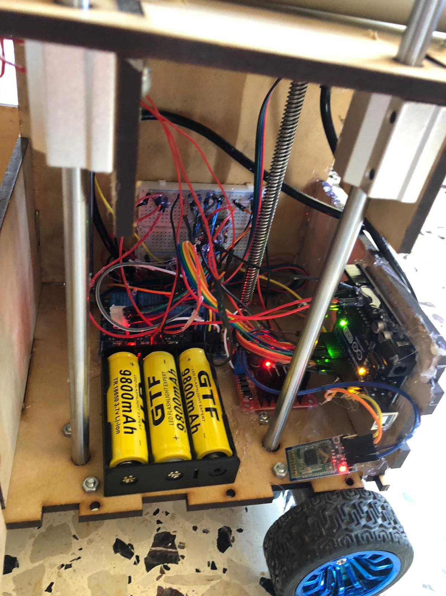

Slide 10
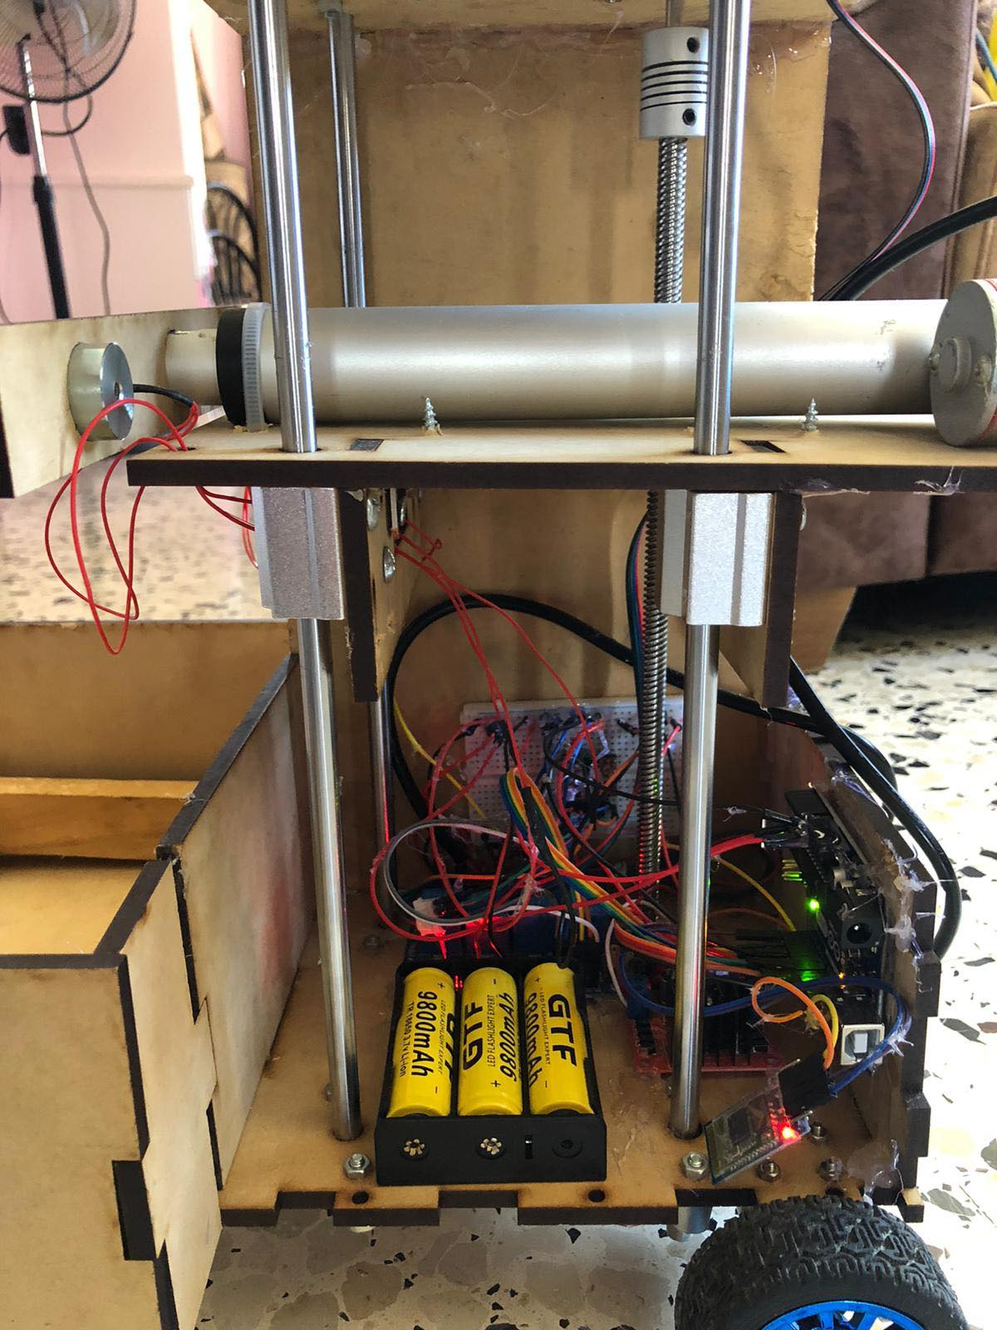
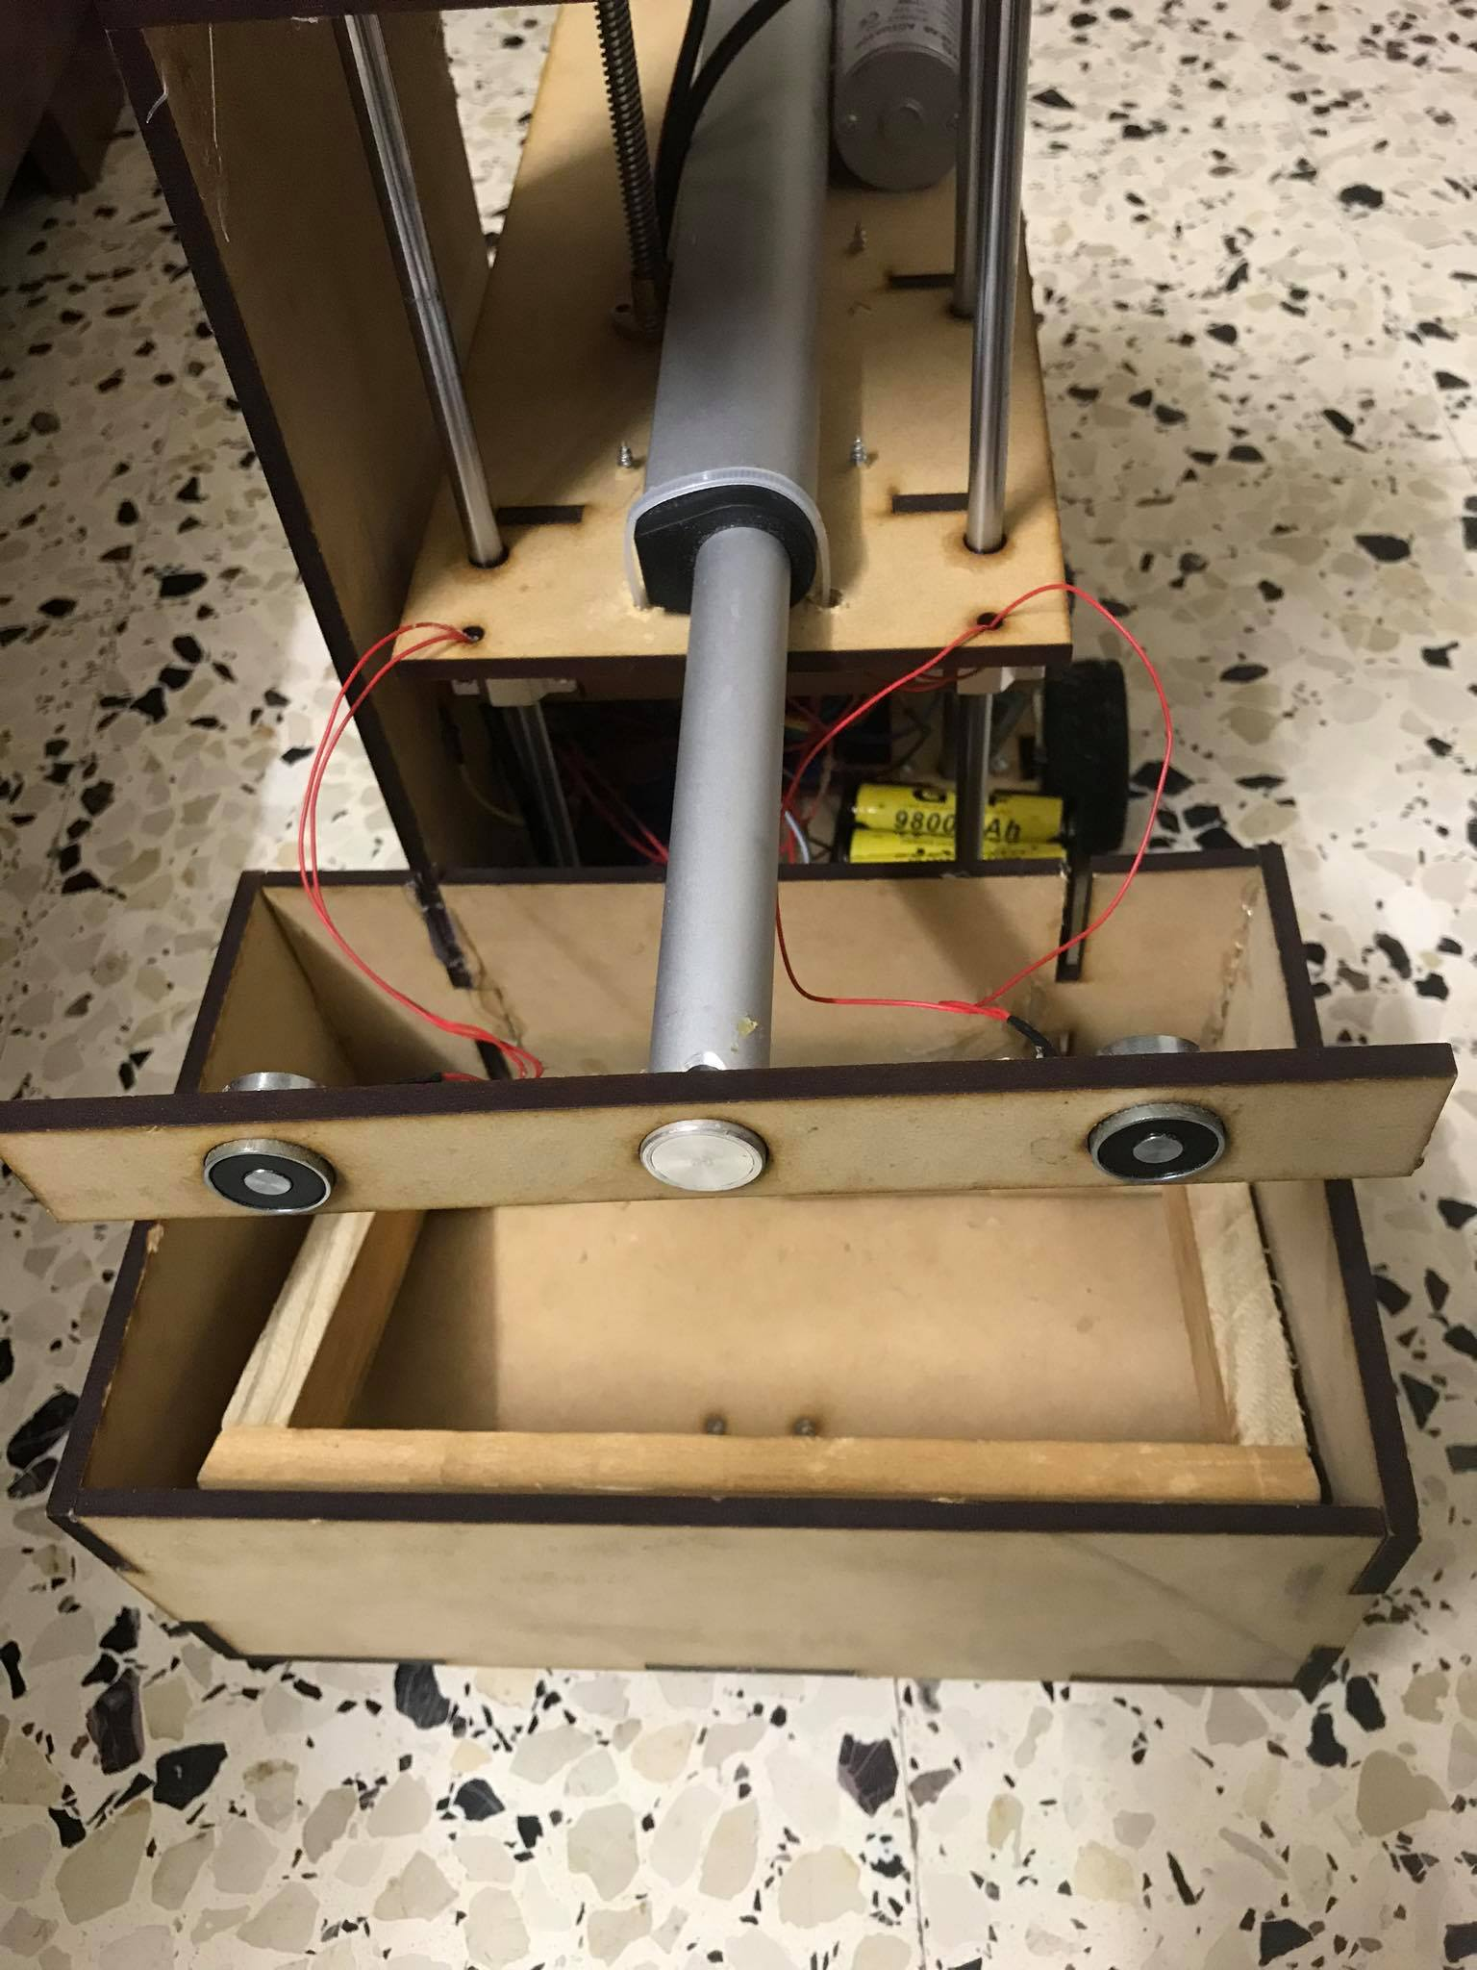

Slide 11
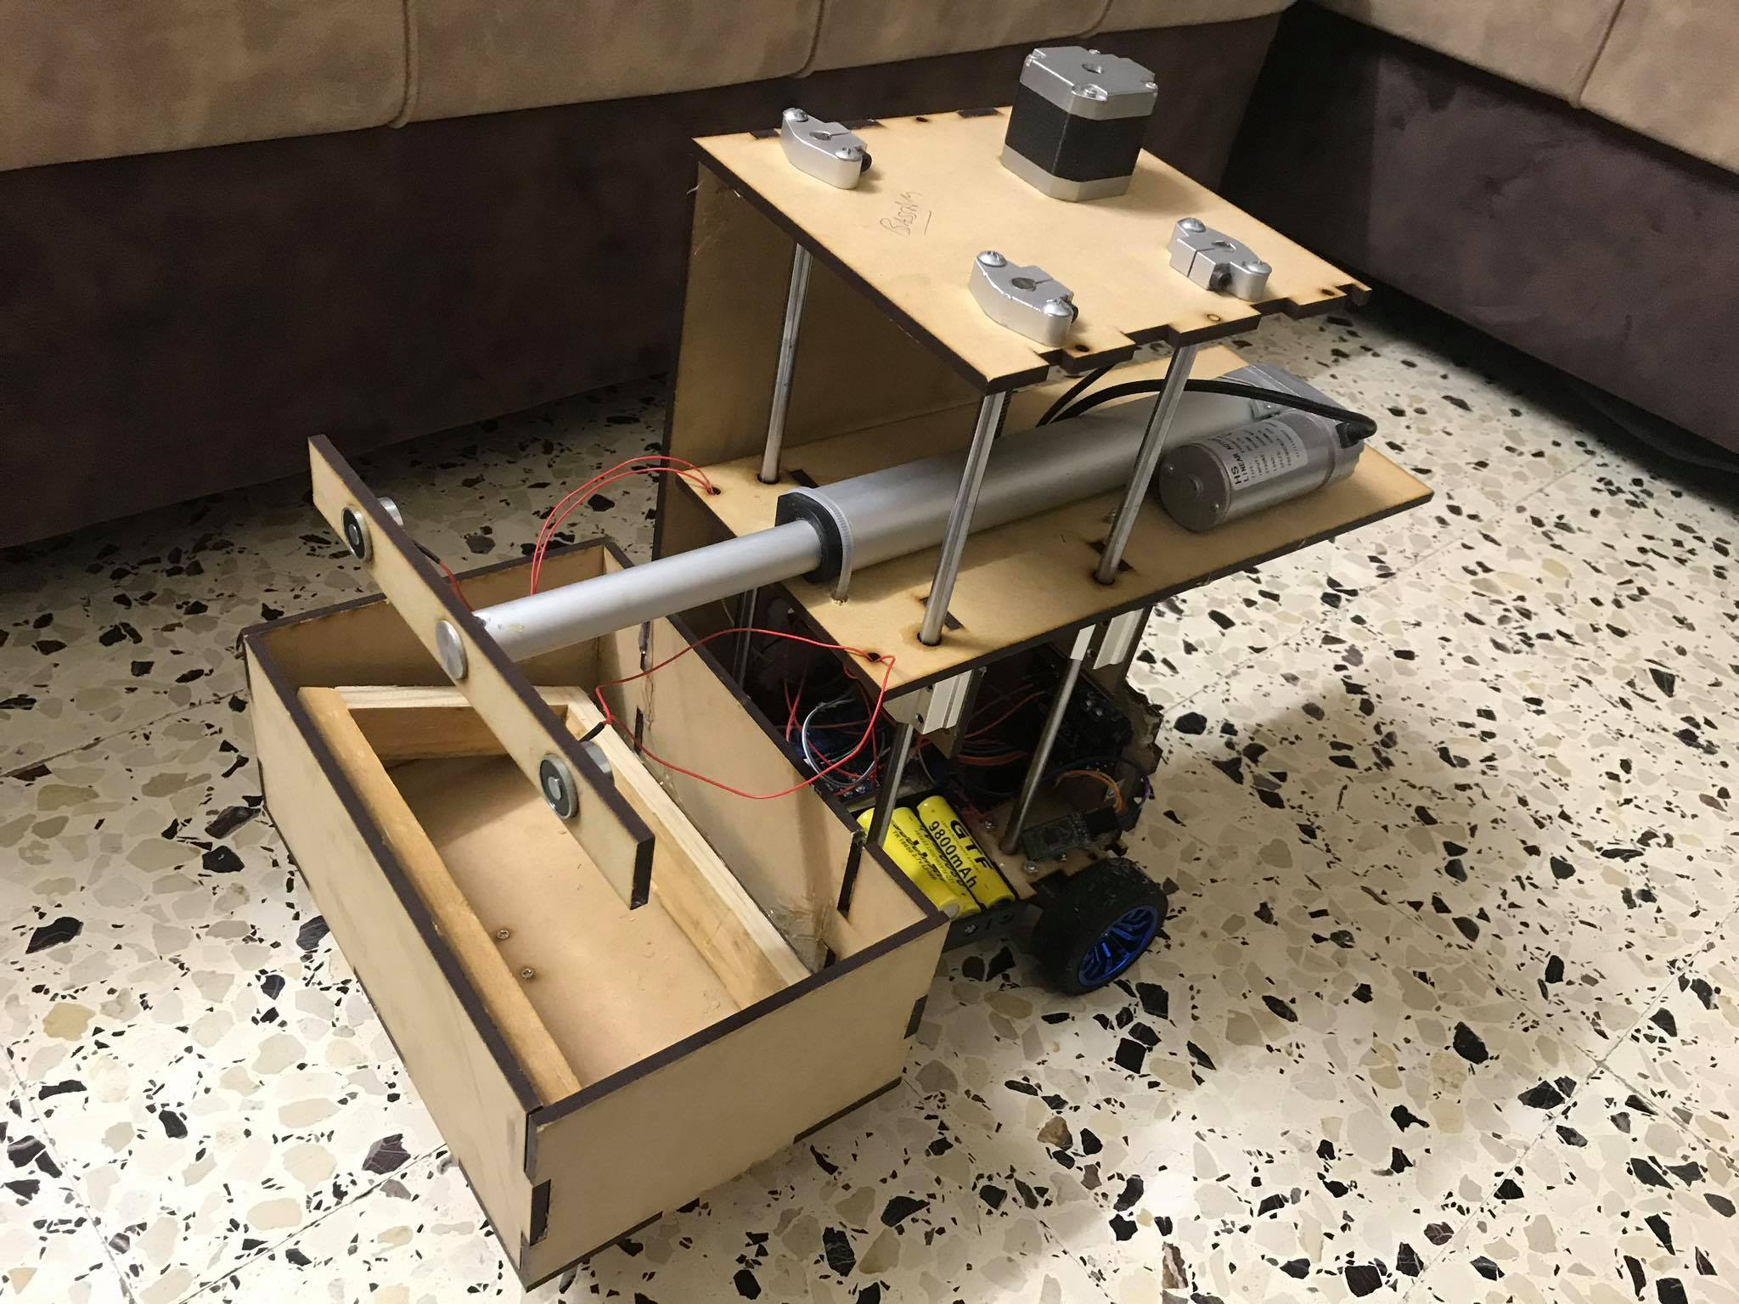

Slide 12
How does it work ?
Its controlled by android mobile application via Bluetooth which the app send literals to the controller a literal for each button like moving it forward or back etc ..

Slide 13
Constrains
Mechanical issues and design issues
High load and size of the robot
COVID-19

Slide 14
Future work
Adding a vibrator on the arm to make the bee leave the frame
Adding a camera to get a closer look of what’s going on
Adding sensors to avoid obstacles
Control it using a WIFI instead of Bluetooth to improve the range

Slide 15
Thank You

