Slide 1
Consilium
Presented by: Fadi Jaber
Mohammad Dwekat
Supervisor: Dr. Samer Arandi

Slide 2
Outline
Introduction.
Features.
Technologies.
Methods and Techniques.
Constrains.
Future work and Recommendation.

Slide 3
What is Consilium?
It’s a Android and Web application to provide communication between patients and doctor in a simplified way.

Slide 4
Motivation
Lack of medical Experiences in different medical specialties.
To protect the privacy in some medical cases.
Internet availability.
There is no application that provides direct communication with the doctors.

Slide 5
Features
Communication with doctors in different fields using text, voice and video chat.
Patients can find the appropriate doctor for them.
Book an appointment between the patient and doctor.
create articles in various fields to help them make a good reputation.
Notifications on messages, and voice, video calls.
Rating system for the doctors.

Slide 6





Used Technologies

Slide 7
Methods and Techniques
Sign Up.
Sign In.
Search for a doctor.
Booking an appointment.
Chatting with doctor.
Article writing by doctor.
Article browsing.
Update profile.

Slide 8
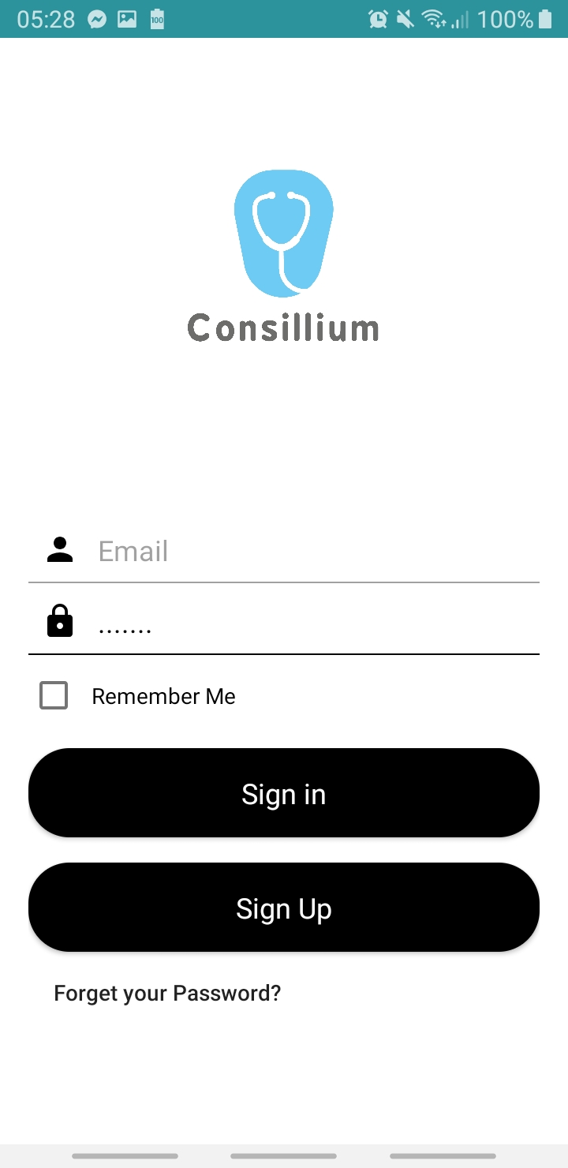
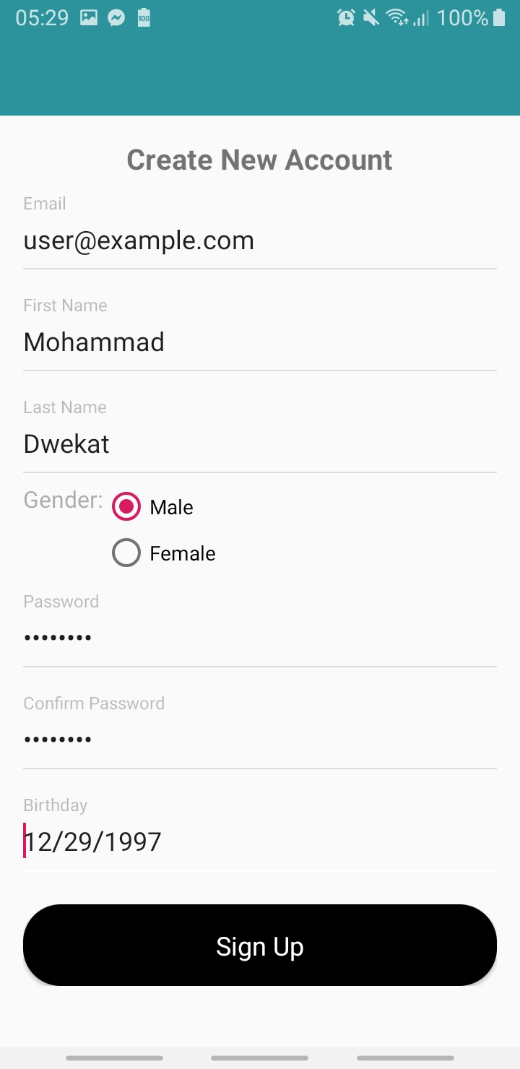
Sign In and Sign Up

Slide 9
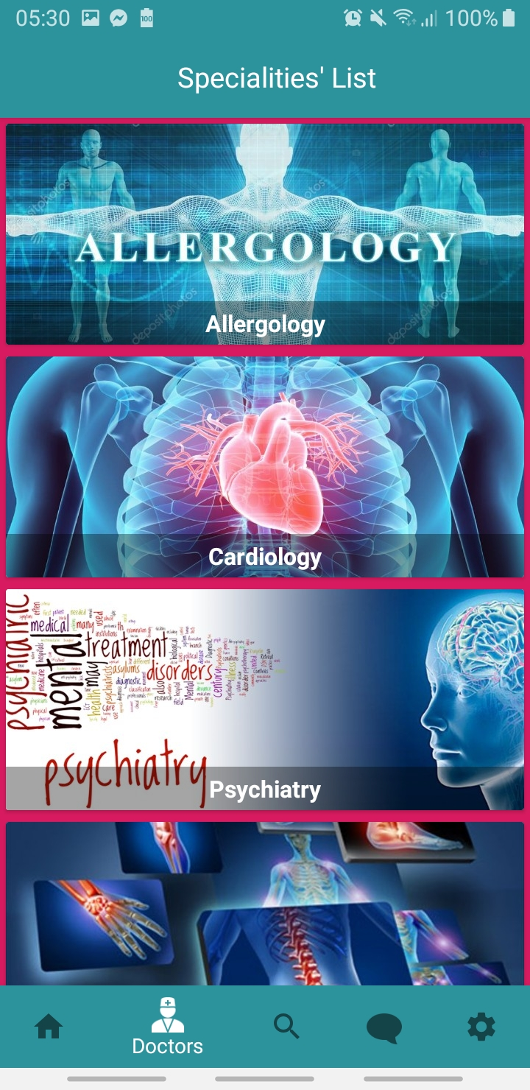
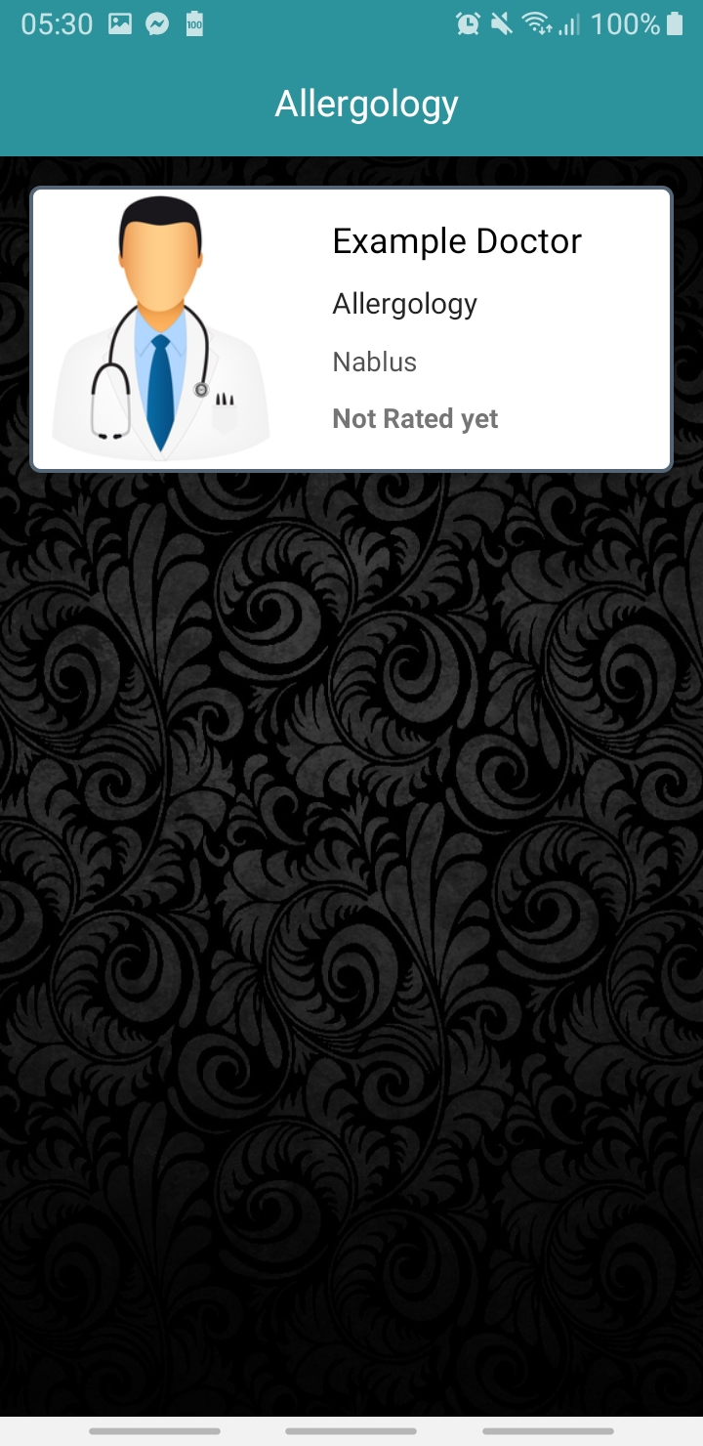
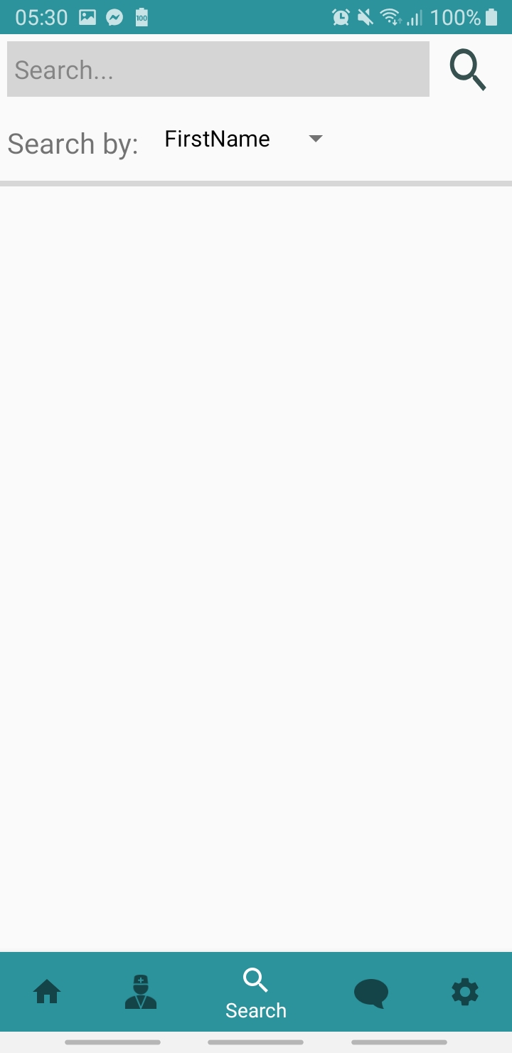
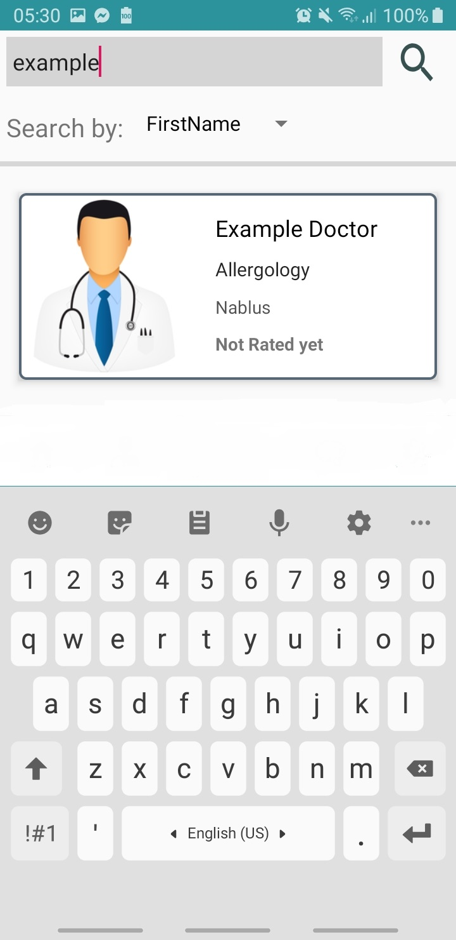
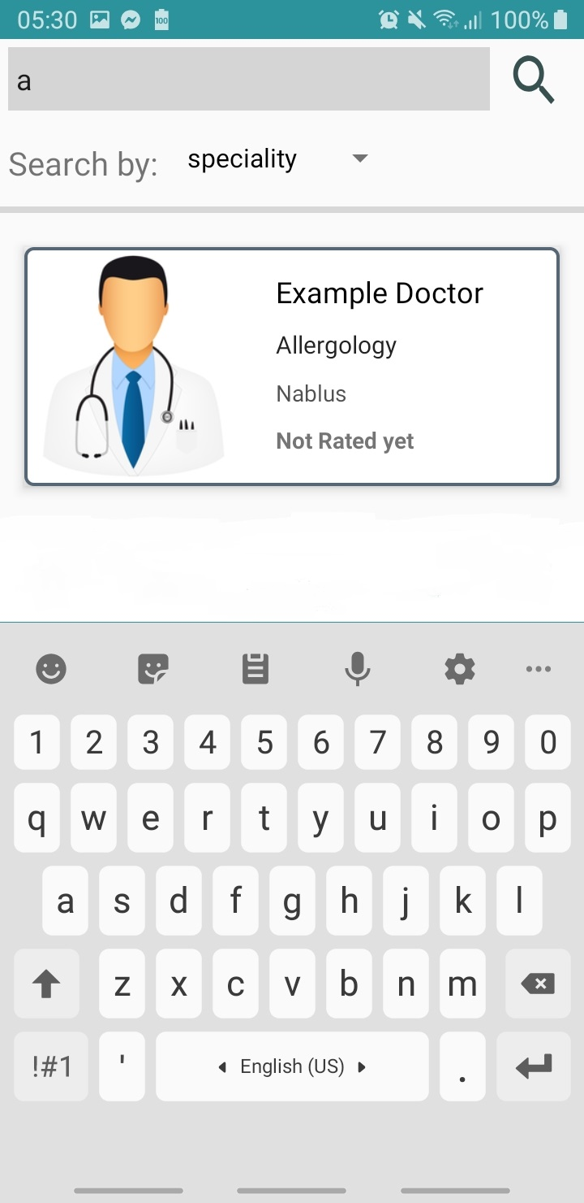
Search for a doctor

Slide 10
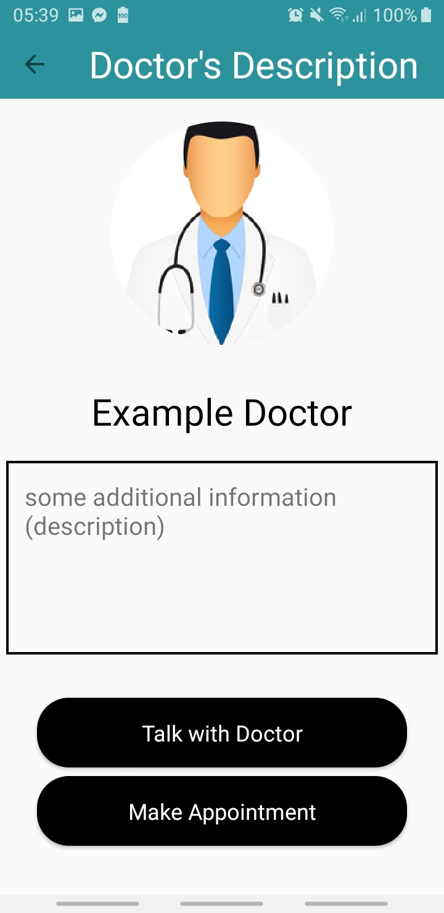
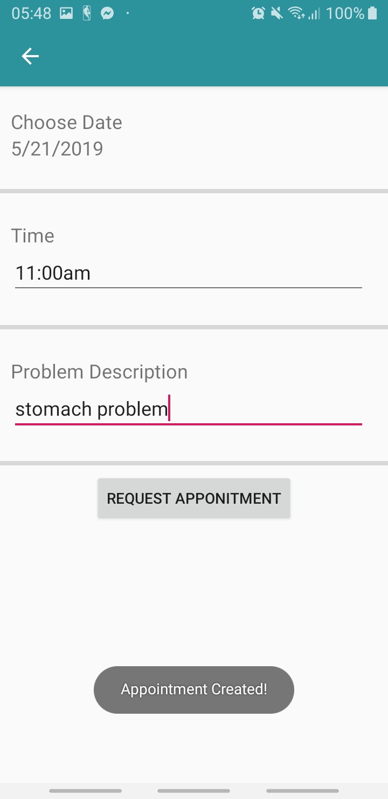
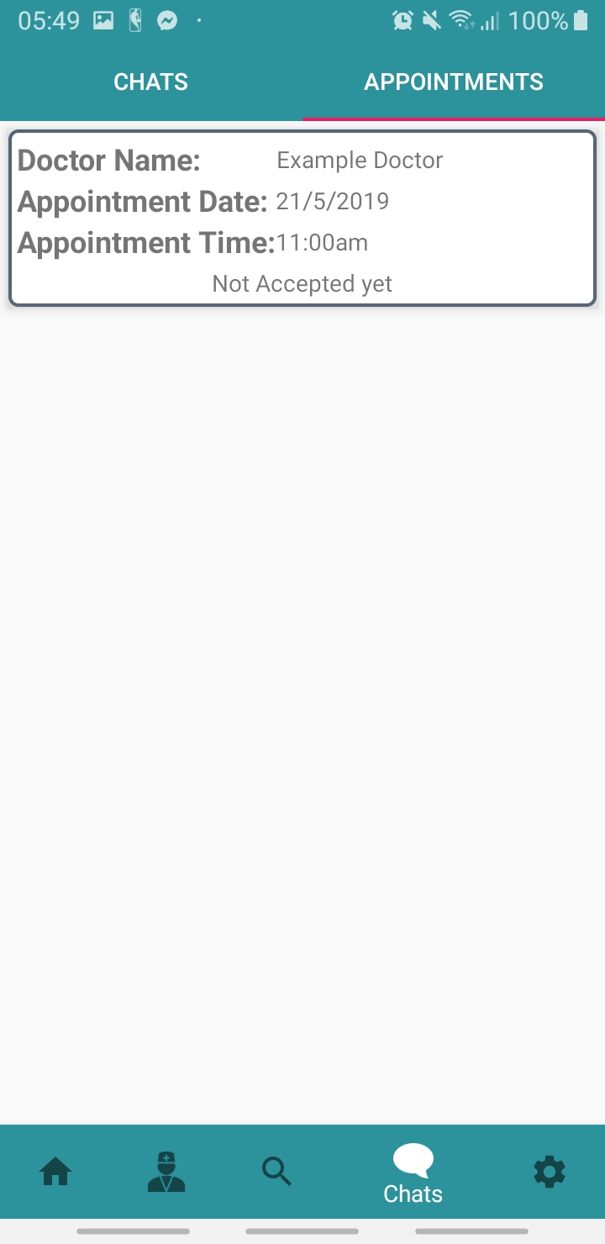
Book an appointment

Slide 11
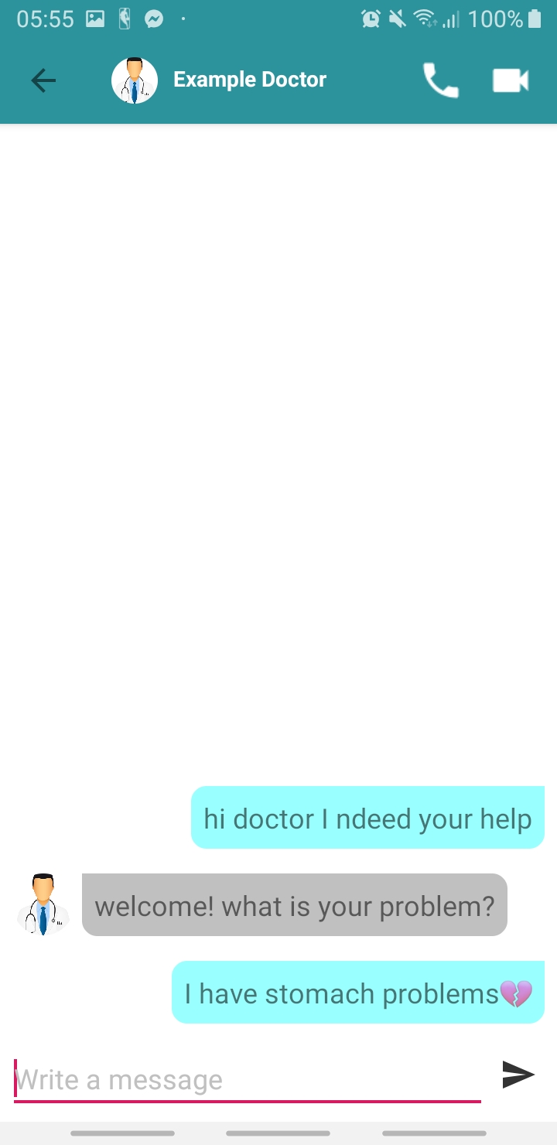
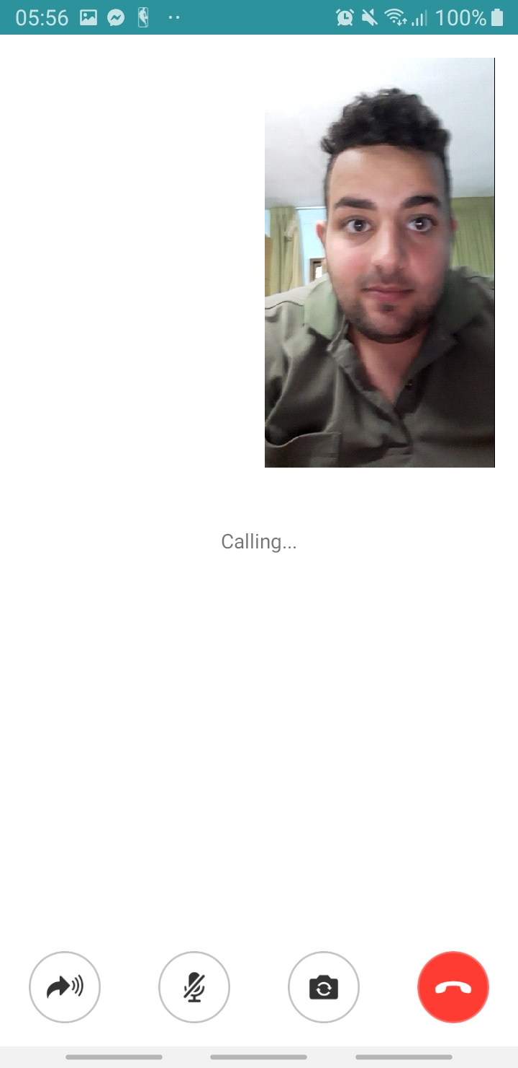
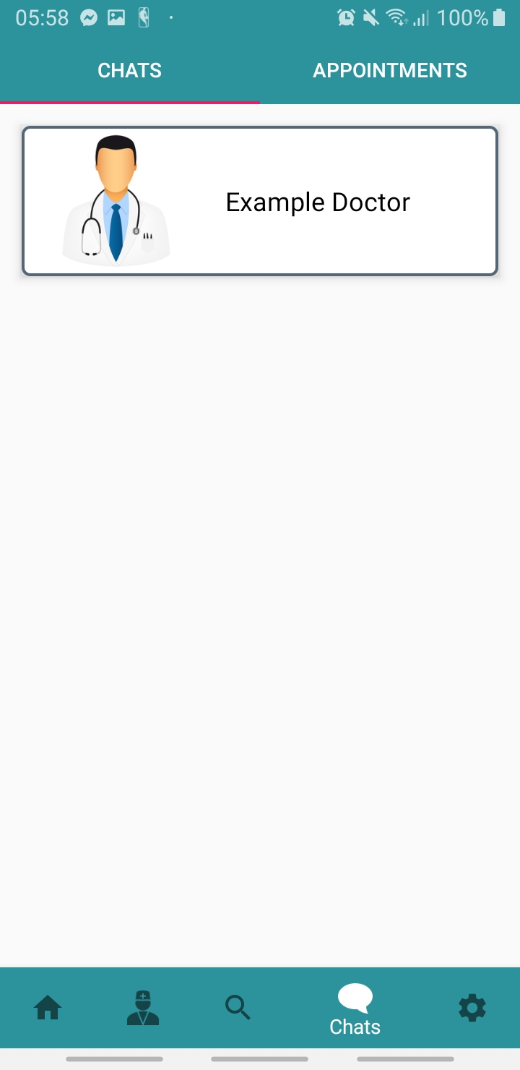
Chat with a Doctor

Slide 12
Article writing by a doctor

Slide 13
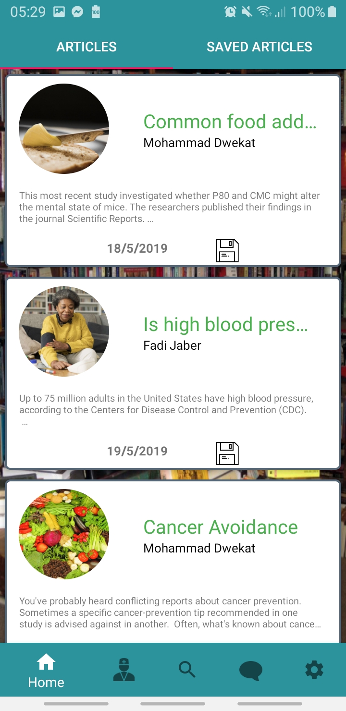
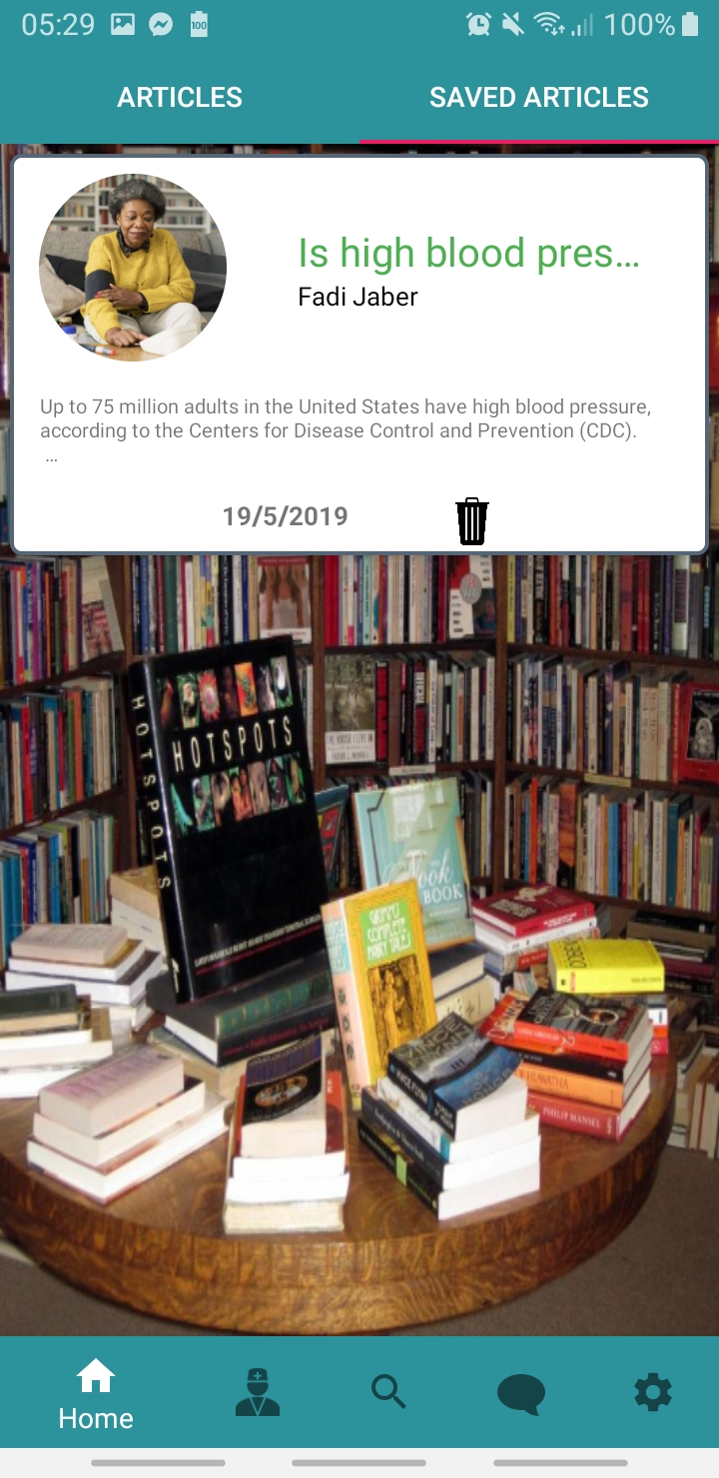
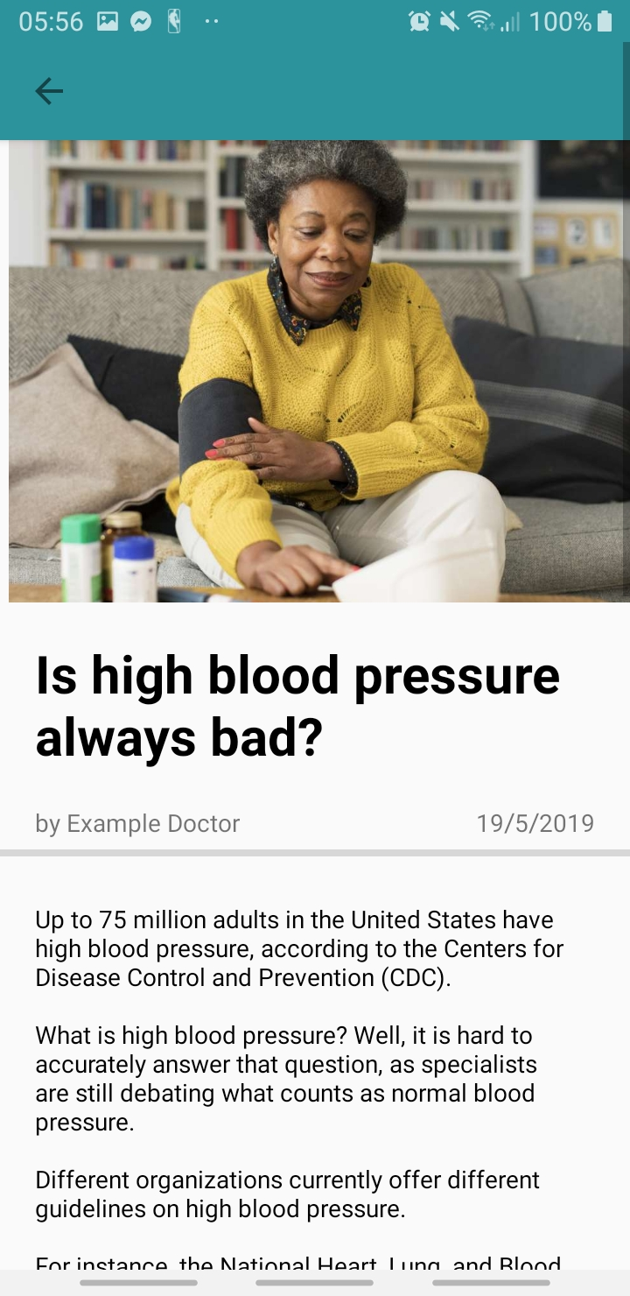
Articles browsing

Slide 14
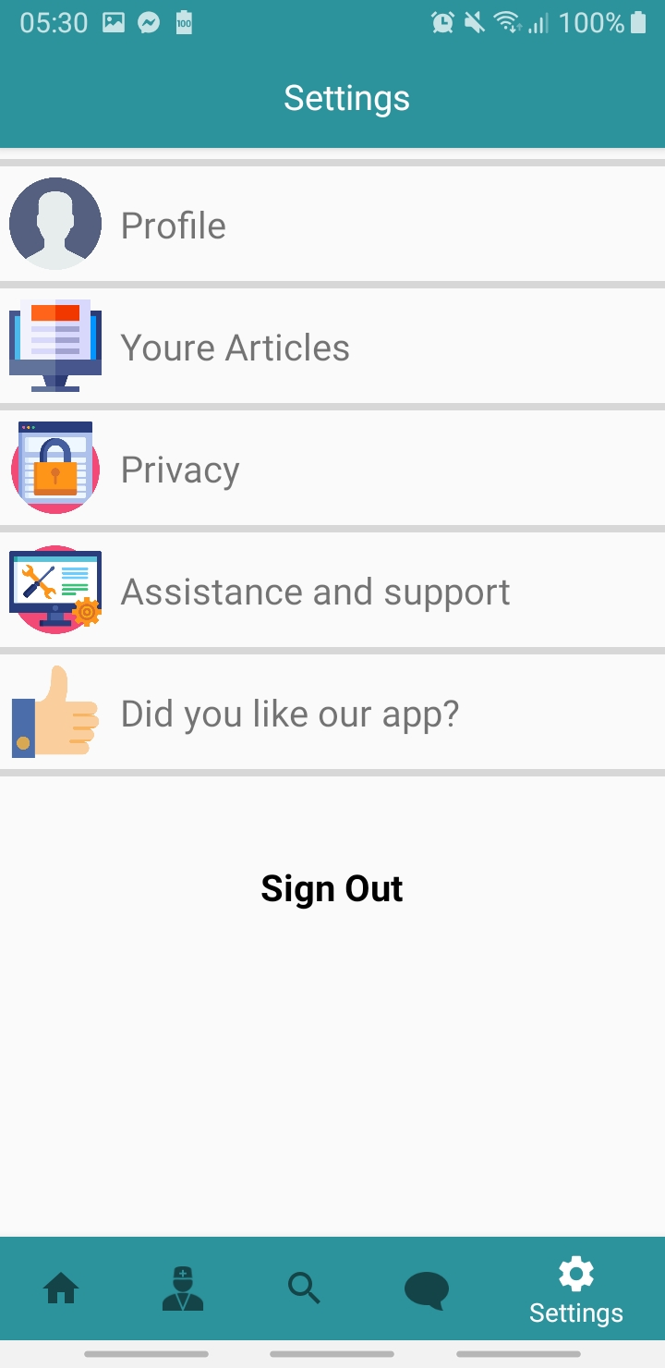
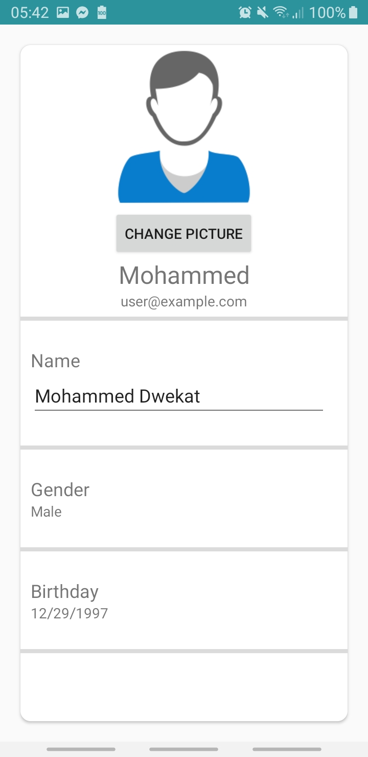
User Profile

Slide 15
Constraints
Lack of time.
Learning a lot of new things.
Lack of experience in Design.

Slide 16
Future Work
Create IOS application.
Adding diagnosing diseases features.
Adding Social media features.
Make new appointment system.

