Slide 1

Graduation Project
Noor al-huda Hamayel
&
Rand Hamayel
supervisor : Eng. Oula Mardawi

Slide 2
  Introduction
  Goals
content
  Technologies Used
  Features
  Future Work

Slide 3
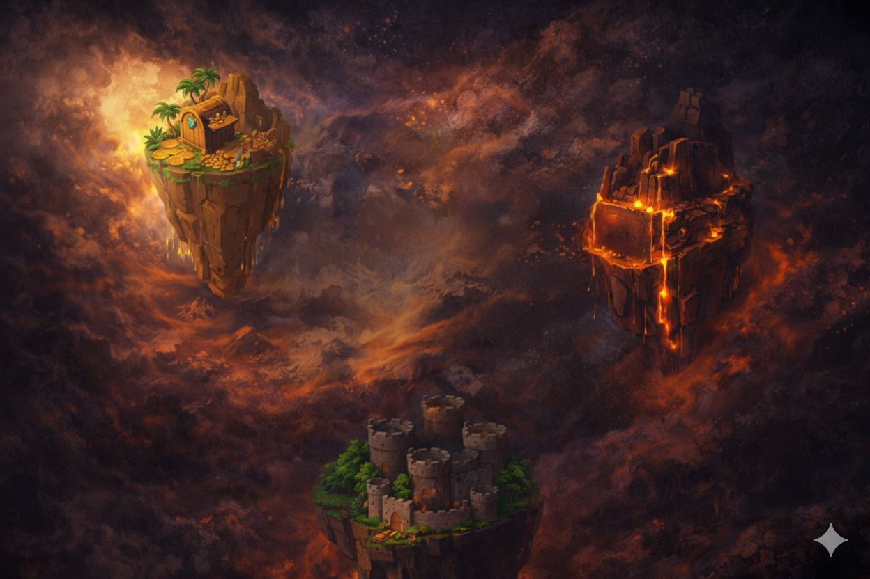
Introduction
Code Treasure is an educational game-based learning platform designed to teach programming concepts through an interactive adventure experience.
Players explore a game map, solve coding challenges, and progress through levels to reach the ultimate treasure.
The platform combines learning and gaming, making programming more engaging, motivating, and accessible for beginners.

Slide 4
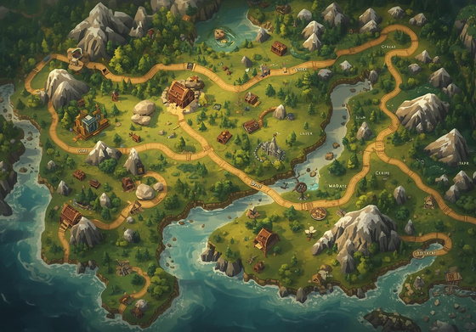
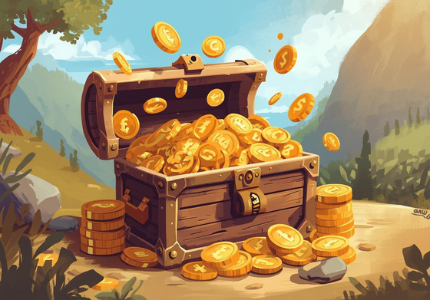
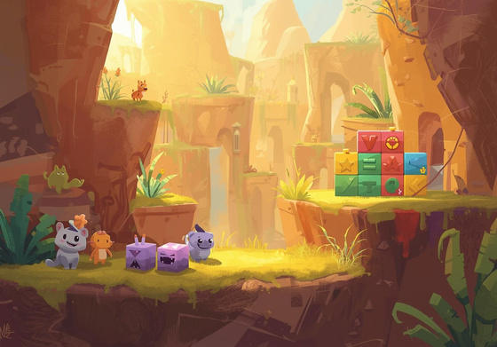
Goals
Motivate learners by using game elements such as challenges, rewards, and progression maps, making the learning experience both effective and enjoyable.
Make learning programming more interactive and engaging through a game-based approach.
Help players improve their programming skills by solving coding questions across different levels.

Slide 5
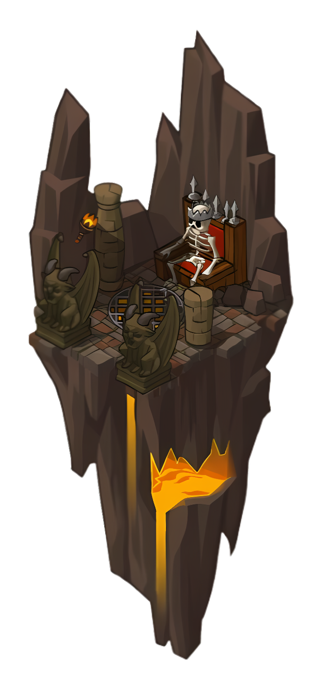
Features

Slide 6


Our game users type
Player
Admin

Slide 7
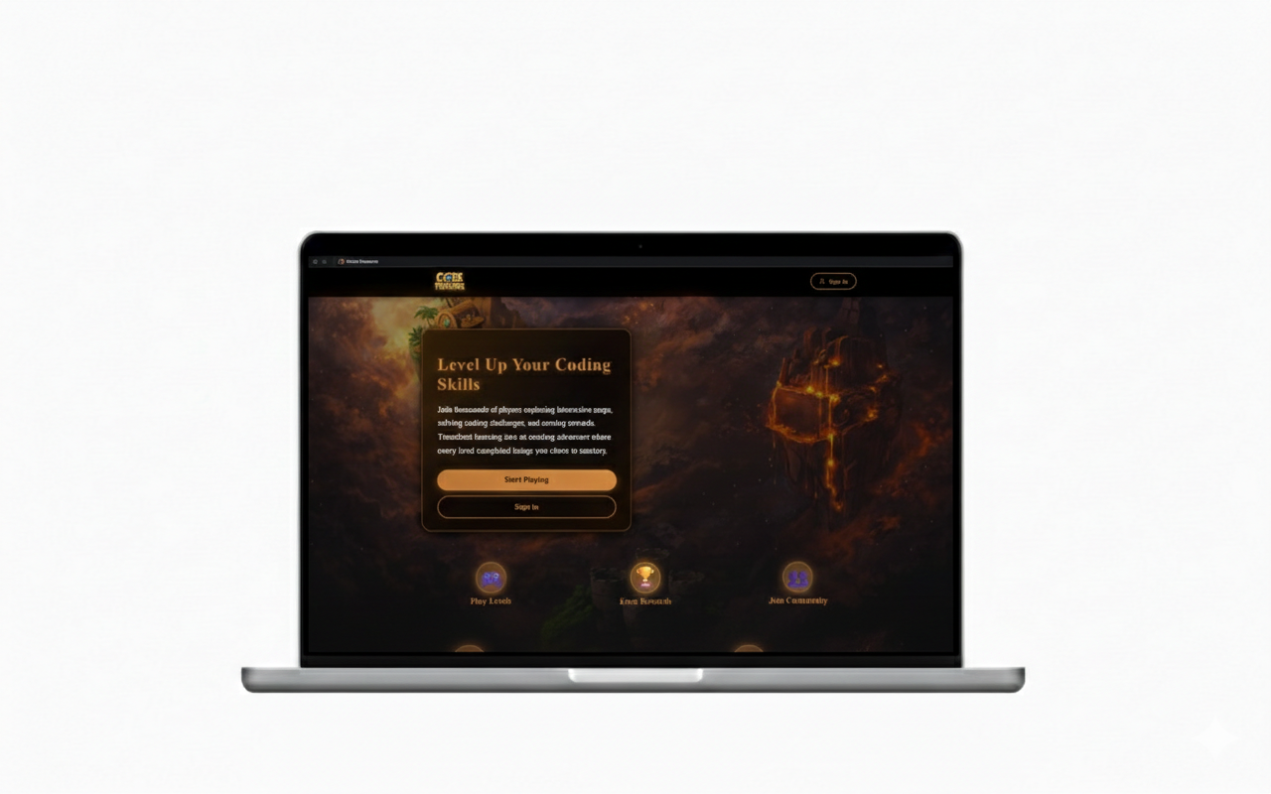
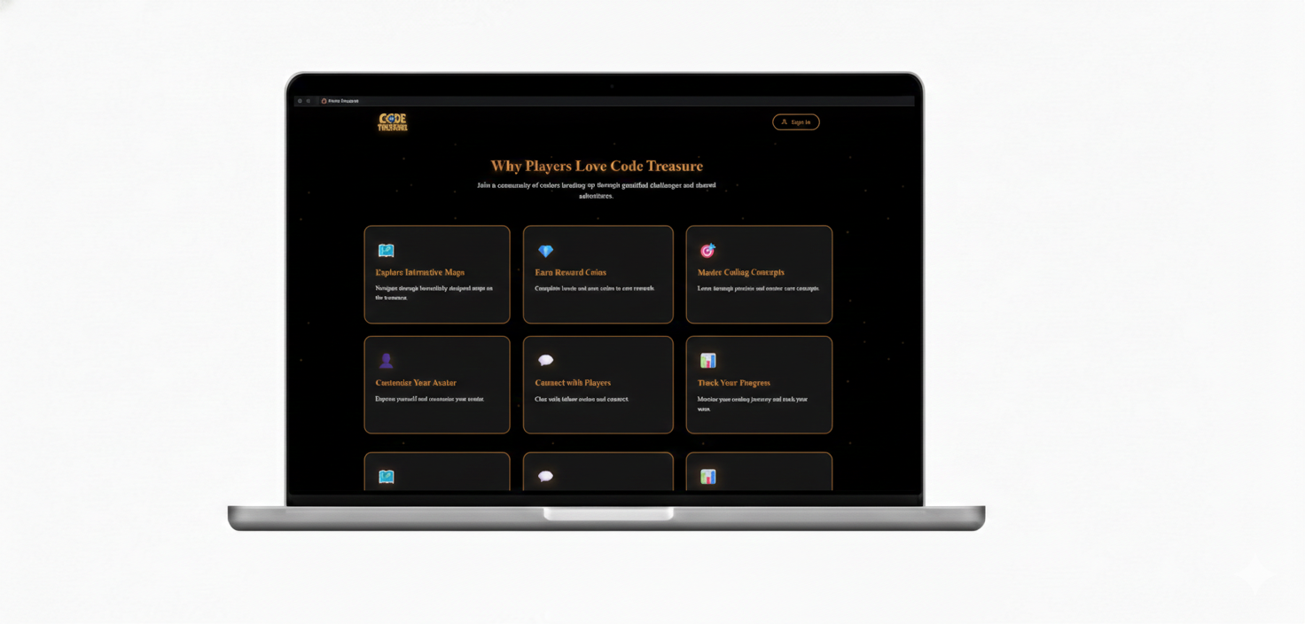
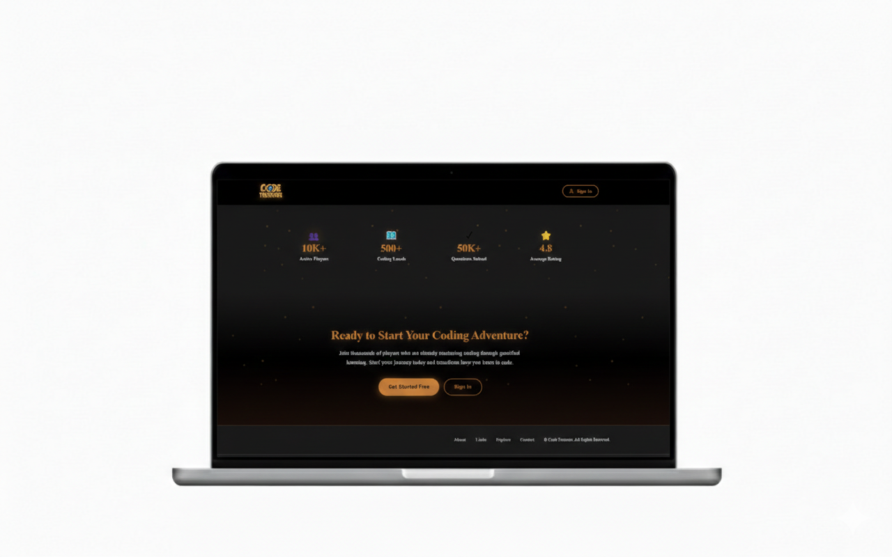
Landing page

Slide 8
Authentication Features
  Admin and Player
  Sign in
  Reset Password
  Player only
  Sign up
  Email validation

Slide 9
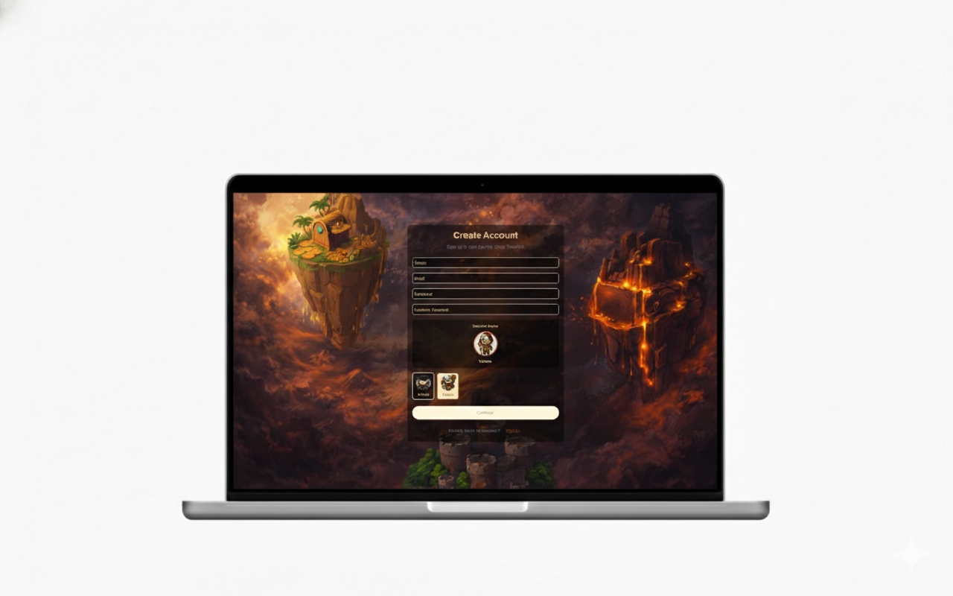
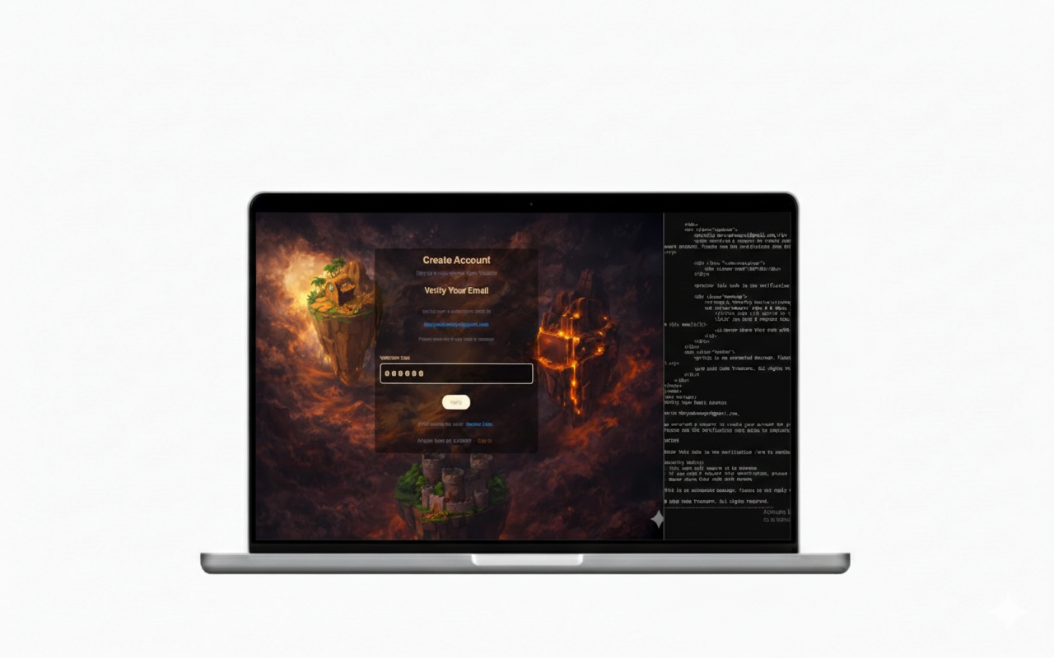
Sign up and Email validation
  After the sign-up process a verification code is sent to the player email

Slide 10
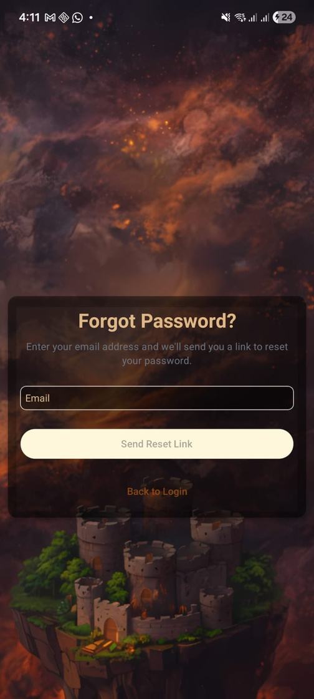
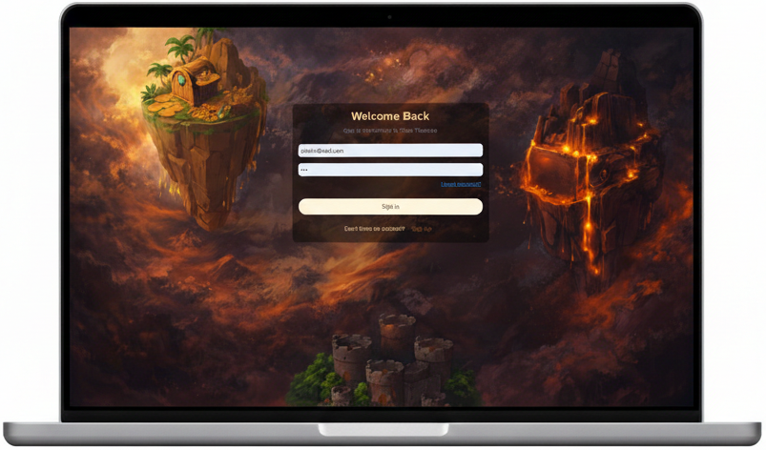
Sign in and Reset password

Slide 11
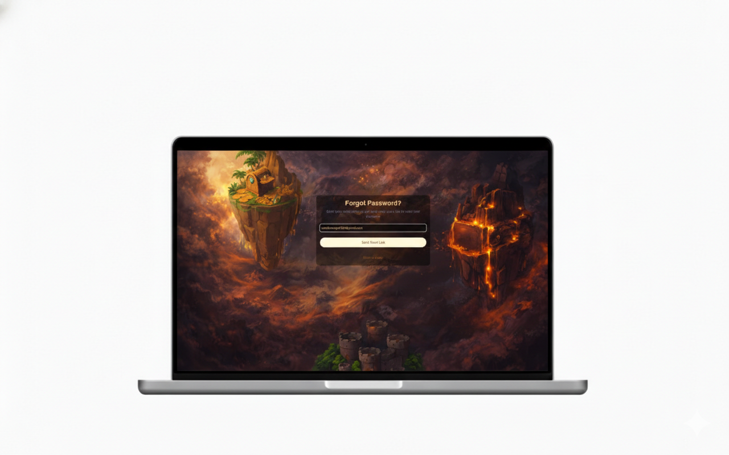
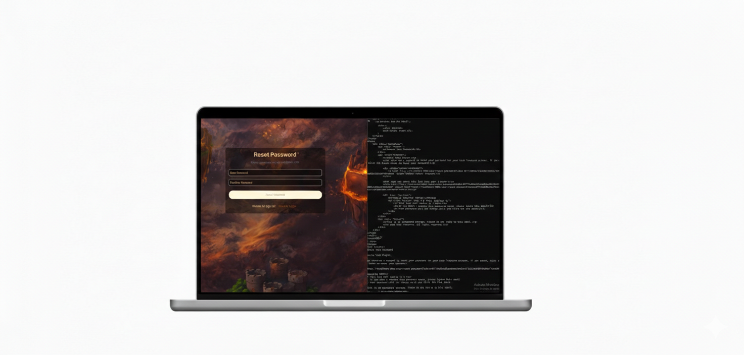
Reset password
  in reset password process a link is sent to the player's email to redirect him to the reset password form

Slide 12
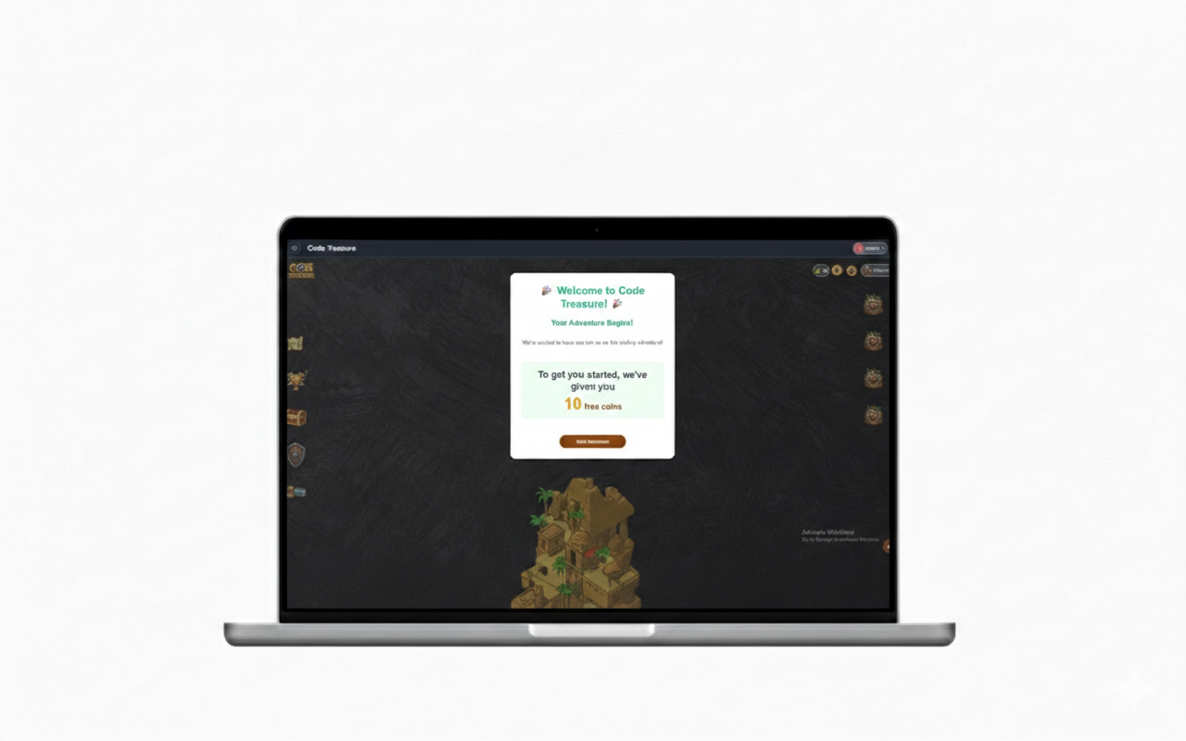
Welcome page

Slide 13
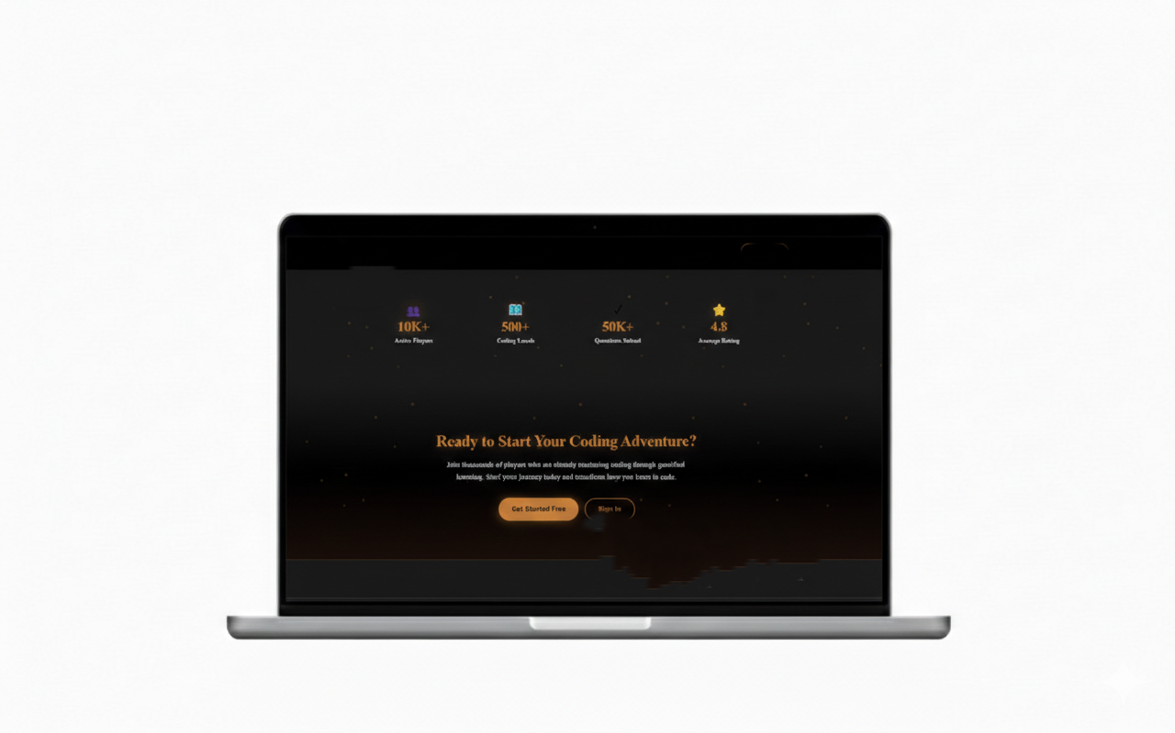
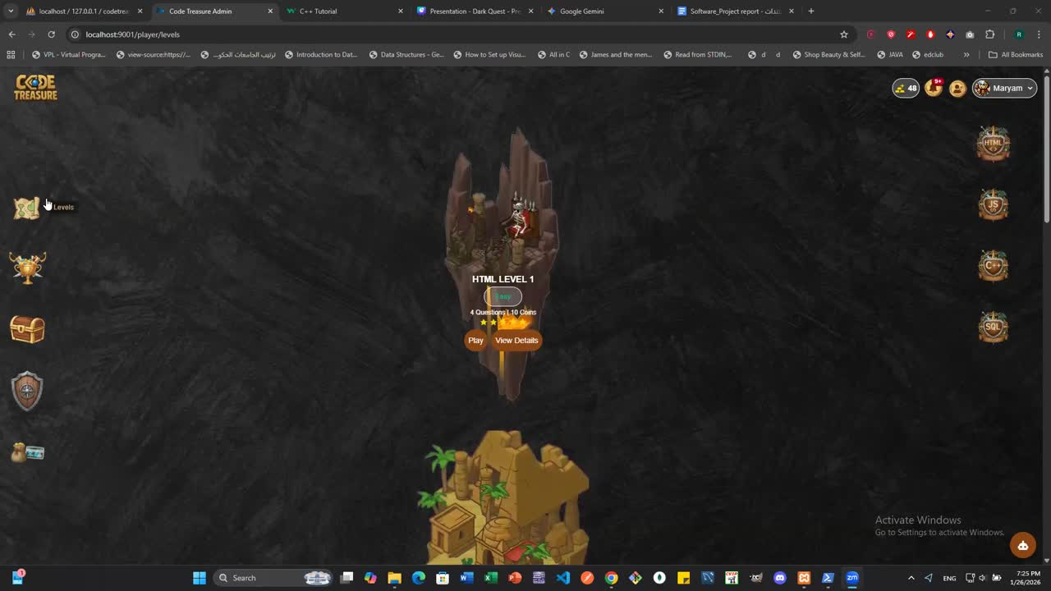
Basic learning path(Levels)

Slide 14
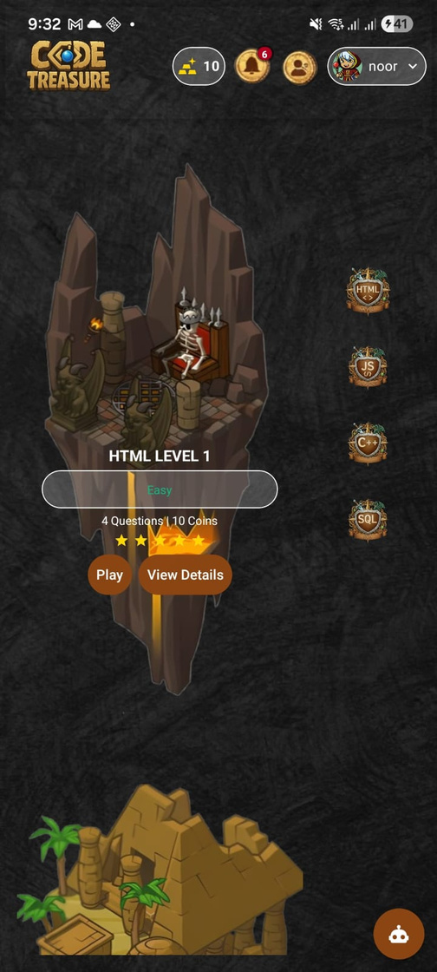
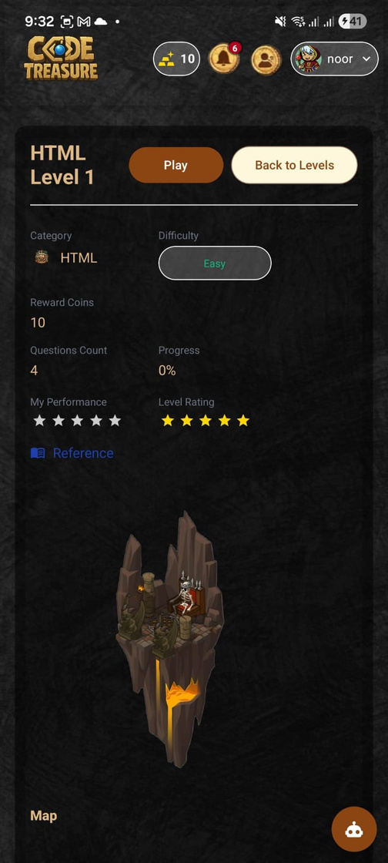
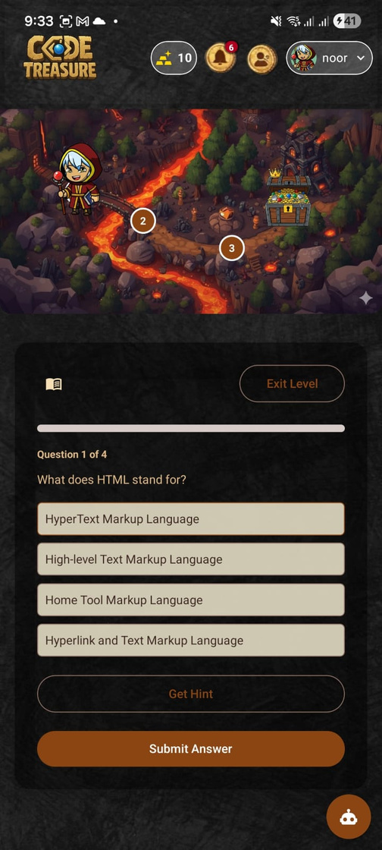
Levels (Mobile)

Slide 15
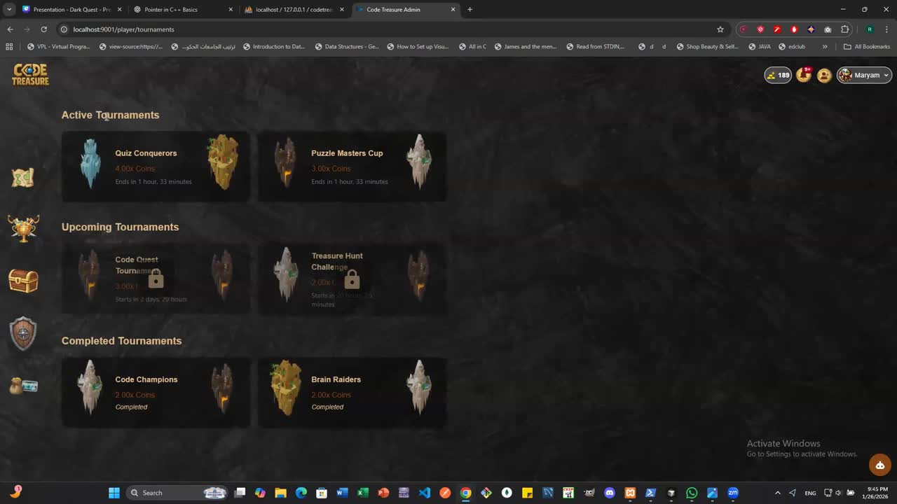
Tournaments

Slide 16
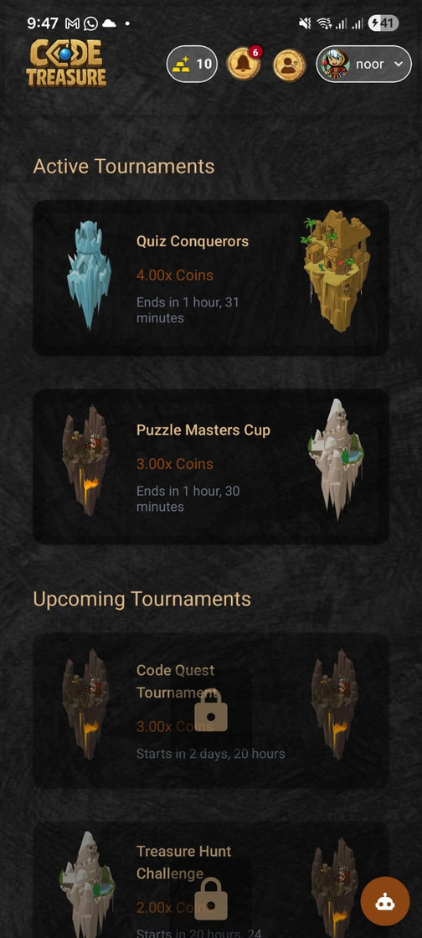
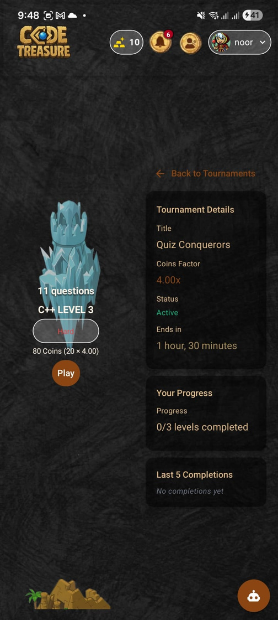
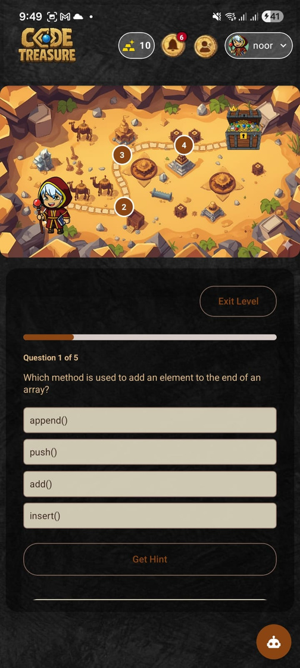
Tournaments(Mobile)

Slide 17
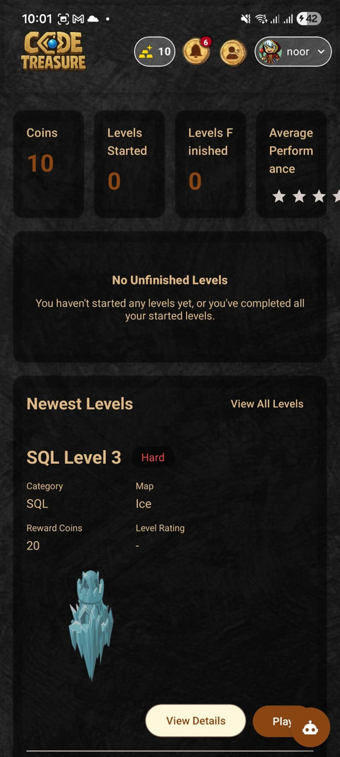
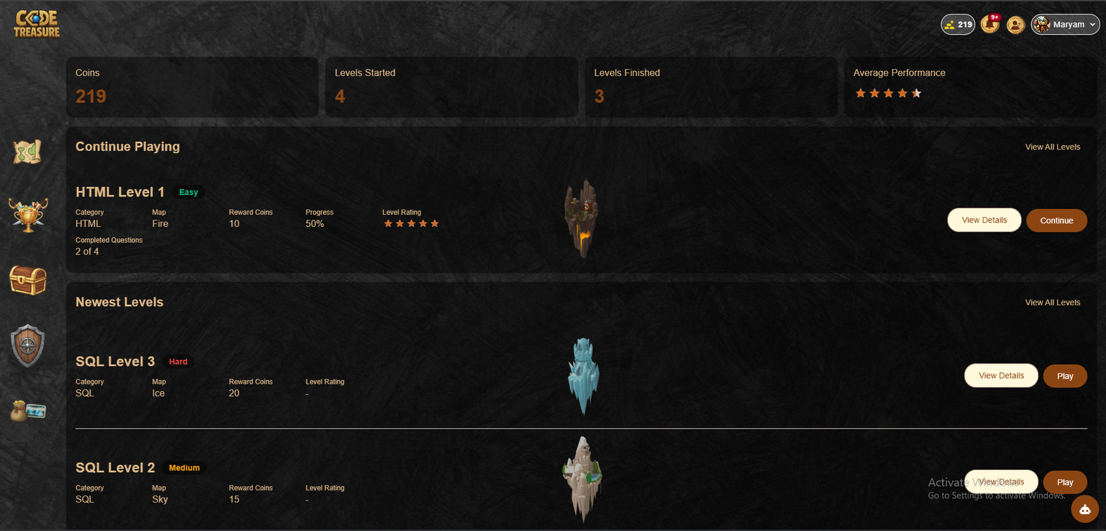
Player Dashboard

Slide 18
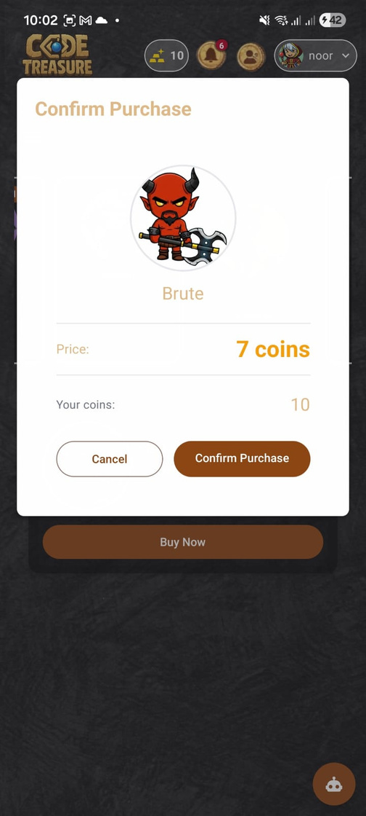
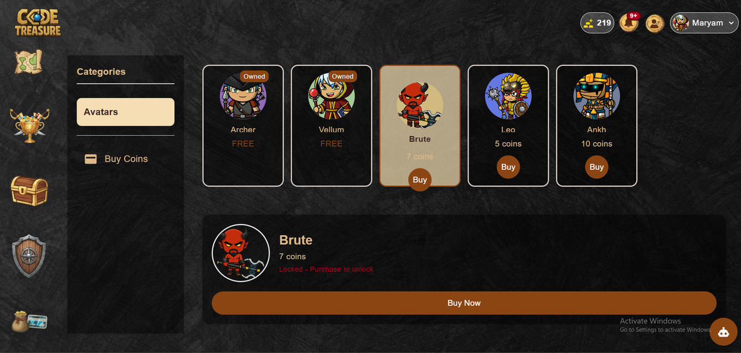
Store

Slide 19
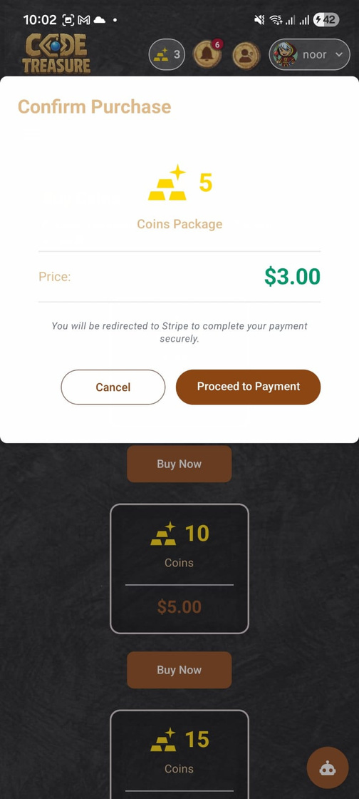
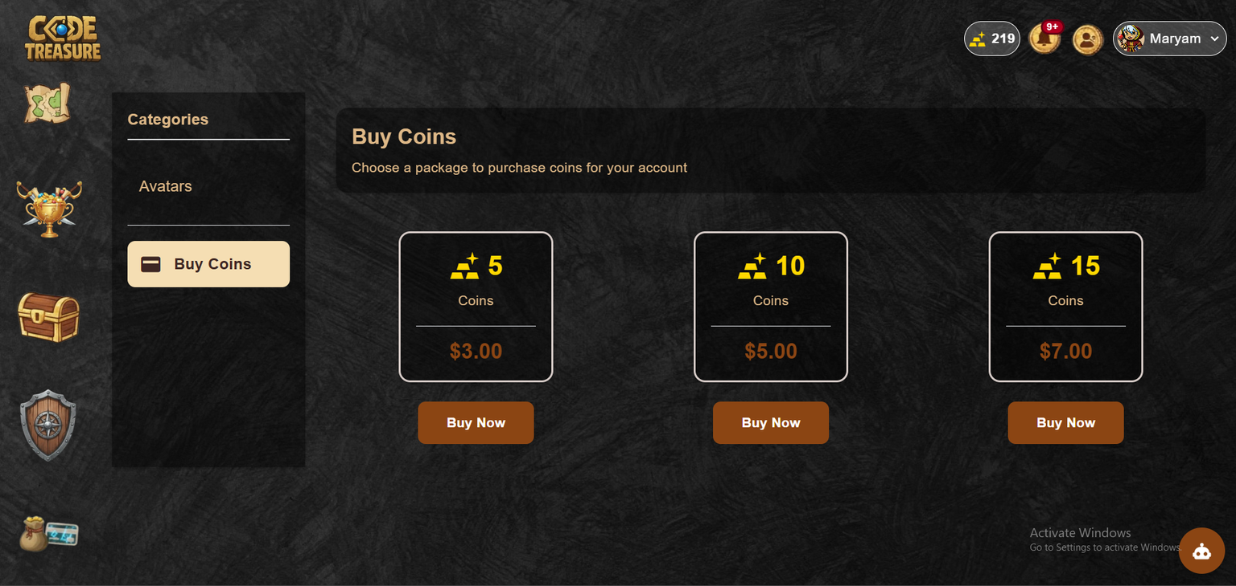
Store

Slide 20
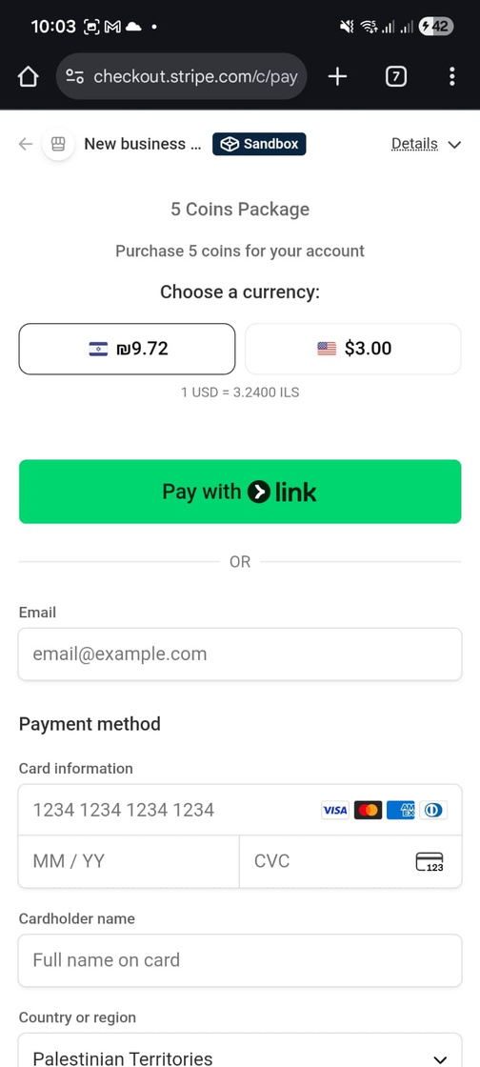
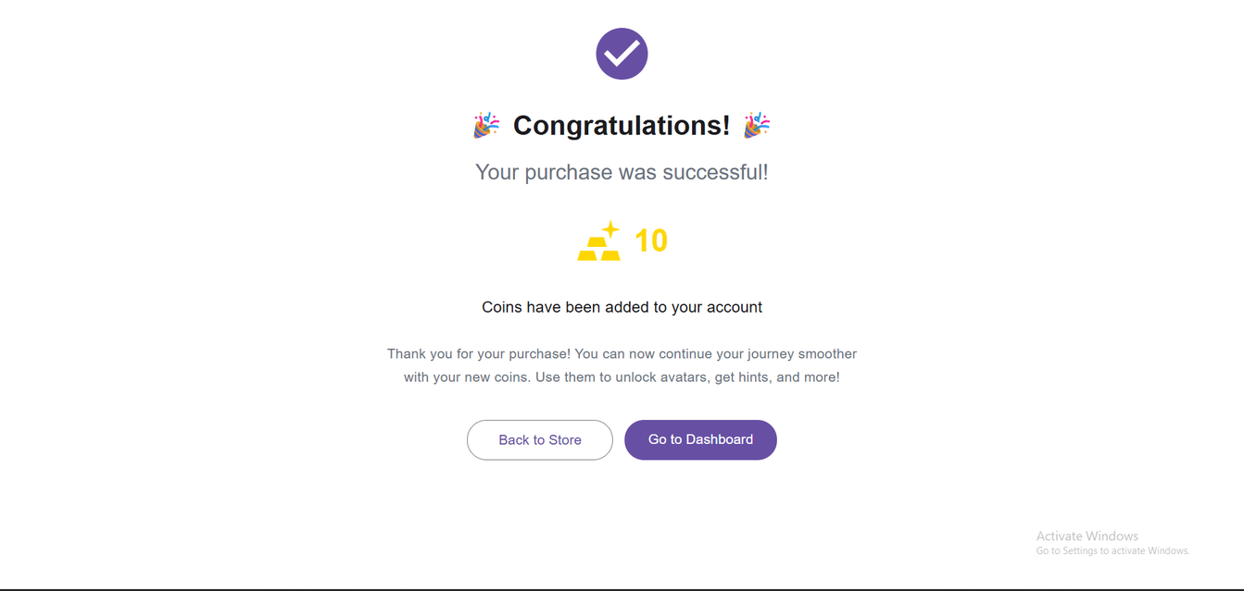
Billing and payment

Slide 21
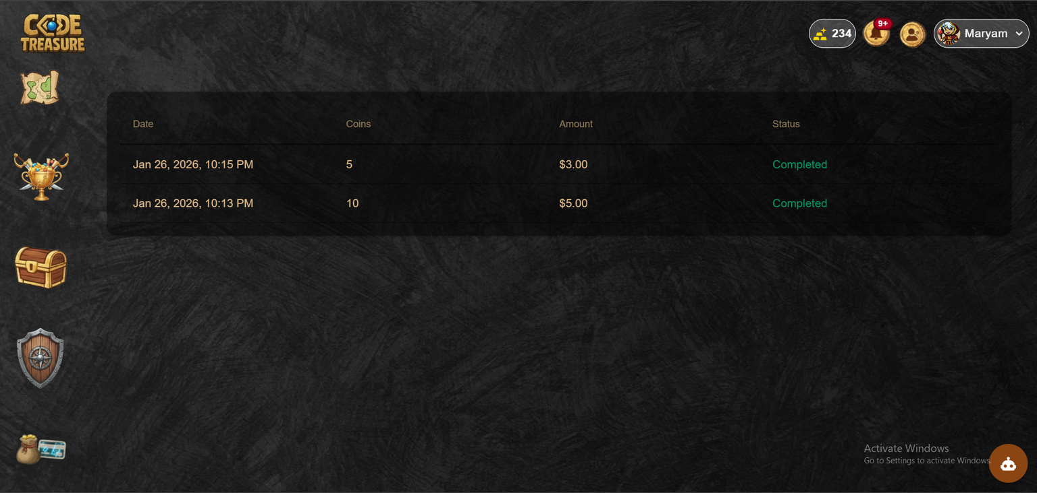
Billing and payment

Slide 22

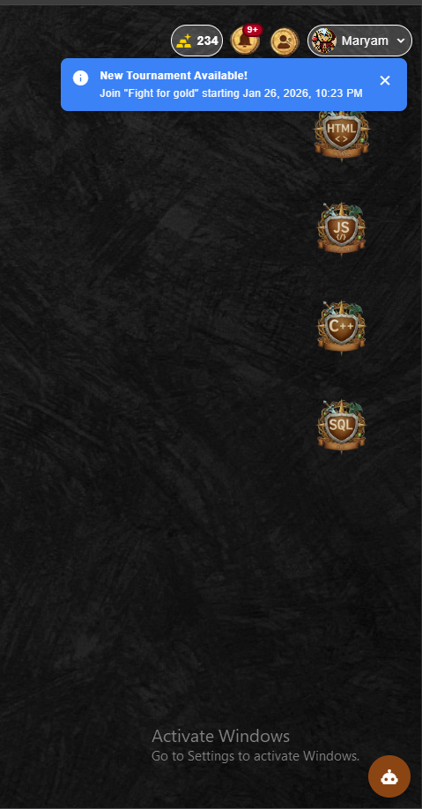
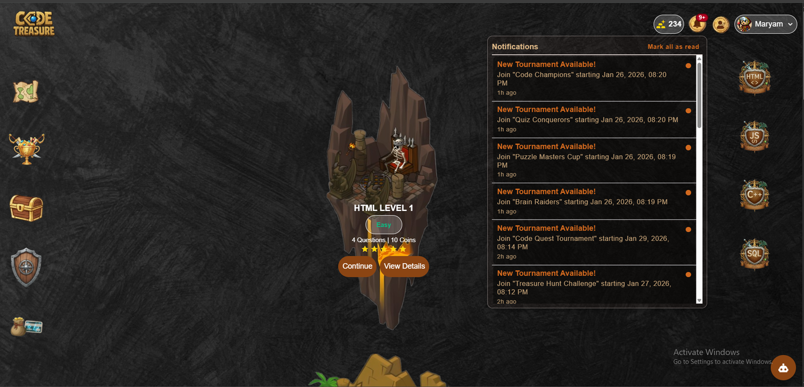
Notifications System

Slide 23
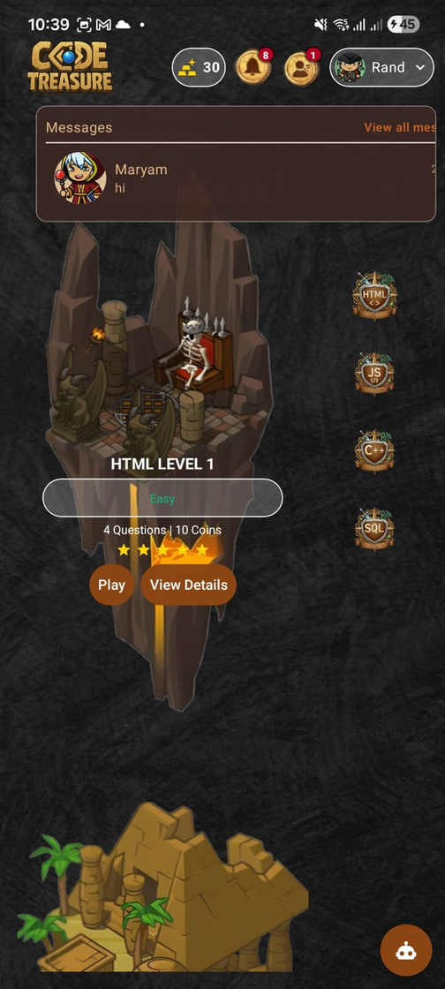
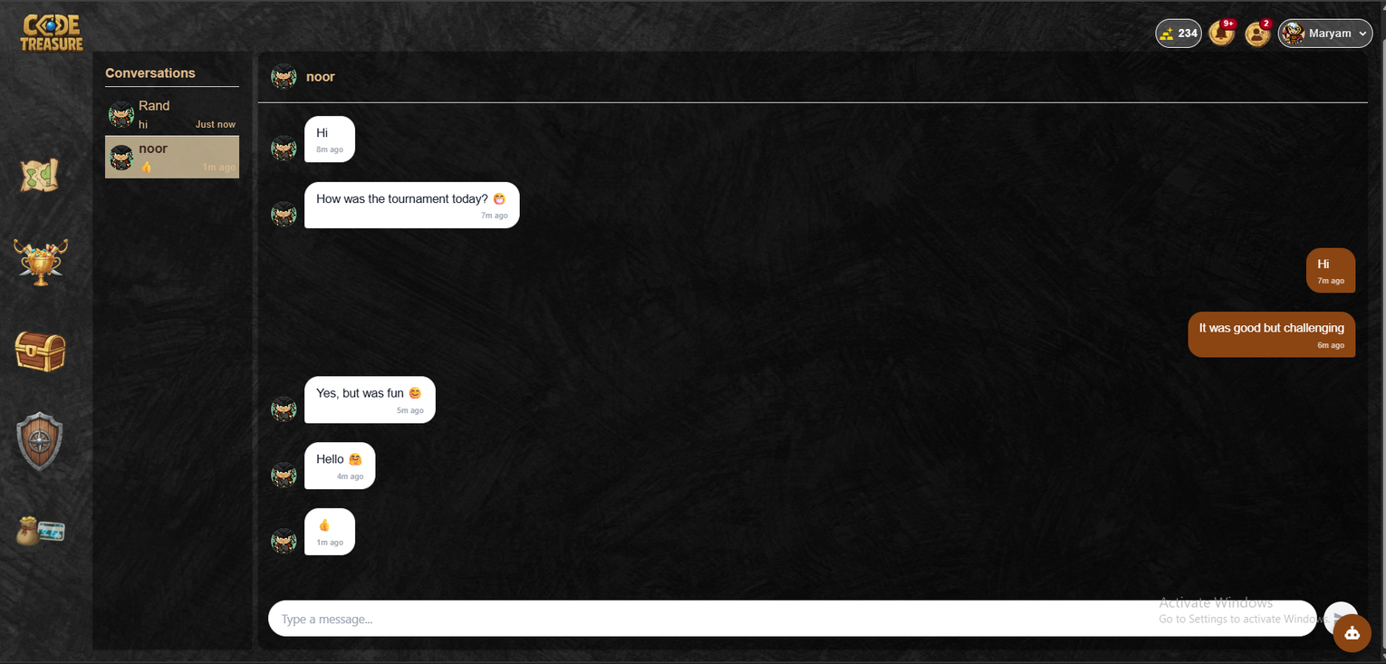
Chat System

Slide 24
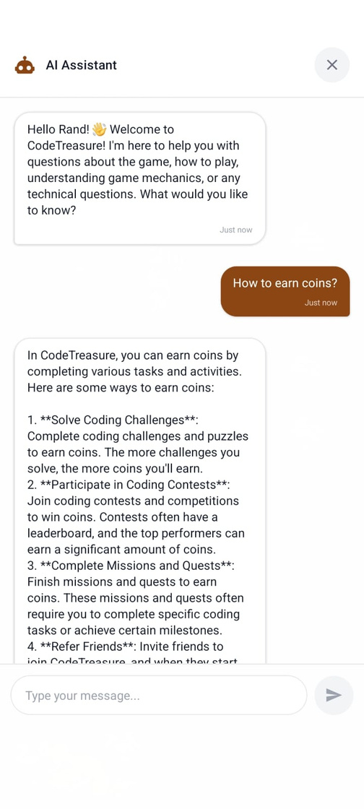
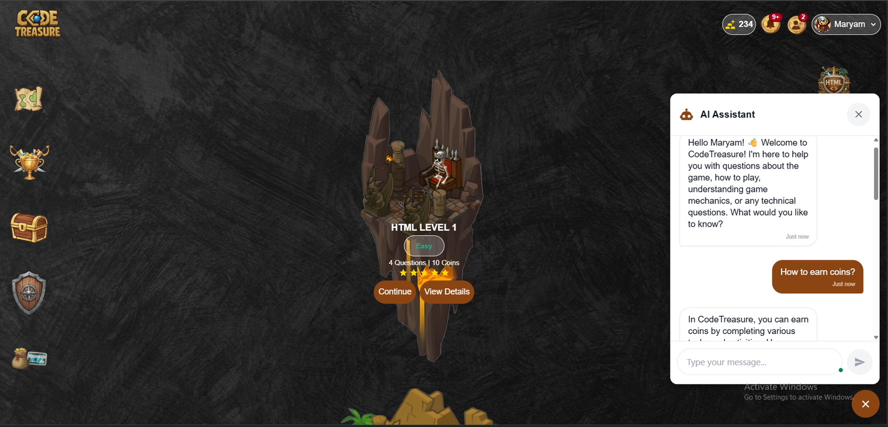
AI assistant

Slide 25
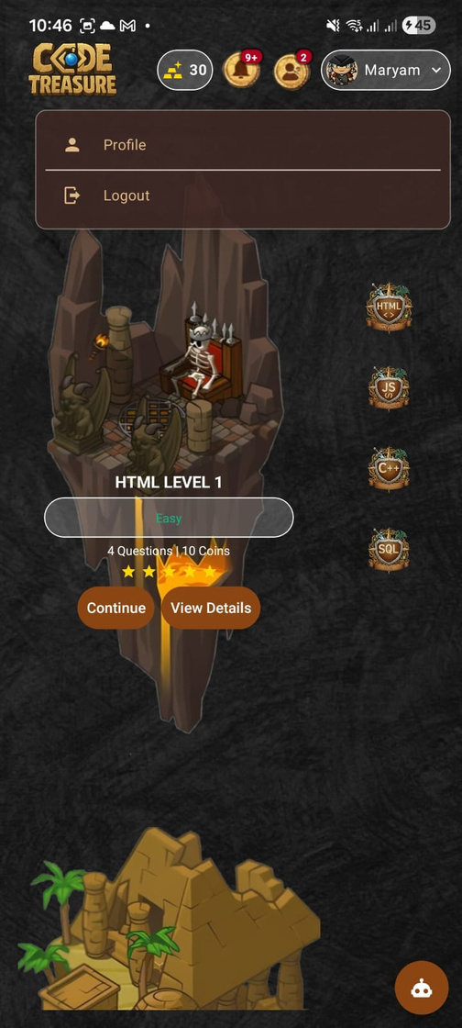
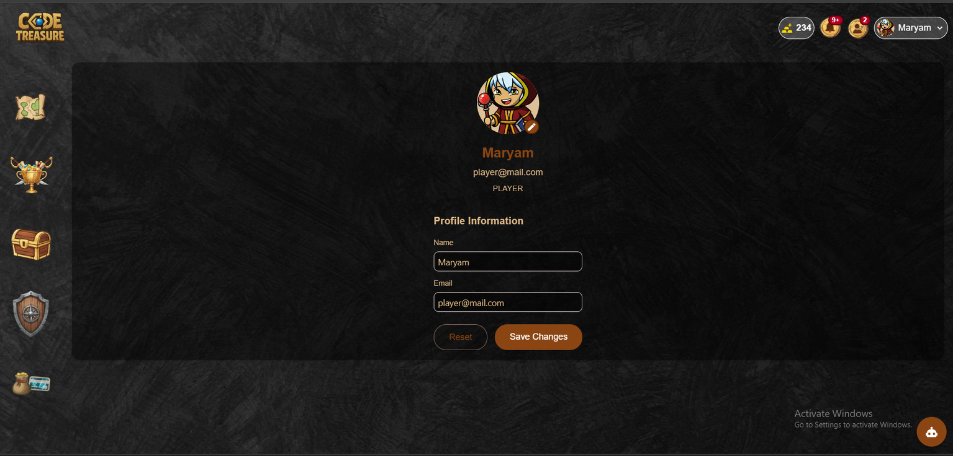
Player Profile

Slide 26
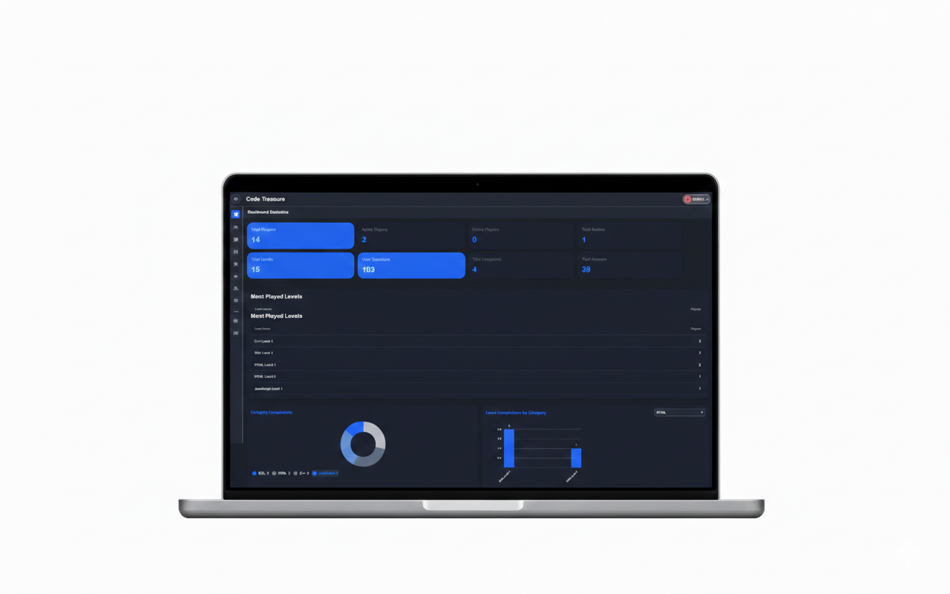
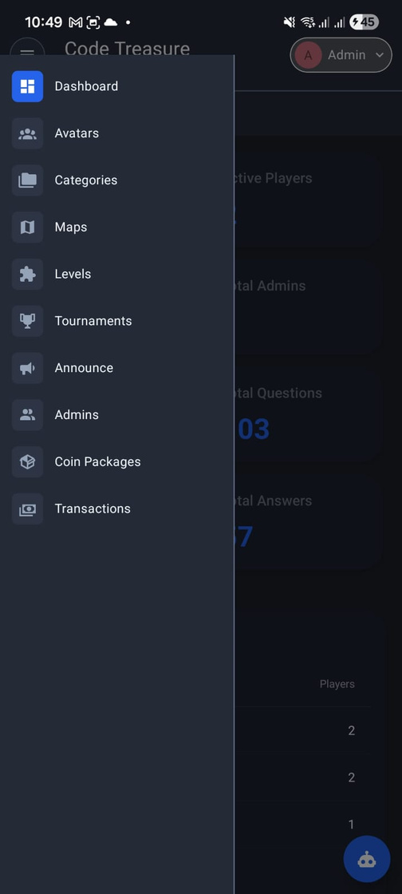
Admin dashboard

Slide 27
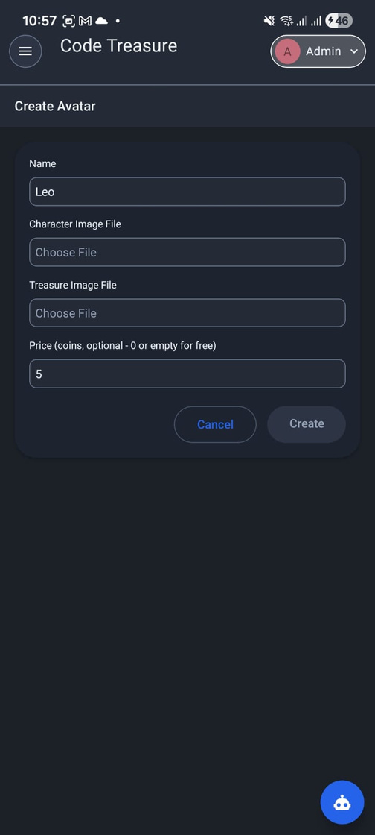
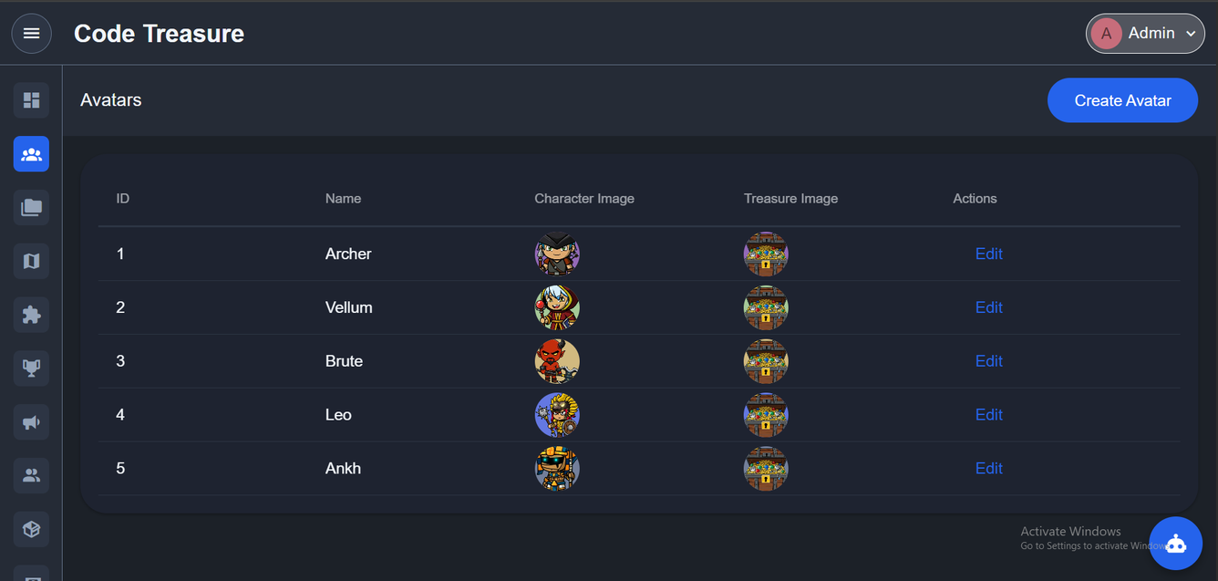
Avatar management

Slide 28
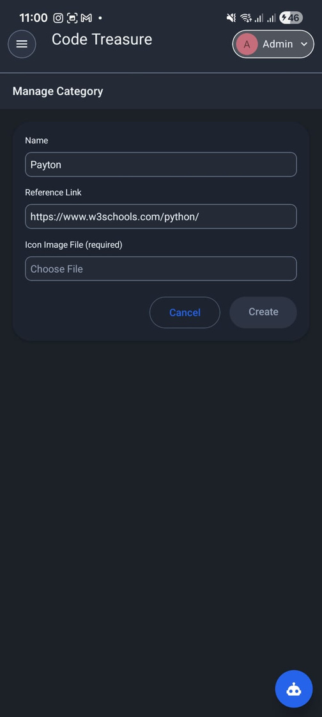
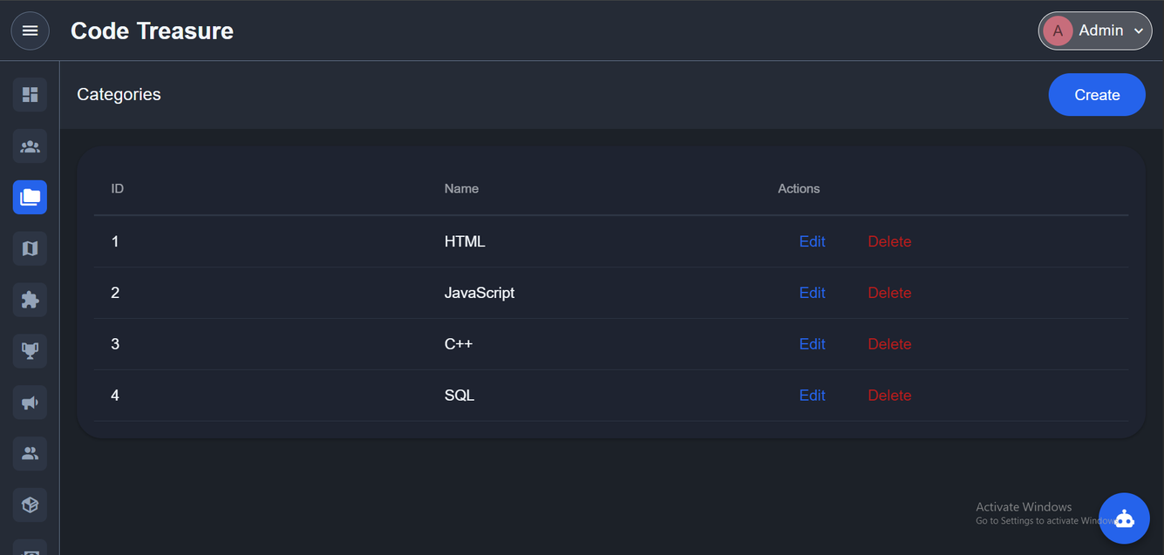
Categories management

Slide 29
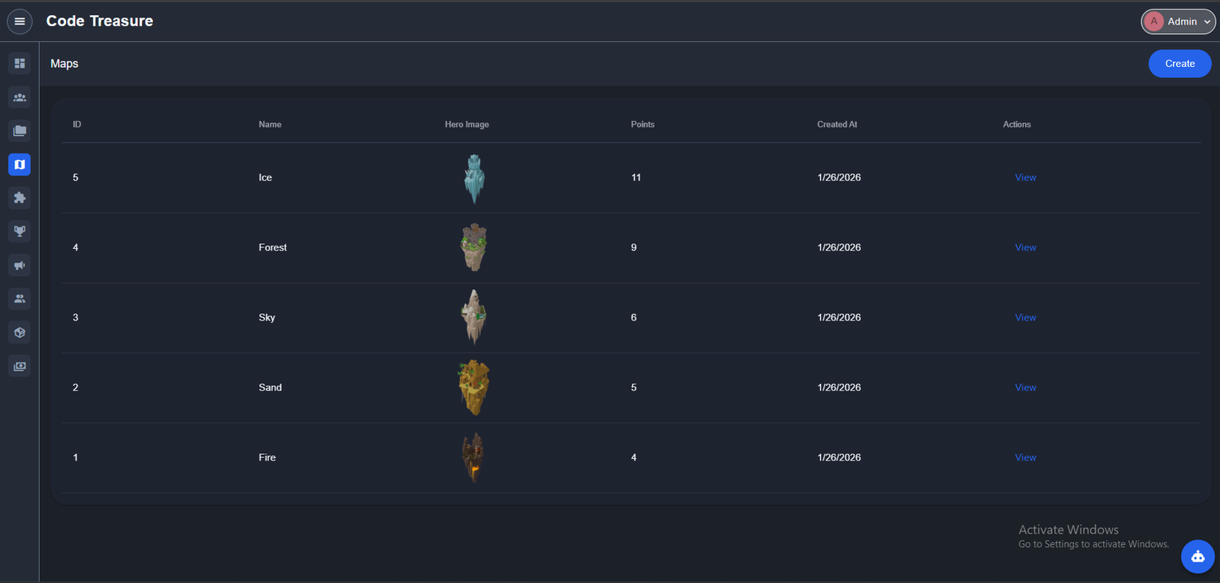
Maps management

Slide 30
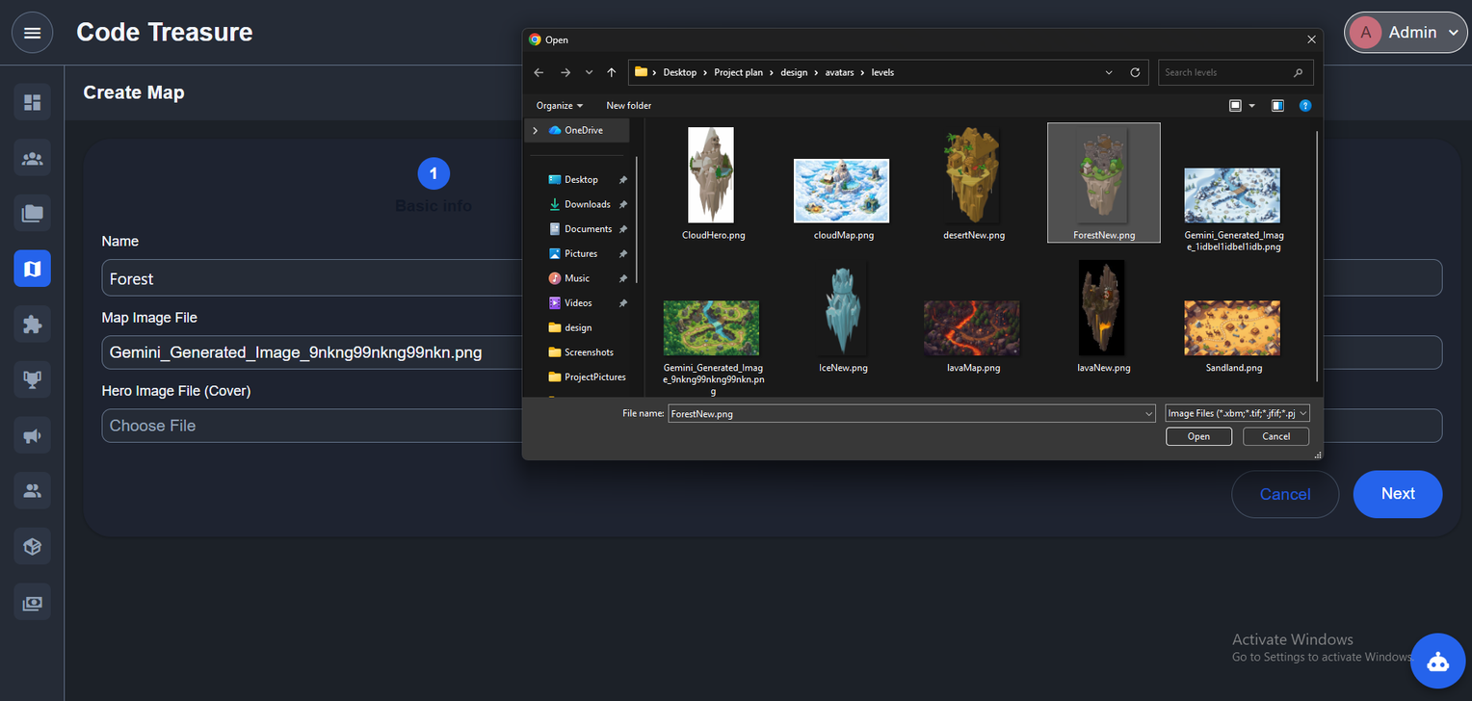
Maps management

Slide 31
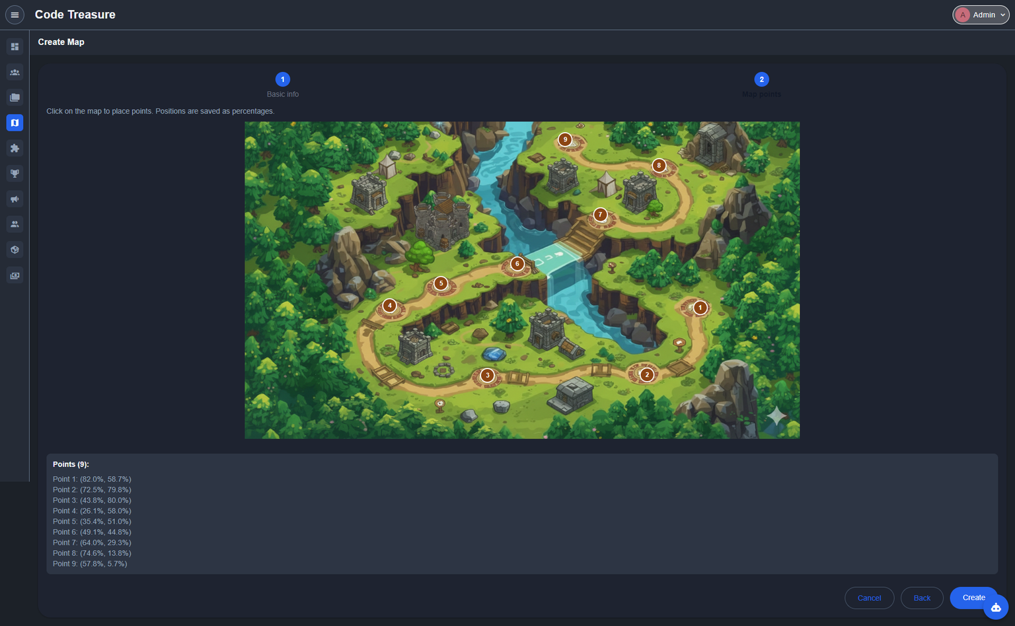
Maps management

Slide 32



Levels management

Slide 33

Levels creation step one

Slide 34


Levels creation step two

Slide 35


Tournaments

Slide 36



Announcement
Admins

Slide 37


Coin packages

Slide 38


Transactions
Admin profile

Slide 39

🛠️ Tools & Technologies Used

Slide 40




nx workspace monorepo multi apps
React Native
Socket.IO
MySQl
🌐 Frontend /⚙️ Backend
🌐 Frontend
🗄️ Database

Slide 41




IDrine e2 cloud storage
Firebase Cloud Messaging (FCM)
JWT (JSON Web Token)
Node.js
⚙️ Backend

Slide 42
Future work
  Adding theme store.
  Implement a level progression system where players must complete a level to unlock the next one.
  ِِAdding different question types, such as code writing, fill-in-the-blank, and drag-and-drop activities.
  Develop an intelligent recommendation system .

Slide 43

Thank You

