Slide 1

Najah Study Hub
Supervised by : Emad Natsheh
Direct by : Tala Hethnawi & Dyala Saadeh

Slide 2
Outline :
Introduction
Motivation of the idea
Features
How application works
Used technologies
Methods and techniques
Constraints
Future work

Slide 3
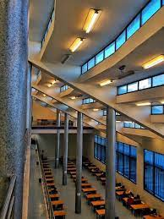
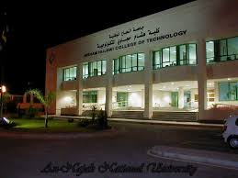

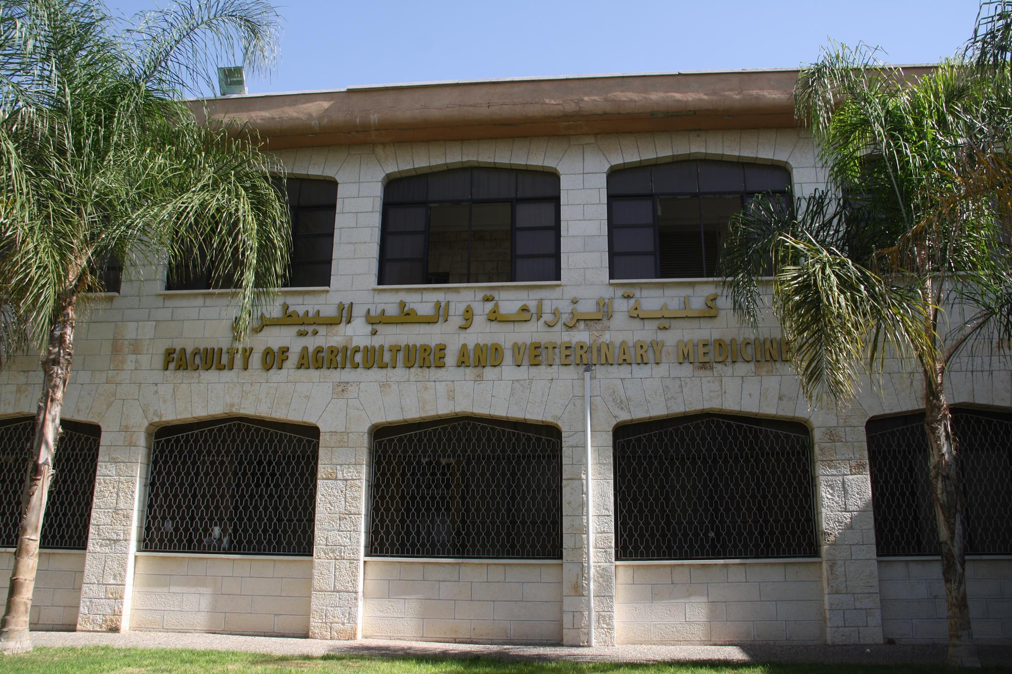
Introduction :
Al-Najah University prides itself on having four branches of its university library distributed on its campus:

Slide 4
Motivation of the idea :
Reviving the university library
Increase the percentage of students who borrow books
Reviving student discussion sessions that discuss a specific books

Slide 5
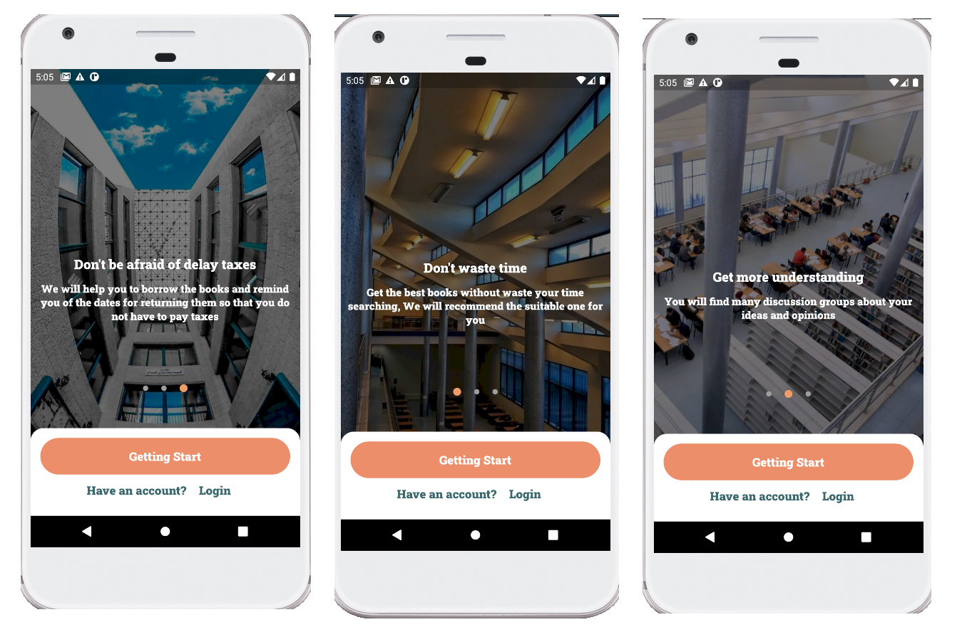
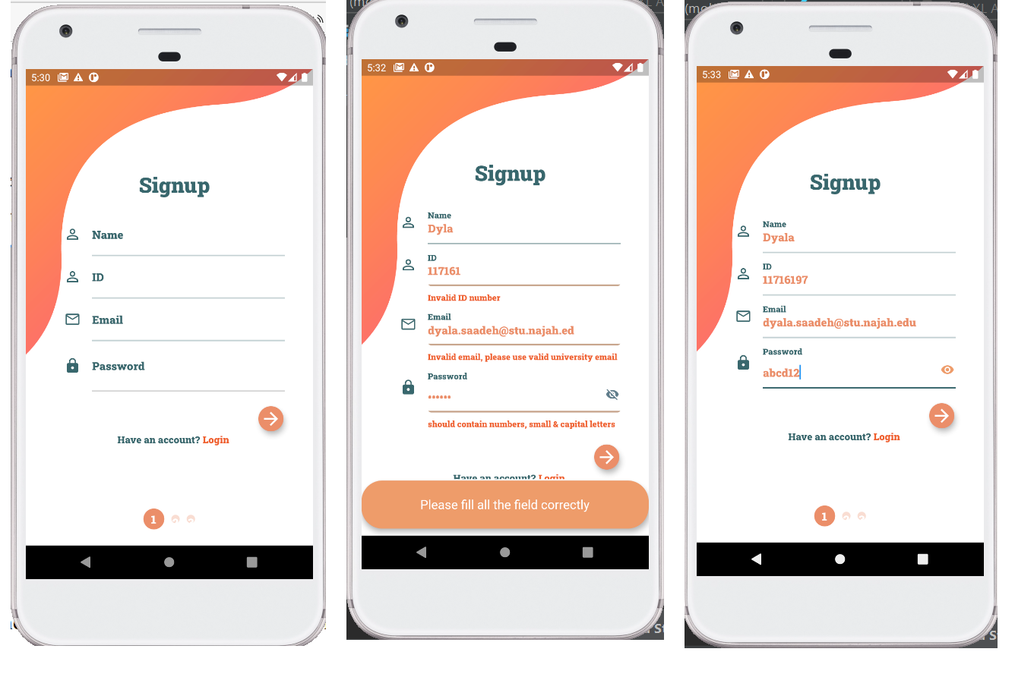
How application works

Slide 6
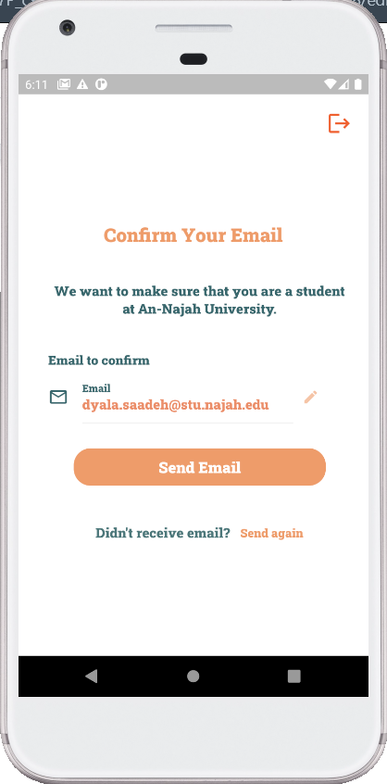
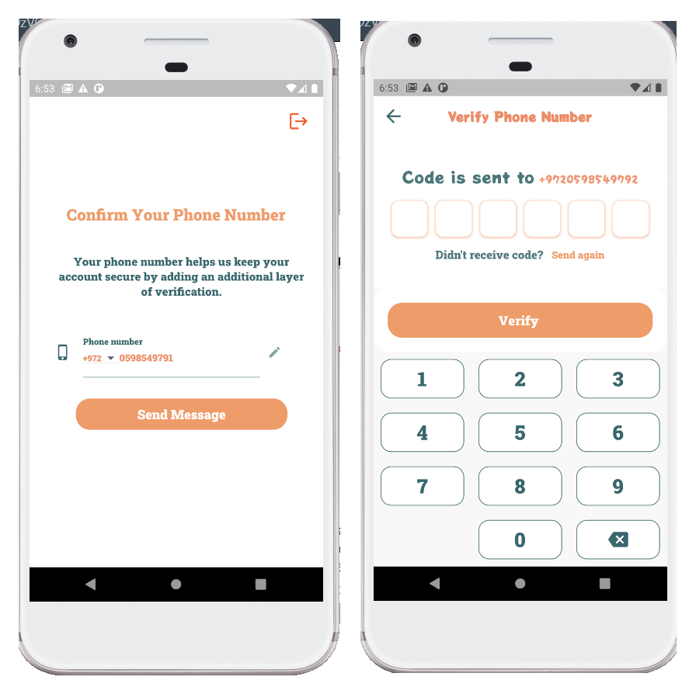
2 Way Verification

Slide 7

Recommendation System

Slide 8
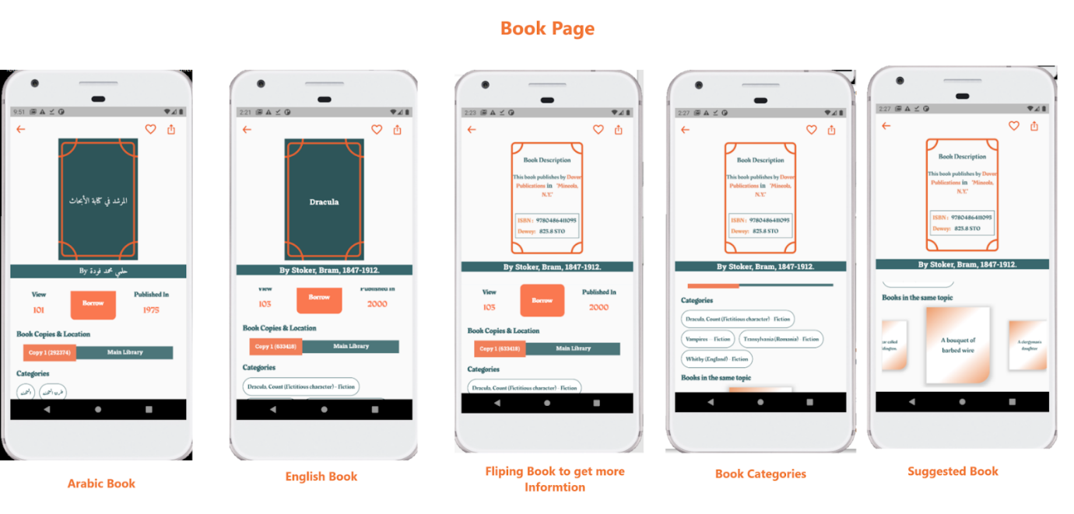

Slide 9
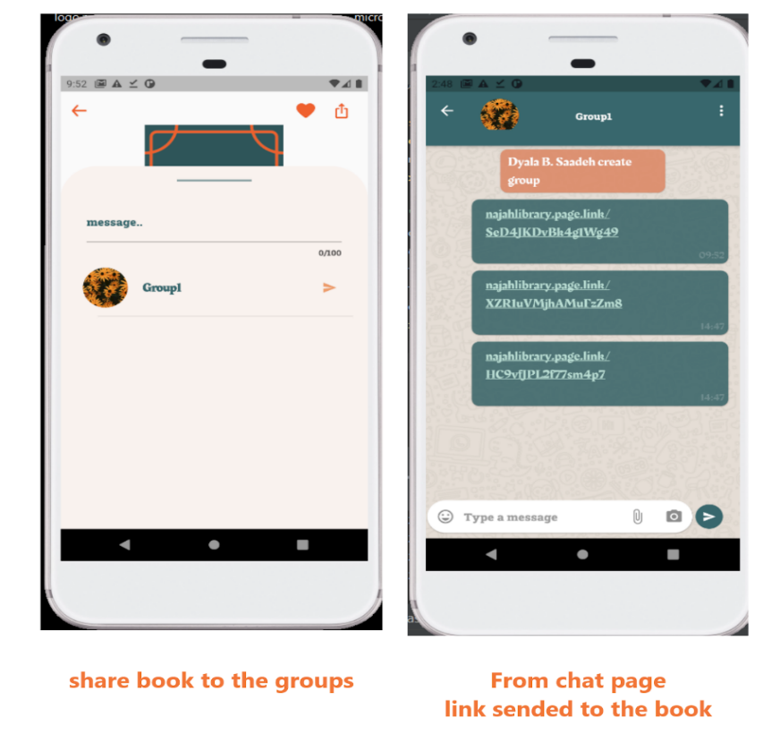

Slide 10
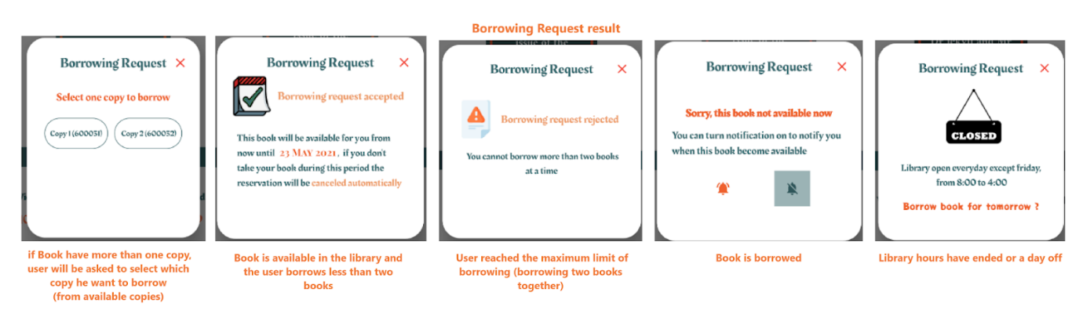

Slide 11
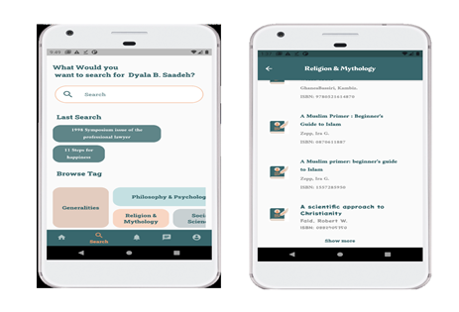

Slide 12
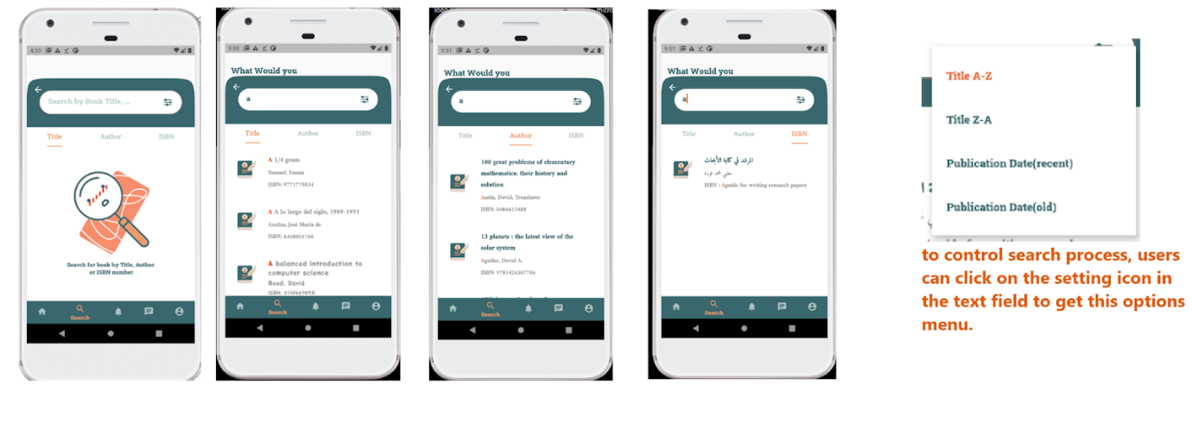

Slide 13
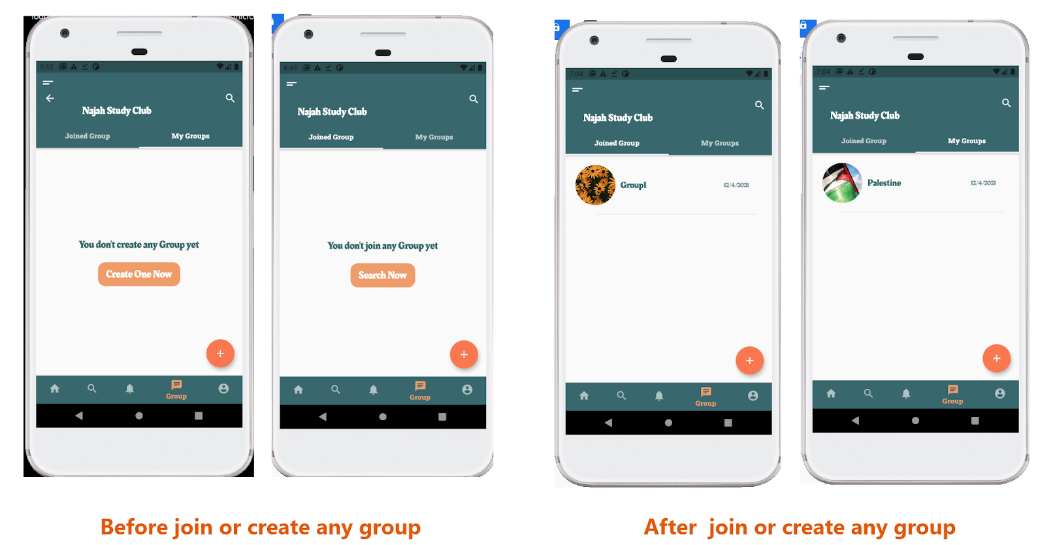

Slide 14
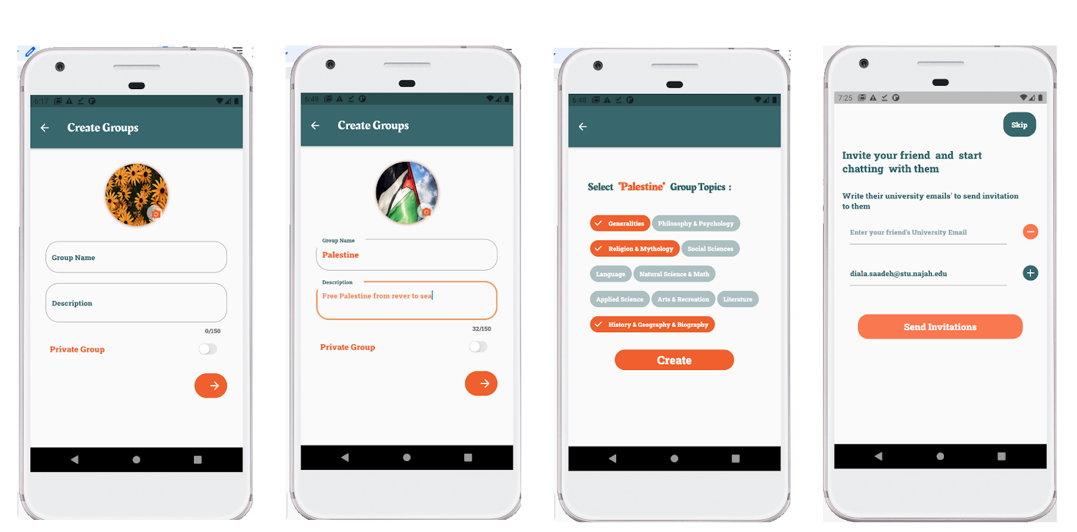

Slide 15
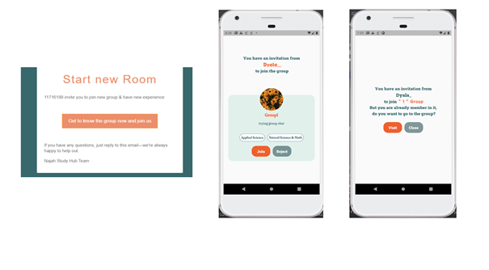

Slide 16
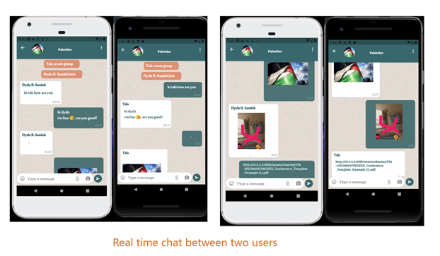

Slide 17
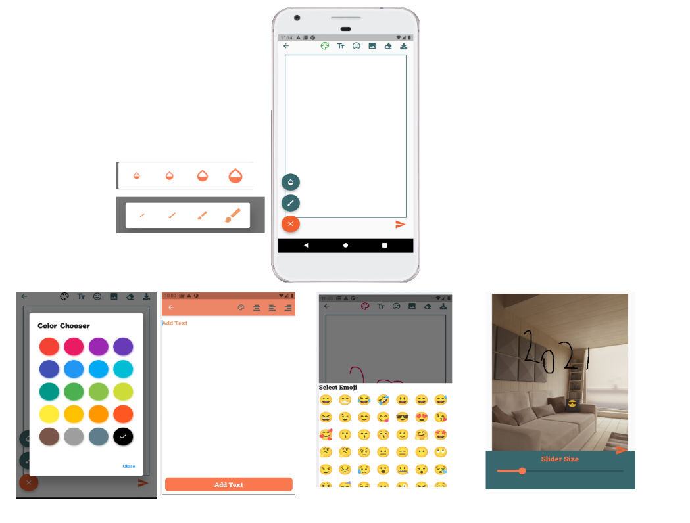

Slide 18
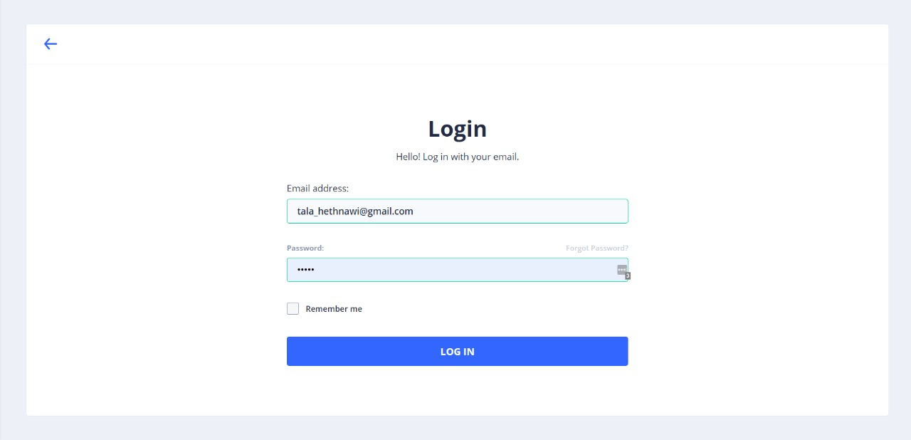
Our website:

Slide 19
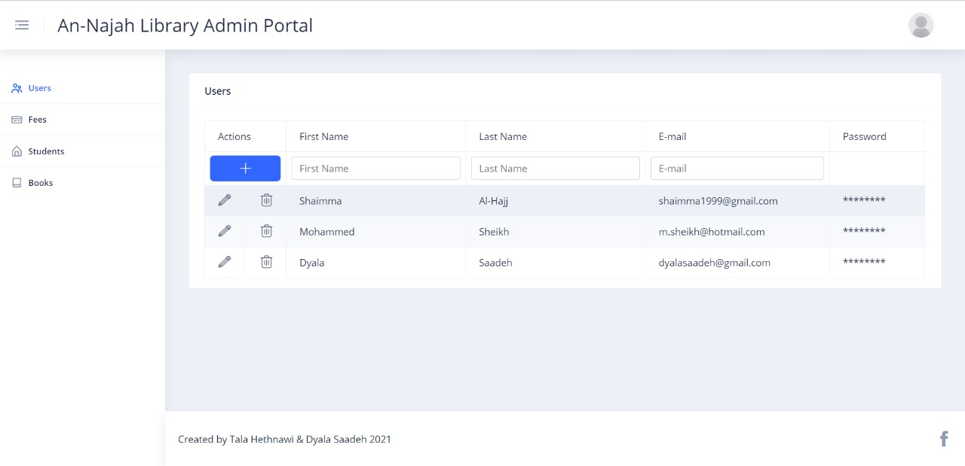

Slide 20
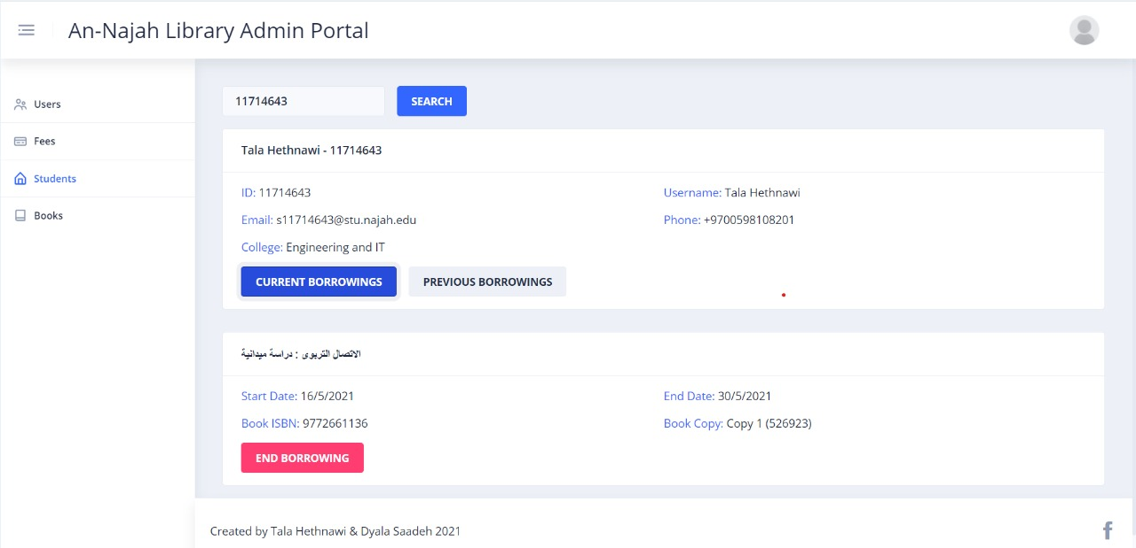

Slide 21
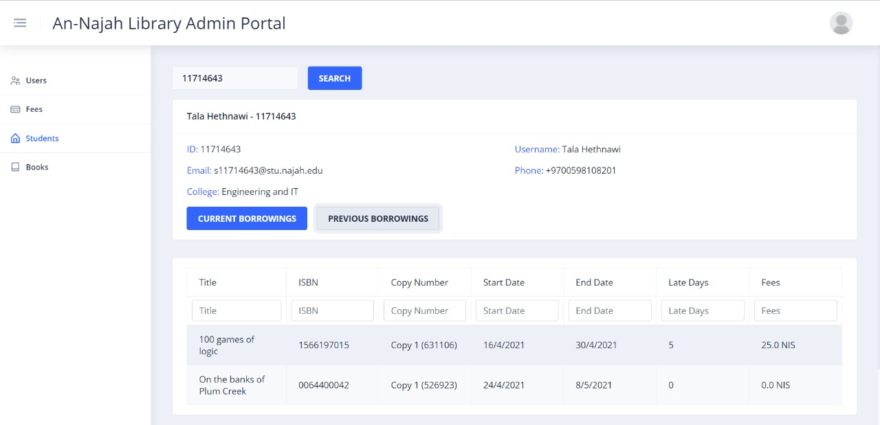

Slide 22
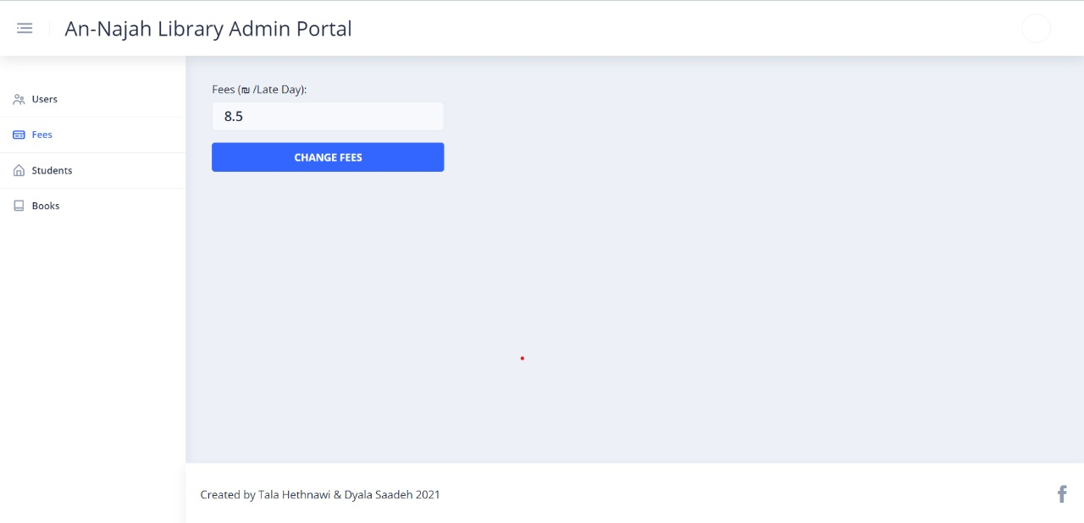

Slide 23
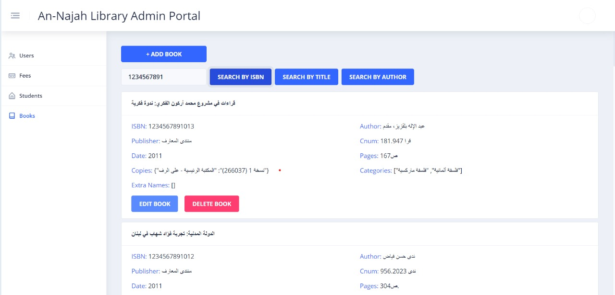

Slide 24
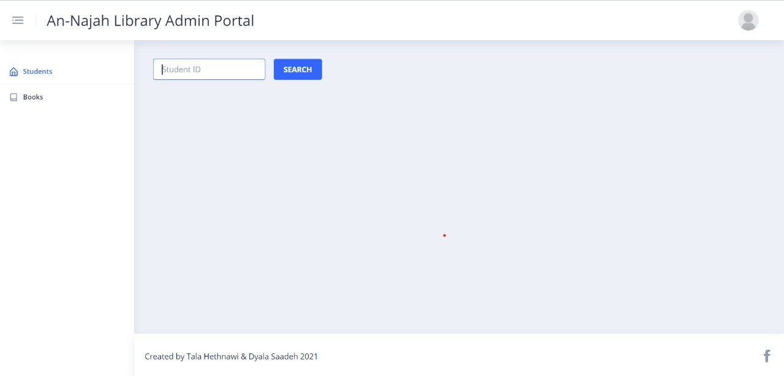

Slide 25
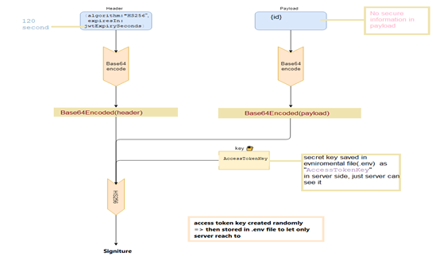
Authentication

Slide 26
Used technologies
Cross-platform mobile development using Flutter.
The Dart programming language used on the client-side.
Creating client-side with design pattern architecture MVVM.
Web development using Angular 2+ framework.
The node.js programming language used on server-sides.
The Python programming language
non-relational databases.
Canvas painting.
Achieving authentication server by working with JWT.
Working with socket.io for client and server side.

Slide 27
Constraints
Unfamiliar with frameworks we use
Official and legal procedures to give data
Different version of flutter
New version of dart
Limited information about programing collaborative system.

Slide 28
Future work
Hybrid model for recommendation system to add content-based
Add other users, such as teachers and graduate students
Have time to make another trainings for model
Give more data form AN-Najah University to test the model, and display book location in the library
Make it more support to IOS system
Developing the group system by setting up an online meeting system
Make real code for notification in backend without use firebase
Give the administrator more permissions such as communication with students to give any help.

Slide 29


