Slide 1
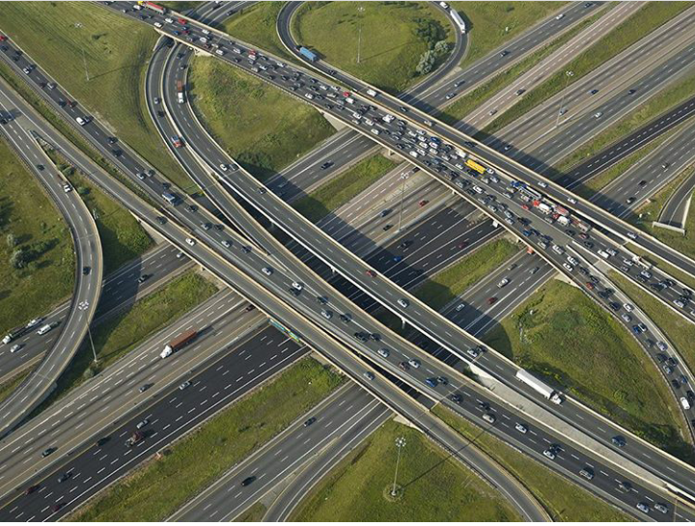
Planning and Design of an Overpass in Nablus City CDB Area

Slide 2
STUDY AREA
The part from the western entrance of Nablus city CBD from “Al-Salam Mosque” to the eastern entrance at “Al-Ballor” intersection of “Faisal Street”.

Slide 3
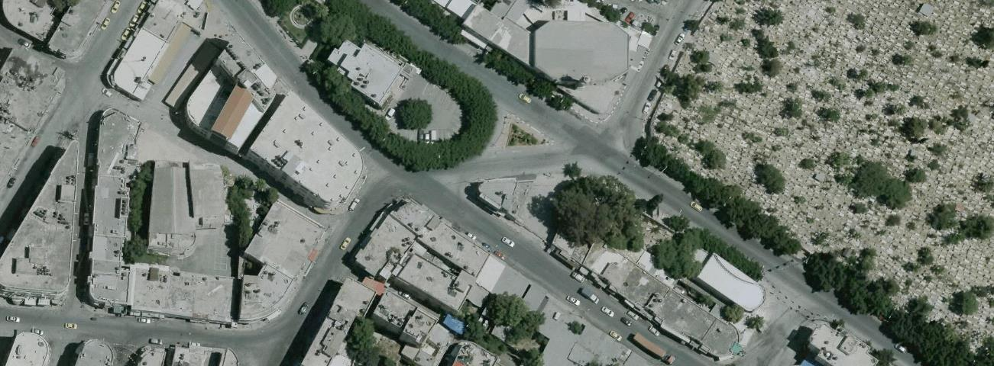
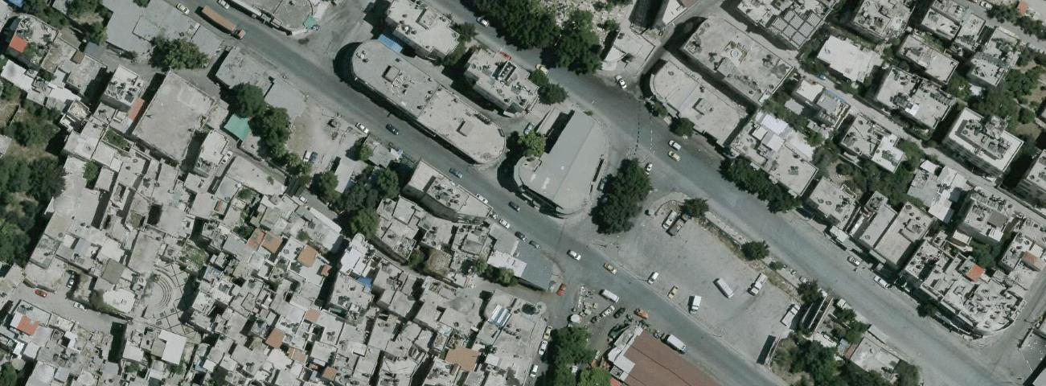
MAJOR INTERSECTIONS
Al-Haj Nimer intersection
Al-Ballor intersection

Slide 4
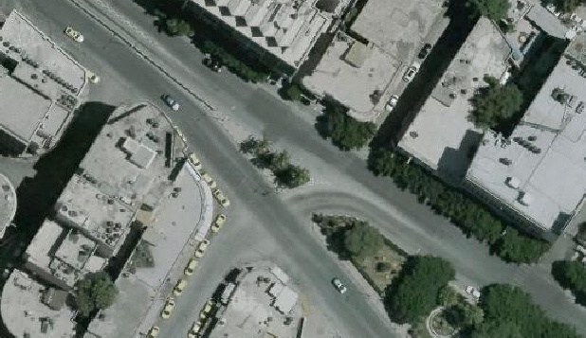
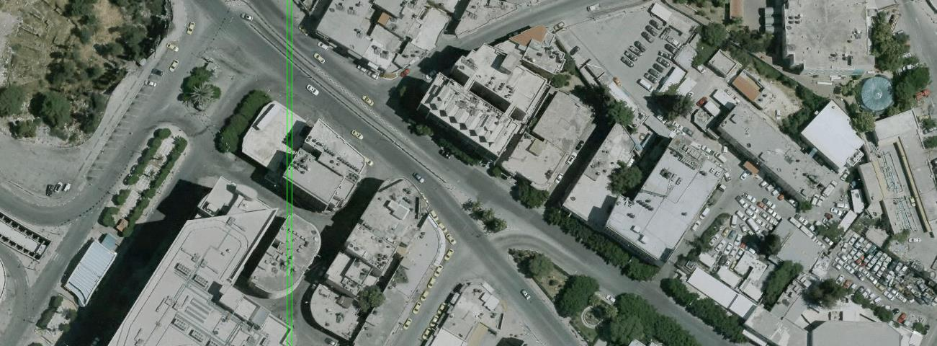
MAJOR INTERSECTIONS
Omar Al-Mokhtar intersection
Al-Watani intersection

Slide 5
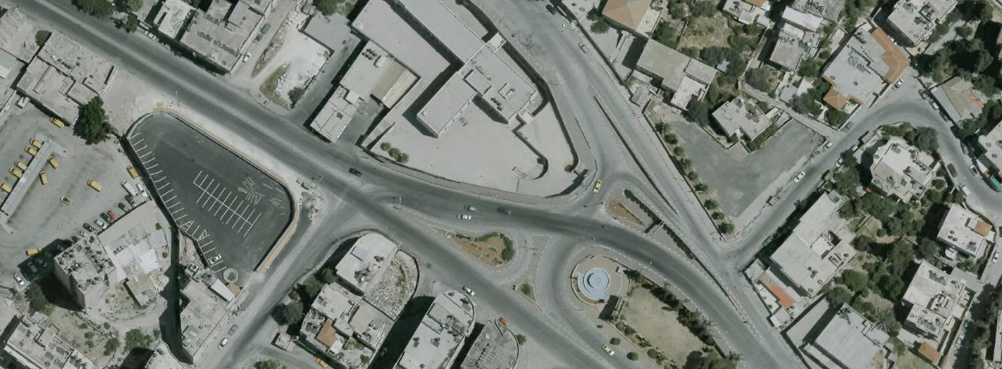
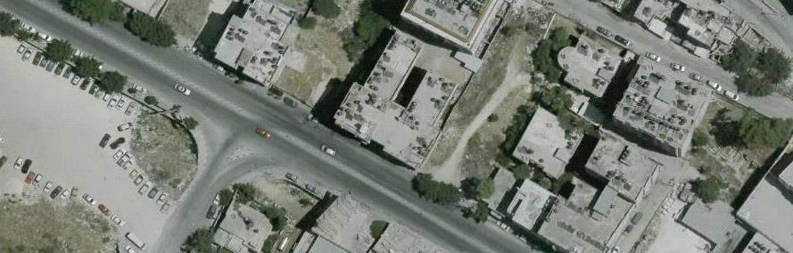
MAJOR INTERSECTIONS
Al-Kendi intersection
Western Terminal intersection

Slide 6
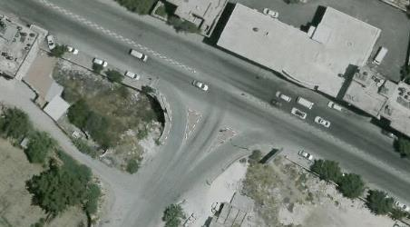
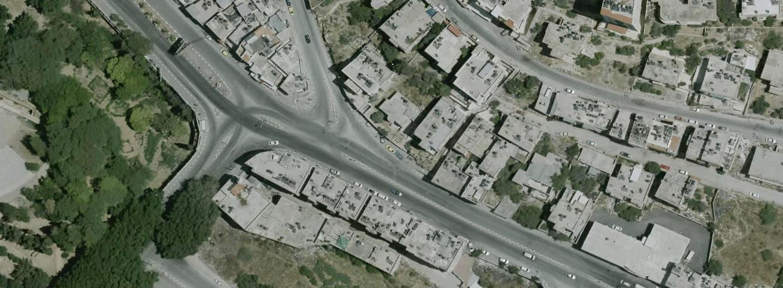
MAJOR INTERSECTIONS
Al-Salam intersection
Samehna intersection

Slide 7
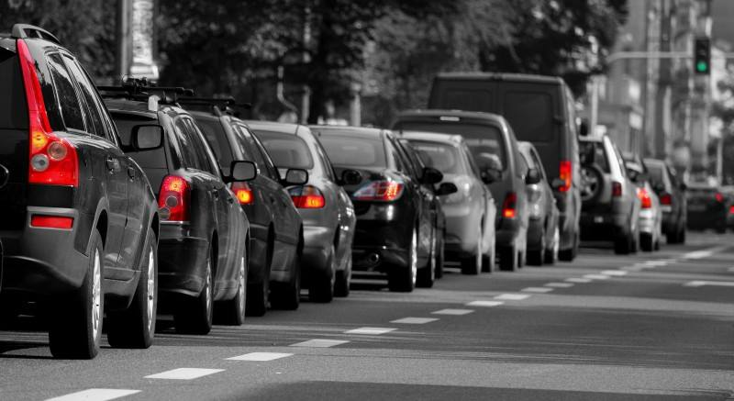
OVERVIEW OF EXISTING PROBLEM
Traffic congestion problems.

Slide 8
PURPOSE
Minimize congestion.
Minimize delay.
Increase level of service.
Determine whether the road network and intersections are able to accommodate the future traffic volume.

Slide 9
METHODOLOGY
Traffic studies.
Intersection traffic count study.
Interview study.
Video recording supplementary traffic studies.
Traffic volume analysis and simulation.

Slide 10
METHODOLOGY
Establishing the design criteria.
Suggestion of alternatives.
Detailed design of the proposed overpass.
Traffic simulation.
Conclusion and recommendations.

Slide 11
DESIGN CRITERIA
Factors influencing highway design:
Functional classification.
Design speed.
Design vehicle.
Design hourly volume (DHV).
Cross section of the roadway.
Level of service (LOS).

Slide 12
DESIGN CRITERIA
Functional classification:
Urban arterial.(AASHTO,2011)
Design speed:
Design speeds for urban arterial roads range from 50 to 100 Km/h.(AAHTO,2011)
for the proposed overpass:70 Km/hr
for the asphalt roads:50 Km/hr

Slide 13
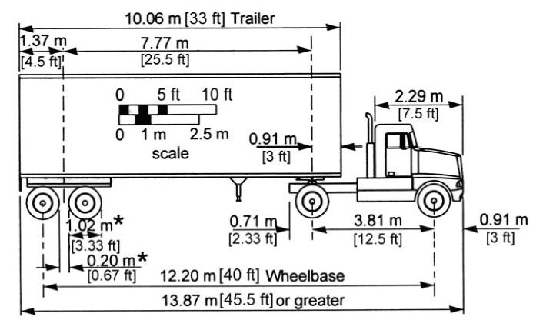
DESIGN CRITERIA
Design vehicle:
For both the asphalt road and the overpass:
Intermediate semitrailer (WB-12).(AASHTO,2011)
Design vehicle used intermediate semitrailer (WB-12)

Slide 14
DESIGN CRITERIA
Design hourly volume (DHV):
Total current through traffic = 3653 veh/hr.
Total through traffic for the overpass = 1571 veh/hr.
Total through traffic for the asphalt road = 2082 veh/hr.

Slide 15
DESIGN CRITERIA
Cross section of the roadway:
      Lane width:
      For the overpass: 3.3m,
      For the Asphalt roads: ranges between (2.4-4m).(AASHTO,2011)
      Medians:
      For the asphalt ranges between (1.8- 20m) including inside shoulder 0.5 m from both side. (AASHTO,2011)
      For the proposed overpass flushed median was assumed with a width of 0.25m due to space restriction. (AASHTO,2011)

Slide 16
DESIGN CRITERIA
      Lateral clearance: A clearance distance was assumed to be 0.6 m. (AASHTO,2011)
      Overpass railing: Overpass railing was assumed to be used for the overpass. (AASHTO,2011)
      Cross slope:
      For both the asphalt road and the over 2%. (AASHTO,2011)
      Number of lanes:
      For the asphalt roads: ranges between one lane to three lanes per direction.
      The overpass: two lanes per direction were assumed. (AASHTO,2011)

Slide 17
DESIGN CRITERIA
  Design of the alignments
    Horizontal alignment:
      Minimum radius for the horizontal alignment of the proposed overpass= 203.1 m.
      Minimum radius for the horizontal alignment of the asphalt road= 89.5 m.
      Minimum recommended length for horizontal curve = 210 m.
      Super elevation : the maximum rates of super elevation (4% to 6%) are applicable for urban design .

Slide 18
DESIGN CRITERIA
      Friction factor (f) : The value used for side friction is 0.15. (AASHTO,2011)
      Sight distance : Two types of sight distances are considered to be part of the characteristic of the road: stopping sight distance, and passing sight distance. Since the road under consideration is a multilane roadway, stopping sight distance is considered only.

Slide 19
DESIGN CRITERIA
    Vertical alignment:
    Maximum roadway grade = 10%. (AASHTO,2011)
    Minimum turning radius: 12.2 m for intermediate semitrailer.

Slide 20
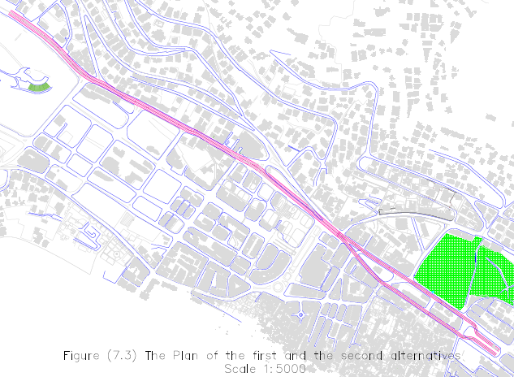
ALTERNATIVES
    The first alternative: The overpass extends from Al-Salam intersection and ends at Al-Baloor intersection, having a split before the old municipality building (The Water Department).

Slide 21
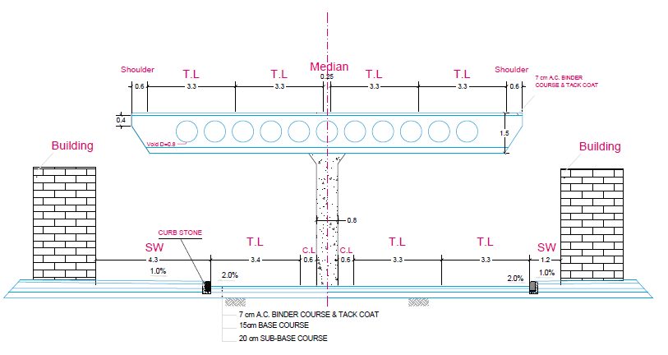
ALTERNATIVES
The cross-section of the first alternative before the split:

Slide 22
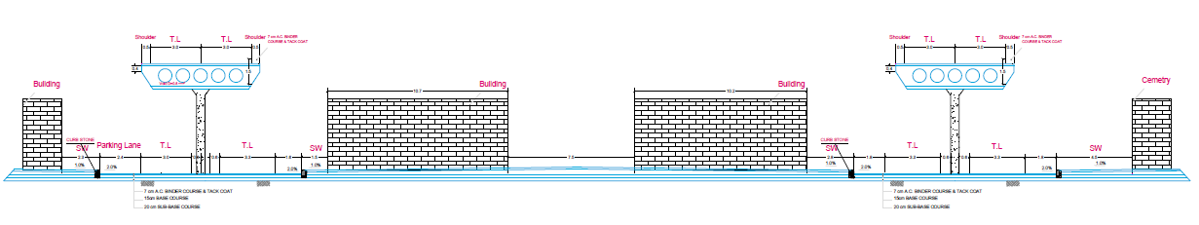
ALTERNATIVES
The cross-section of the first alternative after the split:

Slide 23
ALTERNATIVES
    The first alternative: This alternative is the same as the previous alternative starting from Al-Salam intersection and ending at Al-Ballor intersection with a split before the old municipality building but in this alternative two columns are placed at the sides of the overpass.

Slide 24
ALTERNATIVES
    The cross-section of the second alternative before the split:

Slide 25
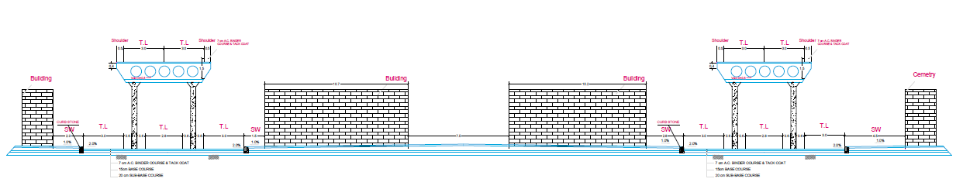
ALTERNATIVES
    The cross-section of the second alternative after the split:

Slide 26
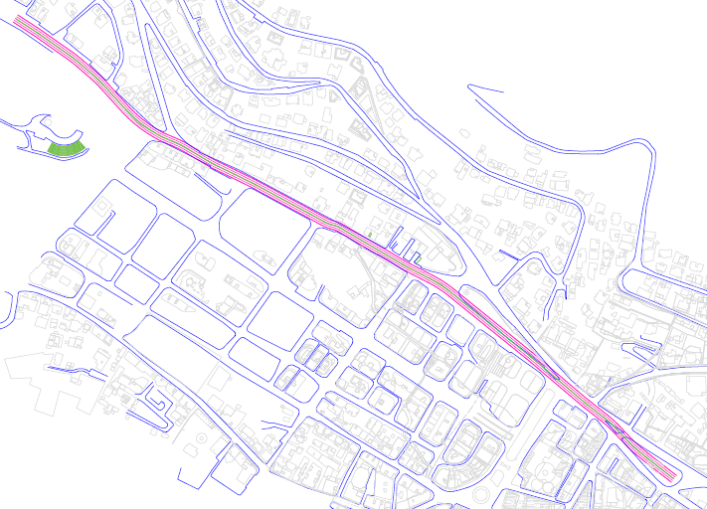
ALTERNATIVES
    The third alternative: In this alternative the overpass stars from Al-Salam intersection and ends at the place of the old municipality building.

Slide 27
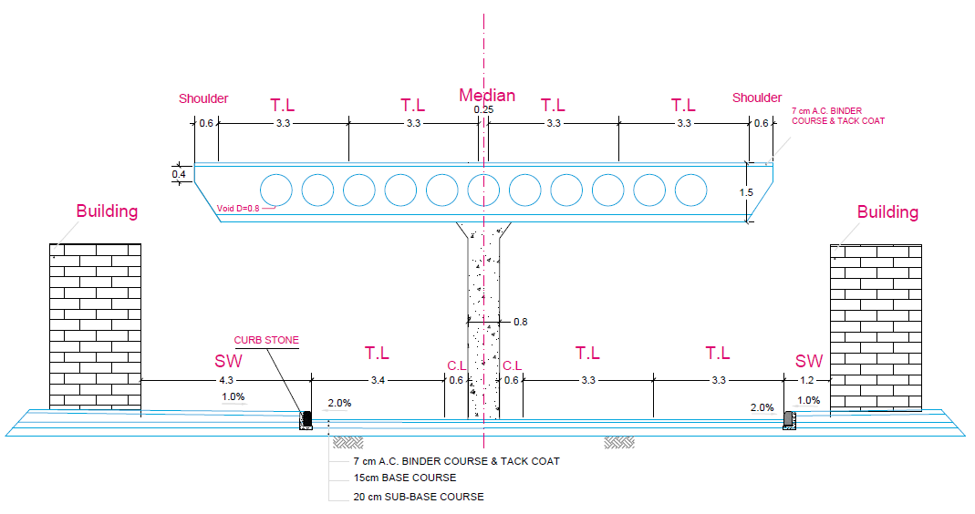
ALTERNATIVES
    The cross-section of the third alternative:

Slide 28
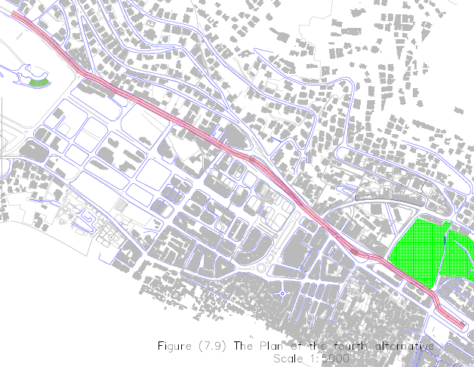
ALTERNATIVES
    The fourth alternative: In this alternative the overpass extends from Al-Salam intersection to Al-Ballor intersection, but starting from the old municipality building. The overpass will pass over the northbound area only until it reaches Al-Ballor intersection.

Slide 29
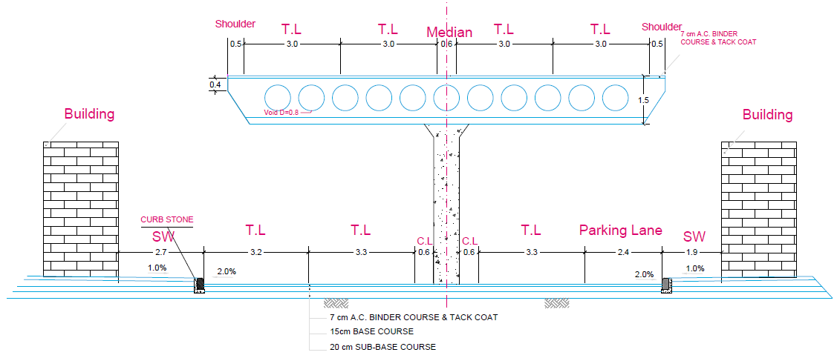
ALTERNATIVES
    The cross-section of the fourth alternative before the municipality:

Slide 30
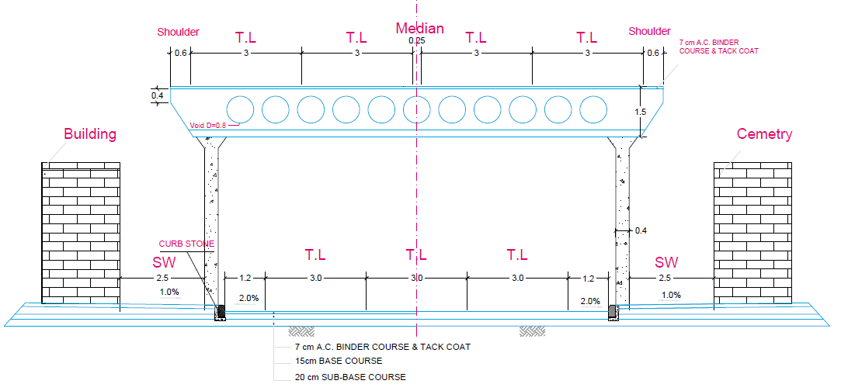
ALTERNATIVES
    The cross-section of the fourth alternative after the municipality:

Slide 31
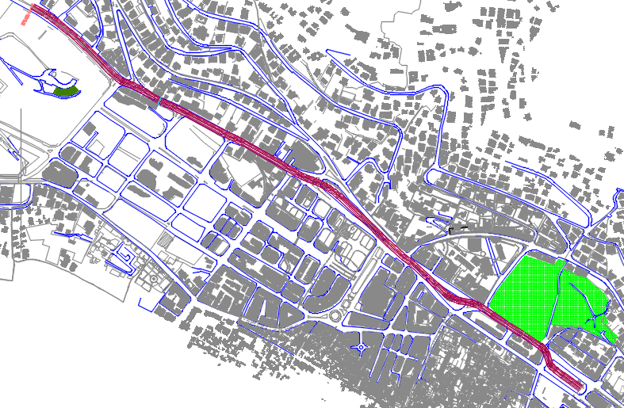
GEOMETRIC DESIGN OF THE PROPOSED OVERPASS
The plan of the proposed overpass:

Slide 32
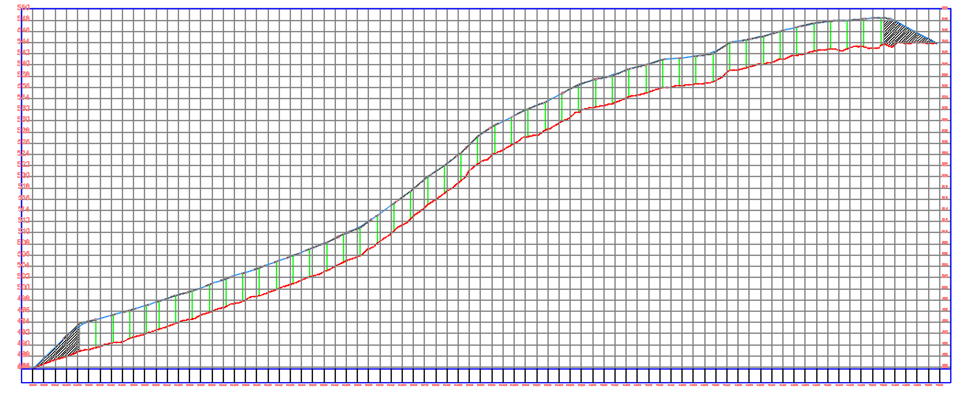
GEOMETRIC DESIGN OF THE PROPOSED OVERPASS
The profile of the proposed overpass:

Slide 33
GEOMETRIC DESIGN OF THE PROPOSED OVERPASS
The cross-section of the proposed overpass:

Slide 34
Level of Service (LOS)
Assume LOS for the proposed overpass = D.
Growth rate r = 4%.
Assume number of lanes = 2 lanes.
Calculated design period = 29 years.

Slide 35
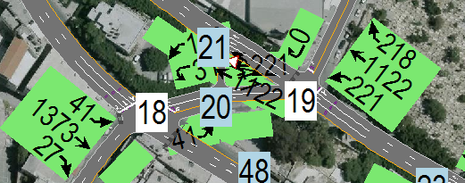

Level of Service (LOS)
For Al-Haj Nimer intersection:
105 sec | Total cycle length for Al-Haj Nimer intersection (ID18)
F | Westbound level of service
A | Southbound level of service
B | Intersection level of service

Slide 36
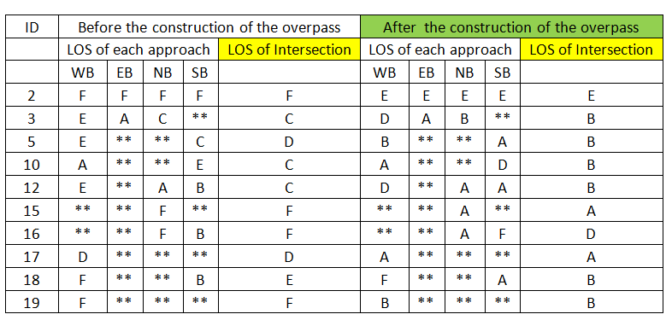
Level of Service (LOS)
The level of service at the intersections before and after the construction of the overpass

Slide 37
CONCLUSIONS
The overpass has a great effect in reducing the congestion, enhancing LOS and reducing delay.
The overpass cost is relatively high, approximately 19 million dollars about 929.54$/m².
The construction of the overpass requires all trees to be cut along the study area.

Slide 38
RECCOMENDATIONS
intensives studies should be prepared based on this project, including detailed feasibility studies, cost estimate as well as social acceptance.
The vehicles are recommended to park at the space available between the columns if the proposed overpass was implemented.
The municipality is recommended in the case of adopting the overpass solution to re-plant trees to substitute those that would be cut in order to support the environmental condition.

Slide 39
Thank You!
Any questions?

