Slide 1
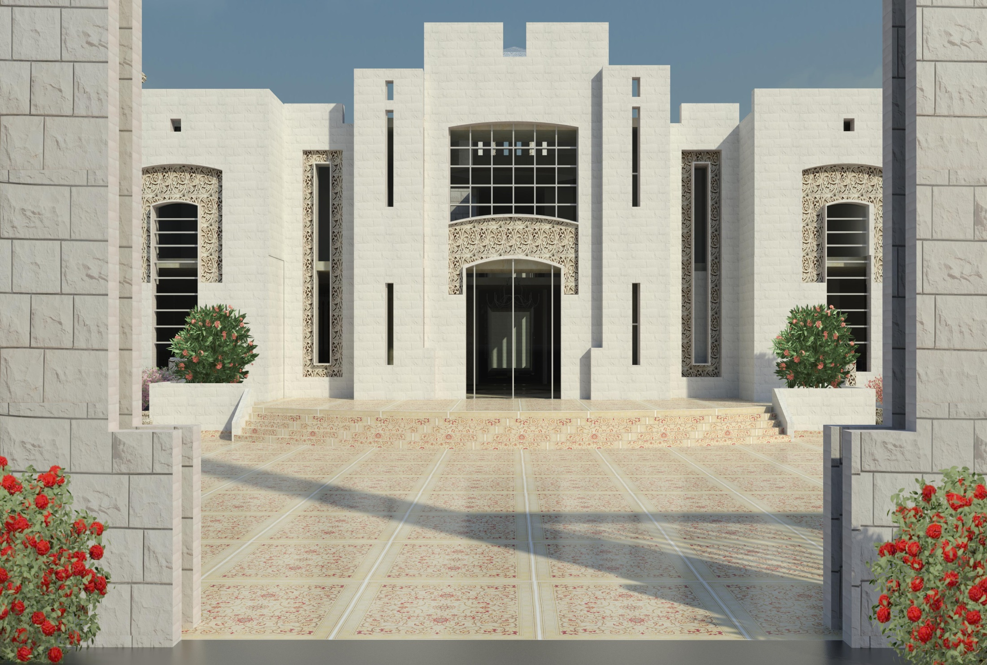



“Nablus Municipality”

Slide 2
“Nablus Municipality”
An Najah N. University
Faculty of Engineering
Building Engineering Department
BY :
Wasan Sami Najjar
Majd
* Fathiye
Supervisor : Arch. Mo’ayad Salhab

Slide 3
Outline
Site description
Architectural Design.
Environmental Design.
Structural Design
Mechanical design
Electrical design
Safety design
Quantity surveying

Slide 4
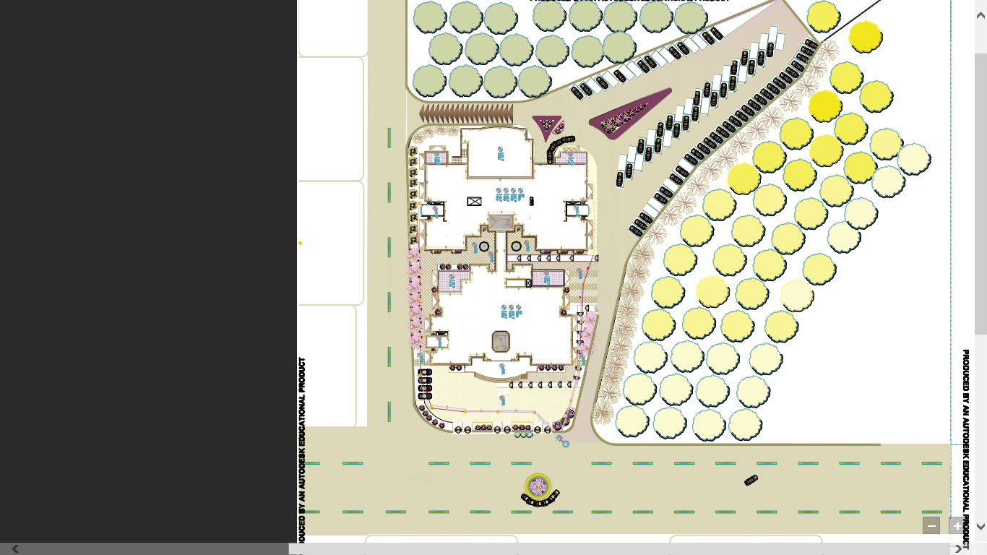
Site description
proposed site.
Muqataa
N
Main street
Main street
Health .c

Slide 5
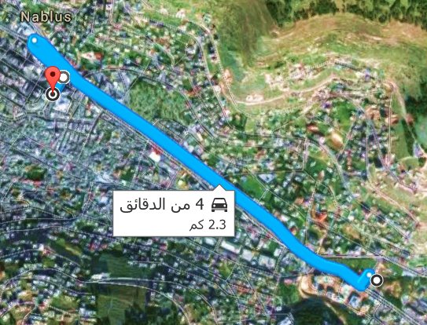
Site description :
2.3 km from the city center( 4 minutes by car)

Slide 6
Architectural
Design

Slide 7
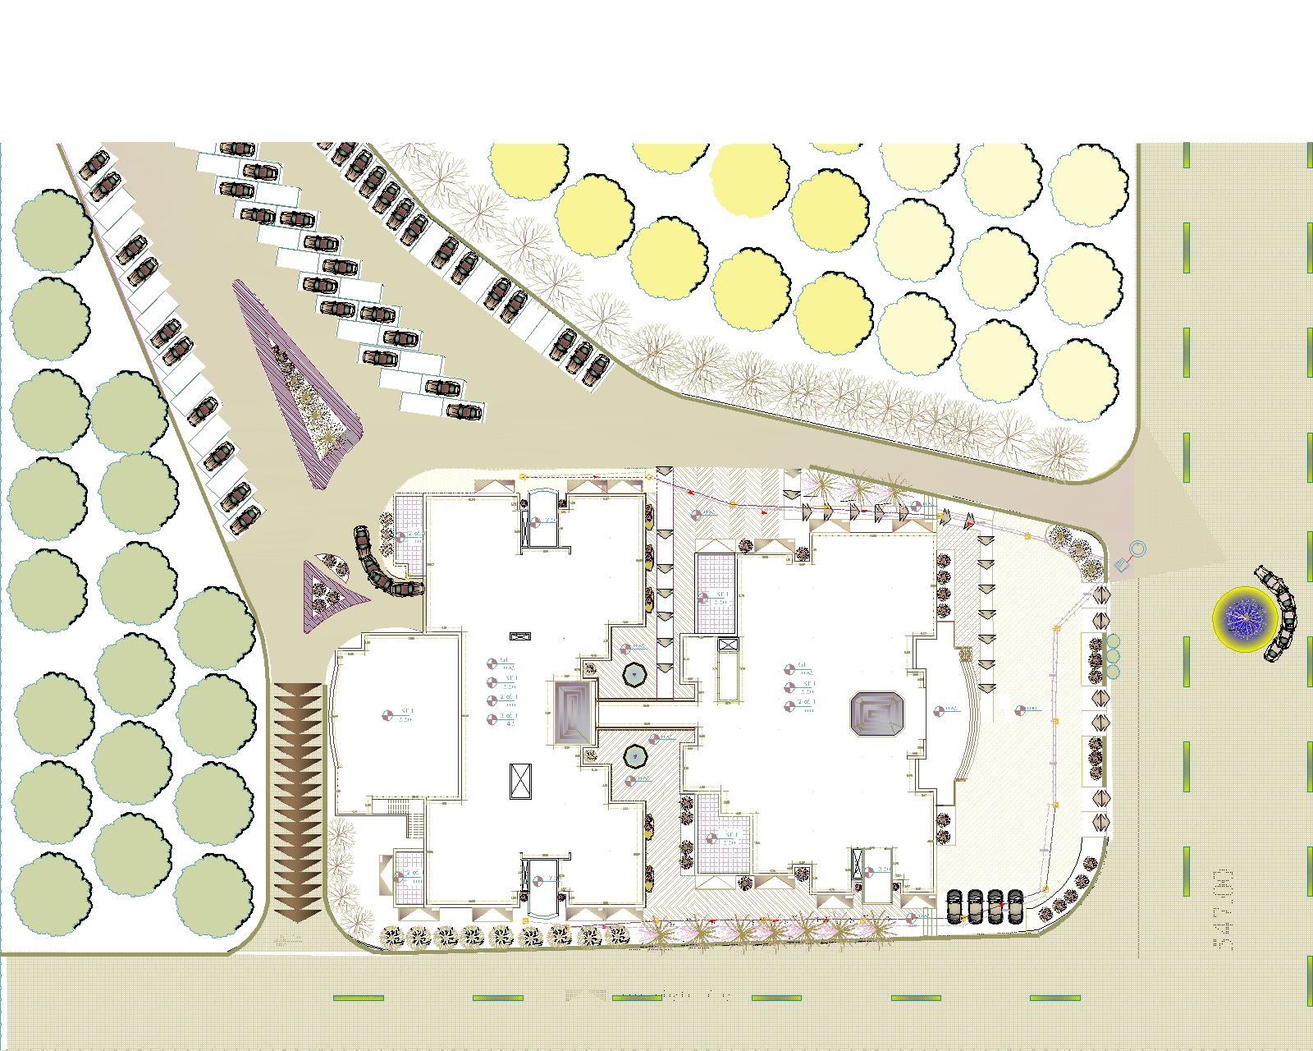
Architectural Design
Describe the building
Main street
Main street

Slide 8
Architectural Design
site plan .
under ground tank .

Slide 9
Architectural Design
site plan .

Slide 10
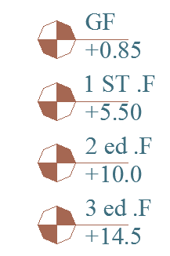
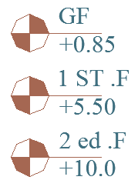
Architectural Design
Describe the building
Main street
Main street

Slide 11
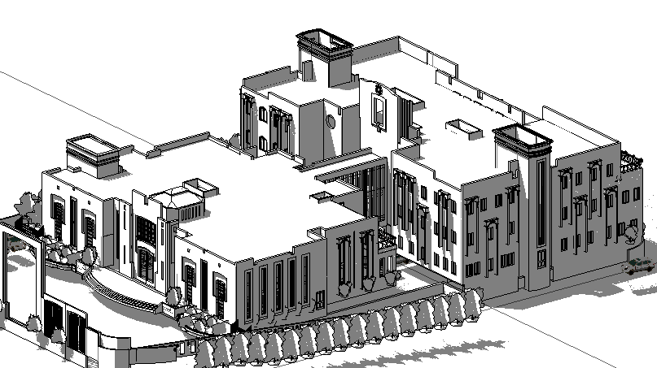
Architectural Design
Describe the building

Slide 12

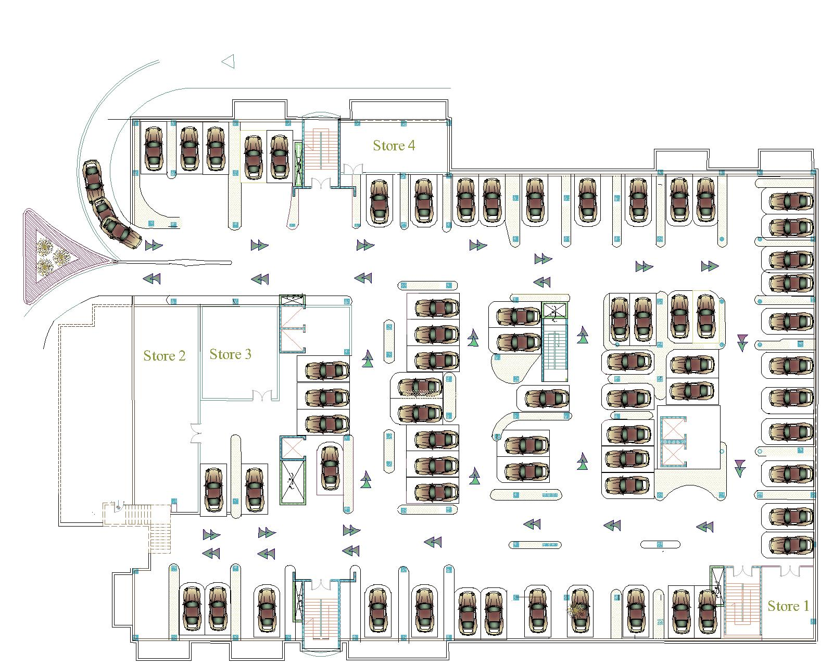
Architectural Design
Tow block have one basement that form the parking for 68 car
store
sore
sore
sore

Slide 13
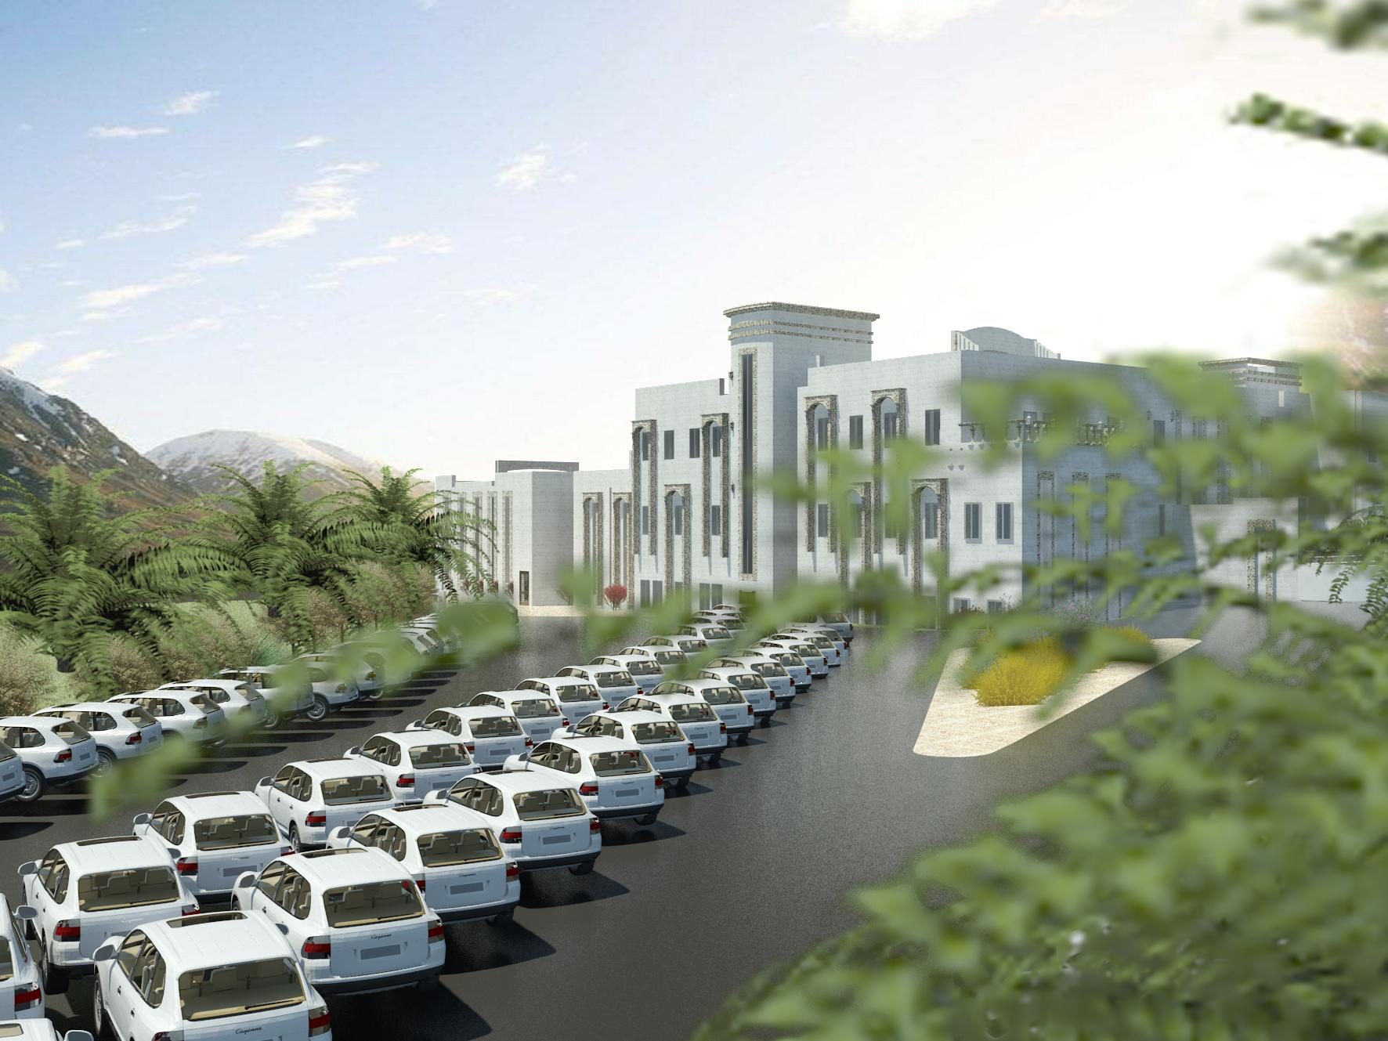
Architectural Design
Outside parking with 87 car

Slide 14
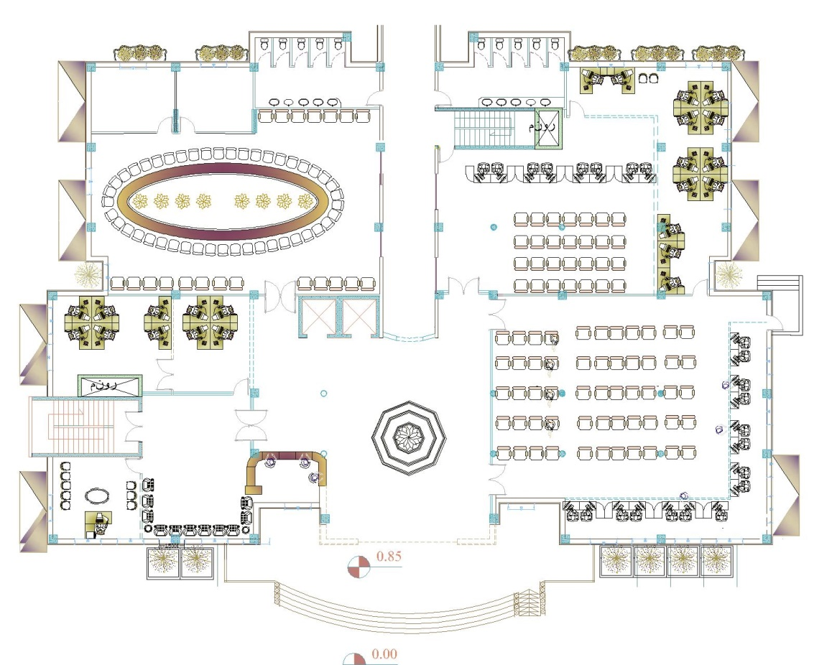
Architectural Design
Private unit
Programming
public service for citizen
Financial Department (reviewing)

Slide 15
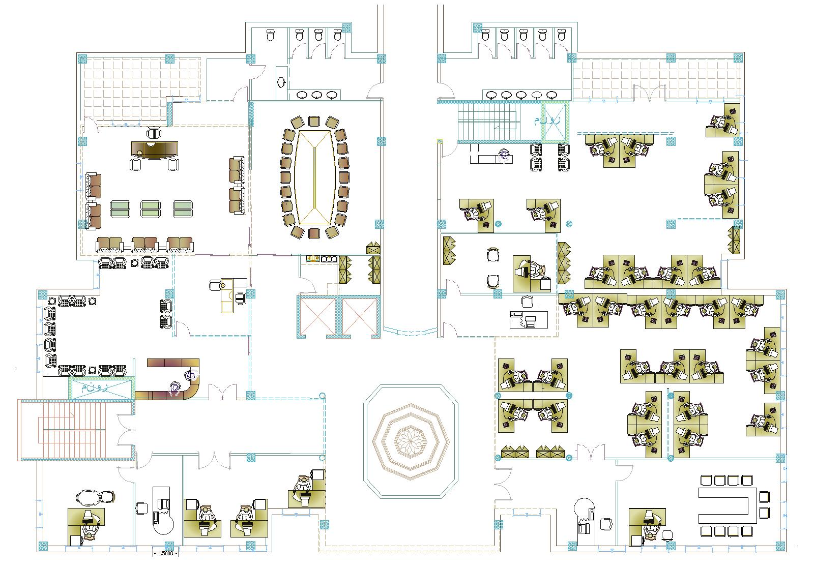
Architectural Design
Municipal director
Unit
Administration unit
finical department

Slide 16
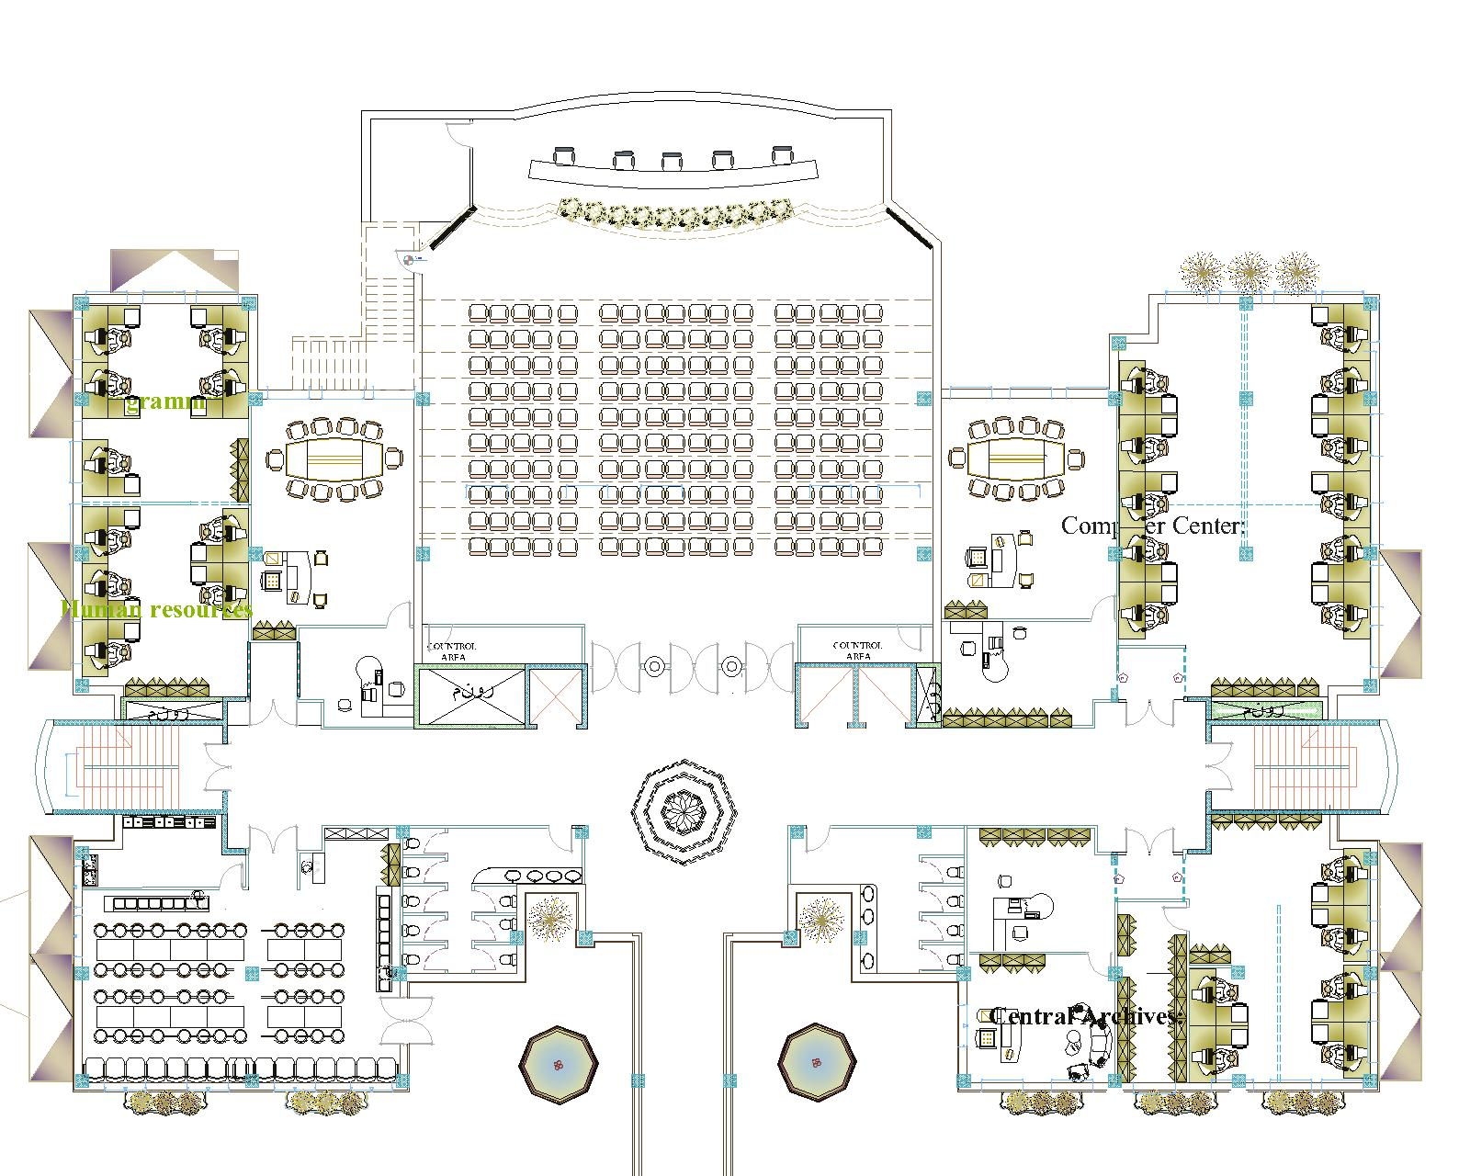
Architectural Design
Theater
computer
Health and Environmental Department
Cafeteria

Slide 17
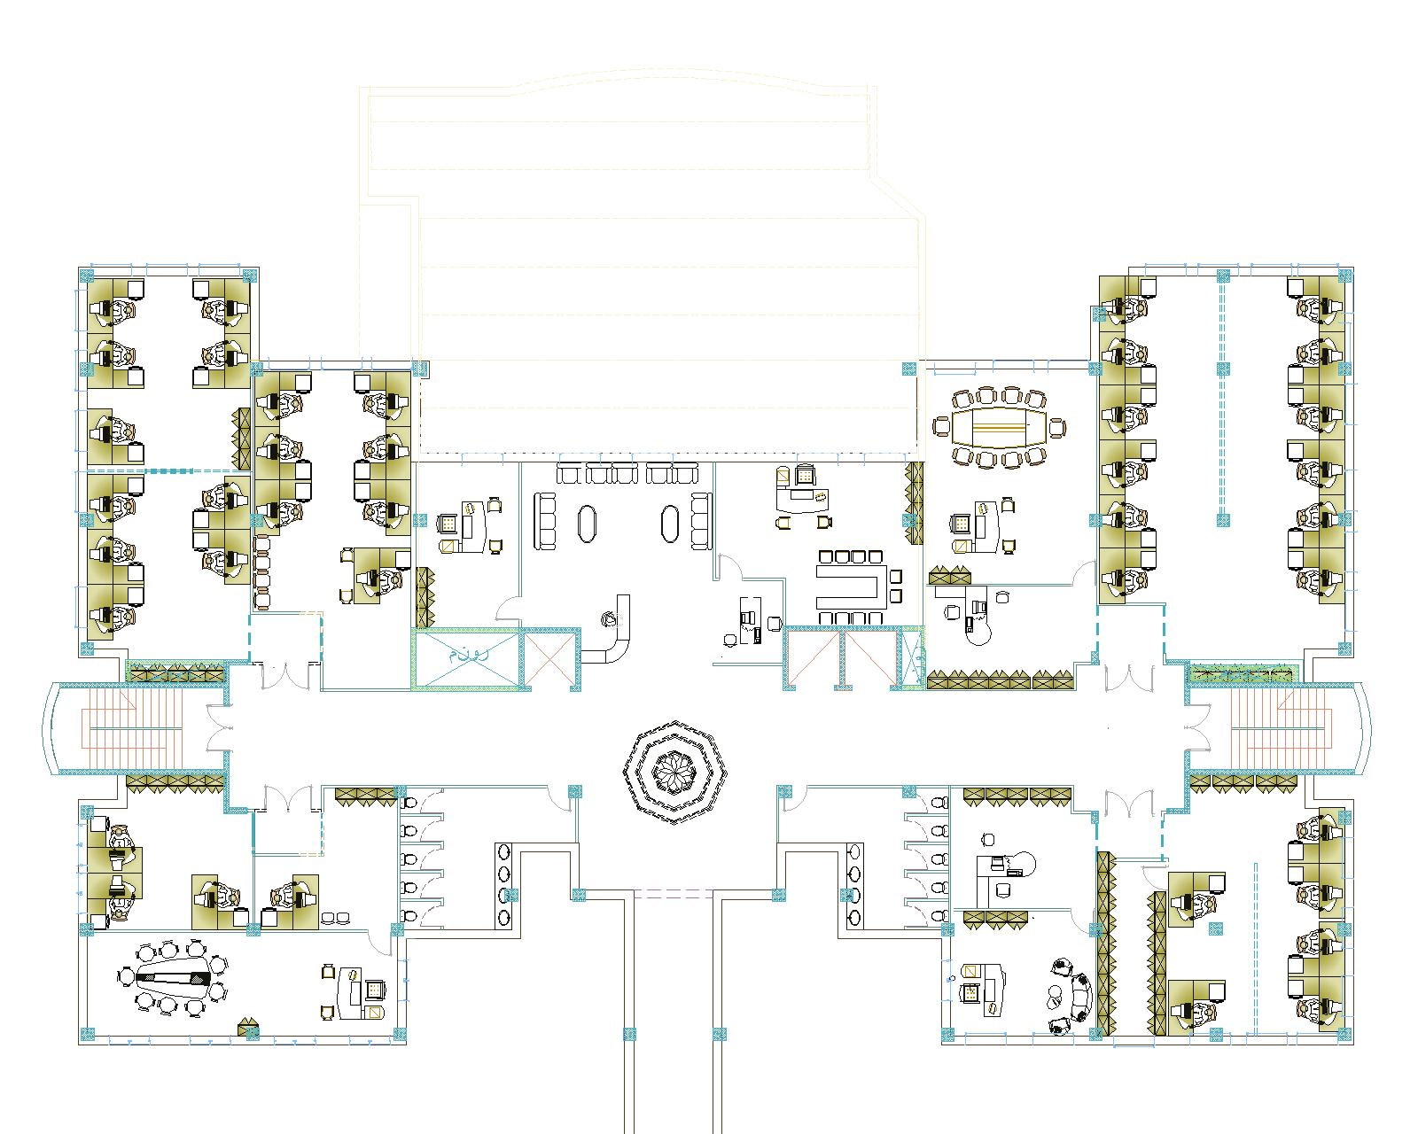
Architectural Design
planning
Department of Water ,Sewerage
engineering department
electrical

Slide 18
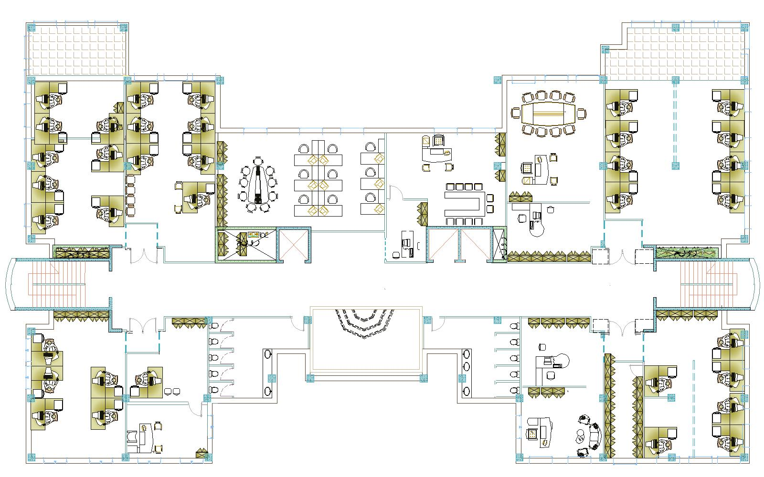
Architectural Design
Bidding, Insurance
Other administrative unit
drawing studio unit
Studies

Slide 19
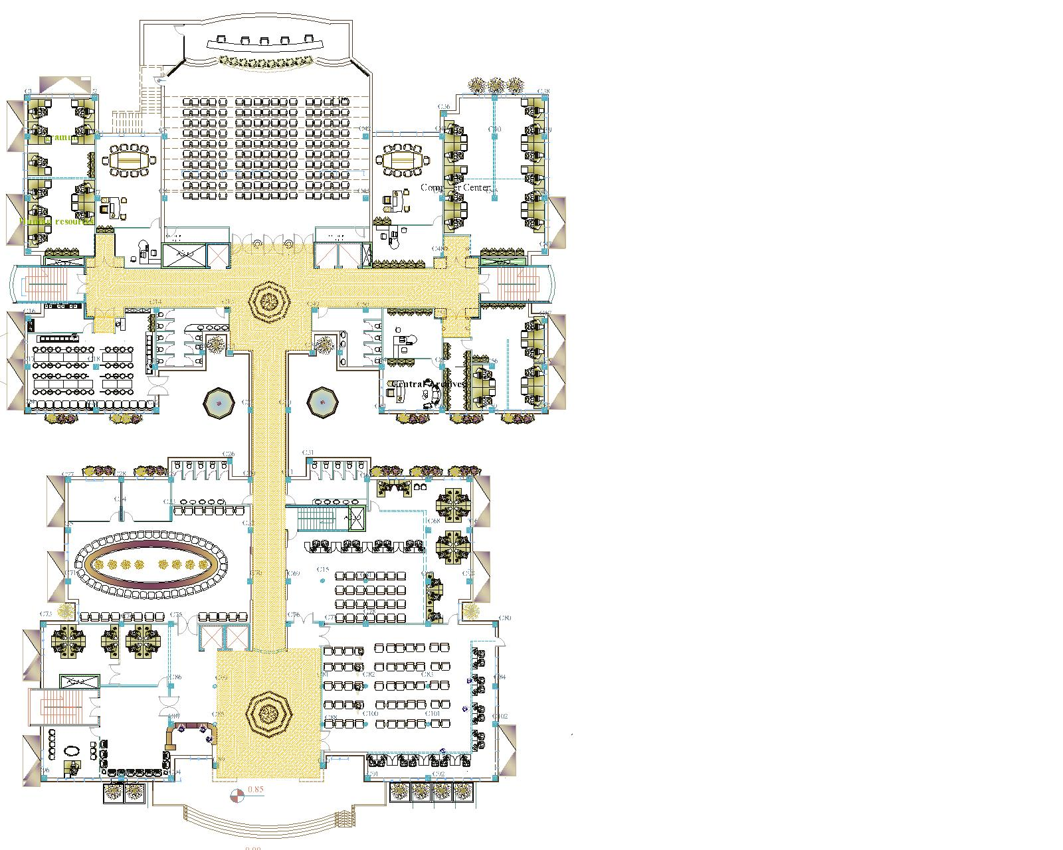
Architectural Design
The circulation designed to be clearly and easy to enter and exit for users

Slide 20
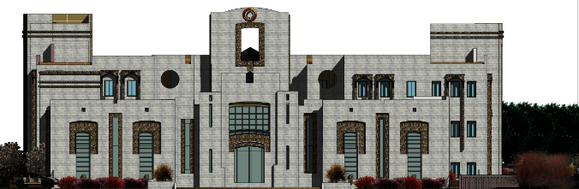
Architectural Design
Elevations
South elevation of the Municipality

Slide 21
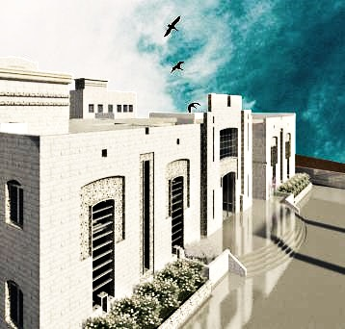
Architectural Design
Elevations
South elevation of the Municipality

Slide 22
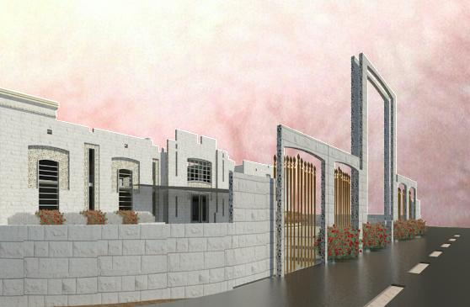
Architectural Design
Elevations
North elevation of the Municipality

Slide 23
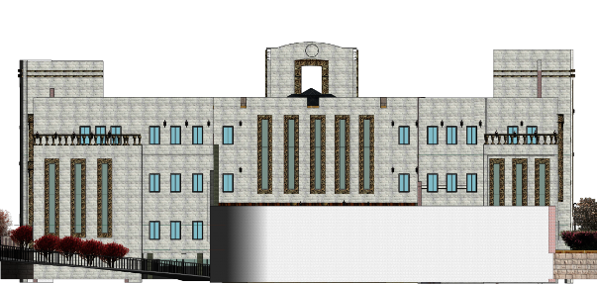
Architectural Design
Elevations
North elevation of the Municipality

Slide 24
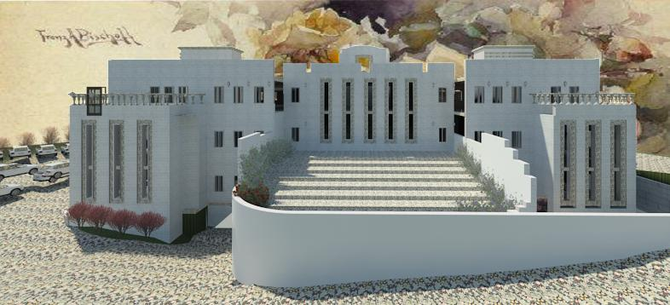
Architectural Design
Elevations
North elevation of the Municipality

Slide 25
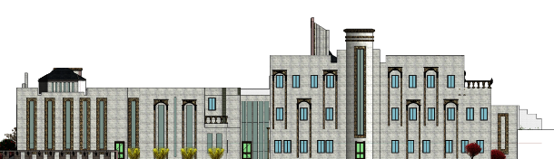
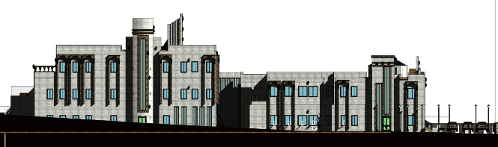
Architectural Design
Elevations
East & west elevation (North ) of the Municipality

Slide 26
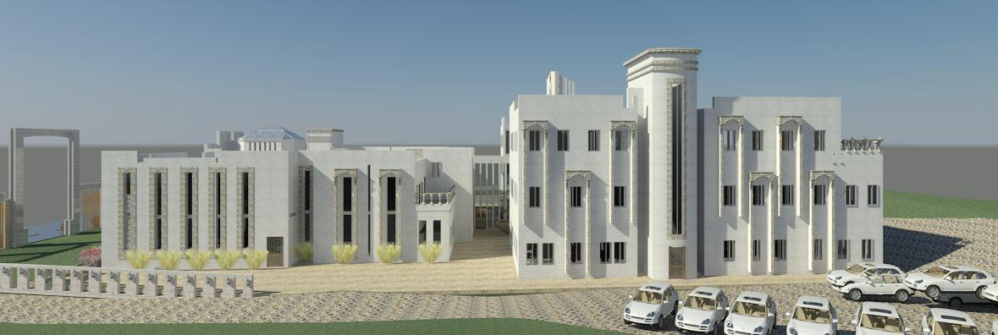
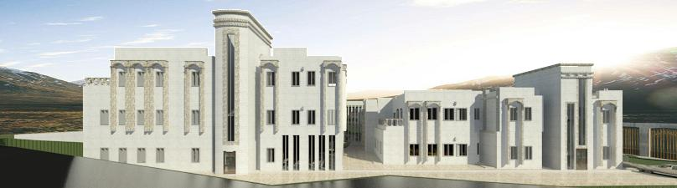
Architectural Design
Elevations
East & west elevation (North ) of the Municipality

Slide 27
Architectural Design
Space Name | Area(m²)
Store 1 | 35
Store 2 | 62
Store 3 | 118
Store 4 | 51
Area for each car | 12.5/car
Total | 2849.5
Space Name | Area(m2)
Reception | 150
Account hall | 122
Financial Department (reviewing) | 72
Public service | 225
Meeting room | 175
Public correspondence | 65
Bathroom | 25.5*2
Waiting area | 76
Service office, Programming | 26
Archive +stores | 38
Total | 1134
Area block I
2270 m2
Space Name | Area
Municipal director | 70
Waiting area and reception | 60
Secretary | 20
conference room | 66
Bathrooms | 25*2
Head administration + secretary | 40
Central Archives | 35
Financial Department (Insurance, Relations Division) | 176
Financial Department (licenses, Legal Department, Bidding, Insurance) | 216
Total | 1134

Slide 28
Architectural Design
Space Name | Area
Studies, Emergency unit | 140
Road management unit | 100
drawing studio unit | 150
Other administrative offices (Warehouse management , Traffic management ,Management of cultural, Fire station management, Women's corner Center) | 190
Bidding, Insurance | 70
Bathrooms | 30*2
Total | 950
Area block II
3150 m2
Space Name | Area
Municipal engineer ,Secretary and Conference room | 150
Planning, GIS unit | 160
Organization unit | 100
Development & Prepare projects Gardens unit | 70
Bathrooms | 30*2
administrative water section | 220
Archives unit | 70
Total | 1000
Space Name | Area(m2)
Department of health and environment | 220
Computer Center | 154
Theater | 410
Cafeteria +kitchen | 120
bathroom | 30*2
total | 1200

Slide 29
Environmental Design

Slide 30
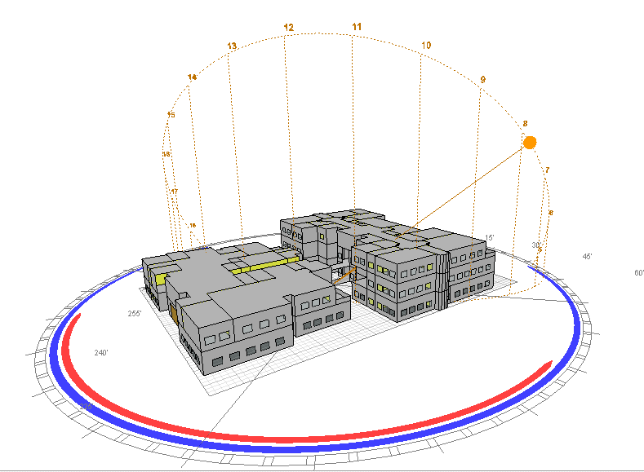
Environmental Design

Slide 31
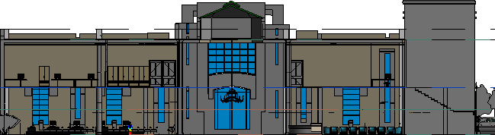
Environmental Design
Natural ventilation
Sky light
E
W

Slide 32
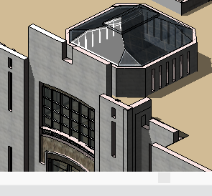
Environmental Design
Natural ventilation
Sky light

Slide 33
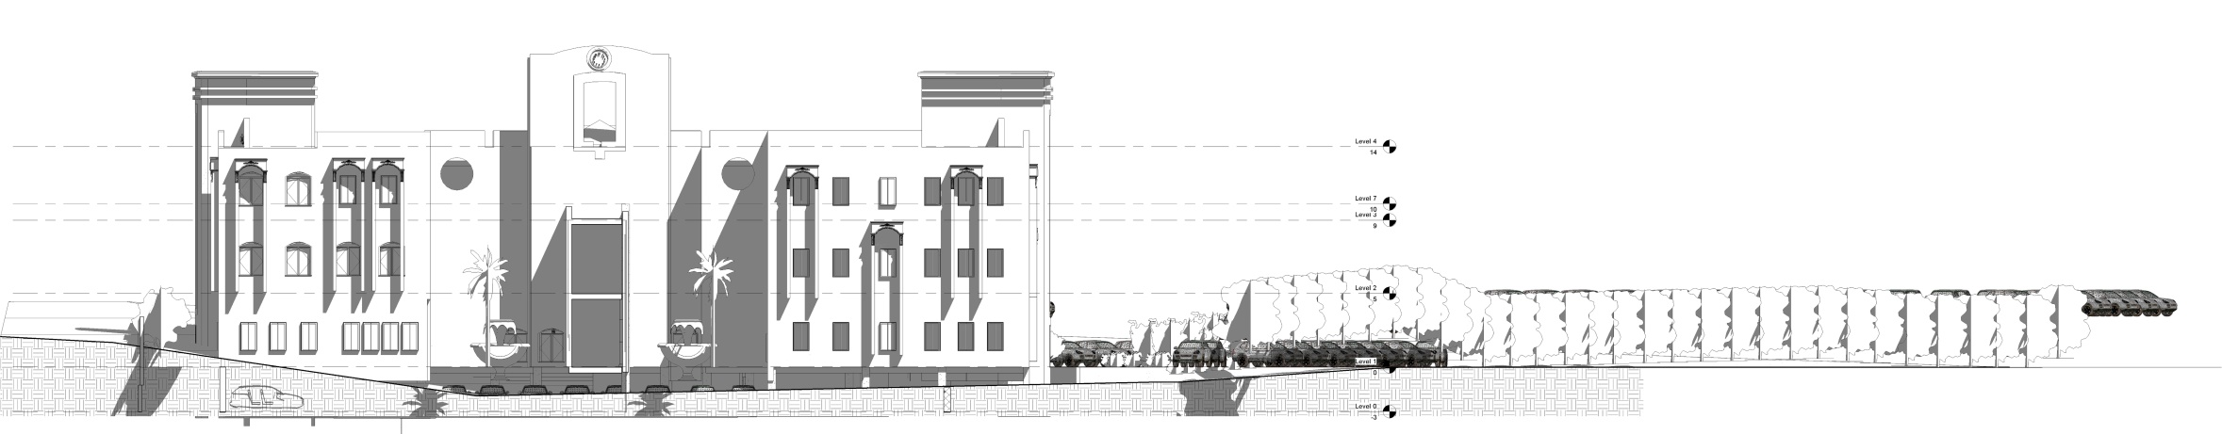
Environmental Design
Natural ventilation
water ponds
E
W
control the relative humidity in the site
water
lead to purification and cooling the air and moistened

Slide 34
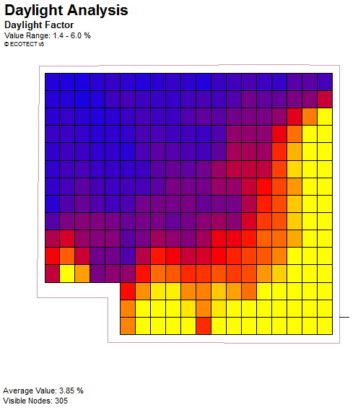

Environmental Design
Daylight:
3.05%
daylight analysis (public service hall south east direction)

Slide 35
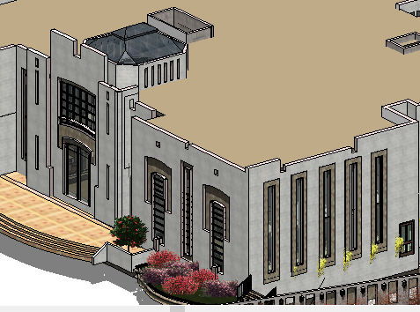
Environmental Design
Daylight:

Slide 36
Environmental Design
Acoustical Design
Wall type one: Hollow Blocks:
STC | Layers
36 | 4-in. Dense hollow block
Plus 4 | Add plaster to both sides
40 | Total
Wall type two: glass wall:
STC | Layers
39 | 1/4" laminated glass.1/2" air gap 1/4" laminated glass
39 | Total

Slide 37
Environmental Design
Acoustical Design
Open-plan Offices
recommend a reverberation time of 0.5 seconds at frequencies between 250 – 4000 Hz.
Result from ecotect
Volume: 356.050 m3
Surface Area: 476.713 m2
Occupancy: 10 (10 x 100%)
Optimum RT (500Hz - Speech): 0.66 s

Slide 38
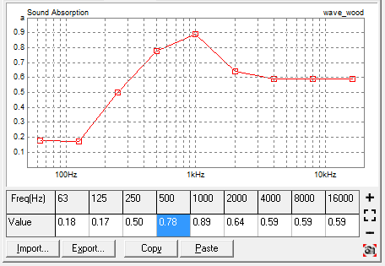
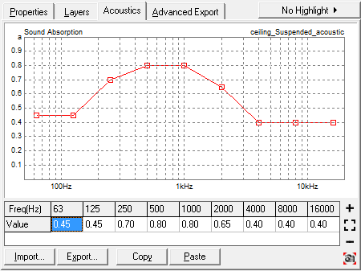
Environmental Design
Acoustical DESIGN
The design :
Wood wave alpha
Gypsum plaster tiles in ceiling 22mm

Slide 39
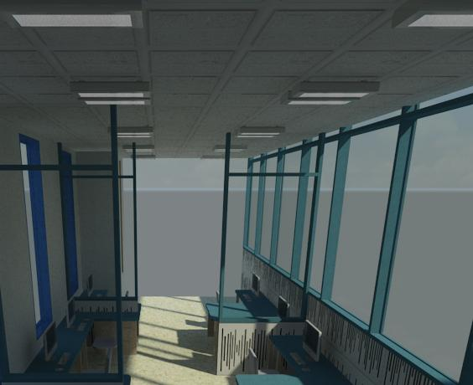
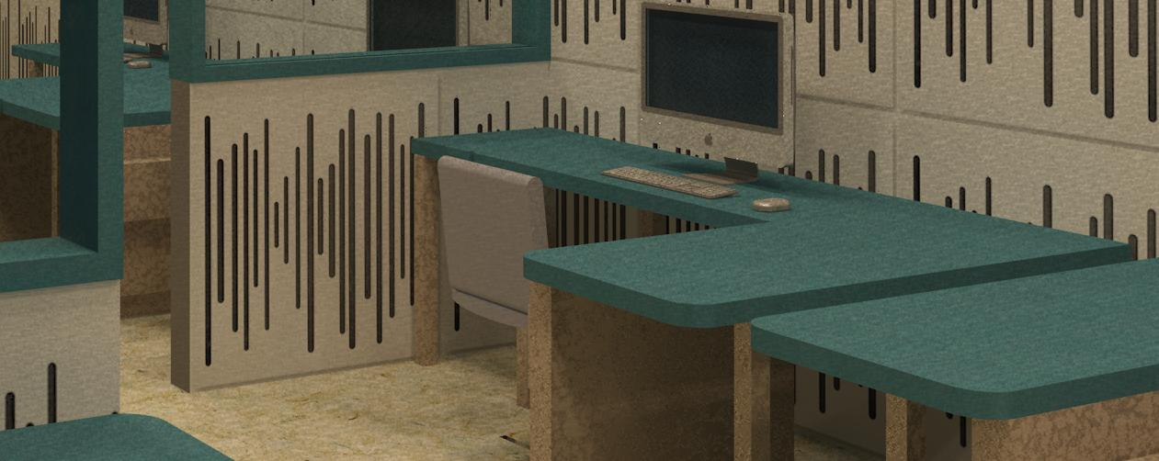
Environmental Design
Acoustical DESIGN
Wood wave alpha
Gypsum plaster tiles in ceiling 22mm

Slide 40
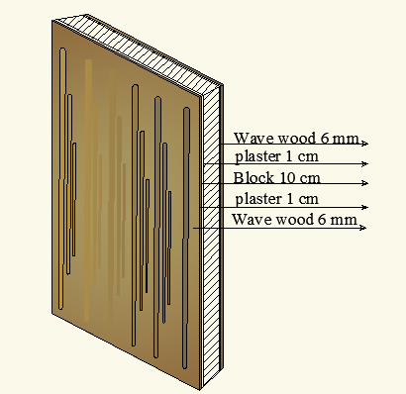
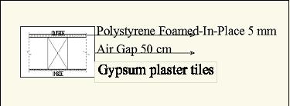
Environmental Design
Acoustical DESIGN
The design :
Gypsum plaster tiles in ceiling 22mm
Wood wave alpha

Slide 41
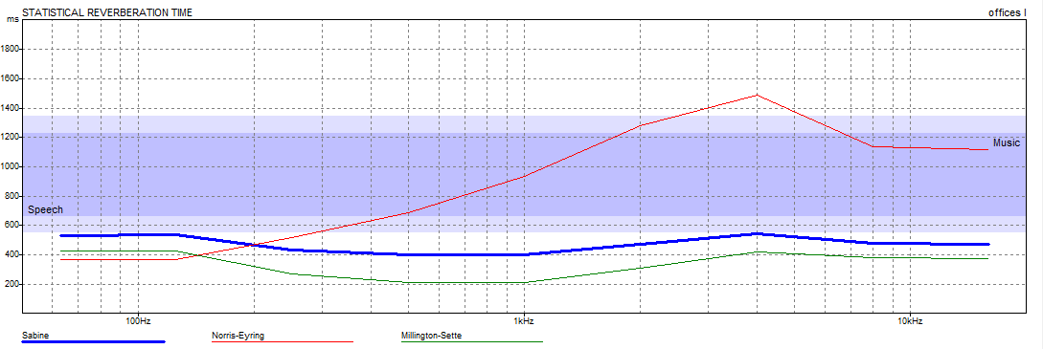
Environmental Design
Acoustical DESIGN
The design :
reverberation time for open office=0.5 sec at frequencies between 250 – 4000 Hz

Slide 42
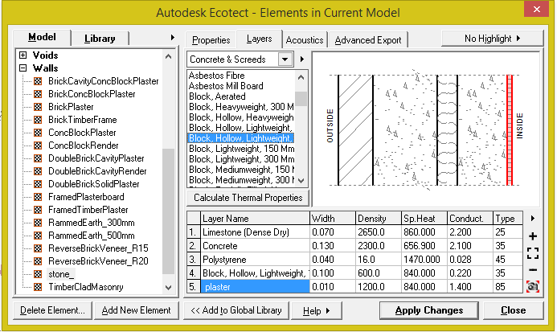
Environmental Design
Thermal Calculations:
layers for external walls
(U = 0.46 W/m².k):

Slide 43
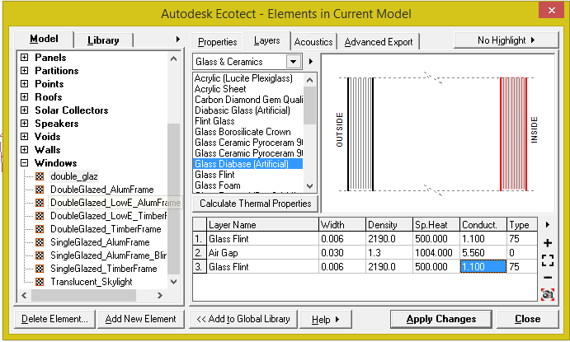
Environmental Design
Thermal Calculations:
We use double glazed window with U=2.7 W/m².k.

Slide 44
Environmental Design
Thermal Calculations:
The design look to be comfortable in 18 c. degree & 26 c. degree.
heating load per m2 = 22.6 KWh
cooling load per m2 =43.1 KWh
Total heating and cooling =67.6 KWh
The Total acceptable range from 30 to 80 KWh .

Slide 45
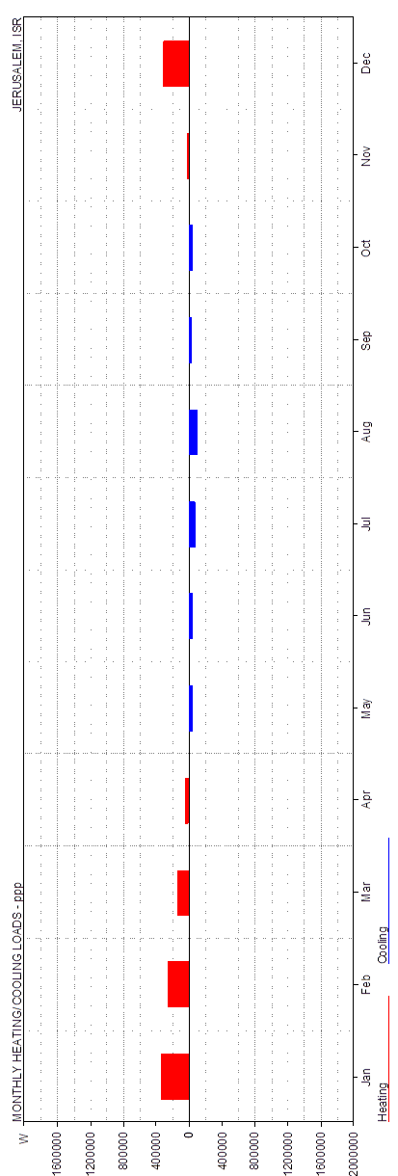
Environmental Design
Thermal Calculations:

Slide 46
Environmental Design
HVAC system
Heating & Cooing load for Ground floor
Space Name | Area(m²) | Heat load kw/m² | cool load kw/m²
Reception | 150 | 3.6 | 8.3
Account hall | 122 | 0.83 | 22
Public service | 225 | 4.6 | 1.5
Meeting room | 175 | 4.7 | 7
Public correspondence(open office) | 65 | 5.2 | 1.1
Waiting area ,corridor | 76 | 1 | 2.5
Service office, Programming | 26 | 2.2 | 0.2
Archive +stores | 38 | 0 | 0
Total | 1134 | 22.1 | 42.6

Slide 47
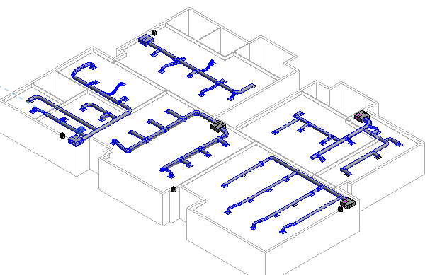
Environmental Design
HVAC system
Using Fan coil unit system
To heat and cool the spaces in winter and summer.

Slide 48
Structural
Design

Slide 49
Structural Design :
The project consist of two blocks :
Blocks
Block B
Block A

Slide 50
Structural Design :
ACI -318-08 for reinforced concrete structural design.
UBC -97 for earthquake load computations.
Software: SAP 2000
Design Codes:

Slide 51
Structural Design :
Materials:
  Concrete strength fc’ = 24Mpa
  Aggregate
  Sand
  Mortar
  Tiles
  Light Weight Block

Slide 52
Structural Design :
Loads:
Loads:
  Superimposed dead load = 4kN/m²
  Live load = 5 kN/m²
Weight of wall =21 KN/m
Bearing capacity = 250 KN/m²

Slide 53
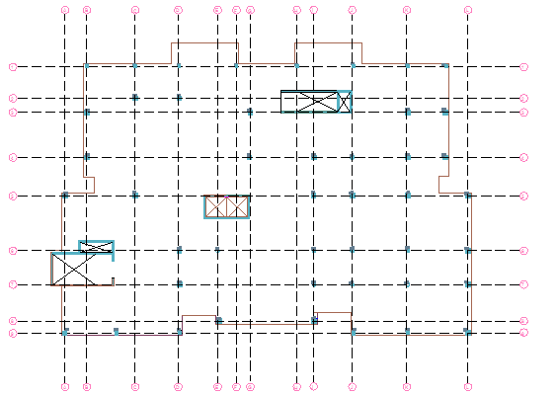
Structural Design :
Columns :
Lay out of columns and center of columns

Slide 54
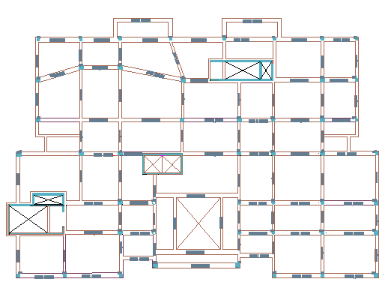
Structural Design :
Columns :
Lay out of Beams

Slide 55
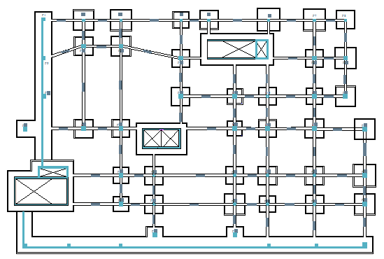
Structural Design :
Footing Plan

Slide 56
Structural Design :
Slab &Beams
  The system of slab used one way ribbed slab
  Drop beams used in design of project
  The direction of reinforcing in Y-direction

Slide 57
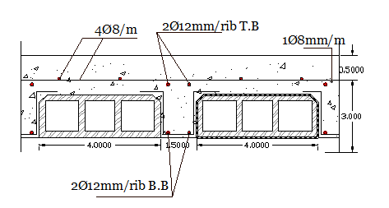
Structural Design :
Slab Thickness:
Slab thickness for the floors = 35cm

Slide 58
Structural Design :
Beam Dimensions for Block A
Column Dimensions for Block A
50* 50 | Main Beams
30*35 | Secondary Beams
50*30 | Tie Beams
Columns 50*50
Columns 40*40

Slide 59
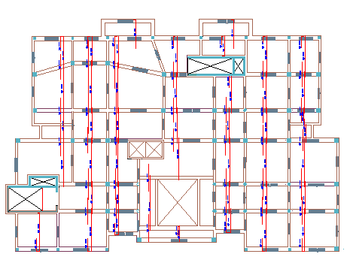
Structural Design :
Reinforcing for slab

Slide 60
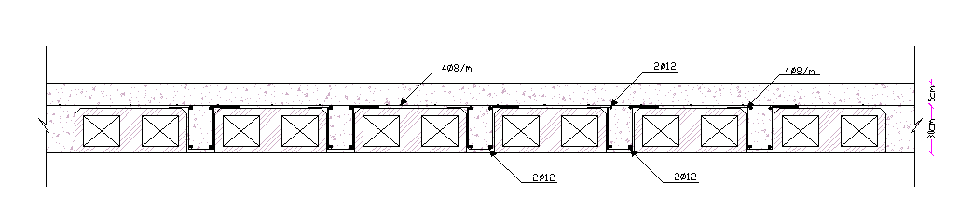
Structural Design :
Section in slab:

Slide 61
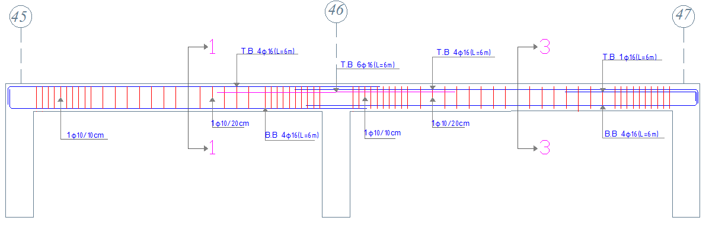
Structural Design :
Section in main beam :

Slide 62
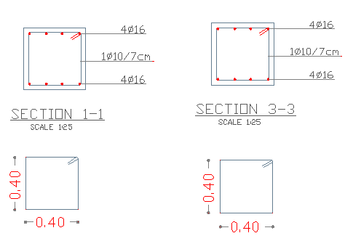
Structural Design :
Section in main beam :

Slide 63
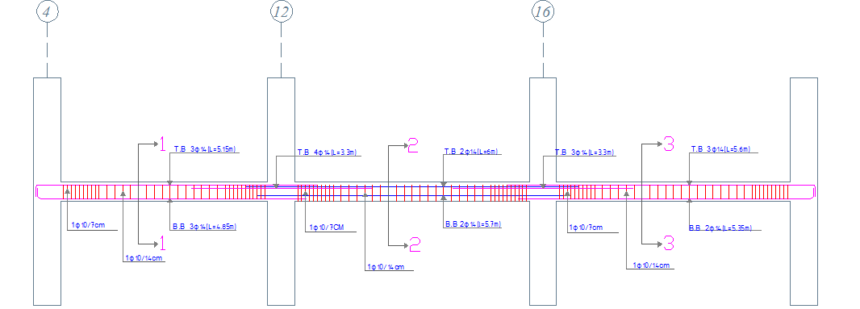
Structural Design :
Section in secondary beam :

Slide 64

Structural Design :
Section in secondary beam :

Slide 65

Structural Design :
Section in Tie beam

Slide 66

Structural Design :
Section in Tie beam

Slide 67




Structural Design :
Section in columns :

Slide 68


Structural Design :
Section in footing:

Slide 69

Structural Design :
Section in shear wall

Slide 70
Structural Design :
Seismic design block A
The type of farm is intermediate
Z= 0.2
Nablus city
Cv =.64
Ca =.34
Ct=.048
R=5.5

Slide 71

Structural Design :
SAP models for block A

Slide 72

Structural Design :
Compatibility check

Slide 73
Structural Design :
Equilibrium Checks:
Error | SAP Calculations | Hand Calculations | Load Type
Zero | 10594.355 | 10594.35 | Live Load
5% | 41682.8 | 39315.39 | Dead Load
Zero | 8475.48 | 8475.48 | Super Imposed Load

Slide 74
Structural Design :
Internal Forces Checks:
Table Shows The Percent Difference In Moment In Slab In Block A
Table Shows The Percent Difference In Beams in Block A
Difference | Manual Moment | Sap Moment | Number
7 | 75 | 68 | 1
4 | 79 | 75 | 2
9.7 | 105 | 95.3 | 3
3.8 | 28.7 | 24.9 | 4
2.55 | 34 | 31.45 | 5
Difference | Manual Moment | Sap Moment | Number
13.62 | 484.75 | 471.13 | B1
14.33 | 422.48 | 408.15 | B2
12.7 | 443.5 | 430.8 | B3
15.5 | 211.5 | 196 | B4
12.9 | 288 | 276 | B5

Slide 75
Structural Design :
Table Shows The Percent Difference In columns in Block A
Difference | Manual Moment | Sap Moment | Number
79 | 1264 | 1343 | C1
38 | 1058 | 1096 | C2
25 | 1195 | 1220 | C3
69 | 1410 | 1479 | C4
68 | 1483 | 1551 | C5

Slide 76
Mechanical
Design
Nablus Municipality

Slide 77

Mechanical Design :
Water Supply System
10m3
10m3
2"
2"
20 m3
horizontal feeder (1.5")&branches( 3/4")
Nablus Municipality

Slide 78

Mechanical Design :
Water Supply System

Slide 79

Mechanical Design
Drainage System

Slide 80
Mechanical Design :
Drainage System

Slide 81

Mechanical Design

Slide 82
Safety
Design

Slide 83



Safety Design:
CO₂ Firefighting System
Fire Sprinkler
fair House station

Slide 84

Safety Design:
Type of hazard | Low | moderate | High
Max. Distance | 4.6 m | 4.6m | 3.7m

Slide 85

Safety Design:

Slide 86

Safety Design:
Emergency exists

Slide 87

Safety Design:

Slide 88

Safety Design:

Slide 89
Electrical Design

Slide 90

Electrical Design :
Average illumination in Lux

Slide 91

Electrical Design :
40 Lamps need for public service area

Slide 92

Electrical Design :
Type of Lamps in public service room

Slide 93

Electrical Design :

Slide 94

Electrical Design :
Lay out of switches and lamps

Slide 95

Electrical Design :
Lay out of sockets

Slide 96
Quantity Surveying and Cost Estimation

Slide 97
Quantity Surveying and Cost Estimation
The price for m² for municipality is 900 shekel.
(This price for :reinforcing,concret,tiling,, ribs ,blocks ,plaster and stone)
type | quantity | quantity/m^2 |  | cost
reinforcemnt | 350 ton | 0.165 | 3500 | 577.5
col con | 52.87 | 0.02 | 400 | 8
concrete | 962.3 | 0.45 | 350 | 157.5
rib | 7967 rib | 3.76 | 2.7 | 10.152
type | quintity | quintity/m^2 |  | cost
tiles | 47.18 | 1 | 20 | 20
plaster | 89.52 | 0.95 | 20 | 19
painting | 89.52 | 0.95 | 50 | 47.5
# of block | 520 | 0.24 | 2.5 | 0.6
# of stone | 812 | 0.38 | 150 | 57
 | Total cost / meter = |  |  | 897.252

Slide 98


