Slide 1

Building Preventive Maintenance Model at National Carton Company
Preperd by: supervisor:
Abdulrahman Saed Dr. Yahya Saleh
Malak Ahmad
Yasmeen Jaone

Slide 2

Agenda
Introduction
Maintenance definition
Maintenance activity
Maintenance objective
Maintenance types
Problem definition
Literature review
Methodology of analysis
Analysis and results
Preventive maintenance model
Conclusion
Recommendation

Slide 3

Maintenance Definition
maintenance is a set of organised activities that are carried out in order to keep an item in its best operational condition with minimum cost acquired

Slide 4

Maintenance activities
Repair
Productivity condition
Item
Minimum cost
replacement

Slide 5

Maintenance objective
Maintenance
Maximization production
Optimising Useful Life of Equipment
Providing Budgetary Control
Optimising Resources Utilisation
Reduce Breakdowns
Reduce Downtime
Improving Equipment Efficiency
Implementing Cost Reduction

Slide 6
Types of maintenance
repair, replacement, or restore action performed on a machine or a facility after the occurrence of a failure in order to bring this machine or facility to at least its minimum acceptable condition.
Preventive maintenance
the maintenance carried out at predetermined intervals or according to prescribed criteria and intended to reduce the probability of failure or the degradation of the functioning and the effects limited.
Predictive maintenance
a process used to determine the maintenance requirements of any physical asset in its operating context." Basically, RCM methodology deals with some key issues not dealt with by other maintenance programs
Correction maintenance
Reliability
Predictive maintenance is a set of activities that detect changes in the physical condition of equipment (signs of failure) in order to carry out the appropriate maintenance work for maximising the service life of equipment without increasing the risk of failure.

Slide 7

Problem definition
The National Carton Company was enhance to build a preventive maintenance programed, and improve the correction maintenance programmed depend on specific data

Slide 8


Problem definition
Correction maintenance
Improvement
Build preventive maintenance programed

Slide 9

Literature review
  Waterbury fire department
  This research done in 2008
  PM program to the effectively decrease out of service and ensure safety of the fire service apparatus within the Waterbury fire department (WFD) fleet
  The research complied data from survey conducted to glean information as to the effectiveness and feasibility of initiating a PM program

Slide 10
Literature review
Results of the study
Increased out of service time
decrease readiness of the fleet
reduce the possibility of unsafe apparatus responding to call for service

Slide 11
Literature review
OPTIMIZING PAVEMENT PREVENTIVE
APPLICATIONS IN TENNESSEE (2009)
meager application of preventive maintenance in this research
Cost-effectiveness analysis of pavement treatment
Integrating preventive maintenance
Optimal timing analysis for preventive maintenance

Slide 12

Methodology
Methodology
Study the current situation
Development the correction maintenance
Build preventive maintenance
Phase 1
Phase 2
Data collection

Slide 13

Analysis and Results
analysis
Curioni
Before starting implement preventive maintenance
after starting implement preventive maintenance
Die cutter
Before starting implement preventive maintenance
after starting implement preventive maintenance

Slide 14

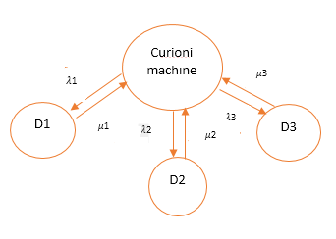
Analysis and result
markov chain for curioni analysis

Slide 15

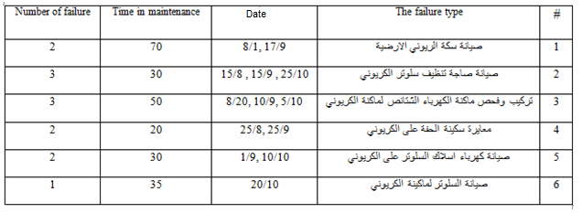

1) Down time 1 (D1)
MTTR & MTBF for D1

Slide 16

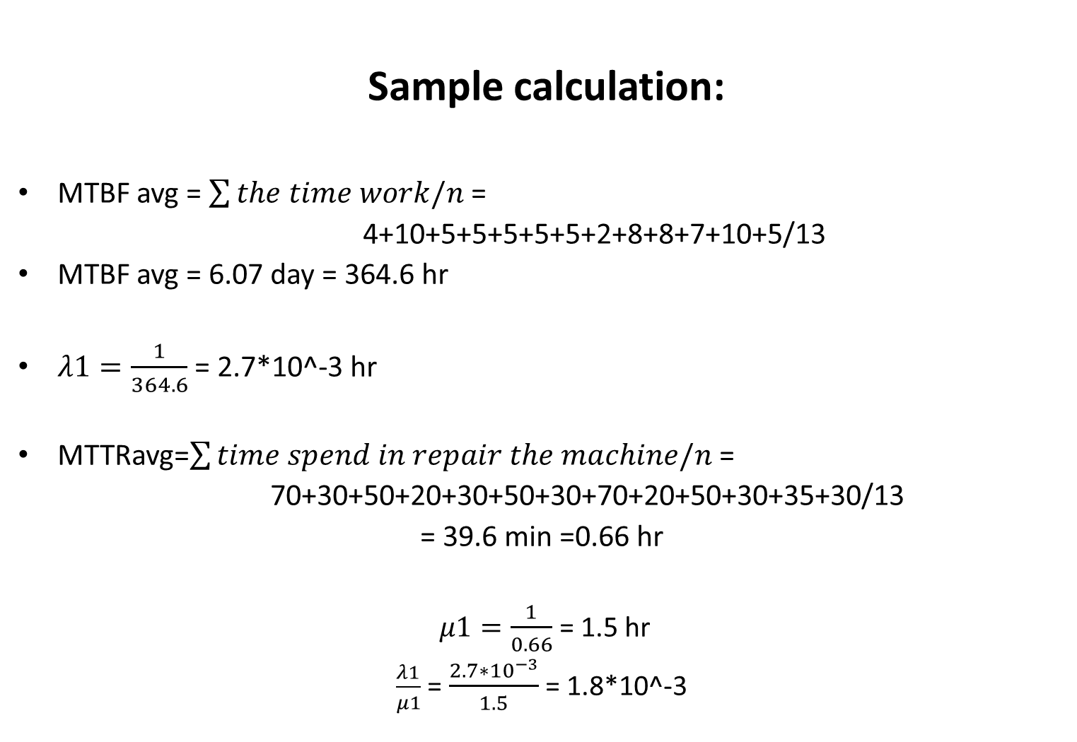
Sample calculation:
MTBF avg = $\sum{the time work/n}$ =
4+10+5+5+5+5+5+2+8+8+7+10+5/13
MTBF avg = 6.07 day = 364.6 hr
$λ1=\frac{1}{364.6}$ = 2.7*10^-3 hr
MTTRavg=$\sum{time spend in repair the machine/n }$=
70+30+50+20+30+50+30+70+20+50+30+35+30/13
= 39.6 min =0.66 hr
$μ1=\frac{1}{0.66}$ = 1.5 hr
$\frac{λ1}{μ1}$ = $\frac{2.7∗{10}^{−3}}{1.5}$ = 1.8*10^-3

Slide 17
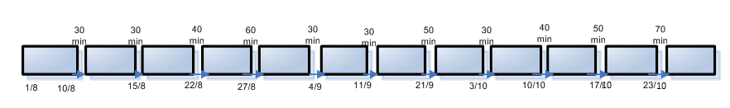

2) Down time 2 (D2)
MTTR & MTBF for D2
$λ2$= $\frac{1}{MTBFavg}$ = $\frac{1}{174.5}$ = 5.7*10^-3 hr
$μ2$ = $\frac{1}{MTTRavg}$ = $\frac{1}{.65}$ = 1.43 hr
$\frac{λ2}{μ2}$ = $\frac{5.7∗{10}^{−3}}{.696}$ = 8.1*10^-3

Slide 18


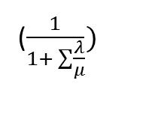
3) Down time 3 (D3)
MTTR & MTTR for D3
$γ$3= $\frac{1}{MTBFavg}$ = $\frac{1}{324}$ = 3.08*10^-3 hr
$μ$3 = $\frac{1}{MTTRavg}$ = $\frac{1}{.708}$ = 1.41 hr
$\frac{γ3}{μ3}$ = $\frac{5.7∗10^−3}{.696}$ = 2.18*10^-3
Now the availability :
A = $=\frac{1}{1+(.048+8.1∗{10}^{−3}+2.18∗{10}^{−3})}$ = 94%.
($\frac{1}{1+ \sum{\frac{λ}{μ}}})$

Slide 19
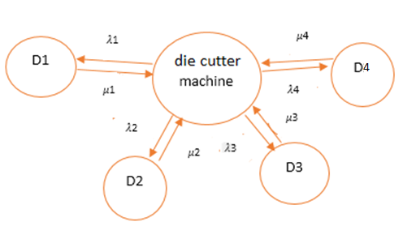

Analysis for die cutter machine
Markov chain for die cutter

Slide 20
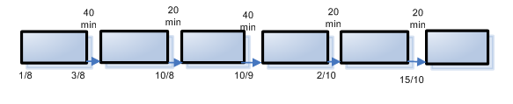
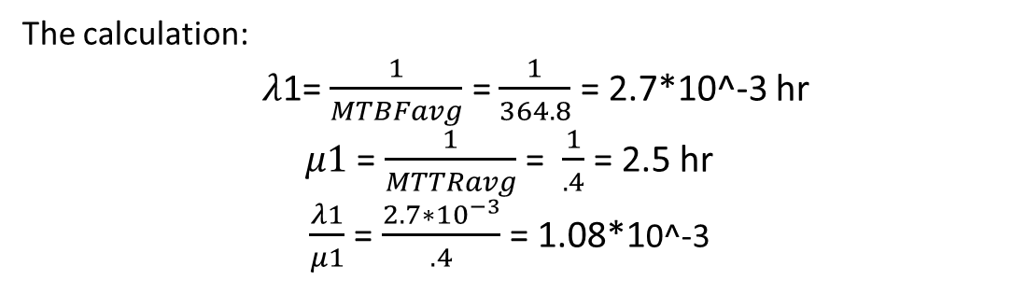
1) Down time 1 (D1)
D1 failure in die cutter
Number of failure | Time in min | date | Type of failure | #
2 | 40 | 3/8, 10/9 | صيانة الفوتوسل و السنسور ل ماكينة الداي كتر | 1
3 | 20 | 10/8, 2/10, 15/10 | اصلاح ماكينة التربيط الخاصة ل ماكينة الدا كتر | 2
MTBF & MTTR for D1
The calculation:
$λ$1= $\frac{1}{MTBFavg}$ = $\frac{1}{364.8}$ = 2.7*10^-3 hr
$μ1$ = $\frac{1}{MTTRavg}$ = $\frac{1}{.4}$ = 2.5 hr
$\frac{λ1}{μ1}$ = $\frac{2.7∗{10}^{−3}}{.4}$ = 1.08*10^-3

Slide 21

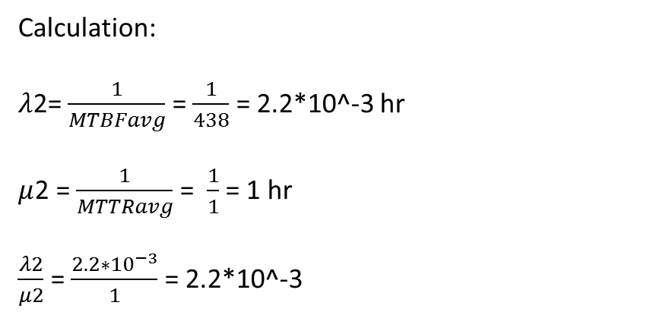
2) Down time 2 (D2)
MTBF & MTTR for D2
Calculation:
$λ$2= $\frac{1}{MTBFavg}$ = $\frac{1}{438}$ = 2.2*10^-3 hr
$μ$2 = $\frac{1}{MTTRavg}$ = $\frac{1}{1}$ = 1 hr
$\frac{λ2}{μ2}$ = $\frac{2.2∗{10}^{−3}}{1}$ = 2.2*10^-3

Slide 22


3) Down time 3 (D3)
MTBF & MTTR for D3
The calculation:
$λ$3= $\frac{1}{MTBFavg}$ = $\frac{1}{170}$ = 5.8*10^-3 hr
$μ$3 = $\frac{1}{MTTRavg}$ = $\frac{1}{1.52}$ = 1.92 hr
$\frac{λ3}{μ3}$ = $\frac{5.8∗{10}^{−3}}{1.92}$ = 3.2*10^-3

Slide 23
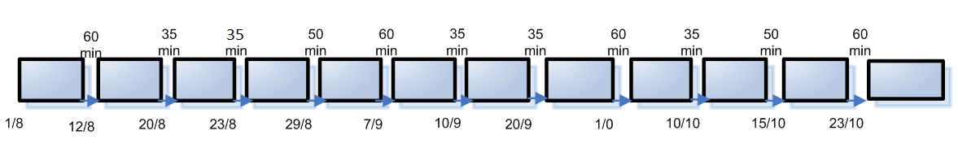
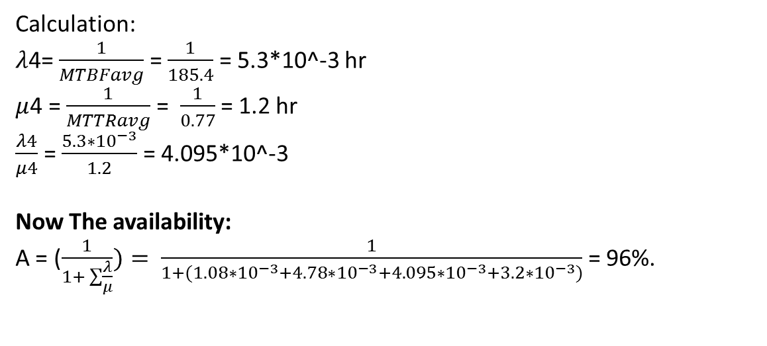
4) Down time 4 (D4)
MTBF & MTTR for D4
Calculation:
$λ$4= $\frac{1}{MTBFavg}$ = $\frac{1}{185.4}$ = 5.3*10^-3 hr
$μ$4 = $\frac{1}{MTTRavg}$ = $\frac{1}{0.77}$ = 1.2 hr
$\frac{λ4}{μ4}$ = $\frac{5.3∗{10}^{−3}}{1.2}$ = 4.095*10^-3
Now The availability:
A = ($\frac{1}{1+ \sum{\frac{λ}{μ}}})= \frac{1}{1+(1.08∗{10}^{−3}+4.78∗{10}^{−3}+4.095∗{10}^{−3}+3.2∗{10}^{−3})}$ = 96%.

Slide 24
analysis after implement preventive maintenance
Analysis for Curioni machine
markov chain for curioni machine

Slide 25
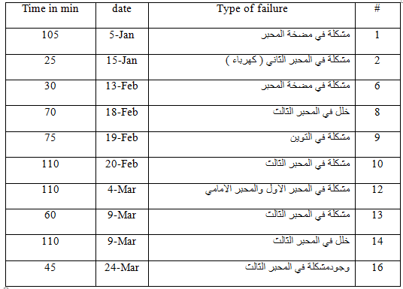
1) Down time 1(D1)
failures on curioni machine

Slide 26
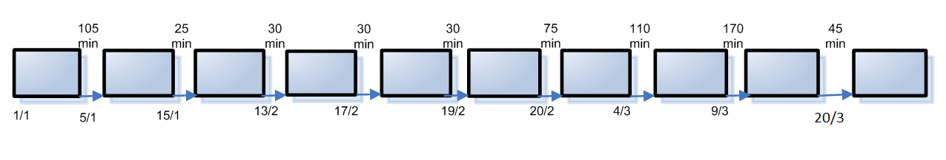
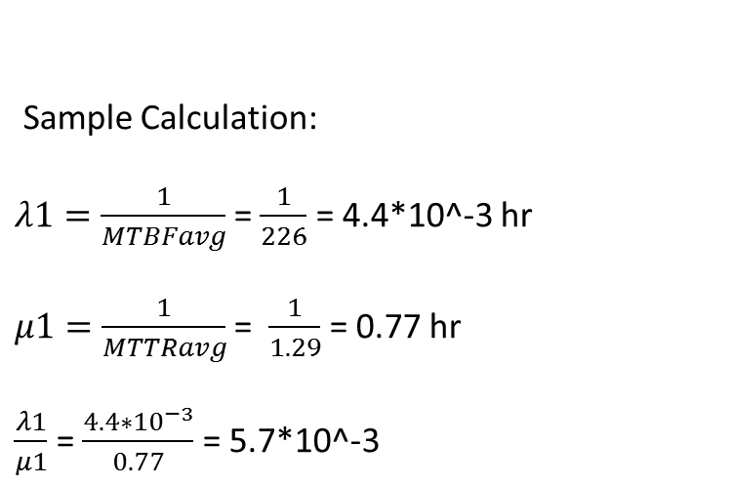
MTBF & MTTR for D1
Sample Calculation:
$λ1=\frac{1}{MTBFavg}$= $\frac{1}{226}$ = 4.4*10^-3 hr
$μ1=\frac{1}{MTTRavg}$= $\frac{1}{1.29}$ = 0.77 hr
$\frac{λ1}{μ1}$ = $\frac{4.4∗{10}^{−3}}{0.77}$ = 5.7*10^-3

Slide 27
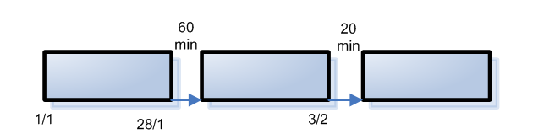
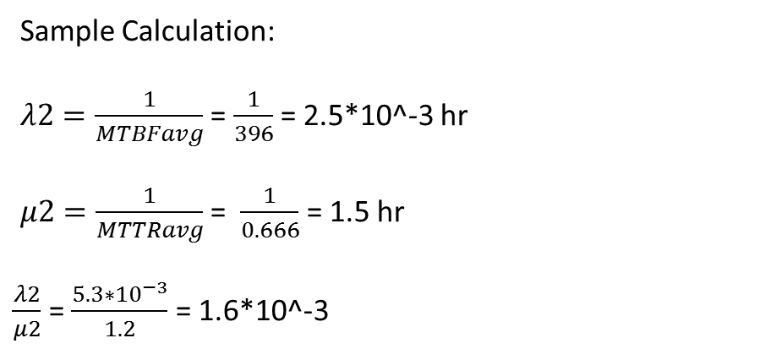
2) Down time 2 (D2)
MTBF & MTTR for D1
Sample Calculation:
$λ2=\frac{1}{MTBFavg}$ = $\frac{1}{396}$ = 2.5*10^-3 hr
$μ2=\frac{1}{MTTRavg}$ = $\frac{1}{0.666}$ = 1.5 hr
$\frac{λ2}{μ2}$ = $\frac{5.3∗{10}^{−3}}{1.2}$ = 1.6*10^-3

Slide 28
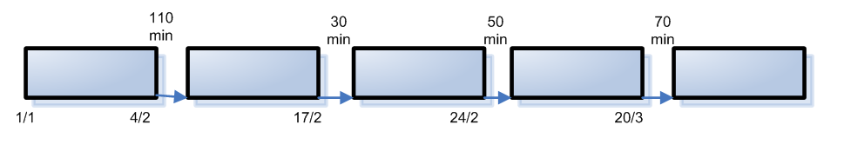
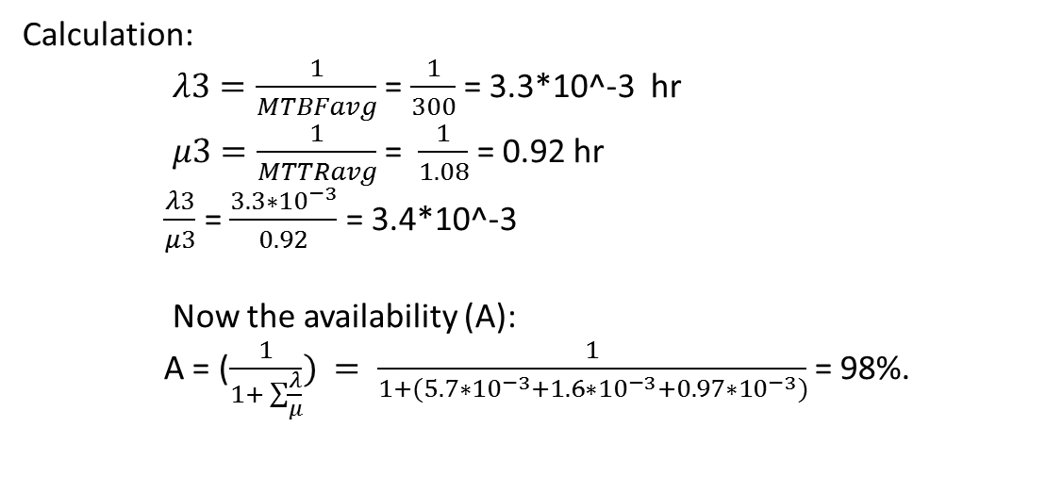
3) Down time 3 :
MTBF & MTTR for D3
Calculation:
    $λ3=\frac{1}{MTBFavg}$ = $\frac{1}{300}$ = 3.3*10^-3 hr
    $μ3=\frac{1}{MTTRavg}$ = $\frac{1}{1.08}$ = 0.92 hr
    $\frac{λ3}{μ3}$ = $\frac{3.3∗{10}^{−3}}{0.92}$ = 3.4*10^-3
    Now the availability (A):
    A = ($\frac{1}{1+ \sum{\frac{λ}{μ}}})$ $= \frac{1}{1+(5.7∗{10}^{−3}+1.6∗{10}^{−3}+0.97∗{10}^{−3})}$ = 98%.

Slide 29

Analysis for die cutter machine:
Markov chain for die cutter

Slide 30
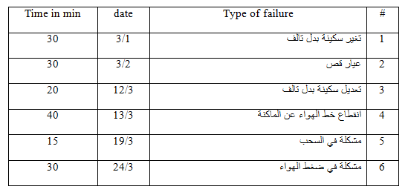
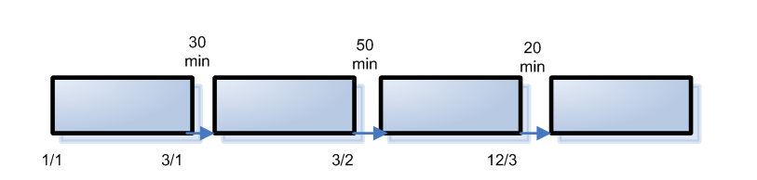
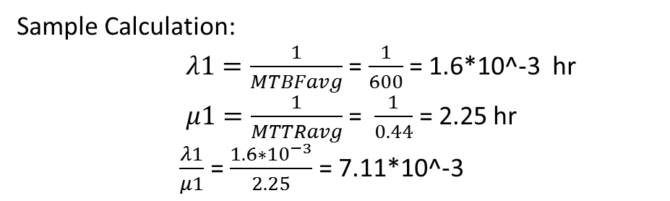
1) Down time 1 (D1)
failures on die cutter machine
MTBF & MTTR for D1
Sample Calculation:
      $λ1=\frac{1}{MTBFavg}$ = $\frac{1}{600}$ = 1.6*10^-3 hr
      $μ1=\frac{1}{MTTRavg}$ = $\frac{1}{0.44}$ = 2.25 hr
      $\frac{λ1}{μ1}$ = $\frac{1.6∗{10}^{−3}}{2.25}$ = 7.11*10^-3

Slide 31
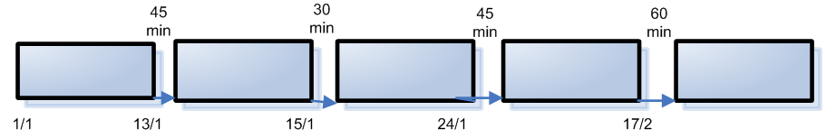

2) Down time 2 (D2)
MTBF & MTTR for D2
Calculation:
$λ2=\frac{1}{MTBFavg}$ = $\frac{1}{282}$ = 3.5*10^-3 hr
$μ2=\frac{1}{MTTRavg}$ = $\frac{1}{0.75}$ = 1.33 hr
$\frac{λ2}{μ2}$ = $\frac{3.5∗{10}^{−3}}{1.33}$ = 2.6*10^-3

Slide 32
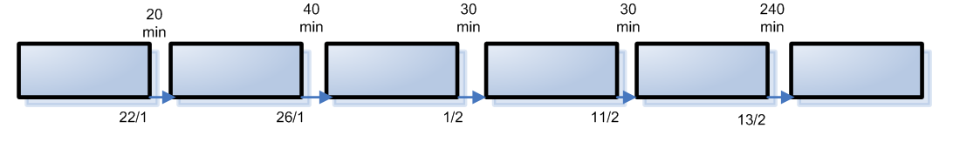
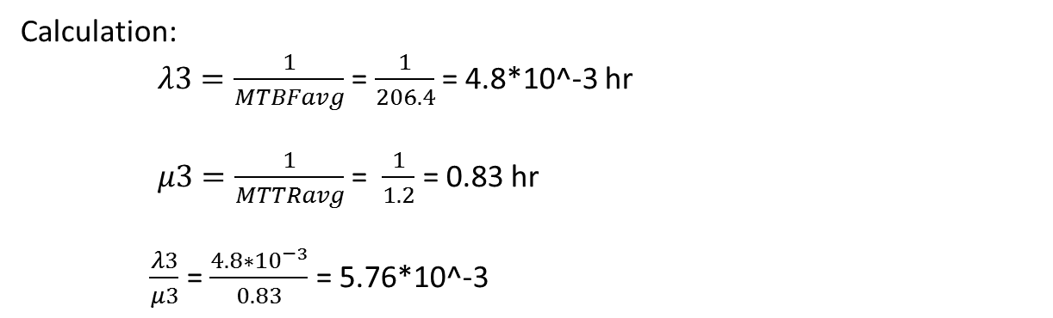
3) Down time 3 (D3):
MTBF & MTTR for D3
Calculation:
    $λ3=\frac{1}{MTBFavg}$ = $\frac{1}{206.4}$ = 4.8*10^-3 hr
    $μ3=\frac{1}{MTTRavg}$ = $\frac{1}{1.2}$ = 0.83 hr
    $\frac{λ3}{μ3}$ = $\frac{4.8∗{10}^{−3}}{0.83}$ = 5.76*10^-3

Slide 33

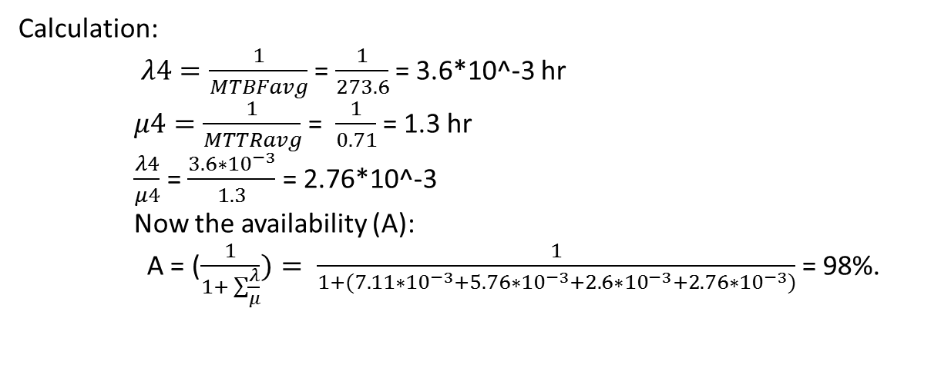
4) Down time 4 ( D4):
MTBF & MTTR for D4
Calculation:
    $λ4=\frac{1}{MTBFavg}$ = $\frac{1}{273.6}$ = 3.6*10^-3 hr
    $μ4=\frac{1}{MTTRavg}$ = $\frac{1}{0.71}$ = 1.3 hr
    $\frac{λ4}{μ4}$ = $\frac{3.6∗{10}^{−3}}{1.3}$ = 2.76*10^-3
    Now the availability (A):
    A = ($\frac{1}{1+ \sum{\frac{λ}{μ}}})= \frac{1}{1+(7.11∗{10}^{−3}+5.76∗{10}^{−3}+2.6∗{10}^{−3}+2.76∗{10}^{−3})}$ = 98%.

Slide 34
Result of analysis
After starting implements preventive maintenance on machines
the availability for the machines increases from 2012 to 2013

Slide 35


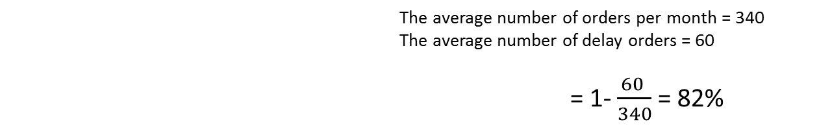
Service level for curioni before implement preventive maintenance
The average number of orders per month = 340
The average number of delay orders = 102
=1- $\frac{ 120 }{340}$= 70%
Service level for curioni after implement preventive maintenance
                The average number of orders per month = 340
                The average number of delay orders = 60
        = 1- $\frac{60 }{340}$= 82%

Slide 36
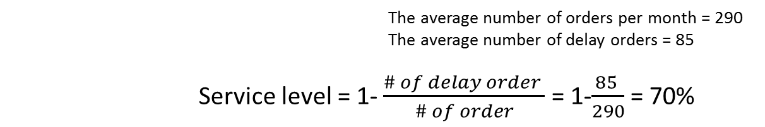
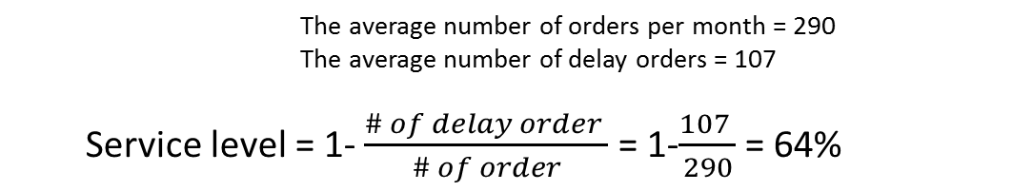
Service level for die cutter before starting implement preventive maintenance
        The average number of orders per month = 290
        The average number of delay orders = 107
  Service level = 1- $\frac{\# of delay order }{\# of order}$ = 1-$\frac{107 }{290}$= 64%
Service level for die cutter after starting implement preventive maintenance
                The average number of orders per month = 290
                The average number of delay orders = 85
        Service level = 1- $\frac{\# of delay order }{\# of order}$ = 1-$\frac{85 }{290}$= 70%

Slide 37
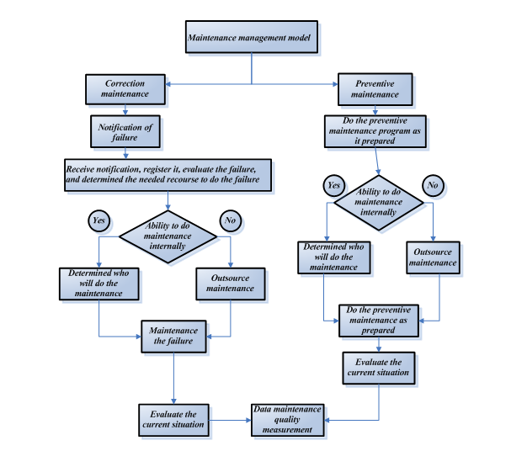
Preventive Maintenance Model
preventive maintenance model in general

Slide 38
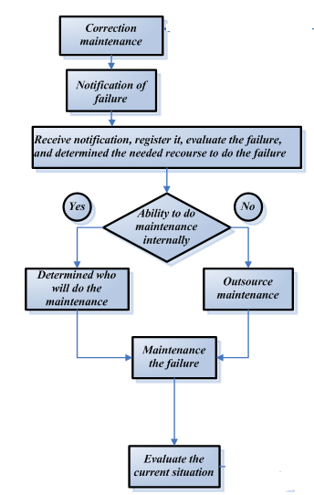

Sample Manuel for corrective maintenance model
correction maintenance procedure

Slide 39
Process name : notification of failure
Objective | To alarm the maintenance department or the manager about failure occur when the machines stop work
Activity of the processes | Failure occur in the machines Alarm the labor of maintenance or the manager about failure alarm maintenance team about the failure
Activities detail description | When failure occur or the labor noticed a problem in the machine, the manager should be informed and he gives a report to the maintenance team to maintain the failure
Responsibilities | Labor operate the machines
Related forms | RFM01

Slide 40
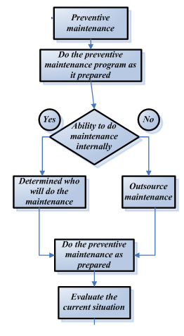
Sample manual for preventive maintenance model

Slide 41
Process name : prepared preventive maintenance
Objective | To know when and how to do the maintenance
Activity of the processes | Prepared tables for maintenance Decided when do the maintenance Decided who do the maintenance.
Activities detail description | Maintenance department prepared tables for do the maintenance and the steps to implement the maintenance in the right way in right time
Responsibilities | Maintenance department
Related forms | PM tables

Slide 42

conclusion
conclusion
develop a model for preventive maintenance
Build regular forms to make preventive maintenance (daily, weekly , monthly , and annually)
Increase the availability after implementing preventive maintenance model
Increase service level for orders
Decrease interrupted in production
Decrease probability sudden failures in machines
Build manual for corrective maintenance and preventive maintenance

Slide 43
Recommendation
The recommendation summarize in
apply the preventive maintenance model on the machines to:
    to prevent the sudden failure on machines
    reducing the cost and waste time.
    improving the production rate
keep improving in the maintenance system to :
    Keeping reduce probability of correction failure
    Keeping the increases the service level for machine
    Keeping improving performance for the machines

Slide 44

Thank you for listening
Any questions ?

