Slide 1
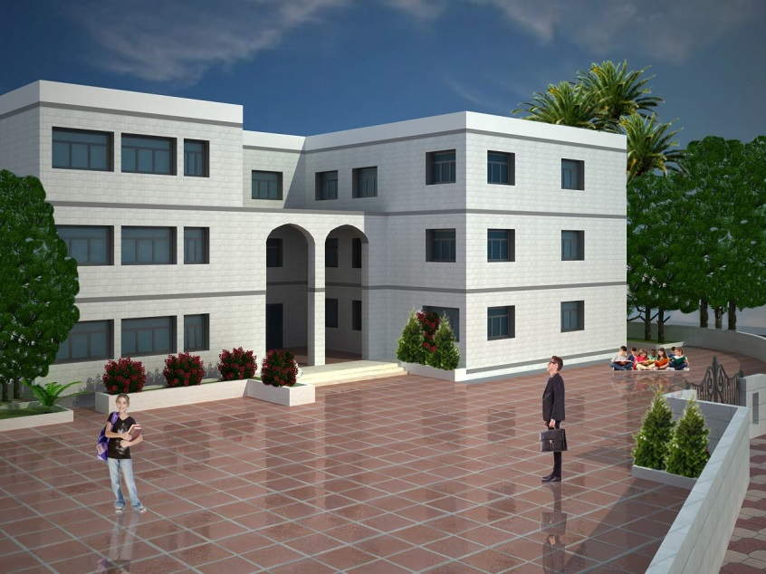
Qaffin Secondary girls school
An-Najah National University
Facility of Engineering
Building Engineering department
Graduation project (II) .68591
Prepared By:
Eleane Jamal Jamlan Mohammad Hasan Hijaz
Lama Hafez Aker Sarah Wadah Zaqzouq
Supervisor:
Dr. Mutasim Babaa
Presented in partial fulfillment of the requirements for Bachelor degree in (Building Engineering).
Notes:
Good afternoon everybody our project is Qaffin Secondary girls school our time is sara eleane m7md and me lama and e our supervisor dr mutasem baba

Slide 2
Table of contents
Introduction To project
Mechanical Design
Architectural Redesign
Structural Design
Electrical Design
Environmental Design
Quantity Surveying
Notes:
I’m going with the introduction of the project and then going to architectural redesign and my partner are going to talk about environmental structural mechanical electrical and quantity serving

Slide 3
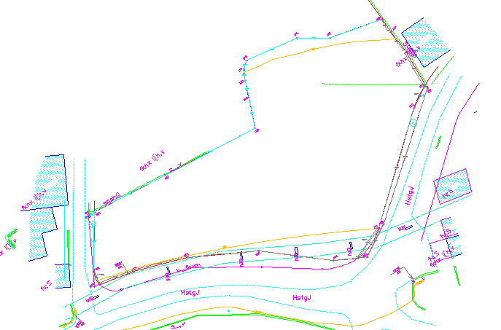
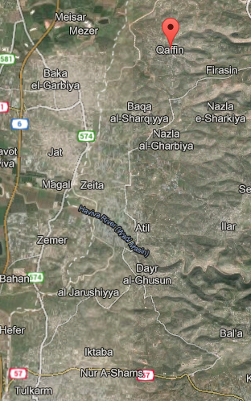
Site location
Figure 1: Site
Notes:
Site of our school going to be in the village of qafin

Slide 4
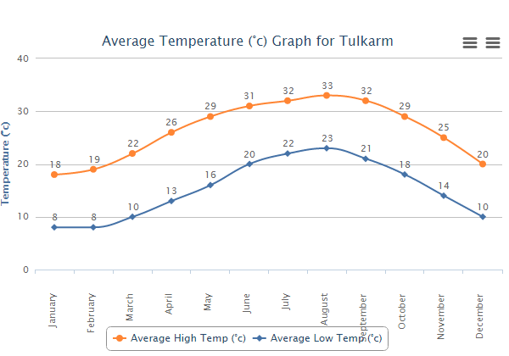
Introduction to project
Relative humidity 69%
Wind speed 3.4 km/h
Figure 2: Average temperature in Tulkarm area

Slide 5

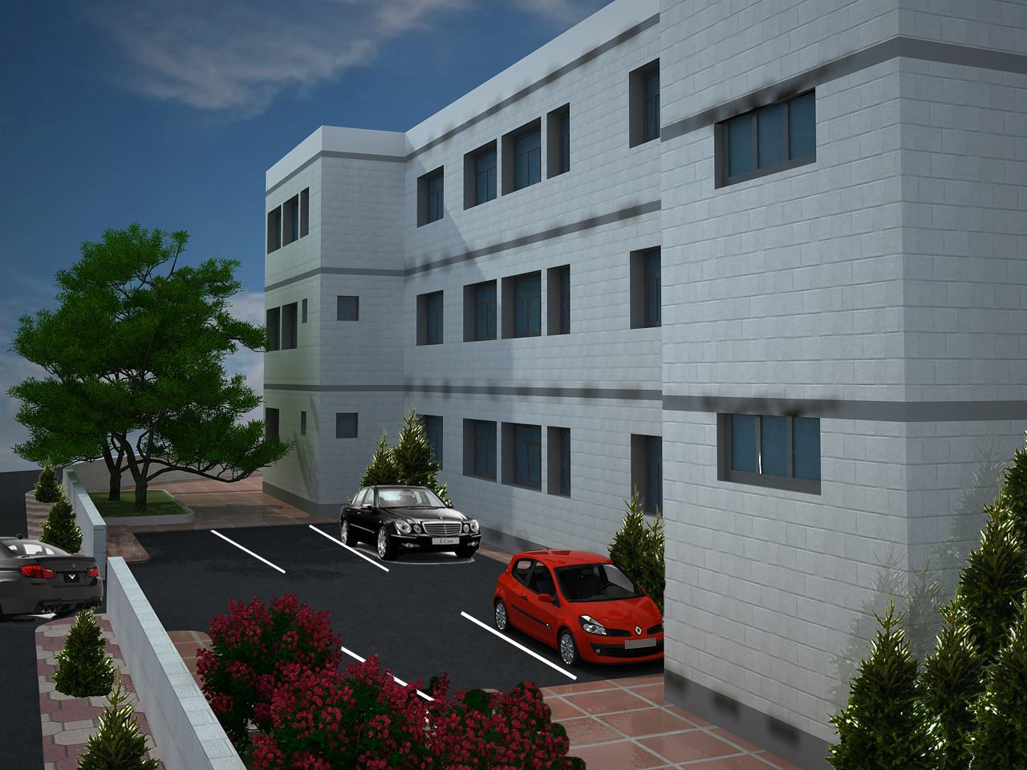
Architectural redesign:
The total area of the school is (2480m²) each floor has an area of 827 m².
Notes:
The shape of the building is obtained from an architectural designer which consists of three floors. The total site area equals (3500m²). Modifications had been made over the architectural design to meet the goals of the project.
The total area of the school is (2480m²) each floor has an area of 827 m².

Slide 6
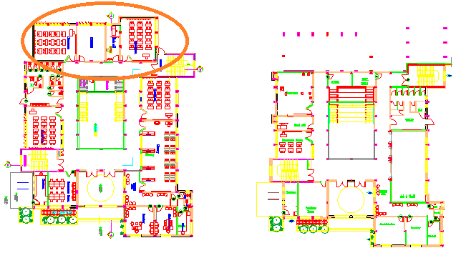
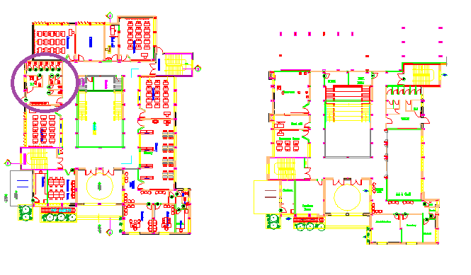
Modifications:
Figure 3: first modification
Figure 4: second modification

Slide 7
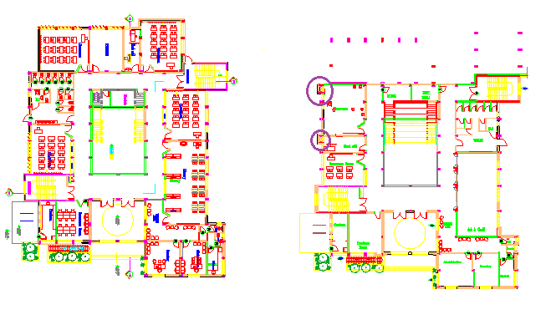
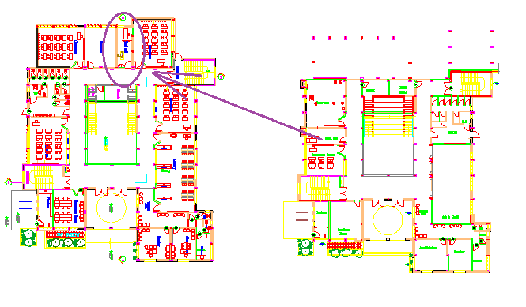
Modifications:
Figure 5: third modification
Figure 6: fourth modification

Slide 8
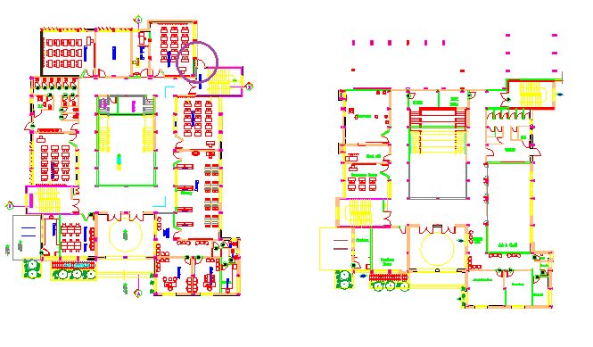
Modifications
Figure 7: fifth modification

Slide 9
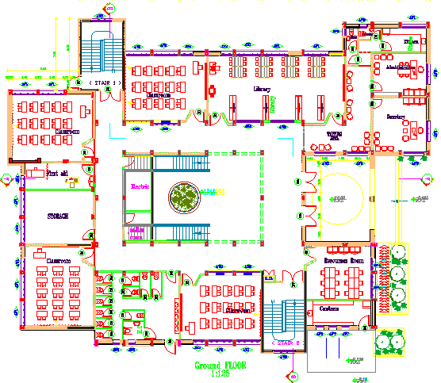
Space name | Number
Class room | 4
Toilets | 13
library | 1
Administration | 1
Resources room | 1
Canteen | 1
Storage | 1
First aid | 1
Kitchen | 1
Secretary | 1
Waiting area | 1
Floor Plans
Figure 9: Ground floor plan

Slide 10
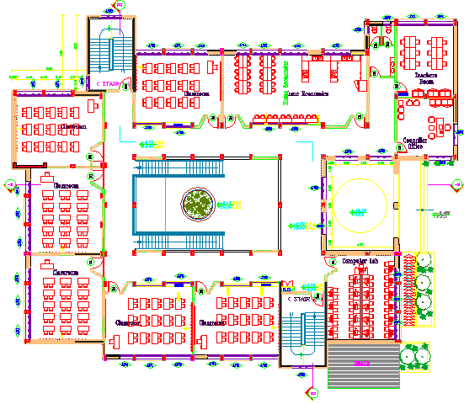
Space name | Number
Class rooms | 6
Computer lab | 1
Home economics | 1
Teatcher room | 1
toilet | 2
Councilor room | 1
Figure 10: first floor plan

Slide 11
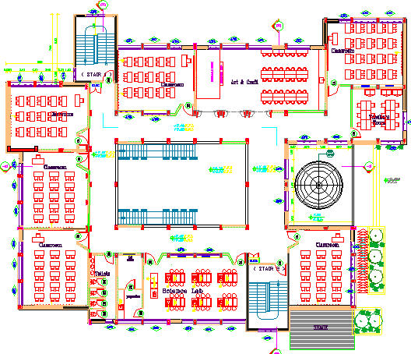
Space name | Number
Class rooms | 6
Science lab | 1
Art and craft | 1
Teatcher room | 1
toilet | 2
Preparation | 1
Lab store | 1
Floor Plans
Figure 11: second floor plan

Slide 12
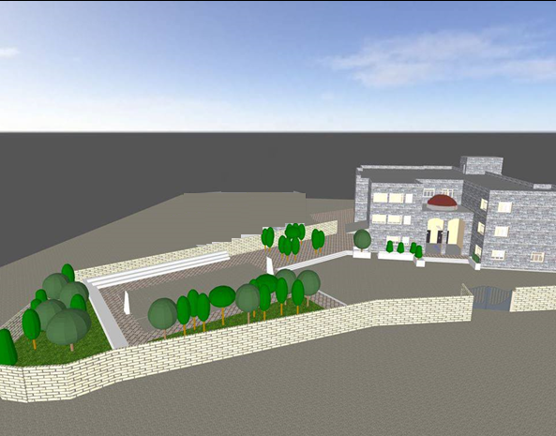
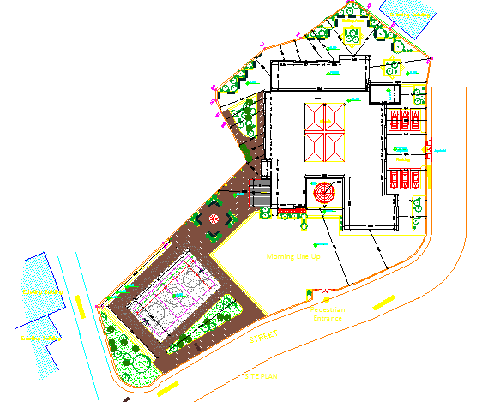
Site plan
Figure 12: site
Figure 13: site plan

Slide 13
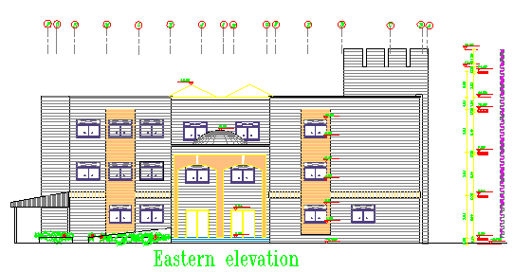
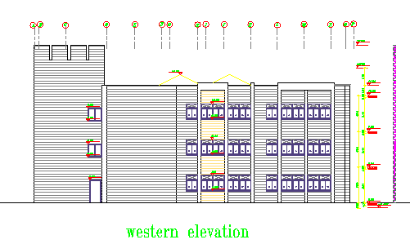
Elevations
Figure 14: Eastern elevation
Figure 15: Western elevation

Slide 14
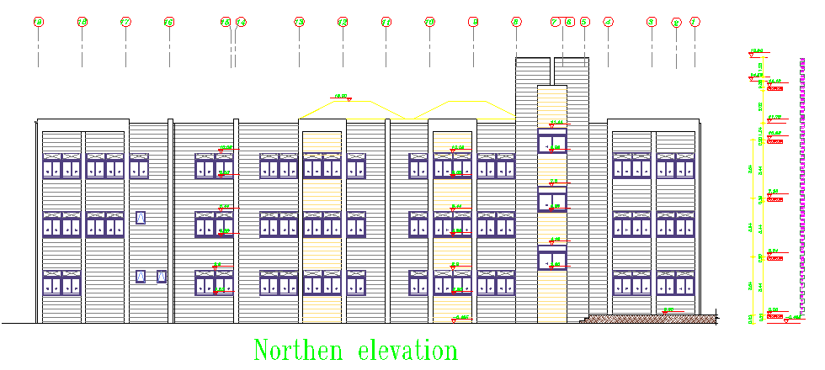
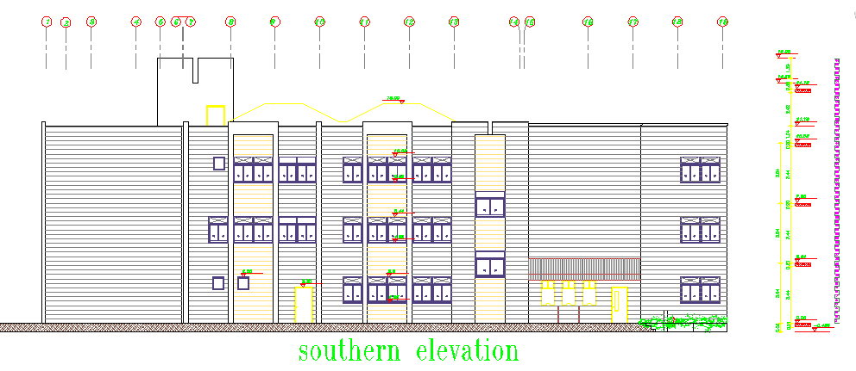
Elevations
Figure 16: Northern elevation
Figure 17: southern elevation

Slide 15
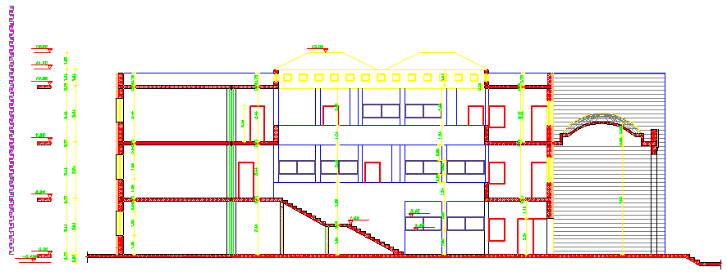
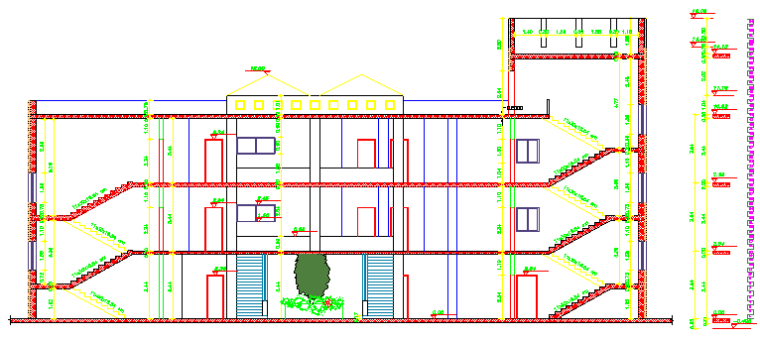
Sections
Figure 18: Section A-A
Figure 19: Section B-B

Slide 16
Table of contents
Introduction To project
Mechanical Design
Architectural Design
Structural Design
Electrical Design
Environmental Design
Quantity Surveying

Slide 17

Environmental Aspects
Maintain human comfort.
Water efficiency.
Natural lighting and minimum glare.
good ventilation in summer.
maintain good acoustical performance (RT60,STC & IIC)
Safe design for reduction of Hazards in school.
Use of green areas.

Slide 18
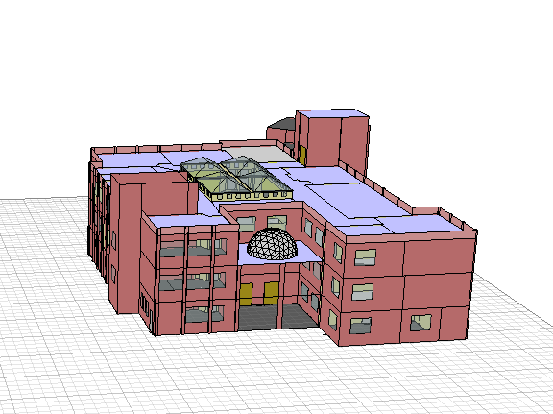
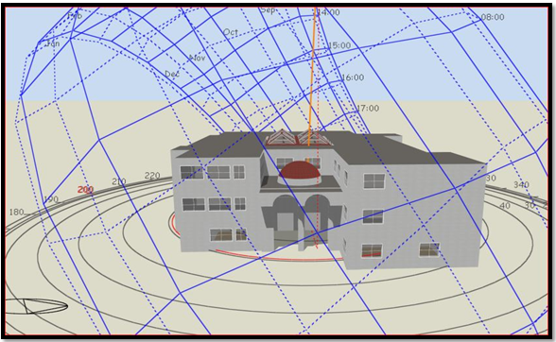
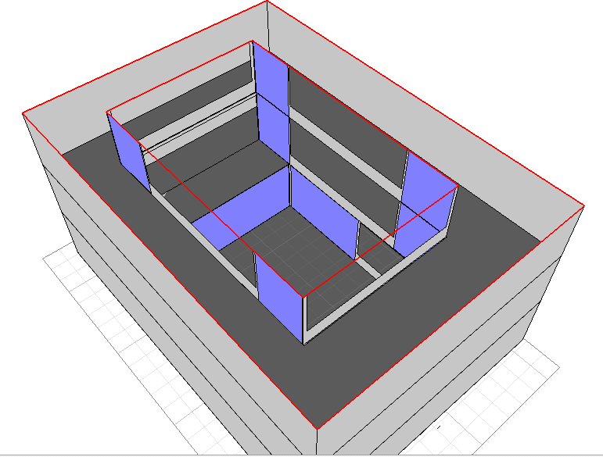
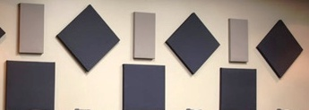
Environmental Design
Environmental design includes :
Teaching spaces orientation and design .
Courtyard analysis.
Day lighting analysis.
Acoustical analysis.
Thermal analysis.

Slide 19
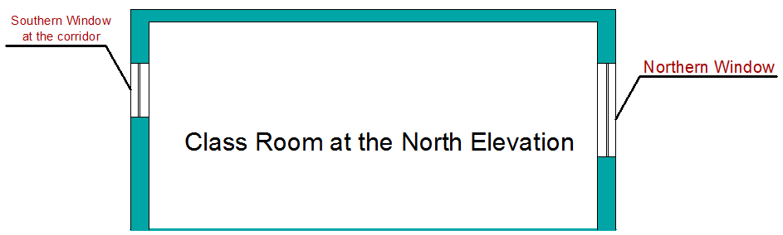
Teaching spaces orientation and design
Each classroom has windows on external wall & partition with corridor
Figure 20 : Section in the classroom

Slide 20
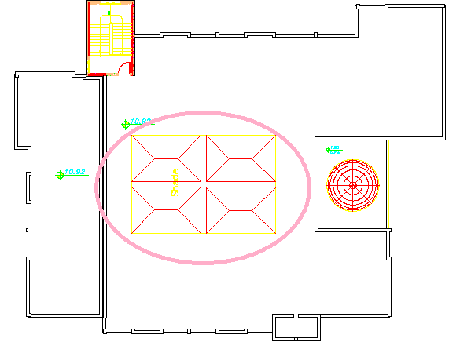
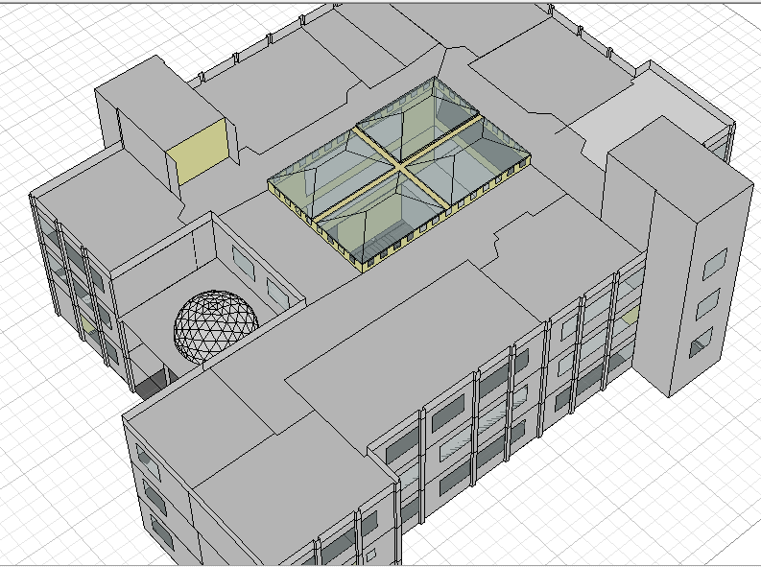
Courtyard analysis
This covered courtyard provides .
shelter for students in winter
good natural daylighting for courtyard space.
natural lighting and ventilation for the classrooms & corridors
The courtyard was treated for:
excessive lighting.
extra heat in summer & ventilation.
reverberation time & noise
Figures 21 : The location of the courtyard

Slide 21
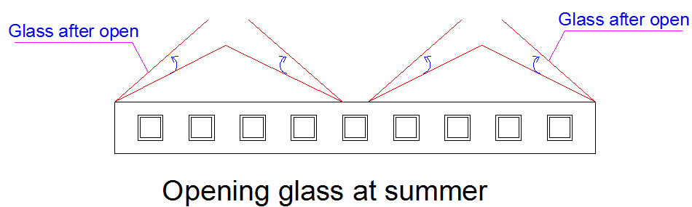
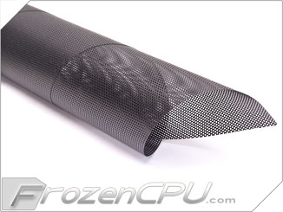
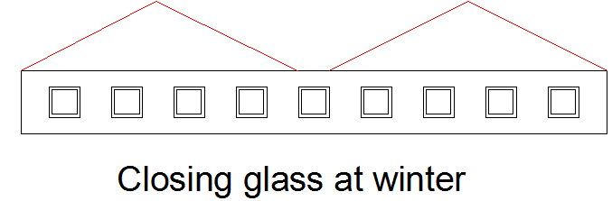
Courtyard analysis
It is recommended to use thin filter materials at the glass bottom to prevent birds and insects from interring the space
Figure 22 : opening glass at summer
Figure 23 : Filter material at the bottom of the court
Figure 24 : Closing glass at winter
Notes:
The court shading is designed to work as a solar chimney by opining the glass from two sides at summer to release heat and it will be closed at winter.

Slide 22
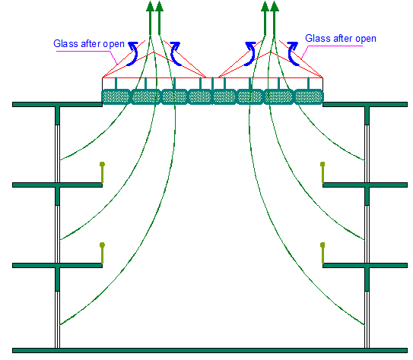
Courtyard analysis
Direction of ventilation at the courtyard
Figure 25 : Section in courtyard

Slide 23
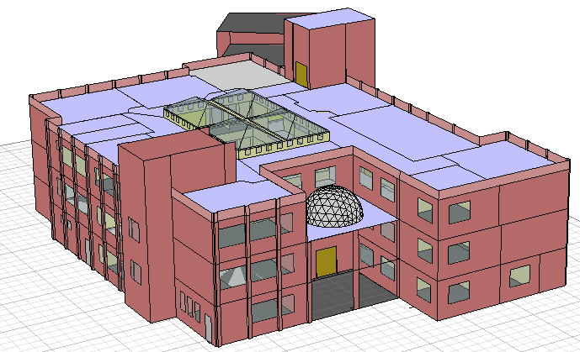
Simulation using Ecotect Program
The school has been analyzed using insulation and natural ventilation without a need for HVAC system.
Figure 26 : School building at Ecotect

Slide 24
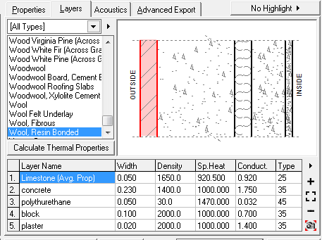
Input data in Ecotect
Figure 27 : Layers of external wall with details
Overall heat transfer coefficient “U-value” is 0.48

Slide 25
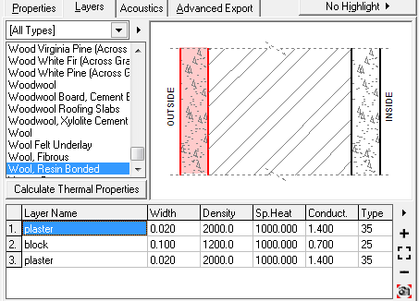
Input data in Ecotect
Figure 28 : Layers of partition with details
Overall heat transfer coefficient “U-value” is 2.93

Slide 26
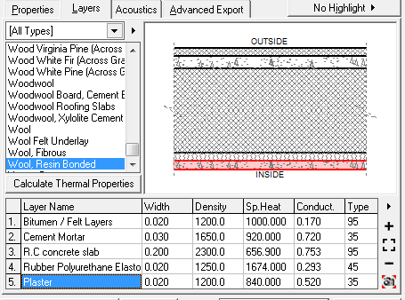
Input data in Ecotect
Figure 29 : Layers of roof with details
Overall heat transfer coefficient “U-value” is 0.74

Slide 27
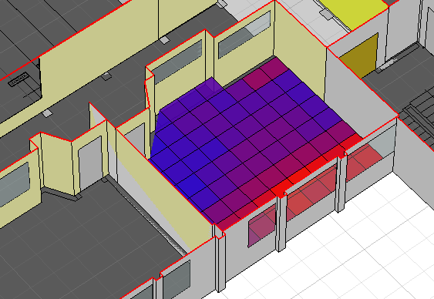
Day lighting analysis
Area | Floor | Orientation | Value
 |  |  | D.F | Lux
Classroom 4 | Ground | North | 5.12% | 460.73
Figure 30 : Daylight value at a northern classroom at ground floor

Slide 28
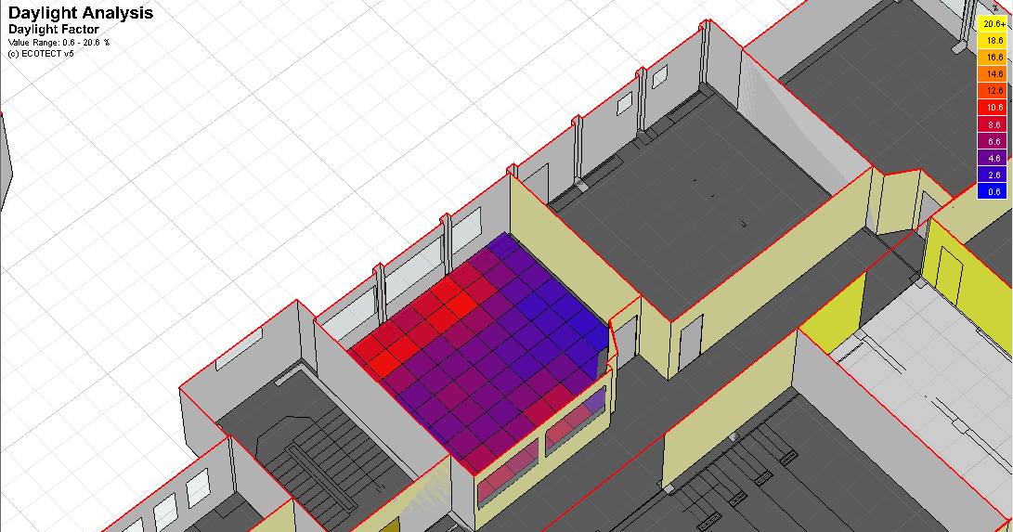
Day lighting analysis
Area | Floor | Orientation | Value
 |  |  | D.F | Lux
Classroom3 | Ground | South | 5.81% | 523.27
Figure 31 : Daylight value at a southern classroom at ground floor
Notes:
After looking at the Daylight factor values for classrooms the daylight is approximately high so, adding internal blinds will be sufficient.

Slide 29
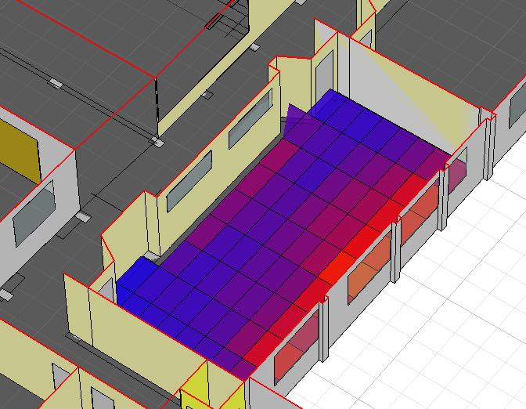
Day lighting analysis
Area | Floor | Orientation | Value
 |  |  | D.F | Lux
Library | Ground | North | 5.21% | 468.60
Figure 32 : Daylight value at the Library at ground floor
Notes:
also trees are planted at outside like Royal Poinciana which will reduce the value and provide natural shading to the school in addition to the acceptable landscape

Slide 30
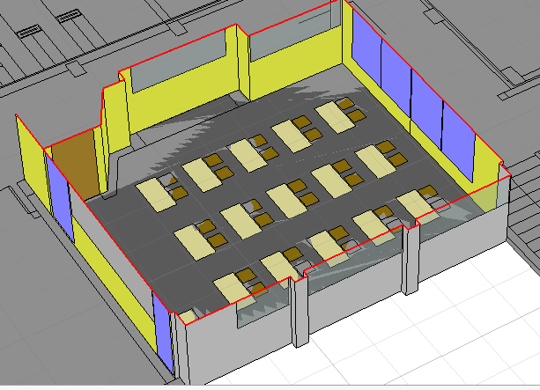
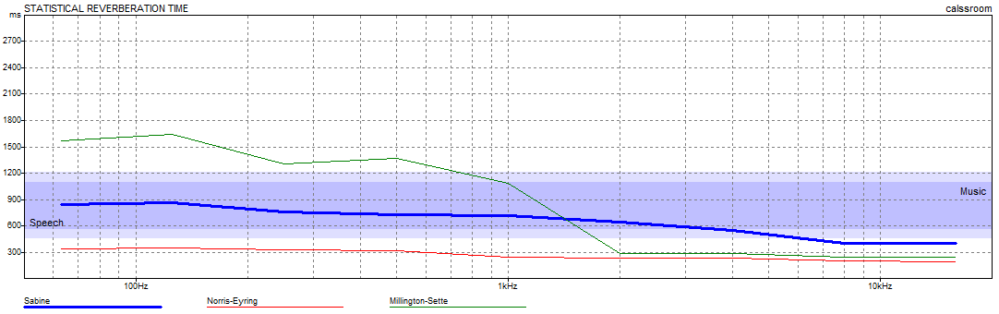
Reverberation Time T60
Figure 33 : Adjustment for classroom
Figure 34 : Reverberation time in classroom
The optimum value of RT60 for classroom is between 0.6-0.8 sec.

Slide 31
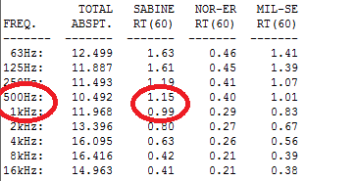
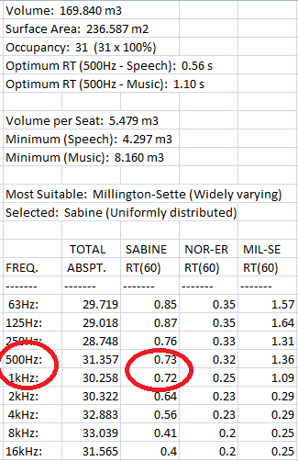
Reverberation Time T60
Figure 36 : Reverberation time at classroom before and after the treatment.

Slide 32
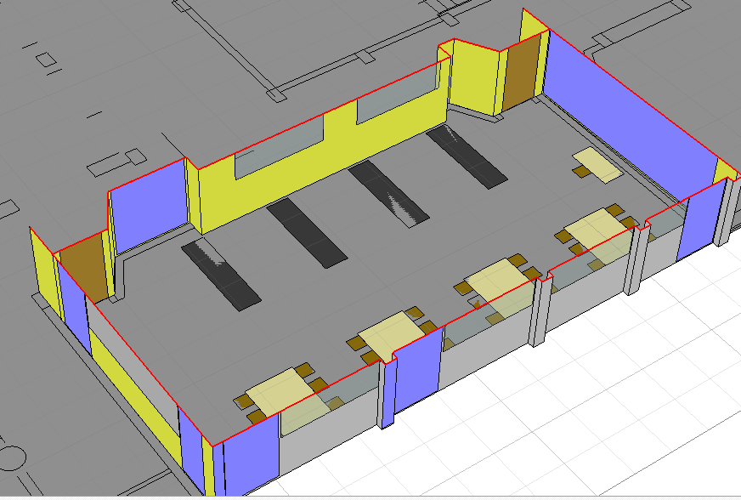
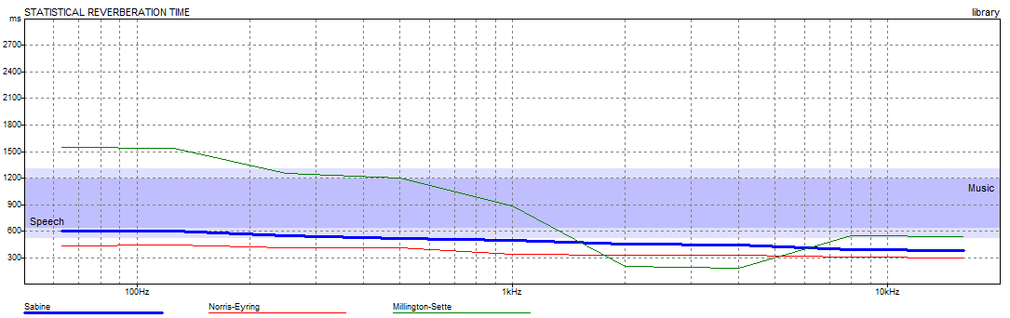
Reverberation Time T60
Figure 37 : Adjustment for library
Figure 38 : Reverberation time in library
The optimum value of RT60 for library is between 0.4-0.6 sec.
The same treatment has done to the library.

Slide 33
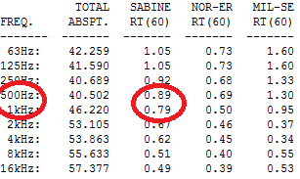
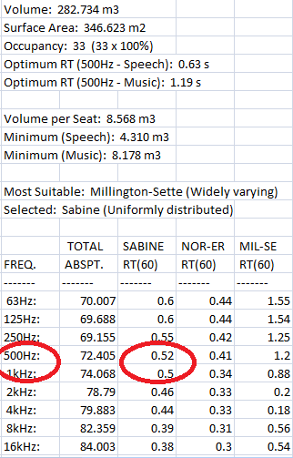
Reverberation Time T60
Figure 39 : Reverberation time at library before and after the treatment .

Slide 34
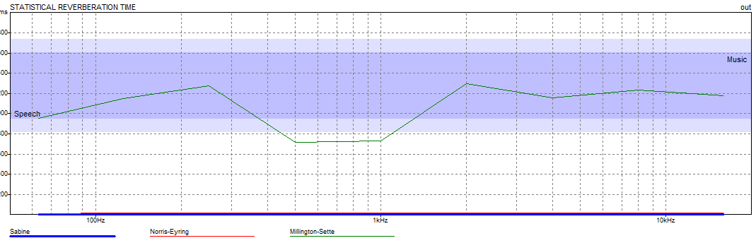
Acoustical treatment for the courtyard
The court is located at the middle of school so, it needs an important acoustical treatment.
Figure 41 : Reverberation time at the courtyard
Figure 40 : Section at the courtyard with wall perforated panels.

Slide 35
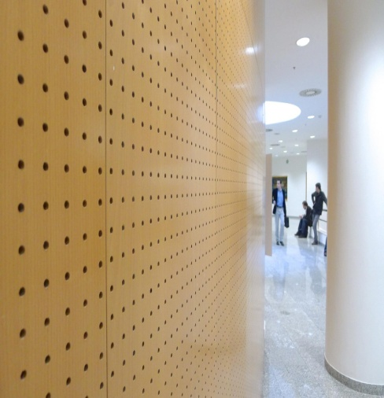
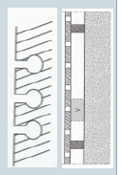
Acoustical treatment for the courtyard
It is suggested to use perforated panels at the walls and ceiling to reduce the noise.
Figure 42 : Perforated panels and its section.

Slide 36
Simulation using Design Builder Program
Insert the building into the program.

Slide 37
Simulation Values gathered over 3624.00 hours
 | Energy Per Total Building Area [kWh/m2] | Energy Per Conditioned Building Area [kWh/m2]
Total Site Energy | 43.22 | 44.56
Net Site Energy | 43.22 | 44.56
Total Source Energy | 116.63 | 120.24
Net Source Energy | 116.63 | 120.24
Table 4 : Site and source energy
Note : the total site energy is equal 44.56 which is within the range of heating with interval of [30-80 KWh/m²]

Slide 38
Simulation Values gathered over 3624.00 hours
 | District Cooling [kWh] | District Heating [kWh]
Heating | 0.00 | 46665.25
Cooling | 58925.03 | 0.00
Interior Lighting | 0.00 | 0.00
Interior Equipment | 0.00 | 0.00
Table 6 : End Uses
District heat appears to be the principal heating source based on energy usage.

Slide 39
Table of contents
Introduction To project
Mechanical Design
Architectural Design
Structural Design
Electrical Design
Environmental Design
Quantity Surveying

Slide 40

Structural Design:
Design code
The American Concrete Institute code ACI 318-08.
The seismic design according to UBC-97&IBC-2009
Analysis method : 3D model by SAP program.

Slide 41
Design data
Bearing capacity = 250 KN/M²
Concrete Strength for slab and beams f'c = 24 Mpa
Concrete strength for columns and footings f'c= 28 Mpa
Steel yield strength Fy = 420 Mpa
Concrete unit weight = 25 KN/m³
Superimposed (SID) = 4 KN/m²
Live Load = 5 KN/m²

Slide 42

3D model
Figure 43: block1 3D
Figure 44: block2 3D

Slide 43
Model checks
1. Equilibrium check
load | manual | sap | error
live | 9990 | 9947 | 0.4%
SID | 15596.2 | 15535 | 0.3%
dead | 23019.5 | 22948.2 | 0.3%
Table 7 : equilibrium check

Slide 44


2. Compatibility check
Figure 45: block1compatability check
Figure 46: block2compatability check

Slide 45
Design of slab
Structural system : One way solid slab.
Slab thickness = 20 cm.
Analysis method : 3D model by SAP program.

Slide 46

Figure 48: Y steel

Slide 47

Figure 49: X steel

Slide 48

Design of beams
Figure 50: Beam detailing

Slide 49

Design of column
Figure 51: column detailing

Slide 50

Design of footing
Figure 52 : single footing

Slide 51

Design of footing
Figure 53: combined footing

Slide 52


Shear wall and wall footing
Figure 54: shear wall
Figure 55: wall footing

Slide 53

Seismic design
The building frame system is assumed as:
R=4.5
I =1.25
Zone 2B, Z=0.2
the soil profile is(SC).
(Ca)=0.24
(C v)=0.32

Slide 54

Dynamic Analysis
Figure 56: response spectrum

Slide 55

Base shear Seismic checks:
V=10986.1 KN
Vmax =1346 KN
Vmin = 6797.7 KN
Since V > Vmax use V max to compare with SAP Result
Figure 57: base shear

Slide 56

periodical time
Figure 59: dynamic analysis
Manual calculation
Ct = 0.0488 * (10.92+2)3\4 = 0.33 s

Slide 57

Structural joint design
The project has 1 structural joints which divide the building into two parts: A and B . It is composed of reinforced concrete parts
The joint construction was made to achieve the seismic requirement .
(0.033m) structural joint is used.

Slide 58
Table of contents
Introduction To project
Mechanical Design
Architectural Design
Structural Design
Electrical Design
Environmental Design
Quantity Surveying

Slide 59

Mechanical Design
Four aspects of mechanical water systems were designed:
Water supply system
Gray water system(for irrigation only)
Storm water system(flushing)
Drainage system

Slide 60

Water supply
Table(8) potable water demand (gpm)
 | Supply control | Fixture units Potable water |  | Water demand (gpm)
 |  | A | B | A | B
Ground floor | Faucet, flush tank | 78.5 | 16 | 37 | 18
First floor | Faucet, Flush tank | - | 18 | - | 19
Second floor | Faucet, flush tank | 42 | 2 | 27 | 5
Figure 60: water tanks
Notes:
At the top of the stair cae we have installed six 2m3 water tanks four of tem connected directly from main potable water supply and two of them are from storm water underground tanks which will be used for flushing

Slide 61


Water supply
Figure 61: water supply

Slide 62

Sanitation systems
Sanitation system contains:
Black water: from WC’s, floor drains, lab’s lavatories and kitchen sinks.
Gray water: from lavatories, water fountains.
Storm water: from rain.
Figure 62: sanitation systems

Slide 63

Storm water harvesting
Figure 63: storm water collection

Slide 64


Fire Fighting system
Figure 64: fir fighting systems

Slide 65

Fire suppression system
Figure 65: fire fighting systems

Slide 66
Table of contents
Introduction To project
Mechanical Design
Architectural Design
Structural Design
Electrical Design
Environmental Design
Quantity Surveying

Slide 67

Electrical design

Slide 68


Artificial lighting
Eavg(lux) | UGR | Uniformity
370 | 10-15 | 0.7

Slide 69


Artificial lighting
Eavg(lux) | UGR | Uniformity
517 | 10-18 | 0.76

Slide 70


Artificial lighting
Library | Perpendicular illuminance | UGR | Uniformity
reading | 500 | 10-15 | 0.85
bookshelves | 250 | 10-12 | 0.8

Slide 71

Sockets arrangement
Figure 66 : sockets arrangement

Slide 72

Photovoltaic geographical system
Figure 67: Photovoltaic program

Slide 73

Photovoltaic system
Total Annual consumption | Total annual cost
11767 KW.H | 7530.8 NIS
Total Annual Generation | Total annual cost
13100 KW.H | 8384 NIS
Total annual Bonus = 8384-7530.8 = 853.12NIS

Slide 74
Table of contents
Introduction To project
Mechanical Design
Architectural Design
Structural Design
Electrical Design
Environmental Design
Quantity Surveying

Slide 75
Quantity surveying
work | unit | Quantity | price
Earth work | M³ | 804 | 40200
concrete works | M³ | 1618 | 533940
steel works | Ton | 97.68 | 273504
Finishing works | M² | 19967 | 1919314
Electrical work |  |  | 11488
Mechanical work |  |  | 46798
Total |  |  | 2,825,244 NIS +80000 NIS (PV)

Slide 76

Special thanks to:
Our supervisour Dr.Mutasim baba
To faculty members of the department
To our families and friends

