Slide 1
Money Keeper
Prepared By: Sahar Samer, Zaina Hammouz.
Supervisors: Dr.Emad Natsheh, Dr.Mona Demaidi

Slide 2
Outlines:
Introduction
Framework and languages.
Platform.
Features and Demo.
Conclusion and Future work.

Slide 3
Introduction:
Money Keeper is an application that allow the users to manage their budget.
Developed using React Native and Firebase.

Slide 4
Framework and Languages:
React Native:
  Created by Facebook.
  Open-source framework.
  React in addition to native capabilities.
Main Language:
  JavaScript.
Style sheet Language:
  CSS.

Slide 5
Platform:
Google’s Firebase :
1-Authentication:
  Secures users’ information and encrypts passwords.
  Provides email verification
2-Realtime Database:
  NoSQL Cloud Database
  Stored as JSON

Slide 6
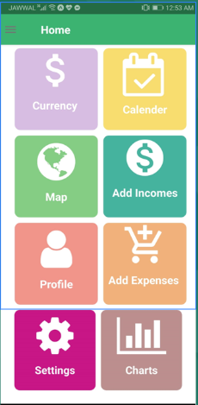
Features and Demo
Home:

Slide 7
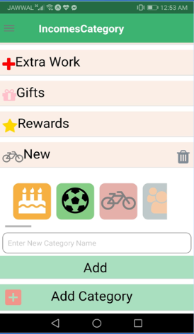
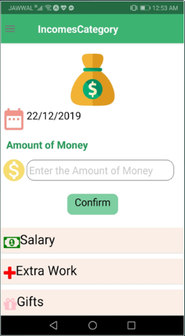
Incomes:

Slide 8
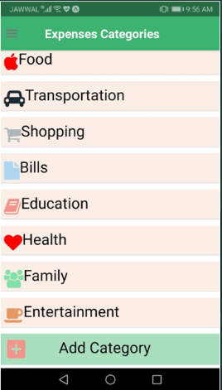
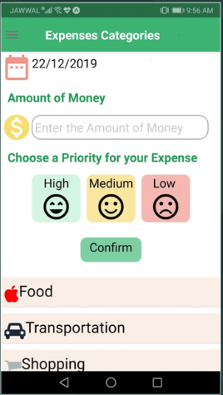
Expenses:

Slide 9
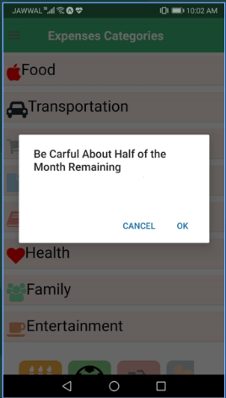
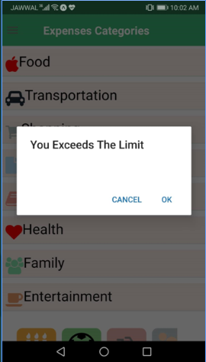
Expenses-Continue

Slide 10
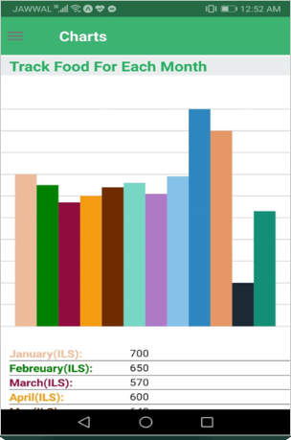
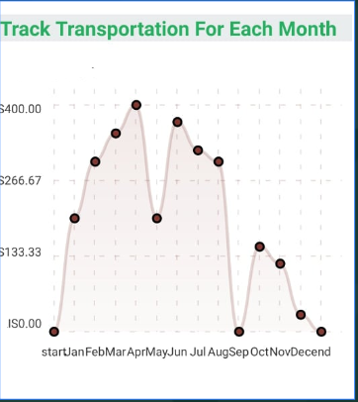
Charts:

Slide 11
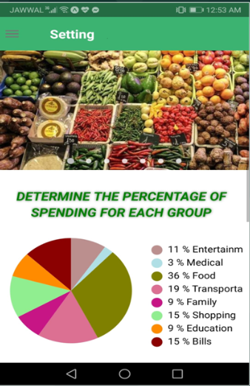
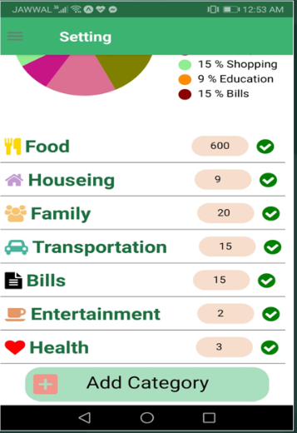
Settings:

Slide 12
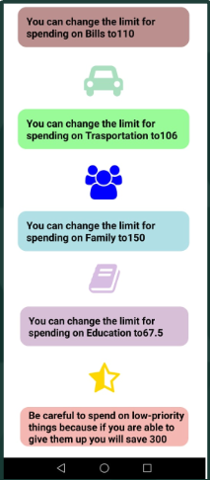
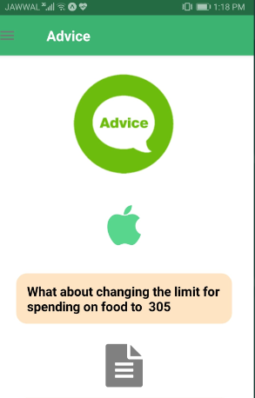
Advice:

Slide 13
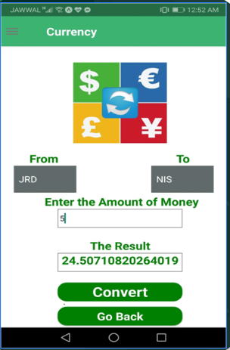
Currency Converter:

Slide 14
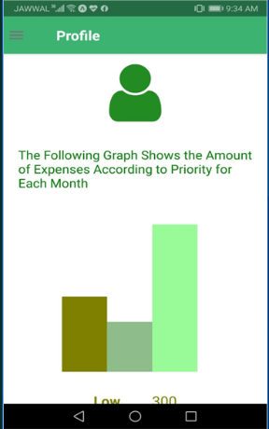
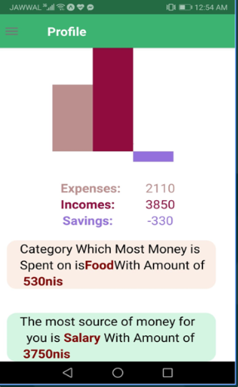
Profile:

Slide 15
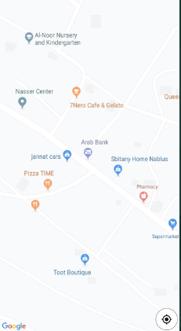
Map:

Slide 16
Conclusion:

Slide 17
FutureWork:
Improving map functionality.
Adding suggestion functionality that can help user to invest according to their savings.
Using AI for predicting the way that the person expense

Slide 18
Thank you

