Slide 1

Graduation Project 2
3D Seismic Design of Omar Al-Alool School
Prepared by:
Hanan Al-Atrash
Samah Abdul-Razeq
Under supervision of:
Dr Mohammad Sama’neh
25-May-2017

Slide 2
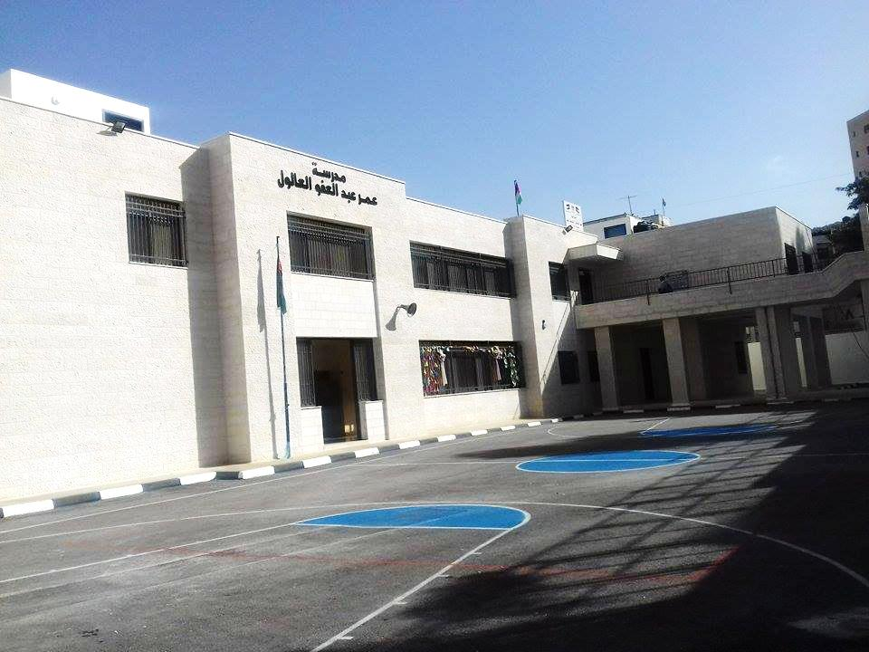
Picture of the project

Slide 3
Project description
The project is located in Nablus city
The project consists of two blocks separated by seismic joints.
Block 1 and Block 2 consist of 3,floors
Total Building Area = 2167m²

Slide 4
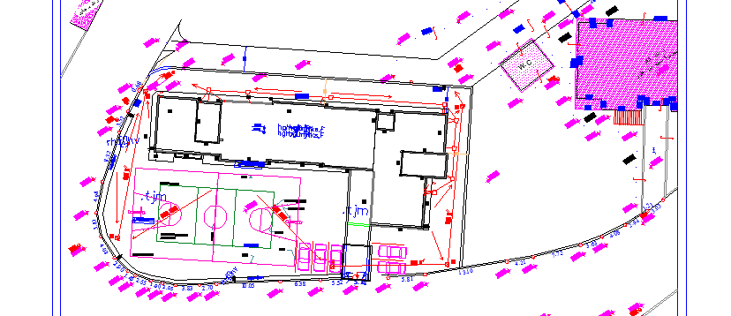
Project description:site plan

Slide 5
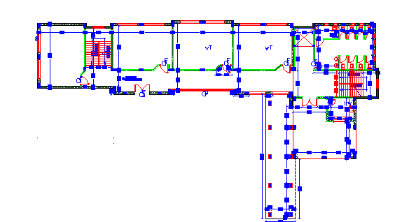
Ground Floor Architectural Plan

Slide 6
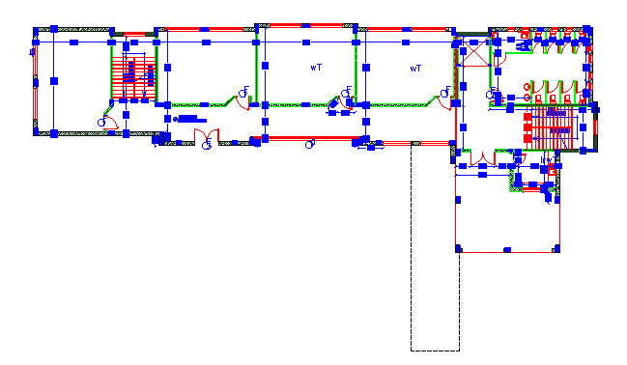
First&Second Floor Architectural Plan

Slide 7
The Codes Used in This Project
The Codes used in this project are the following :
  Uniform Building Code ( UBC-97 ) earth quake loads
  ASCE-7 (2010)
  ACI 318-11

Slide 8
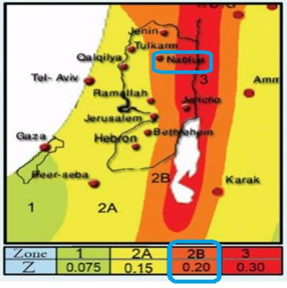
Seismic Zone Requirements (UBC-97)
Seismic Zone Factor (Z) Map Prepared By An-Najah National University is used to determine the seismic zone for Nablus city
Seismic Zone for
Nablus is 2B
Factor (Z) = 0.2

Slide 9
Structural Materials
Concrete
  Used Compressive Strength (f_{c}’) for Slabs, Beams, Columns and Footings is 28 MPa.
  Modulus of Elasticity = 24870 MPa
  Unit Weight for used Concrete is 25 kN/m³

Slide 10
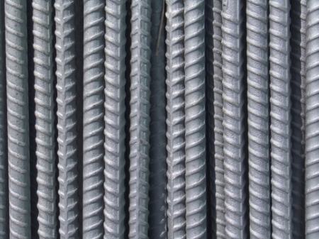
Structural Materials
Reinforcing Steel
  Yielding Stress for used Steel is 420 MPa
  Modulus of Elasticity is 200,000 MPa
  Unit Weight (ɣ) is 77kN/m³

Slide 11
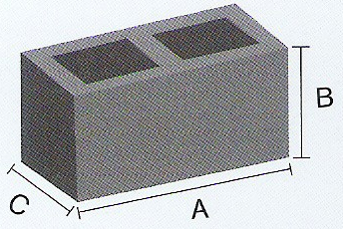
Non-Structural Materials
Concrete Blocks
  The used blocks were of 100 mm thickness, 200mm height and 400mm length in internal partitions and in external walls having a unit weight of 12kN/m³
  Internal partitions are 250mm thickness having two layers of 100mm concrete blocks with an isolation with of 50mm
  For external walls, a single layer of 100mm concrete block is used.

Slide 12
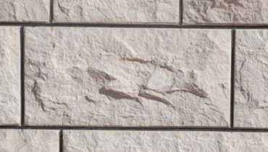
Non-Structural Materials
Building Stones:
  The average density for used building stones is 2700 kg/m³
  The Three main shapes of the used stones are:
    Tobzeh Stone
    Mufajjar Stone
    Matabbeh Stone

Slide 13
Non-Structural Materials
Plastering:
  Three layers of plastering will be used to achieve the required smoothness with an average thickness of 20mm for each layer
Tiles:
  The main two types of tiles that will be used in the building are Mosaic Tiles for internal rooms and Ceramic Tiles for kitchens and WCs with an average density of 2500 kg/m³

Slide 14
The Philosophy of Design
A 3D Model was constructed and analyzed using SAP2000 program taking into consideration the effects of dynamic Loads
Columns and Beams were represented as line elements.
Slabs and shear walls were modeled as area elements.
The connections between the footings and the column necks were represented as pin connections.
One (1D) model for each element was constructed and analyzed using SAP2000 program preliminary design phase.

Slide 15
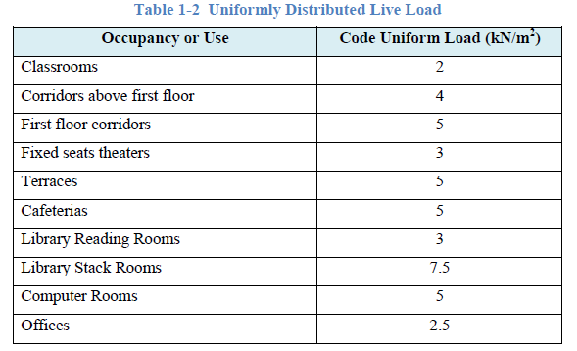
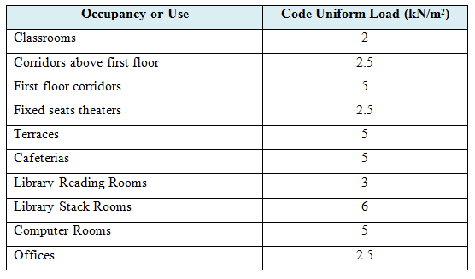
Load Types
Live Load:
Used Live Load = 3.0 kN/m² for class rooms and and 5.0 kN/m² for coridors

Slide 16
Load Types
2. Super Imposed Dead Load:
Filling Material: 120mm of crushed gravel mixed with sand is used having a density of 2000 kg/m³
  Filling Material Load = 0.12 X 2000 = 240 kg/m²
Mortar: 30mm were used with an assumed average density of 2300 kg/m³
  Mortar Load = 0.03X 2300 = 69 kg/m²

Slide 17
Load Types
Tiles: an average thickness of tiles were taken as 30mm with a density of 1700 kg/m³
  Tiles Load = 0.03 X 1700 = 51 kg/m²
Total superimposed dead load = 4 kN/m²

Slide 18
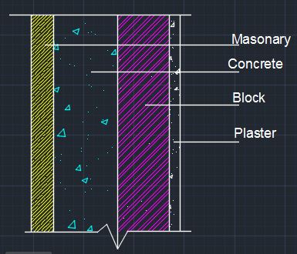
Load Types
External Walls:
Wall weight = weight of masonry + weight of plan concrete +weight of plaster.
Wall weight = (0.05*27+0.15*25+0.1*12+0.015*23)
= 6.645*3.12=20.73 KN/m.
Use wall weight = 21 KN/m.

Slide 19
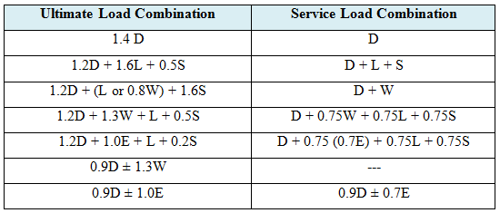
Load Combinations
Using UBC 1997:

Slide 20
Preliminary Design of The Project
To do the preliminary design for the blocks the following procedure is used :
  Determine the load assigns for the block.
  Determine the distribution of beams .
  Determine the thickness of the slab .
  Calculate the ultimate load for the slab.
  Check the shear and the reinforcement for the slab.
  Determine the dimensions of the beams.
  Determine the dimensions of the columns.

Slide 21
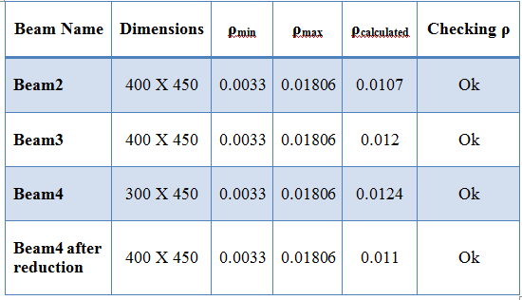
Preliminary Design of The Project
Table 2-2 shows the beam dimensions for Block (1) from the preliminary design stage:
Table 2-2 Beams Properties
Slab thickness = 200mm
Column Dimension = 600x300mm

Slide 22
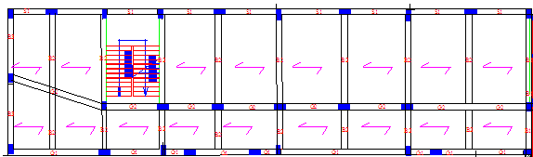
Preliminary Design of The Project

Slide 23
Equivalent Lateral Force (UBC-97)
The Following Parameters are used in the calculations :
  Seismic Zone Factor for Nablus (Zone 2B) = 0.2
  Soil Profile = S_{B}
  C_{a} = 0.2
  C_{v} = 0.2
  Importance Factor (I) = 1.25
  Reduction Factor (R) = 5.5

Slide 24
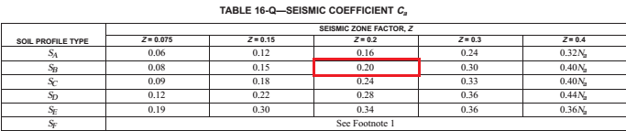
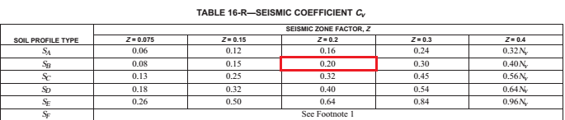
Soil profile type = SB
Seismic coefficients: Ca, Cv values:

Slide 25
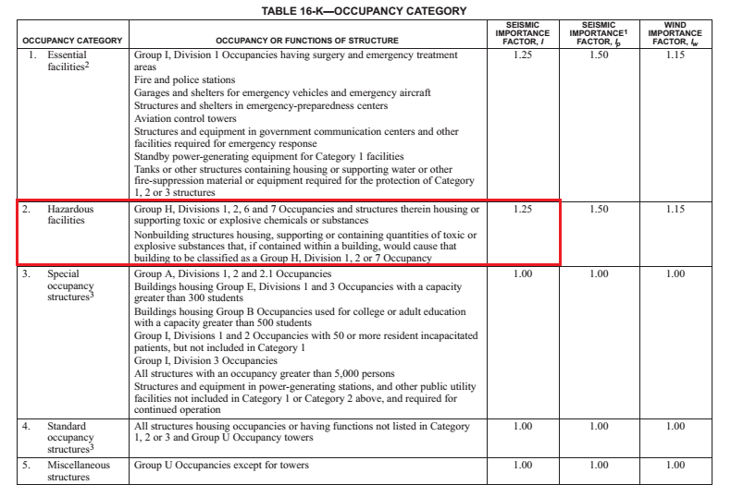
Importance factor I=1.25

Slide 26
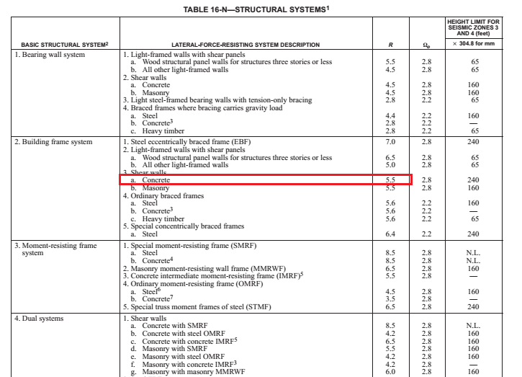
Response modification factor R=5.5

Slide 27



Equivalent Lateral Force (UBC-97)
Due to the existence of concrete shear walls the following formula where used:
  A_{c} = 2.045 m²
For the Calculation of C_{t}:
  C_{t} = 0.0519
  The Natural Period T_{n} = 0.303 sec

Slide 28

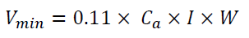

Equivalent Lateral Force (UBC-97)
These are the equations used for Base Shear (V) calculation :

Slide 29






Equivalent Lateral Force (UBC-97)
Applying the previous Equations :
Select The Maximum Value of Base Shear (V) = 2449.7 kN

Slide 30
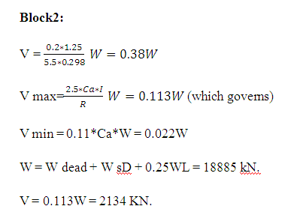
Equivalent Lateral Force (UBC-97)

Slide 31
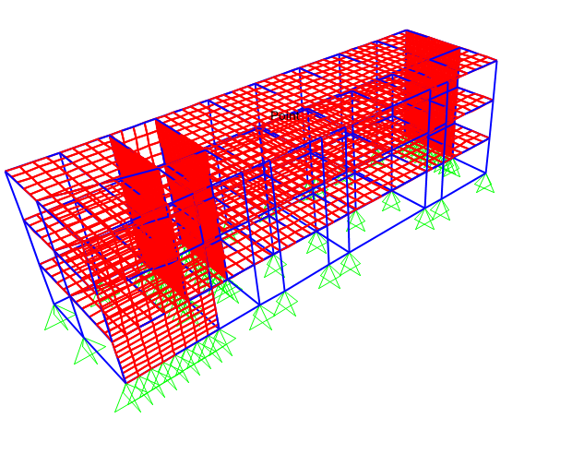
Structural 3D Modeling
The structure is modeled using SAP2000 program

Slide 32
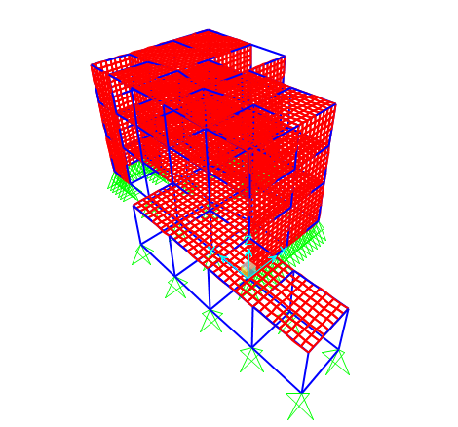
Structural 3D Modeling

Slide 33
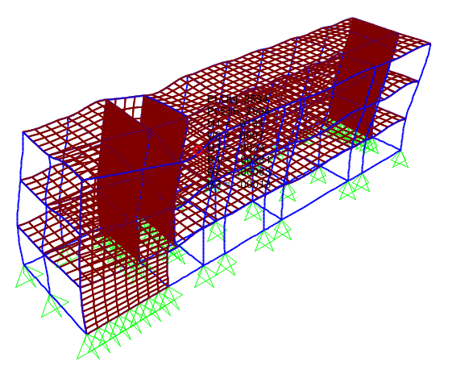
Verification of Structural Analysis
Compatibility Check :
  The following figure proves the compatibility of the model

Slide 34
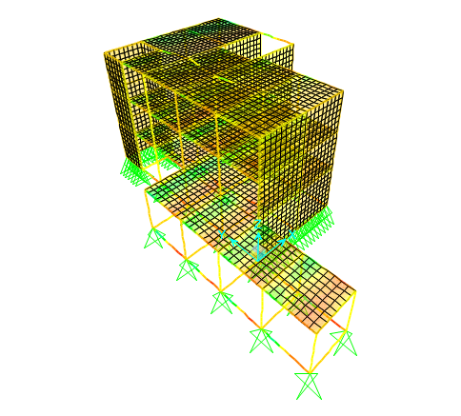
Verification of Structural Analysis

Slide 35
Verification of Structural Analysis
Equilibrium Verification
  The Loads assigned to the model are :
  Own Weight = Calculated automatically in the SAP2000
  Super imposed dead load = 4.0 kN/m²
  Live Load = 3.0 kN/m²
  Earthquake Loads

Slide 36
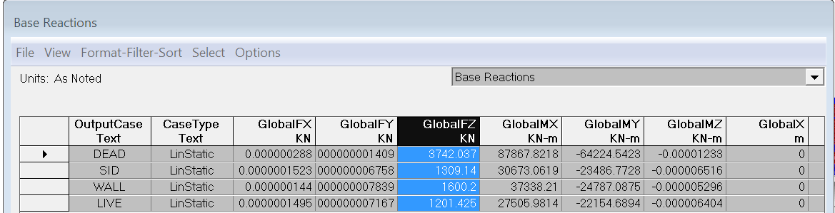
Verification of Structural Analysis
Equilibrium Verification
  The following table shows the base reactions obtained from the analysis of SAP2000
Table Base Reactions From SAP2000 Program

Slide 37
Verification of Structural Analysis
Live Load Verification
  Total Live Load from hand calculation =1201.68 kN
  Total Live Load from SAP2000 program = 1201.4 kN
  Difference Percentage = (5848-5319)/5484 = 0.02%
Dead Loads Verification ( Own Weight )
  Value from SAP2000 Program for Own Weight = 3835kN
  Own Weight = 3742kN
  Difference Percentage = (3835-3742)/3742 = 2.48%

Slide 38
Verification of Structural Analysis
Superimposed Dead Load Verification
  Super Imposed Dead Loads = 1309kN
  Value from SAP2000 Program =1309.1kN
  Difference Percentage = (1309.1-1309)/1309.1 = 0.01%

Slide 39
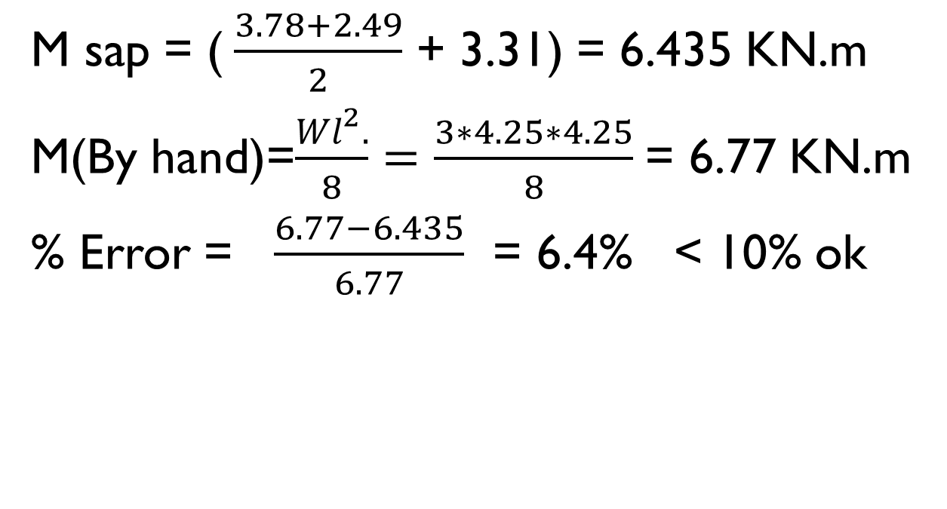
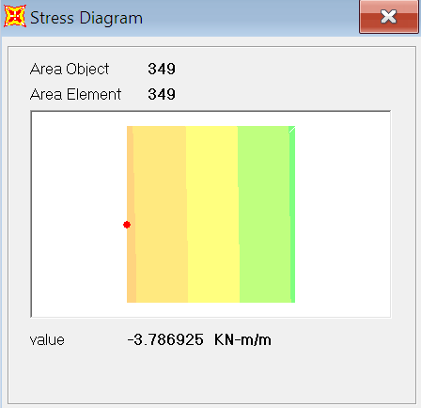
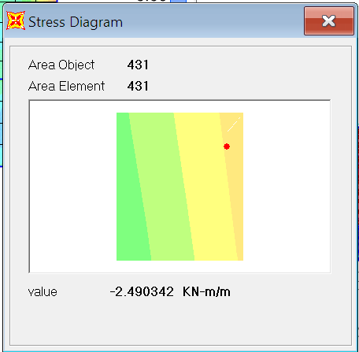
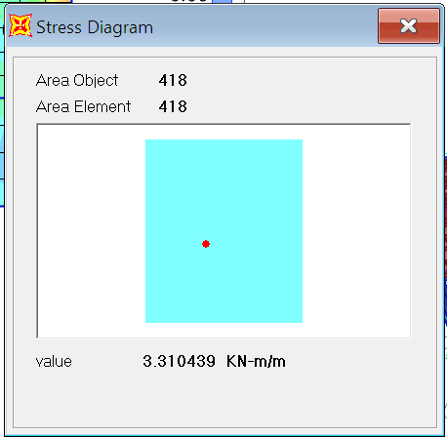
Verification of Internal Forces

Slide 40
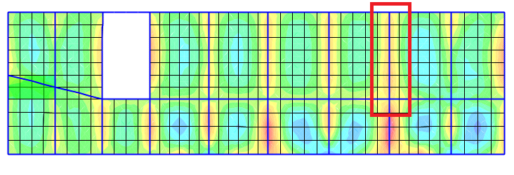
Verification of Internal Forces
Check of Beams Internal Forces
  The following figure shows the beam to be checked
The Plan of The Beam Selected for Internal Forces Check

Slide 41
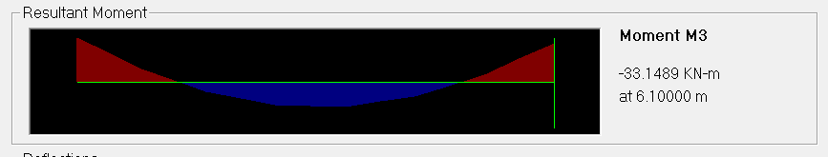
Verification of Internal Forces
Bending Moment Diagram Obtained From SAP2000 :
  Positive Bending Moment from SAP2000 = 38kN.m
  Negative Bending Moment from SAP2000 = 19.7 kN.m
  Center to Center Span of the beam = 6.1 m
  Tributary Width = (4.3+4.25) / 2 = 4.275 m
  Total Live Load = 3 x 4.275 = 12.75 kN/m
  Calculated Moment = Wu L2/8 = 12.75x6.1/8 = 59kN.m
  Moment from SAP2000 = 55.2kN.m
  Difference Percentage = (59 – 55.2)/59 = 6.3%

Slide 42
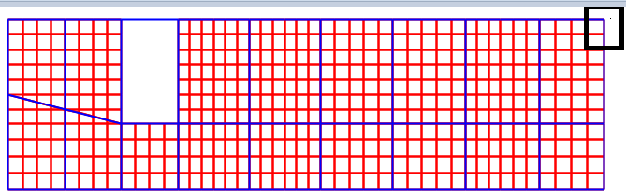
Verification of Internal Forces
Check of Columns Internal Forces
  Figure shows the plan of ground floor where the column is to be checked
Position of the Column to be Checked in Terms of Internal Forces

Slide 43
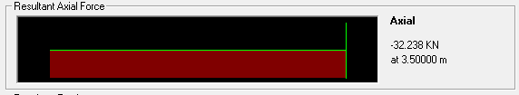
Verification of Internal Forces
For the Live Loads
  Tributary Area = 3.67m²
  Live Load on The Floor = 3kN/m²
  The following figure shows the axial load from SAP2000
  Live Load from SAP2000 = 32.2 kN
  Live Load using tributary area = 3.67 x(3*3) = 33 kN
  Difference Percentage = (32.2 - 33) / 32.2 = 2.6%

Slide 44
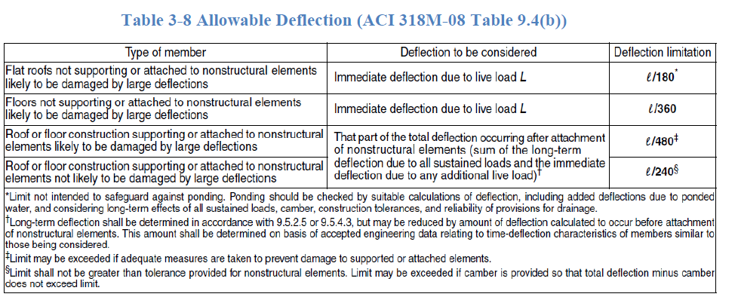
Serviceability Check
The following table shows the allowable deflection limits
  The Selected Limit to be Checked is L/240

Slide 45
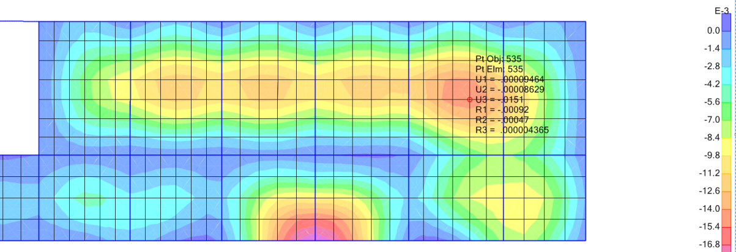
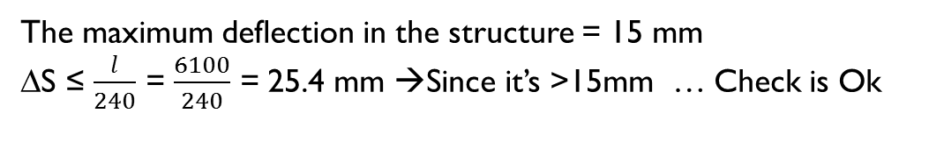
Servicebility Check
This figure shows deflection in the third floor obtained from SAP2000

Slide 46
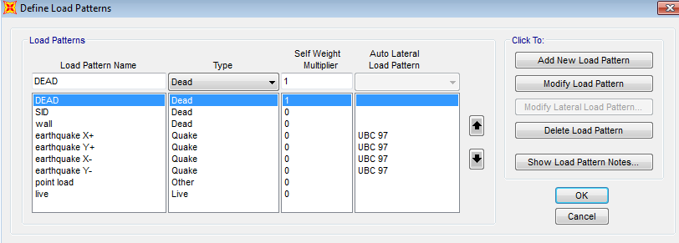
Equivalent Lateral Force (UBC-97)
Define load pattern:

Slide 47
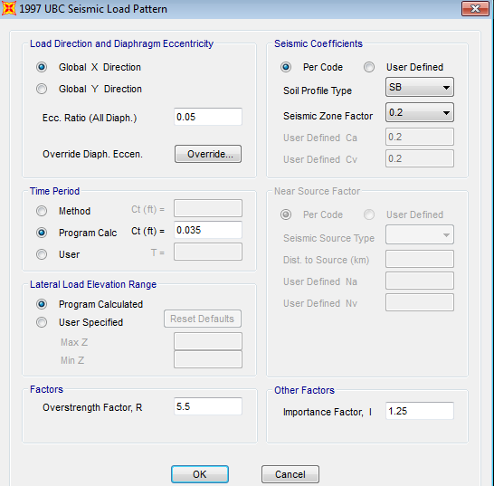
Equivalent Lateral Force (UBC-97)
Assign seismic factors :

Slide 48
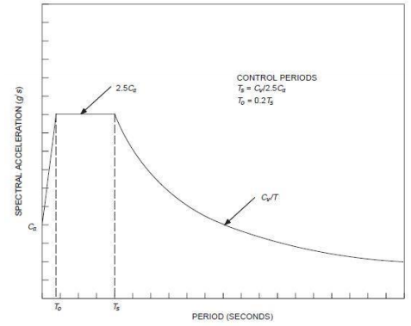
Response Spectrum Analysis

Slide 49
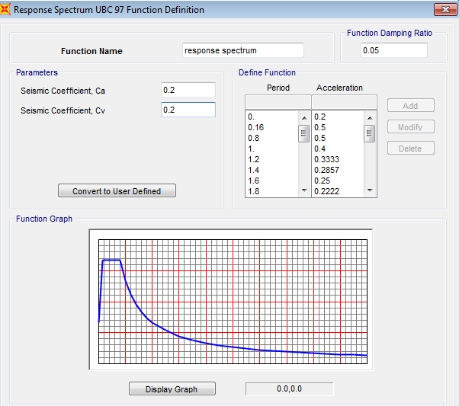
Response Spectrum
Define response spectrum function on SAP 2000 program:

Slide 50
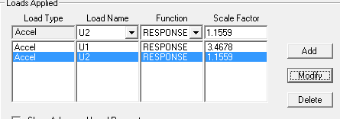
Response Spectrum
Define load cases :
scale factor = gI/R

Slide 51


Response Spectrum
X-direction:
Y-direction:

Slide 52
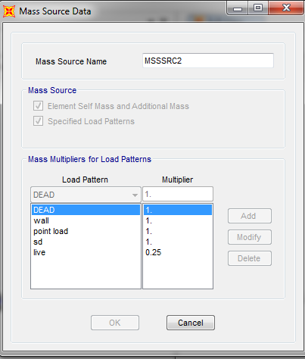
Mass source data
Define mass source:

Slide 53
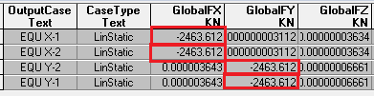
Check of Lateral Forces
The following shows a comparison between the value of lateral forces obtained by hand calculation and by SAP2000.
Seismic Base Shear (V) from SAP2000 according to UBC-1997 = 2463.6kN
Seismic Base Shear (V) from manual calculations = 2449.7 kN
Difference Percentage = (2463-2449.7)/(2463) = 0.05% < 5% , it is acceptable

Slide 54
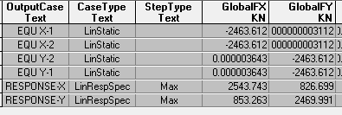
Check of Lateral Forces
The following shows a comparison between the value of lateral forces obtained by SAP2000 from equivalent method and response spectrum.
Base shear from response =2543.7 KN> base shear from static =2463.6 KN

Slide 55
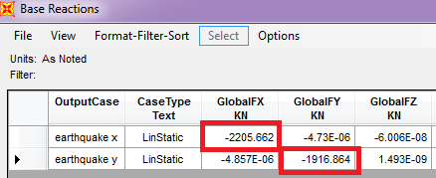
Check of Lateral Forces
The following shows a comparison between the value of lateral forces obtained by hand calculation and by SAP2000.
Seismic Base Shear (V) from SAP2000 according to UBC-1997 = 2205.66kN
Seismic Base Shear (V) from manual calculations = 2134kN
Difference Percentage = 3.2% < 5% , it is acceptable

Slide 56
Period check
  For block1:
  The Natural Period from manual calculations T_{n} = 0.303 sec
1.4*0.303=0.424 sec
Period from sap:
Tx=0.213<0.424 ....... ITS OK.
Ty=.178<0.424 ......... ITS OK.

Slide 57
Period check
  For block2:
  The Natural Period from manual calculations T_{n} = 0.298 sec
1.4*0.298=0.417 sec
from sap:
Tx=0.181<0.417 ...... ITS OK.
Ty=.123<0.417 ....... ITS OK.

Slide 58
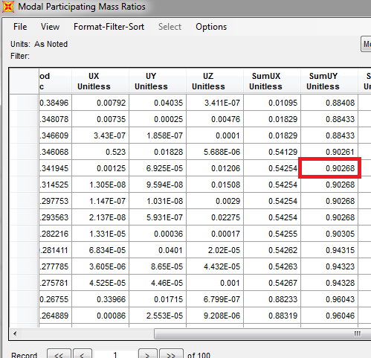
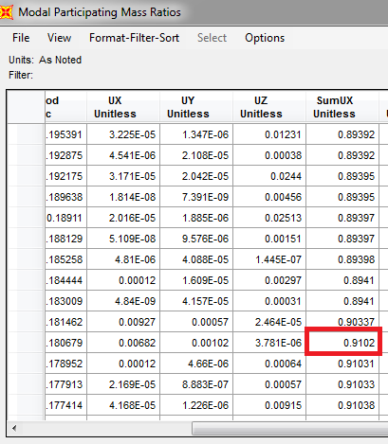
Mass participation ratio
Summation of modes in X and Y is greater than 90%

Slide 59
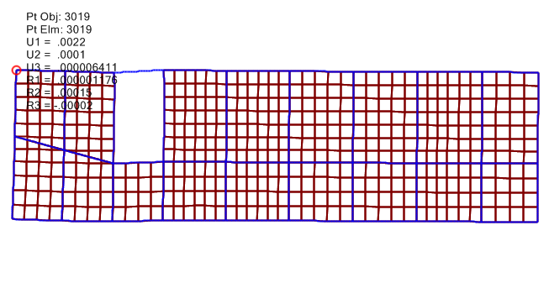
Drift check
In y-direction :
Lateral Drift in y-direction for the First End Point

Slide 60

Drift check
Ux at the first end = 0.00224m
Ux at the second end = 0.0022m
Ux at the midpoint = 0.0022m
Since Ux at the midpoint <
so the diaphragm rigid in x- direction .
In x-direction :
Uy at the first end = 0.001m
Uy at the second end = 0.00003m
Uy at the midpoint = 0.000047m
Since Uy at the midpoint < so the diaphragm rigid in y- direction .

Slide 61
Drift check
The time of structure is less than 0.7 sec, the calculated story drift shall not exceed 0.025 times the story height.
Δ allowable= L/50 = 3.5/50 *1000 = 70mm. < 0.025*3.5*1000 = 87.5mm.
In X-direction:
From SAP, ΔS = 1.06 mm
ΔM = 0.7*5.5*1.06 = 4.081 mm
ΔM < ΔM allowable.
In Y-direction:
From SAP, ΔS = 1.27mm
ΔM = 0.7*5.5*1.27 = 4.9mm
ΔM < ΔM allowable.

Slide 62
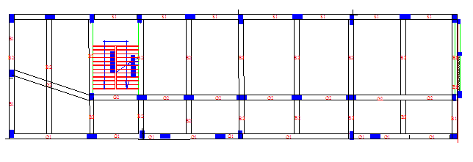
Structural Design of Concrete Members

Slide 63
Structural Design of Concrete Members
The code used for design and detailing is ACI 318-11 regarding seismic and gravity loads.
The structural system is Building Frame System
( Intermediate Frames ).
Provisions were applied to all structural members including:
  Beams
  Columns
  Shear Walls
  Foundations

Slide 64
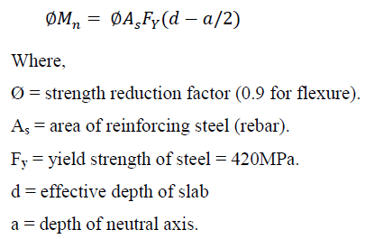

Structural Design of Concrete Members
Design and Detailing of Slabs :
Flexural Capacity of slabs is given by:
Shear Capacity of concrete is given by:

Slide 65

Structural Design of Concrete Members
Sample Design for Slabs :
The GF Slab is going to be designed
Dimensions : Strip width = 1000mm, h = 200mm, d = 160mm
Design in x and y direction:
Ultimate Moment (M_{u}) = 23 kN.m
Reinforcement Ratio =
A_{s,required} = 342.4 mm²/m < A_{s,minimum} = 390 mm2/m
A_{s,used} = 390 mm²/m (4Ø 12mm) (2 Layers)
Ultimate Shear (V_{u}) = 45 kN < Shear Capacity (ØV_{c}) = 105.3 kN
NO need for Shear reinforcement.

Slide 66


Structural Design of Concrete Members
Sample Design for Slabs :
For Ø 12Top Steel, Lap Splice = 1.3 X (L_{dt} ) = 600mm
For Ø 12 Bottom Steel, Lap Splice = L_{dt} = 500mm

Slide 67

Structural Design of Concrete Members
Sample Design for Slabs :
When the longitudinal bar ends
with a beam use 90º hook;
Development (L_{dh} ) = 180mm
Bent Radius = 40mm
Hook Length = 150mm
When the longitudinal bar ends
with a Shear Wall use 180º hook;
Development (L_{dh} ) = 180mm
Bent Radius = 40mm

Slide 68


Structural Design of Concrete Members
Design and Detailing of Intermediate Beams :
Positive moment strength at joints shall be at least one third the negative moment strength.
Negative and positive moment strength at any section shall be at least one fifth the moment strength at joints.
Hoops shall be provided at a distance (2h) from the joints with a spacing equals the minimum of
Other hoops shall be spaced not more than (d/2)

Slide 69



Structural Design of Concrete Members
Sample Design for Beams :
The beam to be designed is (B2) in third floor.
Dimensions : B =400mm, h =400mm, d =360mm, Span =5.7m
Ultimate Moment (M_{u})= 174 kN.m, Ultimate Shear (V_{u})= 154.4 kN
Reinforcement ratio
Area of steel =1876 mm^2
Design results obtained from SAP2000 are OK

Slide 70

Structural Design of Concrete Members
Sample Design for Beams :
For Top Steel, 2Ø16 are provided as continuous bars A_{s}=402mm²
Cut-off bars at a distance of (l_{n}/3) = 2m are used for the remaining area A_{s}= 1643-402 = 1241mm², use 4Ø20.
For Bottom Steel, A_{s}=1302mm², use 4Ø12.
Spacing of Hoops = 80mm (at a distance 2h from joints faces).
Spacing of other Hoops = 150mm.

Slide 71

Structural Design of Concrete Members
  The following figure shows the column to be checked.

Slide 72



Structural Design of Concrete Members
Design and Detailing of Columns :
Spacing (S_{o}) shall be provided at both ends for length (L_{o}):
Max. vertical spacing outside (L_{o}):

Slide 73


Structural Design of Concrete Members
Sample Design for Columns :
The Column to be designed is (C3)
in GF.
Dimensions : (600X400)mm
Clear Length = 3.1m
Ultimate Moment (M_{u})= 59.8 kN.m
Ultimate Axial (P_{u})= 1905 kN
Axial Capacity (Ø P_{n,max}) = 3500 kN
Reinforcement Ratio = 1%
A_{s} = 2400 mm² (16 Ø 14)

Slide 74



Structural Design of Concrete Members
Sample Design for Columns :
For Ø 14, Lap Splice = 800mm
Distance (L_{o}) = 700mm
Spacing (S_{o}) = 100mm
Spacing outside (L_{o}) = 200mm

Slide 75

Design of footing
single footing are used :
According to soil test, the allowable bearing capacity for the soil is 250 kN/m2.
Choose F3 that carries C17 to be a designed sample for single footing:

Slide 76


Slide 77


Slide 78



Checks

Slide 79



Slide 80




Slide 81



Slide 82


Slide 83


Slide 84



Slide 85


Design of wall footing

Slide 86


Design of wall footing

Slide 87


Design of wall footing

Slide 88

Design of wall footing

Slide 89

Design of wall footing

Slide 90


Slide 91



Slide 92


