Slide 1


FOUNDATION DESIGN for a COMMERCIAL
MALL in - NABLUS
By:
Amr Jumaa
Angham Kiwan
Jaser Qadous
Saji Alahmad
Under supervision :
Dr Mohammad Ghazal

Slide 2
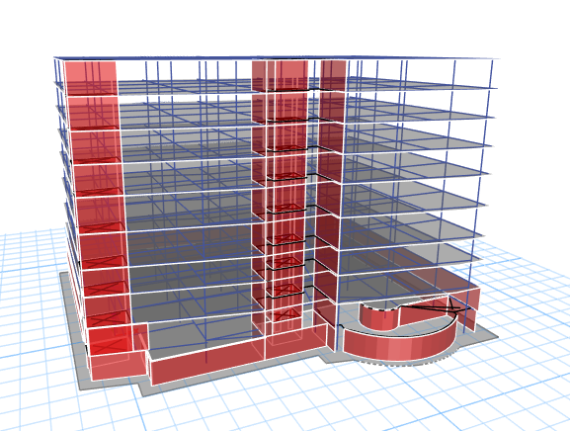
3D ETABS model

Slide 3
Outline:
Introduction
Objectives
Methodology
Analysis
Design
Results and Conclusion

Slide 4
Introduction
foundations is the most important part of a building .it provides a uniform base for the superstructure and transfers the load down to the soil below it uniformly. there ‘s two types of foundations shallow and deep foundations.

Slide 5
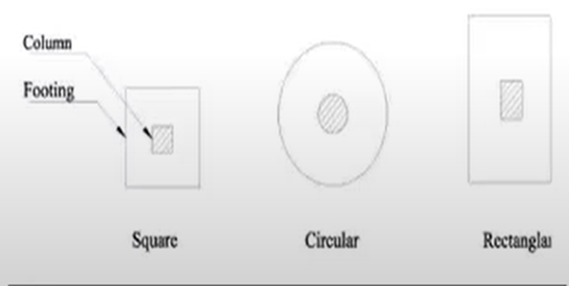
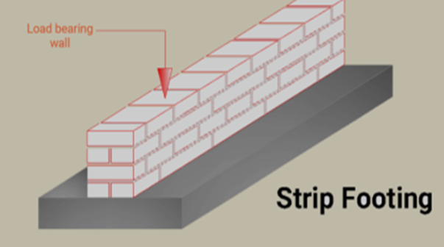
Shallow foundation:
Isolated footing:
Wall or strip footing:

Slide 6
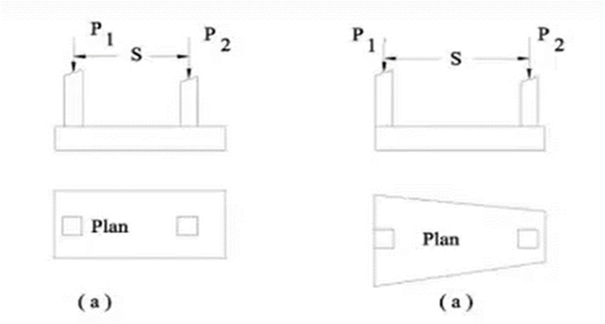
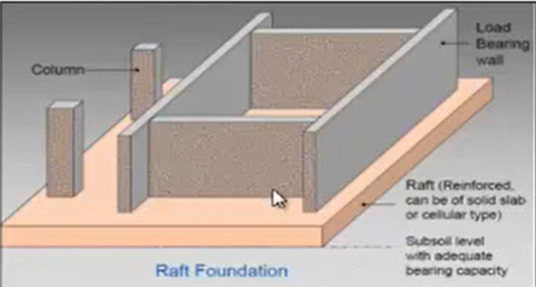
Combined footing
Raft(mat) foundation

Slide 7
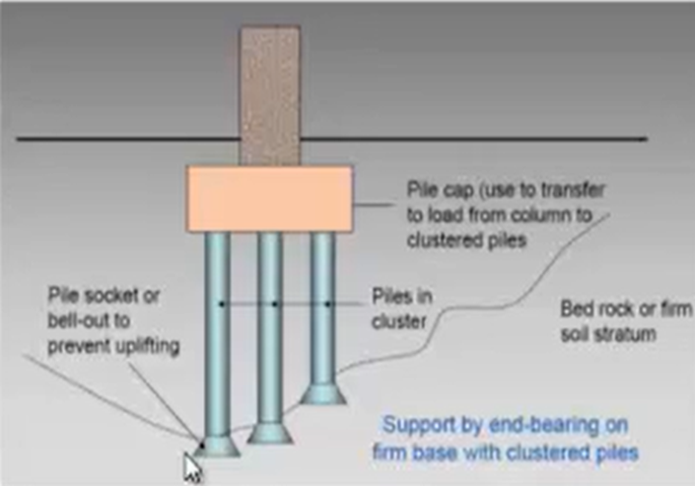
Deep foundation:
Deep foundations are a form of foundations using piles to transfer the loads of a structure down to a firm soil stratum with sufficient load -taking capacity.
Pile foundations

Slide 8
Selection of type of foundations for a building depends on :
Nature of soil
load from the structure.
The allotted cost of foundations.
The available technology.

Slide 9
Therefore, to decide the type of foundation, subsoil exploration must be carried out. Then the soil characteristics within the affected zone below the building should be carefully evaluated. The allowable bearing capacity of the affected soil stress should then be estimated

Slide 10
Objectives
This project aims to analyze and design suitable foundation system for a Commercial mall located at Rafidia Street. The building consists of 10 stories with 1200 meter square plan area of each story.

Slide 11
Methodology
Description of the building.
ETABS was used to analyze and design the structure .

Slide 12
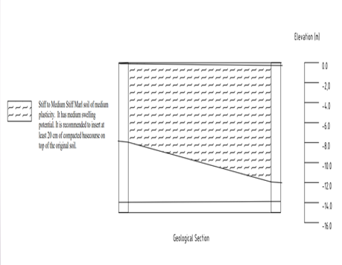
Analysis
Site Description
The soil at the site from geotechnical point of view is Stiff to Medium Stiff Marl soil of medium plasticity. It has medium swelling potential.
Soil Report Recommendation
The top soil layer should be improved by 20 cm base course compacted according to standards, the bearing capacity is 300 KN/m² (3 kg/cm²) .

Slide 13
Description of loads:
The load will be considered as: lateral loads, which come from the soil, that affect on the story of building and gravity loads which are vertical loads that’s effect on structure.

Slide 14
Gravity loads are divided to two types:
Dead load:
Superimposed dead load(SD)→7KN/m²
Live load:
basement 1,2 ( passenger vehicles)=1.92 KN/m² →3KN/m²
Office use and other floor 3KN/m2

Slide 15

Lateral loads:
Seismic loads
The building is in Nablus City, Palestine. Then according to seismic hazard map for Palestine with 2% probability of exceedance in 50 years, the building is within the following conditions that are discussed in the following paragraphs.
according to UBC code.
Soil profile type is (Sc) → (from soil report)
Base shear(V)= (Cv*I*W)/(R*T)
V(max)=(2.5*Ca*I*W)/R
V(min)=(0.11*Ca*I*W)

Slide 16
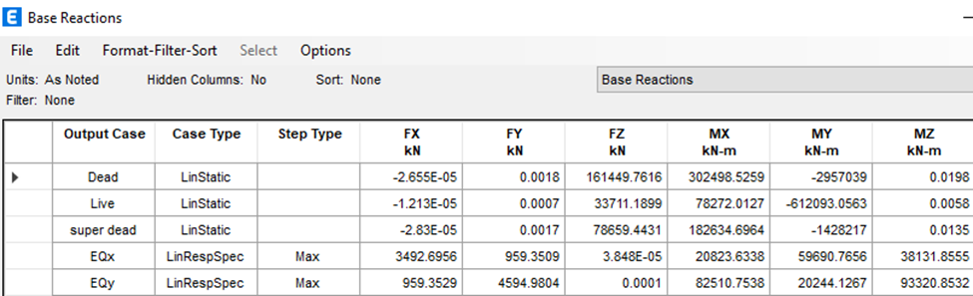
Lateral loads:
Seismic loads
Ca= 0.24 and Cv=0.32
Importance factor(I)=1
Weight(W) = dead load + super imposed
+( 0.25*LL) → from ETABS
W= 114,274+(0.25*33,680) +78,588=201,282KN
Response or ductility factor(R)= 6.5
Period(T)= Ct*(h_{n}) ^{(3/4)}
Ct=.0488→→its dual system
h_{n}=(2.75+3+3.25+2.75+3.5+3.5+3+3+3+3) =30.75
T= 30.75*.0488=0.637 Sec

Slide 17
Design
The summation of isolated area is more than 50% of the area of the plan site ,so the most appropriate foundation system for this project is mat foundation.
Bearing capacity of soil = 300 KN/m².

Slide 18
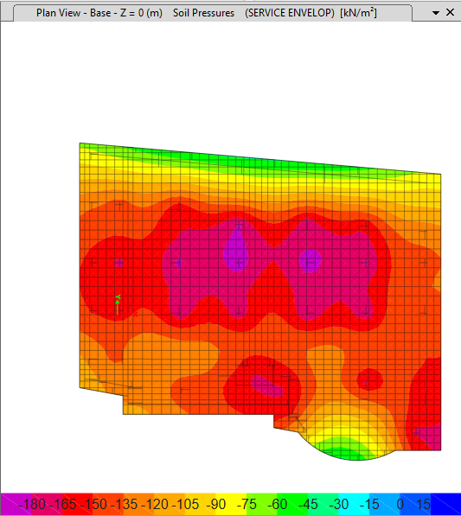
Design
Checks
1.Soil Failure Check
all pressures under the mat is compression and between range (45-180) KN/m² which are less than bearing capacity of soil (300 KN/m²).
Maximum soil pressure =
180 kN/m² <300 kN/m²
so 125 cm thickness is ok.

Slide 19
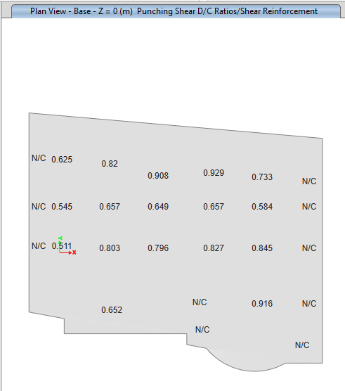
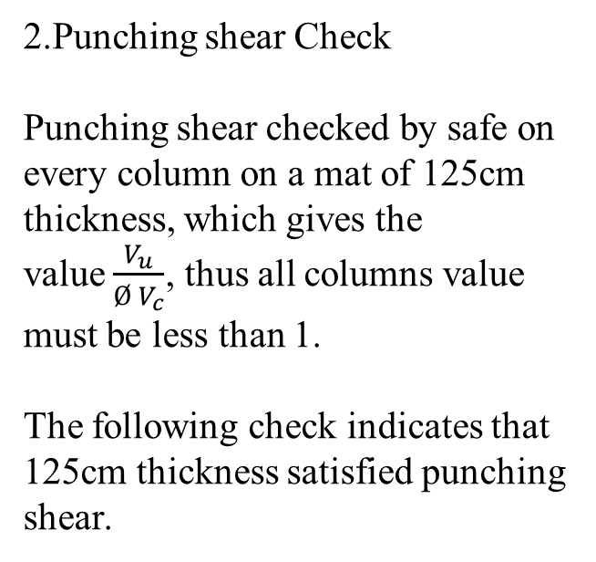
Design
2.Punching shear Check
Punching shear checked by safe on every column on a mat of 125cm thickness, which gives the value$\frac{V_{u}}{Ø V_{c}}$, thus all columns value must be less than 1.
The following check indicates that 125cm thickness satisfied punching shear.

Slide 20
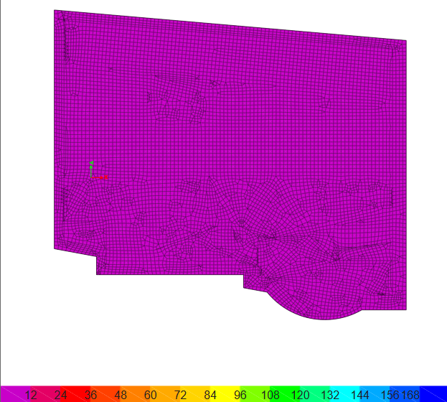
Design
3.Deformed Shape
all displacement is less than 10 mm, which is allowable deformation for mat foundation.

Slide 21
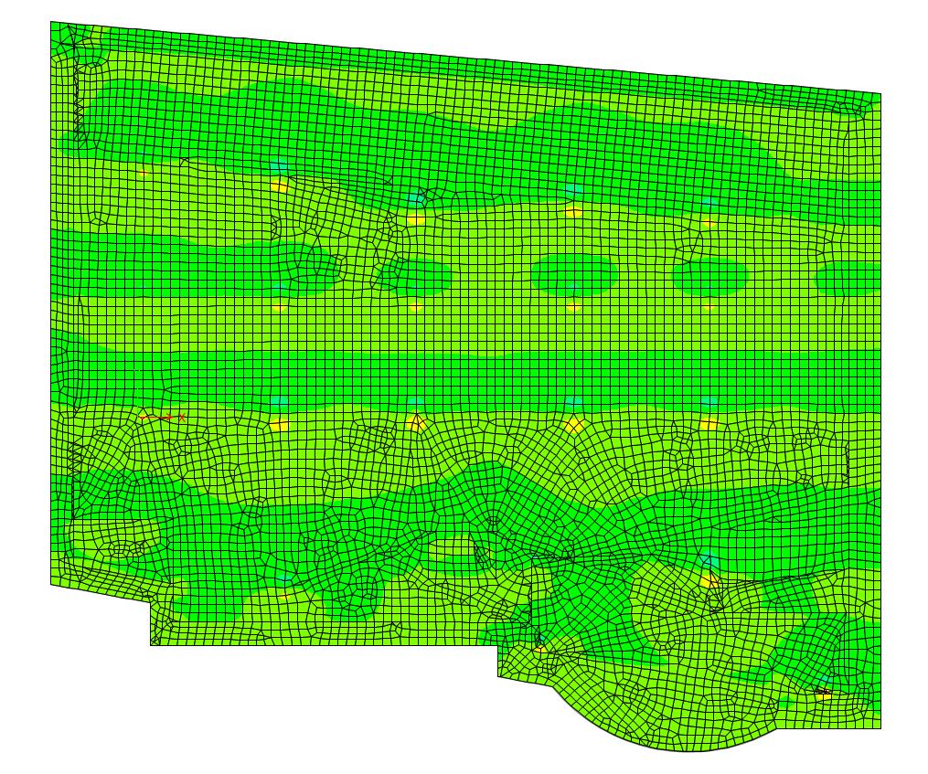
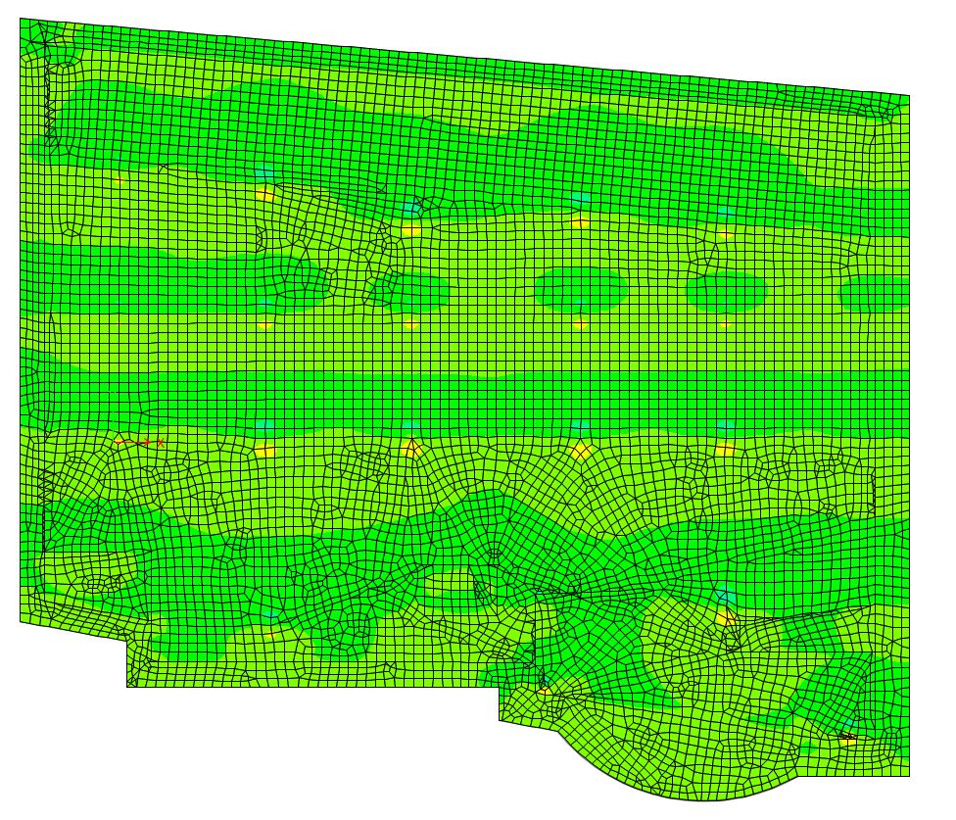
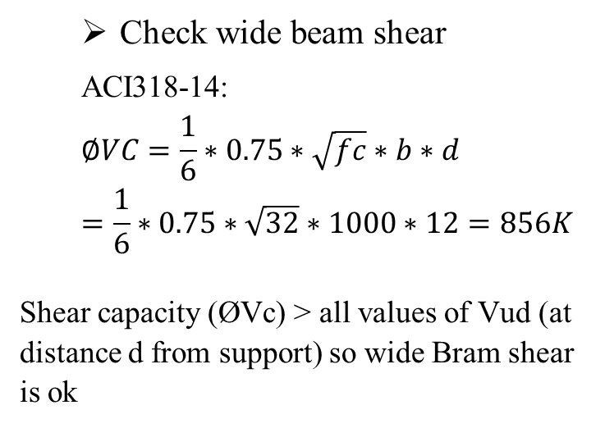
Design
Check wide beam shear
ACI318-14:
$$∅VC=\frac{1}{6}∗0.75∗\sqrt{fc}∗b∗d=\frac{1}{6}∗0.75∗\sqrt{32}∗1000∗12=856K$$
Shear capacity (ØVc) ˃ all values of Vud (at distance d from support) so wide Bram shear is ok
Shear (V13) distribution
Shear (V23) distribution

Slide 22
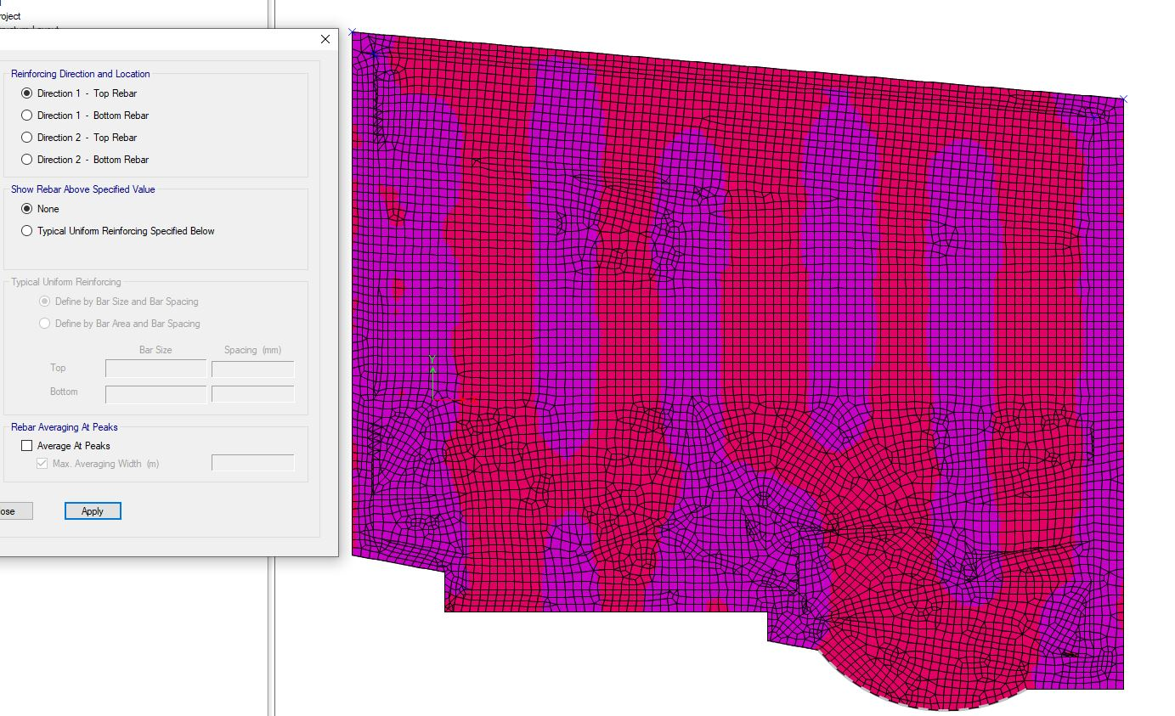
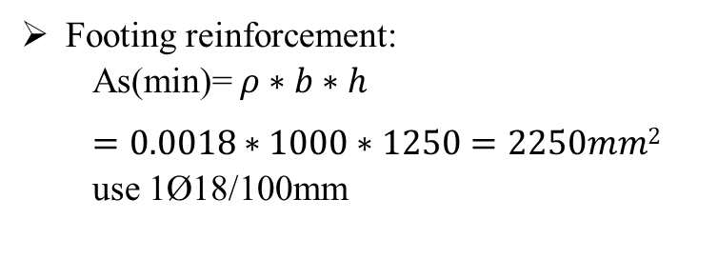
Design
Footing reinforcement:
As(min)= $ρ∗b∗h$
$=0.0018∗1000∗1250=2250mm2$ use 1Ø18/100mm
Top rebar direction-1= As(min)

Slide 23
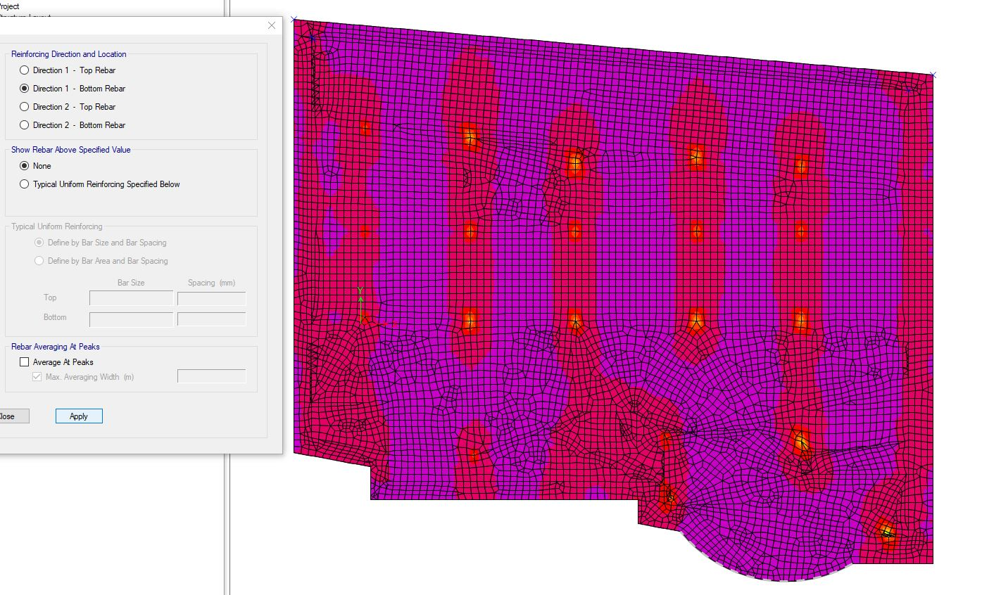
Bottom rebar direction-1= As(min)

Slide 24
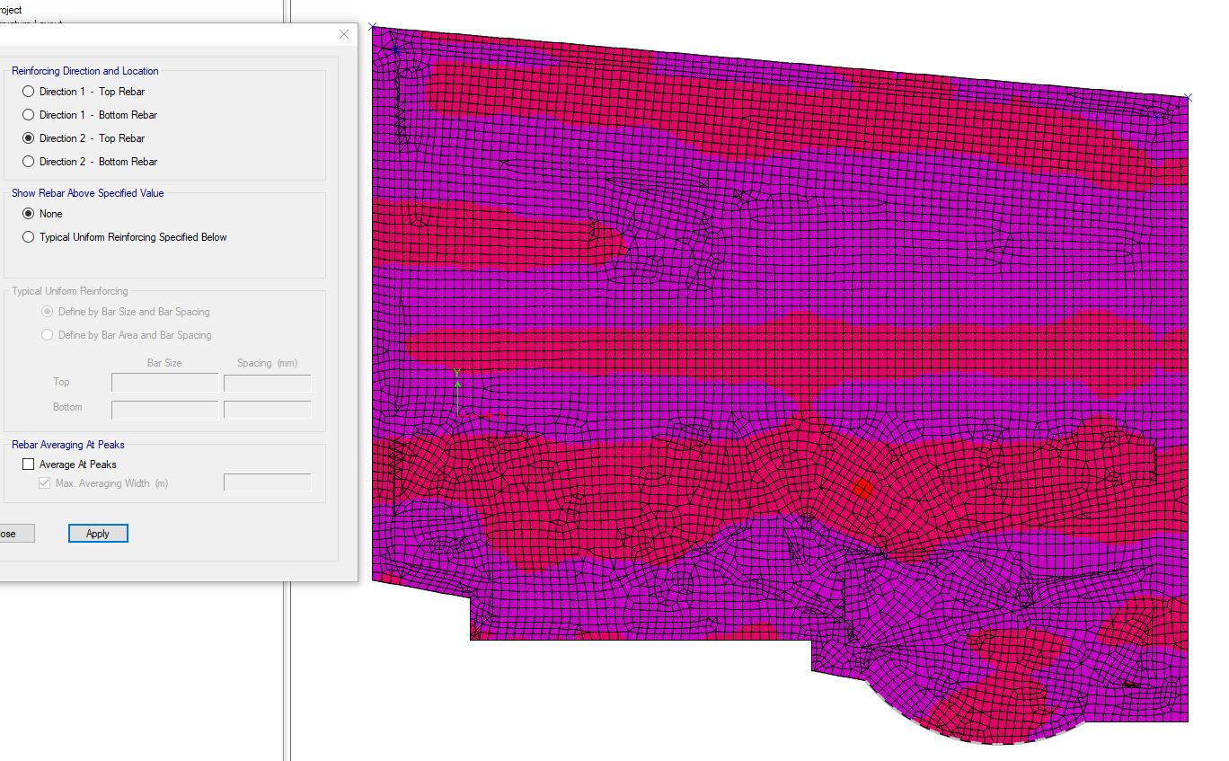
Top rebar direction-2= As(min)

Slide 25
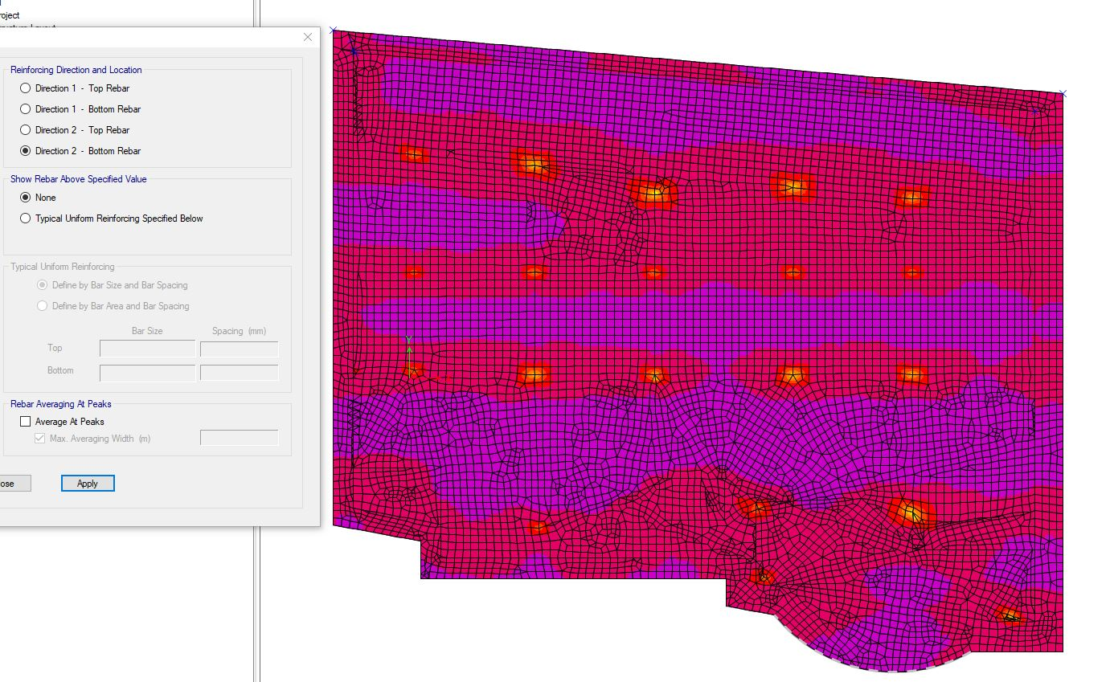
Bottom rebar direction-2 =As(min)

Slide 26
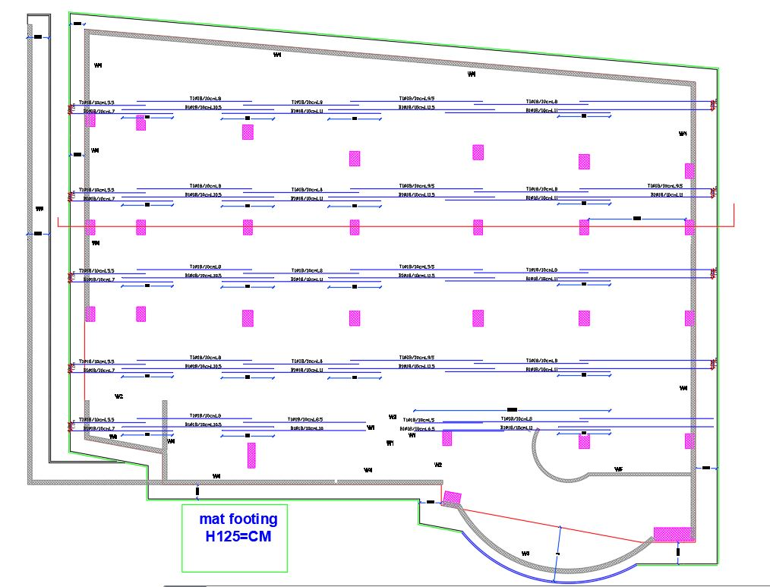
Foundation Reinforcement
The reinforcement of mat foundation in x direction.
use 1Ø18/100mm

Slide 27
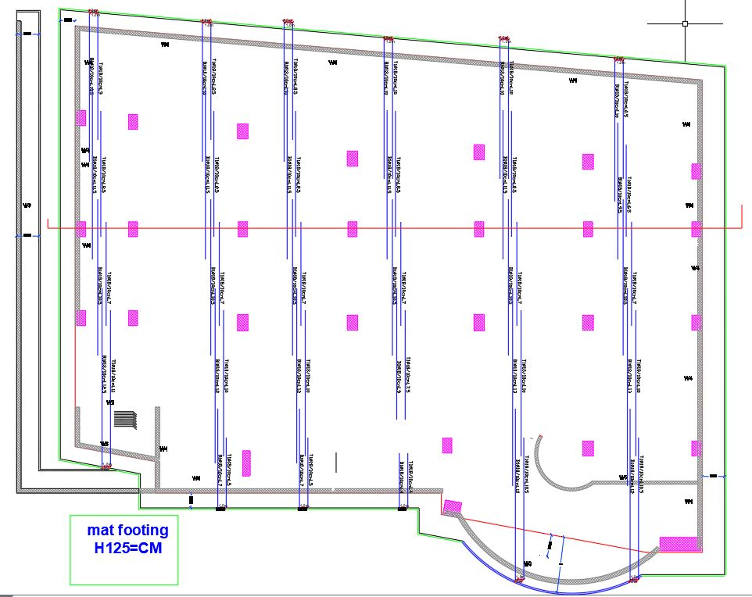
The reinforcement of mat foundation in y direction.
use 1Ø18/100mm

Slide 28
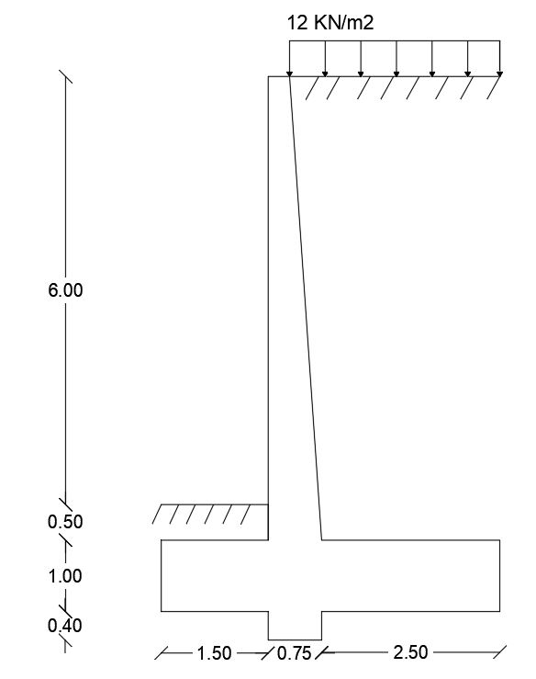
Design of retaining wall
preliminary dimension for retaining wall
γ=20
φ=30
Part | Weight (KN) | Moment arm (KN.m) | Moment(KN.m)
W1 | 118.75 | 2.375 | 282
W2 | 7.5 | 1.875 | 14
W3 | 48.75 | 1.65 | 80.43
W4 | 36.5 | 1.95 | 71.17
W5 | 29.25 | 2.1 | 61.42
W6 | 325 | 3.25 | 1056.25
W7 | 15 | 1 | 15
W8 | 35.4 | 3.025 | 107
sum | 616.5 |  | 1687.27

Slide 29
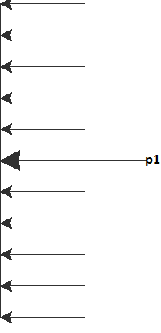
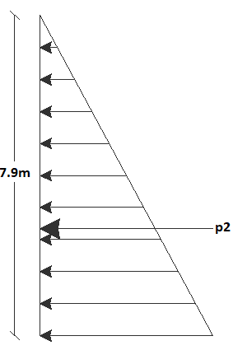
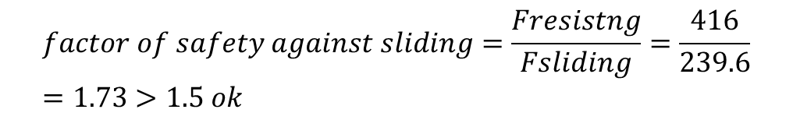
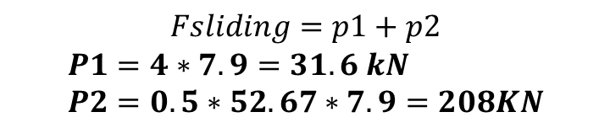
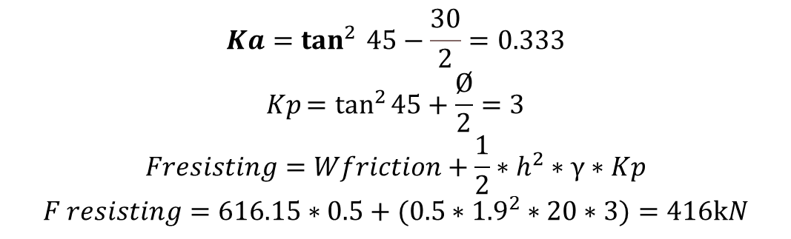
Checks
Check sliding
$$Ka=\tan^{2 }{45−\frac{30}{2}}=0.333$$
$$Kp=\tan^{2}{45+\frac{Ø}{2}}=3$$
$$Fresisting=Wfriction+\frac{1}{2}∗h^{2}∗γ∗Kp$$
$$F resisting=616.15∗0.5+(0.5∗{1.9}^{2}∗20∗3)=416kN$$
$$Fsliding=p1+p2$$
$$P1=4∗7.9=31.6 kN \\ P2=0.5∗52.67∗7.9=208KN$$
$$Fsliding=31.6+208=239.6 KN$$
soil pressure
$$factor of safety against sliding=\frac{Fresistng}{Fsliding}=\frac{416}{239.6}=1.73>1.5 ok$$

Slide 30
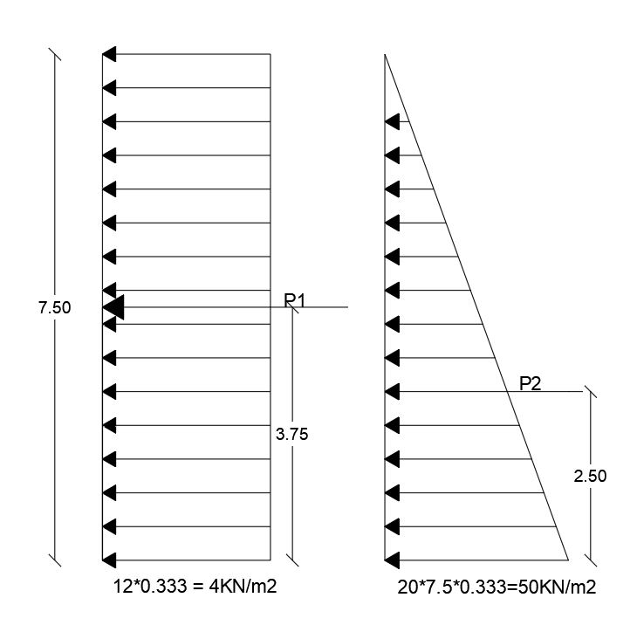
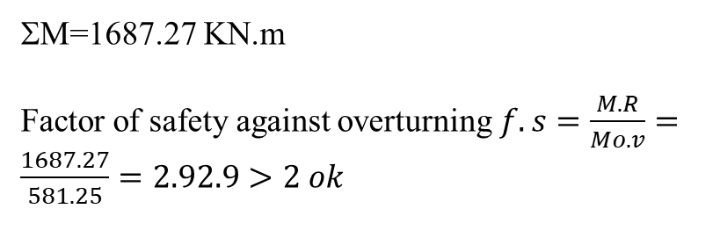
Checks
check overturning
ΣM=1687.27 KN.m
Factor of safety against overturning $f.s=\frac{M.R}{Mo.v}=\frac{1687.27}{581.25}=2.92.9>2 ok$

Slide 31
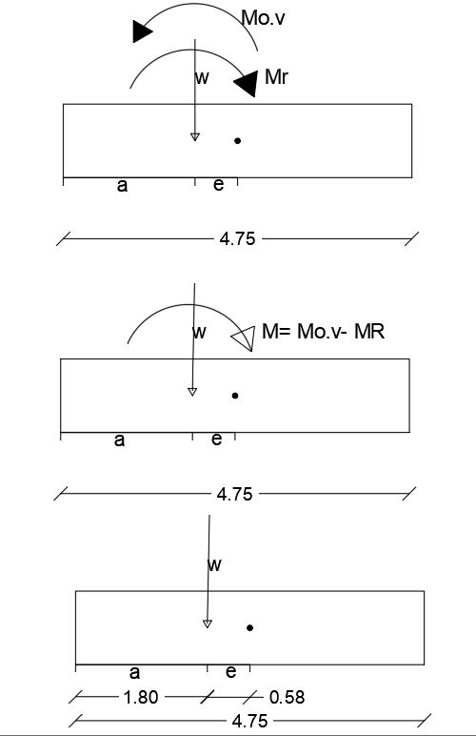
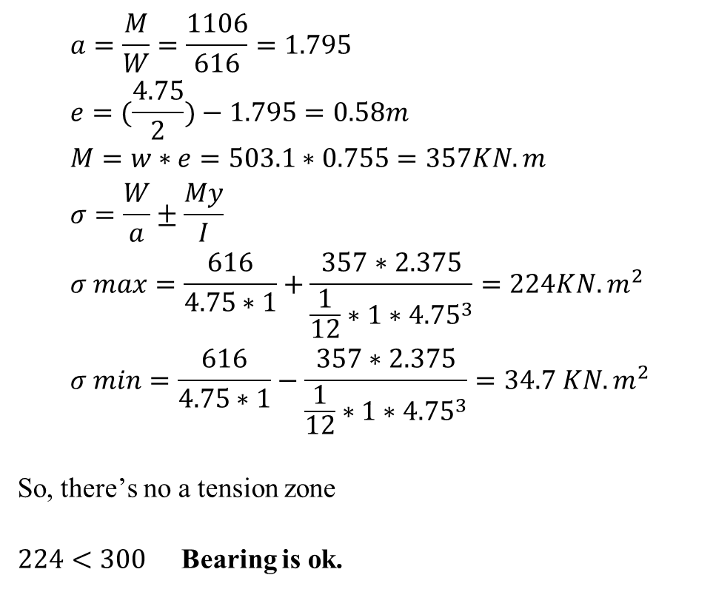
check bearing:
$$a=\frac{M}{W}=\frac{1106}{616}=1.795 \\ e=(\frac{4.75}{2})−1.795=0.58m \\ M=w∗e=503.1∗0.755=357KN.m \\ σ=\frac{W}{a}±\frac{My}{I} \\ σ max=\frac{616}{4.75∗1}+\frac{357∗2.375}{\frac{1}{12}∗1∗{4.75}^{3}}=224KN.m^{2} \\ σ min=\frac{616}{4.75∗1}−\frac{357∗2.375}{\frac{1}{12}∗1∗{4.75}^{3}}=34.7 KN.m^{2}$$
So, there’s no a tension zone
$224<300$ Bearing is ok.

Slide 32
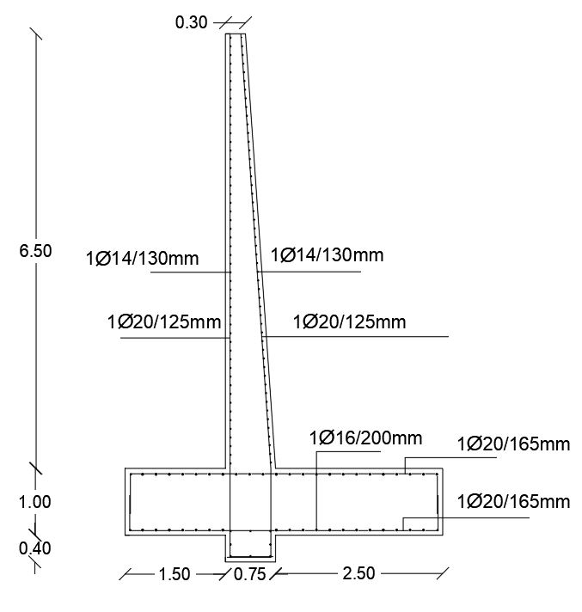
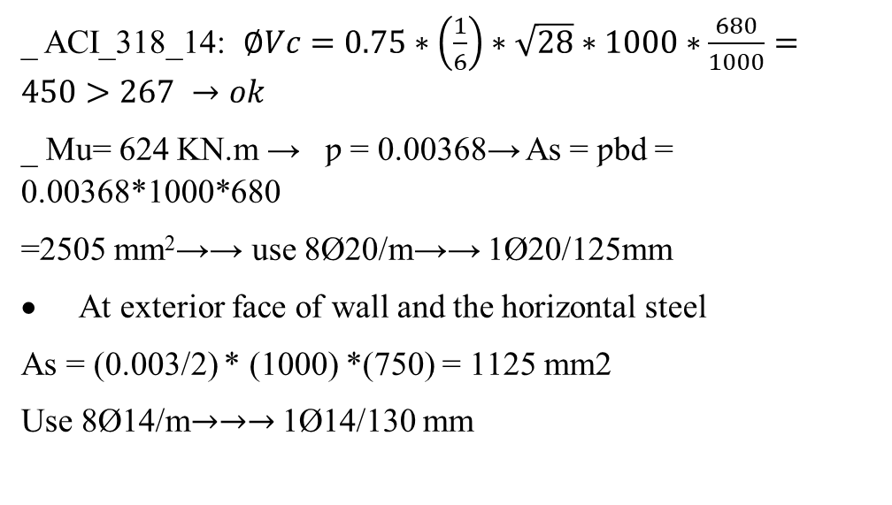
WALL REINFORCMENT
DESIGN OF STEAM:
Thickness(T) =750 mm h= 6.5m d=680mm
Vu = 1.6 * 167 = 267.2 KN
Mu = 1.6 *390 = 624 KN.m
_ ACI_318_14: $∅Vc=0.75∗\left(\frac{1}{6}\right)∗\sqrt{28}∗1000∗\frac{680}{1000}=450>267 →ok$
_ Mu= 624 KN.m → ƿ = 0.00368→ As = ƿbd = 0.00368*1000*680
=2505 mm²→→ use 8Ø20/m→→ 1Ø20/125mm
At exterior face of wall and the horizontal steel
As = (0.003/2) * (1000) *(750) = 1125 mm2
Use 8Ø14/m$→→→$ 1Ø14/130 mm

