Slide 1
Interactive Ruwah graph

Slide 2
This presintation contains
01
03
05
02
04
06
introduction
SYSTEM ARCHITECTURE
CENTRALITY MEASURES
Data base.
Ruwah graph building.
Closeness centrality
Betweenness Centrality
EigenValue
Realted work
INTERACTING WITH THE GRAPH
CONCLUSION

Slide 3
INTRODUCTION

Slide 4
With the continuous achievements in Information Technology and its applications in different life fields, huge amounts of data are generated
Requesting data from historical warehouse is needed in several application.
Prophet Mohammad (Peace Be Upon Him) talks are considered an important source.
The way these Ahadith are saved is by memorizing.

Slide 5
Each Hadith is formed of two parts:
1. The Sanad (the list of Ruwah who participated in narrating the Hadith).
2. The Matn: the talk it self.
This work is related to build up a connected graph for Ruwah.
The work is related to apply a set of graph centrality measures like: Betweennes, Closeness and Eigenvectors.

Slide 6
Outline
Searching &
Graph Building
documenting
Collecting
data
Centrality measurements
Building data Base

Slide 7
RELATED WORK
The authors investigated the opportunity to innovate an automatic Hadith Sanad processing that can help in automatic judgment of Hadith and distinguish between the accepted and rejected Hadith.
Itree the authors reported on a system that automatically generates the transmission chains of a Hadith and graphically display it.

Slide 8
Our contribution in this work can be
summarized as follows:
a
• A simple search mechanism.
• Visualizing the set of Ruwah participating with the searched Rawi in narrating the searched Ahadith.
• The ability to interact with the constructed graph of narrators.
• The ability to compute a set of graph centrality measures.

Slide 9
SYSTEM ARCHITECTURE

Slide 10
Building the database

Slide 11
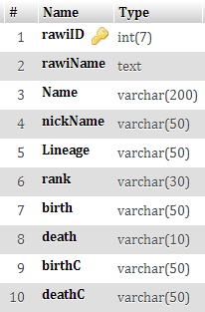
We constructed a database of 50 Ahadith as a sample. The database contains the list of narrators (Sanad) for those 50 Ahadith as well as the Ahadith (Matn) themselves. Moreover, for each Rawi, a list of related information are saved like: Date of Birth, Date of Death,
the places where s/he
lived in and his/her
famous nickname.

Slide 12
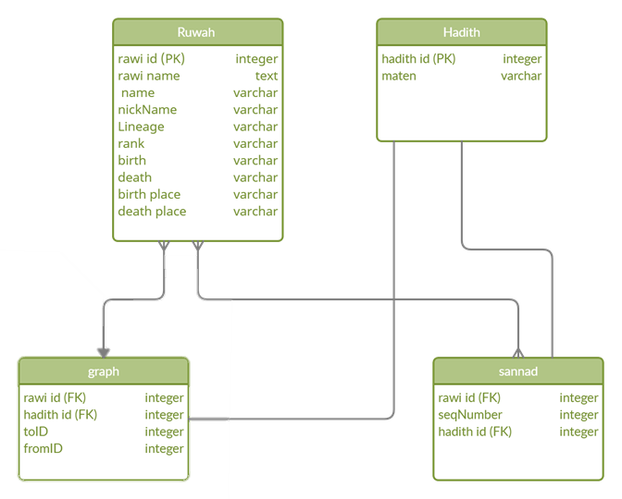

Slide 13
Ruwah graph building

Slide 14
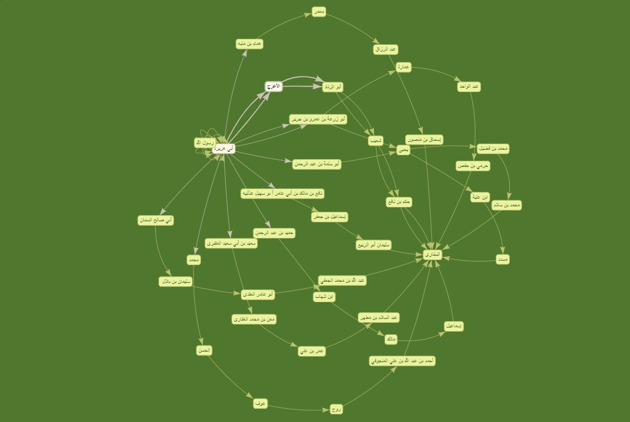

Slide 15

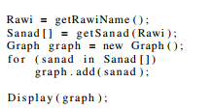
A set of programming techniques and codes were used in visualizing a graph on Ruwah. A JavaScript code with AJAX technique is used to handle the searching for some Rawi.
pseudo code illustrates the
process of graph visualization.
Searching for some Rawi with a specified number of Ahadith.

Slide 16
getRawiName()
array Sanad[ ]
Display(graph)
getSanad(Rawi)
Graph object graph

Slide 17
INTERACTING WITH THE GRAPH

Slide 18
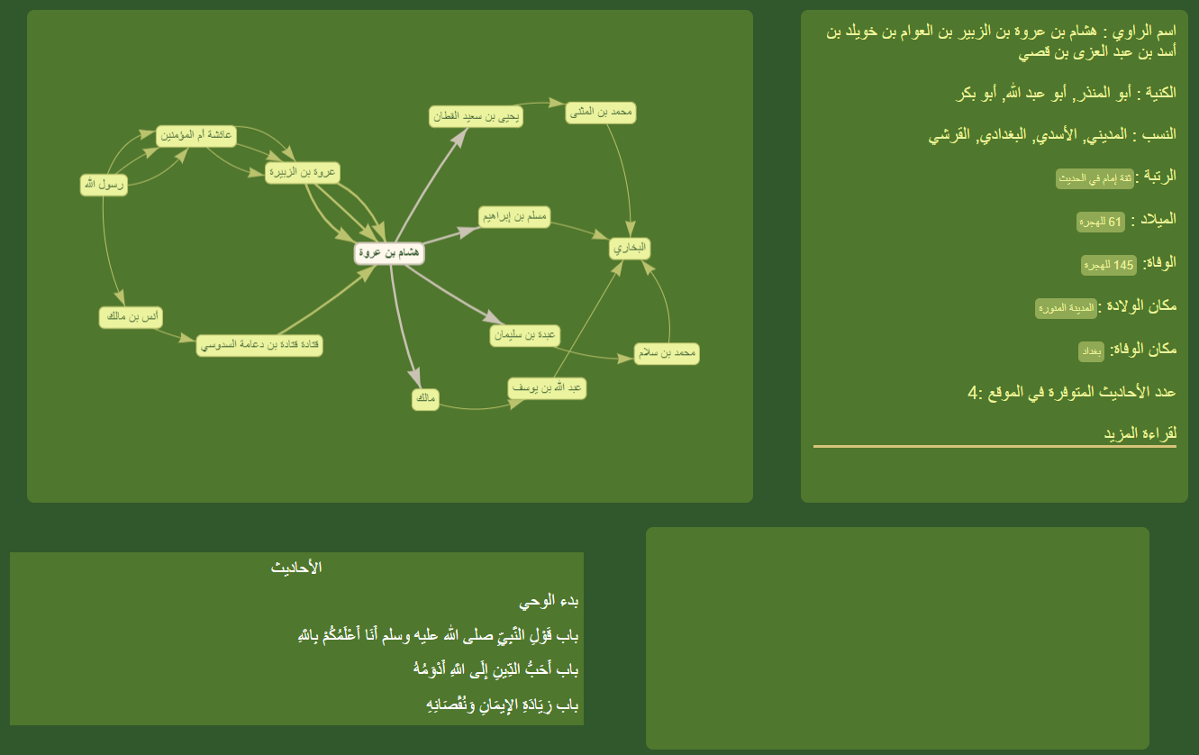
The nodes appear in the generated graph are clickable, in which a user can click one of the nodes to get information from the database regards the clicked node.
Notes:
The user is able for example to click on the birth year of some Rawi, and the system retrieves all Ruwah participating him/her in the birth year. The same for year of death and place of birth

Slide 19
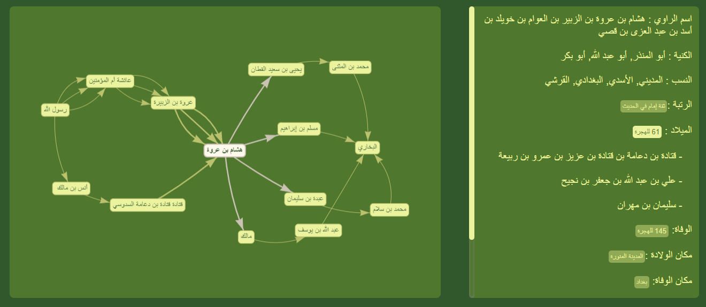
The nodes appear in the generated graph are clickable, in which a user can click one of the nodes to get information from the database regards the clicked node.
Notes:
The user is able for example to click on the birth year of some Rawi, and the system retrieves all Ruwah participating him/her in the birth year. The same for year of death and place of birth

Slide 20
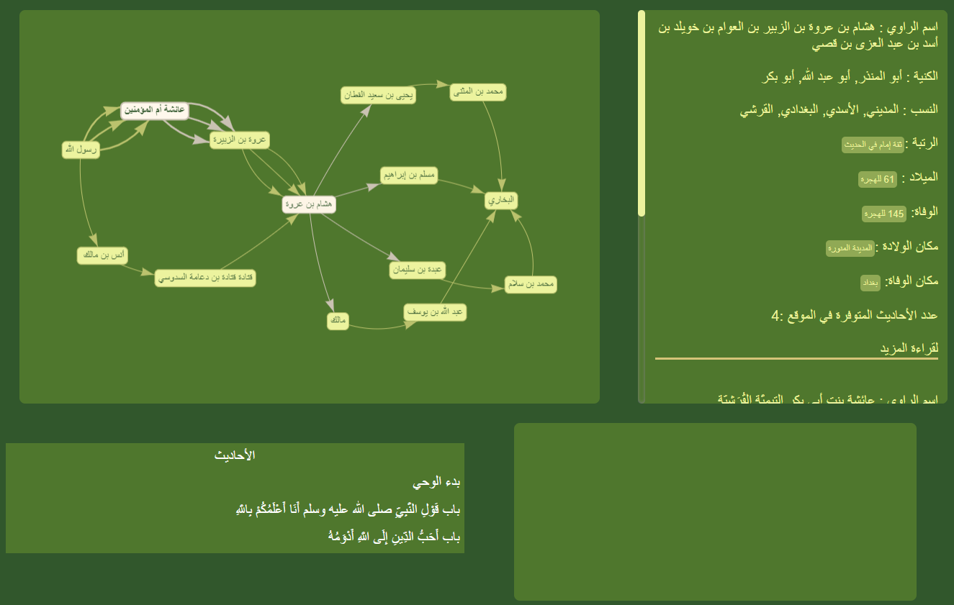
The nodes appear in the generated graph are clickable, in which a user can click one of the nodes to get information from the database regards the clicked node.
Notes:
The user is able for example to click on the birth year of some Rawi, and the system retrieves all Ruwah participating him/her in the birth year. The same for year of death and place of birth

Slide 21
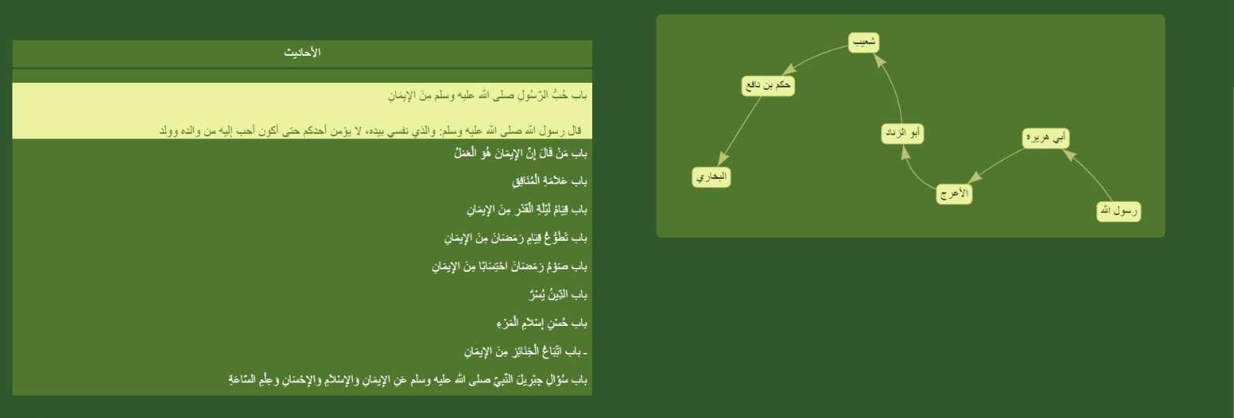
- Draw a small graph contains the sannad for a hadith by clicking on it.
-The Small graph is also clickable and has all the main graph properties.

Slide 22
CENTRALITY MEASURES

Slide 23
these measures emphasize the activity of each Rawi in the process of Narration. for example, with the increase number of in- and out-bound of a given node, this means that the corresponding Rawi has more activity than others in the narration process. In this work, we computed three different centrality measures, mainly: Closeness, Betweenness and EigenValue.

Slide 24
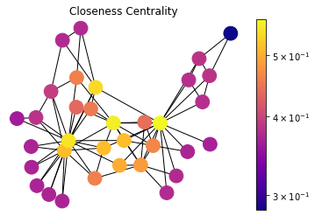
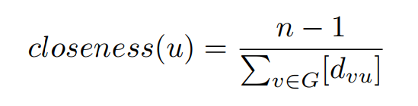
Closeness centrality
In terms of Ruwah, it computes for every Rawi the amount of being closer to other Ruwah that is the Rawi with smallest Closeness means that this Rawi in average narrated most of his/her Ahadith with
the minimum number of Ruwah.

Slide 25
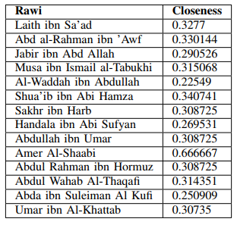

Slide 26
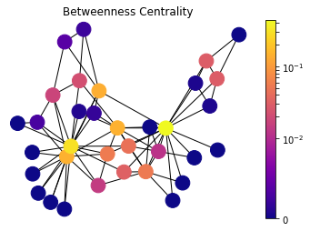
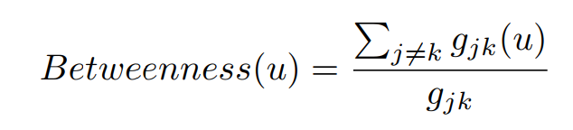
Betweenness Centrality
A Betweenness value of a Rawi measures how many shortest narrations passes through the Rawi and this is important it means that
the Rawi with the biggest value indicates his importance in narrating Ahadith
and the trust worth s/he has

Slide 27
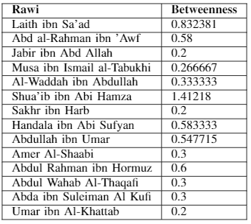

Slide 28
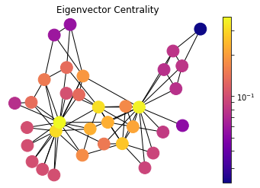
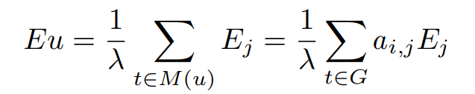
EigenValue
EigenValue quantifies the amount of Rawi importance for the number of narrations transmitted to or by him/her. The Rawi with bigger value indicates a high condense of in- and out-links to his/her corresponding node. In other words, EigenValue in important for sensitivity analysis.

Slide 29
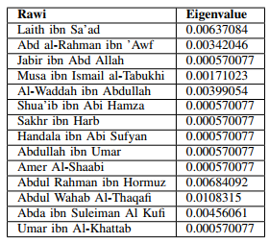

Slide 30
CONCLUSION:
Sanad is the list if narrators involved in narrating the Hadith in which they form a path of narrators.
centrality measures were used to determine the impotence of each node in the graph

Slide 31
Acknowledgment
Working on this project gave us a lot of experience in web based projects and Data Base analyzes. It was a great opportunity, and for that we want to thank the people who helped us and made it easier for us to achieve our goal for this project. We thank All the Professors and lecturers who guided us through our learning process. Special Thanks to our graduation project supervisor ‘Dr. Amjad Hawash’ who helped us guided us through every step of our journey, thank you for your patience and for all your advice. We want to express our deepest gratitude to our families, who we would not to be able to do this without their support.

Slide 32
Thanks
Yara Bsharat
Noor Dabeek
Rama Jaber

