Slide 1

An-Najah National University
Electrical Engineering Department
Charge Controller For PV System
Prepared By:
Ala’a Radwan
Anas Qut
Hussain Ghazi
Supervisors:
Dr. Raed Jabber

Slide 2
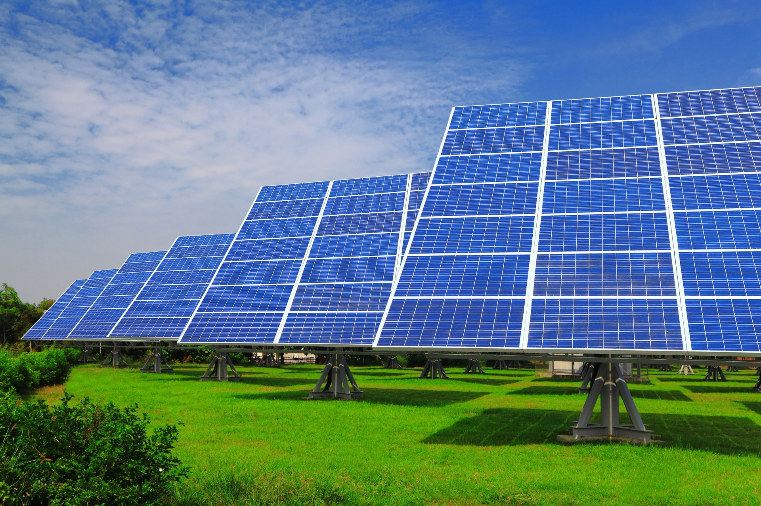
Outline
Over View
Project diagram
Batteries
Buck converter
MOSFET as a Switch
Microcontroller (Adriano)
Measurement instrument
Communication

Slide 3
Over view
Programmable Battery Charge controller
Objectives
Battery Protection from over charge and deep discharge
Increasing life time for batteries and reliability
Communication (the addition for the project)

Slide 4
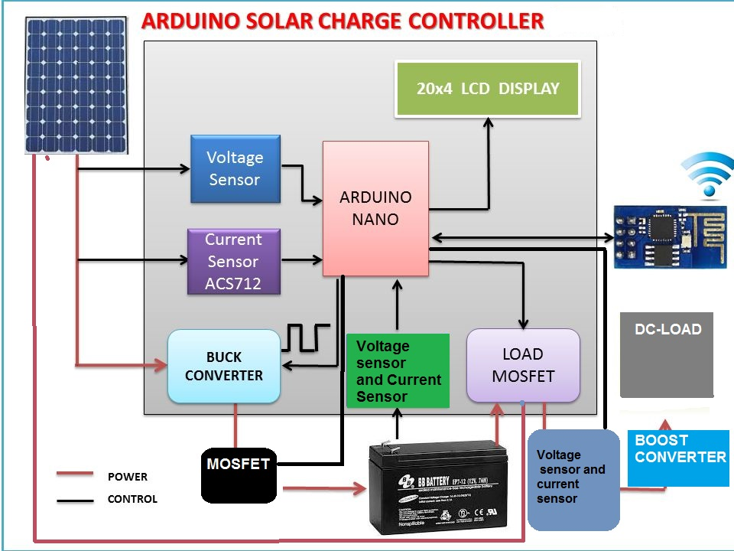
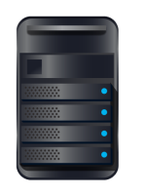
Block diagram of the project
Server

Slide 5
Batteries
Lead acid batteries
Two plates of Lead, cathode and anode
Electrolyte (H2SO4, sulfuric acid and Water H2O)
Capacity depending on battery weight and size(plates area)
Life cycle of charging and discharging , typically around (1000-1100)
Issues for batteries such as Gassing, sulfation and freezing
Notes:
هون حط صورة البوكس

Slide 6
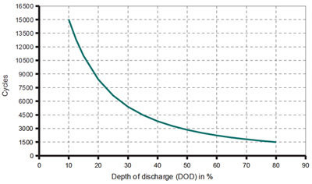
Life cycle of battery VS depth of discharge
DOD

Slide 7
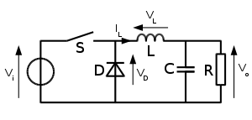
Buck Converter(Basic)
DC-DC Step down converter
Its input is connected to PV terminals and its Output is connected to
battery and load terminals ,
the following circuit diagram for a buck converter
Notes:
هون حط صورة البوكس

Slide 8
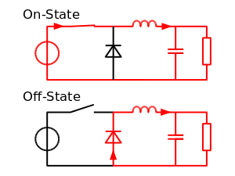
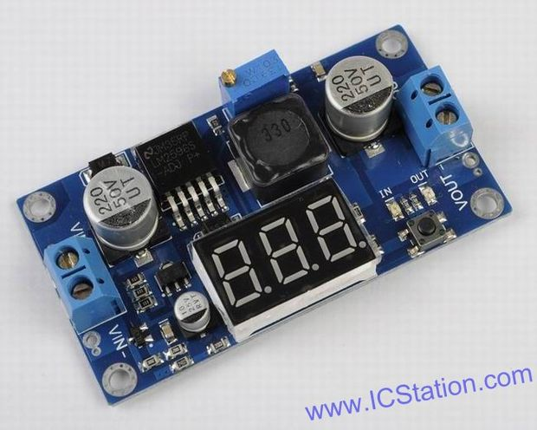
Buck converter

Slide 9

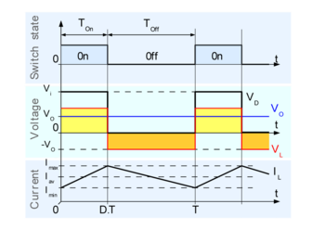
PWM For Buck Converter
Notes:
هون حط صورة البوكس

Slide 10
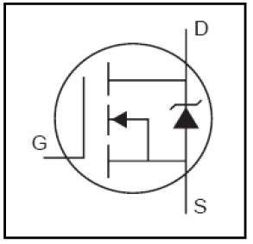
MOSFET as a Switch
The switches which are used in the system would be a MOSFET (Metal Oxide Semiconductor Field Effect Transistor).
most popular transistors used for switching in
circuits.
Why we choose MOSFET?
voltage controlled (little or no current is used)
High Switching frequency (for Buck converter)
MOSFETIRFZ44N
Notes:
هون حط صورة البوكس

Slide 11
MOSFET as a Switch
Where do we use MOSFET in the circuit;
1. After PV Panels ( to get the availability of connect and disconnect the PV panels from the system)
2. Before the battery(to disconnect it when reach's full charge )
3. Before the load(to disconnect the load when there is no enough power to it.
Notes:
هون حط صورة البوكس

Slide 12
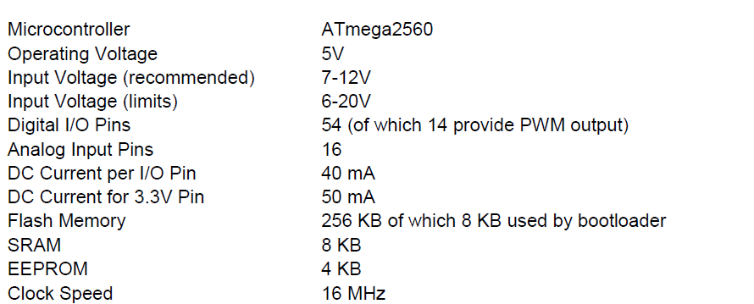
Microcontroller
Arduino Mega2560
Notes:
هون حط صورة البوكس

Slide 13
Main use of Microcontroller
The main purpose of micro controller will be the following
Getting data from sensors that distributed on the over all cct,
Current, voltage and temperature sensors then these data will be processed then a desired calculations will be done.
Such as input power, input energy, approximated battery rate of charge , consumed energy and daily production energy from PV system.
Notes:
هون حط صورة البوكس

Slide 14
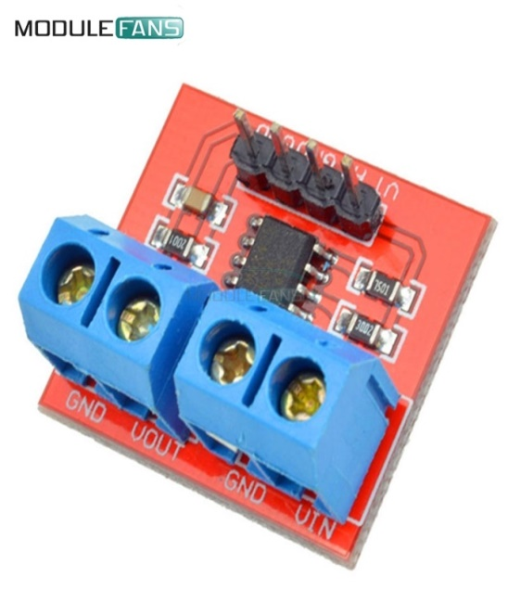
Sensors
voltmeter and current sensors will be implemented in the cct at the input from PV system, On the batteries and on the load.
Also temperature sensors will be implemented in the battery.( to get the battery temperature )
Voltmeter Sensor
Notes:
هون حط صورة البوكس

Slide 15
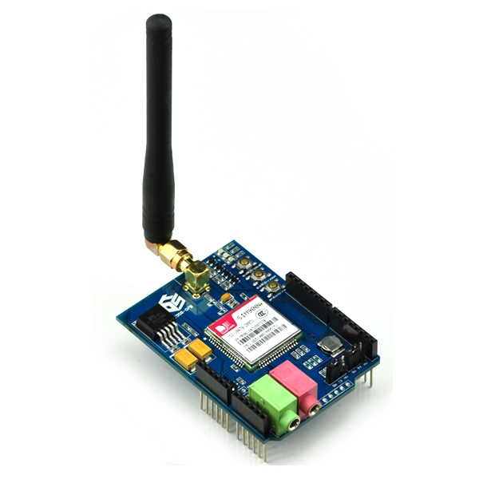
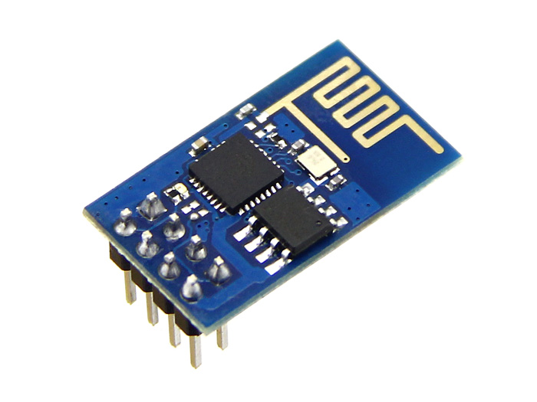
Communication
WIFI sheild
GSM sheild
Notes:
هون حط صورة البوكس

Slide 16
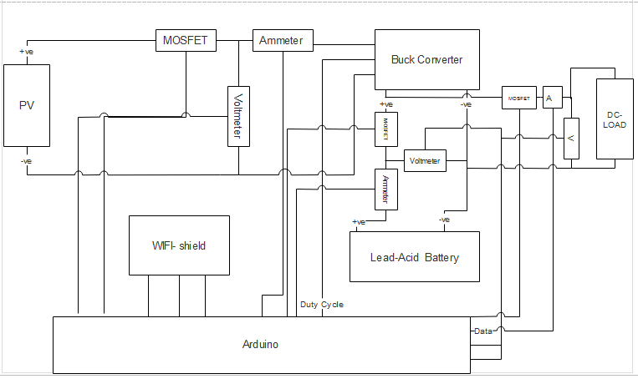
Wiring Block Diagram
Notes:
هون حط صورة البوكس

Slide 17

Questions

