Slide 1
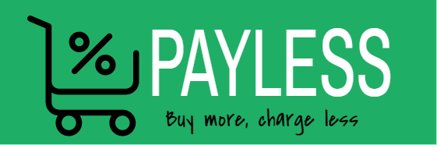
Payless
Bay more charge less
Supervisor:
Maher Abu-baker
Students:
Shatha Jibreel
Tariq Shreem

Slide 2

Outlines
Introduction
Why payless?
System benefits.
competencies.
Tools and technologies .
Revenue stream.
Future plan.
Demo.
Notes:
You have to say what

Slide 3

1
Introduction
Notes:
You have to say what

Slide 4
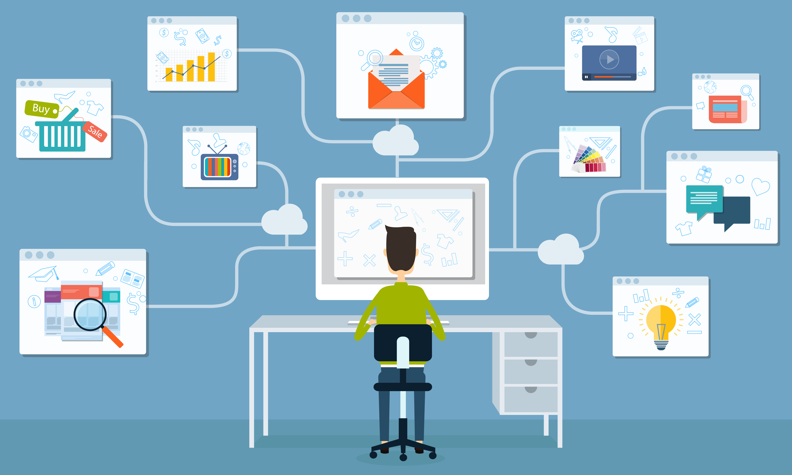
Notes:
You have to say what

Slide 5
2
Why payless?
Notes:
You have to say what

Slide 6

Foreign online shopping system.
Risk of receiving a damaged product.
Latency of receiving the product.

Slide 7
3
System benefits
Notes:
You have to say what

Slide 8

Payless
Save money
Save Time
Free Tax
Easily with less efforts

Slide 9
4
Competencies
Notes:
You have to say what

Slide 10


Payless Competencies
Specialization
Independency
Mobile application
Notes:
You have to say what

Slide 11
5
Tools and technologies
Notes:
You have to say what

Slide 12


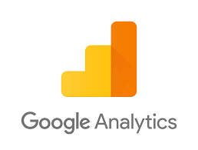

Notes:
You have to say what

Slide 13
6
Revenue stream
Notes:
You have to say what

Slide 14
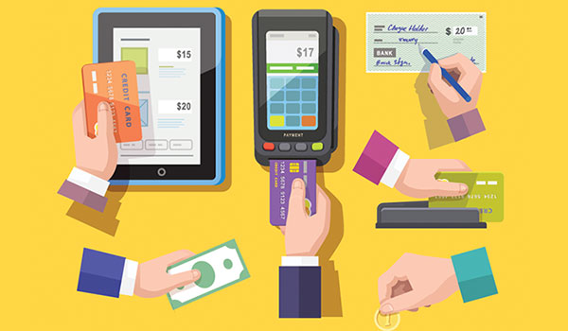
Notes:
You have to say what

Slide 15
7
Future plan
Notes:
You have to say what

Slide 16

Future plan
IOS System
Increasing the number of products we have.
Notes:
You have to say what

Slide 17
8
Demo
Notes:
You have to say what

