Slide 1

Desk-Mate

Slide 2
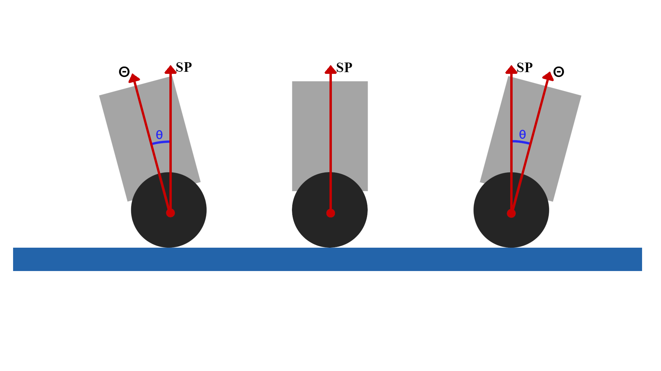
Balancing
ERROR = θ

Slide 3
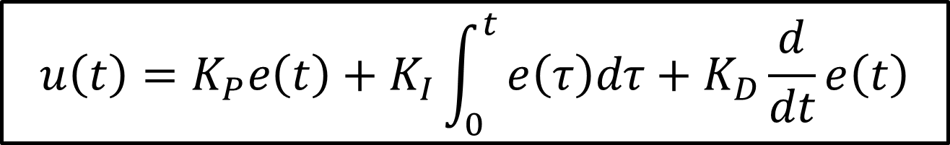
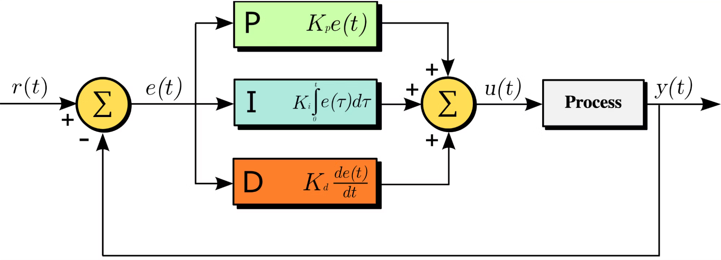
PID Controller

Slide 4
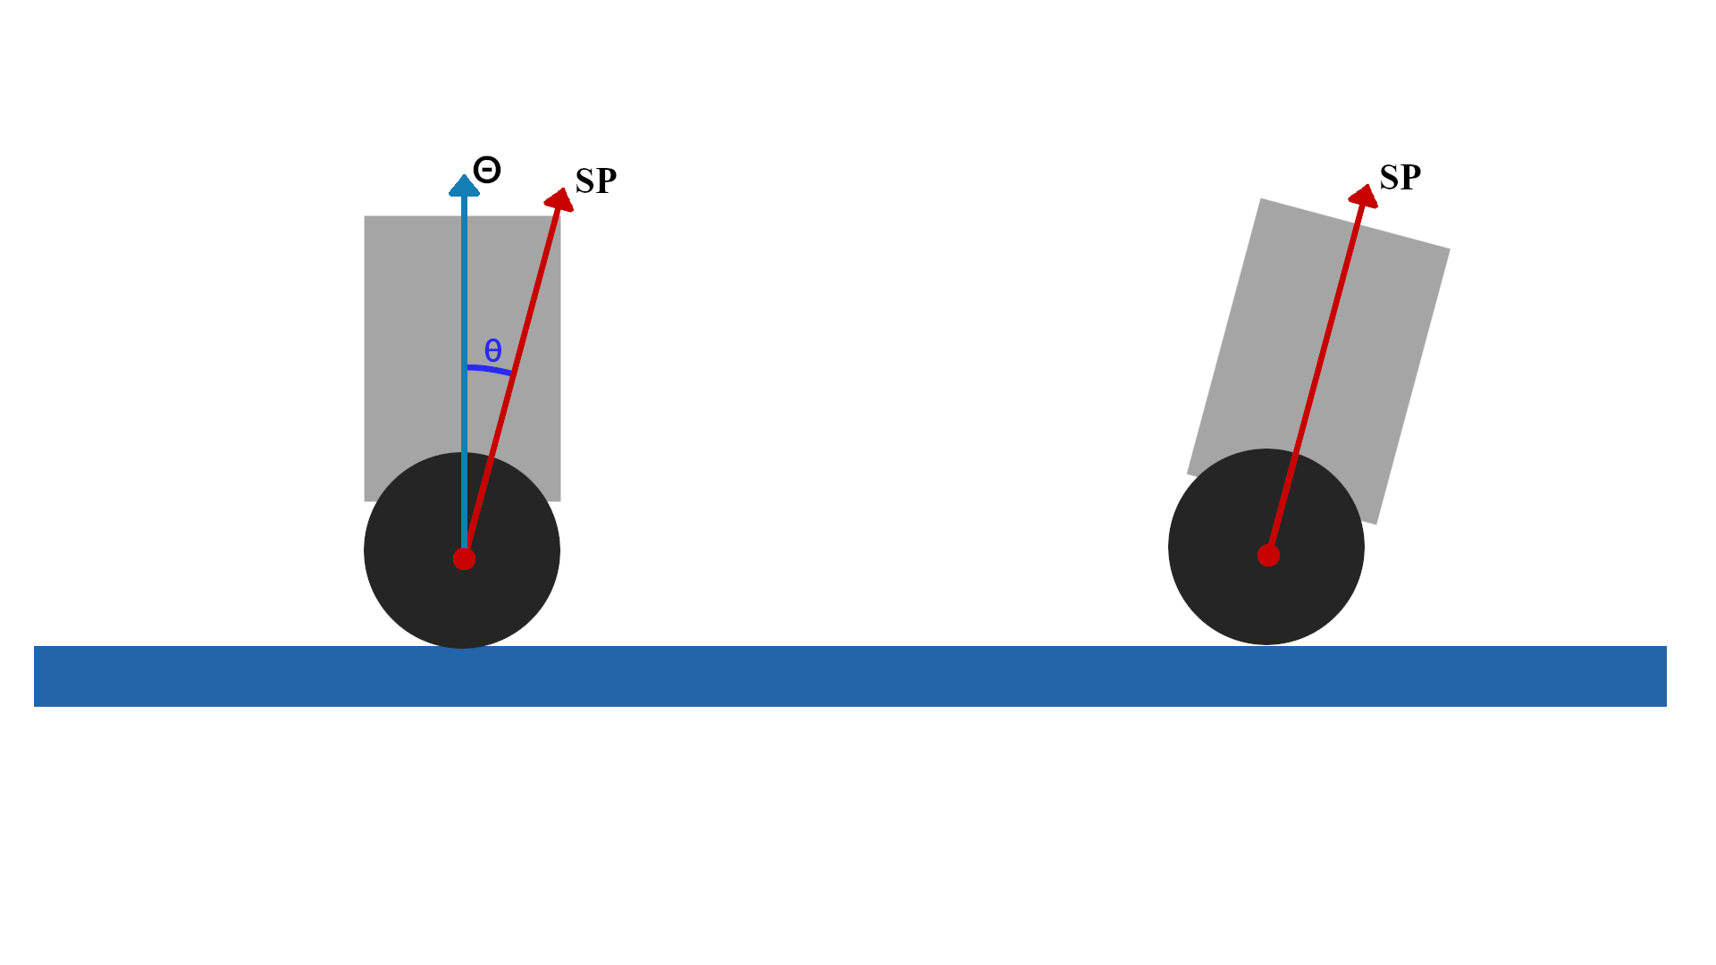
Moving While Balancing

Slide 5

Rotating While Balancing
Compute the base balance motor speed
Set Turn Rate (speed of rotating)
Convert that desired turn into a wheel‐speed offset
Speed Up this motor
•
.Left wheel speed = M + Δ
Slow down this motor
Rotate Clockwise
•
. Right wheel speed = M - Δ

Slide 6
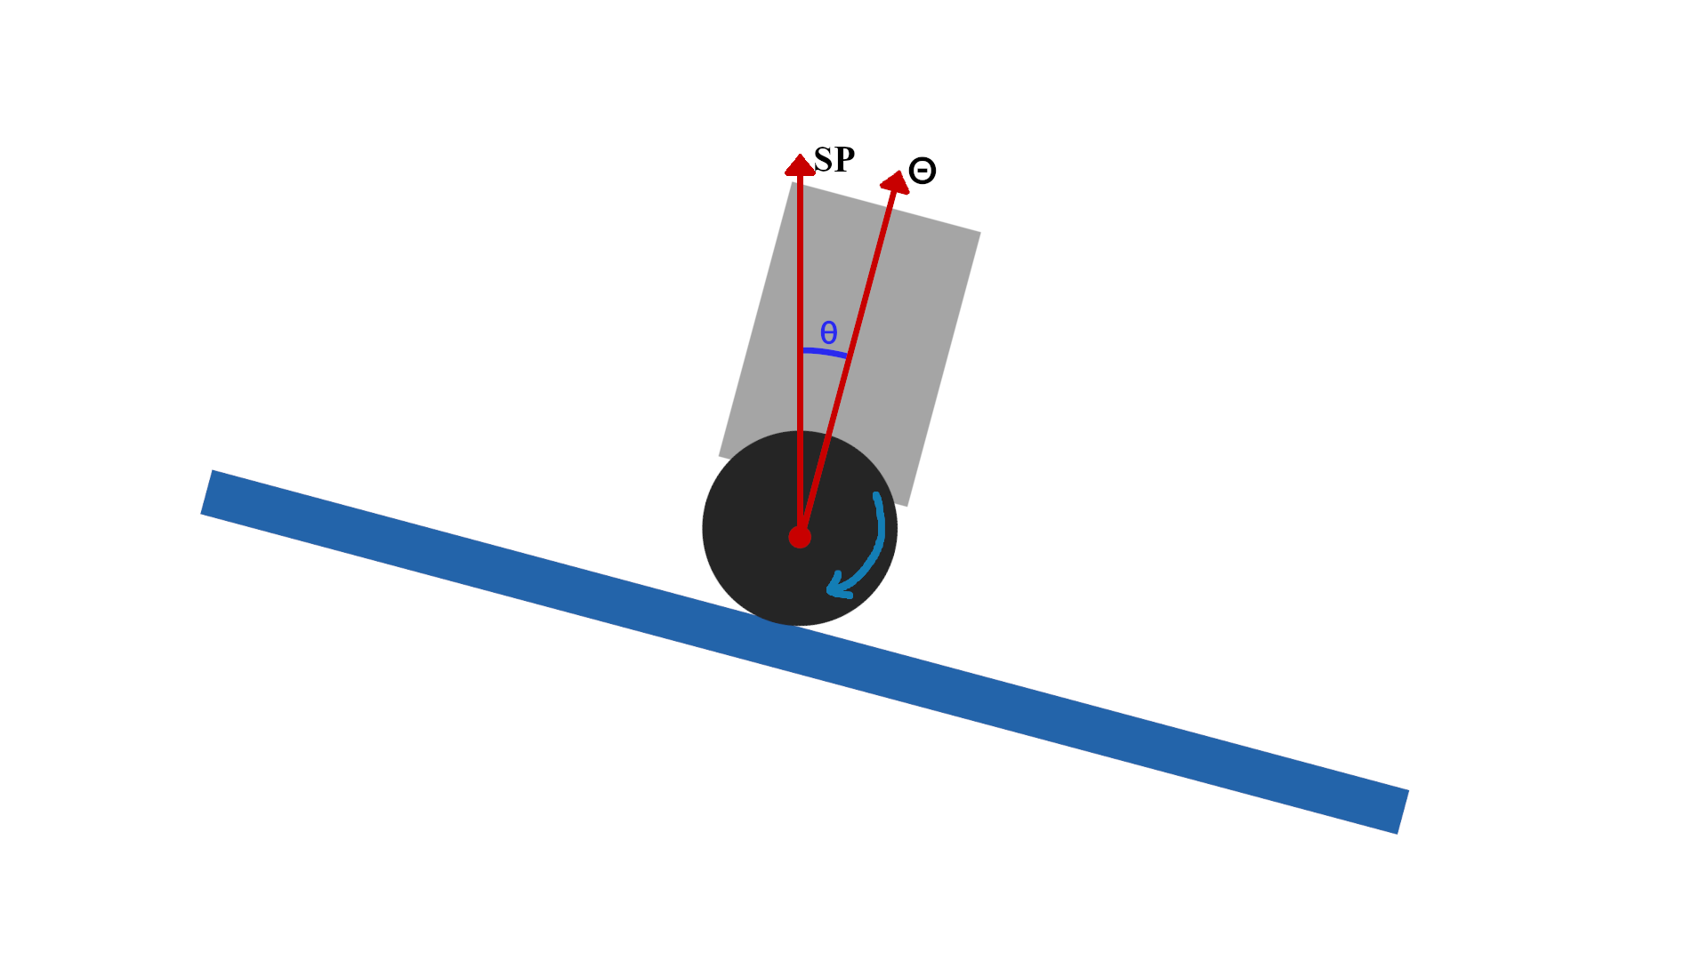
Inclined Desk/Gound Problem
Just small incline (2-3 degrees) is enough to make the robot move.

Slide 7
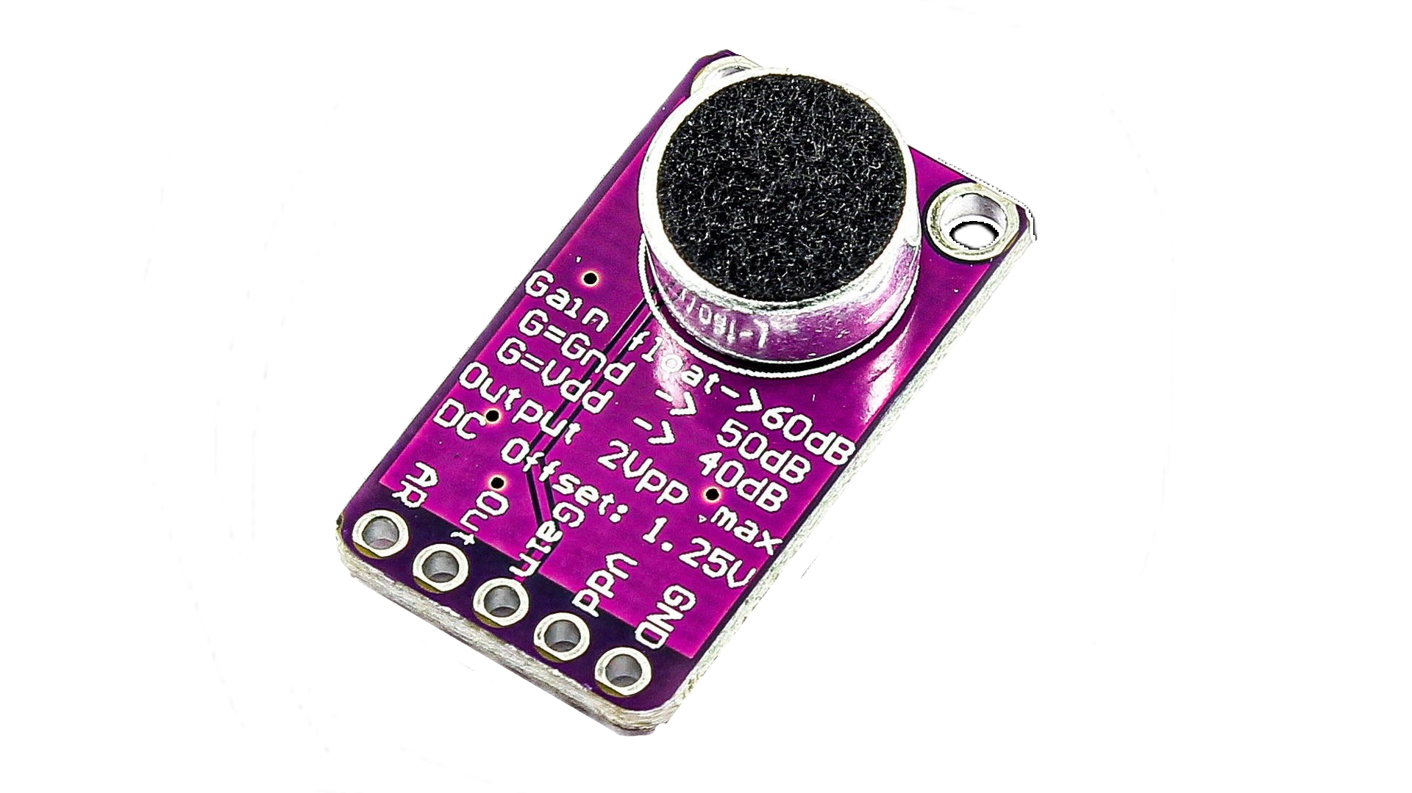




Voice Assistant
Backend Server
MIC
SD Card
Wav File
Voice / Sound
Response as Text
Check for commands
Speaker
SD Card
8-Bit DAC
8-bit Encoded Wav File
16-bit Encoded Wav File
Amplifier
Text To Speech

Slide 8
Voice Commands
Backend Server
MIC
SD Card
Wav File
Voice / Sound
Response as Text
Execute the command
For Example:
- Turn the Light ON
- Turn the Light OFF
- Play Music and Dance
Read the command
Return Name of Command to execute
Check for commands

Slide 9
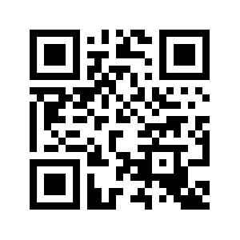

Connect to Any WIFI
Scan it to connect your phone to Desk-Mate via WebSocket
Take IP from DHCP server from router
Generate QR-Code of IP
YES
Try to connect to last previous WIFI
Connected?
NO
Turn the ESP32 as AP
Connect to AP using mobile phone
Send the Desired WIFI Credentials to the ESP32

Slide 10


Get the app via WebSocket
Send http request to the Scanned IP
🔎|192.168.1.12
Desk-Mate return response of all web app files
Mobile Browser renders web app

Slide 11
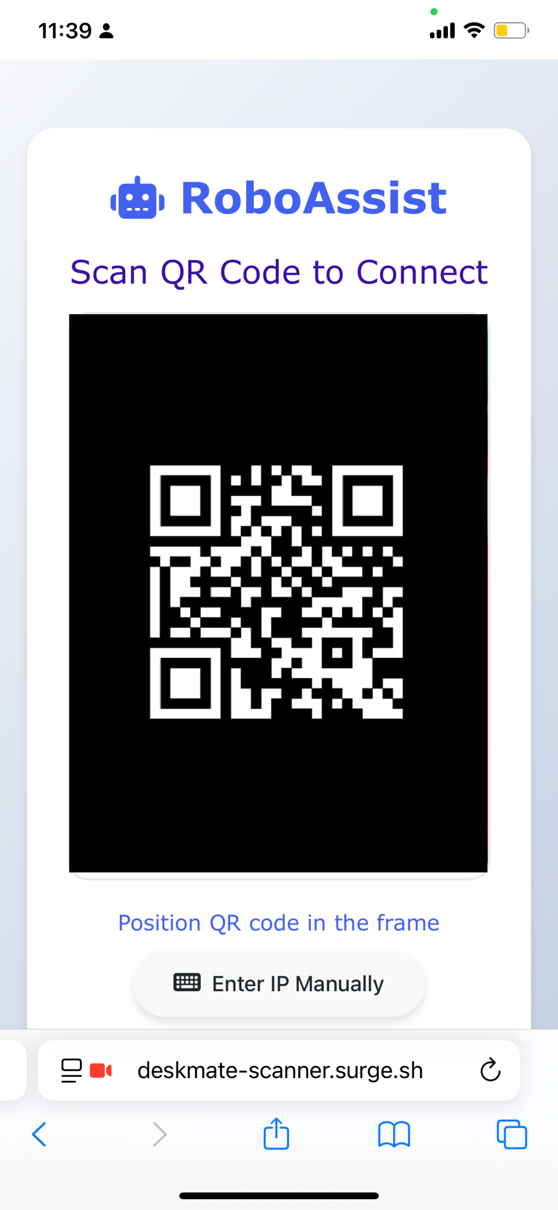
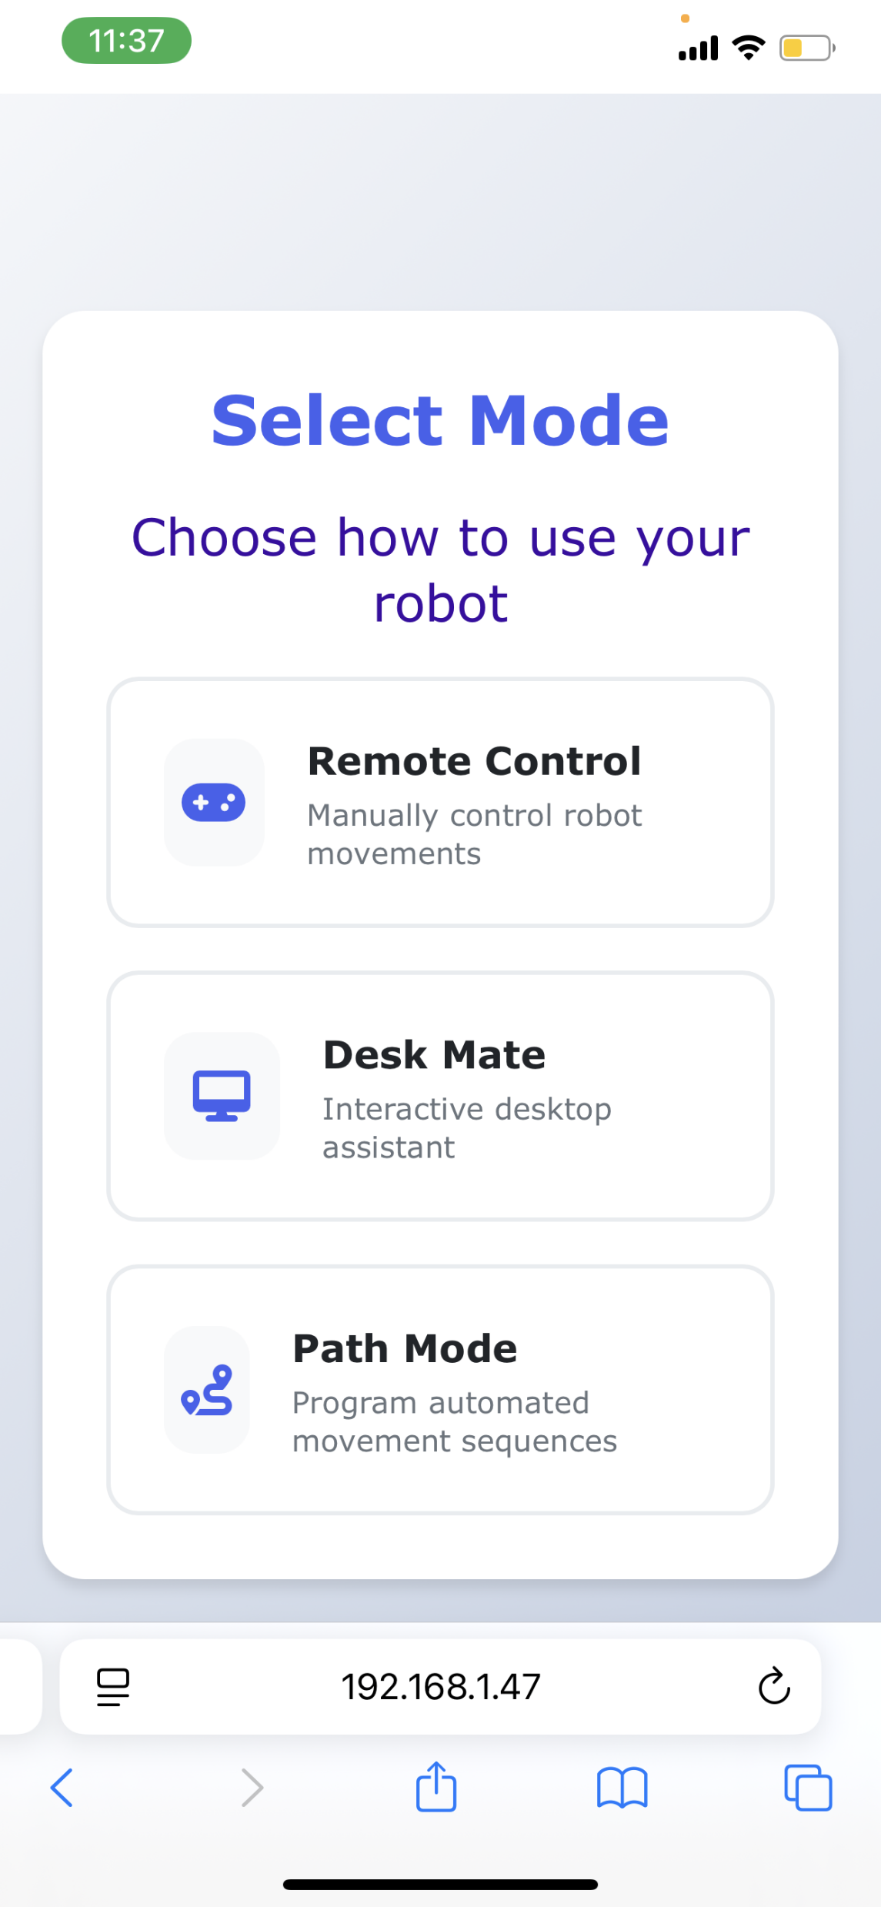
Desk-Mate App

Slide 12
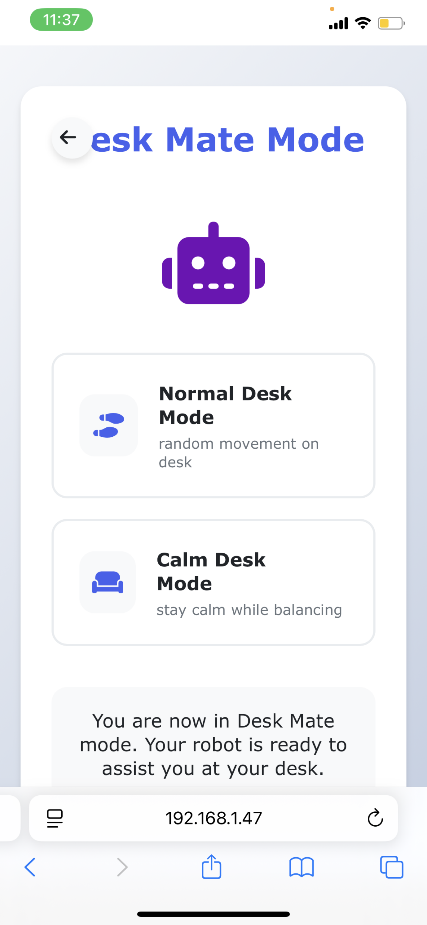
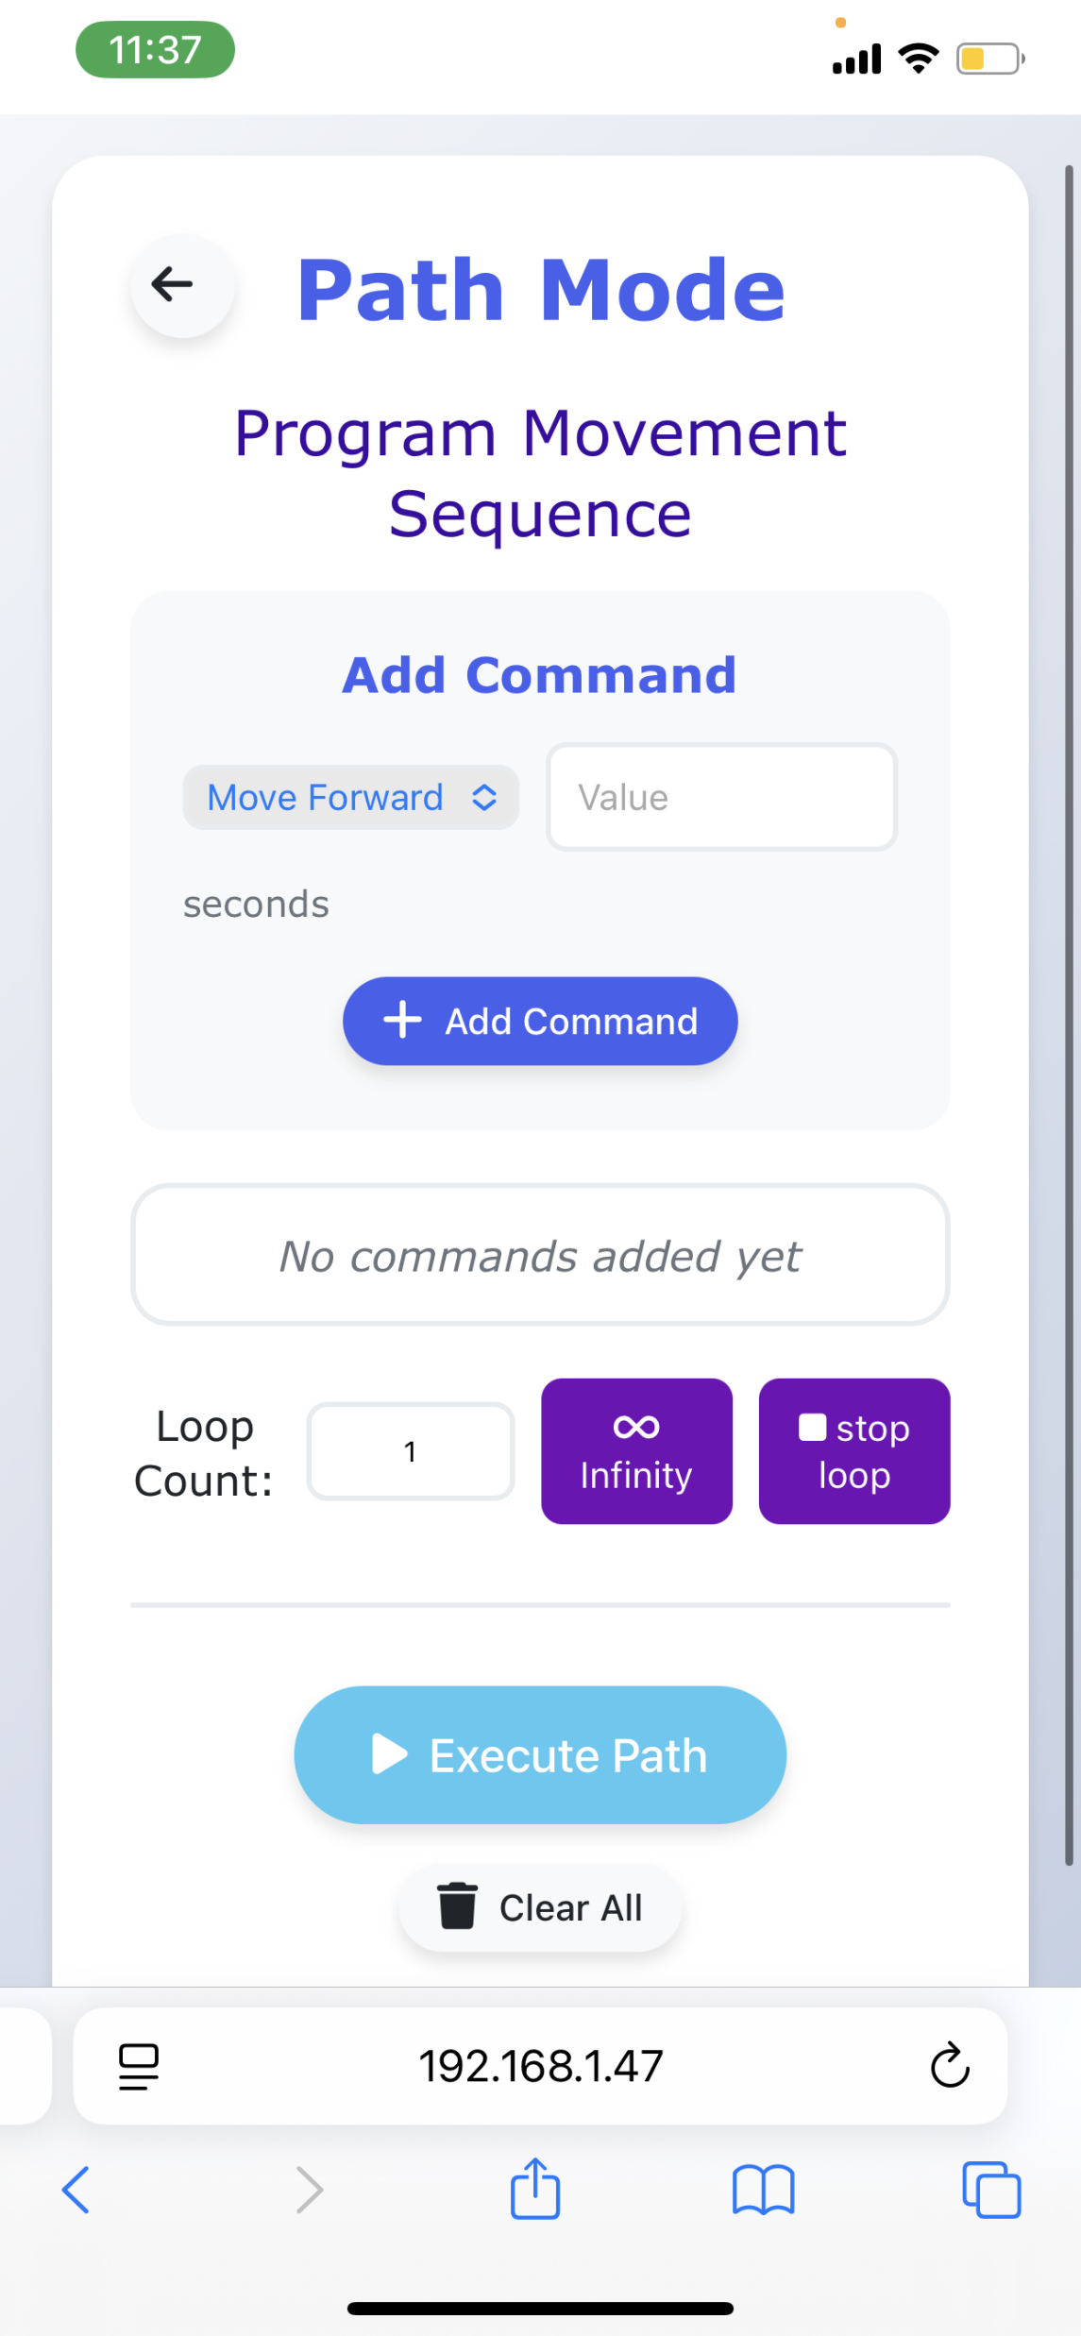
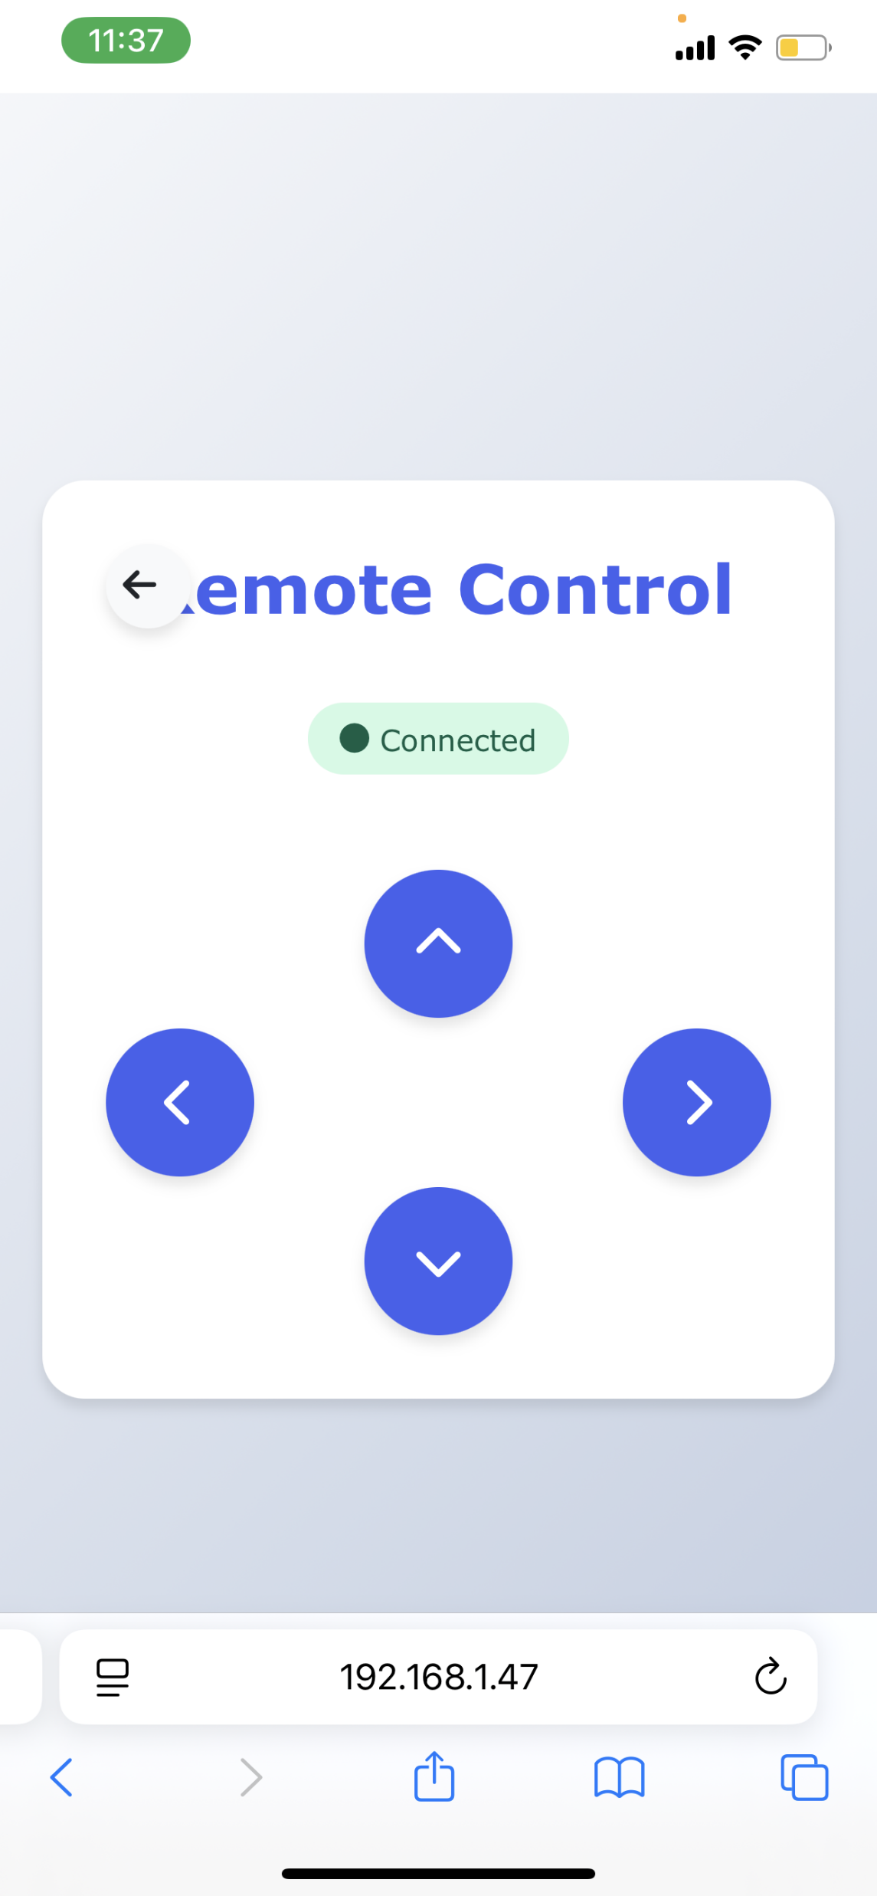
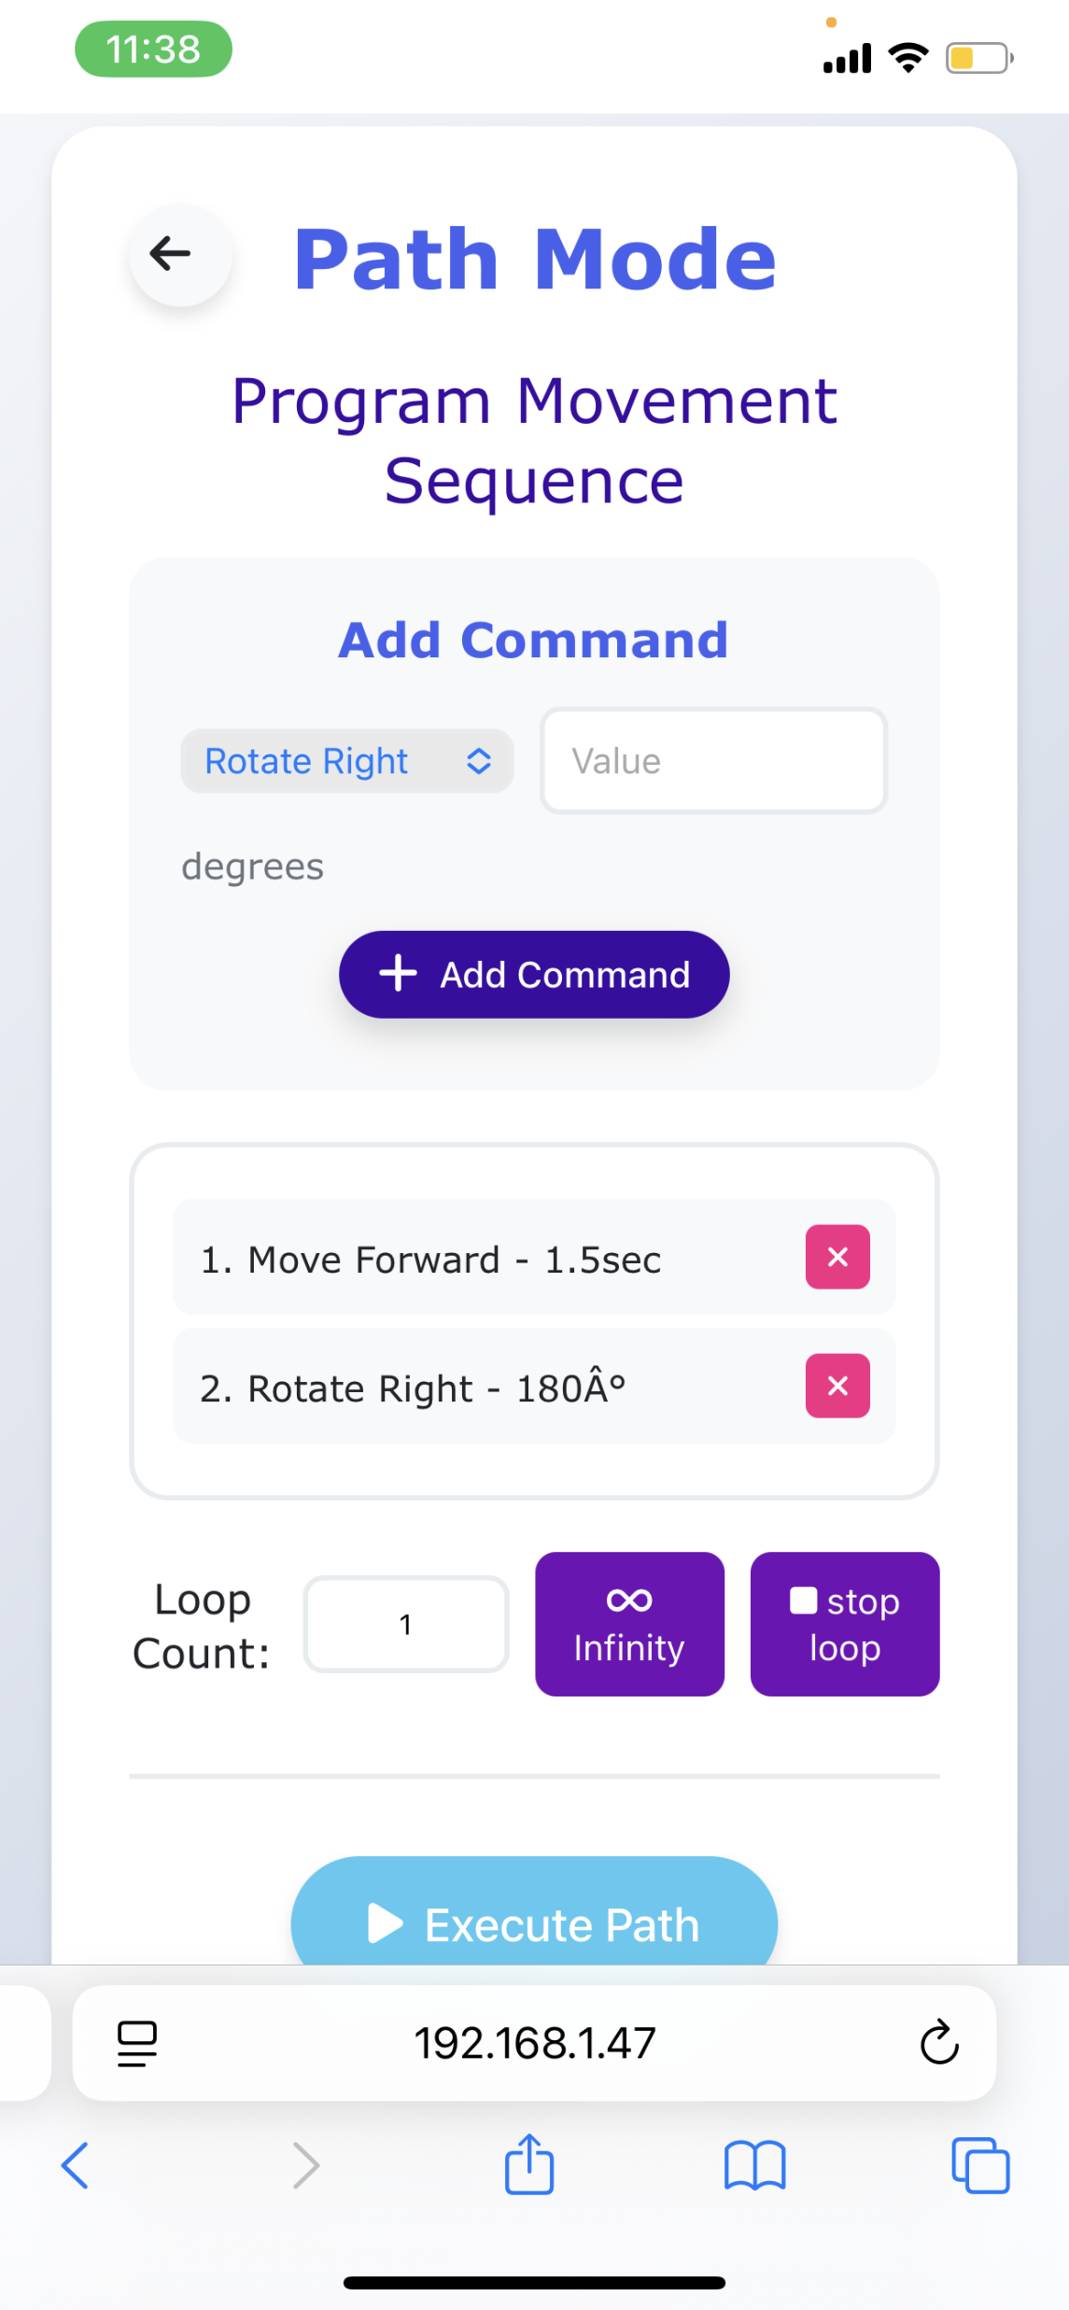
Desk-Mate App

Slide 13
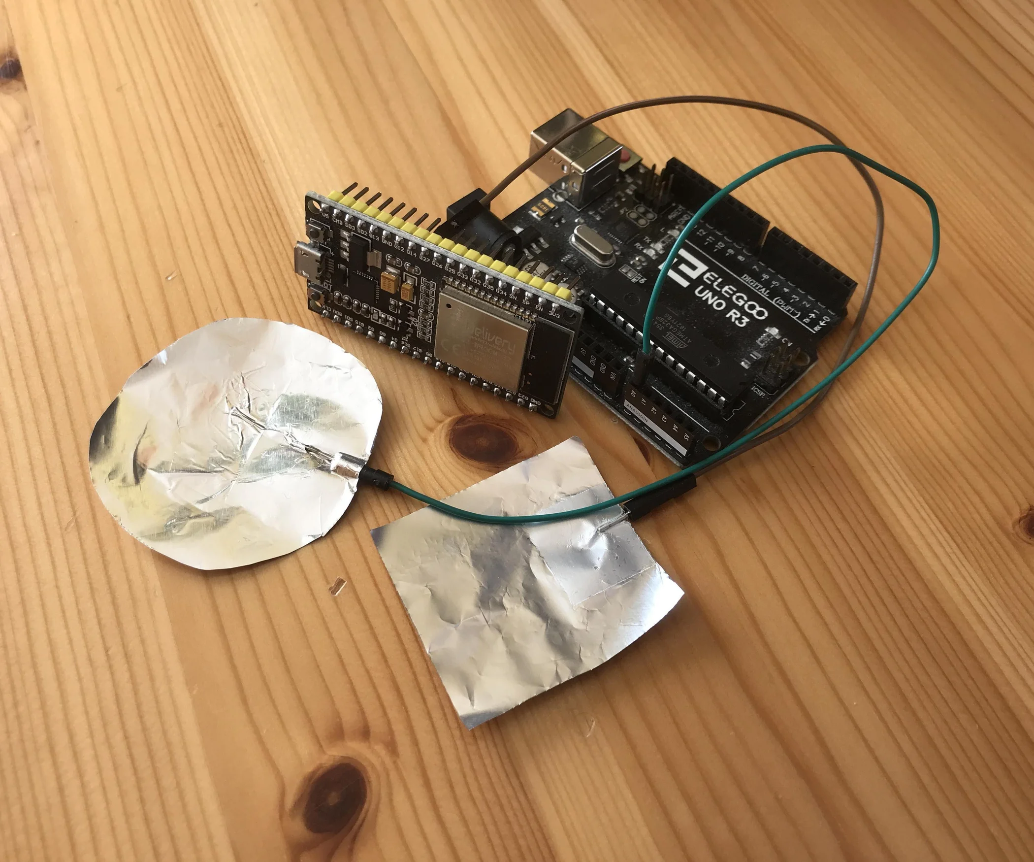
Touch Sensor
•
.Hit / Pat the Robot
•
.Start Recording
.(Voice assistant)

Slide 14
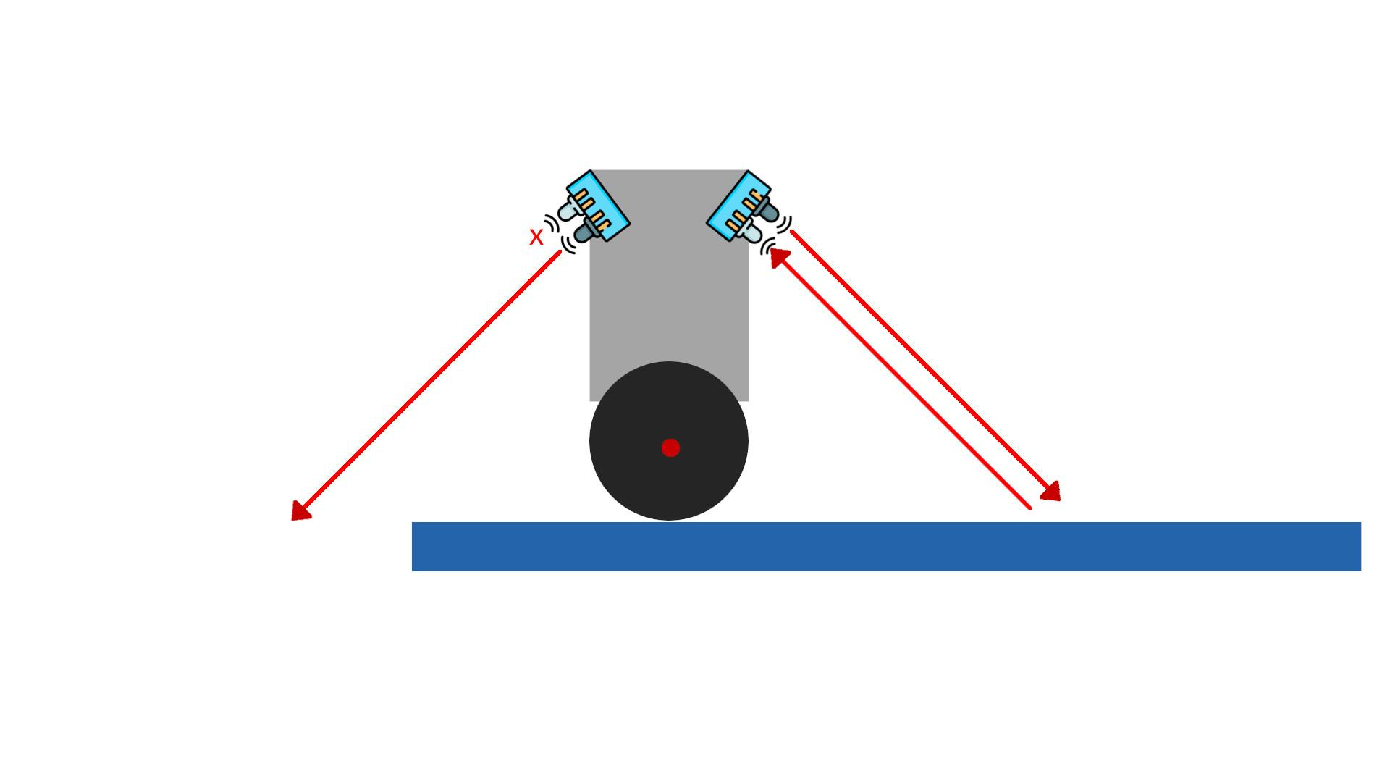
Edge-Detection

Slide 15
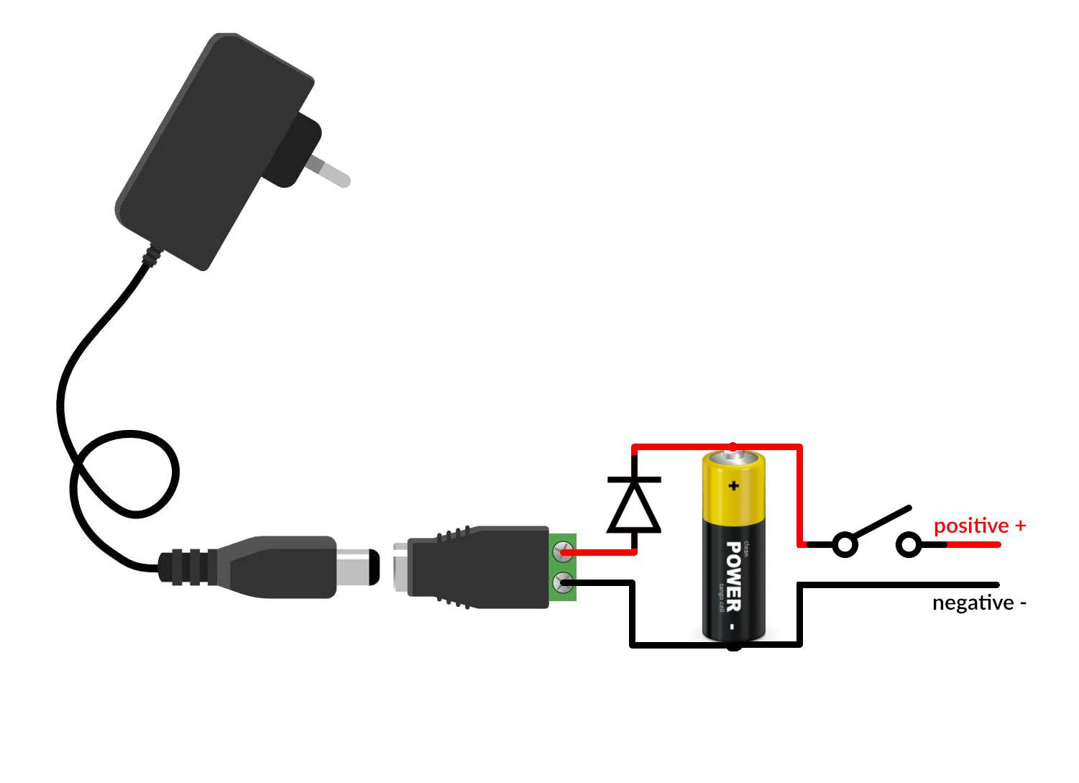
Charge the Robot

Slide 16
Thank you

