Slide 1

An-Najah National University
Faculty of Engineering
Civil Engineering Department
Design of water distribution and sewer collection systems
For Burqa village
Prepared By:
Hussein Fathi Haji
Afif Isam Aqad
Qais Nasser Abed Allkareem
Hisham Hossam Shouli
Supervisor : Dr. Numan Mizyed

Slide 2
Outline
Introduction
Objective
Study Area
Methodology
Results (Water cad , Sewer cad , Storm cad)

Slide 3
Introduction
Water distribution network is necessary to provide the water to the residents in the quality and quantity they need the wastewater collection system is important to improve service sanitation
Also we can use storm water to save village from disasters

Slide 4
Objective
Studying and analyzing the existing water distribution network of Burqa village
redesign network in order to meet the future needs of the residents in Burqa
Design a new wastewater collection system network for the village
Design a new storm collection system network for the village

Slide 5
Study Area
Topography
Location
climate
Water recourses
population

Slide 6
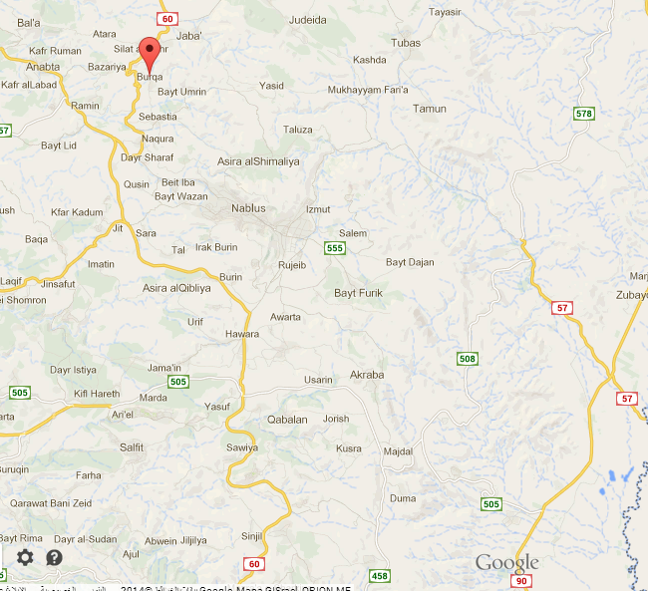
Location

Slide 7
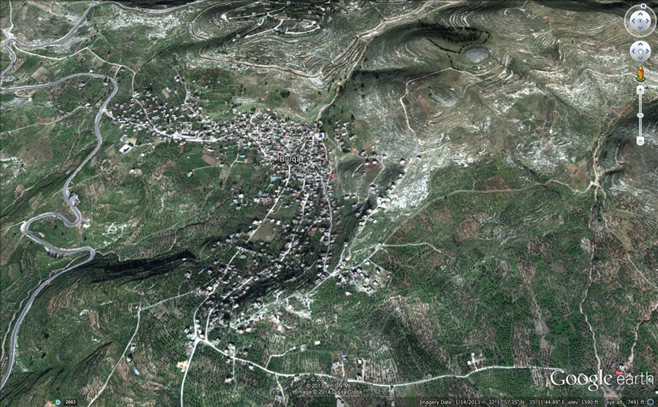
Topography

Slide 8
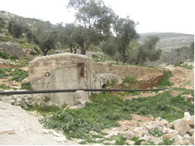
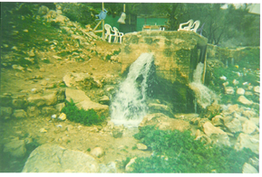
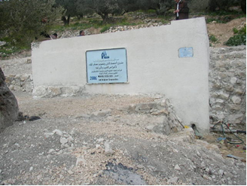
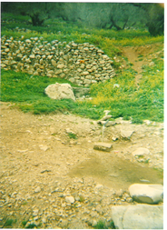
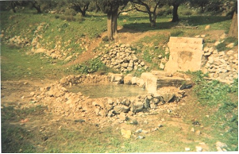
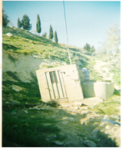
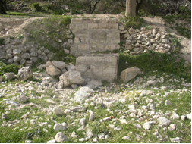
Water Resources

Slide 9
Climate

Slide 12
Rainfall

Slide 13
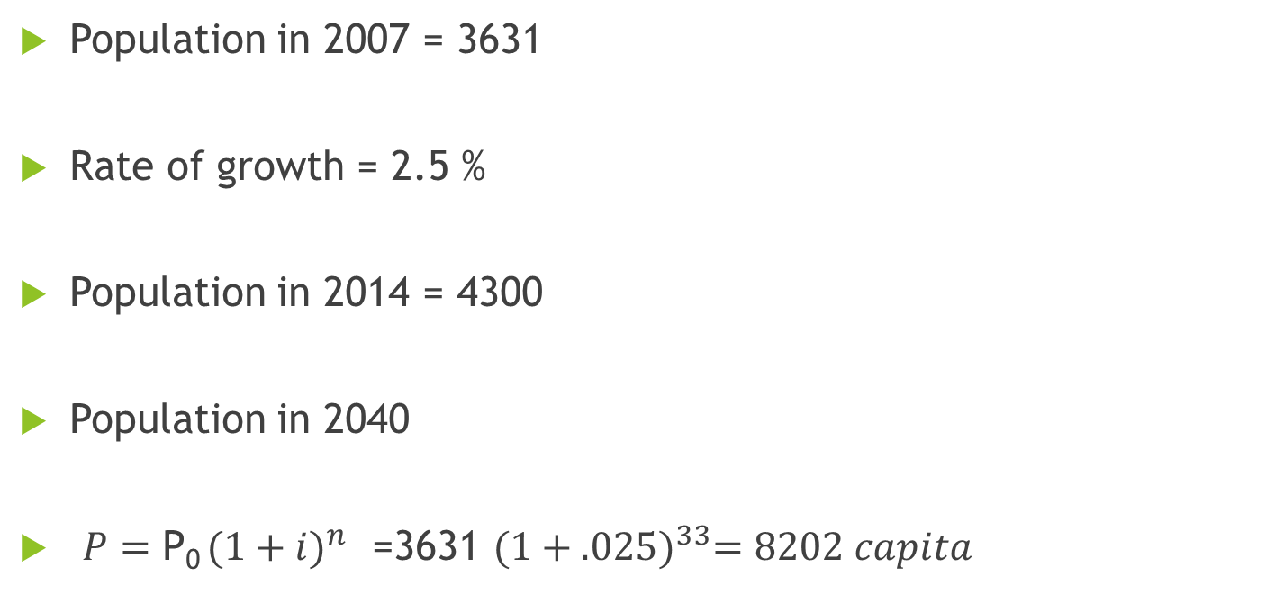
Population
Population in 2007 = 3631
Rate of growth = 2.5 %
Population in 2014 = 4300
Population in 2040
${P=\text{P}\text{0} (1+i)}^{n}$ =3631 ${(1+.025)}^{33}=8202 capita$

Slide 14
Methodology for distribution network
Data Collection
Prepare map by AutoCAD
Model Development
Analysis of existing and future networks
Conclusions and Recommendations
Collects maps ,population etc.
Possess maps
Use WaterCAD.
Velocity & Pressure in future state.
Improve WDN for Burqa village

Slide 15
Design standards
1- Pressure head:
Maximum pressure: 70 m H2O
Minimum pressure: 15 m H2O
2- Velocity:
Maximum velocity: 2m/s
Minimum velocity: 0.2m/s
3- Water Demand:
120 L/c.d according to WHO
4- Pipes
For dimensioning and design of steel pipes, AWWA-C200-97 was utilized.

Slide 16
Analysis of Existing network System

Slide 17
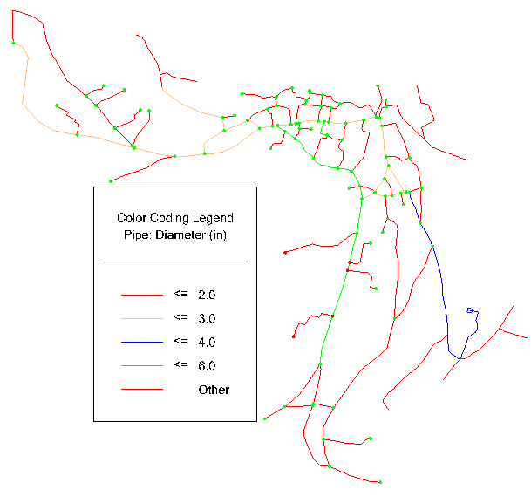

Existing distribution network

Slide 18
Data input (current supply)
Elevation from contour map
Volume of Tank = 150 m³
Supply = 420 m³/d
Loss = 20 %
Consumption = 336 m³/d

Slide 19
Pressure of existing network (existing supply)

Slide 20
Velocity of existing network (existing supply)

Slide 21
Data input (Future Demand)
Elevation from contour map
Demand = 120 L /c.d
Loss = 20 %
Average Daily Demand = 1189 m³/d
By taking
Daily peak factor = 1.5
Hourly peak factor = 2
Maximum Hourly Demand = 149 m³/h

Slide 22
Pressure of existing network (future supply)

Slide 23
Analysis of Proposed Changes

Slide 24
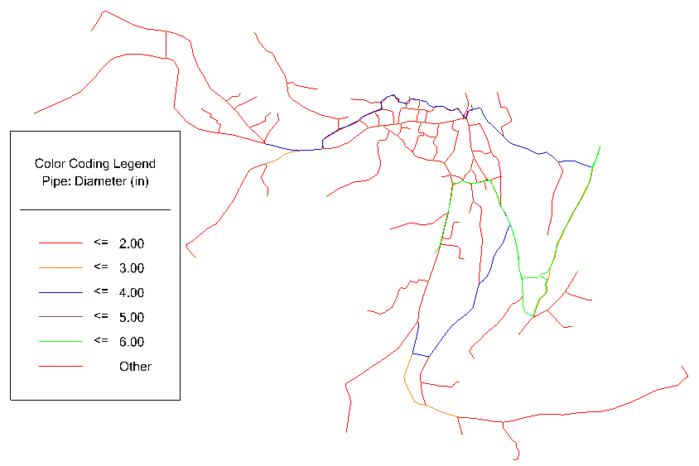
Proposed Changes

Slide 25
Data input (Future Demand)
Elevation from contour map
Demand = 120 L /c.d
Loss = 20 %
Average Daily Demand = 1189 m³/d
By taking
Daily peak factor = 1.5
Hourly peak factor = 2
Maximum Hourly Demand = 149 m³/h

Slide 26
Pressure of existing network (future supply)

Slide 27
Velocity of existing network (future supply)

Slide 28
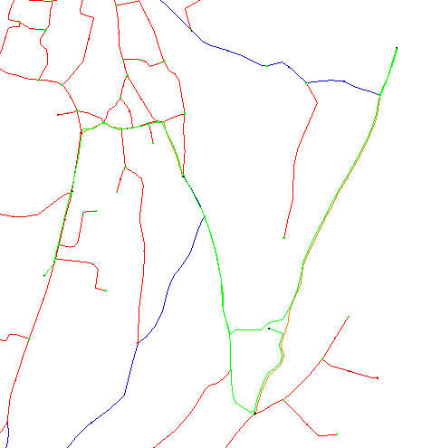
Conveyance System
Tank2
Velocity = 1.3 m/s
Diameter = 6 in
Reservoir
Tank1

Slide 29
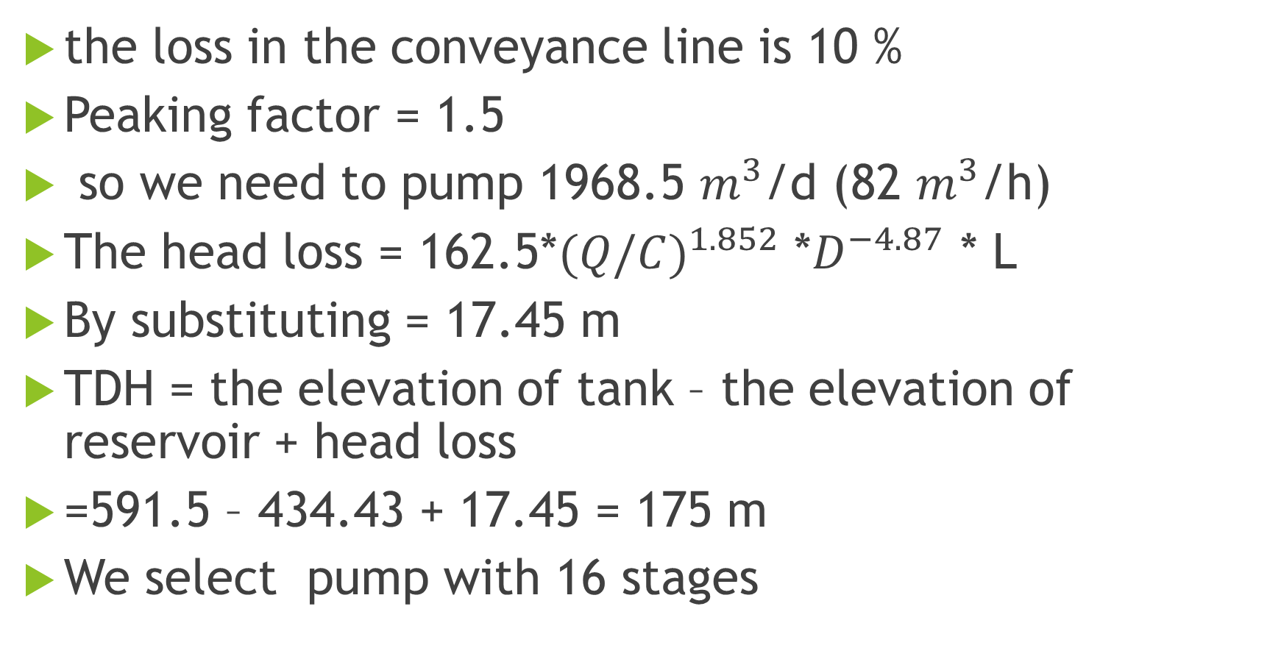
Pump
the loss in the conveyance line is 10 %
Peaking factor = 1.5
so we need to pump 1968.5 $m^{3}$/d (82 $m^{3}$/h)
The head loss = 162.5*${(Q/C)}^{1.852}$ *$D^{−4.87}$ * L
By substituting = 17.45 m
TDH = the elevation of tank – the elevation of reservoir + head loss
=591.5 – 434.43 + 17.45 = 175 m
We select pump with 16 stages

Slide 30
Design of wastewater collection system

Slide 31
Design standards
1- Cover:
Maximum cover: 5 m
Minimum cover: 1 m
2- Velocity:
Maximum velocity: 3 m/s
Minimum velocity: .6 m/s
3- Slope:
Maximum slope: 15 %
Minimum slope: .5 %

Slide 32
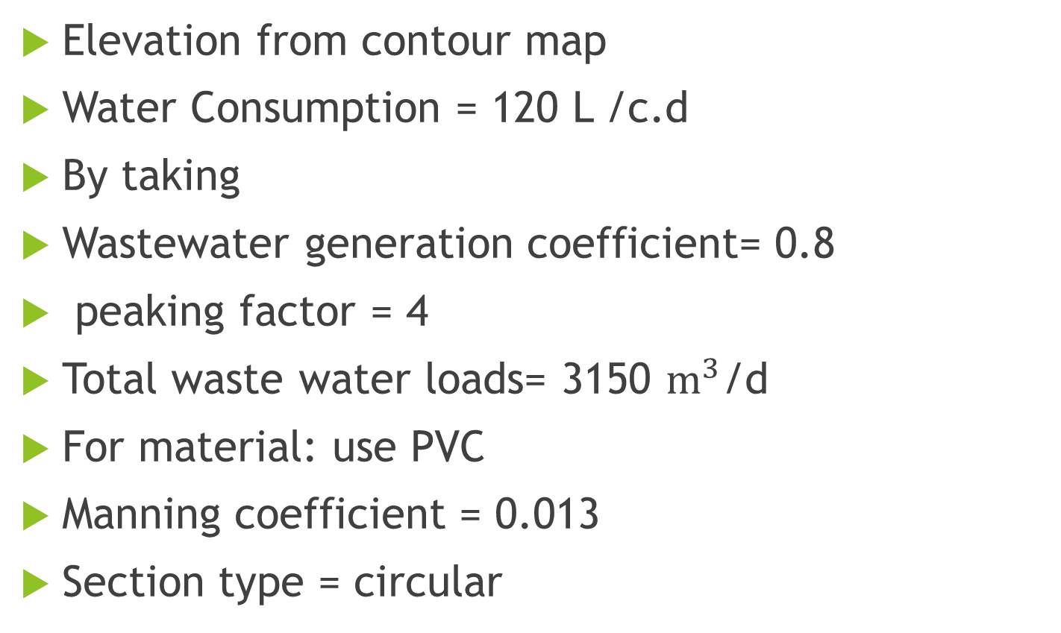
Data input(Sewercad)
Elevation from contour map
Water Consumption = 120 L /c.d
By taking
Wastewater generation coefficient= 0.8
peaking factor = 4
Total waste water loads= 3150 $m^{3}$/d
For material: use PVC
Manning coefficient = 0.013
Section type = circular

Slide 33
Result

Slide 34
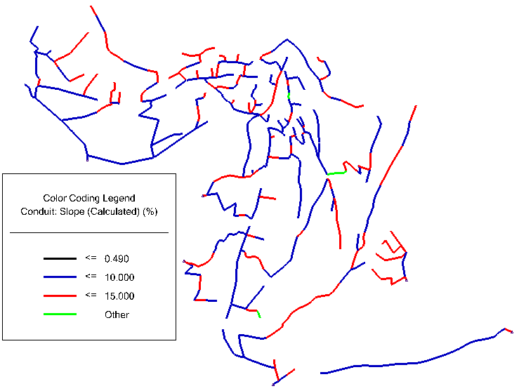
Slope (sewer network)

Slide 35
Slope (sewer network)

Slide 36
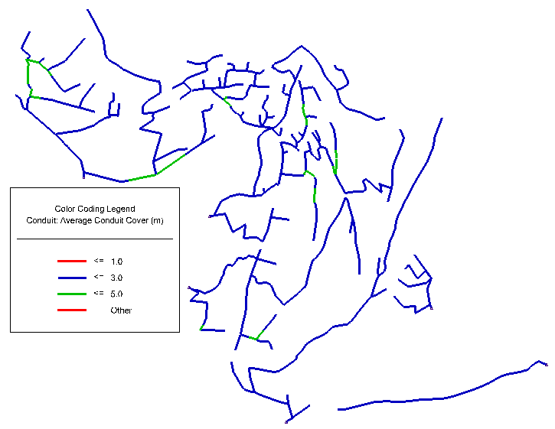
Average cover(sewer network)

Slide 37
Cover-Average(sewer network)

Slide 38
Velocity(sewer network)

Slide 39
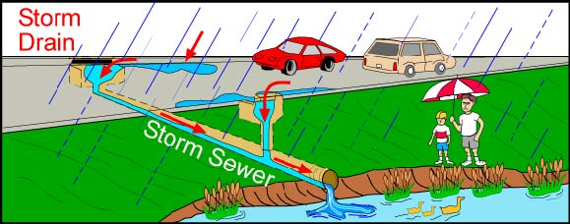

Slide 40
Design standards
1- Cover:
Maximum cover: 4.5m
Minimum cover: 1m
2- Velocity:
Maximum velocity: 8 m/s
Minimum velocity: 0.6 m/s
3- Slope:
Maximum slope: 12 %
Minimum slope: 0.5 %

Slide 41
Data input

Slide 42
Information needed for the design of storm water drainage system
Metrological and hydrological data
Rainfall intensity
Storm duration and occurrence
Return period
2. Topographical data
Elevations
Boundaries of the catchments areas
Point of collection
3. Classification of catchments areas
Run off coefficient = 0.5
4. Type of Materials
PVC
N = 0.013

Slide 43
Rational method
Q = C i A
Where;
Q = is the run-off in m³/sec
C = is the Run-off coefficient
i = is the average rainfall intensity in mm/hr,
A = is the drainage area in m²

Slide 44
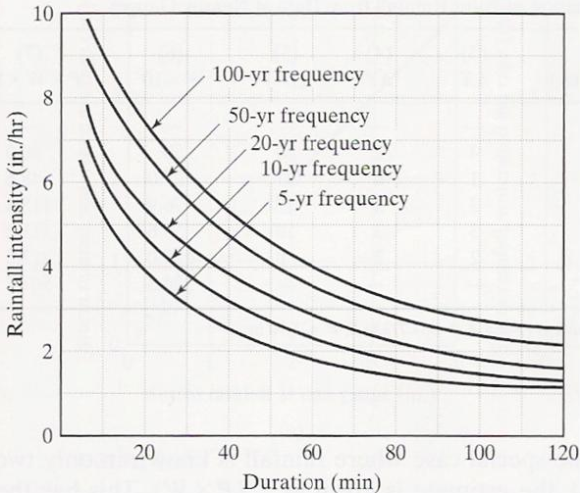
IDF Curves
Return period =10
Duration=time of concentration

Slide 45
Software Programs
StormCAD
Civil 3D
GIS

Slide 46
Result

Slide 47
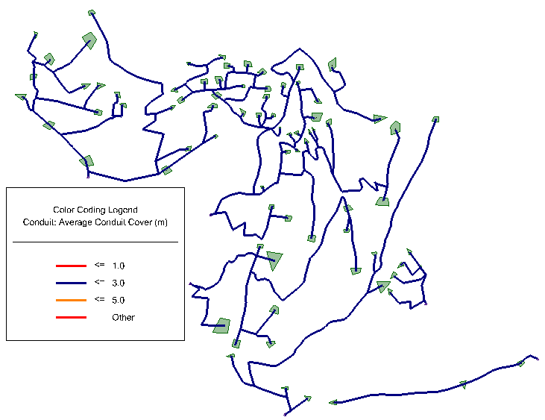
Cover-average

Slide 48
Cover-average

Slide 49
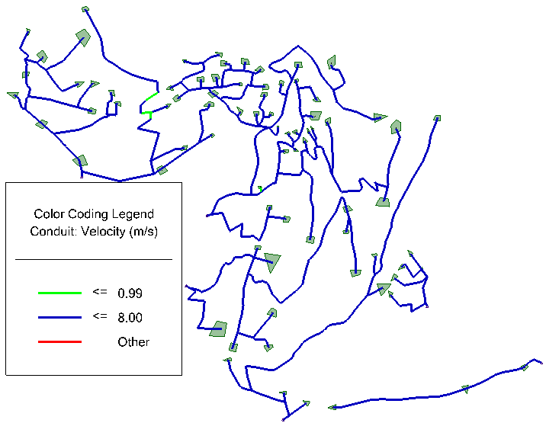
Velocity

Slide 50
Velocity

Slide 51
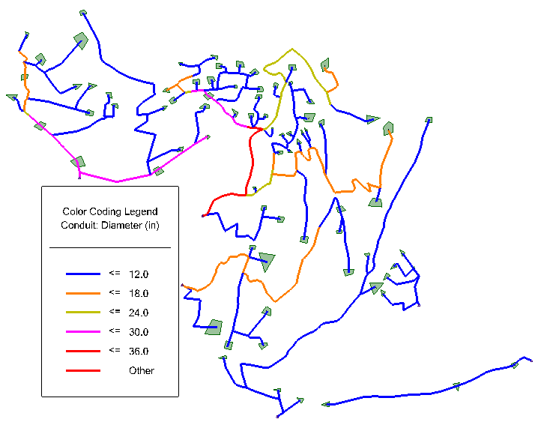
Diameter

Slide 52
Slope

Slide 53
Excavation
(Trench dimension)
Width of trench at least 70 cm
Depth of trench at least 120 cm

Slide 54
Conclusions
For water network For sewer network
Length (km) | Pipe Diameter
2.0 | 6"
2.2 | 4"
1.2 | 3"
13.0 | 2"
18.4 | Total
Length (km) | Pipe Diameter
14.2 | 8"
14.2 | Total
Number of manholes = 512
Volume of excavation (m³) = 18000
Volume of excavation (m³ )= 13000

Slide 55
Conclusions for storm network
Conduit Description | Length (km)
Circle - 10.0 in | 1.8
Circle - 12.0 in | 1.6
Circle - 15.0 in | 1.0
Circle - 18.0 in | 1.2
Circle - 24.0 in | 0.8
Circle - 30.0 in | 1.0
Circle - 36.0 in | 0.5
Circle - 8.0 in | 6.3
Total Length | 14.2
Number of catch basin = 512
Volume of excavation (m³) = 17000

Slide 56
Thank you

Slide 57
Any Questions

